Slide 1




A MAC protocol for UWB Very Low Power Mobile Ad-hoc
Networks based on Dynamic Channel Coding with Interference
Mitigation
MICS
Mobile Information and Communication Systems
Jean-Yves Le Boudec
joint work with
Ruben Merz, Bozidar Radunovic, Joerg Widmer

Slide 2
Contents
Goal of our Research
Ultra Wide Band physical layer
A Theoretical Look at MAC Protocols
Interference Mitigation
Our MAC protocol
  dynamic channel coding
  private MAC

Slide 3
1. Goal of our research
Design a MAC protocol for UWB that is joint with the physical layer
  fully utilizes the specificity of UWB
  cooperates with PHY
This presentation
  a MAC protocol for low power UWB (1 microwatt radiated power)

Slide 4
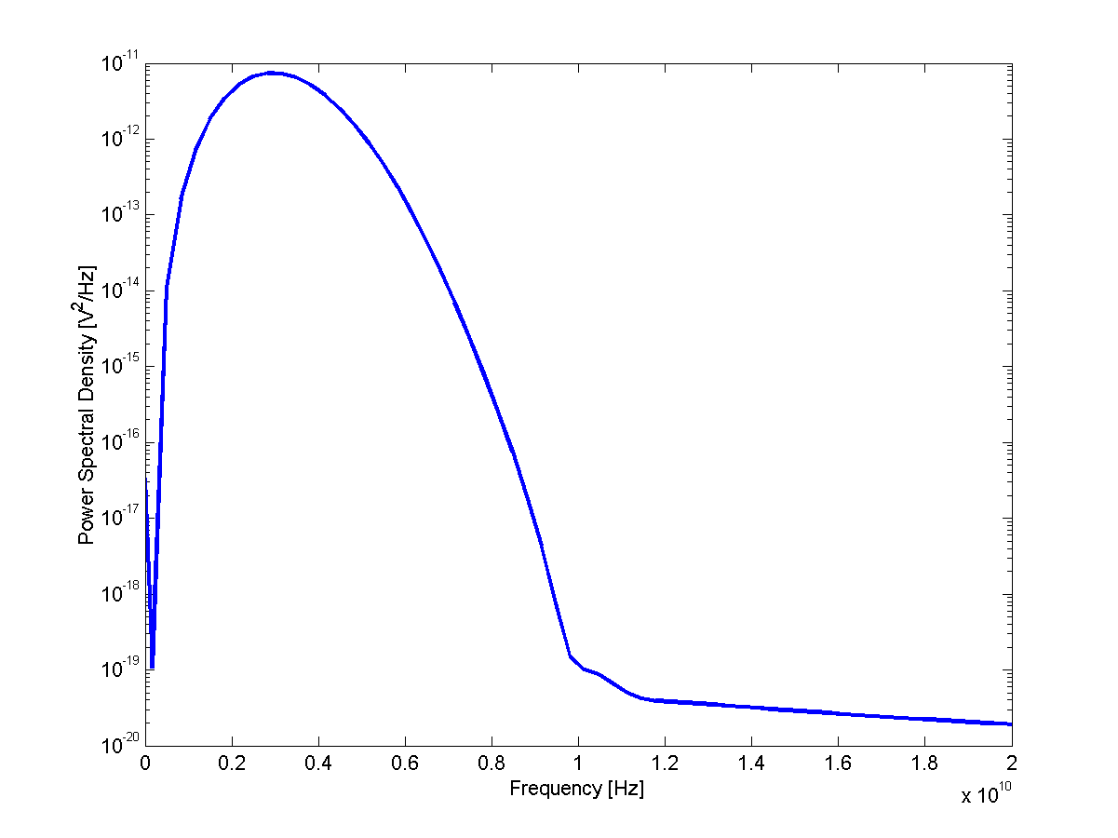
2. Ultra Wide Band
Radio transmission technology that uses the full spectrum
  over 500 MHz
  in practice uses a 3 GHz band
  unlicensed
  potential very low cost, 10 to 100 meters range
Energy density
from [DeBenedetto, SRI 2003]

Slide 5
Ultra Wide Band PHY
Many Physical layers proposed at IEEE 802.15.3
Theoretical results [Verdu2002] state that optimal transmission scheme should be « peaky », i.e. send short pulses
We assume pulse based PHY with PPM [WinScholtz2000]
  pulse position modulation
‘0’
‘1’
δ

Slide 6
Time Hopping
Low spectral density requires randomness in inter pulse spacing
  use time hopping, one pulse per PRP slots
  PRP = Pulse Repetition Period
Time Hopping Sequence
  the sequence of time slot indices at a pulse may be transmitted by one source
  generated by a pseudo-random number generator
  one per user
PRP = 9
THS = 3 2 6 …
1
2
3
4
5
6
7
8
9
1
2
3
4
5
6
7
8
9
1
2
3
4
5
6
7
8
PRP× T_{c}
T_{c}

Slide 7

Parameters for Very Low Power UWB
FCC regulation and technology impose orders of magnitudes to numbers [source IEEE 802.15.3 submitted proposal, STM, May 2003]
radiated power depends on PRP
for 1 microwatt, PRP = 280
P_{peak}= 0.28 mW
T_{c}= 0.2 ns
PRP≥ 10
PRP× T_{c}
T_{c}

Slide 8
Bit Rates for Very Low Power UWB
Maximum : 18 Mb/s for one user
depends on noise and attenuation
  30 meters, maximum is 6 Mb/s for one user
Multi-user environment:
  with our proposal, we can keep per user rate close to the one user values
  unlike with traditional MACs

Slide 9
PHY does Coding plus Modulation
code rate R
‘0’
‘1’
δ
channel
code
modu-
lator
data bits
coded bits
PRP× T_{c}
T_{c}
L data bits
L/R coded bits
L/R pulses
channel code adds redundancy for coping with noise and errors

Slide 10
Incremental Redundancy Codes
A family of codes that cover rates from 1 to 1/10
No penalty for sending incremental bits later
encoder
decoder
R₁
k data bits
R₁
k/R₁ coded bits
incremental redundancy
R₂ Δ R₁
k/R₂ - k/R₁ bits
R₁
k data bits
R₂
k/R₂ coded bits

Slide 11
3. Optimal MAC Design
MAC protocol = Multiple Access Control to radio channel
Traditional approaches in wireless LANs are based on « exclusion »
  only one source can send at a time in the channel or in a given sub-channel
  TDMA, CSMA/CA, MACA etc.
  used in WiFi, BlueTooth
  interference is either below a noise threshold or is banned
There are unexploited dimensions
  interference can often be allowed
    example CA/CDMA [Muqattash-Krunz2003]
  coding can be adaptive

Slide 12
Searching For Optimal Design
Model a general wireless ad-hoc network with
  variable coding rate
  exclusion (i.e. scheduling in the time domain)
  arbitrary, possibly multipath, routing
  protocol overhead of exclusion not accounted for
Numerically solve for the allocation of powers and schedules that achieves proportional fairness
  other objectives are known to be buggy [Radunovic Infocom2004]
  random and symmetric networks up to 60 nodes
Example
  when can S1 and S2 send ; at which power ?

Slide 13
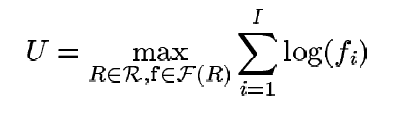
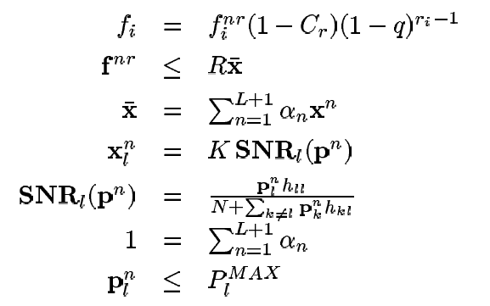
S1
D1
D2
S2
example:
  S1 can send during time slot n at power p₁^{n}
  duration of time slot n is α_{n}
  Find: optimal time slot durations and power levels

Slide 14
The CSMA/CA (WiFi) Solution
Ignore the cost of collisions :
CSMA/CA, TDMA etc:
If S1 can send to D1, S2 should be silent
5.5 Mb/s
S1
D1
5.5 Mb/s
D2
S2

Slide 15
Properties of Optimal MAC Design
When sending, send at full power
If a source S2 is inside an « exclusion region » around a destination D1, interference from S2 should be combated, otherwise not
  size of exclusion region can be computed numerically based on characteristics of link S1-D1 and average power of interfering sources
S1 and S2 should send simultaneously and adapt rates
S1
D1
D2
S2
S1
D1
S1 and S2 should not send simultaneously
S2
D2

Slide 16
Compare to CSMA/CA
when interference is not very large, it is more efficient to allow it
CSMA/CA, TDMA etc:
If S1 can send to D1, S2 should be silent
5.5 Mb/s
S1
D1
5.5 Mb/s
D2
S2
Theoretical Optimal:
S1 and S2 interfere
6 Mb/s
S1
D1
10.4 Mb/s
D2
S2

Slide 17
What this tells us for UWB
The optimal design depends on size of exclusion region
We find numerically that the size of exclusion region is of the order of 1 meter
We are in the intermediate case
  we need an exclusion mechanism
  we should allow interference in many cases

Slide 18
4. Interference Mitigation
Goal: combat interference when a source is interfering with a nearby destination (inside exclusion region)
Our solution is : interference mitigation
Implemented at demodulator
channel
code
modu-
lator
de-
modu-
lator
channel
code
data bits
coded bits
coded bits
data bits
THS
corre
lator
x₁ x₂ x₃ x₄ x₅ x₆
MLE
estimation
block of decoded bits

Slide 19
Interference Mitigation Uses Erasures
Idea: transform interference in erasure
  if received energy at demodulator is high, declare an erasure and ignore the sample
    high = larger than 5 * average output level
  may be due to collision or noise
  kills interfering pulses, but also some valid pulses when noise is high

Slide 20
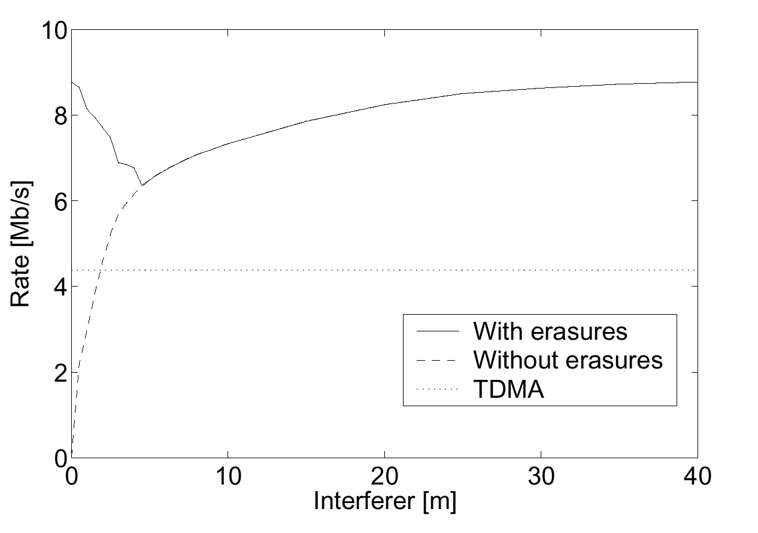
Example of Performance
S1
D1
D2
S2
rate for S1—D1
with interference mitigation
Time Sharing
without interference mitigation
exclusion region
d = distance S2—D1

Slide 21
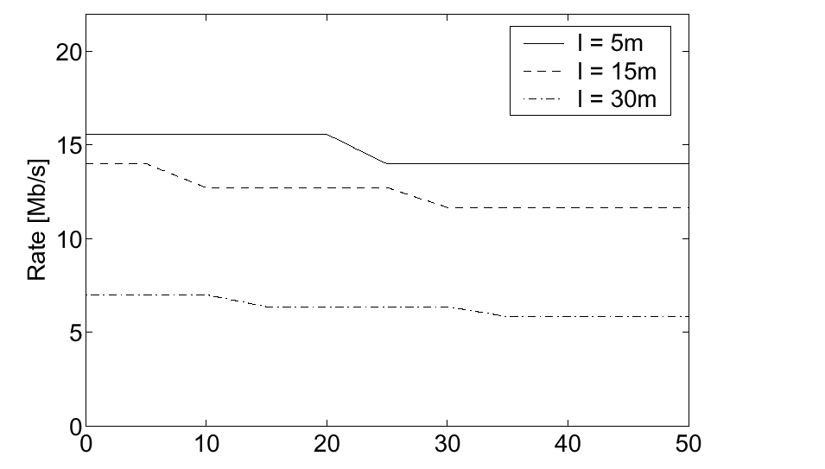
Impact of Number of Interferers
works well because probability of two pulses colliding is small

Slide 22
What this tells us
Interference mitigation removes the exclusion region almost totally
Suggested MAC design
  use interference mitigation
  allow interference
  adapt the code rate to the level of interference

Slide 23
5. Dynamic Channel Coding MAC Protocol
Our concrete MAC protocol
Based on our theretical results
  allow interference
  adapt code
It remains to solve
  the « Private MAC Problem »:
  several sources send to same destination
  carrier sensing not possible

Slide 24

Different Time Hopping Sequences are Used
B
A
Trans Req
THS(A), Code = R_{N}
Trans Reply
Time Hopping Sequence
  Common Random Number Generator for all nodes
  Seed = MAC address, or combination of MAC addresses
Request phase
  THS seed = A
Data exchange phase
  THS seed = AB
THS(AB),Code = R_{N}
Data
THS(AB), Code = R_{i}
NACK
THS(AB),Code = R_{N}
Incremental Red.
THS(AB)
ACK
THS(AB),Code = R_{N}

Slide 25
Dynamic Channel Coding
B
A
Trans Req
THS(A), Code = R_{N}
Goal: use the most economical code
  set for every packet
  avoid hard failure
Source keeps estimate of code to use in
codeIndex (say i)
If destination cannot decode (hard failure)
  NACK sent to source
  source does
  codeIndex = 2 * i
  source sends incremental redundancy
Trans Reply
THS(AB),Code = R_{N}
code
Index
=i
Data 1
THS(AB), Code = R_{i}
NACK
code
Index
= 2i
THS(AB),Code = R_{N}
Incremental Red.
THS(AB), R_{i} Δ R_{2i}

Slide 26
B
A
A safety margin of 2 indices is kept
If destination can decode, it can also compute the most economical code index j that would have been sufficient
  returns j+2 in ACK
Trans Req
THS(A), Code = R_{N}
Trans Reply
THS(AB),Code = R_{N}
code
Index
=i
Data 1
THS(AB), Code = R_{i}
NACK
code
Index
= 2i
THS(AB),Code = R_{N}
Incremental Red.
THS(AB), R_{i} Δ R_{2i}
This avoids most hard failures and adapts to varying channel (mobility, fading)
Requests / Acks / Nacks sent on lowest rate code in the reverse direction
ACK, codeIndex = j+2
code
Index
= j+2
THS(AB),Code = R_{N}
Data 2
THS(AB),Code = R_{j+2}
code
Index
= j+1
ACK, codeIndex = j+1
THS(AB),Code = R_{N}

Slide 27
Concurrent Access
Concurrent access to different destinations occurs without direct coordination
  dynamic channel coding adapts automatically
Access to same destination requires a mutual exclusion protocol
  combination of invitation and receiver based
  solved by the “private MAC” part of our protocol

Slide 28
B
A
C
Trans Req
THS(A), Code = R_{N}
C attempts to transmit to A
  A is busy
Trans Reply
THS(AB),Code = R_{N}
Data
THS(AB), Code = R_{i}
Trans Req
no collision, interference
NACK
THS(A),Code = R_{N}
THS(AB),Code = R_{N}
Incremental Red.
C waits for either
  Trans Reply
  or Idle
THS(AB)
ACK
THS(AB),Code = R_{N}
Idle
Idle
THS(B), Code = R_{N}
THS(A), Code = R_{N}
Trans Req
THS(A),Code = R_{N}

Slide 29
B
A
C
start
Idle
start
THS(A), Code = R_{N}
Trans Req
expire
suspend
THS(A),Code = R_{N}
Trans Reply
Both B and C compete for A and were deferred
  B and C compute backoff timer in [0,cwnd_{max}]
  Timer started on hearing Idle
  Timer suspended if TransReq overheard
  If this fails, double cwnd_{max} and restart
THS(AC),Code =R_{N}
Data
THS(AC),Code = R_{k}
ACK
THS(AC),Code =R_{N}
Idle
resume
THS(A), Code = R_{N}
start
expire
Trans Req
suspend
THS(A), Code = R_{N}

Slide 30
Simulation Results
We implemented the Dynamic Channel Coding MAC in ns2, based on tables computed in Matlab
  we redesigned ns2 PHY to support interference /collision during a transmission
We compared the performance to
  802.11 like (CSMA)
  CA/CDMA (manage interference, constant rate)
Notes:
UDP CBR sources 2KB packets a1 packet every 1 ms

Slide 31
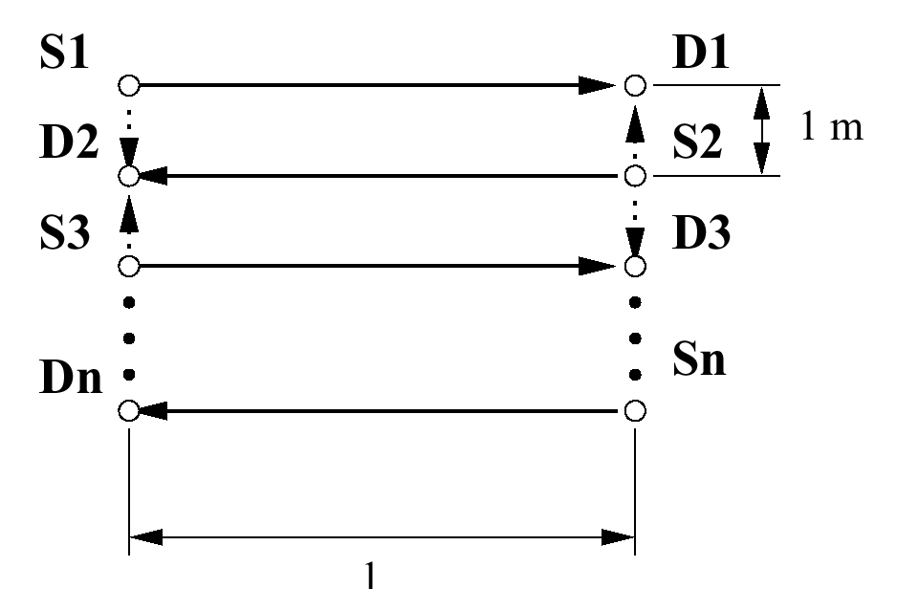
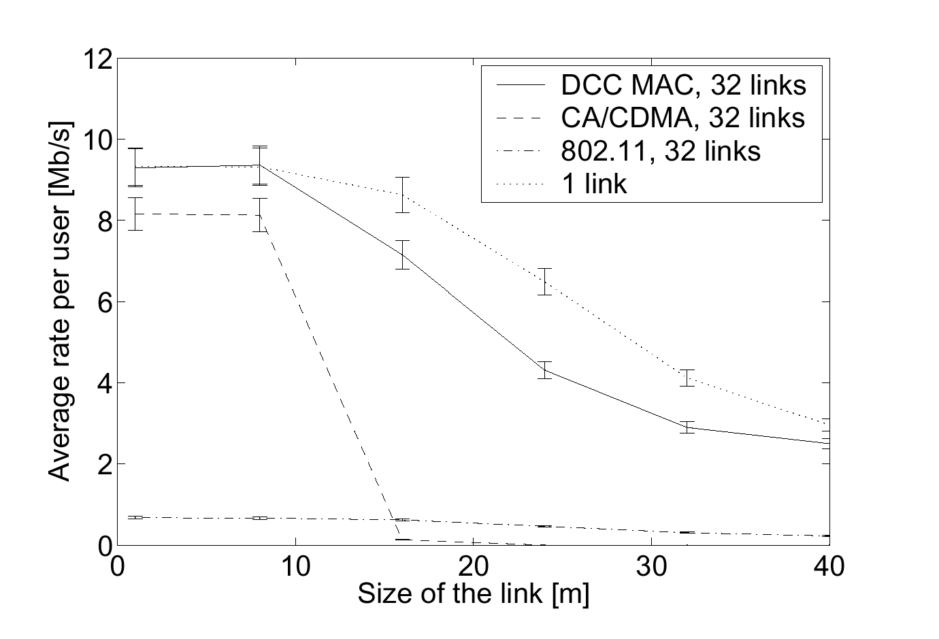
Near-Far Scenario
1 link alone
DCC
CA/CDMA
802.11

Slide 32
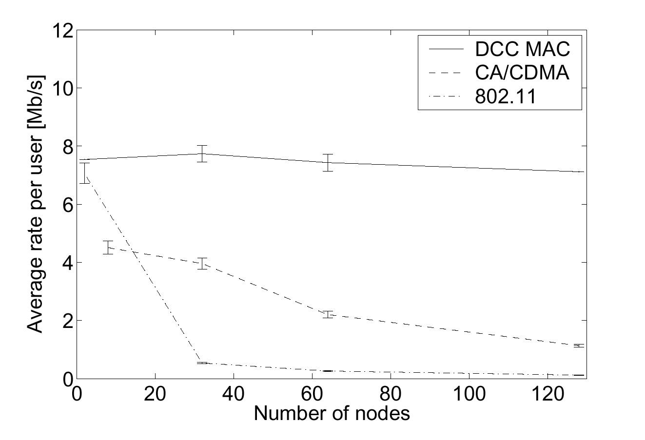
Random Network
DCC
CA/CDMA
802.11

Slide 33
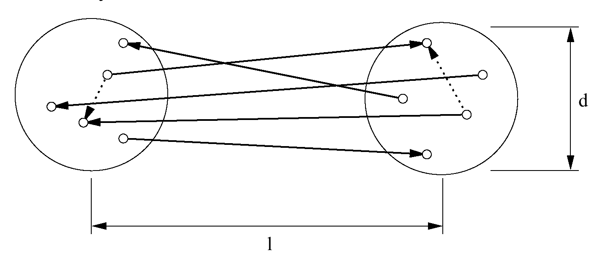
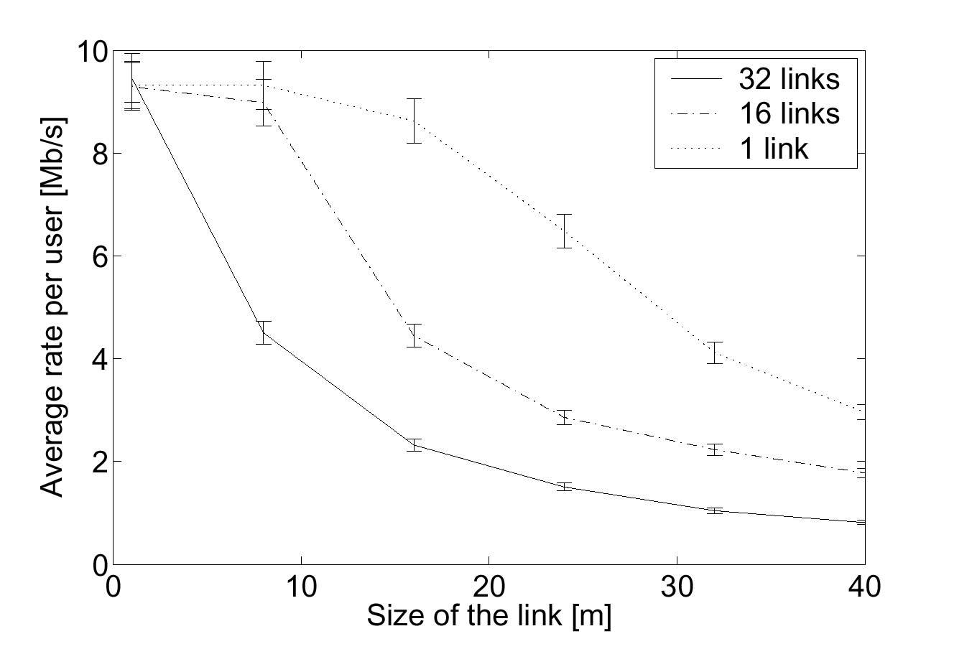
Clustered
Random Network
DCC
CA/CDMA
802.11

Slide 34
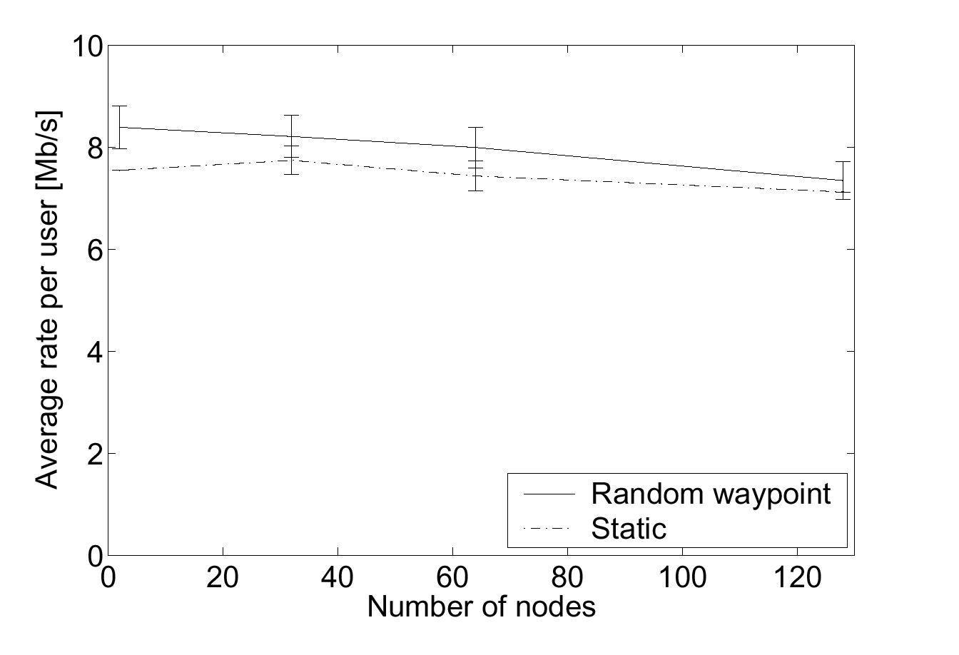
Impact of Mobility

Slide 35
Conclusion
We have designed a protocol for very low power UWB
Design is joint with Physical Layer
Uses other ingredient than classical MAC protocols
  allow interference
  always use maximum power or nothing
  adapt channel rate
Dynamic Channel Coding provides good mobility support
Provides superior performance
  several Mb/s per node for distances up to 30 meter and for up to 120 nodes transmitting in parallel

Slide 36
More Information
J. Y. Le Boudec, R. Merz, B. Radunovic, J. Widmer
"A MAC protocol for UWB Very Low Power Mobile Ad-hoc Networks based on Dynamic Channel Coding with Interference Mitigation"
Technical report No. IC/2004/02

