Slide 1




A MAC protocol for UWB Very Low Power Mobile Ad-hoc
Networks based on Dynamic Channel Coding with Interference
Mitigation
MICS
Mobile Information and Communication Systems
Jean-Yves Le Boudec
joint work with
Ruben Merz, Bozidar Radunovic, Joerg Widmer

Slide 2
Contents
Goal of our Research
Assumptions on Ultra Wide Band physical layer
Interference Mitigation
A Theoretical Look at MAC Protocols
Our MAC protocol
  dynamic channel coding
  private MAC

Slide 3
1. Goal of our research
Design a MAC protocol for UWB that is joint with the physical layer
  fully utilizes the specificity of UWB
  cooperates with PHY
  uses modern possibilities of variable rate codes
Simple nodes
  a node can only send XOR receive, and to/from only one neighbour
This presentation
  a MAC protocol for low power UWB (1 microwatt emitted power)

Slide 4
2. Assumptions on Ultra Wide Band PHY
Many Physical layers proposed at IEEE 802.15.3
Theoretical results [Verdu2002] state that optimal transmission scheme should be « peaky », i.e. send short pulses
We assume pulse based PHY with PPM [WinScholtz2000]
  pulse position modulation
‘0’
‘1’
δ

Slide 5
Time Hopping
Low spectral density requires randomness in inter pulse spacing
  use time hopping, one pulse per PRP slots
  PRP = Pulse Repetition Period
Time Hopping Sequence
  the sequence of time slot indices at a pulse may be transmitted by one source
  generated by a pseudo-random number generator
  one per user
PRP = 9
THS = 3 2 6 …
1
2
3
4
5
6
7
8
9
1
2
3
4
5
6
7
8
9
1
2
3
4
5
6
7
8
PRP× T_{c}
T_{c}

Slide 6

Parameters for Very Low Power UWB
FCC regulation and technology impose orders of magnitudes to numbers [source IEEE 802.15.3 submitted proposal, STM, May 2003]
radiated power depends on PRP
For example for 1 microwatt, PRP = 280
  other values apply to different PHY assumptions ( limited total BW, frequency hopping)
P_{peak}= 0.28 mW
T_{c}= 0.2 ns
PRP≥ 10
PRP× T_{c}
T_{c}

Slide 7
Bit Rates for Very Low Power UWB with our Parameter Set
Maximum : 18 Mb/s for one user
depends on noise and attenuation
  30 meters, maximum is 6 Mb/s for one user
Multi-user environment:
  with our proposal, we can keep per user rate close to the one user values
  unlike with traditional MACs

Slide 8
We Decouple Modulation from Coding
channel
code
modu-
lator
de-
modu-
lator
channel
code
data bits
coded bits
coded bits
data bits
THS
corre
lator
x₁ x₂ x₃ x₄ x₅ x₆
MLE
estimation
block of decoded bits
channel code adds redundancy for coping with noise and errors

Slide 9
We Use Incremental Redundancy Codes
A family of codes that cover rates from 1 to 1/10
No penalty for sending incremental bits later
encoder
decoder
R₁
k data bits
R₁
k/R₁ coded bits
incremental redundancy
R₂ Δ R₁
k/R₂ - k/R₁ bits
R₁
k data bits
R₂
k/R₂ coded bits

Slide 10
3. Interference Mitigation
Even with large PRP interference may cause noticeable rate reduction
  when a source is interfering with a nearby destination
Theoretical Solution: joint decoding – too complex, requires knowing all THSs
We use an alternative: « interference mitigation »
Implemented at demodulator

Slide 11
Interference Mitigation Uses Erasures
Idea: transform interference in erasure
  if received energy at demodulator is high, declare an erasure and ignore the sample
    high = larger than 5 * average output level
  may be due to collision or noise
  kills interfering pulses, but also some valid pulses when noise is high

Slide 12
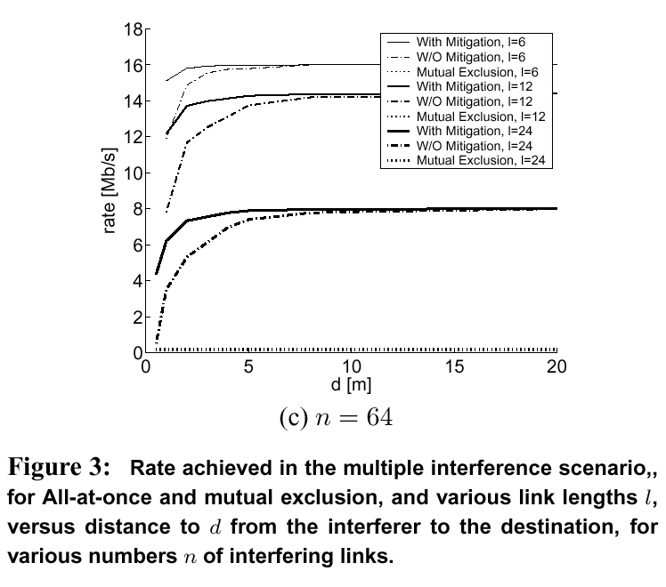
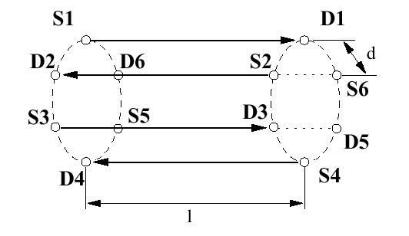
Example of Performance

Slide 13
4. Optimal MAC Design
MAC protocol = Multiple Access Control to radio channel
Traditional approaches in wireless LANs are based on « mutual exclusion »
  only one source can send at a time in the channel or in a given sub-channel
  TDMA, CSMA/CA, MACA etc.
  used in WiFi, BlueTooth
  interference is either below a noise threshold or is banned
There are unexploited dimensions
  interference can often be allowed
    example CA/CDMA [Muqattash-Krunz2003]
  coding can be adaptive
    adapt to channel variation at the time scale of a packet, including interference

Slide 14
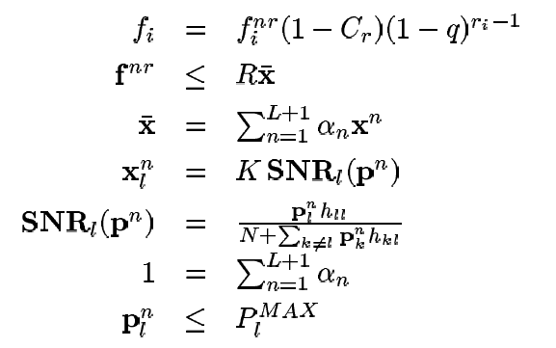
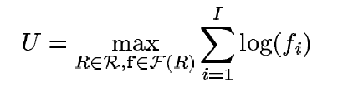
Searching For Optimal Design
Model a general wireless ad-hoc network with
  variable coding rate
  exclusion (i.e. scheduling in the time domain)
  arbitrary, possibly multipath, routing
  protocol overhead of exclusion not accounted for
Numerically solve for the allocation of powers and schedules that achieves proportional fairness
  other objectives are known to be buggy [Radunovic Infocom2004]
  random and symmetric networks up to 60 nodes

Slide 15
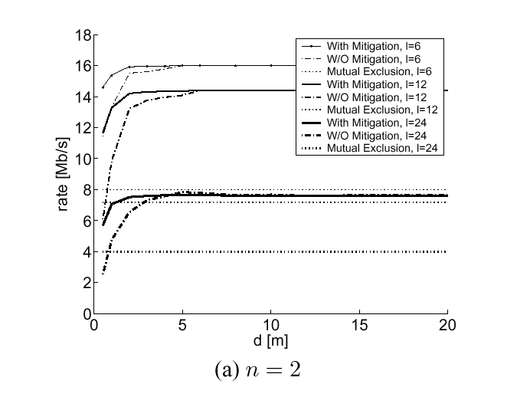
Mutual Exclusion is not Optimal
Allow Interference
Mutual Exclusion

Slide 16
Allow Interference
Mutual Exclusion
6 Mb/s
5 Mb/s
S1
D1
S1
D1
D2
S2
D2
S2
11 Mb/s
5 Mb/s

Slide 17
What this tells us
Suggested MAC design for very low power with interference mitigation
  allow interference
  adapt the code rate to the level of interference

Slide 18
5. Dynamic Channel Coding MAC Protocol
Our concrete MAC protocol
Based on our theretical results
  allow interference
  adapt code
It remains to solve
  the « Private MAC Problem »:
  several sources send to same destination
  carrier sensing not possible

Slide 19

Different Time Hopping Sequences are Used
B
A
Trans Req
THS(A), Code = R_{N}
Trans Reply
Time Hopping Sequence
  Common Random Number Generator for all nodes
  Seed = MAC address, or combination of MAC addresses
Request phase
  THS seed = A
Data exchange phase
  THS seed = AB
THS(AB),Code = R_{N}
Data
THS(AB), Code = R_{i}
NACK
THS(AB),Code = R_{N}
Incremental Red.
THS(AB)
ACK
THS(AB),Code = R_{N}

Slide 20
Dynamic Channel Coding
B
A
Trans Req
THS(A), Code = R_{N}
Goal: use the most economical code
  set for every packet
  avoid hard failure
Source keeps estimate of code to use in
codeIndex (say i)
If destination cannot decode (hard failure)
  NACK sent to source
  source does
  codeIndex = 2 * i
  source sends incremental redundancy
Trans Reply
THS(AB),Code = R_{N}
code
Index
=i
Data 1
THS(AB), Code = R_{i}
NACK
code
Index
= 2i
THS(AB),Code = R_{N}
Incremental Red.
THS(AB), R_{i} Δ R_{2i}

Slide 21
B
A
A safety margin of 2 indices is kept
If destination can decode, it can also compute the most economical code index j that would have been sufficient
  returns j+2 in ACK
Trans Req
THS(A), Code = R_{N}
Trans Reply
THS(AB),Code = R_{N}
code
Index
=i
Data 1
THS(AB), Code = R_{i}
NACK
code
Index
= 2i
THS(AB),Code = R_{N}
Incremental Red.
THS(AB), R_{i} Δ R_{2i}
This avoids most hard failures and adapts to varying channel (mobility, fading, interference)
Requests / Acks / Nacks sent on lowest rate code in the reverse direction
ACK, codeIndex = j+2
code
Index
= j+2
THS(AB),Code = R_{N}
Data 2
THS(AB),Code = R_{j+2}
code
Index
= j+1
ACK, codeIndex = j+1
THS(AB),Code = R_{N}

Slide 22
Concurrent Access
Concurrent access to different destinations occurs without direct coordination
  dynamic channel coding adapts automatically
Access to same destination requires a mutual exclusion protocol
  combination of invitation and receiver based
  solved by the “private MAC” part of our protocol

Slide 23
B
A
C
Trans Req
THS(A), Code = R_{N}
C attempts to transmit to A
  A is busy
Trans Reply
THS(AB),Code = R_{N}
Data
THS(AB), Code = R_{i}
Trans Req
no collision, interference
NACK
THS(A),Code = R_{N}
THS(AB),Code = R_{N}
Incremental Red.
C waits for either
  Trans Reply
  or Idle
THS(AB)
ACK
THS(AB),Code = R_{N}
Idle
Idle
THS(B), Code = R_{N}
THS(A), Code = R_{N}
Trans Req
THS(A),Code = R_{N}

Slide 24
B
A
C
start
Idle
start
THS(A), Code = R_{N}
Trans Req
expire
suspend
THS(A),Code = R_{N}
Trans Reply
Both B and C compete for A and were deferred
  B and C compute backoff timer in [0,cwnd_{max}]
  Timer started on hearing Idle
  Timer suspended if TransReq overheard
  If this fails, double cwnd_{max} and restart
THS(AC),Code =R_{N}
Data
THS(AC),Code = R_{k}
ACK
THS(AC),Code =R_{N}
Idle
resume
THS(A), Code = R_{N}
start
expire
Trans Req
suspend
THS(A), Code = R_{N}

Slide 25
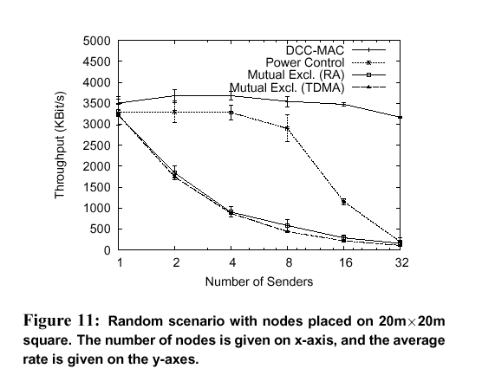
Simulation Results
We implemented the Dynamic Channel Coding MAC in ns2, based on tables computed in Matlab
  we redesigned ns2 PHY to support interference /collision during a transmission
We compared the performance to
  mutual exclusion (TDMA, Random Access); power control
Notes:
UDP CBR sources 2KB packets a1 packet every 1 ms

Slide 26
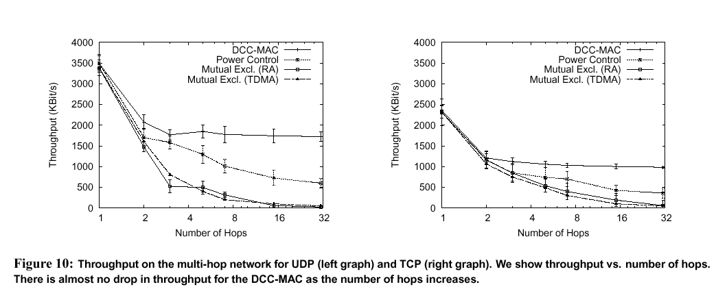
With UDP and TCP Traffic

Slide 27
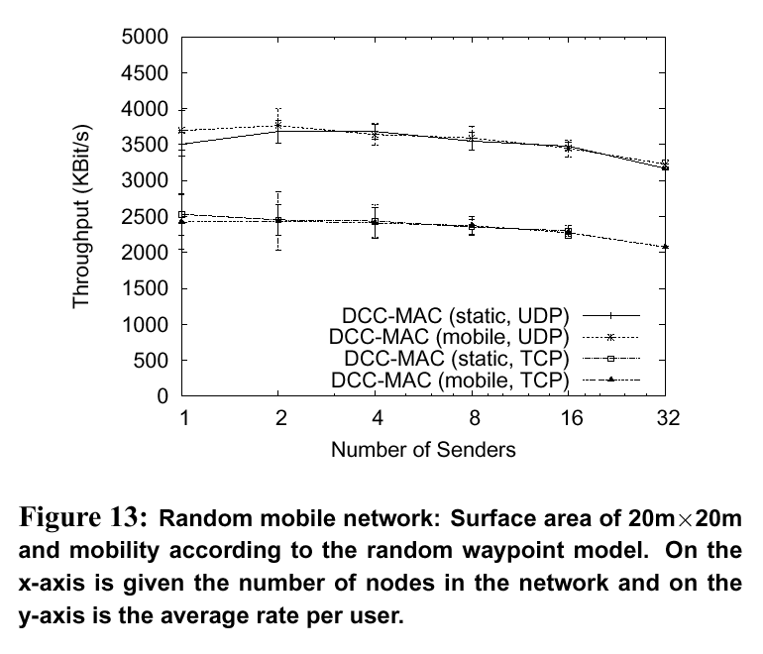
With Mobility

Slide 28
Conclusion
We have designed a protocol for very low power UWB
Design is joint with Physical Layer
Uses other ingredient than classical MAC protocols
  allow interference
  always use maximum power or nothing
  adapt channel rate
Dynamic Channel Coding provides
  good mobility support
  superior performance: several Mb/s per node for distances up to 30 meter and for up to 120 nodes transmitting in parallel
Further Research
  higher power (low PRP): mutual exclusion is optimal when interference is high – requires a combination
  extensions to support hybrid systems (higher power : video) combined with lower power

Slide 29
More Information
J. Y. Le Boudec, R. Merz, B. Radunovic, J. Widmer
"A MAC protocol for UWB Very Low Power Mobile Ad-hoc Networks based on Dynamic Channel Coding with Interference Mitigation"
Technical report No. IC/2004/02

