Slide 1

Terminode Routing - A Scalable Routing Scheme for Large Mobile
Ad Hoc Networks
Ljubica Blažević
Jean-Yves Le Boudec
Silvia Giordano
http://lcawww.epfl.ch
EPFL-Switzerland
Notes:
In my thesis I was interested in routing.

Slide 2
Goal: Design Routing Protocol for Terminode Network
Requirements:
  scalability (geography, number of terminodes)
  support irregular network
  minimal intermediate system functions and overhead
Introduction

Slide 3

Existing Routing Protocols
Topology-based (MANET) protocols use info. about links in network (ex.DSR,AODV,ZRP, DSDV,OLSR)
  difficult to maintain topological structure for more than 100 nodes
Scalability can be achieved through geography (ex. LAR,GPSR, GRA, GFP)
  reduction of control traffic, router state information
  routes may not be optimal
  location inaccuracy is not well supported
  difficult with irregular topologies
Terminode Routing combines both
  geography-based until close to destination; there on MANET-like
Introduction

Slide 4

Terminode Routing
Every terminode is identified by two addresses:
  End-system Unique Identifier (EUI)
  Location-Dependent Address (LDA): (longitude, latitude, height)
    obtained with GPS or GPS-free positioning system
    location management assumed to exist
Source S knows EUI_{D} and approximate value of LDA_{D}. How can S reach D?
Terminode Routing

Slide 5
Terminode routing =
TRR(location-based) + TLR(MANET-like)
Elements of Terminode Routing:
  Terminode Remote Routing (TRR): location-based, far from destination
  Terminode Local Routing (TLR): non location-based, close to destination
  Interworking between the two
Terminode Routing
direction LDA_{D}
S
D
To EUI_{D}

Slide 6
Terminode Remote Routing (TRR)
Default method: Geodesic Packet Forwarding (GPF)
  packet is sent to a neighbour geographically closest to D’s location
Anchored Geodesic Packet Forwarding (AGPF) helps in case of obstacles and voids
Terminode Routing

Slide 7
GPF - Problems
Greedy mode: packet can be “stuck” in local minimum
Perimeter mode is used in that case:
  uses planar subgraph of wireless network graph to route around perimeter of a void
  problem: may loop due to mobility
Terminode Routing
S
D

Slide 8

Anchors help to go around Connectivity Voids
AP1
direction AP2
AP2
direction LDA_{D}
direction AP1
Terminode Routing
D
S
AGPF routes along anchored paths (list of geographic points - anchors)
AGPF = source routing with anchors

Slide 9
Anchored Path Discovery
List of anchors found by GMPD or FAPD
Geographical Map-Based Path Dicovery (GMPD)
  map identifies areas with higher node density (towns and highways)
  anchored paths found with help of map
Friend Assisted Path Discovery (FAPD)
  a terminode can ask its friends to help in finding a path
    terminode has a good path to a friend
Terminode Routing

Slide 10
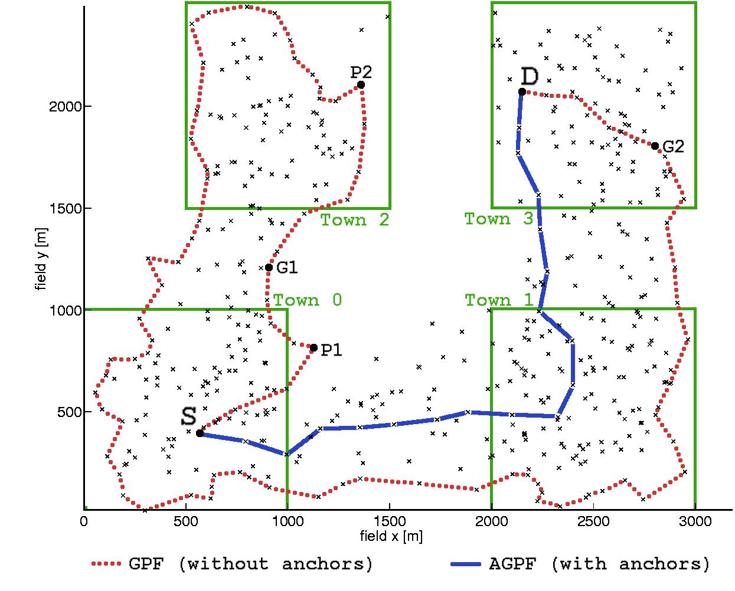
GMPD Illustrated
Terminode Routing

Slide 11
(a). FAPD Illustrated
Anchored
F5
AP1=F1.location
F1
AP1, AP2= F4.location
F4
F2
Terminode Routing
S
D
F3
S’s list of friends {F1,F2,F3}
F1’s list of friends {F4,F5}

Slide 12
(b). FAPD Illustrated
AP1
AP2
Terminode Routing
S
Anchored Path To D: {AP1, AP2}
D

Slide 13
Terminode Local Routing (TLR)
Inspired by existing MANET protocols
Desirable characteristics of TLR:
  low overhead
  handles well problems due to location management inaccuracy
  loop-free at all times
Terminode Routing

Slide 14
Illustration of advantages with TLR
TLR helps when the destination has moved from its reference position more than scope of one transmission range
D (dest)
Terminode Routing
LDA_{D}
D in TLR_routing_table

Slide 15
Interworking of TRR and TLR
TRR is performed until some node finds destination to be within 2 hops
  from there on, only TLR is used
This simple way may not work ; then use more complex method to expedite termination of TRR
A’s routing table
Direction LDA_{D}
To
NxT Hop
Terminode Routing
EUI_{D}
EUI_{B}
S
B
D
A

Slide 16
On-Line Demonstration
Java Applet implementation of TLR, TRR, GMPD

Slide 17
Conclusions
Designed terminode routing: scalable strategy for large mobile ad hoc networks
Tested: TLR + TRR + FAPD or GMPD scales well under different simulation parameters

Slide 18
TLR Operation
TLR consists of two methods:
  1. building of TLR routing tables
  2. TLR packet forwarding
All nodes keep link states for nodes in the 2-hop area
  X sends in a HELLO message: {EUI_{X}, LDA_{X}, EUIs of its immediate neighbours };
  HELLO messages are periodically broadcasted at the MAC layer
  X’s routing table:
    immediate neighbours’ EUI and LDA (used for TRR)
    2-hop nodes: EUI and next hop node
  all entries are associated with a timeout
X has packet p to forward to D with TLR
Terminode Routing
  if (p.use_tlr_bit=0) p.use_tlr_bit:=1
  if (EUI_{D} in X.TLR_routing_table)
    transmit(p, X.TLR_routing_table.next_hop(EUI_{D}))
  else drop p

Slide 19
TRR termination
If D has moved considerably from LDA_{D} (known at the source), normal termination not possible
    packet may circulate around LDA_{D} and eventually die (after TLL expiration)
Our goal: detect packet circulation problem and react
One solution is limiting lifetime of packets:
X sets: p.ttl=min(3, p.ttl)
Terminode Routing
Expedite termination of TRR if:
dist(LDA_{D}, LDA_{X})<X.transmission_range && D not in X.TLR_routing_table

Slide 20
A variant of how TRR termination is expedited-
Restricted Local Flooding (RLF)
RLF expands search area of D and improves probability of finding D
Restricted Local Flooding: 6 duplicates, 4 hops
RLF never results in network-wide flooding
RLF is activated at X:
X creates several copies of packet (p_{i} ) and selects different locations around itself (L_{i}) :
p_{i}.LDA_{D}:=L_{i}
X sends p_{i} by GPF
Terminode Routing

Slide 21
RLF operation
D
6 copies (p_{i},i=1..6 )
sent by unicast
L3
x
L2
x
p_{i}.LDA_{D}=Li,
p_{i}.ttl=4
L4
x
L1
x
Terminode Routing
LDA_{D}
L5
x
L6
x

Slide 22
Performance Evaluation
Simulations were performed in GloMoSim:
  IEEE 802.11 MAC protocol is used; nominal radio range is 250 meters and 2Mbs data rate (model of the Lucent WaveLAN card)
  Piggypacking implemented (promiscuous use of network interface)
  HELLO messages sent every 1 s (if no data is to be sent); TLR routing entries expire after 2s (if not updated)
Small networks (100 nodes)
  performance similar to LAR1, better than Manet (AODV)
Large networks (500-600 nodes)
  Manet collapse
  LAR1 continue to work
  Terminode routing improves 20-30% above LAR1

Slide 23
Terminode Routing Performance Evaluation
Simulations were performed in GloMoSim:
  IEEE 802.11 MAC protocol is used; nominal radio range is 250 meters and 2Mbs data rate (model of the Lucent WaveLAN card)
  Piggypacking implemented (promiscuous use of network interface)
  HELLO messages sent every 1 s (if no data is to be sent); TLR routing entries expire after 2s (if not updated)
Simulation parameters:
  size of the network
  node distributions (uniform and non-uniform)
  mobility level
Terminode Routing

Slide 24
Location Management
In SMALL nets (#nodes=100) our location management:
  location discovery is on-demand: initiated by source, based on controlled flooding of network; destination sends its location back to source
  location tracking: once two nodes begin communication, data packets periodically piggyback local sender’s location
In BIG nets (#nodes=600)
  we assume idealized location management with no control overhead
  however, we assume the location information can be stale
  the location information lifetime parameter is the destination location update interval
Terminode Routing

Slide 25
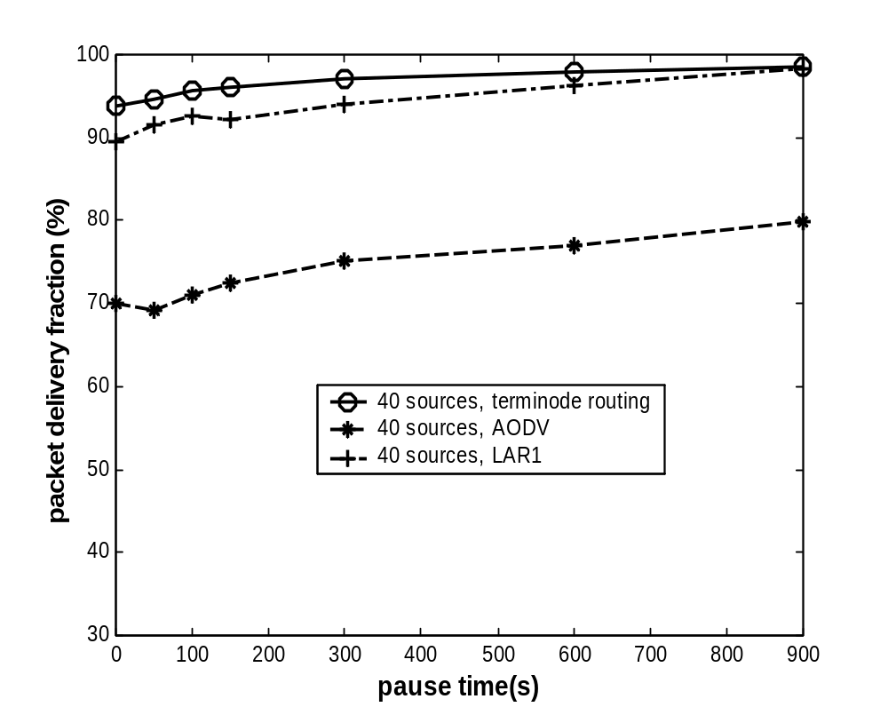
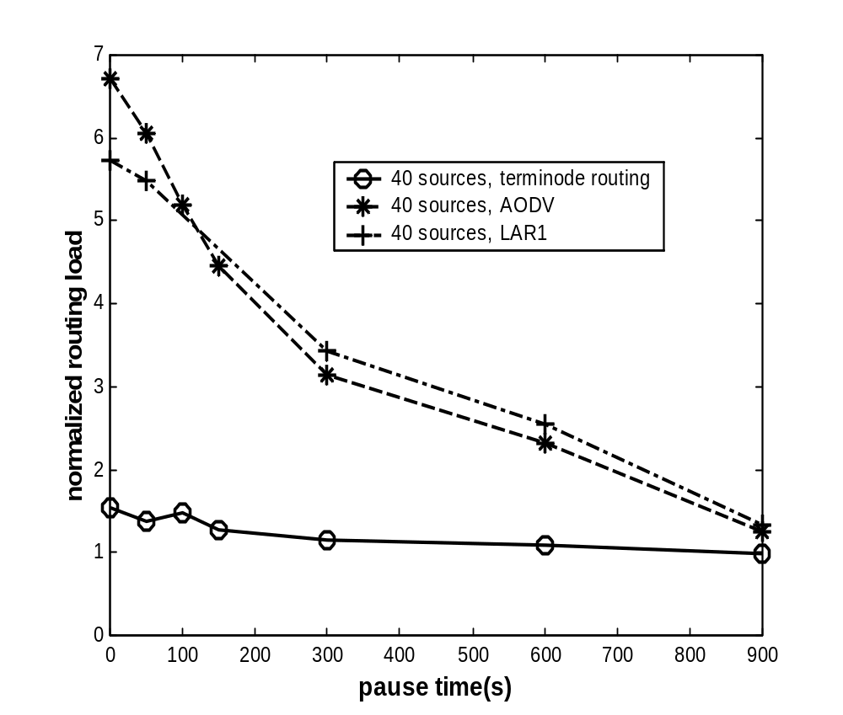
In small networks TR better than MANET
Terminode routing outperforms LAR1 and AODV in packet delivery success
Terminode Routing has lowest routing load compared to LAR1 and AODV
100 nodes, terrain:2200m X 600m; mobility: Random Waypoint (v=0-20m/s);
40 CBR applications (2x64bytes per second)

Slide 26
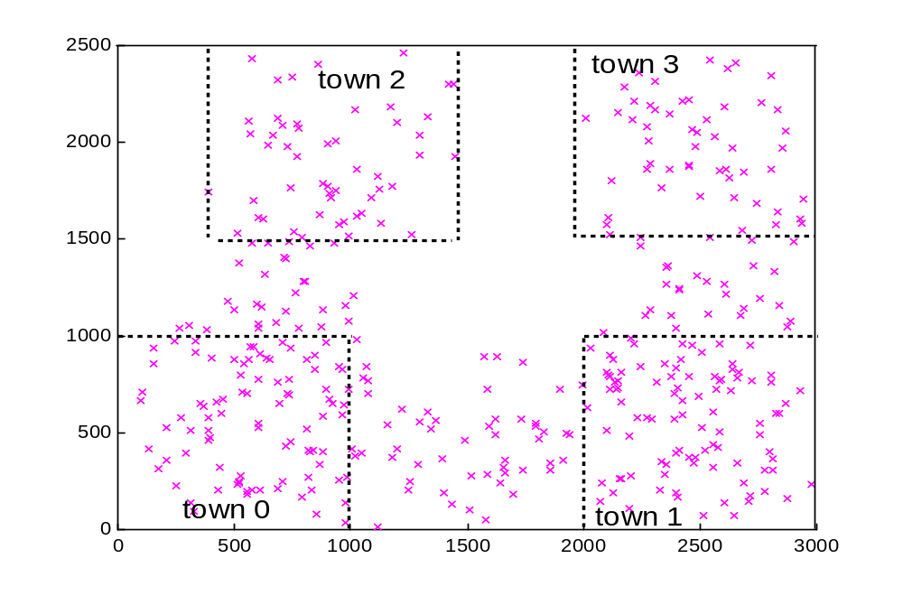


Large Network, Non-Uniform node distribution
We designed new mobility model referred to as restricted random waypoint that is close to real life
Nodes move in the same town area by random waypoint model, before moving to a different town
stay_in_town parameter defines locality of movements within a town
Terminode Routing

Slide 27
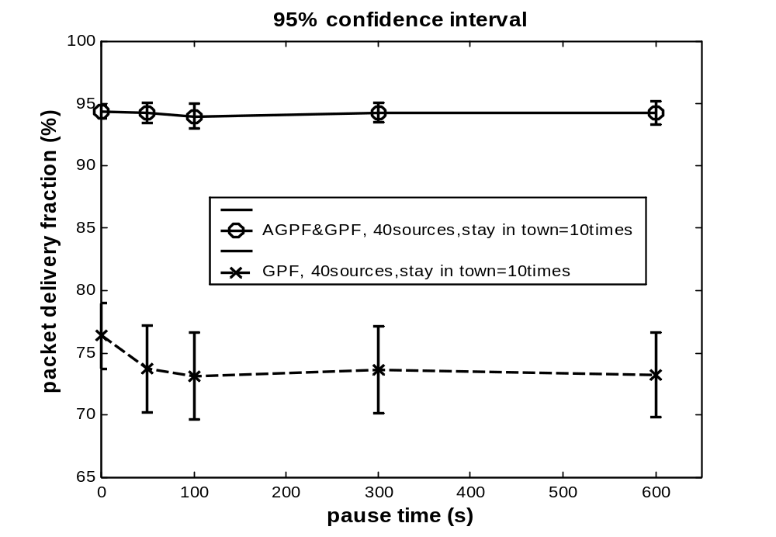
Results for different levels of mobility
while movements are localized
stay_in_town=10
500 nodes,
mobility: Restricted Random Waypoint (v=0-20m/s)
40 CBR applications (2x64bytes per second)
location info. lifetime = 5 sec
Terminode Routing
AGPF improves GPF
over 20%

