Slide 1
Random Trip
Stationarity, Perfect Simulation and Long Range Dependence
Jean-Yves Le Boudec (EPFL)
joint work with
Milan Vojnovic (Microsoft Research Cambridge)

Slide 2
Resources
This slide show
http://ica1www.epfl.ch/RandomTrip/slides/RandomTripLEBNov05.ppt
Documentation about random trip model, including ns2 code for download
http://ica1www.epfl.ch/RandomTrip/
This slide show is based on material from
[L-Vojnovic-Infocom05] J.-Y. Le Boudec and M. Vojnovic
Perfect Simulation and Stationarity of a Class of Mobility Models
IEEE INFOCOM 2005
http://infoscience.epfl.ch/getfile.py?mode=best&recid=30089
[L-04] Tutorial on Palm calculus applied to mobility models
http://lcawww.epfl.ch/Publications/LeBoudec/LeBoudecV04.pdf

Slide 3
Abstract
The simulation of mobility models often cause problems due to long transients or even lack of convergence to a stationary regime ("The random waypoint model considered harmful"). To analyze this, we define a formally sound framework, which we call the random trip model.
It is a generic mobility model for independent mobiles that contains as special cases: the random waypoint on convex or non convex domains, random walk, billiards, city section, space graph and other models. We use Palm calculus to study the model and give a necessary and sufficient condition for a stationary regime to exist. When this condition is satisfied, we compute the stationary regime and give an algorithm to start a simulation in steady state (perfect simulation). The algorithm does not require the knowledge of geometric constants. For the special case of random waypoint, we provide for the first time a proof and a sufficient and necessary condition of the existence of a stationary regime. Further, we extend its applicability to a broad class of non convex and multi-site examples, and provide a ready-to-use algorithm for perfect simulation. For the special case of random walks or billiards we show that, in the stationary regime, the mobile location is uniformly distributed and is independent of the speed vector, and that there is no speed decay. Our framework provides a rich set of well understood models that can be used to simulate mobile networks with independent node movements. Our perfect sampling is implemented to use with ns-2, and it is freely available to download from http://ica1www.epfl.ch/RandomTrip.

Slide 4
Contents
Issues with mobility models
The random Trip Model
Stability
Perfect Simulation
Long range dependent examples

Slide 5
Mobility models are used to evaluate system designs
Simplest example: random waypoint:
  Mobile picks next waypoint M_{n} uniformly in area, independent of past and present
  Mobile picks next speed V_{n} uniformly in [v_{min} , v_{max}]
  independent of past and present
  Mobile moves towards M_{n} at constant speed V_{n}
M_{n-1}
M_{n}

Slide 6
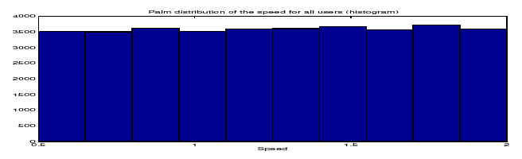
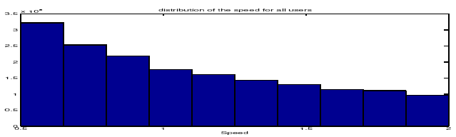
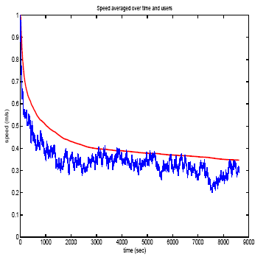
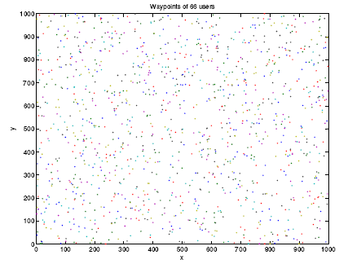
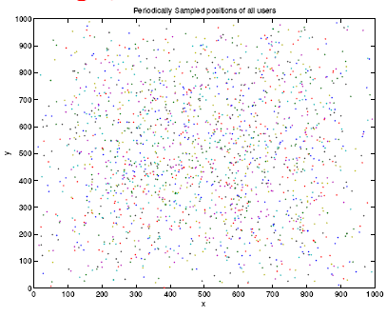
Issues with this simple Model
Distributions of speed, location, distances, etc change with simulation time:
Distributions of speeds at times 0 s and 2000 s
Samples of location at times 0 s and 2000 s
Sample of instant speed for one
and average of 100 users

Slide 7
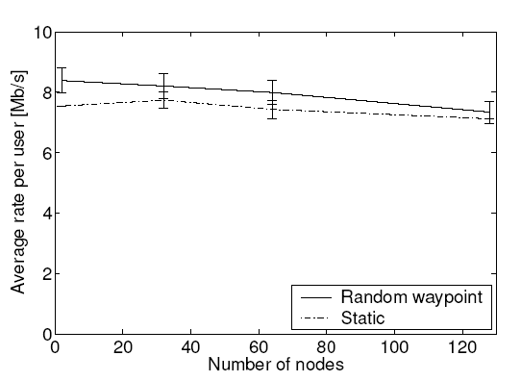
Why does it matter ?
A (true) example: Compare impact of mobility on a protocol:
  Experimenter places nodes uniformly for static case, according to random waypoint for mobile case
  Finds that static is better
Q. Find the bug !
A. In the mobile case, the nodes are more often towards the center, distance between nodes is shorter, performance is better
The comparison is flawed. Should use for static case the same distribution of node location as random waypoint. Is there such a distribution to compare against ?
Random waypoint
Static

Slide 8
Issues with Mobility Models
Is there a stable distribution of the simulation state ( = Stationary regime) reached if we run the simulation long enough ?
If so,
  how long is long enough ?
  If it is too long, is there a way to get to the stable distribution without running long simulations (perfect simulation)

Slide 9
Contents
Issues with mobility models
The random Trip Model
Stability
Perfect Simulation
Long range dependent examples

Slide 10
The Random Trip model
Goals: define mobility models
  That are feature rich, more realistic
  For which we can solve the issues mentioned earlier
Random Trip [L-Vojnovic-Infocom05] is one such model
  mobile picks a path in a set of paths and a speed
  at end of path, mobile picks a new path and speed
  driven by a Markov chain
M_{n+1}=P_{n+1}(0)
trip end
Path P_{n} : [0,1] → A
trip duration S_{n}
Here Markov chain is P_{n}
trip start
M_{n}=P_{n}(0)
domain A

Slide 11
Random Waypoint is a Random Trip Model
Example (RWP):
Path:
P_{n} = (M_{n}, M_{n+1})
P_{n}(u) = u M_{n} + (1-u) M_{n}+1, u∈[0,1]
Trip duration: S_{n} = (length of P_{n}) / V_{n}
V_{n} = numeric speed drawn from a given distribution
Other examples of random trip in next slides

Slide 12
RWP with pauses on general connected domain
Here Markov chain is
(P_{n}, I_{n})
where
I_{n} = “pause” or I_{n} =“move”

Slide 13
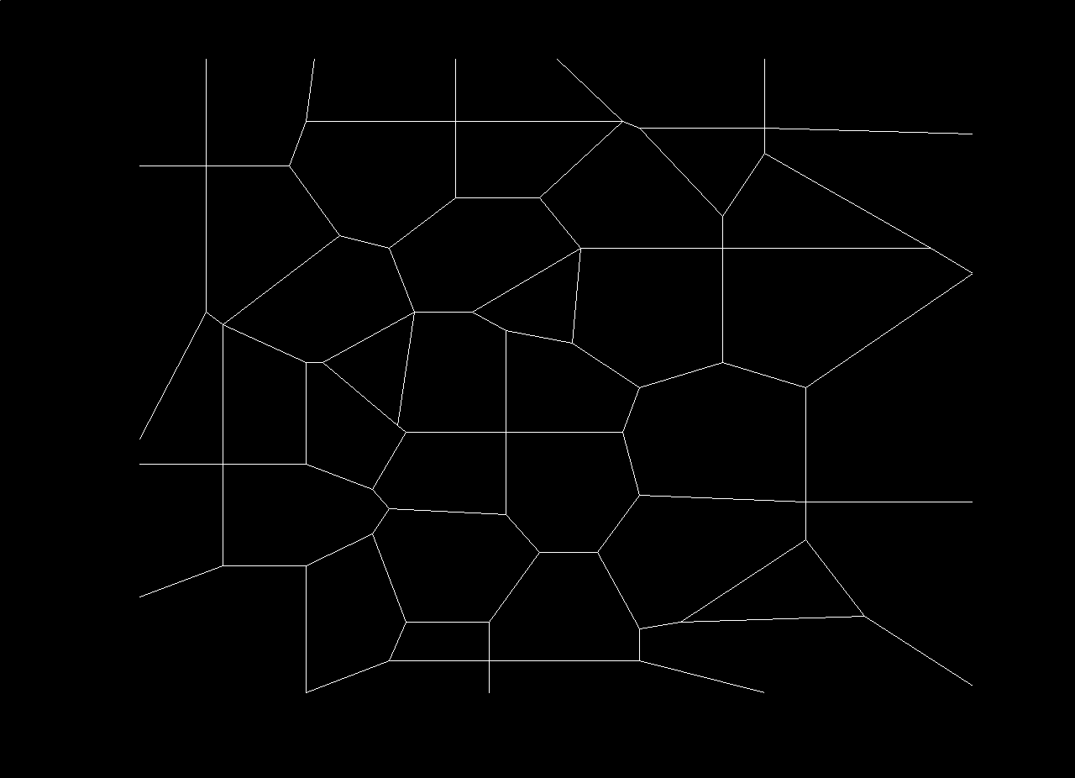
City Section

Slide 14
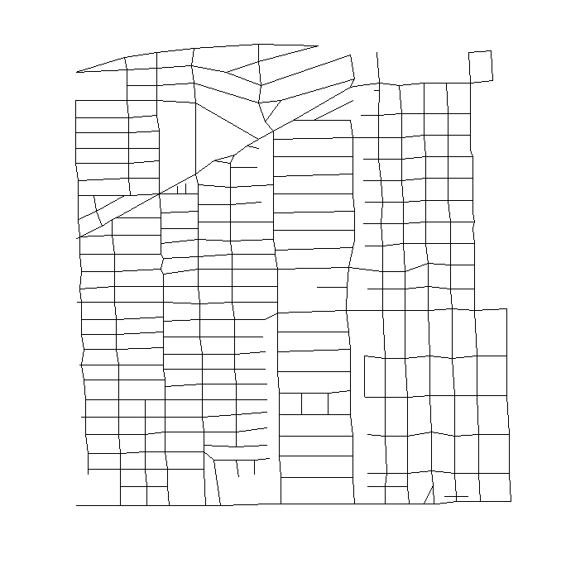
Space graphs are readily available from road-map databases
Example: Houston section, from US Bureau’s TIGER database
(S. PalChaudhuri et al, 2004)

Slide 15
Restricted RWP (Blažević et al, 2004)
Here Markov chain is
(P_{n}, I_{n}, L_{n}, L_{n+1}, R_{n})
Where
I_{n} = “pause” or I_{n} =“move”
L_{n} = current sub-domain
L_{n+1} = next subdomain
R_{n} = number of trips in this visit to the current domain

Slide 16
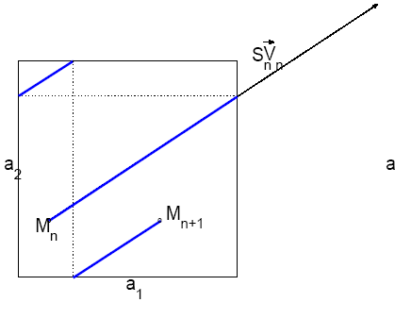
Random walk on torus with pauses

Slide 17
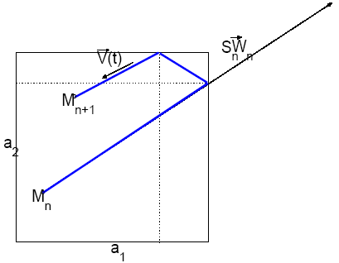
Billiards with pauses

Slide 18
Assumptions for Random Trip Model
Model is defined by a sequence of paths P_{n} and trip durations S_{n}, and uses an auxiliary state information I_{n}
Hypotheses
  (P_{n}, I_{n}) is a Markov chain (possibly on a non enumerable state space)
  Trip duration S_{n} is statistically determined by the state of the Markov chain (P_{n}, I_{n})
  (P_{n}, I_{n}) is a Harris recurrent chain
    i.e. is stable in some sense
These are quite general assumptions
  Trip duration may depend on chosen path

Slide 19
Contents
Issues with mobility models
The random Trip Model
Stability
Perfect Simulation
Long range dependent examples

Slide 20
Solving the Issue
1. Is there a stationary regime ?
Theorem [L-Vojnovic-Infocom 05]:
  there is a stationary regime for random trip iff the expected trip time is finite
  If there is a stationary regime, the simulation state converges in distribution to the stationary regime
Application to random waypoint with speed chosen uniformly in [v_{min},v_{max}]
  Yes if v_{min} >0, no if v_{min}=0
  Solves a long-standing issue on random waypoint.

Slide 21
A Fair Comparison
If there is a stationary regime, we can compare different mobility patterns provided that
  They are in the stationary regime
  They have the same stationary distributions of locations
Example: we revisit the comparison by sampling the static case from the stationary regime of the random waypoint
  Run the simulation long enough, then stop the mobility pattern
Static, same node location as RWP
Random waypoint
Static, from uniform

Slide 22
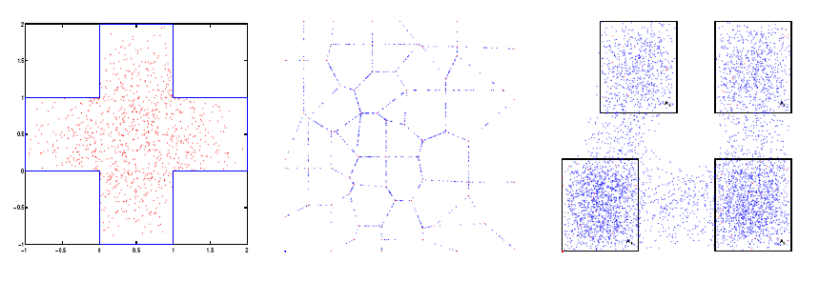
The Issues remain with Random Trip Models
Do not expect stationary distribution to be same as distrib at trip endpoints
Samples of node locations from stationary distribution
  (At t=0 node location is uniformly distributed)

Slide 23
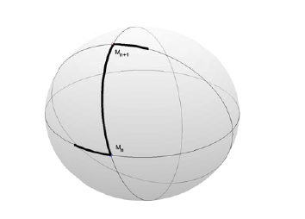
In some cases it is very simple
Stationary distribution of location is uniform for
  Random waypoint on sphere
  Random walk
  Billiards if speed vector is completely symmetric (goes up/down [right/left] with equal proba)

Slide 24
Contents
Issues with mobility models
The random Trip Model
Stability
Perfect Simulation
Long range dependent examples

Slide 25
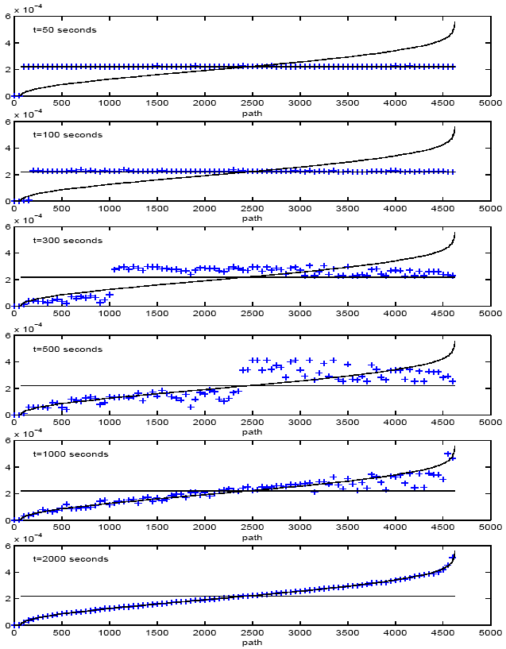
Solving the Issue
2. How long is long enough ?
Stationary regime can be obtained by running simulation long enough
but…
It can be very long
  Initial transient longs at least as large as typical simulation runs

Slide 26
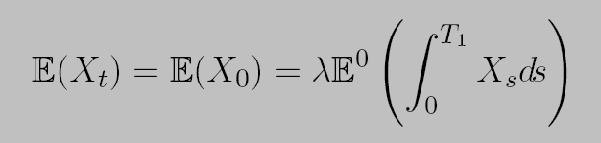
Palm Calculus gives Stationary Distribution
There is an alternative to running the simulation long enough
Perfect simulation is possible (stationary regime at time 0) thanks to Palm calculus
Relates time averages to event averages
  Inversion Formula
  by convention T₀ · 0 < T₁
Time average of observation X
Event average, i.e. sampled at end trips

Slide 27
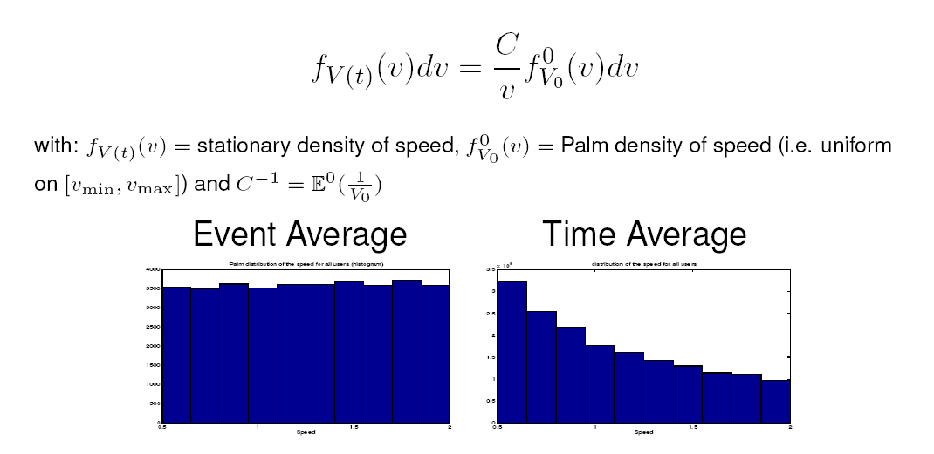
Example : random waypoint
Inversion Formula Gives Relation between
Speed Distributions at Waypoint and at Arbitrary Point in Time

Slide 28
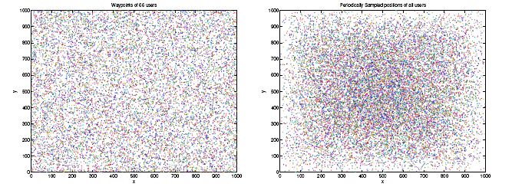
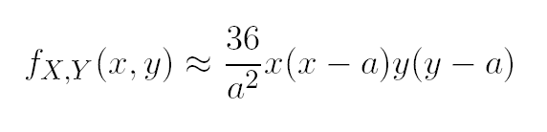
Distribution of Location was Previously Known only Approximately
Conventional approaches finds that closed form expression for density is too difficult [Bettstetter04]
Approximation of density in area [0; a] [0; a] [Bettstetter04]:

Slide 29
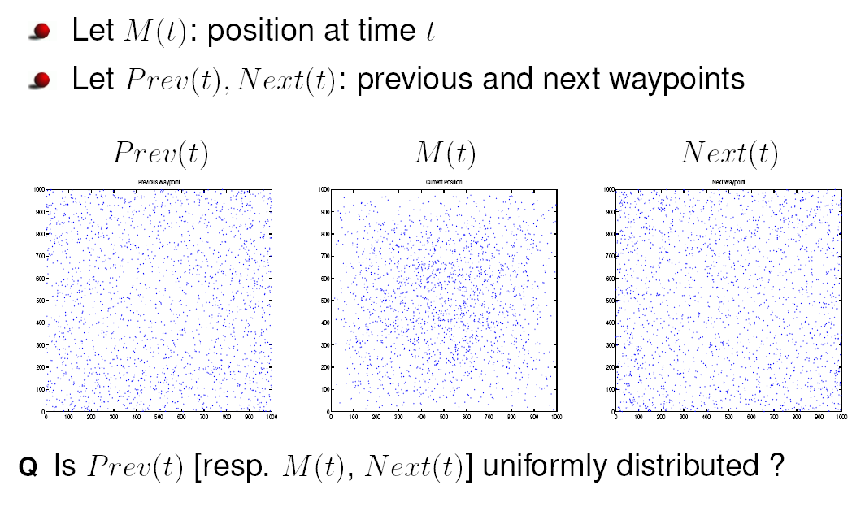
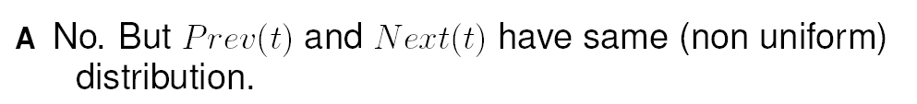
Previous and Next Waypoints

Slide 30
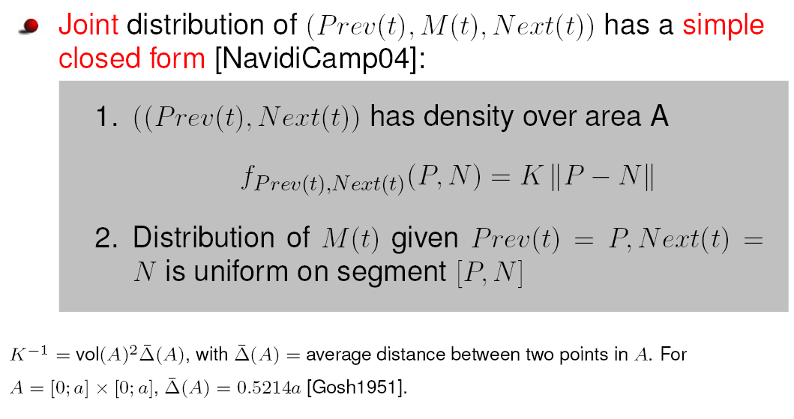
Stationary Distribution of Location Is also Obtained By Inversion Formula
back

Slide 31
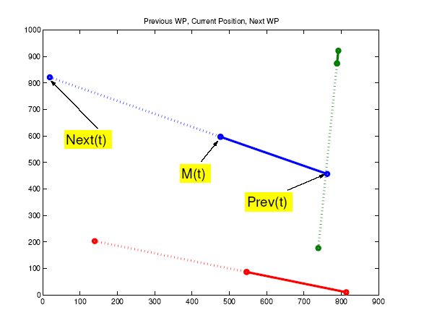
Stationary Distribution of Location
Valid for any convex area

Slide 32
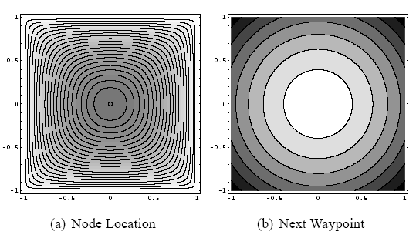
The stationary distribution of random waypoint is obtained in closed form [L-04]
Contour plots of density of stationary distribution

Slide 33
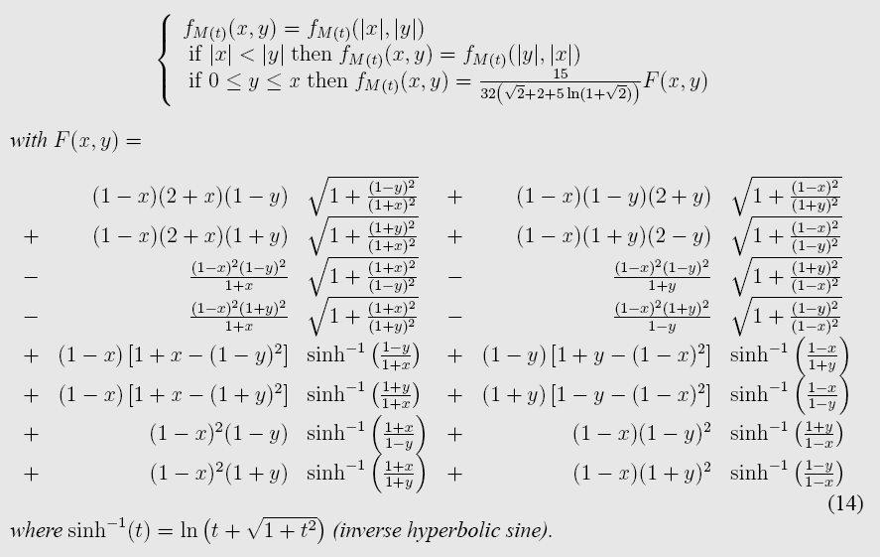
Closed Forms

Slide 34
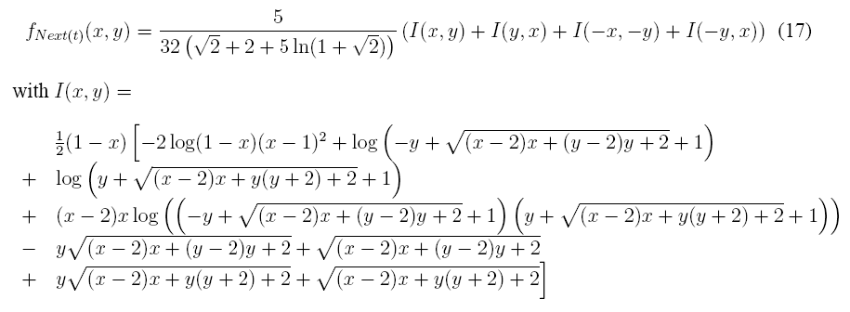

Slide 35
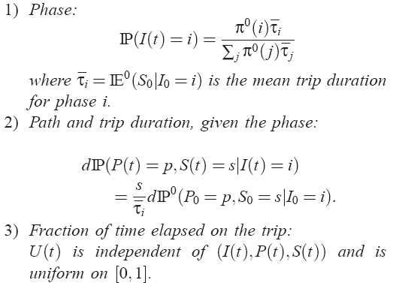
But we do not need complex formulae
The joint distribution of (Prev(t), Next(t), M(t)) is simpler
True for any random trip model :
  Stationary regime at arbitrary time has the simple generic, representation:
For random waypoint we have Navidi and Camp’s formula

Slide 36
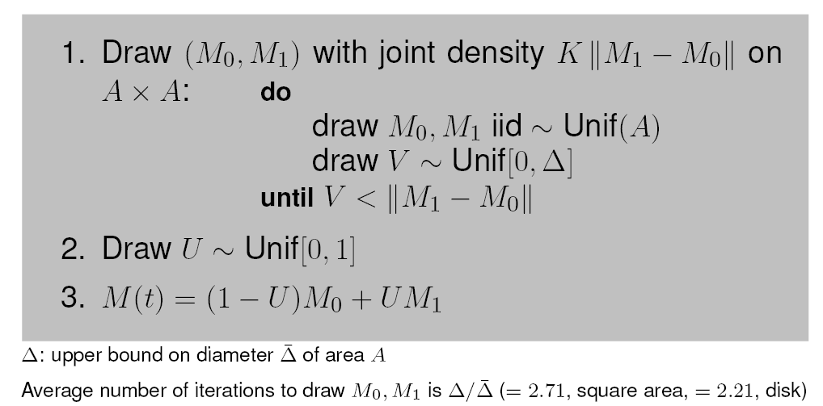
Perfect Simulation follows immediately
Perfect simulation := sample stationary regime at time 0
Perfect sampling uses generic representation and does not require geometric constants
  Uses representation seen before + rejection sampling
  Example for random waypoint:

Slide 37
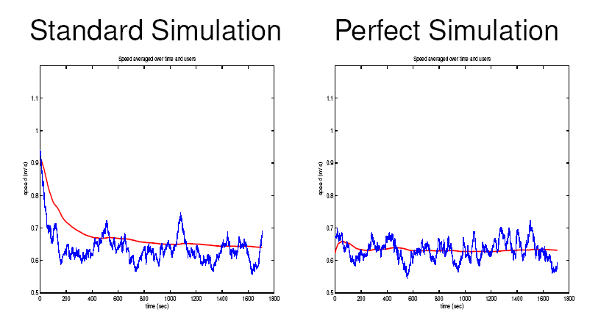
Example: Random Waypoint
No Speed Decay

Slide 38
Contents
Issues with mobility models
The random Trip Model
Stability
Perfect Simulation
Long range dependent examples

Slide 39
Why Long Range Dependent Models ?
Mobility models may exhibit some aspects of long range dependence
  See Augustin Chaintreau, Pan Hui, Jon Crowcroft, Christophe Diot, Richard Gass, and James Scott. "Impact of Human Mobility on the Design of Opportunistic Forwarding Algorithms".
The random trip model supports LRD

Slide 40
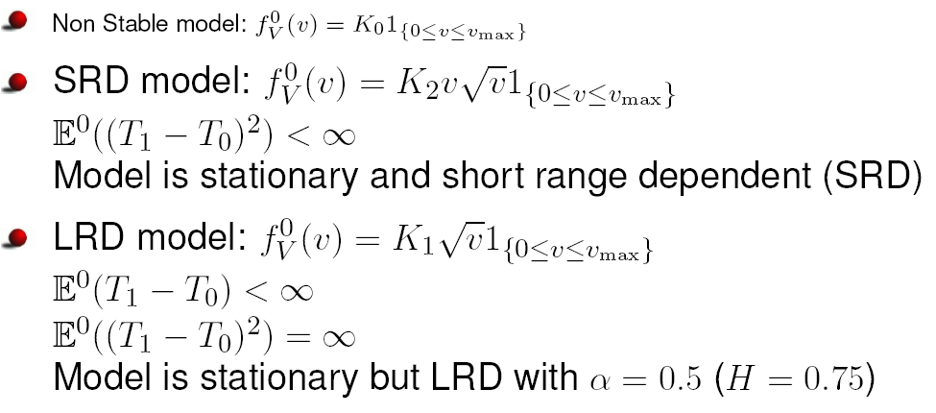
Long Range Dependent Random Waypoint
Consider the random waypoint without pause, like before, but change the distribution of speed:

Slide 41
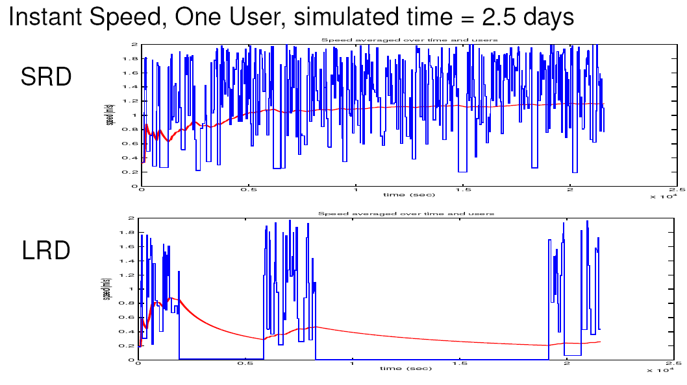
LRD means high variability

Slide 42
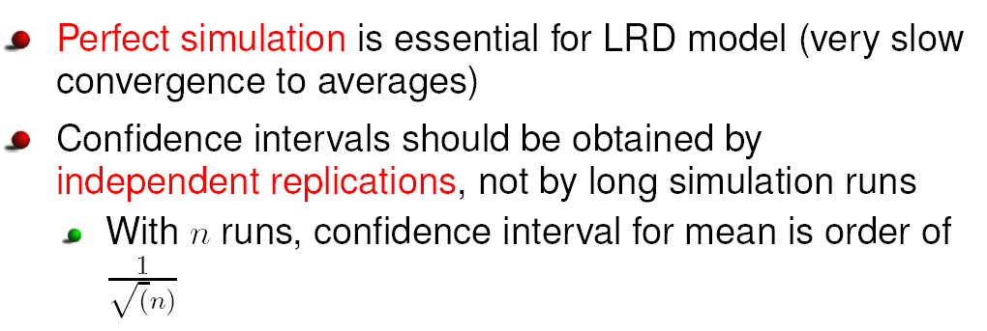
Practical Implications

Slide 43
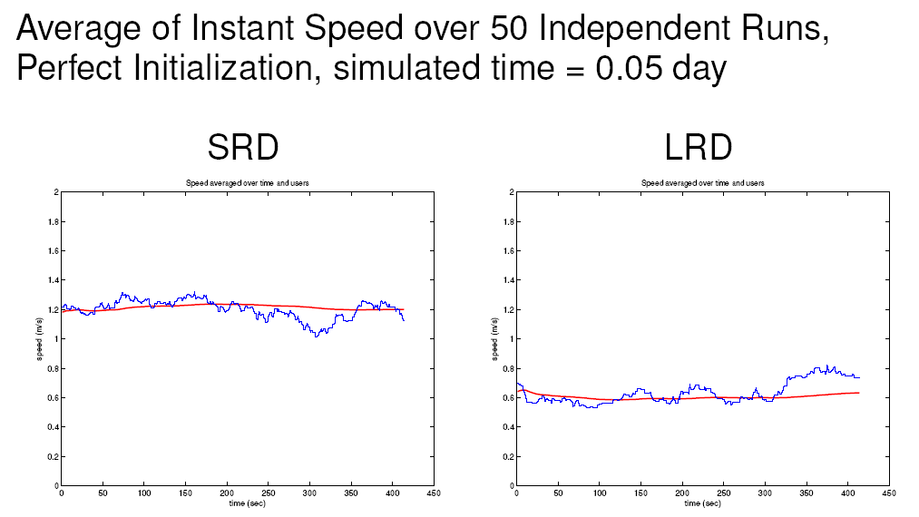
Average Over Independent Runs

Slide 44
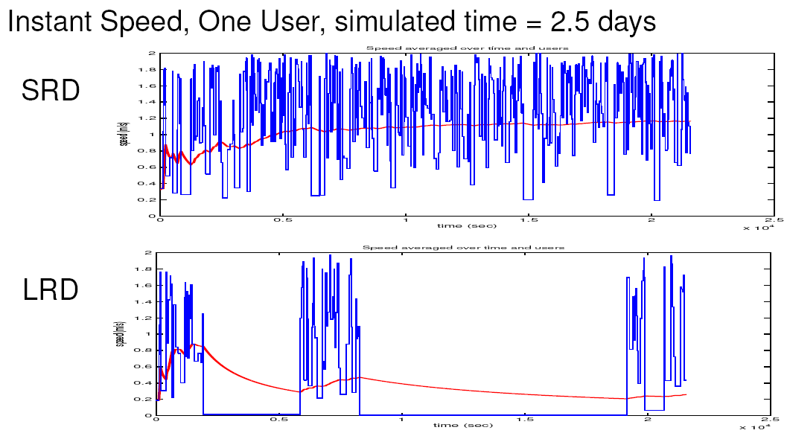
Compare to Single Long Run

Slide 45
Conclusion
The random trip model provides a rich set of mobility models for single node mobility
Using Palm calculus, the issues of stability and perfect simulation are solved
Random Trip is implemented in ns2 (by S. PalChaudhuri) and is available at
web site given earlier

