Slide 1
Mean Field Methods for Computer and Communication Systems
Jean-Yves Le Boudec
EPFL
ACCESS Distinguished Lecture Series, Stockholm, May 28, 2012

Slide 2
Contents
Mean Field Interaction Model
Convergence to ODE
Finite Horizon: Fast Simulation and Decoupling assumption
Infinite Horizon: Fixed Point Method and Decoupling assumption

Slide 3
Mean Field Interaction Model
1

Slide 4
Mean Field
A model introduced in Physics
interaction between particles is via distribution of states of all particle
An approximation method for a large collection of particles
assumes independence in the master equation
Why do we care in information and communication systems ?
Model interaction of many objects:
Distributed systems, communication protocols, game theory, self-organized systems

Slide 5
Mean Field Interaction Model
Time is discrete
N objects, N large
Object n has state X_{n}(t)
(X^{N}₁(t), …, X^{N}_{N}(t)) is Markov
Objects are observable only through their state
“Occupancy measure” M^{N}(t) = distribution of object states at time t

Slide 6
Mean Field Interaction Model
Time is discrete
N objects, N large
Object n has state X_{n}(t)
(X^{N}₁(t), …, X^{N}_{N}(t)) is Markov
Objects are observable only through their state
“Occupancy measure” M^{N}(t) = distribution of object states at time t
Theorem [Gast (2011)] M^{N}(t) is Markov
Called “Mean Field Interaction Models” in the Performance Evaluation community [McDonald(2007), Benaïm and Le Boudec(2008)]

Slide 7
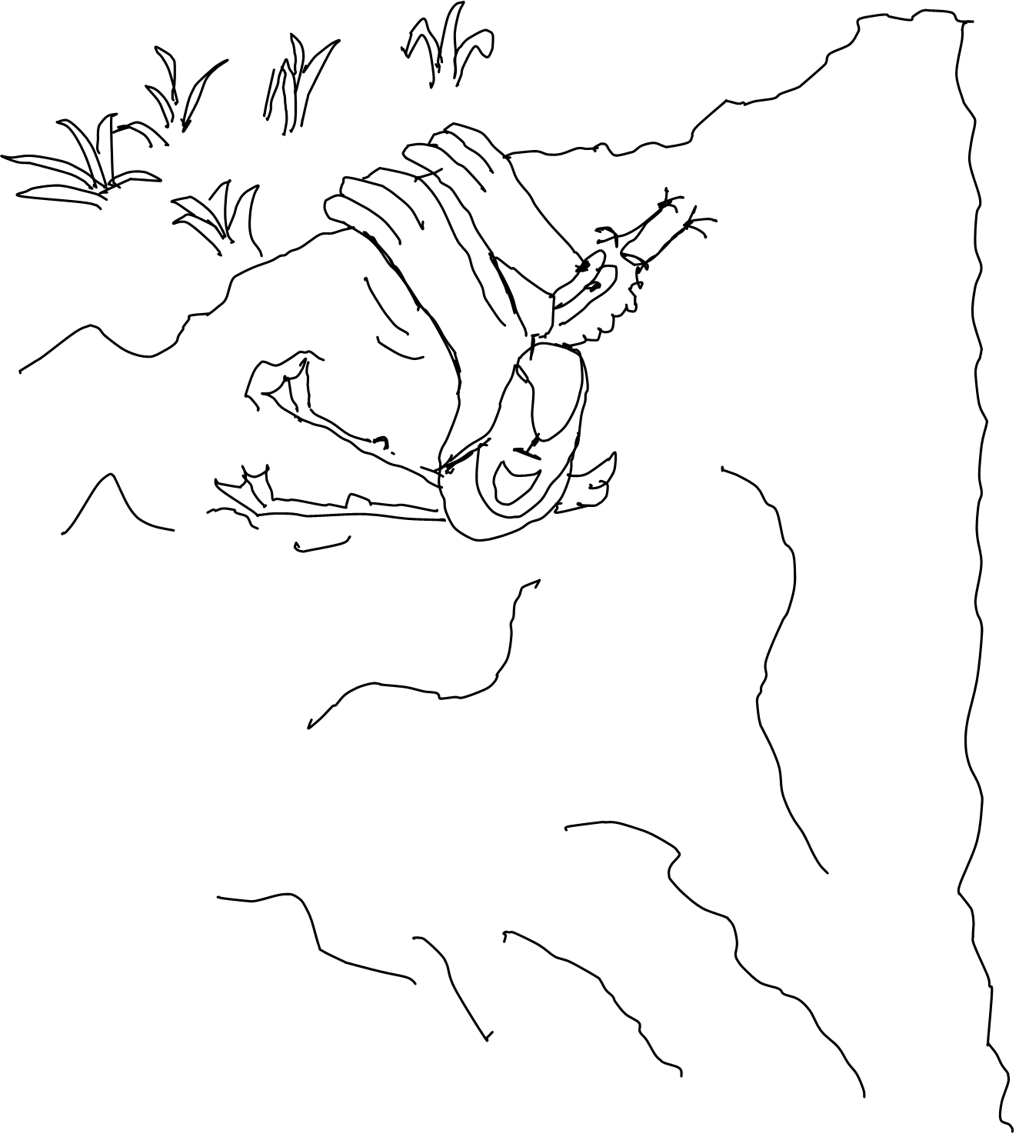

A Few Examples Where Applied
Never again !
E.L.

Slide 8
Example: 2-Step Malware
Mobile nodes are either
`S’ Susceptible
`D’ Dormant
`A’ Active
Time is discrete
Nodes meet pairwise (bluetooth)
One interaction per time slot, I(N) = 1/N; mean field limit is an ODE
State space is finite = {`S’ , `A’ ,`D’}
Occupancy measure is M(t) = (S(t), D(t), A(t)) with S(t)+ D(t) + A(t) =1
S(t) = proportion of nodes in state `S’ [Benaïm and Le Boudec(2008)]
Possible interactions:
Recovery
D -> S
Mutual upgrade
D + D -> A + A
Infection by active
D + A -> A + A
Recovery
A -> S
Recruitment by Dormant
S + D -> D + D
Direct infection
S -> D
Direct infection
S -> A

Slide 9
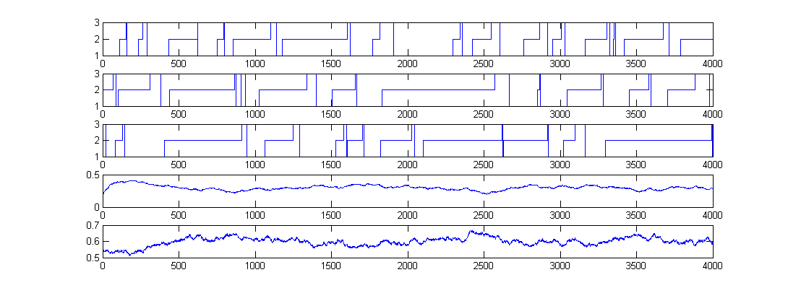
Simulation Runs, N=1000 nodes
Node 1
State = D
State = A
State = S
Node 2
Node 3
D(t)
Proportion of nodes
In state i=1
A(t)
Proportion of nodes
In state i=2

Slide 10
Sample Runs with N = 1000

Slide 11
Example: TCP and ECN
[Tinnakornsrisuphap and Makowski(2003)] At, every time step, all connections update their state: I(N)=1
Time is discrete, mean field limit is also in discrete time (iterated map)
Similar examples: HTTP Metastability [Baccelli et al.(2004)Baccelli, Lelarge, and McDonald] Reputation System [Le Boudec et al.(2007)Le Boudec, McDonald, and Mundinger, Gomez-Serrano et 10, 2012]
ECN Feedback q(R(t))
1
n
ECN router
queue length R(t)
N
N connections

Slide 12
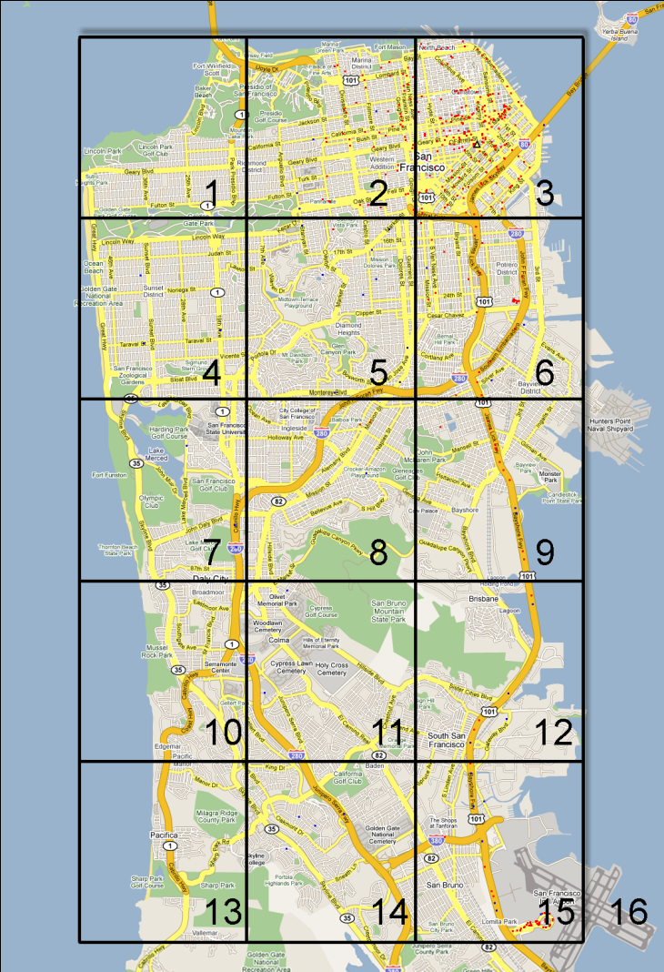
The Importance of Being Spatial
Mobile node state = (c, t) c = 1 … 16 (position)
t ∊ R⁺ (age of gossip)
Time is continuous, I(N) = 1
Occupancy measure is F_{c}(z,t) = proportion of nodes that at location c and have age ≤ z [Age of Gossip, Chaintreau et al.(2009)]
no class 16 classes
Qqplots simulation vs mean field

Slide 13
What can we do with a Mean Field Interaction Model ?
Large N asymptotics, Finite Horizon
fluid limit of occupancy measure (ODE)
decoupling assumption
(fast simulation)
Issues
When valid
How to formulate the fluid limit
Large t asymptotic
Stationary approximation of occupancy measure
Decoupling assumption
Issues
When valid

Slide 14
Convergence to ode
E. L.
2.

Slide 15
Intensity I(N)
I(N) = expected number of transitions per object per time unit
A mean field limit occurs when we re-scale time by I(N) i.e. we consider X^{N}(t/I(N))
I(N) = O(1): mean field limit is in discrete time [Le Boudec et al (2007)] I(N) = O(1/N): mean field limit is in continuous time [Benaïm and Le Boudec (2008)]

Slide 16
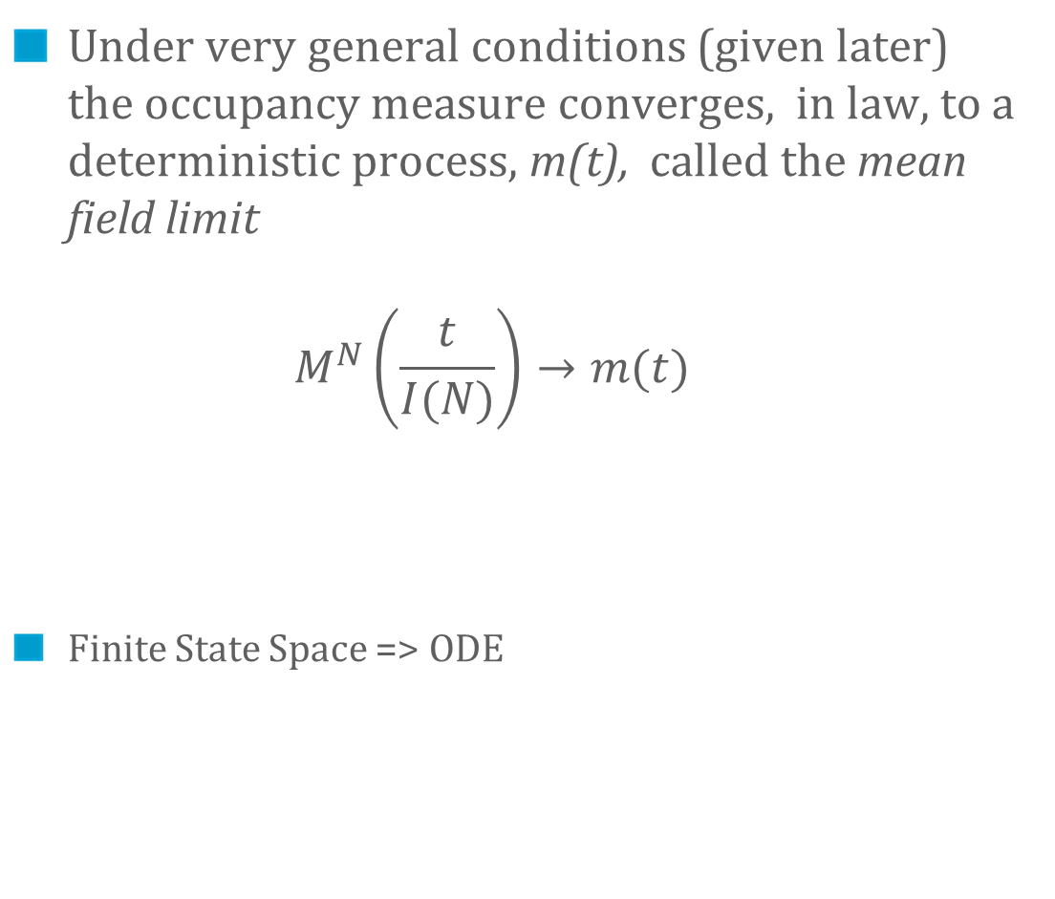
The Mean Field Limit
Under very general conditions (given later) the occupancy measure converges, in law, to a deterministic process, m(t), called the mean field limit $M^{N}\left(\frac{t}{I(N)}\right)→m(t)$
Finite State Space => ODE

Slide 17
Mean Field Limit
N = +∞
Stochastic
system
N = 1000

Slide 18
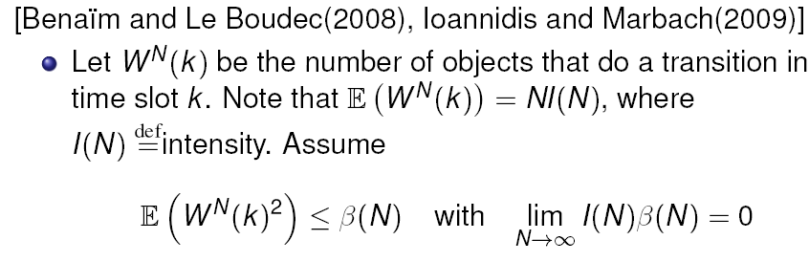
Sufficient Conditions for Convergence
[Kurtz 1970], see also [Bordenav et al 2008], [Graham 2000]
Sufficient conditon verifiable by inspection: Example: I(N) = 1/N Second moment of number of objects affected in one timeslot = o(N)
Similar result when mean field limit is in discrete time [Le Boudec et al 2007]

Slide 19
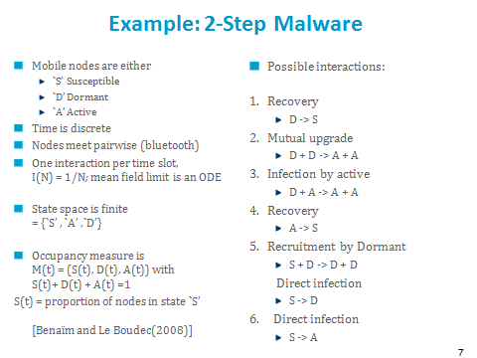
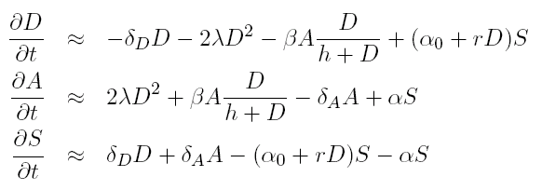
Example: Convergence to Mean Field
Rescale time such that one time step = 1/N
Number of transitions per time step is bounded by 2, therefore there is convergence to mean field
=
=
=

Slide 20
Formulating the Mean Field Limit
Drift = sum over all transitions of proba of transition x Delta to system state M^{N}(t)
Re-scale drift by intensity
Equation for mean field limit is
dm/dt = limit of rescaled drift
Can be automated http://icawww1.epfl.ch/IS/tsed
drift =
=
=
=

Slide 21
Convergence to Mean Field
For the general state space, things may be more complex (fluid limit is not an ODE, e.g. [Chaintreau et al, 2009], [Gomez-Serrano et al, 2012])
E. L.
For the finite state space case, there are many simple results, often verifiable by inspection For example [Kurtz 1970] or [Benaim, Le Boudec 2008]
E.L.

Slide 22
FINITE HORIZON : Fast Simulation and Decoupling assumption
3.

Slide 23
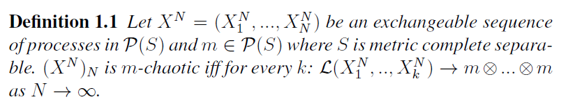
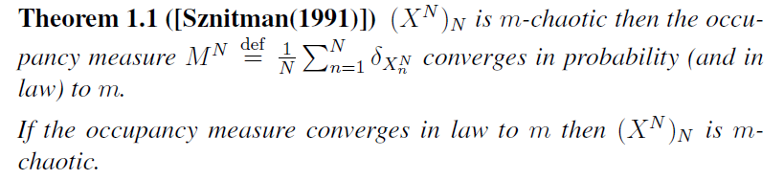
Convergence to Mean Field Limit is Equivalent to Propagation of Chaos

Slide 24
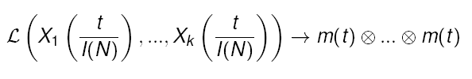
Propagation of Chaos = Decoupling Assumption
(Propagation of Chaos) k objects are asymptotically independent with common law equal to the mean field limit, for any fixed k
(Decoupling Assumption) (also called Mean Field Approximation, or Fast Simulation) The law of one object is asymptotically as if all other objects were drawn randomly with replacement from m(t)

Slide 25
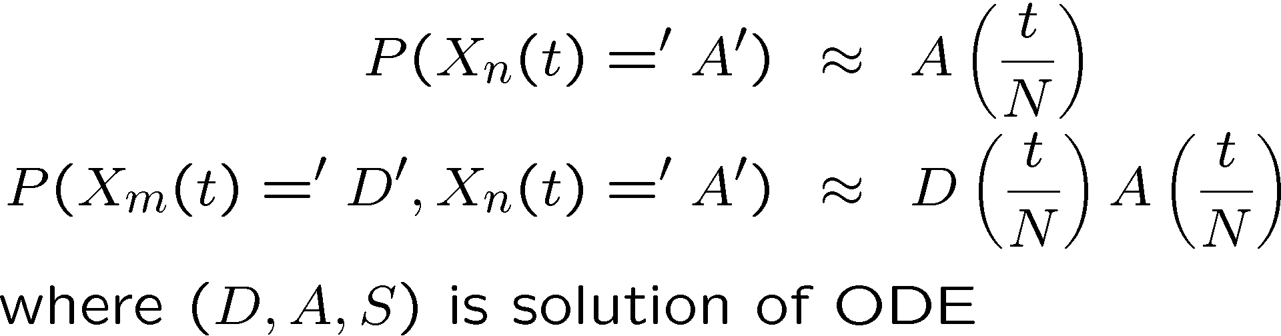
The Two Interpretations of the Mean Field Limit
At any time t
Thus for large t :
Prob (node n is dormant) ≈ 0.3
Prob (node n is active) ≈ 0.6
Prob (node n is susceptible) ≈ 0.1
m(t) approximates both
the occupancy measure M^{N}(t)
the state probability for one object at time t, drawn at random among N

Slide 26
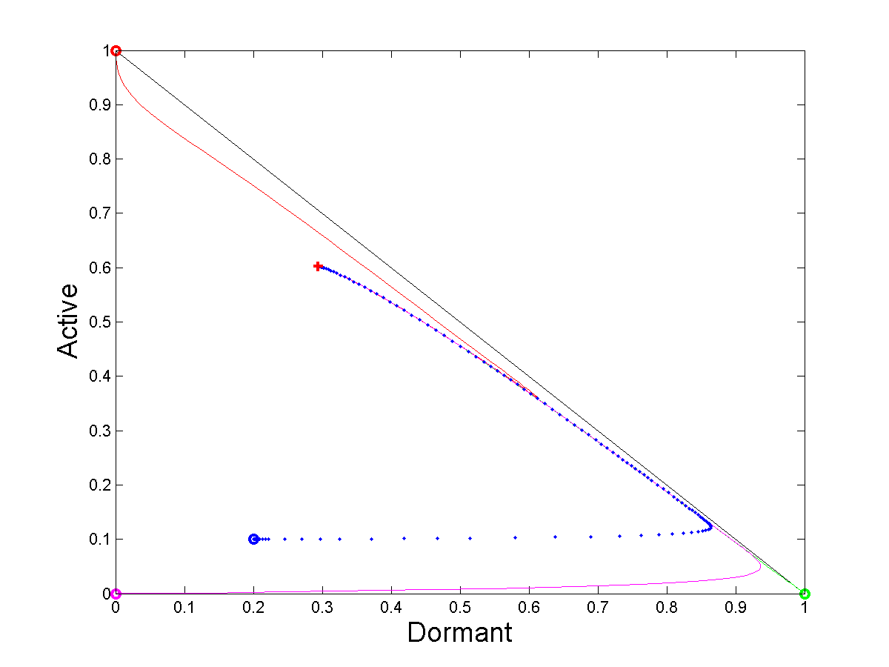
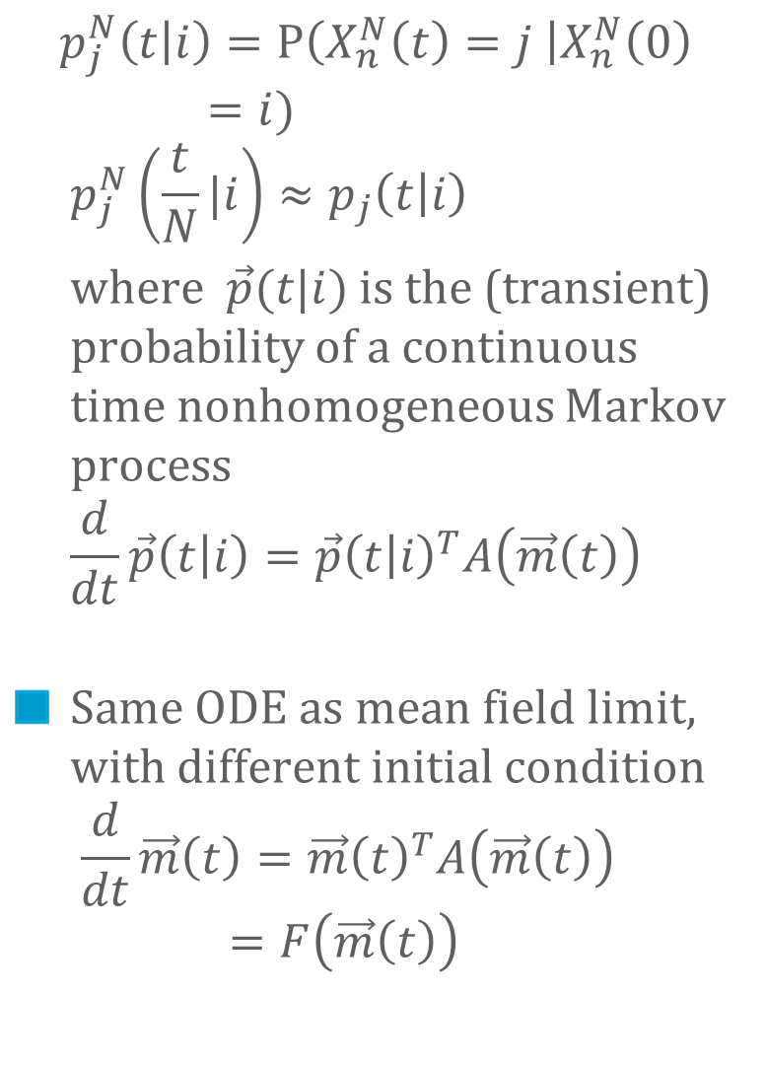
« Fast Simulation »
$$p_{j}^{N}\left(t | i\right)=P\left(X_{n}^{N}\left(t\right)=j \right|X_{n}^{N}\left(0\right)=i) \\ p_{j}^{N}\left(\frac{t}{N}|i\right)≈p_{j}\left(t | i\right)$$
where $\vec{p}(t|i)$is the (transient) probability of a continuous time nonhomogeneous Markov process $$\frac{d}{dt}\vec{p}\left(t | i\right)=\vec{p}{\left(t | i\right)}^{T}A\left(\vec{m}\left(t\right)\right)$$
Same ODE as mean field limit, with different initial condition $\frac{d}{dt}\vec{m}\left(t\right)=\vec{m}{\left(t\right)}^{T}A\left(\vec{m}\left(t\right)\right)=F\left(\vec{m}\left(t\right)\right)$
pdf of node 2
occupancy measure
μ(t)
pdf of node 3
pdf of node 1

Slide 27
The Decoupling Assumption
The evolution for one object as if the other objects had a state drawn randomly and independently from the distribution m(t)
Is valid over finite horizon whenever mean field convergence occurs
Can be used to analyze or simulate evolution of k objects

Slide 28
Infinite Horizon: Fixed Point Method and Decoupling assumption
4.

Slide 29
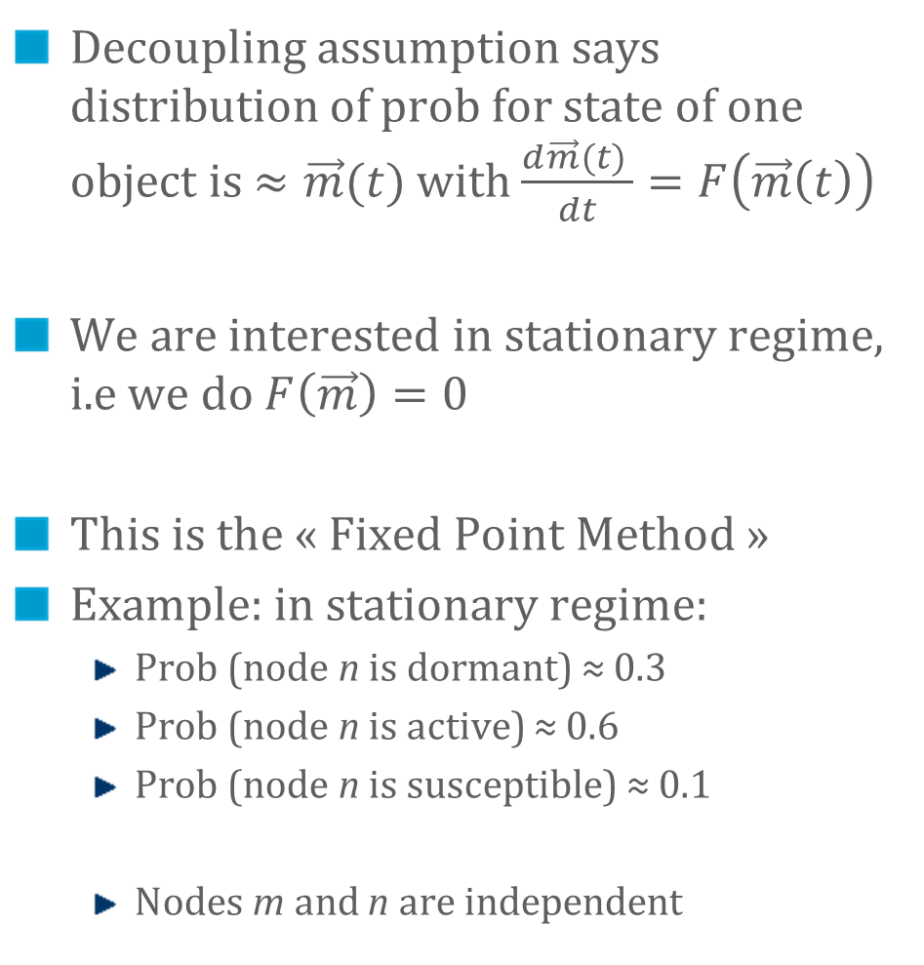
The Fixed Point Method
Decoupling assumption says distribution of prob for state of one object is $≈\vec{m}(t)$ with $\frac{d\vec{m}(t) }{dt}=F\left(\vec{m}\left(t\right)\right)$
We are interested in stationary regime, i.e we do $F\left(\vec{m}\right)=0$
This is the « Fixed Point Method »
Example: in stationary regime:
Prob (node n is dormant) ≈ 0.3
Prob (node n is active) ≈ 0.6
Prob (node n is susceptible) ≈ 0.1
Nodes m and n are independent

Slide 30

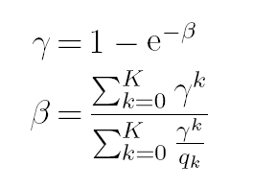
Example: 802.11 Analysis, Bianchi’s Formula
ODE for mean field limit
802.11 single cell
m_{i} = proba one node is in backoff stage I
β= attempt rate
γ = collision proba
See [Benaim and Le Boudec , 2008] for this analysis
Solve for Fixed Point:
Bianchi’s
Fixed
Point
Equation
[Bianchi 1998]

Slide 31
2-Step Malware, Again
Same as before except for one parameter value : h = 0.1 instead of 0.3
The ODE does not converge to a unique attractor (limit cycle)
The equation F(m) = 0 has a unique solution (red cross) – but it is not the stationary regime !

Slide 32
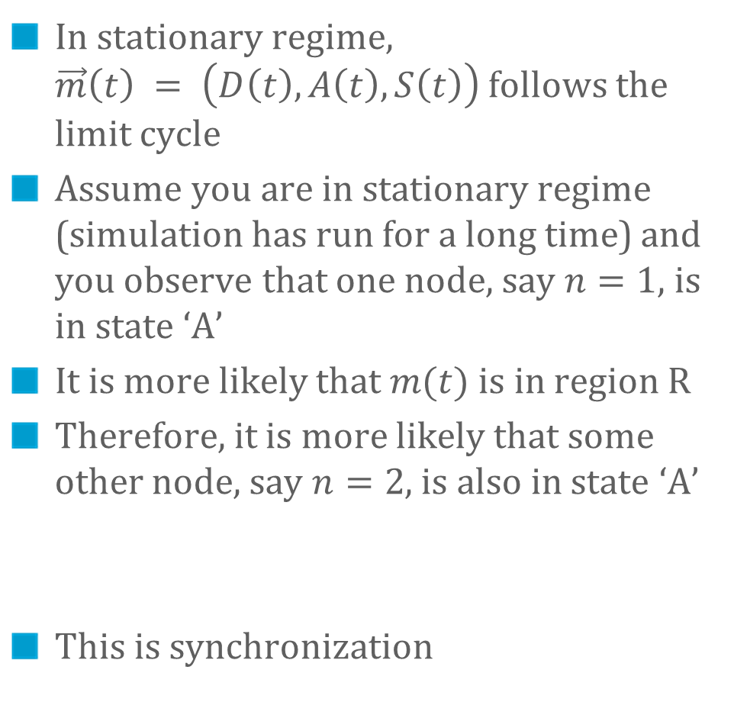
Example Where Fixed Point Method Fails
In stationary regime, $\vec{m}\left(t\right) = \left(D\left(t\right), A\left(t\right), S\left(t\right)\right)$follows the limit cycle
Assume you are in stationary regime (simulation has run for a long time) and you observe that one node, say $n=1$, is in state ‘A’
It is more likely that $m(t)$ is in region R
Therefore, it is more likely that some other node, say $n=2$, is also in state ‘A’
This is synchronization
R
h=0.1

Slide 33
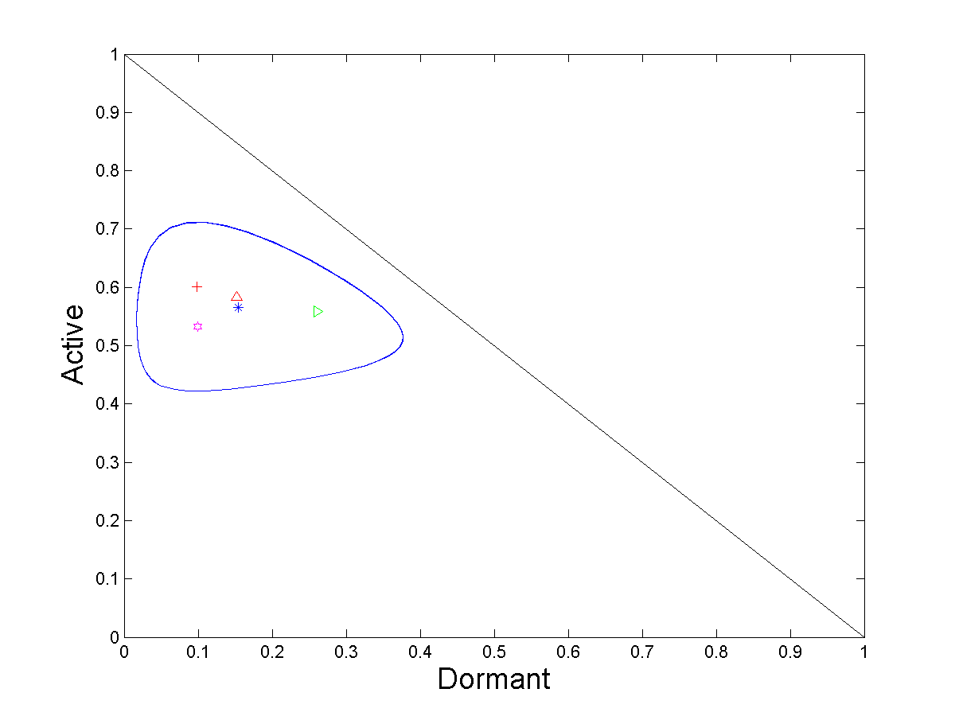
Joint PDFs of Two Nodes in Stationary Regime
Stationary point of ODE
Mean of Limit of ϖ^{N} = pdf of one node in stationary regime
pdf of node 2 in stationary regime, given node 1 is A
pdf of node 2 in stationary regime, given node 1 is D
pdf of node 2 in stationary regime, given node 1 is S

Slide 34
Where is the Catch ?
Decoupling assumption says that nodes m and n are asymptotically independent
There is mean field convergence for this example
But we saw that nodes may not be asymptotically independent
… is there a contradiction ?

Slide 35
Markov chain is ergodic
Mean Field
Convergence
m_{i}(t) m_{j}(t)
≠
m_{i}(t) m_{j}(t)
The decoupling assumption may not hold in stationary regime, even for perfectly regular models

Slide 36
Result 1: Fixed Point Method Holds under (H)
Assume that
(H) ODE has a unique global stable point to which all trajectories converge
Theorem [e.g. Benaim et al 2008] : The limit of stationary distribution of M^{N} is concentrated on this fixed point
The decoupling assumption holds in stationary regime

Slide 37
Result 2: Birkhoff Center
Here: Birkhoff center = limit cycle  fixed point
Theorem in [Benaim] says that the stochastic system for large N is close to the Birkhoff center, i.e. the stationary regime of ODE is a good approximation of the stationary regime of stochastic system

Slide 38
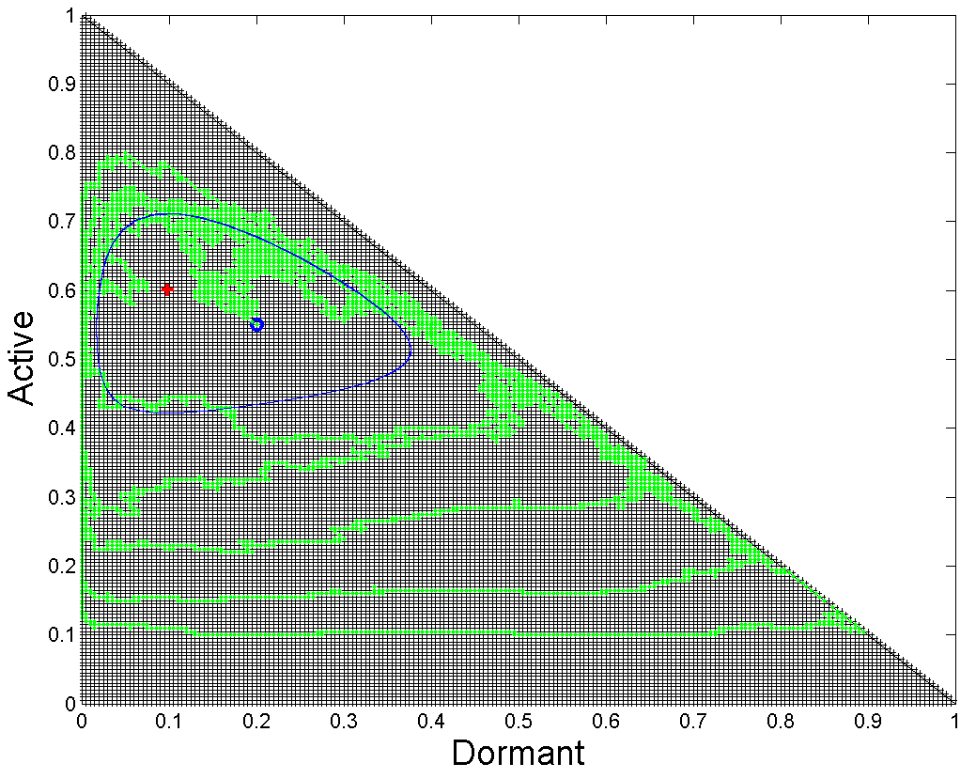
Stationary Behaviour of Mean Field Limit is not predicted by Structure of Markov Chain
M^{N}(t) is a Markov chain on S^{N}={(a, b, c) ≥ 0, a + b + c =1, a, b, c multiples of 1/N}
M^{N}(t) is ergodic and aperiodic
Depending on parameter, there is or is not a limit cycle for m(t)
S^{N} (for N = 200)
h = 0.3
h = 0.1

Slide 39
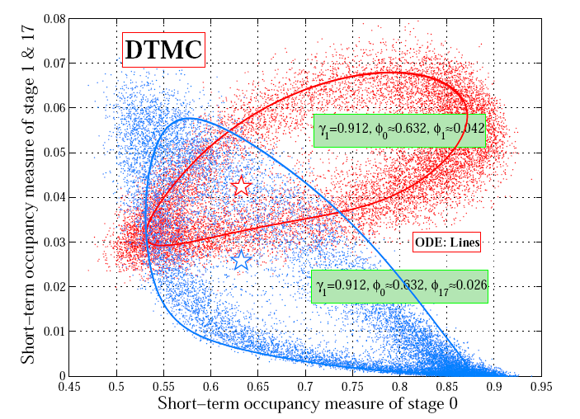
Example: 802.11 with Heterogeneous Nodes
[Cho et al, 2010] Two classes of nodes with heterogeneous parameters (restransmission probability) Fixed point equation has a unique solution, but this is not the stationary proba There is a limit cycle

Slide 40
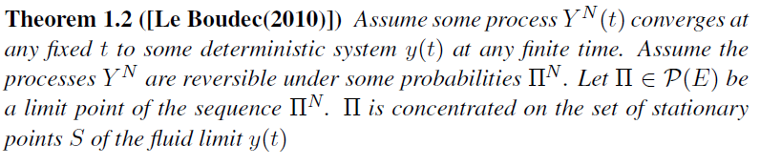
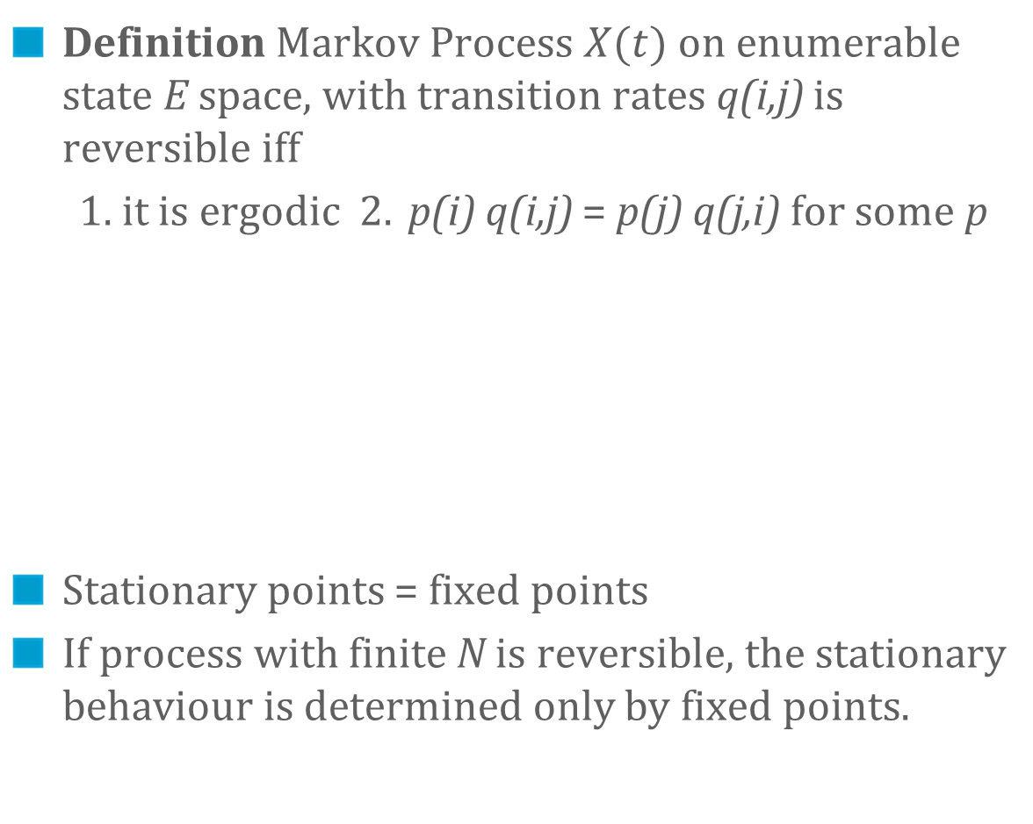
Result 3: In the Reversible Case, the Fixed Point Method Always Works
Definition Markov Process $X(t)$ on enumerable state E space, with transition rates q(i,j) is reversible iff
1. it is ergodic 2. p(i) q(i,j) = p(j) q(j,i) for some p
Stationary points = fixed points
If process with finite N is reversible, the stationary behaviour is determined only by fixed points.

Slide 41
A Correct Method
1. Write dynamical system equations in transient regime
2. Study the stationary regime of dynamical system
if converges to unique stationary point m* then make fixed point assumption
else objects are coupled in stationary regime by mean field limit m(t)
Hard to predict outcome of 2 (except for reversible case)

Slide 42
Conclusion
Mean field models are frequent in large scale systems
Validity of approach is often simple by inspection
Mean field is both
ODE for fluid limit
Fast simulation using decoupling assumption
Decoupling assumption holds at finite horizon; may not hold in stationary regime.
Stationary regime is more than stationary points, in general
(except for reversible case)

Slide 43
Thank You …

Slide 44
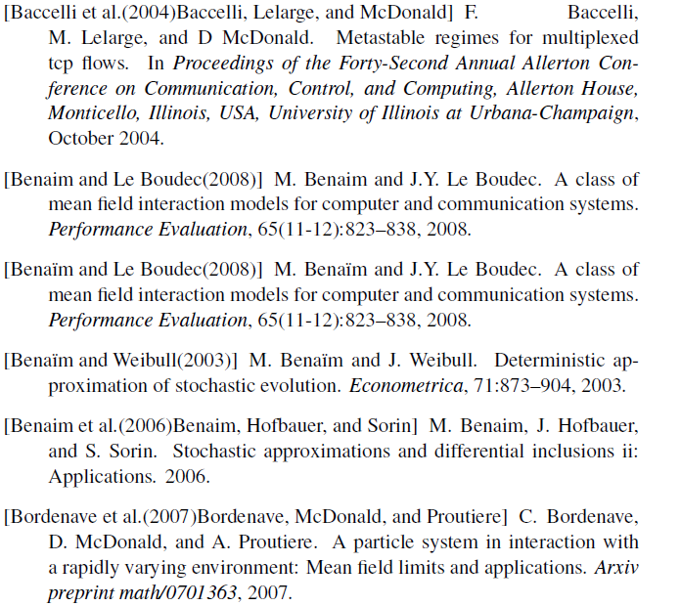
References

Slide 45
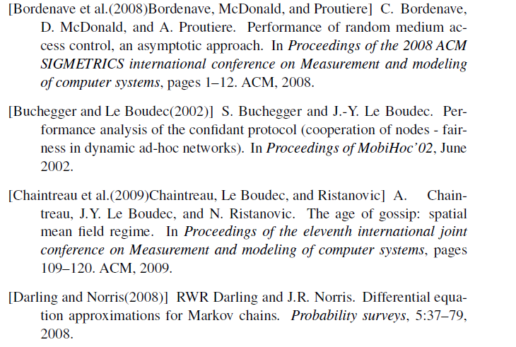
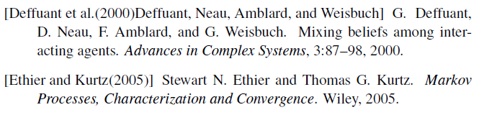

Slide 46
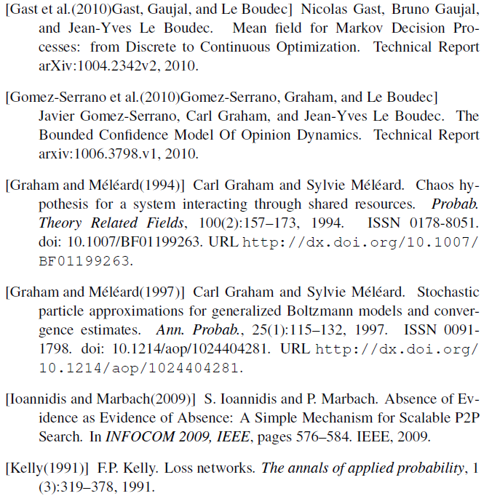
[Gomez-Serrano et al, 2012] Gomez-Serrano J., Graham C. and Le Boudec J.-Y. The Bounded Confidence Model Of Opinion Dynamics Mathematical Models and Methods in Applied Sciences, Vol. 22, Nr. 2, pp. 1150007-1--1150007-46, 2012.
2

Slide 47
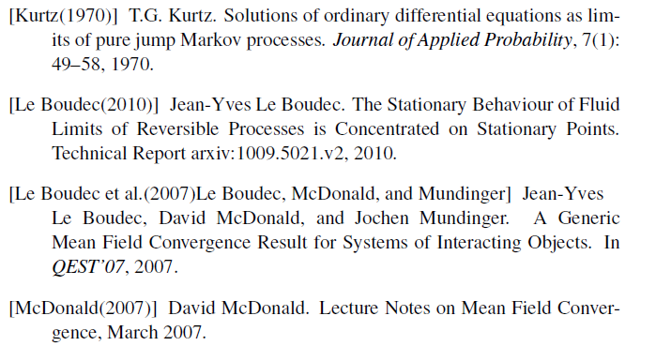
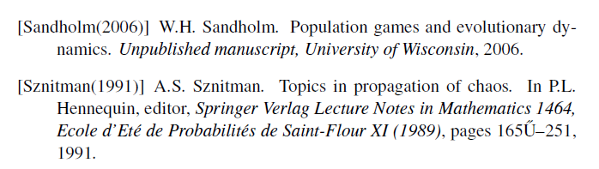

Slide 48
