Slide 1

Satisfiability of Elastic Demand in the smart grid
Jean-Yves Le Boudec,
Joint work with Dan-Cristian Tomozei
EPFL
Feb 2nd, 2011

Slide 2
Contents
The Grid and Elastic Demand
One Day in the life of Robert Longirod
Modelling Approach
Conclusions
[arXiv:1011.5606v1] Jean-Yves Le Boudec and Dan-Cristian Tomozei
« Satisfiability of Elastic Demand in the Smart Grid », Nov 2010, arxiv.org

Slide 3
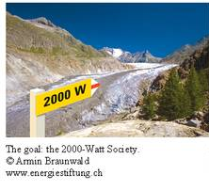
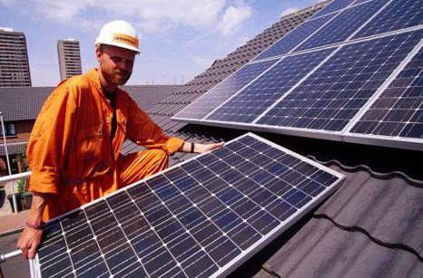
The Swiss Dream…
2000 W society = energy expenditure per capita as it was in 1960 in Western Europe (in CH; = 63.1 GJ per year per capita)
Today: 5000 – 6000 W
Realistic Goal for 2050: 3500 W [The 2000 Watt Society –Standard or Guidepost? Energiespiegel Nr 18, April 2007, PSI, Switzerland]

Slide 4
The British Dream…
 | Watts | kWh/d
Swiss dream | 2000 | 48
Today CH | 6000 | 144
2050 CH | 3500 | 84
MacKay’s model UK | 5200 | 125
2050 UK | 2833 | 68
2008 UK grid | 750 | 18
2050 UK grid | 2000 | 48
David MacKay 2009 « Sustainable Energy without the Hot Air »
An aggressive, though not unrealistic plan requires ca 3000W, ¾ of which is by the electrical grid

Slide 5
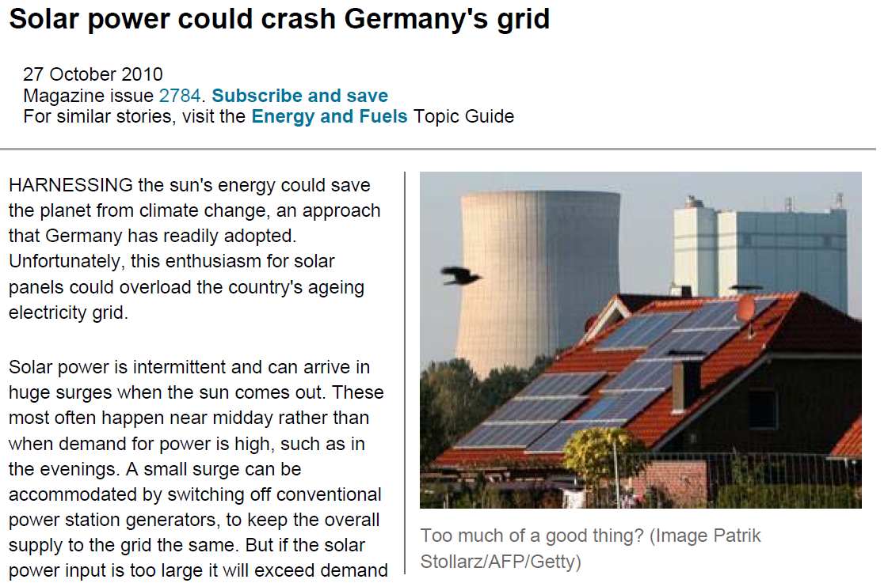
Volatility in demand
Increased volatility in supply
Calls for intelligent demand and supply
« Adaptive Appliances »

Slide 6
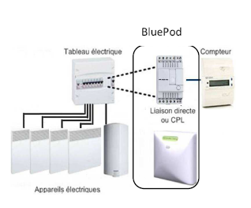

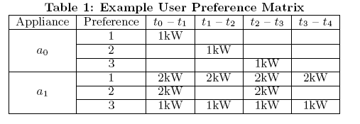
Management of Energy Demand
Managing End-User Preferences in the Smart Grid, C. Wang and M. d. Groot, E-energy 2010, Passau, Germany, 2010
Demand response by load switch
For thermal load www.voltalis.com

Slide 7
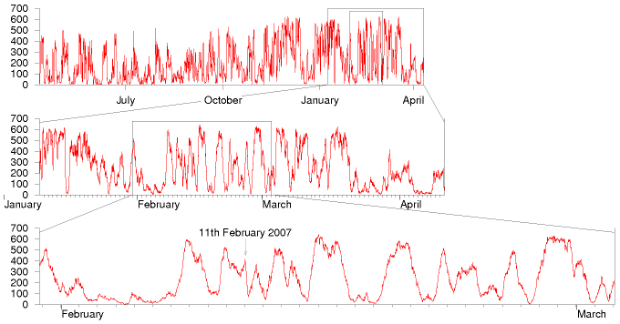
Beyond Demand Response
Demand response = shave the peak mean does not adapt
Tomorrow (2050)
adapt to wind, tidal, solar etc over several days
Wind energy production in MW of Eire in 2006. Source: Sustainable Energy - without the hot air by David JC MacKay (online)

Slide 8
One Day in the Life of Robert Longirod

Slide 9

One Day in the Life of Robert Longirod
We are in May 2050, in the 3500W society
Robert Longirod is telecom engineer at the swiss branch of Huawei Technologies

Slide 10
A fatal exception 8E has occurred at 0028:C881E33670F in UXD DXC 32
883FA2332EBD. The current application will be terminated. .
Robert wakes up at 6:45
Walks to the bathroom to take a shower
No hot water !
Home automation controller hung yesterday night. Hot water was not replenished overnight.

Slide 11
Robert is a philosoph and takes a cold shower.
Now is time for a good, hot, espresso. Robert imagines the smell of the first coffee of the day and smiles …
…but no coffee !

Slide 12
Robert re-programmed his end user preferences in the smart grid yesterday night and made a mistake !
Fortunately, the fridge works and there is some orange juice left.

Slide 13
Robert now walks to his lounge and prepares to work. Today, Robert is telecommuting – this saves time and energy.
Strange, the lounge is dark – shutters are blocked closed … the home automation controller, of course !

Slide 14
Not a serious problem anyhow; the shutters can be opened manually.
Robert sits at his table and opens his desktop …

Slide 15
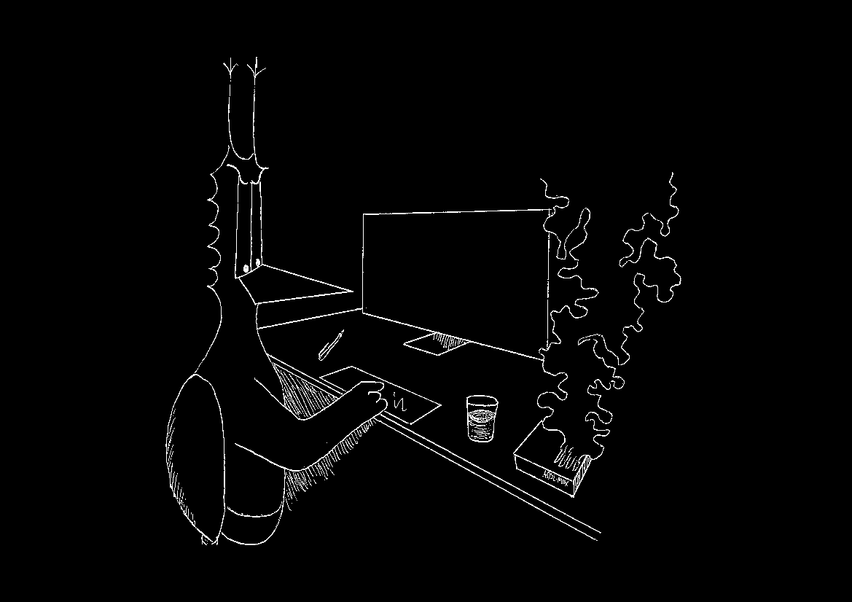
The femtocell has burnt, no internet access …

Slide 16
Robert is a bit worried. There is an important meeting at 10:00 scheduled with two co-workers.
« If I am not at that meeting, it is George who will get the work. I must be there »
Robert decides to do something exceptional: drive to work !

Slide 17
In the garage …
The e-car is not charged.
The batteries were used to power the grid. Normal, Robert did not plan to go anywhere today…

Slide 18
Robert cycles to work
While pedalling back home in the evening, he hopes that the washing machine did its job…

Slide 19
Intelligent Demand Management must Be Simple, Adaptive and Distributed
Global, optimal schedules
are hard,
error prone
and do not account for last minute changes
More realistic is
elastic demand,
with best effort service with statistical guarantees.
[Keshav and Rosenberg 2010]

Slide 20
Possible Directions for Distributed Control
Network
Users
Signals marginal price to users
Whether a true price or a congestion signal is an issue
Delay / reduce demand
Defer heating / cooling /battery loading
Substitute local source
Substitute battery

Slide 21
Modelling Approach

Slide 22
A Preliminary Issue is Stability
We want first to study if elastic demand / adaptation is feasible
Assume supply is random and load is elastic
Users act a distributed buffer
Hot water tanks, batteries
We leave out (for now) the details of signals and algorithms
A very coarse, but fundamental criterion: is there a control mechanism that can stabilize demand
Instability can be generated by
Delays in demand
Increase in demand due to delay

Slide 23


A Demand / Supply Model
Inspired by [Meyn et al 2010]
volatility
forecast
Supply Gª(t)
Natural Demand Dª(t)
Expressed Demand Eª(t)
Evaporation μ Z(t)
+
.
evaporation
Latent
Backlogged
Demand Z(t)
Satisfied
Demand
Returning demand B(t) = λ Z(t)
delay
Frustrated Demand F(t)

Slide 24
The Control Problem
Control variable: G(t-1), production bought one second ago in real time market
Controller sees only supply Gª(t) and expressed demand Eª(t)
Our (initial) problem: keep Z(t) stable
Assume ramp-up constraint only G(t)-G(t-1) ≤ ζ
Supply Gª(t)
Natural Demand Dª(t)
Expressed Demand Eª(t)
Evaporation μ Z(t)
+
.
Latent
Backlogged
Demand Z(t)
Satisfied
Demand
Returning demand B(t) = λ Z(t)
Frustrated Demand F(t)

Slide 25


Threshold Based Policies
Forecast supply is adjusted to forecast demand
R(t) := reserve = excess of demand over supply
Threshold policy:
if R(t) < r* increase supply as much as possible (considering ramp up constraint)
else set R(t)=r*

Slide 26
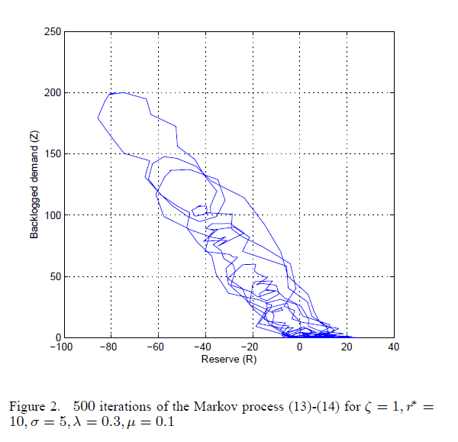

Slide 27
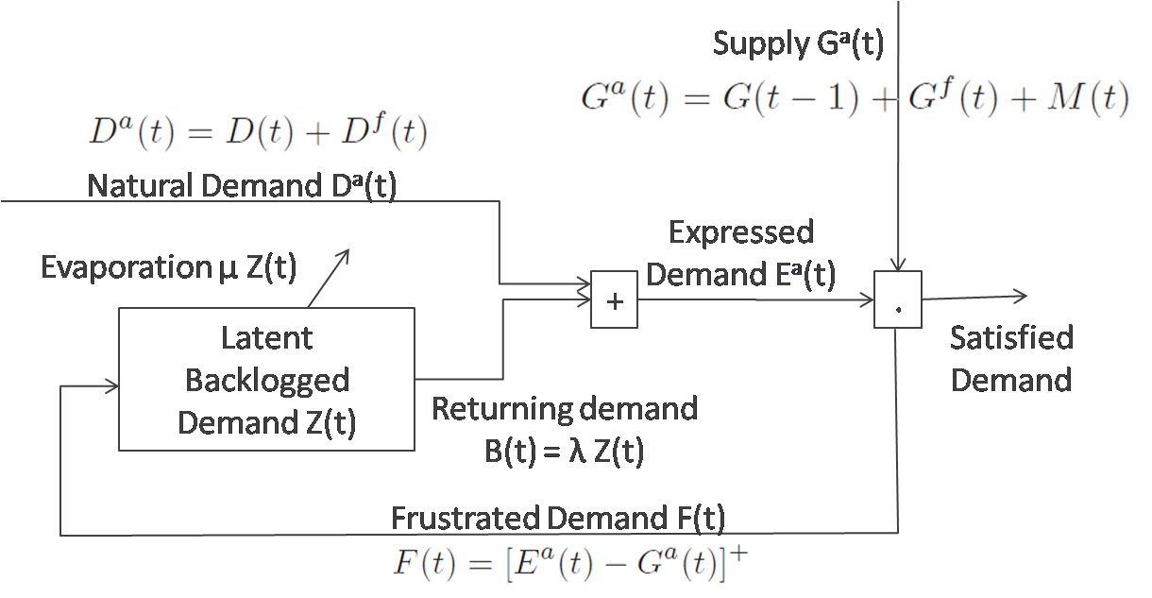
Findings
If evaporation μ is positive, the system is stable (ergodic, positive recurrent Markov chain) for any threshold r*
If evaporation is negative, the system is unstable for any threshold r*
Delay does not play a role in stability
Nor do ramp-up constraint and size of reserves

Slide 28
The Role of Negative Evaporation
Negative Evaporation means
The simple fact of delaying a demand makes the returning demand larger than the original one. (do not confuse with the sum of returning demand + current demand, which is always larger than current demand)
Could that happen ?

Slide 29

Evaporation: Heating Appliances
Assume the model [MacKay 2009] then delayed heating is less heating (this is what makes Voltalis be accepted by French households)
Pure thermal load = positive evaporation
This is true for heat provided, is not necessarily true for energy consumed
Depends whether coefficient of performance e is constant or not; true for resistance based heating
Delayed heating with air heat pump with cold air may have negative evaporation (bad coefficient of performance when air is cold)
heat provided
to building
leakiness
outside
inertia

Slide 30
Conclusions
A first model of adaptive appliances with volatile demand and supply
Suggests that negative evaporation makes system unstable,
thus detailed analysis is required to avoid it
Model can be used to quantify more detailed quantities
E.g. amount of backlog

