Slide 1

Mean Field for Markov Decision Processes: from Discrete to Continuous Optimization
Jean-Yves Le Boudec,
Nicolas Gast,
Bruno Gaujal
July 26, 2011

Slide 2
Contents
Mean Field Interaction Model
Mean Field Interaction Model with Central Control
Convergence and Asymptotically Optimal Policy

Slide 3
Mean Field Interaction Model
1

Slide 4
Mean Field Interaction Model
Time is discrete
N objects, N large
Object n has state X_{n}(t)
(X^{N}₁(t), …, X^{N}_{N}(t)) is Markov
Objects are observable only through their state
“Occupancy measure” M^{N}(t) = distribution of object states at time t
Example [Khouzani 2010 ]: M^{N} (t) = (S(t), I(t), R(t), D(t)) with S(t)+ I(t) + R(t) + D(t) =1
S(t) = proportion of nodes in state `S’
βI
S
I
α
q
b
D
R

Slide 5
Mean Field Interaction Model
Time is discrete
N objects, N large
Object n has state X_{n}(t)
(X^{N}₁(t), …, X^{N}_{N}(t)) is Markov
Objects are observable only through their state
“Occupancy measure” M^{N}(t) = distribution of object states at time t
Theorem [Gast (2011)] M^{N}(t) is Markov
Called “Mean Field Interaction Models” in the Performance Evaluation community [McDonald(2007), Benaïm and Le Boudec(2008)]

Slide 6
Intensity I(N)
I(N) = expected number of transitions per object per time unit
A mean field limit occurs when we re-scale time by I(N) i.e. we consider X^{N}(t/I(N))
I(N) = O(1): mean field limit is in discrete time [Le Boudec et al (2007)] I(N) = O(1/N): mean field limit is in continuous time [Benaïm and Le Boudec (2008)]

Slide 7
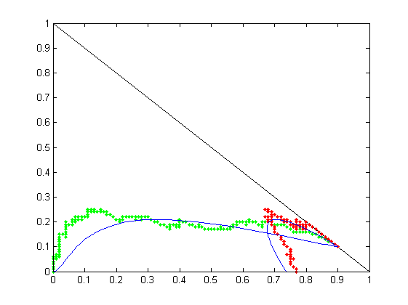
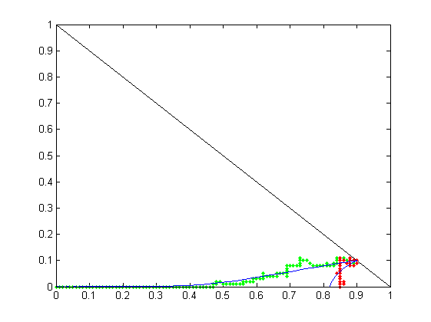
Virus Infection [Khouzani 2010]
I
α = 0.1
N nodes, homogeneous, pairwise meetings
One interaction per time slot, I(N) = 1/N; mean field limit is an ODE
Occupancy measure is M(t) = (S(t), I(t), R(t), D(t)) with S(t)+ I(t) + R(t) + D(t) =1
S(t) = proportion of nodes in state `S’
(S+R, I)
(S, I)
mean field limit
dead nodes
S+R
or S
α = 0.7
I
βI
S
I
N = 100, q=b =0.1, β =0.6
α
q
b
D
R
S+R
or S

Slide 8
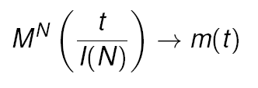
The Mean Field Limit
Under very general conditions (given later) the occupancy measure converges, in law, to a deterministic process, m(t), called the mean field limit
Finite State Space => ODE

Slide 9
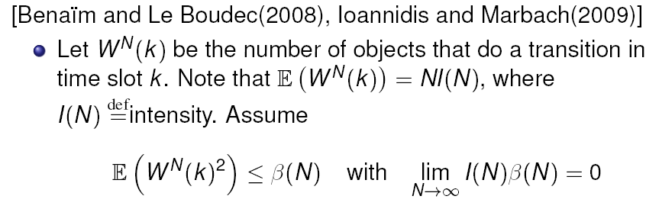
Sufficient Conditions for Convergence
[Kurtz 1970], see also [Bordenav et al 2008], [Graham 2000]
Sufficient conditon verifiable by inspection: Example: I(N) = 1/N Second moment of number of objects affected in one timeslot = o(N)
Similar result when mean field limit is in discrete time [Le Boudec et al 2007]

Slide 10
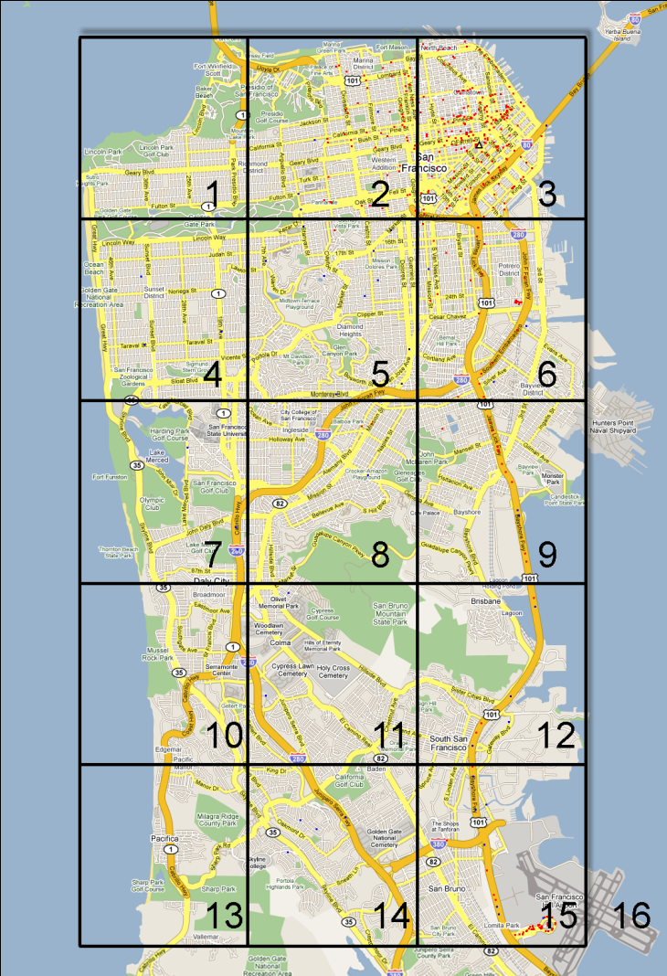
The Importance of Being Spatial
Mobile node state = (c, t) c = 1 … 16 (position)
t ∊ R⁺ (age of gossip)
Time is continuous, I(N) = 1
Occupancy measure is F_{c}(z,t) = proportion of nodes that at location c and have age ≤ z [Age of Gossip, Chaintreau et al.(2009)]

Slide 11
Mean Field Interaction Model with Central Control
2

Slide 12
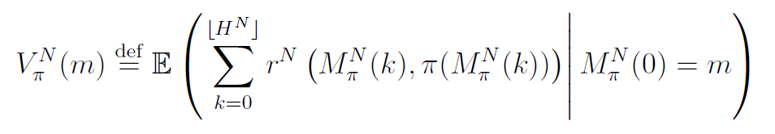
Markov Decision Process
Central controller
Action state A (metric, compact)
Running reward depends on state and action
Goal: maximize expected reward over horizon T
Policy π selects action at every time slot
Optimal policy can be assumed Markovian (X^{N}₁(t), …, X^{N}_{N}(t)) -> action
Controller observes only object states
=> π depends on M^{N}(t) only

Slide 13
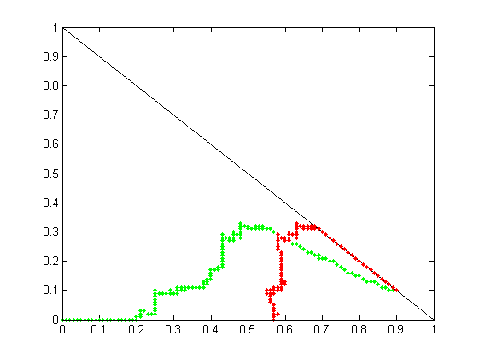
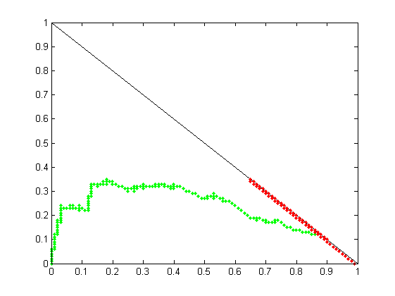
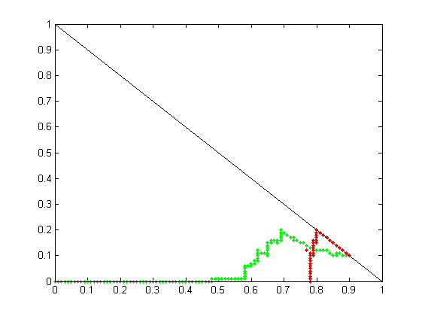
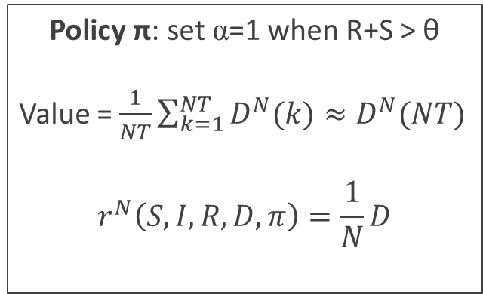
Example
Policy π: set α=1 when R+S > θ
Value = $\frac{1}{NT}\sum_{k=1}^{NT}{D^{N}(k)}≈D^{N}(NT)$
$$r^{N}\left(S,I,R,D,π\right)=\frac{1}{N}D$$
θ = 0.68
θ = 0.65
θ = 0. 8

Slide 14
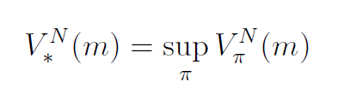
Optimal Control
Optimal Control Problem
Can be found by iterative methods
State space explosion (for m)
Find a policy π that achieves (or approaches) the supremum in
m is the initial condition of occupancy measure

Slide 15
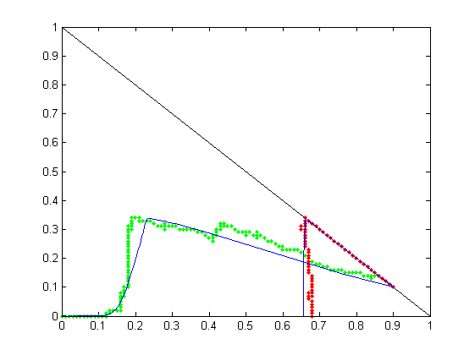
Can We Replace MDP By Mean Field Limit ?
Assume the mean field model converges to fluid limit for every action
E.g. mean and std dev of transitions per time slot is O(1)
Can we replace MDP by optimal control of mean field limit ?

Slide 16
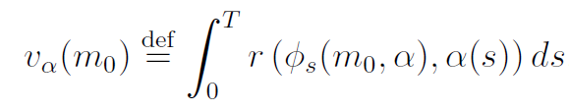
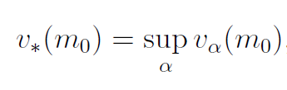
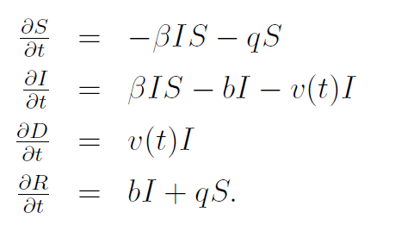
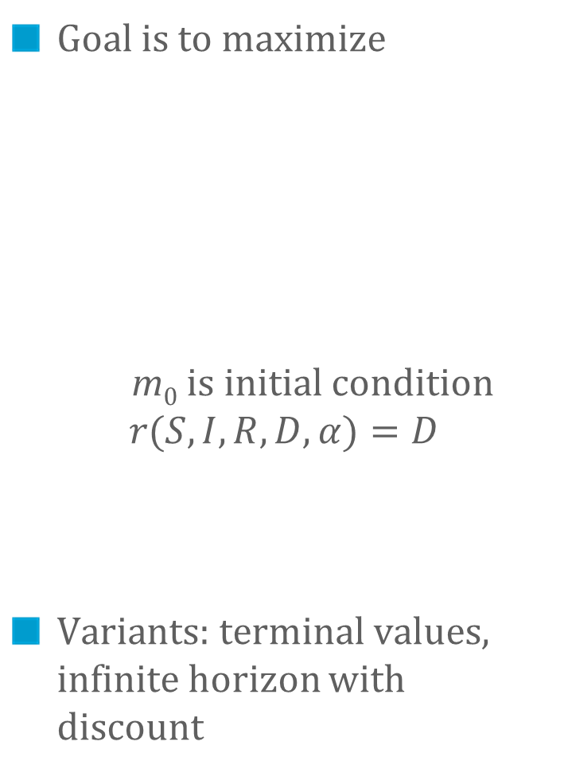
Controlled ODE
Mean field limit is an ODE
Control = action function α(t)
Example:
Goal is to maximize
m₀ is initial condition $$r(S,I,R,D,α)=D$$
Variants: terminal values, infinite horizon with discount
if t > t₀ α(t) = 1 else α(t) = 0
α
α

Slide 17
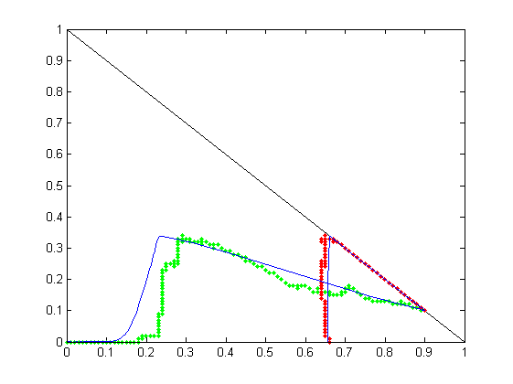
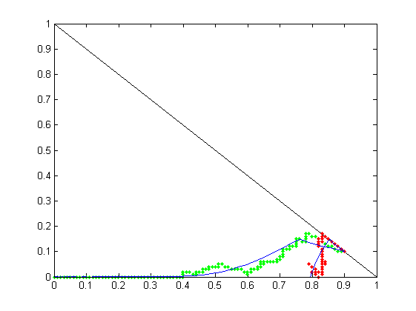
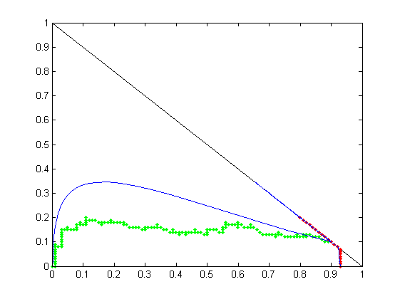
Optimal Control for Fluid Limit
Optimal function α(t) Can be obtained with Pontryagin’s maximum principle or Hamilton Jacobi Bellman equation.
t₀ =5.6
t₀ =1
t₀ =25

Slide 18
Convergence, Asymptotically Optimal policy
3

Slide 19
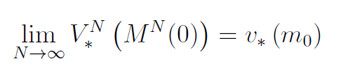
Convergence Theorem
Theorem [Gast 2011] Under reasonable regularity and scaling assumptions:
Optimal value for system
with N objects (MDP)
Optimal value for fluid limit

Slide 20
Convergence Theorem
Theorem [Gast 2011] Under reasonable regularity and scaling assumptions:
Does this give us an asymptotically optimal policy ?
Optimal policy of system with N objects may not converge

Slide 21

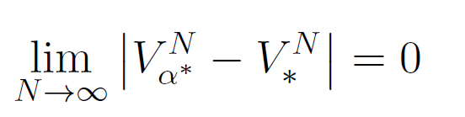

Asymptotically Optimal Policy
Let be an optimal policy for mean field limit
Define the following control for the system with N objects
At time slot k, pick same action as optimal fluid limit would take at time t = k I(N)
This defines a time dependent policy.
Let = value function when applying to system with N objects
Theorem [Gast 2011]
Optimal value for system
with N objects (MDP)
Value of this policy

Slide 22
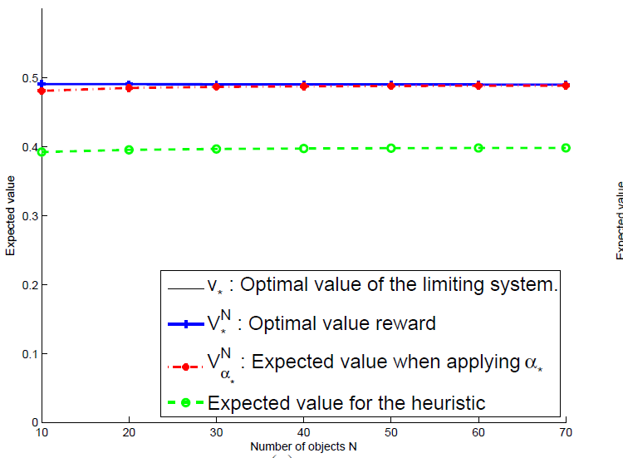

Slide 23
Conclusions
Optimal control on mean field limit is justified
A practical, asymptotically optimal policy can be derived

Slide 24
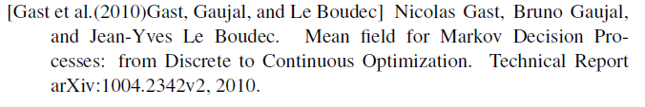
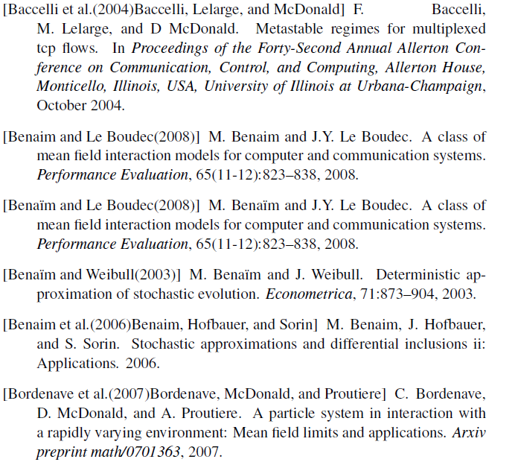
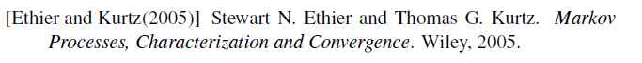
Questions ?
[Khouzani 2010]

