Slide 1

Satisfiability of Elastic Demand in the smart grid
Jean-Yves Le Boudec,
Dan-Cristian Tomozei
EPFL
May 26, 2011

Slide 2
Demand Management
Variable Supply
Variable Demand
Frequency Response becomes insufficient
Demand management required in future grid

Slide 3
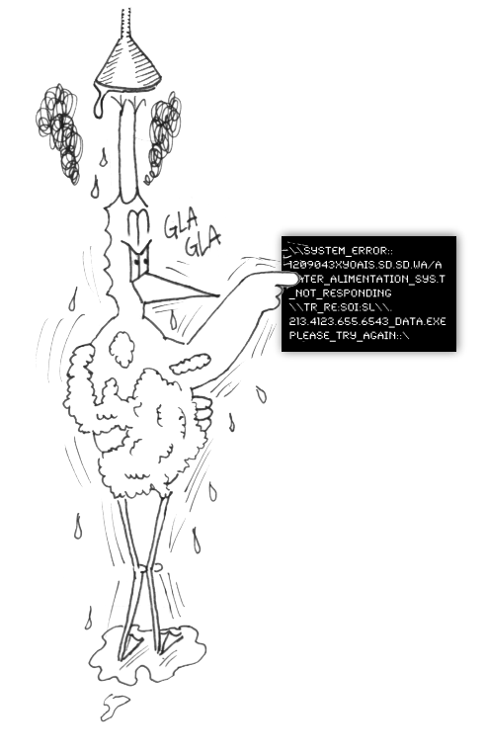
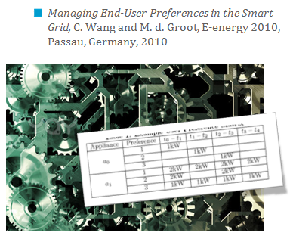
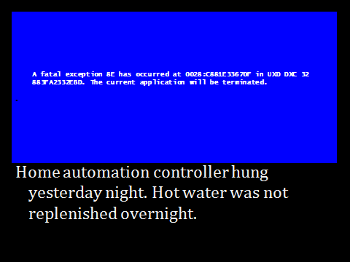
Demand Management must Be Simple, Adaptive and Distributed
Global, optimal schedules
But they are
inflexible
complex

Slide 4
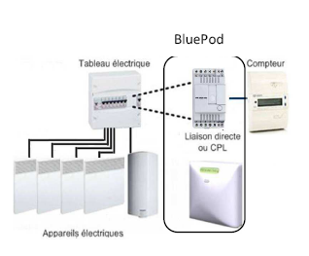
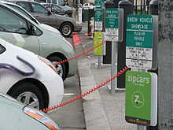

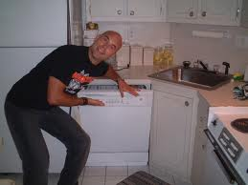
Adaptive Appliances
Some Demand can be delayed !
DSO provides best effort service with statistical guarantees [Keshav and Rosenberg 2010]
Voltalis Bluepod switches off thermal load for 30 mn
Programmable dishwasher
PeakSaver cycles AC for 15mn

Slide 5
Our Problem Statement
Is elastic demand feasible ?
We leave out (for now) the details of signals and algorithms
Problem Statement Is there a control mechanism that can stabilize demand ?
Instability can be generated by
Delays in demand
Higher returning demand
A very course (but fundamental) first step

Slide 6
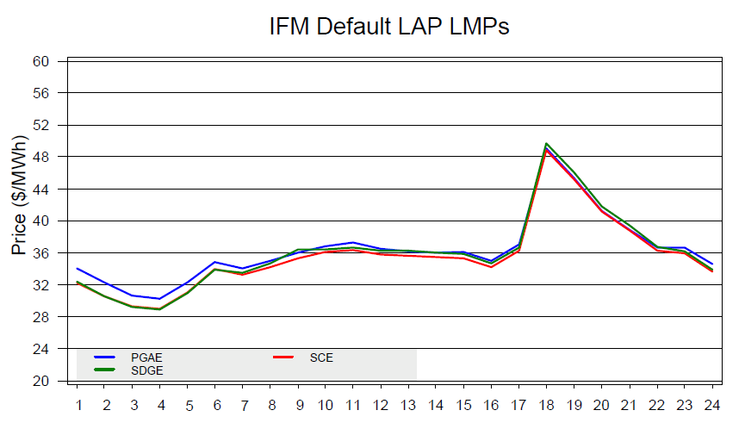

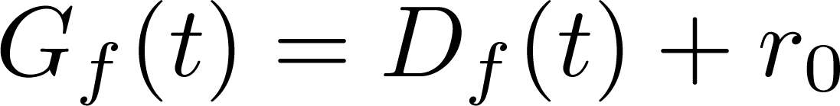
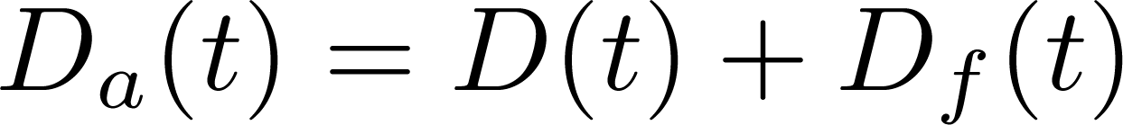
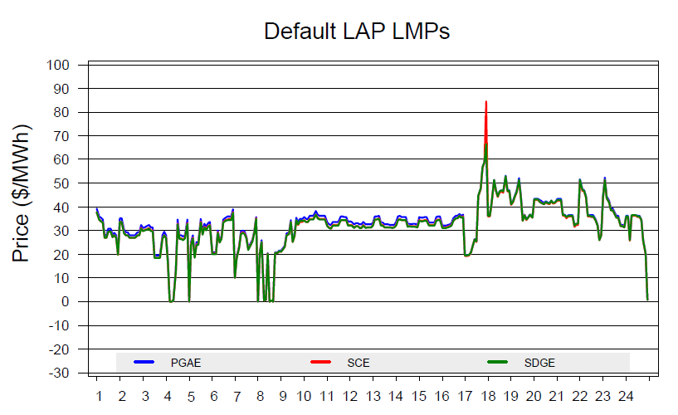
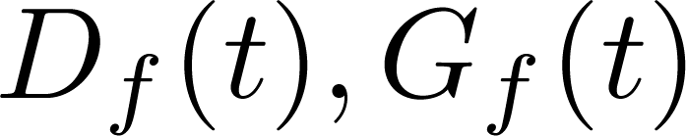
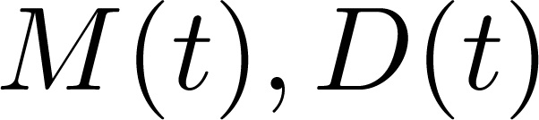


Macroscopic Model
Step 1: Day-ahead market
Forecast demand :
Forecast supply :
Step 2: Real-time market
Actual demand :
Actual supply :
Deterministic processes :
Random processes :
Control :
Ramp up, ramp down

Slide 7







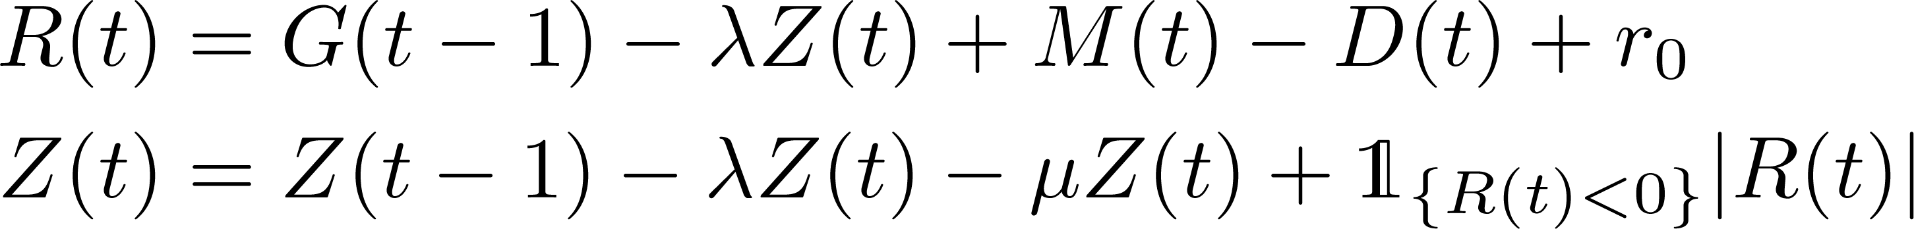
Macroscopic Model
Control
Ramping Constraint
Randomness
Supply
Natural Demand
Evaporation
Expressed
Demand
Satisfied
Demand
Returning Demand
Frustrated
Demand
Reserve
(Excess supply)
Backlogged Demand

Slide 8
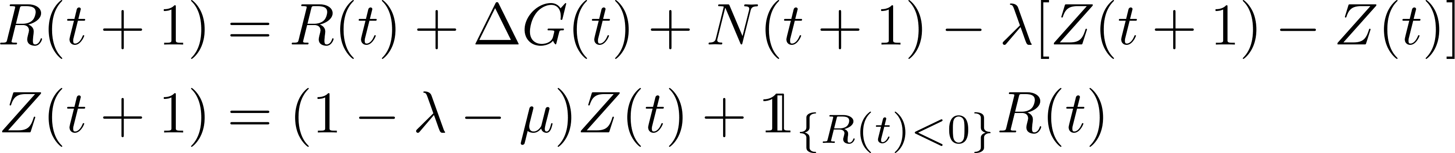
Macroscopic Model – Normal Assumption
Assumption : (M – D) = ARIMA(0, 1, 0)
2-d Markov chain on continuous state space

Slide 9
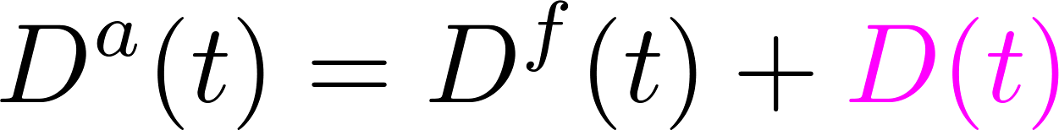
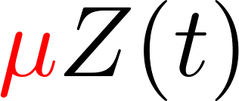
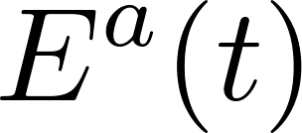
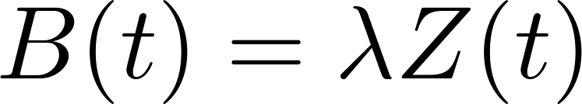
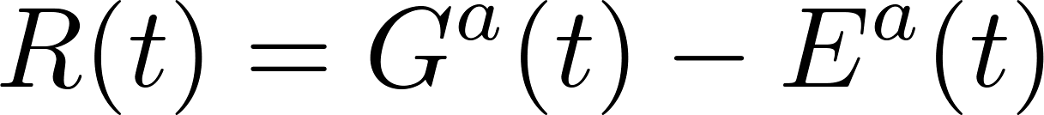
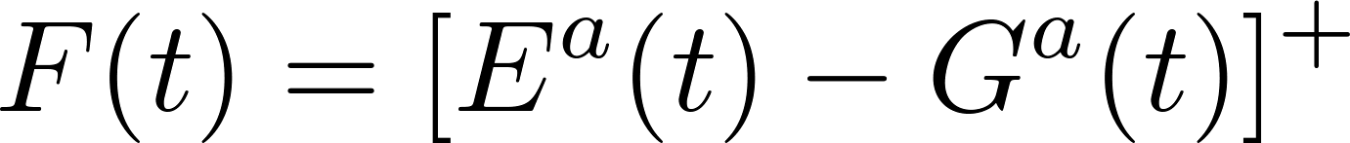
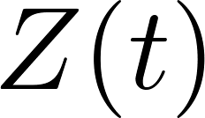
The Control Problem
Control variable: G(t-1) production bought one second ago in real time market
Controller sees only supply Gª(t) and expressed demand Eª(t)
Our Problem: keep backlog Z(t) stable
Ramp-up and ramp-down constraints
ξ ≤ G(t) ⎼ G(t-1) ≤ ζ
Control
Randomness
Supply
Natural Demand
Evaporation
Expressed
Demand
Satisfied
Demand
Returning
Demand
Frustrated
Demand
Reserve
(Excess supply)
Backlogged Demand

Slide 10


Threshold Based Policies
Forecast supply is adjusted to forecast demand
R(t) := reserve = excess of demand over supply
Threshold policy:
if R(t) < r* increase supply as much as possible (considering ramp up constraint)
else set R(t)=r*

Slide 11
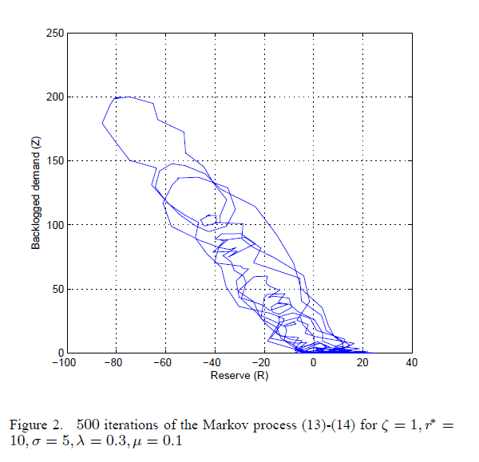
r*

Slide 12
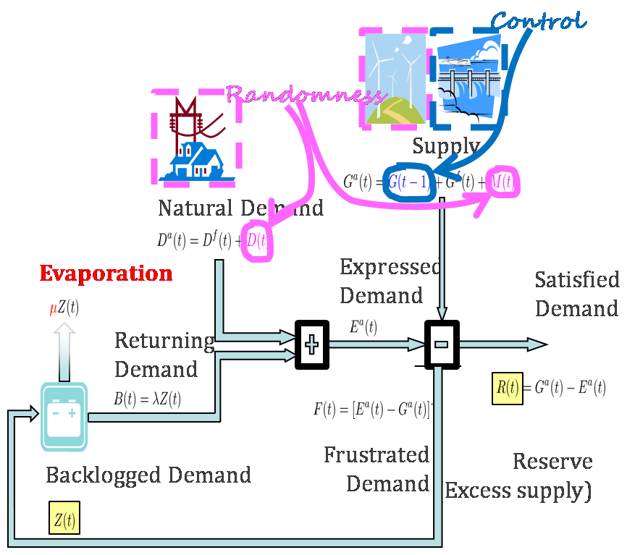
Findings
If evaporation μ is positive, system is stable (ergodic, positive recurrent Markov chain) for any threshold r*
If evaporation is negative, system unstable for any threshold r*
Delay does not play a role in stability
Nor do ramp-up / ramp down constraints or size of reserve

Slide 13
More Detailed Findings
Case 1: Positive evaporation
Postponing a task = discount
Theorem 1: The Markov chain (R,Z) is Harris recurrent and ergodic. It converges to the unique steady state probability distribution, for any threshold and any strictly positive ramp-up constraint.
Case 2: Negative evaporation
Postponing a task = penalty
Theorem 2: The Markov chain (R,Z) is non-positive, for any threshold.
Method of Proof: quadratic Lyapunov (case 1) or logarithmic L. (case 2)
Evaporation
Backlogged Demand

Slide 14
Evaporation
Evaporation = dropped fraction of delayed demand
Negative evaporation means: delaying a demand makes the returning demand larger than the original one
Could this happen ? Does letting your house cool down now implies spending more heat later ? (vs keeping constant temperature)
Do not confuse with the sum of returning demand + current demand, which is always larger than current demand)

Slide 15

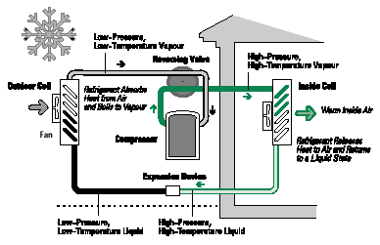
Evaporation: Heating Appliances
Assume the house model of [MacKay 2009] then delayed heating is less heating
If heat = energy, then evaporation is positive.
This is why Voltalis bluepod is accepted by users
If heat = heat pump, coefficient of performance may be variable Delayed heating with air heat pump may have negative evaporation
heat provided
to building
leakiness
outside
inertia

Slide 16
Batteries
Thermal loss is non linear, delayed loading causes negative evaporation
(charging at higher intensity)

Slide 17
Conclusions
A first model of adaptive appliances with volatile demand and supply
Suggests that negative evaporation makes system unstable,
thus detailed analysis is required to avoid it
Model can be used to quantify more detailed quantities
E.g. amount of backlog, optimal reserve

Slide 18
Questions ?
[1] Cho, Meyn – Efficiency and marginal cost pricing in dynamic competitive markets with friction
[2] Papavasiliou, Oren - Integration of Contracted Renewable Energy and Spot Market Supply to Serve Flexible Loads
[3] Operational Requirements and Generation Fleet Capability at 20% RPS (CAISO - 31 August, 2010)

