Slide 1
Satisfiability of Elastic Demand in the smart grid
Jean-Yves Le Boudec,
Dan-Cristian Tomozei
EPFL
Energy Systems Day
Isaac Newton Institute
Cambridge, 2012 March 12

Slide 2
Contents
Introduction
A Model of Elastic Demand
Stability Results

Slide 3
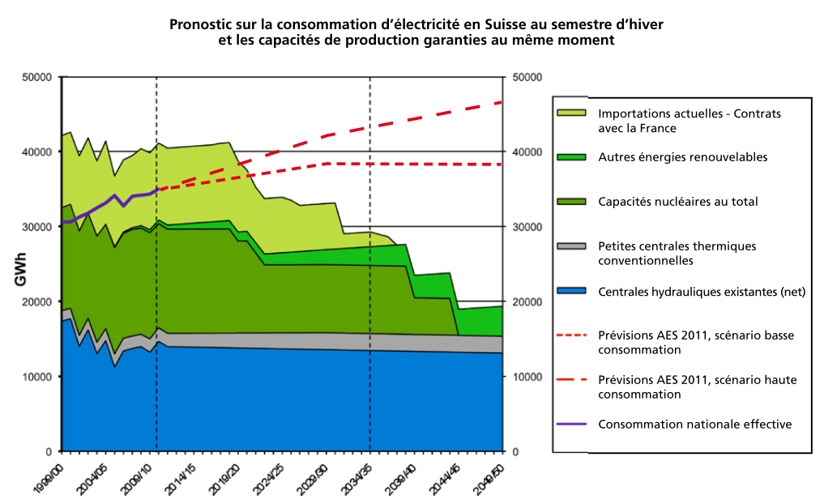
Swiss Future Supply is Uncertain
Winter semester forecasts 2011-2012
Source: ASE (Association des Entreprises Electriques Suisses, )

Slide 4
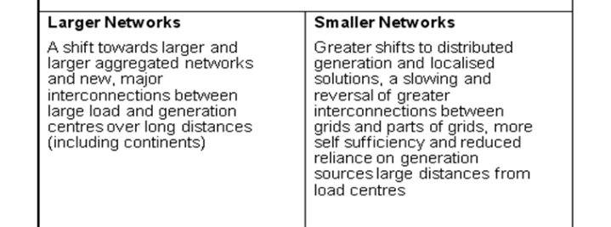

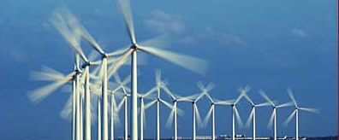
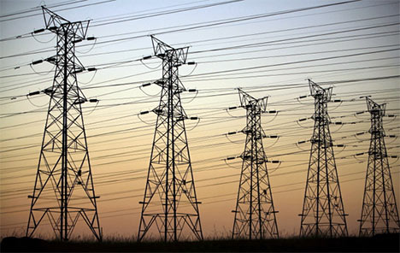
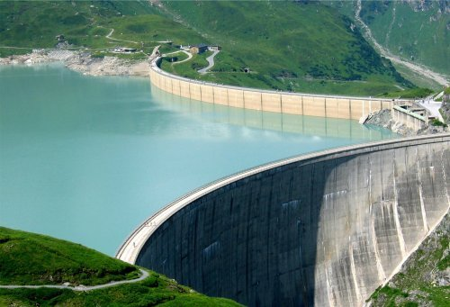

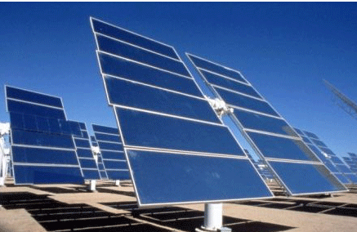
Smart Grid Vision : Larger Network
Source:
ELECTRICITY SUPPLY SYSTEMS OF THE FUTURE
White paper on behalf of the CIGRE Technical Committee
TC Chair: Klaus Froelich
2011

Slide 5
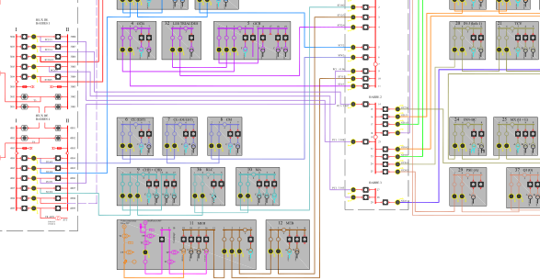
Smart Grid Vision : Smaller, More Autonomous Networks
Flexible services as alternative to blackout, including across slack bus
Islanded operation possible
Source:
ELECTRICITY SUPPLY SYSTEMS OF THE FUTURE
White paper on behalf of the CIGRE Technical Committee
TC Chair: Klaus Froelich
2011
EPFL Smart Grid

Slide 6
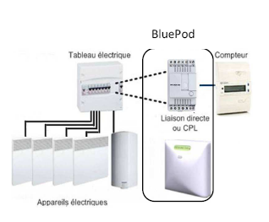
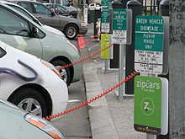
Flexible Services
Flexible services = distribution network operator may interrupt / modulate power
elastic loads support graceful degradation
Thermal load (Voltalis), washing machines (Romande Energie«commande centralisée») e-cars,
Voltalis Bluepod switches off thermal load for 60 mn

Slide 7
Our Problem Statement
Do elastic services work ?
Delays
Returning load
Problem Statement Is there a control mechanism that can stabilize demand ?
A very course (but fundamental) first step
We leave out for now the details of signals and algorithms

Slide 8
A MODEL OF ELASTIC DEMAND
2.

Slide 9


Macroscopic Model of Cho and Meyn [1], non elastic demand, mapped to discrete time
Step 1: Day-ahead market
Step 2: Real-time market
Forecast demand: $D^{f}\left(t\right)$
Forecast supply: $G^{f}\left(t\right)=D^{f}\left(t\right)+r_{0}$
Actual demand $D^{a}\left(t\right)=D\left(t\right)+D^{f}\left(t\right)$
Actual supply$G^{a}\left(t\right)=G\left(t−1\right)+G^{f}\left(t\right)+M(t)$
control
random
deterministic
We now add the effect of elastic demand / flexible service Some demand can be «frustrated» (delayed)

Slide 10



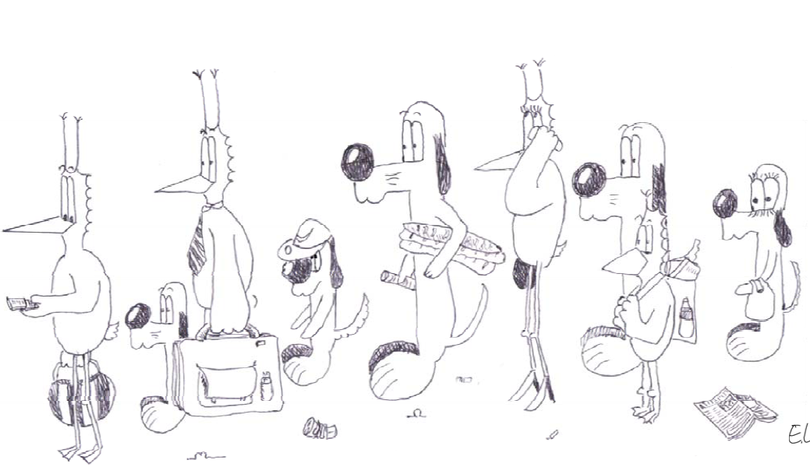




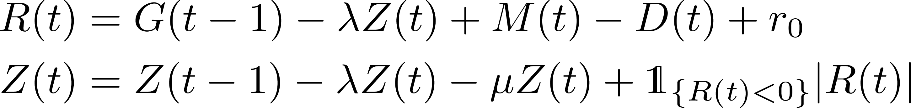

Our Macroscopic Model with Elastic Demand
Control
Ramping Constraint
Randomness
Supply
Natural Demand
Evaporation
Expressed
Demand
$$min⁡(E^{a}\left(t\right), G^{a}\left(t\right))$$
Satisfied
Demand
Returning Demand
Frustrated
Demand
Reserve
(Excess supply)
Backlogged Demand

Slide 11








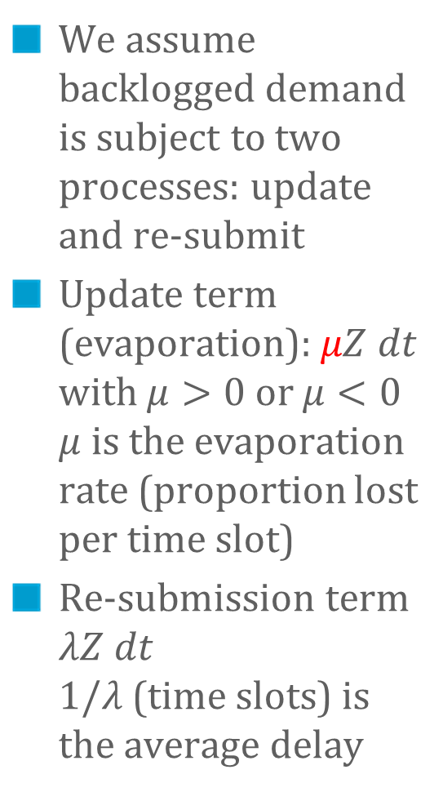
Backlogged Demand
We assume backlogged demand is subject to two processes: update and re-submit
Update term (evaporation): $μZ dt$ with $μ>0$ or $μ<0$ $μ$ is the evaporation rate (proportion lost per time slot)
Re-submission term $λZ dt$ $1/λ$ (time slots) is the average delay
Control
Randomness
Supply
Natural Demand
Evaporation
Expressed
Demand
Satisfied
Demand
Returning
Demand
Frustrated
Demand
Reserve
(Excess supply)
Backlogged Demand

Slide 12
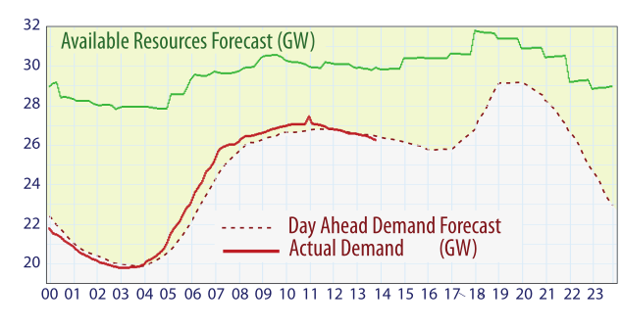
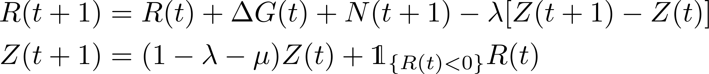

Macroscopic Model, continued
Assumption : $(M – D) =$ ARIMA(0, 1, 0) typical for deviation from forecast $\left(M\left(t+1\right)−D\left(t+1\right)−M\left(t\right)−D\left(t\right)\right)≔N\left(t+1\right)∼N(0,σ^{2})$
2-d Markov chain on continuous state space
S. Meyn
“Dynamic Models and Dynamic Markets
for Electric Power Markets”

Slide 13
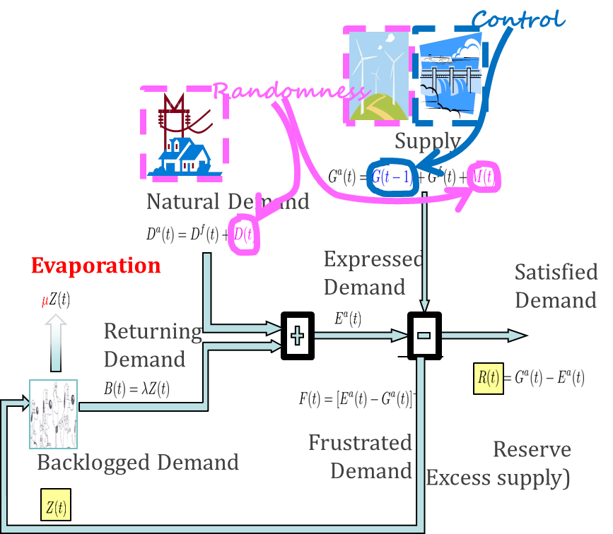
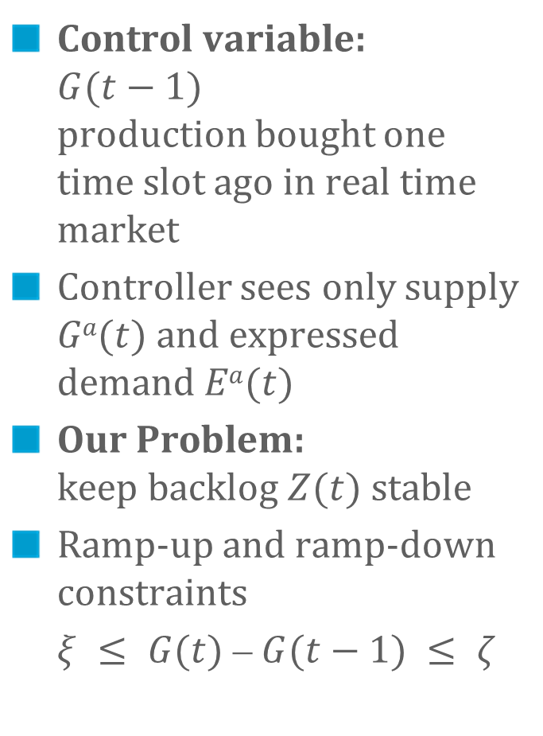
The Control Problem
Control variable: $G(t−1)$ production bought one time slot ago in real time market
Controller sees only supply $Ga(t)$and expressed demand $Ea(t)$
Our Problem: keep backlog $Z(t)$ stable
Ramp-up and ramp-down constraints
$ξ ≤ G(t) ⎼ G(t−1) ≤ ζ$

Slide 14


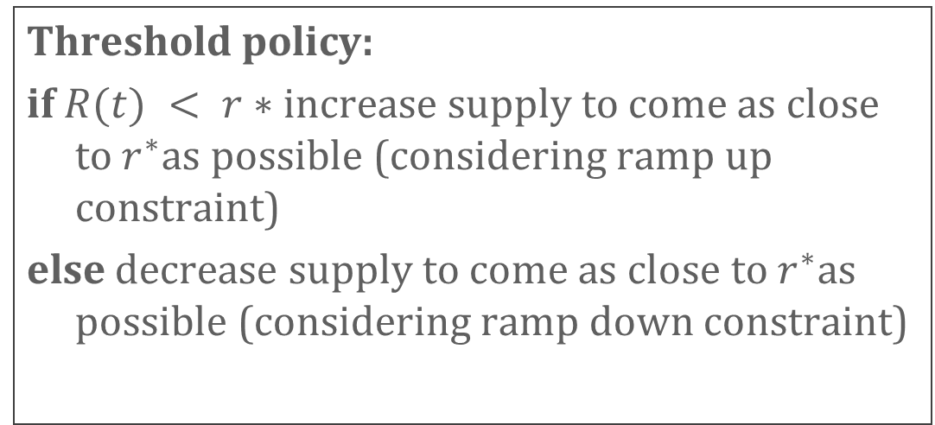
Threshold Based Policies
Forecast supply is adjusted to forecast demand
R(t) := reserve = excess of demand over supply
Threshold policy:
if $R(t) < r∗$increase supply to come as close to $r^{∗}$as possible (considering ramp up constraint)
else decrease supply to come as close to $r^{∗}$as possible (considering ramp down constraint)

Slide 15
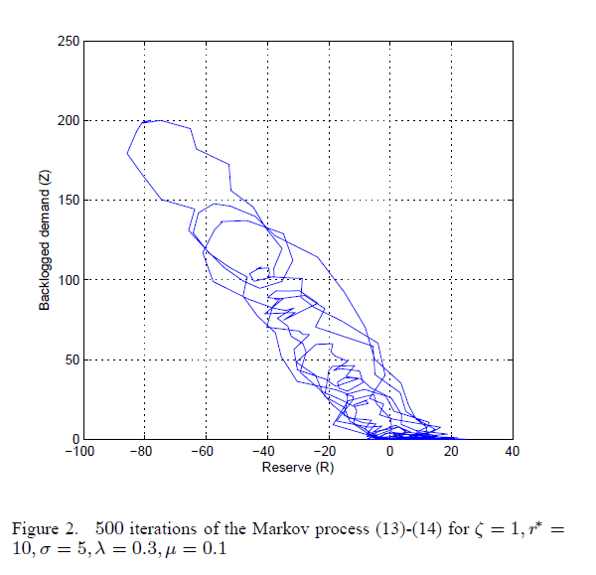
Simulation
r*
Linearized system: 1 is eigenvalue

Slide 16
Stability Results
3.

Slide 17
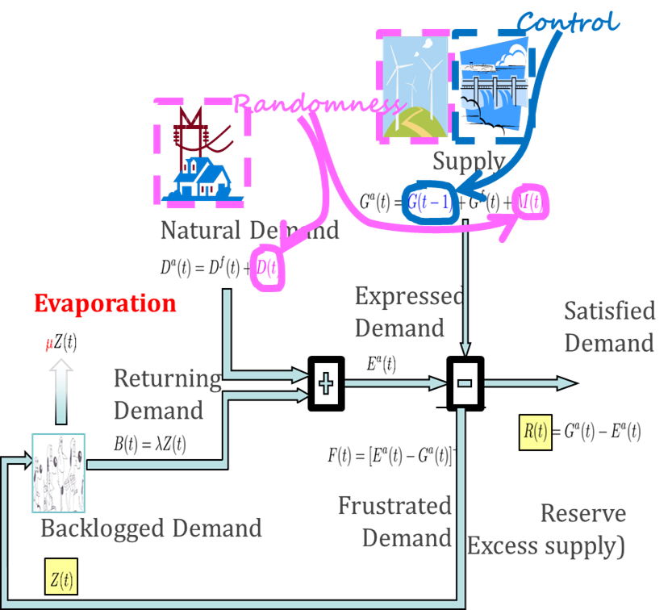
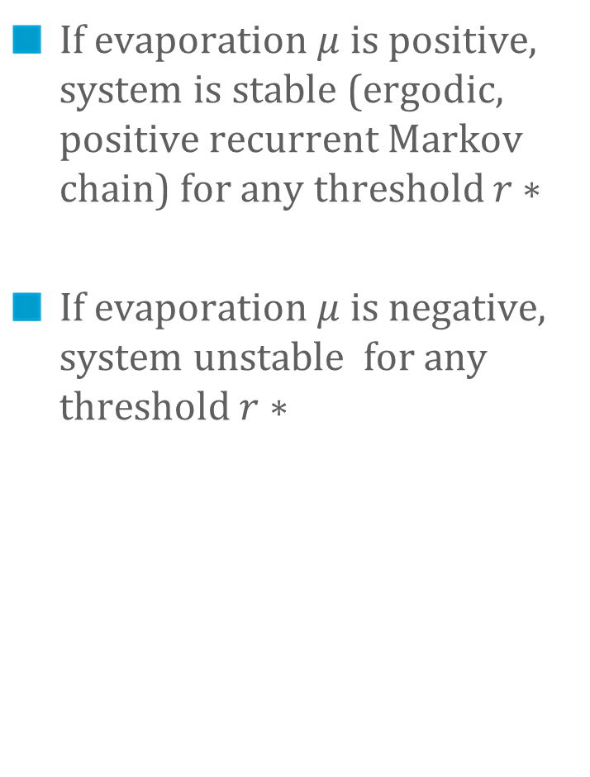
Findings
If evaporation $μ$ is positive, system is stable (ergodic, positive recurrent Markov chain) for any threshold $r∗$
If evaporation $μ$ is negative, system unstable for any threshold $r∗$
Delay does not play a role in stability
Nor do ramp-up / ramp down constraints or size of reserve

Slide 18
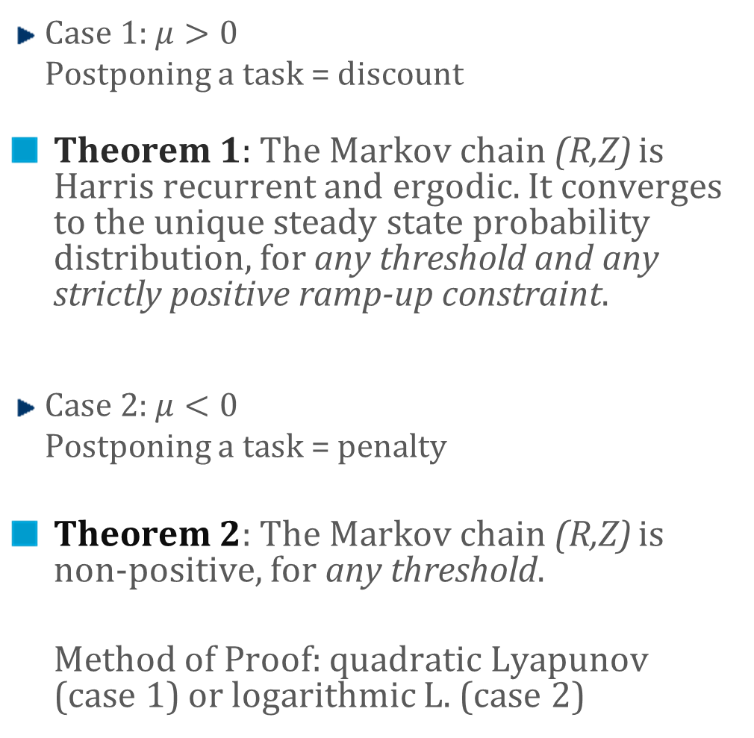
More Detailed Findings
Case 1: $μ>0$
Postponing a task = discount
Theorem 1: The Markov chain (R,Z) is Harris recurrent and ergodic. It converges to the unique steady state probability distribution, for any threshold and any strictly positive ramp-up constraint.
Case 2: $μ<0$
Postponing a task = penalty
Theorem 2: The Markov chain (R,Z) is non-positive, for any threshold.
Method of Proof: quadratic Lyapunov (case 1) or logarithmic L. (case 2)
Evaporation
Backlogged Demand

Slide 19
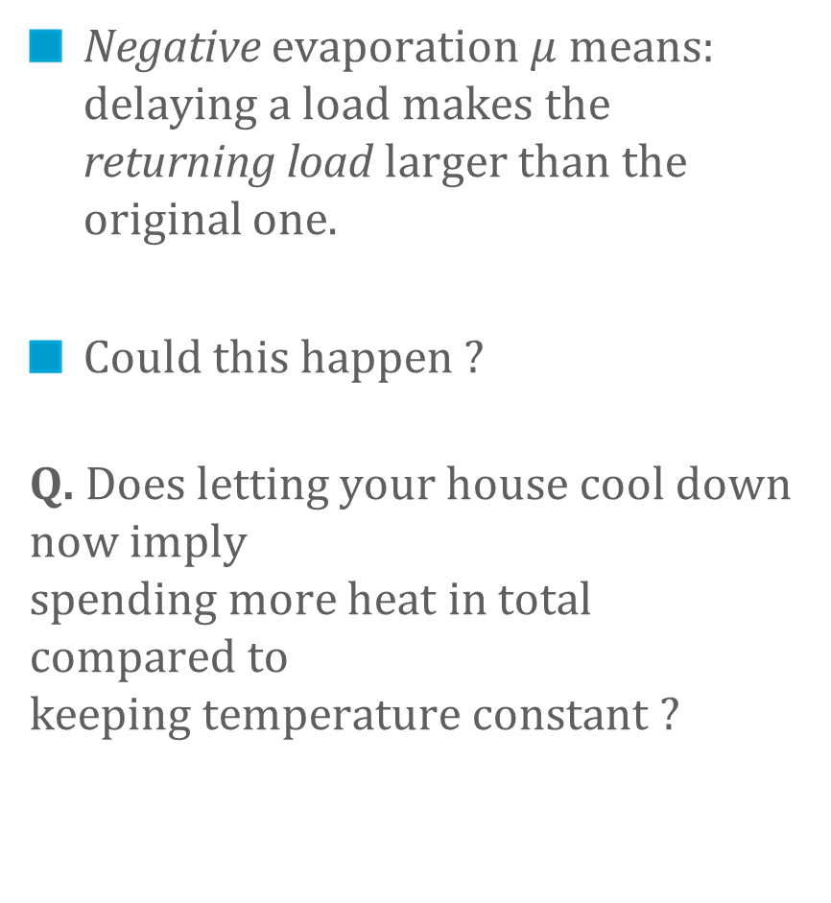
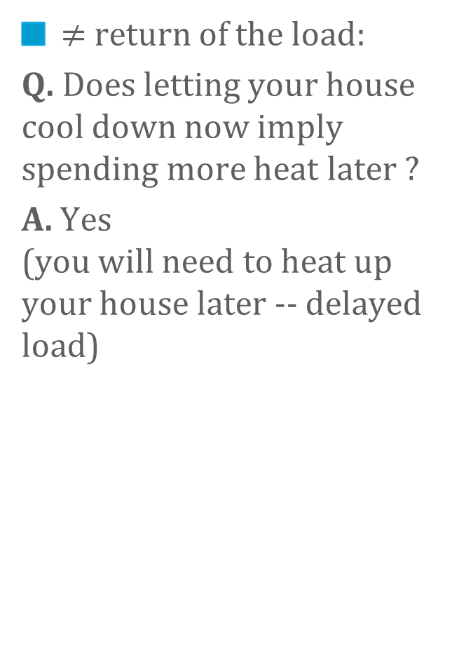
Evaporation
Negative evaporation $μ$ means: delaying a load makes the returning load larger than the original one.
Could this happen ?
Q. Does letting your house cool down now imply spending more heat in total compared to keeping temperature constant ?
$≠$ return of the load:
Q. Does letting your house cool down now imply spending more heat later ?
A. Yes (you will need to heat up your house later -- delayed load)

Slide 20


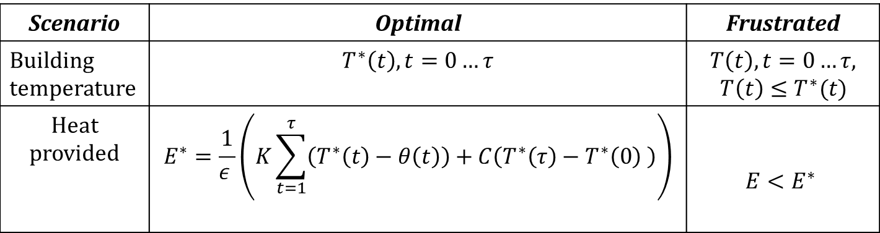

Assume the house model of [6] $ε\sum_{t=1}^{τ}{d\left(t\right)}=K\sum_{t=1}^{τ}{\left(T\left(t\right)−θ\left(t\right)\right)}+C(T\left(τ\right)−T(0)$
heat provided
to building
leakiness
outside
inertia
efficiency
achieved $t^{o}$
E, total energy provided
Scenario | Optimal | Frustrated
Building temperature | $$T^{∗}\left(t\right), t=0…τ$$ | $$T\left(t\right), t=0…τ, \\ T\left(t\right)≤T^{∗}(t)$$
Heat provided | $$E^{∗}=\frac{1}{ε }\left(K\sum_{t=1}^{τ}{\left(T^{∗}\left(t\right)−θ\left(t\right)\right)}+C\left(T^{∗}\left(τ\right)−T^{∗}\left(0\right) \right)\right)$$ | $$E<E^{∗}$$

Slide 21
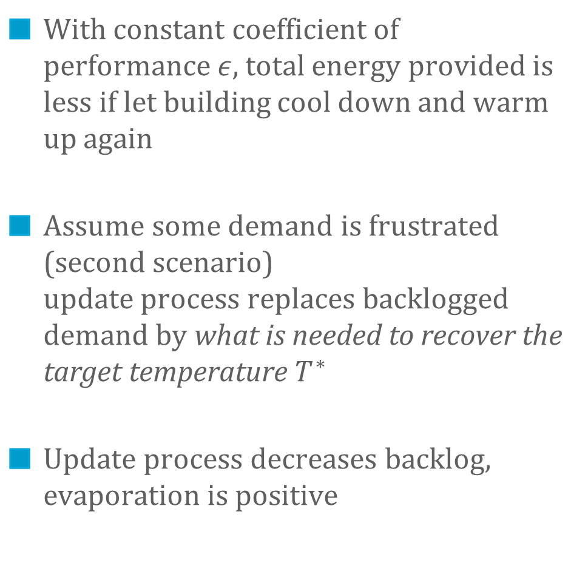
When Delayed Heating is Less Heat
With constant coefficient of performance $ε$, total energy provided is less if let building cool down and warm up again
Assume some demand is frustrated (second scenario) update process replaces backlogged demand by what is needed to recover the target temperature $T^{∗}$
Update process decreases backlog, evaporation is positive
Evaporation
Backlogged Demand

Slide 22
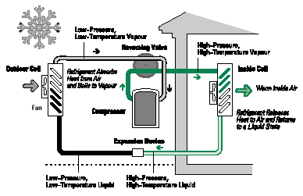
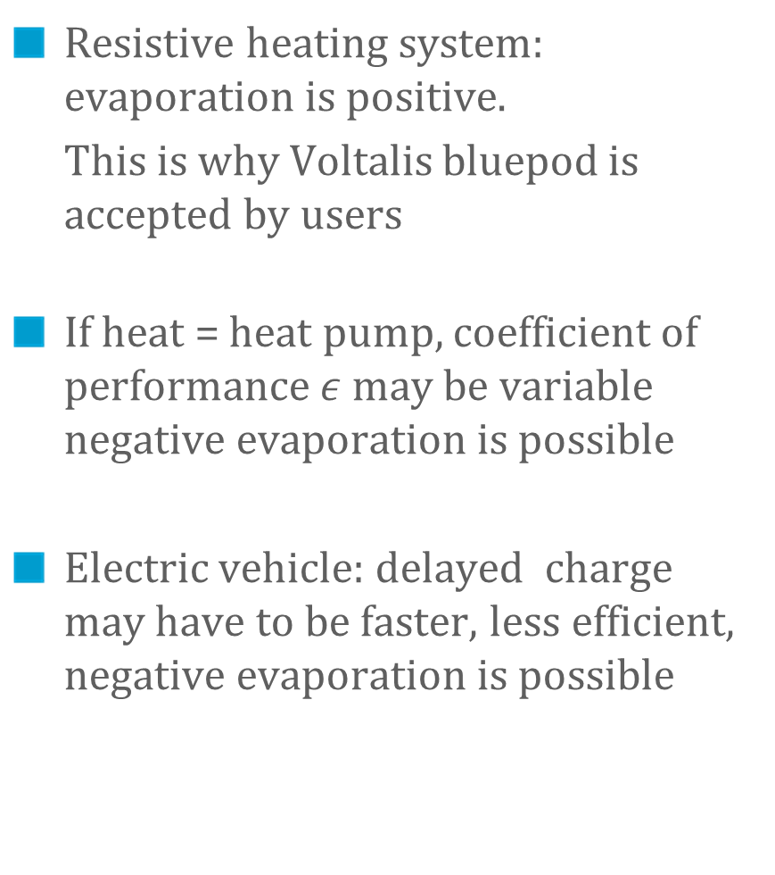
The Sign of Evaporation
Resistive heating system: evaporation is positive.
This is why Voltalis bluepod is accepted by users
If heat = heat pump, coefficient of performance $ε$ may be variable negative evaporation is possible
Electric vehicle: delayed charge may have to be faster, less efficient, negative evaporation is possible

Slide 23
Conclusions
A first model of adaptive appliances with volatile demand and supply
Suggests that negative evaporation makes system unstable Existing demand-response positive experience (with Voltalis/PeakSaver) might not carry over to other loads
Model suggests that large backlogs are possible Backlogged load is a new threat to grid operation Need to measure and forecast backlogged load

Slide 24
Questions ?
[1] Cho, Meyn – Efficiency and marginal cost pricing in dynamic competitive markets with friction, Theoretical Economics, 2010
[2] Le Boudec, Tomozei, Satisfiability of Elastic Demand in the Smart Grid, Energy 2011 and ArXiv.1011.5606
[3] Le Boudec, Tomozei, Demand Response Using Service Curves, IEEE ISGT-EUROPE, 2011
[4] Le Boudec, Tomozei, A Demand-Response Calculus with Perfect Batteries, WoNeCa, 2012
[5] Papavasiliou, Oren - Integration of Contracted Renewable Energy and Spot Market Supply to Serve Flexible Loads, 18th World Congress of the International Federation of Automatic Control, 2011
[6] David MacKay, Sustainable Energy – Without the Hot Air, UIT Cambridge, 2009

