Slide 1

Greening of Mobile Networks : Myths and Opportunities
Jean-Yves Le Boudec
EPFL
May 31st – June 1, 2010

Slide 2
Contents
Greening Cellular Networks
Dream and Reality
What next

Slide 3
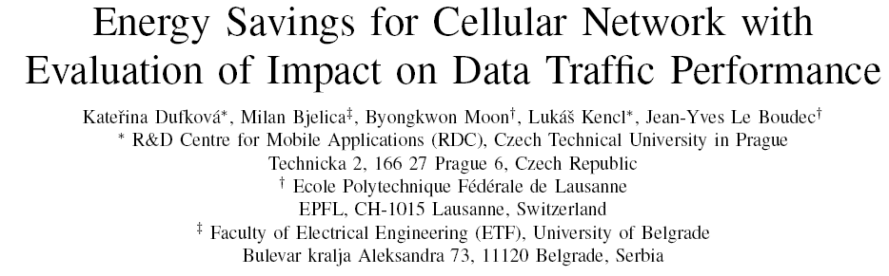
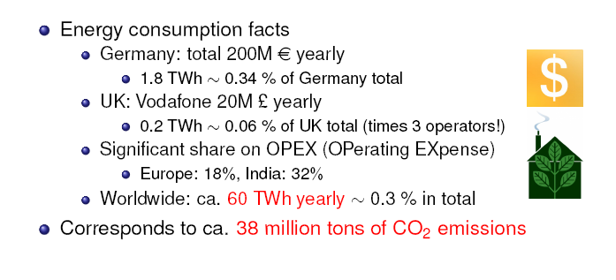
Mobile Operator Energy Consumption Facts
EuropeanWireless2010

Slide 4
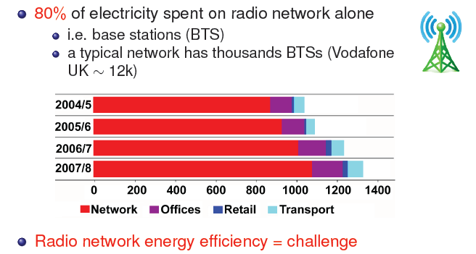
Radio Network Is A Major Electricity Consumer

Slide 5
Traffic Proportional Energy Consumption
Today’s equipment power consumption is largely traffic insensitive
Power amplifiers, non idling processors
Tomorrow’s equipment will be much more energy proportional
In the rest of this section I focus on operation and design

Slide 6
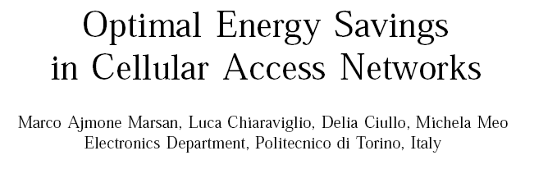
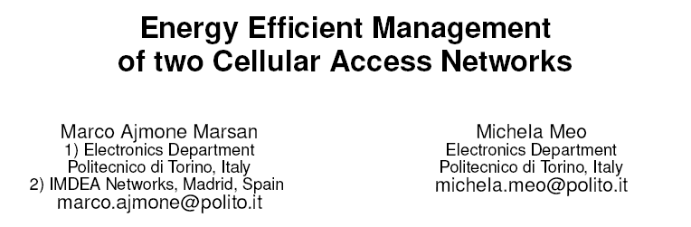
Save Energy by Shutting Down Base Stations
GreenComm‘09
GreenMetrics‘09
Savings up to 25-30% can be achieved
Network sharing allows shutting down entire network at off peak periods

Slide 7

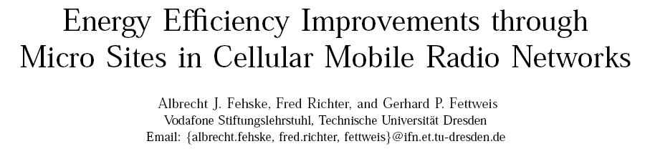
Save Energy by Optimal Network Design
GreenComm‘09
Design and route according to energy consumption (optical switching vs IP routing)
Femto cells to reduce energy consumption of down and up link
GreenComm‘09

Slide 8
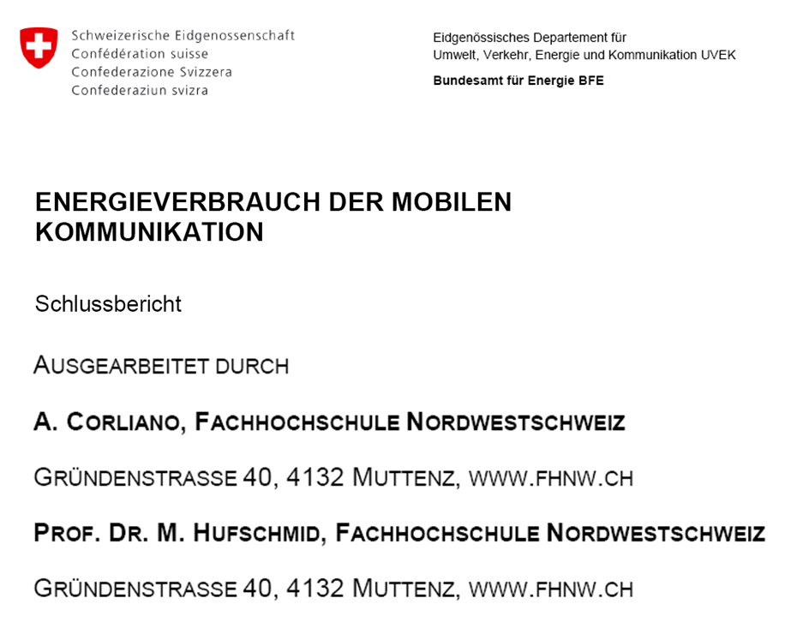
Femto Cells:
Assume 20 % swiss households equipped with 3G femtocell, 15W
Increases power consumption of households by 0.5 %
Compare to existing mobile phone network power consumption (RF + BB) : + 50 %

Slide 9
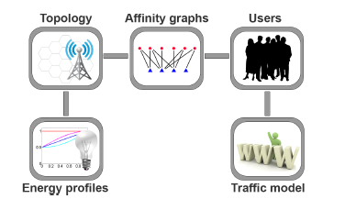
Online Dynamical Allocation
Idea:
Predict aggregate traffic
Decide resource allocation every say 2-5 mn
Optimize network predicted cost subject to quality of service
Efficient for data traffic
EuropeanWireless2010

Slide 10
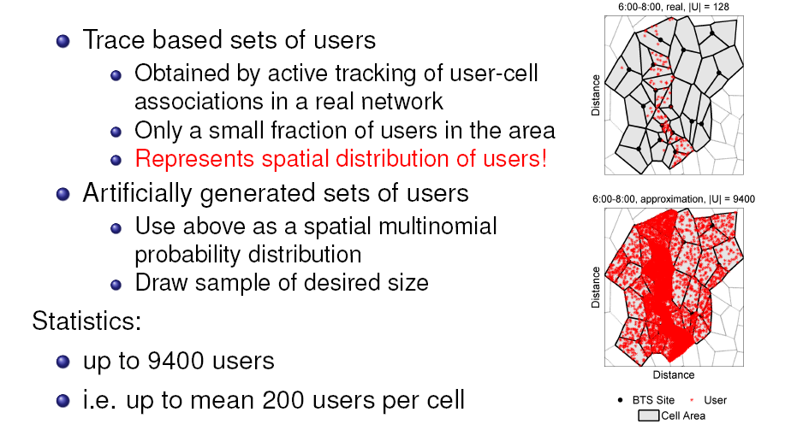
Experimental Results

Slide 11
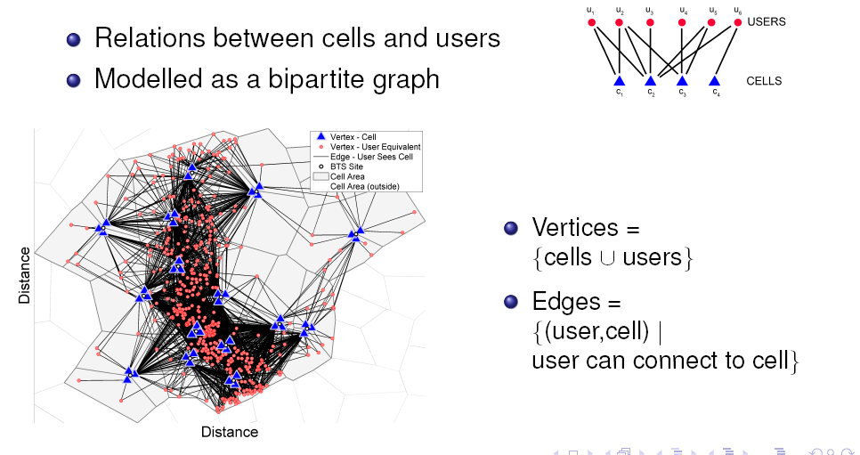
Optimal Allocation of Users to Cell by Binary Integer Programming Heuristic

Slide 12
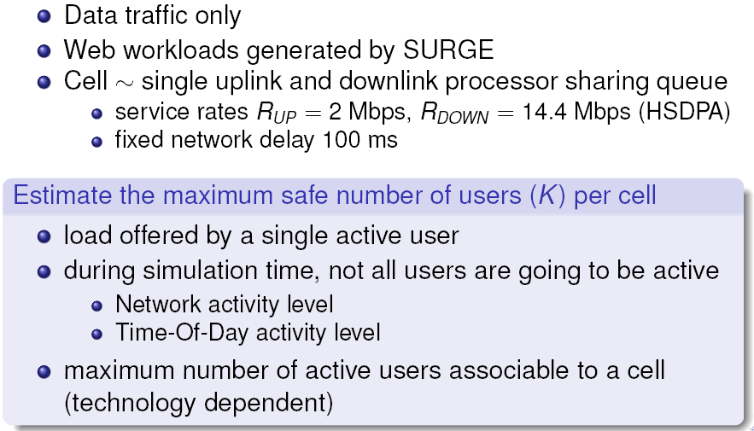
Traffic Model

Slide 13
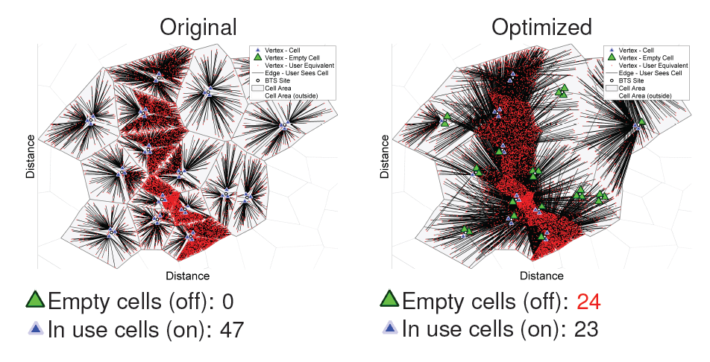
Example of Result

Slide 14
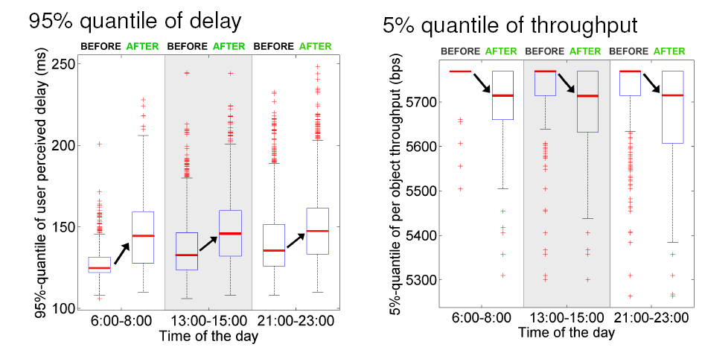
Impact on Network Performance

Slide 15
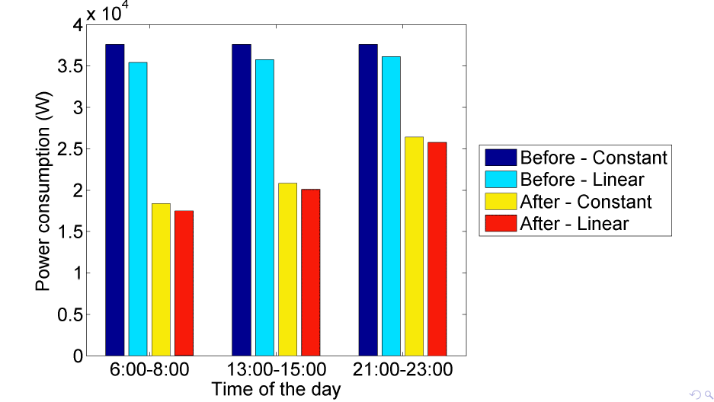
Energy Savings up to 40%

Slide 16
Next Steps: Dynamical Allocation of Resources
Planning / design
Exploit heterogeneous power performance tradeoffs (micro-sites, optical fiber vs embedded electronics)
Online operation
Traffic measurement
Short term forecast
Online Optimization

Slide 17
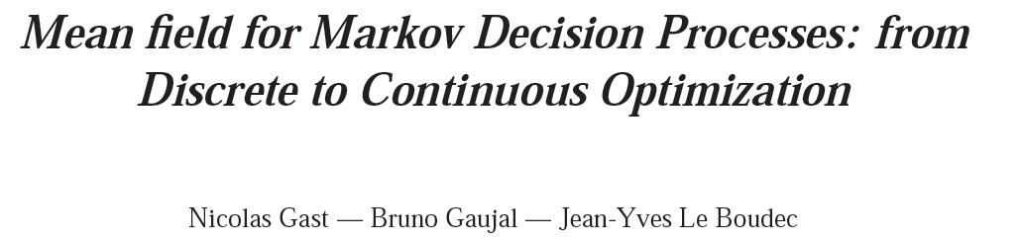
Online Optimization with Mean Field
Most practical cases produce NP hard problems
A natural alternative is Markov Decision Processes
Similar complexity issues
Mean Field Approximation of MDPs is a promising direction
Transforms discrete state space in continuous one
Threshold based policies can be computed
INRIA RR 7239; April 2010

Slide 18
Take Home Message
Greening mobile networks saves significant amounts of energy
Is possible by smart design and allocation of resources

Slide 19

Contents
Greening Cellular Networks
Dream and Reality
What next

Slide 20
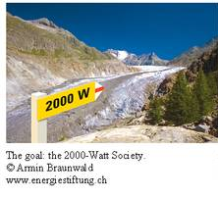
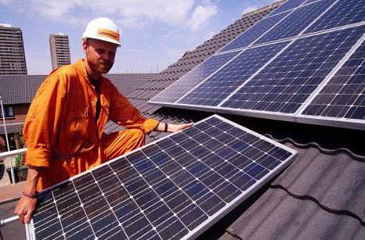
I Had A Dream …
2000 W society = energy expenditure per capita as it was in 1960 in Western Europe (in CH; = 63.1 GJ per year per capita)
Today: 5000 – 6000 W
Realistic Goal for 2050: 3500 W [The 2000 Watt Society –Standard or Guidepost? Energiespiegel Nr 18, April 2007, PSI, Switzerland]

Slide 21
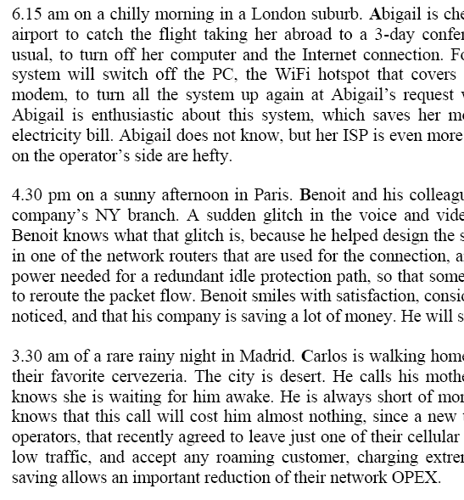
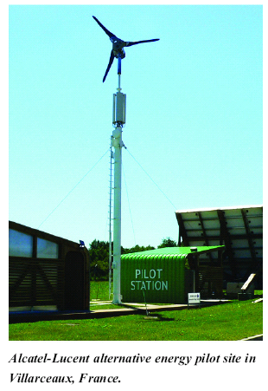
Mobile Networks can contribute, too…
[Key Challenges for Green Networking
by Ulrich Barth, Patty Wong, Didier Bourse
ERCIM News, Vol 79, Oct 2009]
[Fabio Neri et al., working document, May 2010]

Slide 22
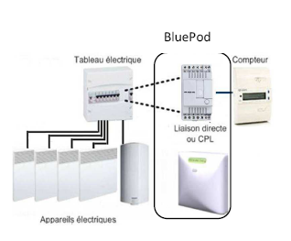

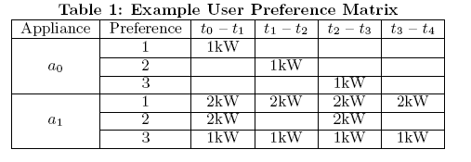
Intelligent Management of Energy Consumption and Production
Managing End-User Preferences in the Smart Grid, C. Wang and M. d. Groot, E-energy 2010, Passau, Germany, 2010
www.voltalis.com

Slide 23
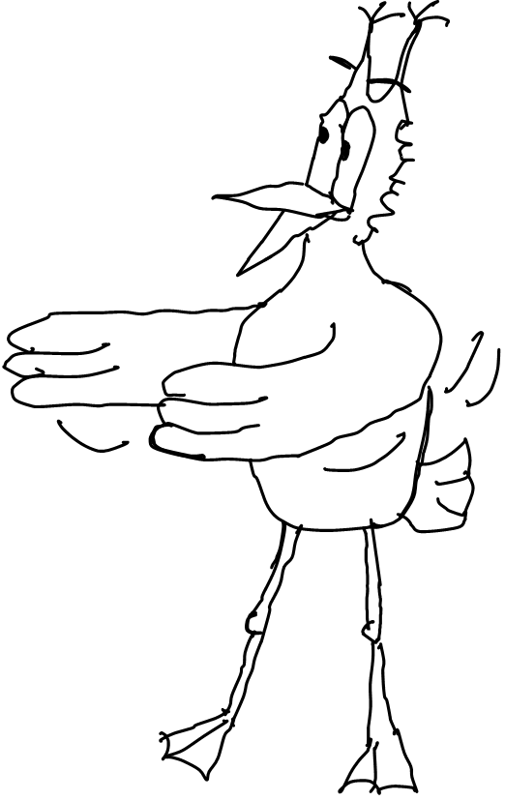
One Day in the Life of Robert Longirod
We are in May 2050, in the 3500W society
Robert Longirod is telecom engineer at the swiss branch of Huawei Technologies

Slide 24
A fatal exception 8E has occurred at 0028:C881E33670F in UXD DXC 32
883FA2332EBD. The current application will be terminated. .
Robert wakes up at 6:45
Walks to the bathroom to take a shower
No hot water !
Home automation controller hung yesterday night. Hot water was not replenished overnight.

Slide 25
Robert is a philosoph and takes a cold shower.
Now is time for a good, hot, espresso. Robert imagines the smell of the first coffee of the day and smiles …
…but no coffee !

Slide 26
Robert re-programmed his end user preferences in the smart grid yesterday night and made a mistake !
Fortunately, the fridge works and there is some orange juice left.

Slide 27
Robert now walks to his lounge and prepares to work. Today, Robert is telecommuting – this saves time and energy.
Strange, the lounge is dark – shutters are blocked closed … the home automation controller, of course !

Slide 28
Not a serious problem anyhow; the shutters can be opened manually.
Robert sits at his table and opens his desktop …

Slide 29
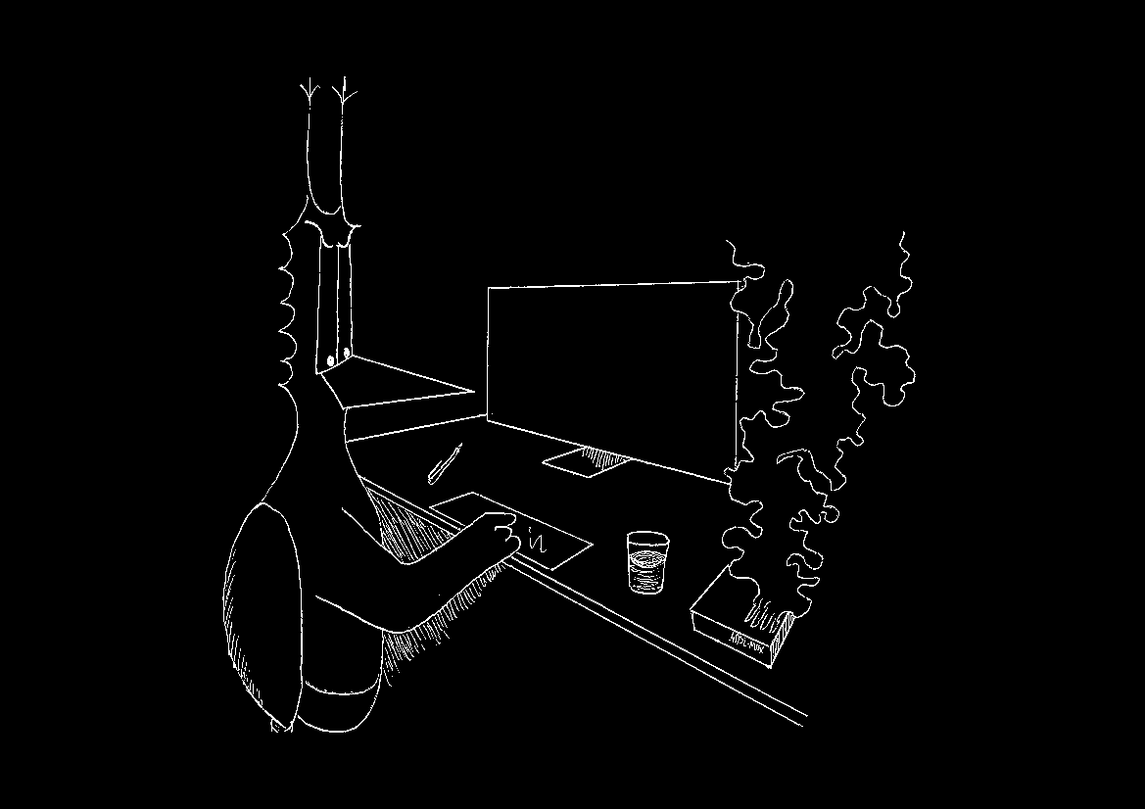
The femtocell has burnt, no internet access …

Slide 30
Robert is a bit worried. There is an important meeting at 10:00 scheduled with two co-workers.
« If I am not at that meeting, it is George who will get the work. I must be there »
Robert decides to do something exceptional: drive to work !

Slide 31
In the garage …
The e-car is not charged.
The batteries were used to power the grid. Normal, Robert did not plan to go anywhere today…

Slide 32
Robert cycles to work
While pedalling back home in the evening, he hopes that the washing machine did its job…

Slide 33
Smart energy management issues
man machine interactions
Difficult
Apple
reliable hardware and software
can we make Airbus grade equipment at low cost ?

Slide 34
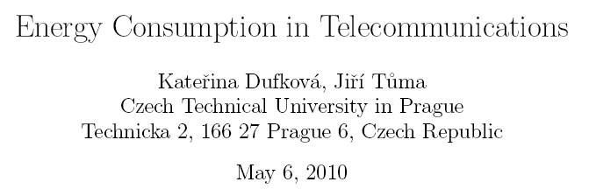
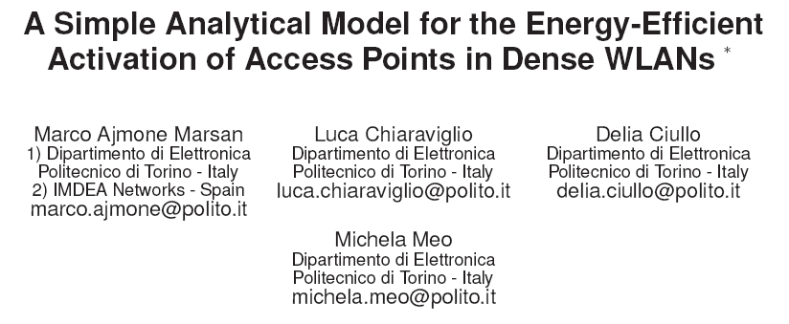
Impact of Saving Energy in Radio Network
Saving energy in radio access network is a must
Savings by putting access points to sleep could save 7.5% electricity consumption of mobile operators worldwide[Marsan2010]
But global impact is modest
0.01% to 0.03% of total electricity consumption [Dufkova 2010]
0.001% to 0.004 % of primary energy sources
e-Energy 2010, Passau

Slide 35
The Myth of e-cars
Q:
A:
Replace all cars and trucks of Switzerland by electrical vehicles. What is the impact on the power grid ?
excluding air transport
x 2 ≥ 6 new nuclear plants + cover the country with windmills + put solar cells on all roofs
Source: Prof. Hubert Kirrmann, ABB / EPFL

Slide 36
Take-Home Message
Transportation and domestic usages are major energy consumers and have a major problem
Energy management is much harder than often envisioned

Slide 37
Contents
Greening Cellular Networks
Dream and Reality
What next

Slide 38
Roadmap for Green Telecom
We need to continue making the telecom infrastructure
Sober
Energy proportional
However, the telecom infrastructure can help reduce energy consumption dramatically
Home, office and workshop automation
Transportation
Availability and reliability of the telecom grid is vital

Slide 39
The 2000 W society will need
telecom infrastructure that is
Low cost
Pervasive
Easy to use (and program to)
Reliable

Slide 40
Cost of deploying and maintaining pervasive, 4G

Slide 41
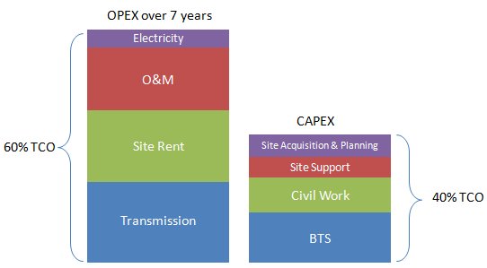
Radio Access Network
“traditional RAN will become far too expensive for mobile operators to keep competitive in the future mobile internet world. Therefore, the RAN should be re-architected to adapt to the new environment”
China Mobile Research Institute
White Paper 1.0.0 March 2010

Slide 42
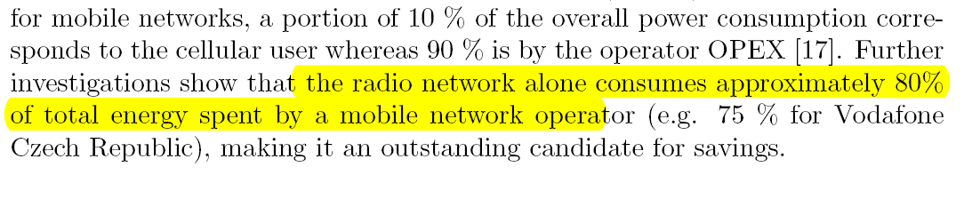

Slide 43
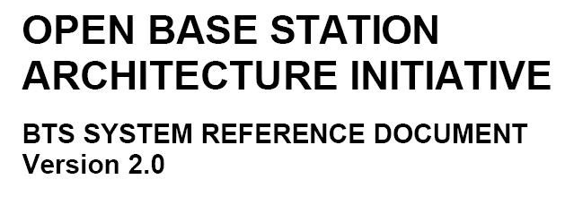
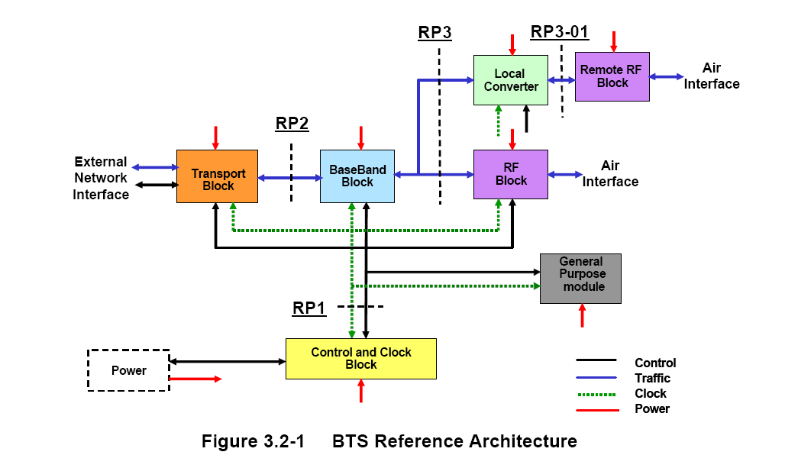
Base Stations become Commodity

Slide 44
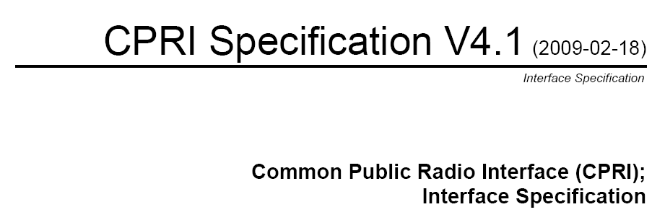
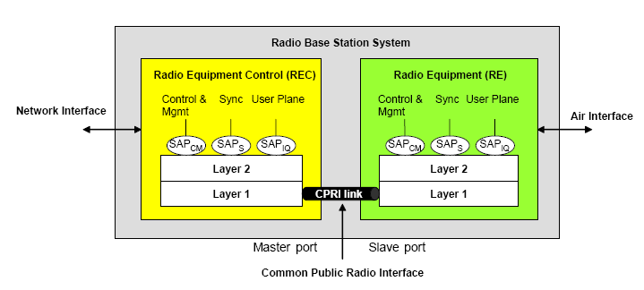

Slide 45
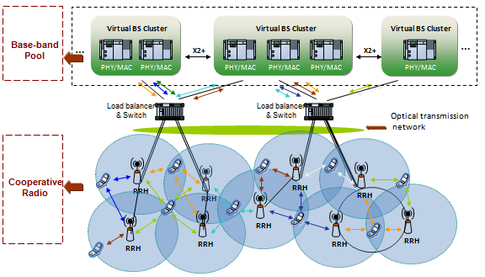
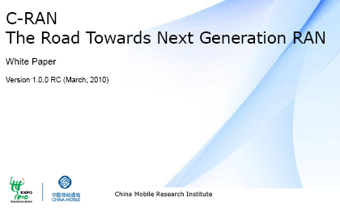
Reduce Cost of Radio Access Network by Separating RF from Processing
Simple Radio access network
Processing (inc. PHY) and datain a small number of processing / data centers [China Mobile Research Institute White Paper 1.0.0 March 2010]
Low CAPEX + OPEX low energy data center techniques

Slide 46
Radio Access Network Sharing
In countries with competing telecoms, deployment of multiple 4G nets might be a problem
Range
E-smog
Real estate
Energy efficiency
Radio access network sharing is an option

Slide 47
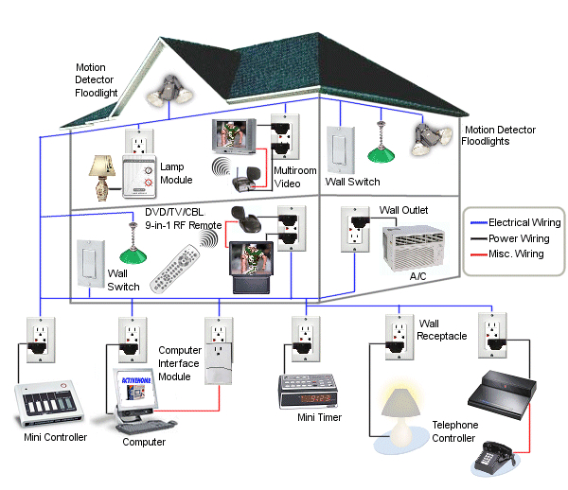
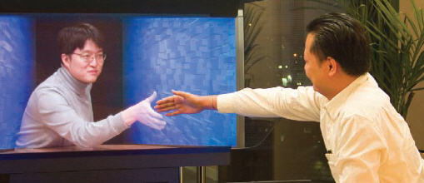
Radio Access Network Operator (RANO)
Operator 1
Operator 2
Operator 3
Radio
Access
Network
Operator

Slide 48
Radio Access Network Operator (RANO)
Benefits
Issues
Reduced energy consumption of radio network
Reduced costs of telecom services vital for energy saving
Nature of operator (local community, private company, monopoly ? )
Competition versus social optimum

Slide 49
Complexity of (secure) software

Slide 50
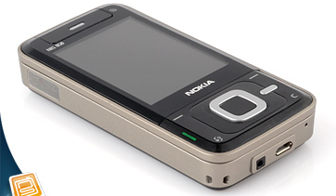
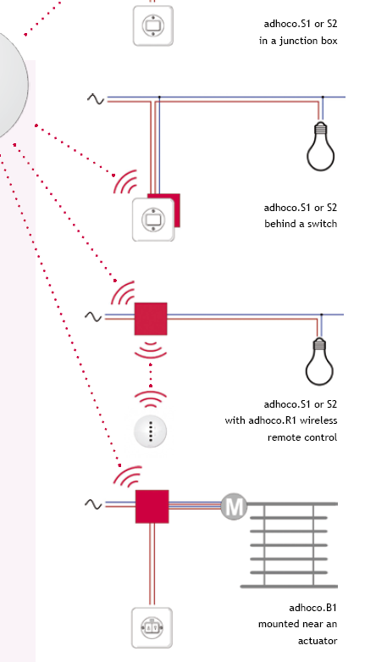
Cloud Computing
Make software and system simple
Query, control
Content Centric Operator
report

Slide 51
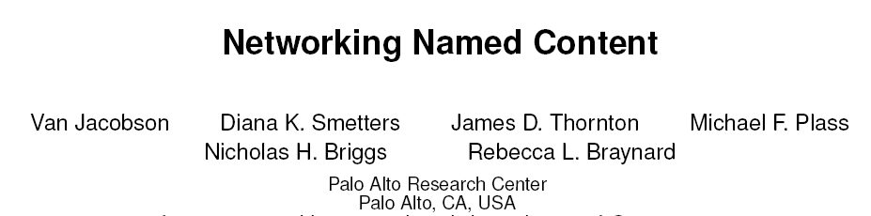
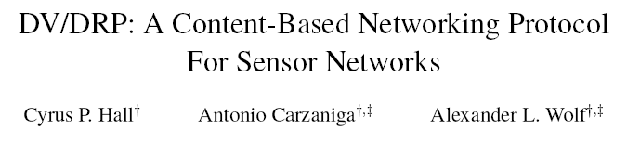
Content Centric Networking
Replace connection and end-host naming by secure object naming
Expected to simplify design and operation

Slide 52
Weights…
Mobile networks of the future will be energy sober with energy consumption proportional to traffic
Traffic proportional equipment
Smart design and adaptive resource allocation
Minor impact on the energy problem
Mobile networks are vital to the 2000 W society and must be simple and reliable. Research on new paradigms
Network sharing, Radio Access Network Operator
Simple and secure content centric networking
Major impact on the energy problem

Slide 53
The Line
Greening mobile networks is a must
But do not cross the line
Network operation and usage must be simple and reliable

