Slide 1

Palm Calculus
Made Easy
The Importance of the Viewpoint
JY Le Boudec
2009
Illustration : Elias Le Boudec

Slide 2
Part of this work is joint work with Milan Vojnovic
Full text of this lecture:
  [1] J.-Y. Le Boudec, "Palm Calculus or the Importance of the View Point"; Chapter 11 of "Performance Evaluation Lecture Notes (Methods, Practice and Theory for the Performance Evaluation of Computer and Communication Systems)“
  http://perfeval.epfl.ch/printMe/perf.pdf
See also
  [2] J.-Y. Le Boudec, "Understanding the simulation of mobility models with Palm calculus", Performance Evaluation, Vol. 64, Nr. 2, pp. 126-147, 2007, online at http://infoscience.epfl.ch/record/90488
  [3] Elements of queueing theory: Palm Martingale calculus and stochastic recurrences F Baccelli, P Bremaud - 2003, Springer
  [4] J.-Y. Le Boudec and Milan Vojnovic, The Random Trip Model: Stability, Stationary Regime, and Perfect Simulation IEEE/ACM Transactions on Networking, 14(6):1153–1166, 2006.
Answers to Quizes are at the end of the slide show

Slide 3

Contents
Informal Introduction
Palm Calculus
Application to Simulation
Freezing Simulations

Slide 4
Quiz 1
Le calcul de Palm c’est:
  Un procédé de titrage de l’alcool de dattes
  Une application des probabilités conditionnelles
  Une application de la théorie ergodique
  Une méthode utilisée par certains champions de natation

Slide 5
What Is Palm Calculus About ?
Performance metric comes with a viewpoint
  Sampling method, sampling clock
Often implicit
May not correspond to the need

Slide 6
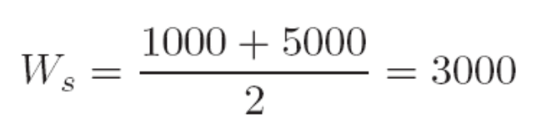
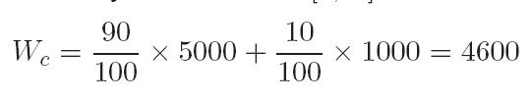
Example: Gatekeper
job arrival
0
90
100
190
200
290
300
t (ms)
Jobs served by two processors
Red processor slower
Scheduling as shown
5000
5000
5000
1000
1000
1000
System designer says
  Average execution time is
Customer says
  Average execution time is

Slide 7
Sampling Bias
W_{s} and W_{c} are different: sampling bias
System designer / Customer Representative should worry about the definition of a correct viewpoint
  W_{c} makes more sense than W_{s}
Palm Calculus is a set of formulas for relating different viewpoints
Most formulas are very elementary to derive
  this is well hidden

Slide 8
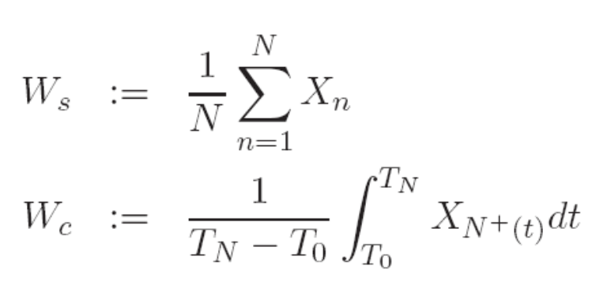
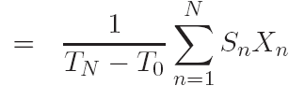
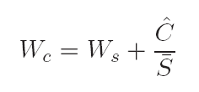
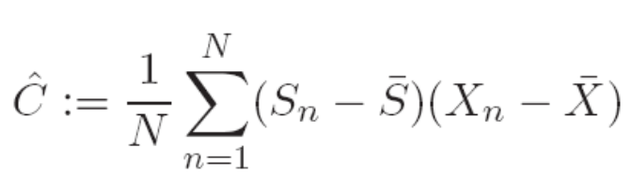
Large Time Heuristic
Pretend you do a simulation
Take a long period of time
Estimate the quantities of interest
Do some maths
job arrival
0
T₁
T₂
T₃
T₄
T₅
T₆
t (ms)
S₅
X₁
X₃
X₅
X₂
X₄
X₆

Slide 9
Features of a Palm Calculus Formula
Relates different sampling methods
  Time average
  Event average
We did not make any assumption on
  Independence
  Distribution

Slide 10
Example: Stop and Go
timeout
t₀
t₁
t₀
t (ms)
Source always sends packets
α = proportion of non acked packets
Compute throughput as a function of t₀, t₁ and α
  t₀ = mean transmission time (no failure)
  t₁ = timer duration

Slide 11
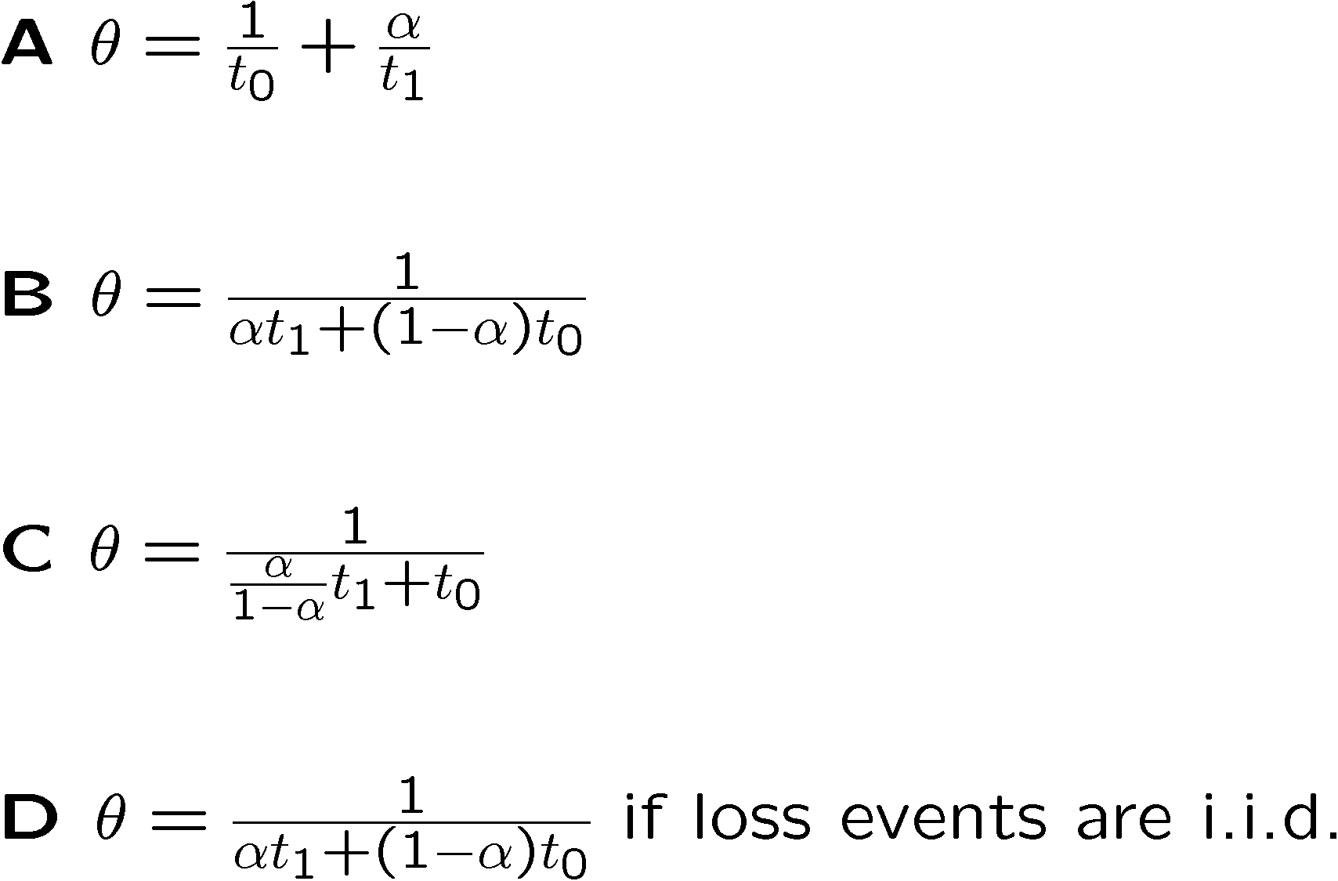
Quiz 2: Stop and Go
timeout
t₀
t₁
t₀
t (ms)

Slide 12
Quiz 2: Stop and Go
timeout
t₀
t₁
t₀
t (ms)
T₀
T₁
T₂
T₃

Slide 13
Features of a Palm Calculus Formula
Relates different sampling methods
  Event clock a: all transmission attempts
  Event clock s: successful transmission attempts
We did not make any assumption on
  Independence
  Distribution
timeout
t₀
t₁
t₀
a,s
a
a,s

Slide 14
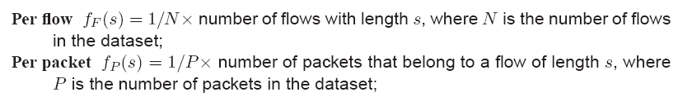
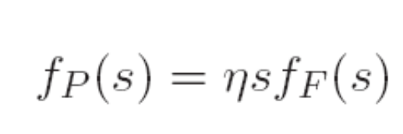
Other Contexts
Empirical distribution of flow sizes
  Packets arriving at a router are classified into flows
  «flow clock »: what is the size of an arbitrary flow ?
  « packet clock »: what is an arbitrary packet’s flow size ?
Let f_{F}(s) and f_{P}(s) be the corresponding PDFs
Palm formula (η is some constant)

Slide 15
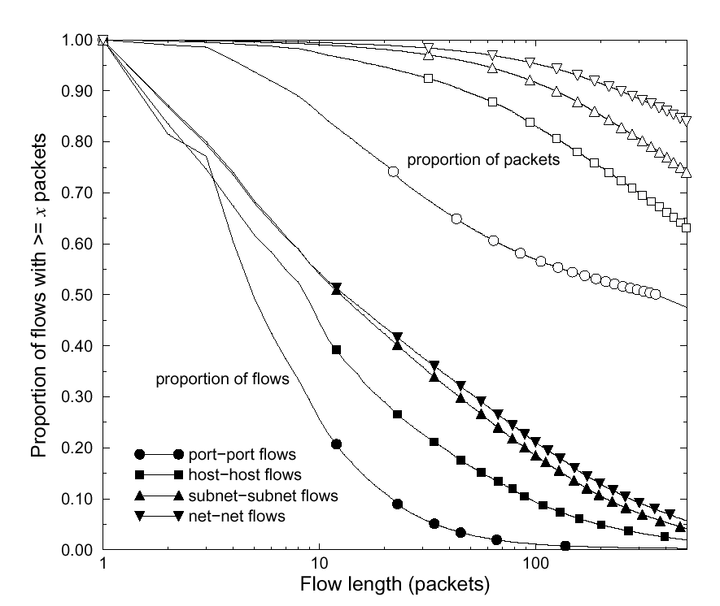
Load Sensitive Routing of Long-Lived IP Flows
Anees Shaikh, Jennifer Rexford and Kang G. Shin
Proceedings of Sigcomm'99
ECDF, per packet viewpoint
ECDF, per flow viewpoint

Slide 16

The Cyclist’s Paradox
Cyclist does round trip in Switzerland
  Trip is 50% downhills, 50% uphills
  Speed is 10 km/h uphills, 50 km/h downhills
Average speed at trip end is 16.7 km/h
  Cyclist is frustrated by low speed, was expecting more
Different Sampling methods
  km clock: « average speed » is 30 km/h
  time clock: average speed is 16.7 km/h

Slide 17
Take Home Message
Metric definition should include sampling method
Quantitative relations often exist between different sampling methods
  Can often be obtained by elementary heuristic
  Are robust to distributional / independence hypotheses

Slide 18
Contents
Informal Introduction
Palm Calculus
Application to Simulation
Freezing Simulations

Slide 19
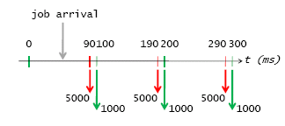


Palm Calculus : Framework
A stationary process (simulation) with state S(t).
Some quantity X(t). Assume that
(S(t);X(t)) is jointly stationary
i.e., S(t) is in a stationary regime and X(t) depends on the past, present and future state of the simulation in a way that is invariant by shift of time origin.
Examples
  Jointly stationary with S(t): X(t) = time to wait until next job service opportunity
  Not jointly stationary with S(t): X(t) = time at which next job service opportunity will occur

Slide 20

Stationary Point Process
Consider some selected transitions of the simulation, occurring at times T_{n}.
  Example: T_{n} = time of n^{th} service opportunity
T_{n} is a called a stationary point process associated to S(t)
  Stationary because S(t) is stationary
  Jointly stationary with S(t)
Time 0 is the arbitrary point in time

Slide 21
Palm Expectation
Assume: X(t), S(t) are jointly stationary, T_{n} is a stationary point process associated with S(t)
Definition : the Palm Expectation is
E^{t}(X(t)) = E(X(t) | a selected transition occurs at t)
By stationarity: E^{t}(X(t)) = E⁰(X(0))
Example:
  T_{n} = time of n^{th} service opportunity
  E^{t}(X(t)) = E⁰(X(0)) = average service time at an arbitrary service opportunity

Slide 22
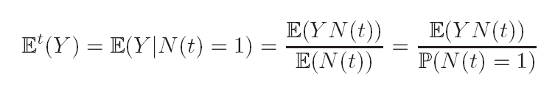
Formal Definition
In discrete time, we have an elementary conditional probability
In continuous time, the definition is a little more sophisticated
  uses Radon Nikodym derivative– see support document
  See also [BaccelliBremaud87] for a formal treatment
Palm probability is defined similarly

Slide 23
Ergodic Interpretation
Assume simulation is stationary + ergodic:
E(X(t)) = E(X(0)) expresses the time average viewpoint.
E^{t}(X(t)) = E⁰(X(0)) expresses the event average viewpoint.

Slide 24
Quiz 3: Gatekeeper
  Which is the estimate of a Palm expectation ?
  W_{s}
  W_{c}
  None
  Both
job arrival
0
T₁
T₂
T₃
T₄
T₅
T₆
t (ms)
S₅
X₁
X₃
X₅
X₂
X₄
X₆

Slide 25
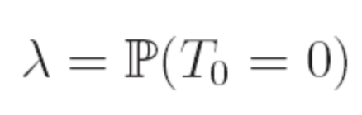
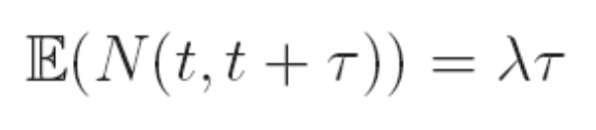
Intensity of a Stationary Point Process
Intensity of selected transitions: λ := expected number of transitions per time unit
  Discrete time:
  Discrete or Continuous time:

Slide 26
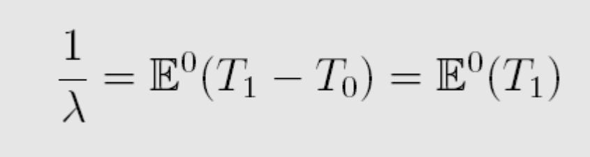
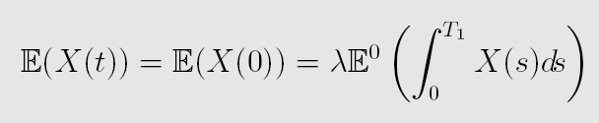
Two Palm Calculus Formulae
Intensity Formula:
where by convention T₀ ≤ 0 < T₁
Inversion Formula
The proofs are simple in discrete time – see lecture notes

Slide 27

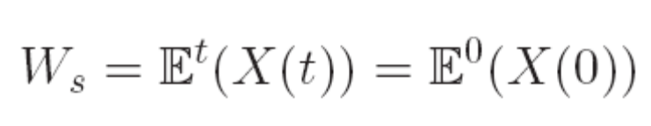
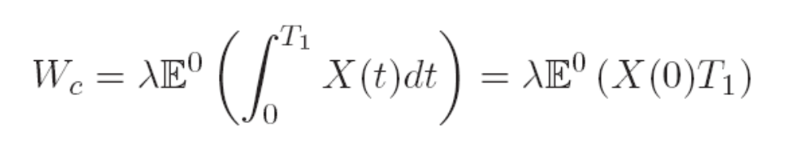
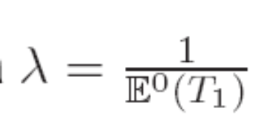
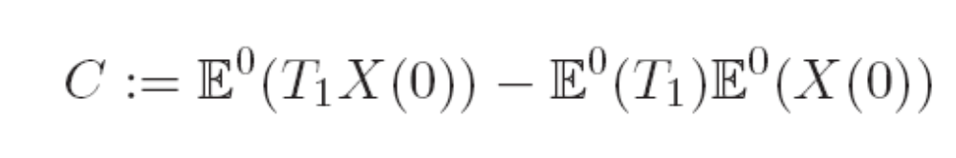
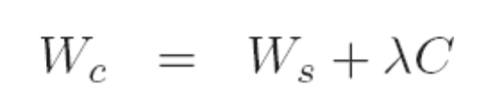
Gatekeeper, re-visited
X(t) = next execution time
Inversion formula
Intensity formula
Define C as covariance:

Slide 28
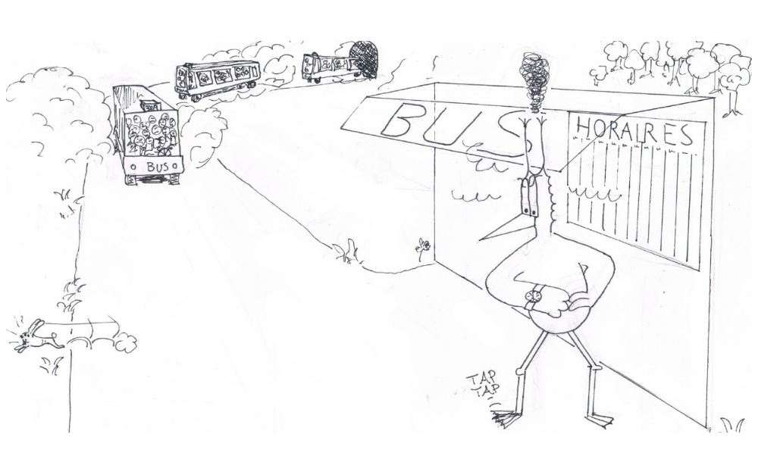
Feller’s Paradox
Inspector estimates
E⁰(T₁-T₀) = E⁰(X(0)) = 1 / λ
Joe estimates
E(X(t)) = E(X(0))
Inversion formula:
Joe’s estimate is always larger
At bus stop λ buses in average per hour.
Inspector measures time interval between buses.
Joe arrives once and measures
X(t) = time elapsed since last but + time until next bus
Can Joe and the inspector agree ?

Slide 29
Little’s Formula
Little’s formula: λ R = N
  R = mean response time
  N = mean number in system
  λ = intensity of arrival process
  System is stationary = stable
R is a Palm expectation
R
System
λ
λ

Slide 30

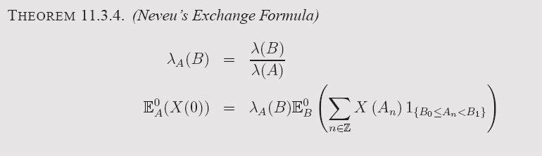
Two Event Clocks
Two event clocks, A and B, intensities λ(A) and λ(B)
We can measure the intensity of process B with A’s clock
λ_{A}(B) = number of B-points per tick of A clock
Same as inversion formula but with A replacing the standard clock

Slide 31
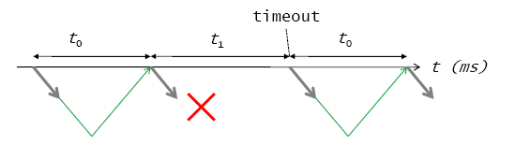
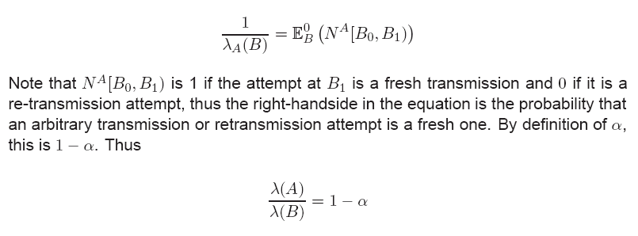


Stop and Go
A
A
A
B
B
B
B

Slide 32
Contents
Informal Introduction
Palm Calculus
Application to Simulation
Freezing Simulations

Slide 33
Example: Mobility Model
In its simplest form (random waypoint):
  Mobile picks next waypoint M_{n} uniformly in area, independent of past and present
  Mobile picks next speed V_{n} uniformly in [v_{min}; v_{max}]
  independent of past and present
  Mobile moves towards M_{n} at constant speed V_{n}
M_{n-1}
M_{n}

Slide 34
Instant Speed
Ask a mobile : what is you current speed ?
  At an arbitrary waypoint: uniform [v_{min}, v_{max}]
  At an arbitrary point in time ?

Slide 35
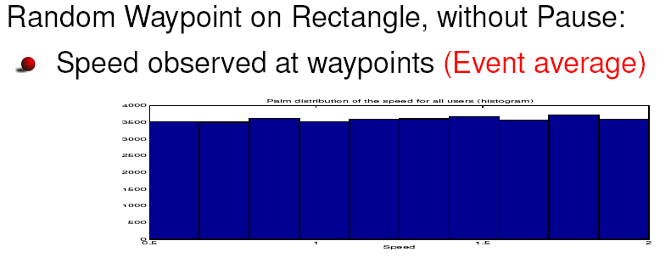
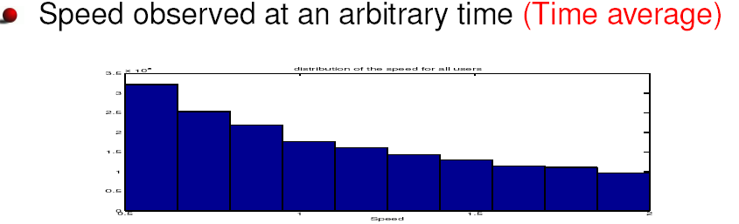
Stationary Distribution of Speed

Slide 36
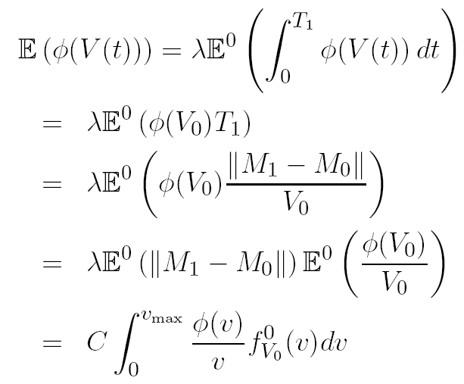
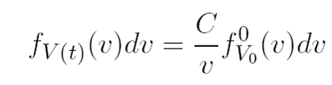
Relation between the Two Viewpoints
Inversion formula:

Slide 37
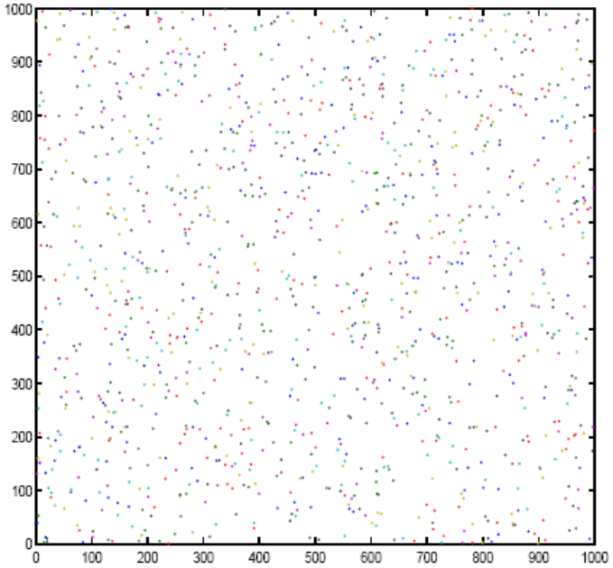
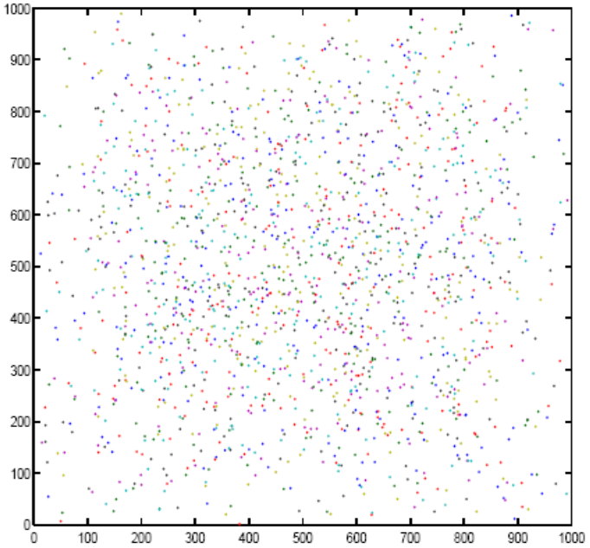
Quiz 4: Location
  X is at time 0 sec, Y at time 2000 sec
  Y is at time 0 2000 sec, Y at time 0 sec
  Both are at time 0 sec
  Both are at time 2000 sec
Time = x sec
Time = y sec

Slide 38
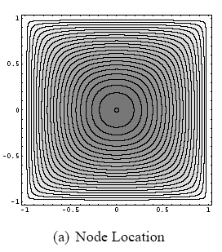
Stationary Distribution of Location
PDF f_{M(t)}(m) can be computed in closed form

Slide 39
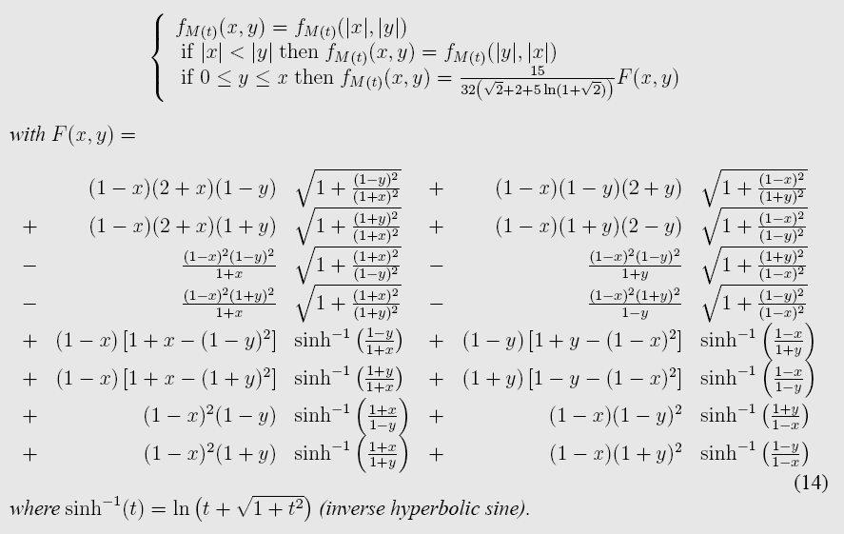
Closed Form

Slide 40
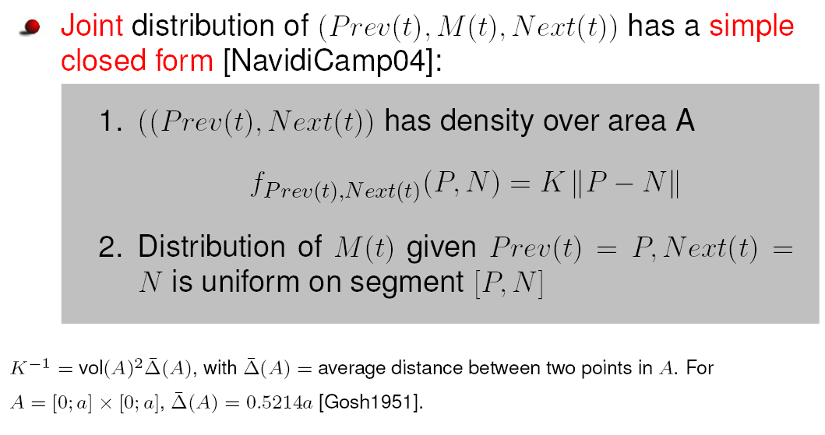
Stationary Distribution of Location Is also Obtained By Inversion Formula

Slide 41
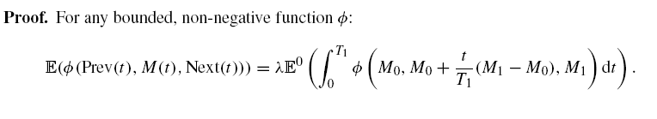
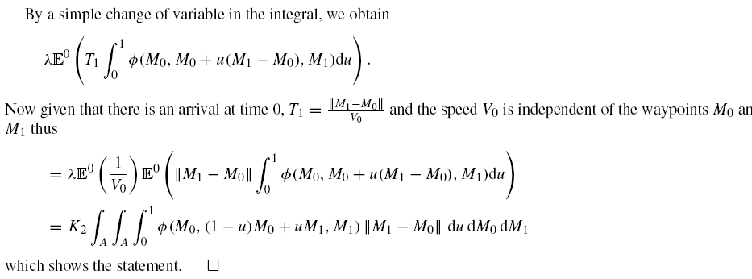

Slide 42
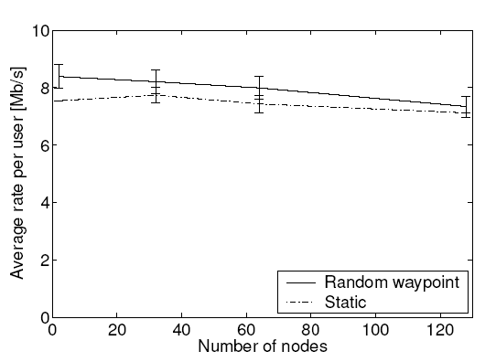
Quiz 5: Find the Cause
Throughput of UWB MAC layer is higher in mobile scenario
  It is a coding bug in the simulation program
  Mobility increases capacity
  Doppler effect increases capacity
  It is a design bug in the simulation program
Random waypoint
Static

Slide 43
Comparison is Flawed
UWB MAC adapts rate to channel state
  Wireless link is shorter in average with RWP stationary distrib
  Sample Static Case from RWP’s Stationary Distribution of location
Static, same node location as RWP
Random waypoint
Static, from uniform

Slide 44
Perfect Simulation
Definition: simulation that starts in steady state
  An alternative to removing transients
  Possible when inversion formula is tractable [L, Vojnovic, Infocom 2005]
Example : random waypoint
  Same applies to a large class of mobility models
  Applies more generally to stochastic recurrences

Slide 45
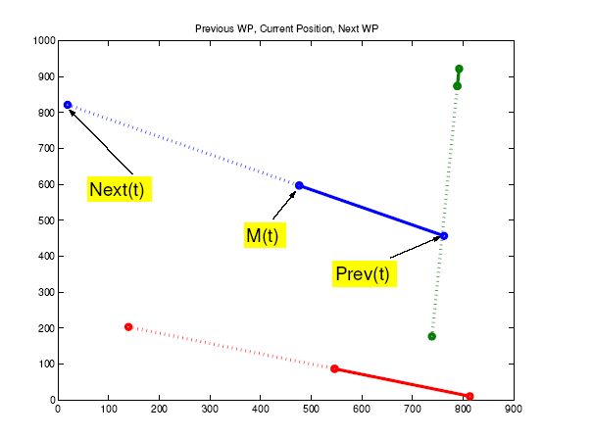
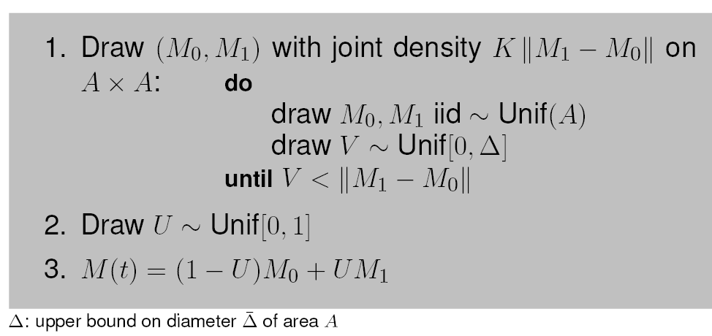
Perfect Simulation Algorithm
  Sample Prev and Next waypoints from their joint
  stationary distribution
  Sample M uniformly on segment [Prev,Next]
  Sample speed V from stationary distribution

Slide 46
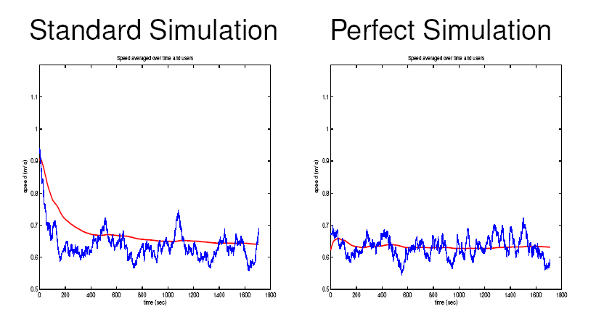
No speed decay

Slide 47
Contents
Informal Introduction
Palm Calculus
Application to Simulation
Freezing Simulations

Slide 48
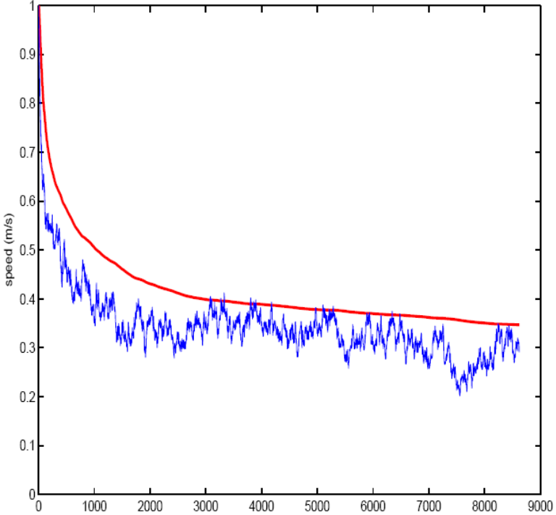
Even Stranger
Distributions do not seem to stabilize with time
  When v_{min} = 0
  Some published simulations stopped at 900 sec
900 s
100 users average
Speed (m/s)
1 user
Time (s)

Slide 49
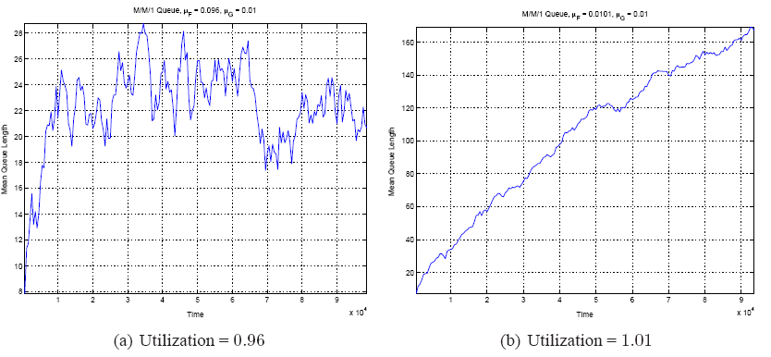
Back to Roots
The steady-state issue:
  Does the distribution of state reach some steady-state after some time?
A well known problem in queuing theory
Steady state
No steady state
(explosion)

Slide 50
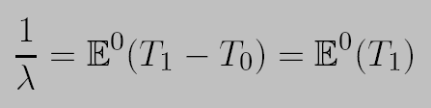
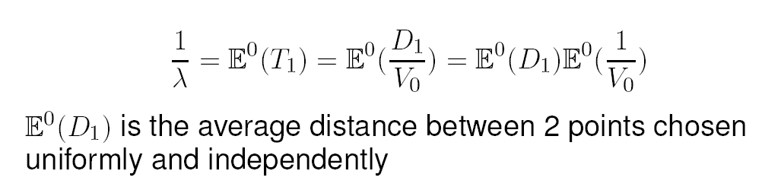
A Necessary Condition
Intensity formula
Is valid in stationary regime (like all Palm calculus)
Thus: it is necessary (for a stationary regime to exist) that the trip mean duration is finite
thus: necessary condition: E⁰(V₀) < 1

Slide 51
Conversely
The condition is also sufficient
  i.e. v_{min} > 0 implies a stationary regime
  True more generally for any stochastic recurrence

Slide 52
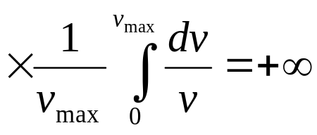
A Random waypoint model that has no stationary regime !
Assume that at trip transitions, node speed is sampled uniformly on [v_{min},v_{max}]
Take v_{min} = 0 and v_{max} > 0
Mean trip duration = (mean trip distance)
Mean trip duration is infinite !
Was often used in practice
Speed decay: “considered harmful” [YLN03]

Slide 53
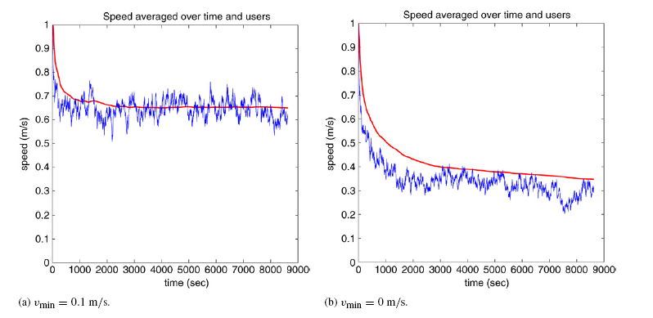
What happens when the model does not have a stationary regime ?
Blue line is one sample
Red line is estimate of E(V(t))

Slide 54
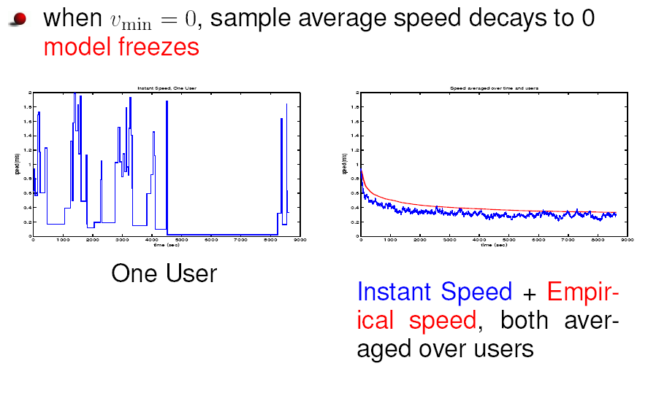
What happens when the model does not have a stationary regime ?
The simulation becomes old

Slide 55
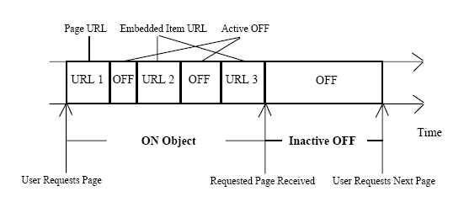
Load Simulator Surge
Barford and Crovella, Sigmetrics 98
User modelled as sequence of downloads, followed by “think time”
  A stochastic recurrence
Requested file size is Pareto, p=1 (i.e. infinite mean)
A freezing load generator !

Slide 56
Conclusions
A metric should specify the sampling method
  Different sampling methods may give very different values
Palm calculus contains a few important formulas
  Mostly can be derived heuristically
Freezing simulation is a (nasty) pattern to be aware of
  Happens when mean time to next recurrence is 1

Slide 57
ANSWERS
  1. B
  2. Stop and Go: C
  3. Gatekeeper: A
  4. Location: A
  5. Find the Cause: D

