Slide 1
A Generic Mean Field Convergence Result for Systems of Interacting Objects
From Micro to Macro
Jean-Yves Le Boudec, EPFL
Joint work with David McDonald, U. of Ottawa
and Jochen Mundinger, EPFL

Slide 2
Most of the material in this presentation is based on
J.-Y. Le Boudec, D. McDonald and J. Mundinger
A Generic Mean Field Convergence Result for Systems of Interacting Objects
4th International Conference on the Quantitative Evaluation of SysTems (QEST) 2007
this paper and this slide show are also available from my web page

Slide 3
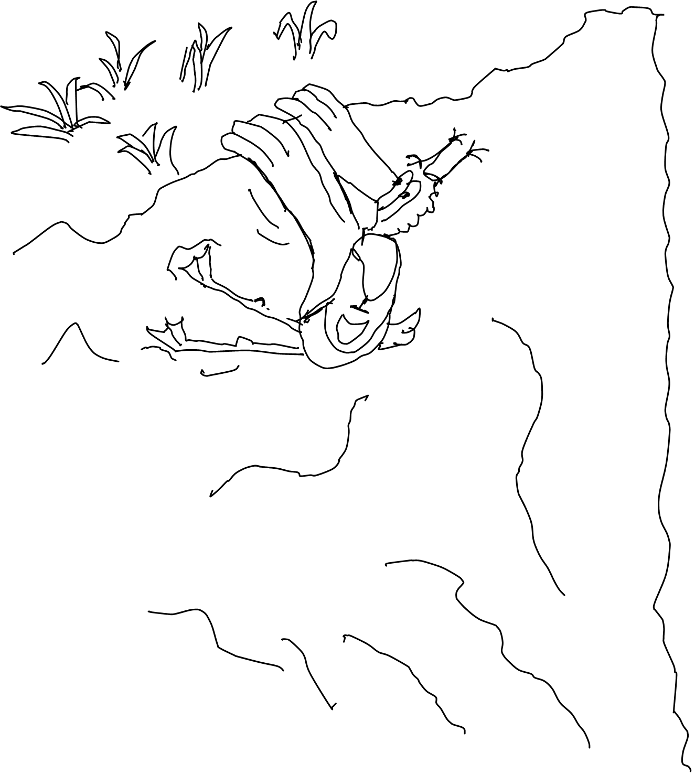
Contents
Motivation
A Generic Model for a System of Interacting Objects
Convergence to the Mean Field
Fast Simulation
E.L.

Slide 4
Goal of this Research
Find re-usable approximations of large scale systems

Slide 5
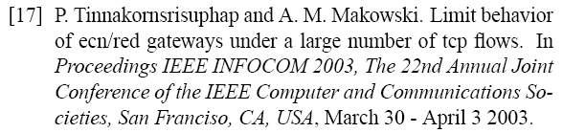
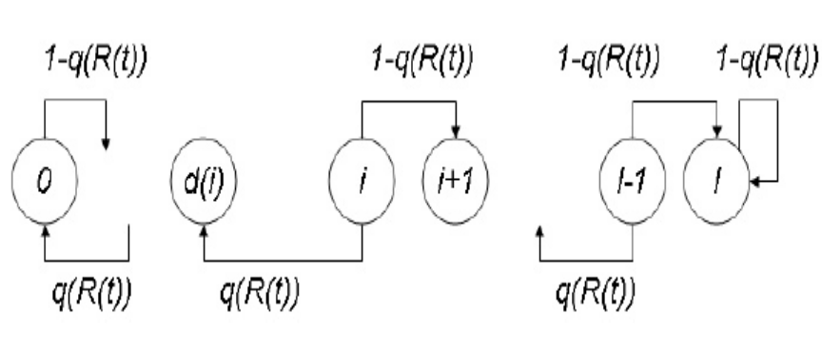
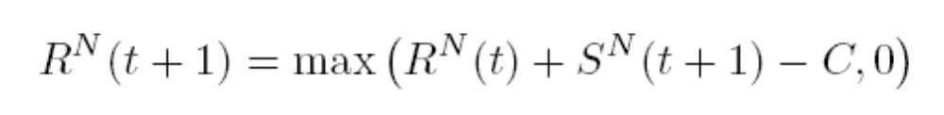

Motivating Example : ECN/TCP Gateways
ECN Feedback q(R(t))
N
connections
ECN router
queue length R(t)
connection i
rate s_{i}
System Equations: (time is discrete):
  Every connection runs a Markov chain ; q(R(t)) is marking function
  The transition probabilities of the Markov chain depends on R(t)
  let M^{N}_{i}(t) = nb of connections in state i at time t
no ECN received
ECN received

Slide 6
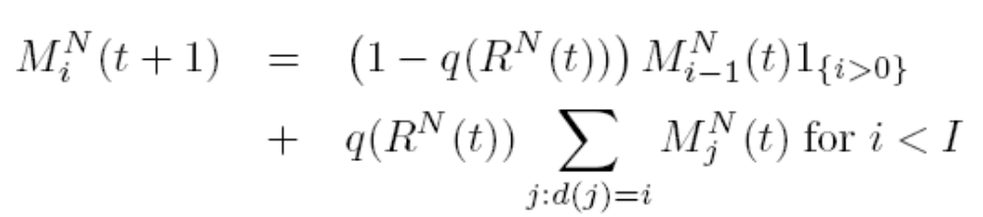
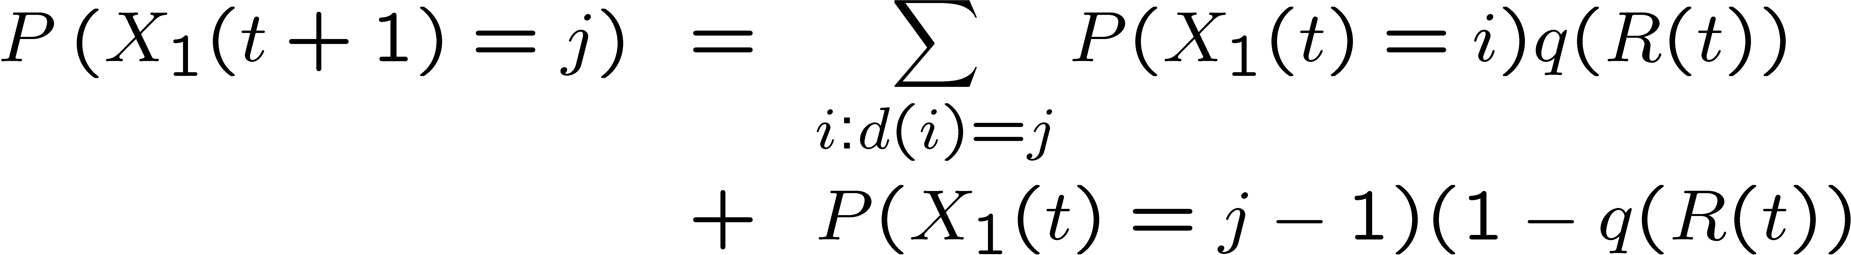
Mean Field Approximations
  M^{N}_{i}(t) = nb of connections in state i at time t
A fluid approximation is
  This gives a deterministic equation (macro)
  This is in fact the “mean field equation”
  When is it valid ?
Mean field approximation for one connection is
  i.e. pretend X₁(t) and R(t) are independent
ECN Feedback q(R(t))
N
connections
ECN router
queue length R(t)
connection i
rate s_{i}

Slide 7
Contents
Motivation
A Generic Model for a System of Interacting Objects
Convergence to the Mean Field
Fast Simulation
E.L.

Slide 8

2. Mean Field Interaction Model
A Generic Model, with generic results
Time is discrete
N objects
Every object has a state in .
Mean field approx reduces size of model from S^{N} to S
Informally: object n evolves depending only on
  Its own state
  How many other objects are in each state

Slide 9
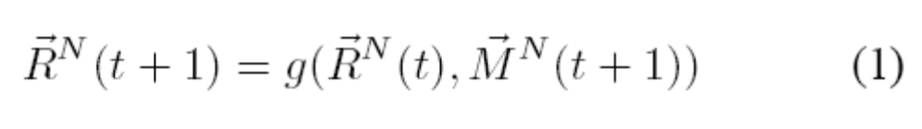
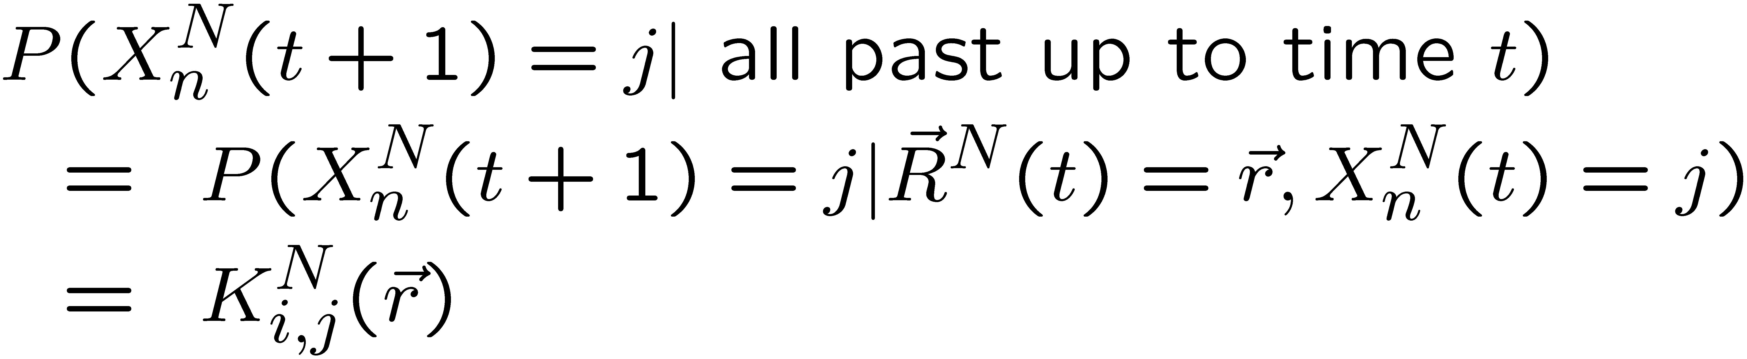
Model assumptions:
X^{N}_{n}(t) : state of object n at time t
M^{N}_{i}(t) = proportion of objects that are in state i
M^{N} is the “occupancy measure”
R^{N}(t) = “history” of occupancy measure
Conditional to history up to time t, objects draws next state independent of each other according to

Slide 10
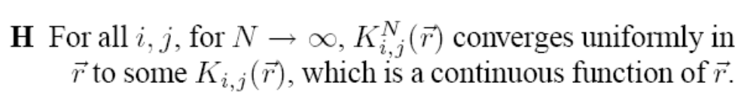
Two Mild Hypotheses
g() is continuous

Slide 11
Back to our example
ECN Feedback q(R(t))
no ECN received
N
connections
ECN router
ECN received
queue length R(t)
connection i
rate s_{i}
One object = one TCP connection
  State = sending rate
  Next state depends only on current state + value of R(t)
  Evolution of R(t) depends only on how many objects are in each state
  Fits in our framework if q() is continuous

Slide 12
The Model supports Heterogeneous (Multiclass) Settings
Same as previous but introduce multiclass model
Aggressive connections, normal connection
State of an object = (c, i)
  c : class
  i : sending rate
Objects may change class or not
Also fits in our framework
Mean Field does not mean all objects are exchangeable !

Slide 13
Contents
Motivation
A Generic Model for a System of Interacting Objects
Convergence to the Mean Field
Fast Simulation
E.L.

Slide 14
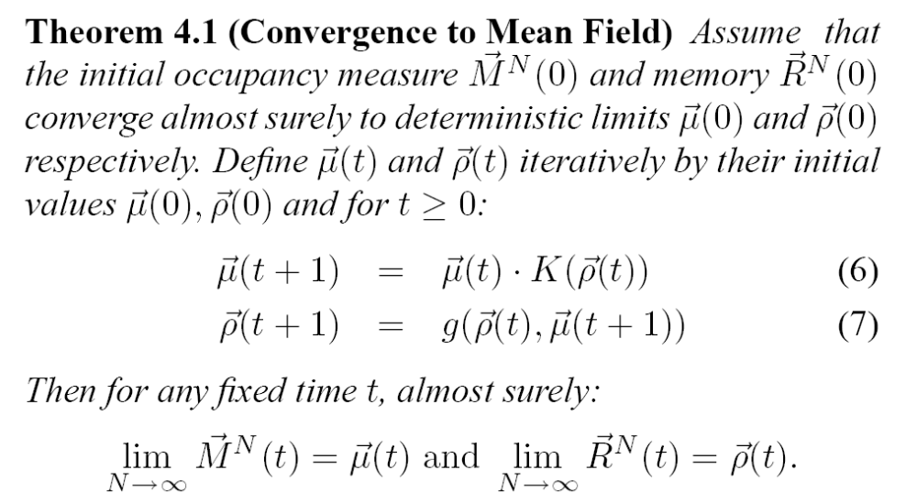
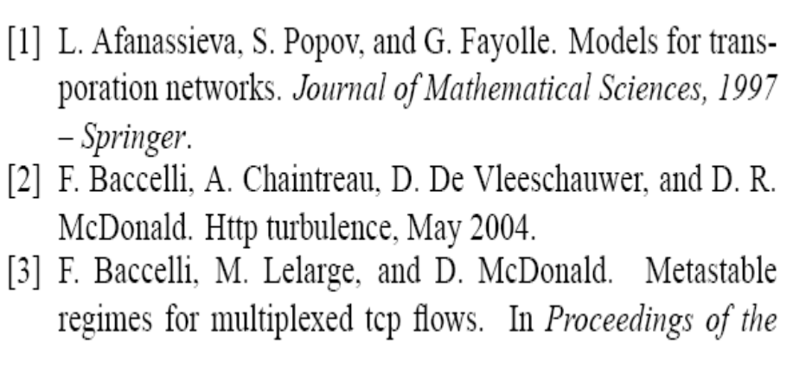
  A slightly weaker form was proven in many references mentioned in particular
  A close, continuous time cousin is in

Slide 15
Practical Application
This replaces the stochastic system by a deterministic, dynamical system
This justifies the mean field equation (“fluid approximation”) in the large N regime

Slide 16
Contents
Motivation
A Generic Model for a System of Interacting Objects
Convergence to the Mean Field
Fast Simulation
E.L.

Slide 17
Fast Simulation / Analysis of One Object
Assume we are interested in one object in particular
  E.g. distribution of time until a TCP connection reaches maximum rate
  Time until a peer receives complete video
For large N, since mean field convergence holds, one may forget the details of the states of all other objects and replace them by the deterministic dynamical system
The next theorem says that, essentially, this is valid

Slide 18
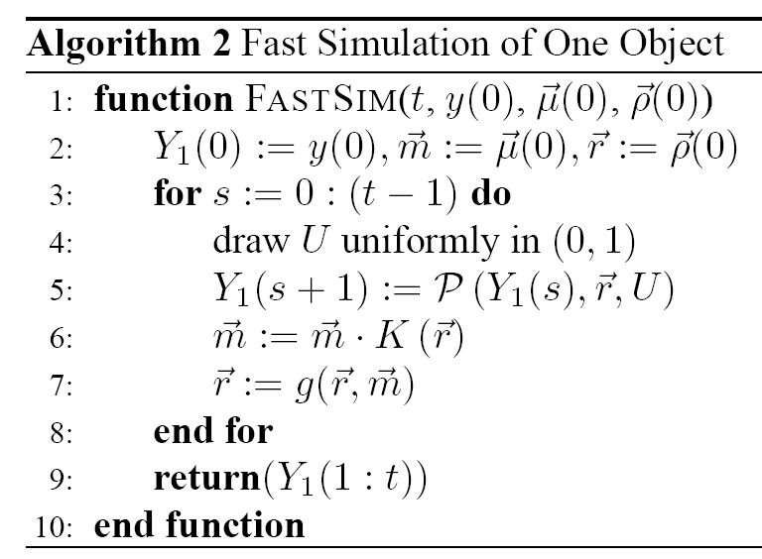
Fast Simulation Algorithm
State of one specific object
Returns next state for one object
When transition matrix is K
Replace true value by deterministic
limit
This is the mean field independence
approximation

Slide 19
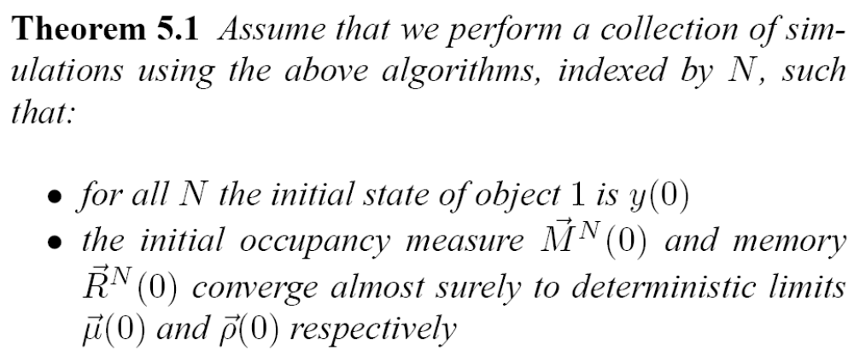
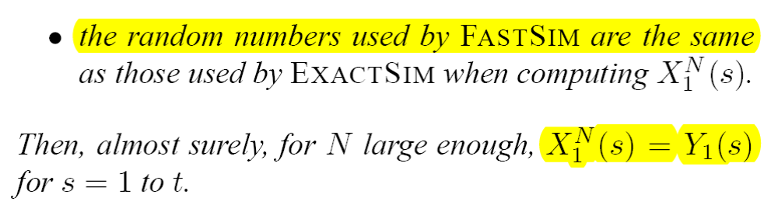
Fast Simulation Result

Slide 20
Practical Application
This justifies the mean field approximation (based on the independence assumption) for the stochastic state of one object as a large N asymptotic
Gives a method for fast simulation or analysis
  The state space for Y₁ has S states, instead of S^{N}

Slide 21
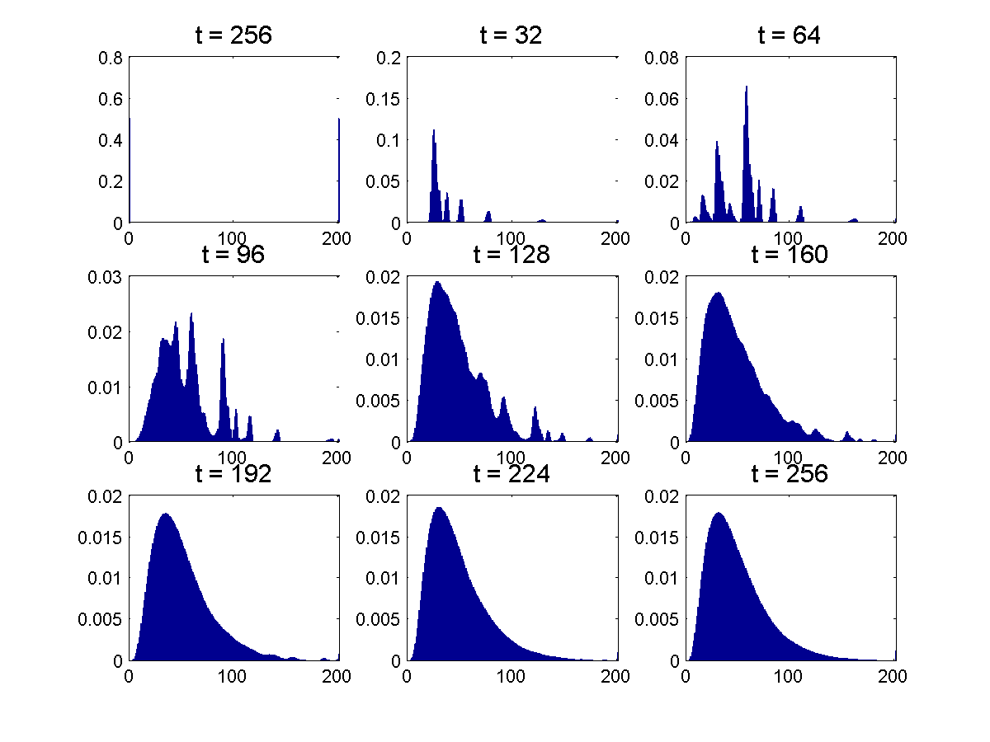
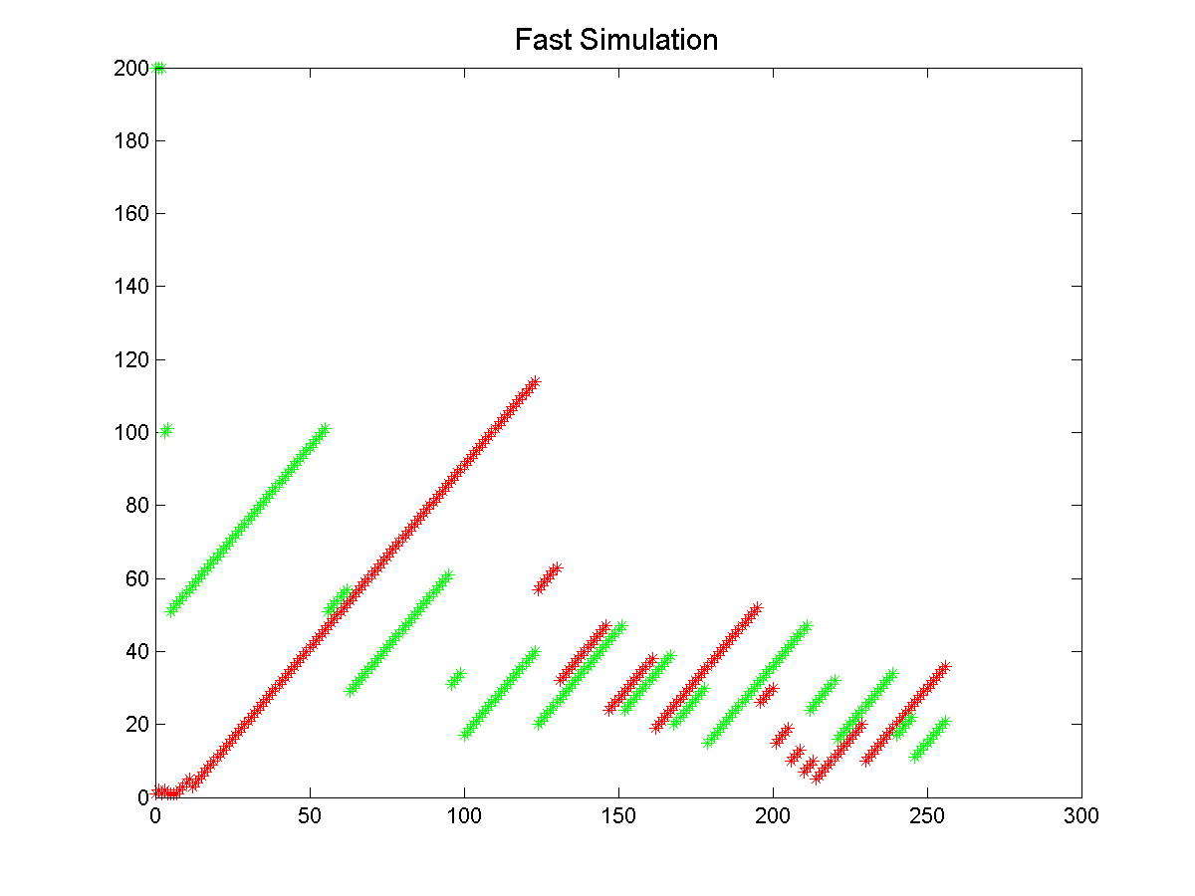
Example
ECN Feedback q(R(t))
N
connections
ECN router
queue length R(t)
connection i
rate s_{i}
X₁(t)
X₂(t)
1. Mean field equation
(fluid approximation)
2. Fast simulation of 2 TCP connections

Slide 22
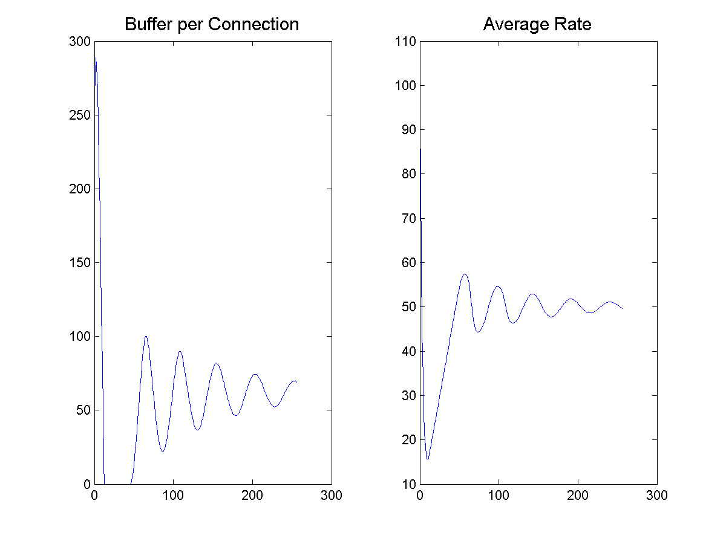
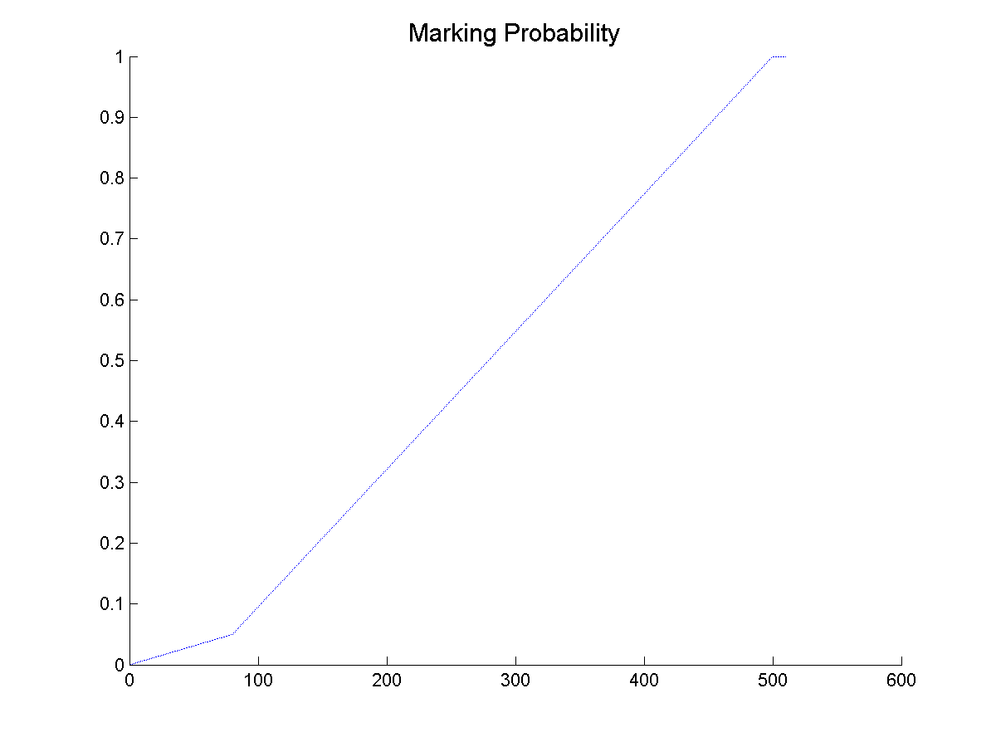

Slide 23
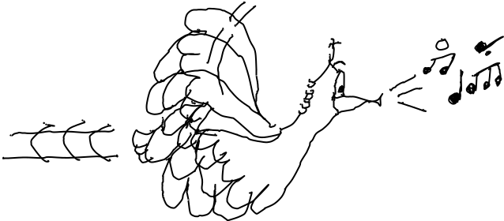
Conclusion
A generic model where the following holds
  fluid approximation (convergence to mean field)
  fast simulation (mean field approximation)
There are also finer approximations (central limit theorem based gaussian approximations)
Provides a powerful tool to analyze large scale systems
Further work: Extend the modelling framework to:
  birth and death of objects
  transitions that affect several objects simultaneously
  enumerable but infinite set of states
E. L.

