Slide 1
Mean Field Methods for Computer and Communication Systems
Jean-Yves Le Boudec
EPFL
July 2010

Slide 2
Contents
Mean Field Interaction Model
The Mean Field Limit
Convergence to Mean Field
The Decoupling Assumption
Optimization

Slide 3
Mean Field Interaction Model: Common Assumptions
Time is discrete or continuous
N objects
Object n has state X_{n}(t)
(X^{N}₁(t), …, X^{N}_{N}(t)) is Markov => M^{N}(t) = occupancy measure process is also Markov
Objects can be observed only through their state
N is large
Called “Mean Field Interaction Models” in the Performance Evaluation community [McDonald(2007), Benaïm and Le Boudec(2008)]

Slide 4
Intensity I(N)
I(N) = expected number of transitions per object per time unit
The mean field limit occurs when we re-scale time by I(N) i.e. we consider X^{N}(t/I(N))
In discrete time
I(N) = O(1): mean field limit is in discrete time
I(N) = O(1/N): mean field limit is in continuous time

Slide 5
Example: 2-Step Malware
Mobile nodes are either
`S’ Susceptible
`D’ Dormant
`A’ Active
Time is discrete
Nodes meet pairwise (bluetooth)
One interaction per time slot, I(N) = 1/N; mean field limit is an ODE
State space is finite = {`S’ , `A’ ,`D’}
Occupancy measure is M(t) = (S(t), D(t), A(t)) with S(t)+ D(t) + A(t) =1
S(t) = proportion of nodes in state `S’ [Benaïm and Le Boudec(2008)]
Possible interactions:
Recovery
D -> S
Mutual upgrade
D + D -> A + A
Infection by active
D + A -> A + A
Recovery
A -> S
Recruitment by Dormant
S + D -> D + D
Direct infection
S -> D
Direct infection
S -> A

Slide 6
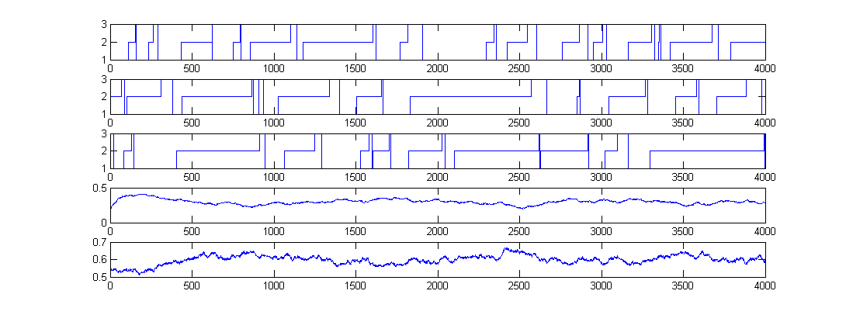
Simulation Runs, N=1000 nodes
Node 1
State = D
State = A
State = S
Node 2
Node 3
D(t)
Proportion of nodes
In state i=1
A(t)
Proportion of nodes
In state i=2

Slide 7
Sample Runs with N = 1000

Slide 8
Example: WiFi Collision Resolution Protocol
N nodes, state = retransmission stage k
Time is discrete, I(N) = 1/N; mean field limit is an ODE
Occupancy measure is M(t) = [M₀(t),...,M_{K}(t)] with M_{k}(t) = proportion of nodes at stage k
[Bordenave et al.(2008)Bordenave, McDonald, and Proutiere, Bordenave et al.(2007)Bordenave, McDonald, and Proutiere]

Slide 9
Example: HTTP Metastability
N flows between hosts and servers
Flow n is OFF or ON
Time is discrete, occupancy measure = proportion of ON flows
At every time step, every flow switches state with proba matrix that depends on the proportion of ON flows
I(N) = 1; Mean field limit is an iterated map (discrete time)
[Baccelli et al.(2004)Baccelli, Lelarge, and McDonald]
Other Examples where the mean field limit is in discrete time:
TCP flows with a buffer in [Tinnakornsrisuphap and Makowski(2003)]
Reputation System in [Le Boudec et al.(2007)Le Boudec, McDonald, and Mundinger]

Slide 10
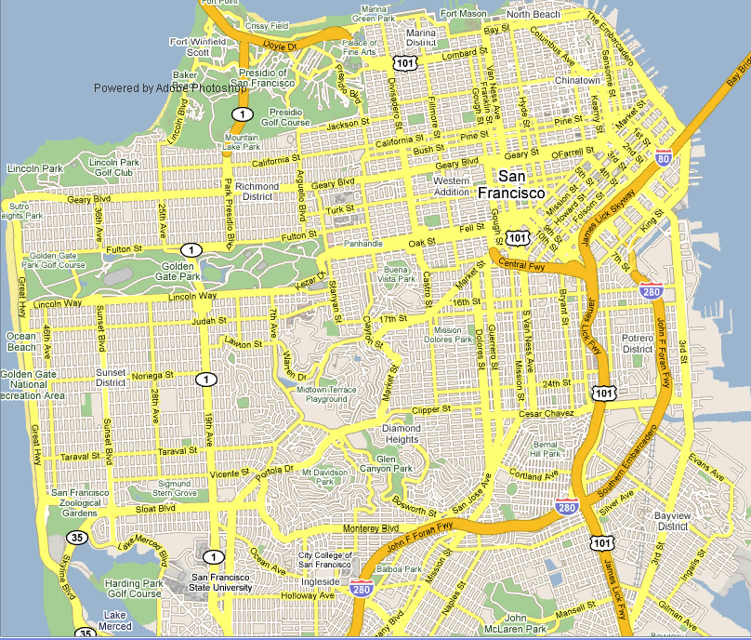
Example: Age of Gossip

Slide 11
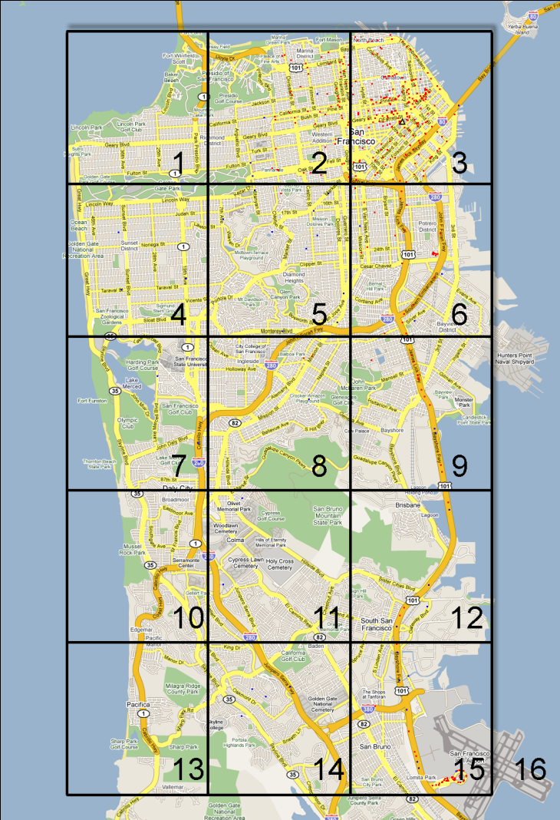
Example: Age of Gossip
Mobile node state = (c, t) c = 1 … 16 (position)
t ∊ R⁺ (age)
Time is continuous, I(N) = 1
Occupancy measure is F_{c}(z,t) = proportion of nodes that at location c and have age ≤ z [Chaintreau et al.(2009)Chaintreau, Le Boudec, and Ristanovic]

Slide 12
Extension to a Resource
Model can be complexified by adding a global resource R(t)
Slow: R(t) is expected to change state at the same rate I(N) as one object -> call it an object of a special class
Fast: R(t) is change state at the aggregate rate N I(N) -> requires special extensions of the theory
[Bordenave et al.(2007)Bordenave, McDonald, and Proutiere] [Benaïm and Le Boudec(2008)]

Slide 13

Contents
Mean Field Interaction Model
The Mean Field Limit
Convergence to Mean Field
The Decoupling Assumption
Optimization

Slide 14
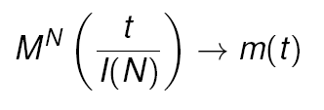
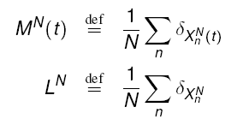
The Mean Field Limit
Under very general conditions (given later) the occupancy measure converges, in some sense, to a deterministic process, m(t), called the mean field limit
[Graham and Méléard(1994)] consider the occupancy measure L^{N} in path space

Slide 15
Mean Field Limit
N = +∞
Stochastic
system
N = 1000

Slide 16
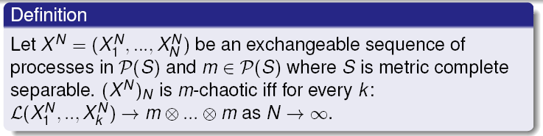
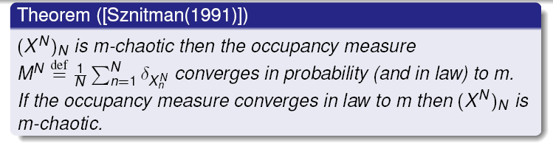
Propagation of Chaos is Equivalent to Convergence to a Deterministic Limit

Slide 17
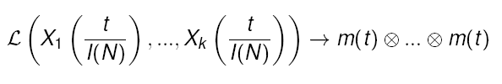
Propagation of Chaos Decoupling Assumption
(Propagation of Chaos) If the initial condition (X^{N}_{n} (0))_{n=1…N} is exchangeable and there is mean field convergence then the sequence (X^{N}_{n})_{n=1…N} indexed by N is m-chaotic k objects are asymptotically independent with common law equal to the mean field limit, for any fixed k
(Decoupling Assumption) (also called Mean Field Approximation, or Fast Simulation) The law of one object is asymptotically as if all other objects were drawn randomly with replacement from m(t)

Slide 18
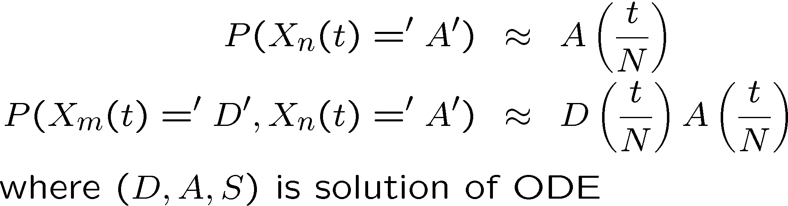
Example: Propagation of Chaos
At any time t
Thus for large t :
Prob (node n is dormant) ≈ 0.3
Prob (node n is active) ≈ 0.6
Prob (node n is susceptible) ≈ 0.1

Slide 19
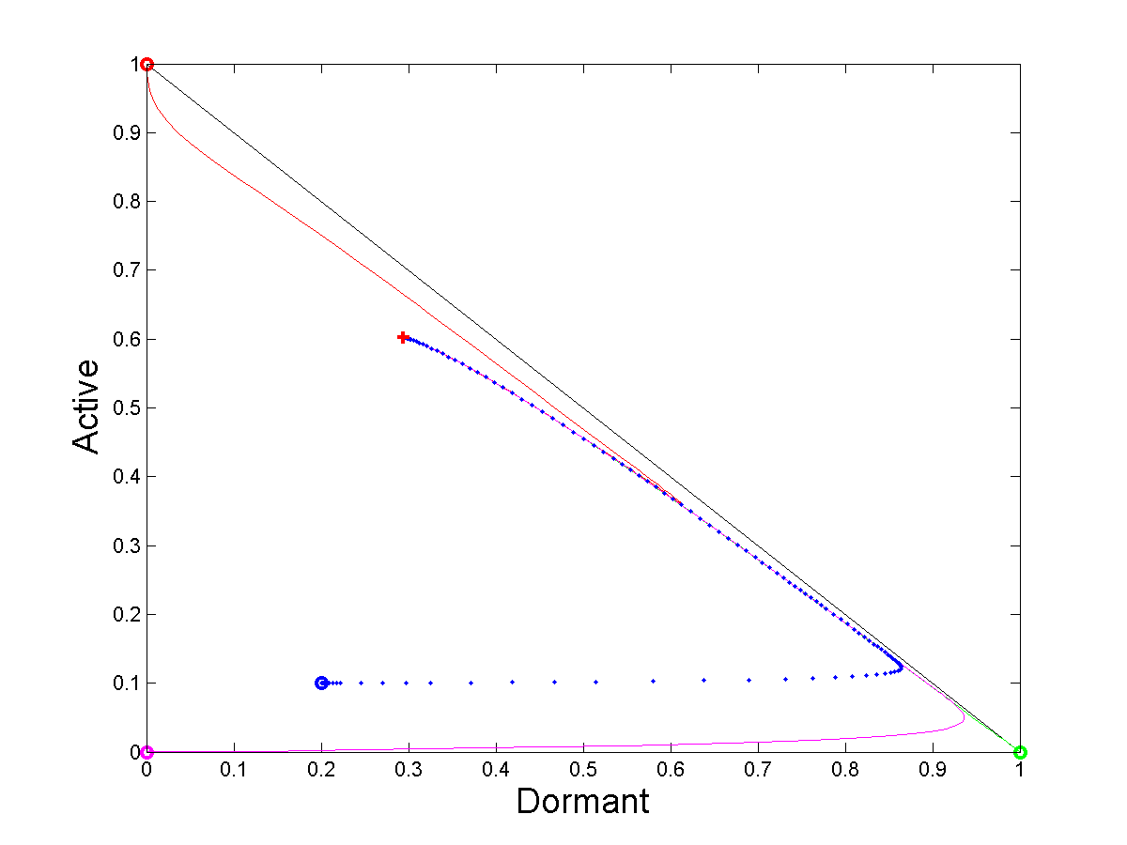


Example: Decoupling Assumption
Let p^{N}_{j}(t|i) be the probability that a node that starts in state i is in state j at time t:
The decoupling assumptions says that
where p(t|i) is a continuous time, non homogeneous process
pdf of node 2
occupancy measure
μ(t)
pdf of node 3
pdf of node 1

Slide 20
The Two Interpretations of the Mean Field Limit
m(t) is the approximation for large N of
the occupancy measure M^{N}(t)
the state probability for one object at time t

Slide 21
Contents
Mean Field Interaction Model
The Mean Field Limit
Convergence to Mean Field
The Decoupling Assumption
Optimization

Slide 22


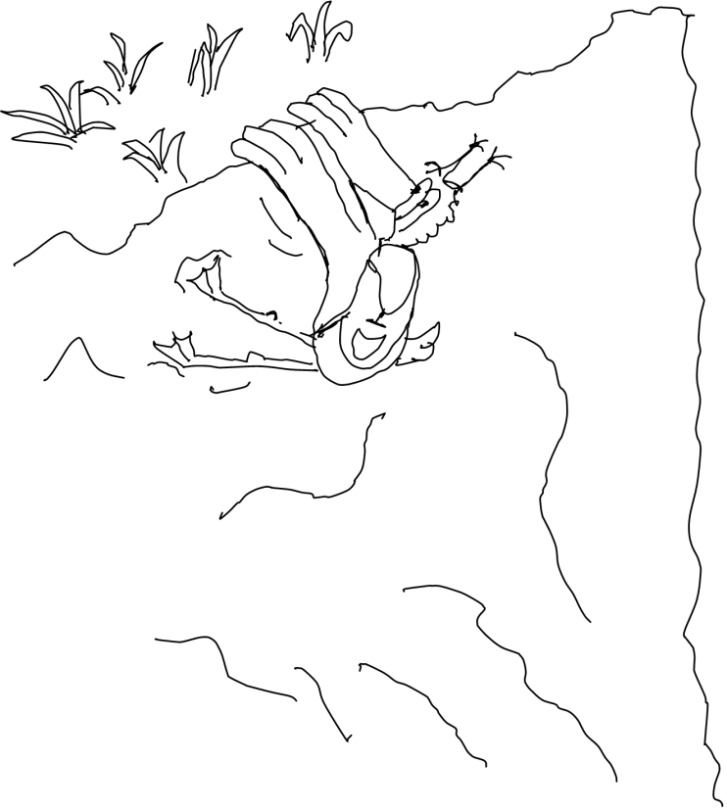
The General Case
Convergence to the mean field limit is very often true
A general method is known [Sznitman(1991)]:
Describe original system as a markov system; make it a martingale problem, using the generator
Show that the limiting problem is defined as a martingale problem with unique solution
Show that any limit point is solution of the limitingmartingale problem
Find some compactness argument (with weak topology)
Requires knowing [Ethier and Kurtz(2005)]
Never again !

Slide 23
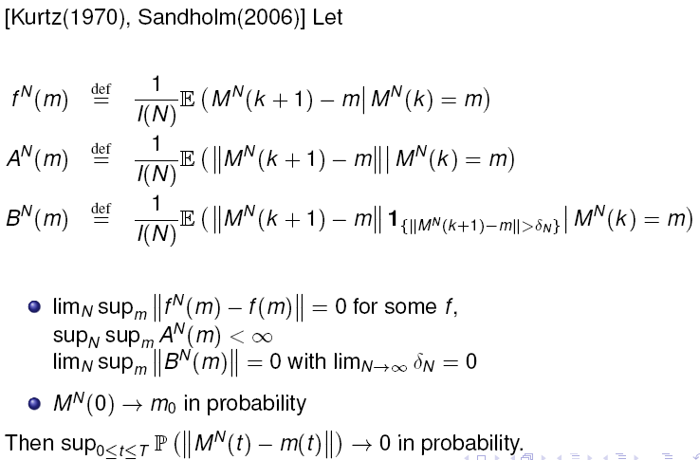
Kurtz’s Theorem
Original Sytem is in discrete time and I(N) -> 0; limit is in continuous time
State space for one object is finite

Slide 24
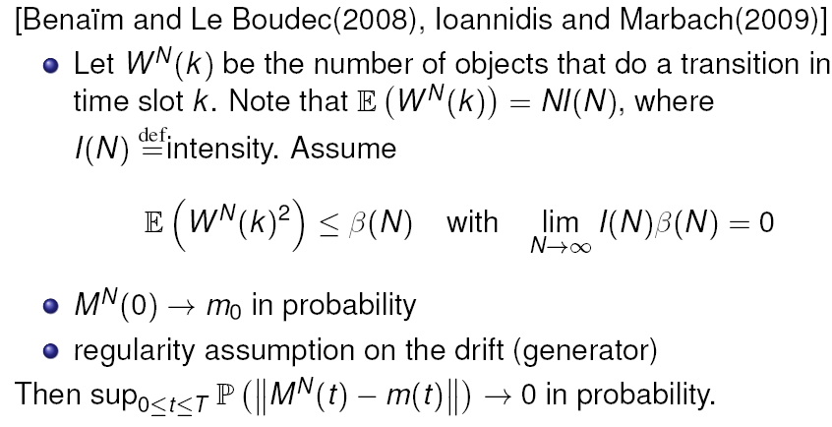
Discrete Time, Finite State Space per Object
Refinement + simplification, with a fast resource
When limit is non continuous:

Slide 25
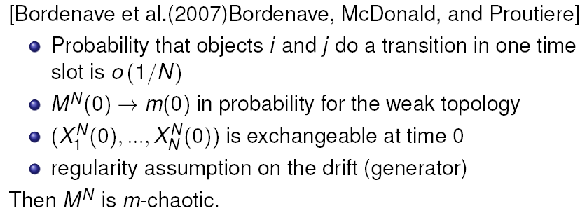
Discrete Time, Enumerable State Space per Object
State space is enumerable with discrete topology, perhaps infinite; with a fast resource
Essentially : same as previous plus exchangeability at time 0

Slide 26
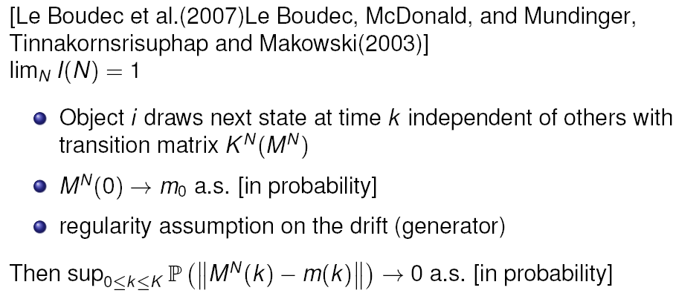
Discrete Time, Discrete Time Limit
Mean field limit is in discrete time

Slide 27
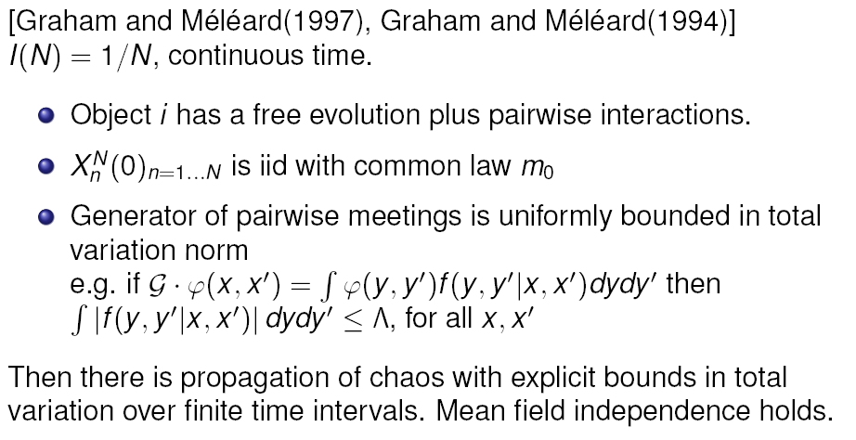
Continuous Time
« Kurtz’s theorem » also holds in continuous time (finite state space)
Graham and Méléard: A generic result for general state space (in particular non enumerable).

Slide 28
Age of Gossip
[Graham and Méléard 1997] applies, i.e. mean field convergence occurs for iid initial conditions
[Chaintreau et al.(2009)Chaintreau, Le Boudec, and Ristanovic] shows more, i.e. weak convergence of initial condition suffices
Important for non stationary cases
Every taxi has a state
Position in area c = 0 … 16
Age of last received information

Slide 29
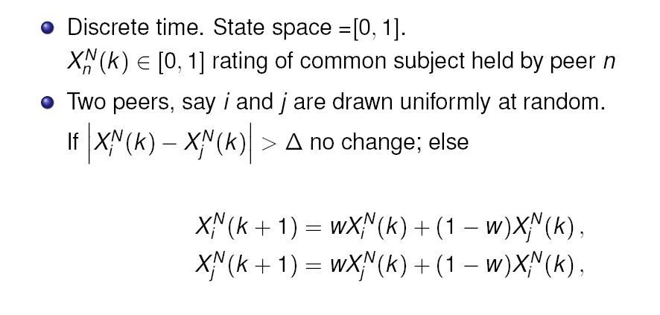
The Bounded Confidence Model
Introduced in [Deffuant et al (2000)], used in mobile networks in [Buchegger and Le Boudec 2002]; Proof of convergence to Mean Field in [Gomez, Graham, Le Boudec 2010]

Slide 30
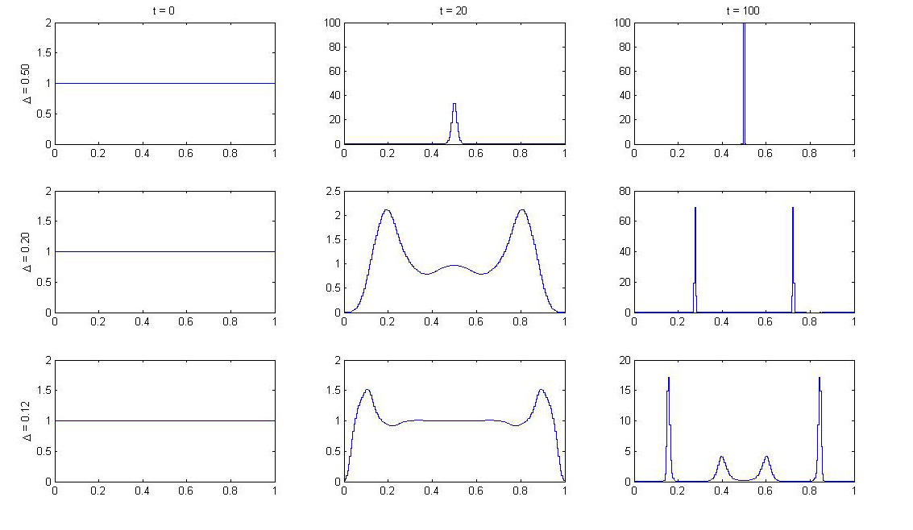
PDF of Mean Field Limit

Slide 31
Is There Convergence to Mean Field ?
Intuitively, yes
Discretized version of the problem:
Make set of ratings discrete
Generic results apply: number of meetings is upper bounded by 2
There is convergence for any initial condition such that M^{N}(0) -> m₀
This is what matlab does.
However, there can be no similar result for the real version of the problem
There are some initial conditions such that M^{N}(0) -> m₀ while there is not convergence to the mean field
There is convergence to mean field if initial condition is iid from m₀

Slide 32
Contents
Mean Field Interaction Model
The Mean Field Limit
Convergence to Mean Field
Writing the Fluid Equations
The Decoupling Assumption
Optimization

Slide 33
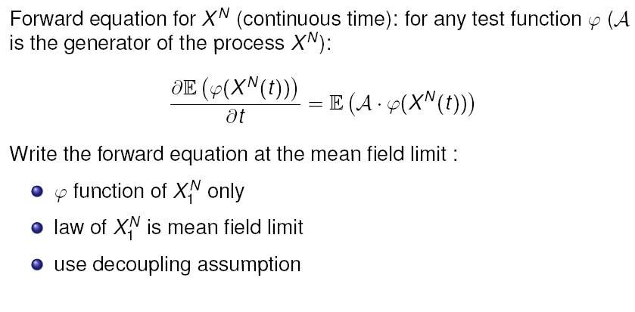
Mean Field Assumption Helps Write the Mean Field Equation
Writing the equations of the mean field limit is simple, though sometimes done with errors
Ex: [Deffuant et al.(2000)Deffuant, Neau, Amblard, and Weisbuch]
This is « micro to macro »

Slide 34
Contents
Mean Field Interaction Model
The Mean Field Limit
Convergence to Mean Field
The Decoupling Assumption
Optimization

Slide 35
Decoupling Assumption
Is true when mean field convergence holds, i.e. almost always
It is often used in stationary regime

Slide 36
Example
In stationary regime:
Prob (node n is dormant) ≈ 0.3
Prob (node n is active) ≈ 0.6
Prob (node n is susceptible) ≈ 0.1
Nodes m and n are independent
We are in the good case: the diagram commutes
t -> +1
Law of M^{N}(t)
ϖ^{N}
N -> +1
N -> +1
δ_{μ(t)}
δ_{m*}
t -> +1

Slide 37
Counter-Example
The ODE does not converge to a unique attractor (limit cycle)
Assumption H does not hold; does the decoupling assumption still hold ?
Same as before
Except for one parameter value
h = 0.1 instead of 0.3

Slide 38
Decoupling Assumption Does Not Hold Here In Stationary Regime
In stationary regime, m(t) = (D(t), A(t), S(t)) follows the limit cycle
Assume you are in stationary regime (simulation has run for a long time) and you observe that one node, say n=1, is in state ‘A’
It is more likely that m(t) is in region R
Therefore, it is more likely that some other node, say n=2, is also in state ‘A’
This is synchronization
R

Slide 39
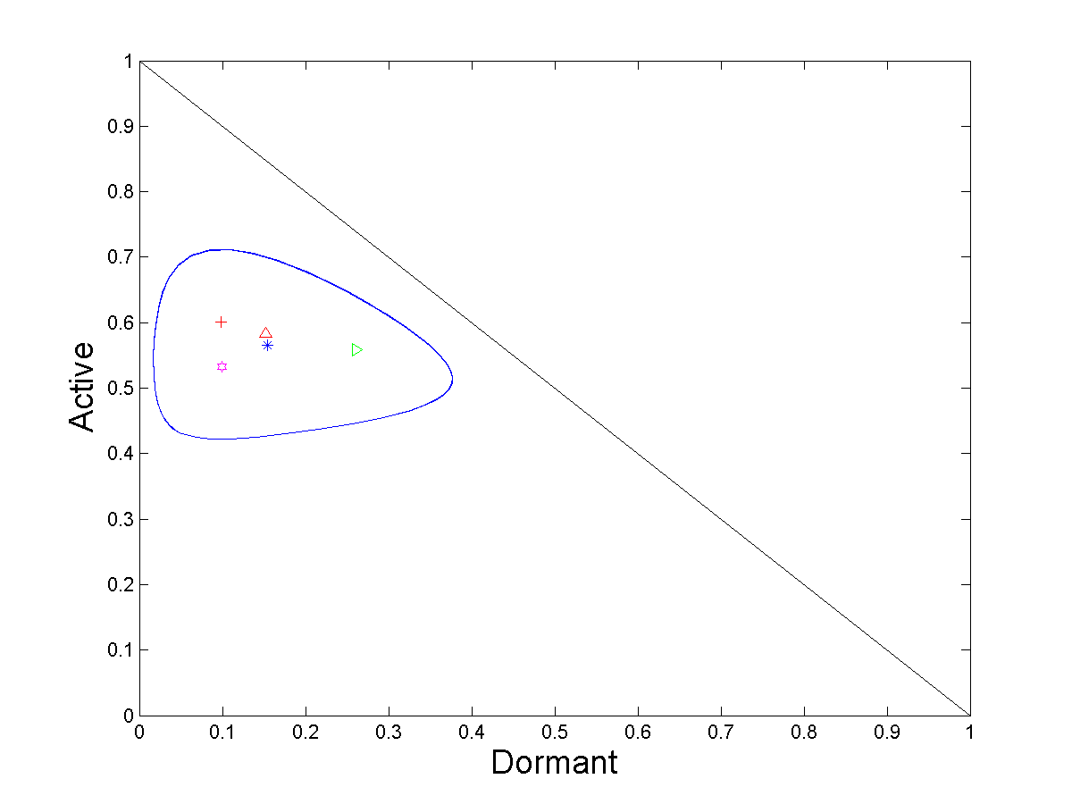
Numerical Example
Stationary point of ODE
Mean of Limit of ϖ^{N} = pdf of one node in stationary regime
pdf of node 2 in stationary regime, given node 1 is A
pdf of node 2 in stationary regime, given node 1 is D
pdf of node 2 in stationary regime, given node 1 is S

Slide 40
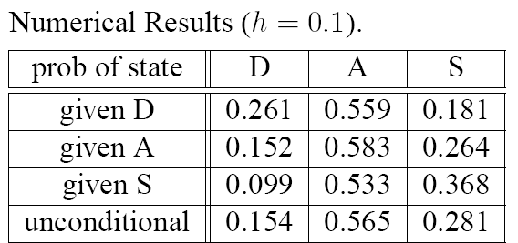

Slide 41
Where is the Catch ?
Fluid approximation and fast simulation result say that nodes m and n are asymptotically independent
But we saw that nodes may not be asymptotically independent
… is there a contradiction ?

Slide 42
The Diagram Does Not Commute
For large t and N: where T is the period of the limit cycle

Slide 43
Generic Result for Stationary Regime
Original system (stochastic):
(X^{N}(t)) is Markov, finite, discrete time
Assume it is irreducible, thus has a unique stationary proba ν^{N}
Let ϖ^{N} be the corresponding stationary distribution for M^{N}(t), i.e. P(M^{N}(t)=(x₁,…,x_{I})) = ϖ^{N}(x₁,…,x_{I}) for x_{i} of the form k/n, k integer
Theorem [Benaim] Birkhoff Center: closure of set of points s.t. m∊ ω(m) Omega limit: ω(m) = set of limit points of orbit starting at m

Slide 44
Here: Birkhoff center = limit cycle  fixed point
The theorem says that the stochastic system for large N is close to the Birkhoff center, i.e. the stationary regime of ODE is a good approximation of the stationary regime of stochastic system

Slide 45
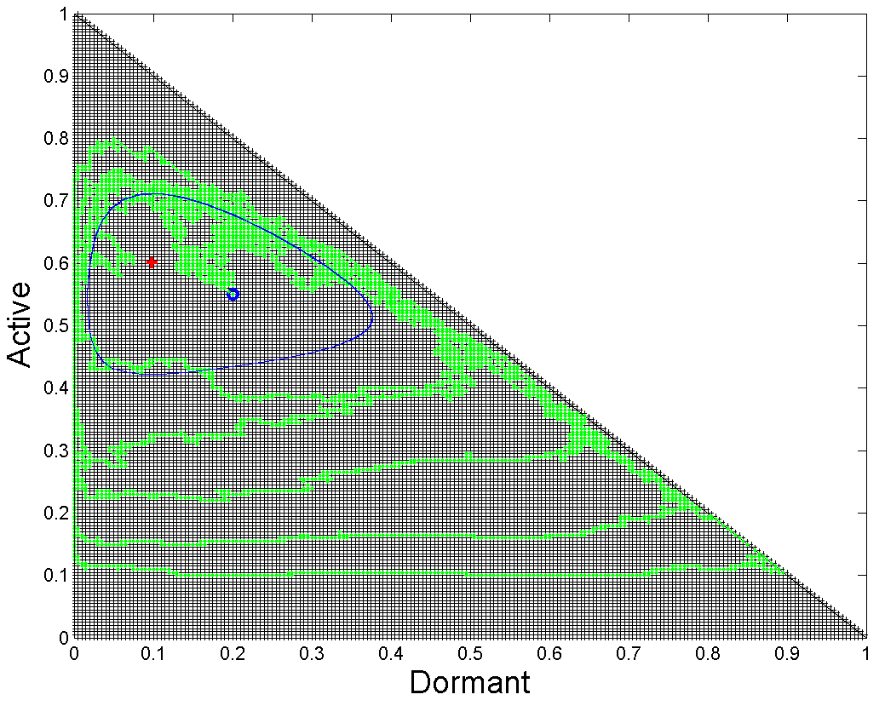
Quiz
M^{N}(t) is a Markov chain on E={(a, b, c) ¸ 0, a + b + c =1, a, b, c multiples of 1/N}
A. M^{N}(t) is periodic, this is why there is a limit cycle for large N.
B. For large N, the stationary proba of M^{N} tends to be concentrated on the blue cycle.
C. For large N, the stationary proba of M^{N} tends to a Dirac.
D. M^{N}(t) is not ergodic, this is why there is a limit cycle for large N.
E (for N = 200)

Slide 46
Decoupling Assumption in Stationary Regime Holds under (H)
For large N the decoupling assumption holds at any fixed time t
It holds in stationary regime under assumption (H)
(H) ODE has a unique global stable point to which all trajectories converge
Otherwise the decoupling assumption may not hold in stationary regime
It has nothing to do with the properties at finite N
In our example, for h=0.3 the decoupling assumption holds in stationary regime
For h=0.1 it does not
Study the ODE !

Slide 47
Existence and Unicity of a Fixed Point are not Sufficient for Validity of Fixed Point Method
Essential assumption is
(H) μ(τ) converges to a unique m*
It is not sufficient to find that there is a unique stationary point, i.e. a unique solution to F(m*)=0
Counter Example on figure
(X^{N}(t)) is irreducible and thus has a unique stationary probability η^{Ν}
There is a unique stationary point ( = fixed point ) (red cross)
F(m*)=0 has a unique solution
but it is not a stable equilibrium
The fixed point method would say here
Prob (node n is dormant) ≈ 0.1
Nodes are independent
… but in reality
We have seen that nodes are not independent, but are correlated and synchronized

Slide 48
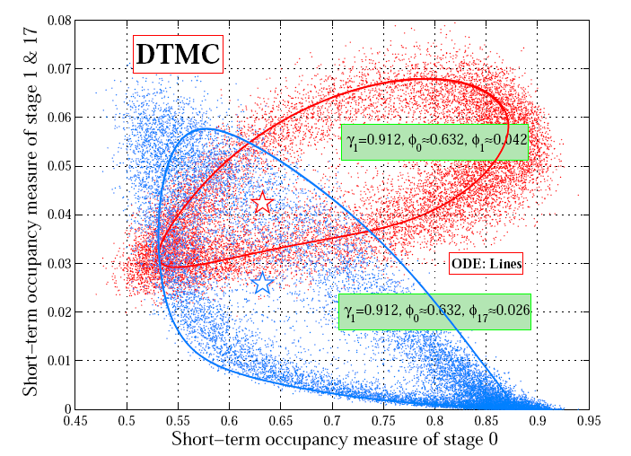
Example: 802.11 with Heterogeneous Nodes
[Cho2010] Two classes of nodes with heterogeneous parameters (restransmission probability) Fixed point equation has a unique solution There is a limit cycle

Slide 49
Contents
Mean Field Interaction Model
The Mean Field Limit
Convergence to Mean Field
The Decoupling Assumption
Optimization

Slide 50
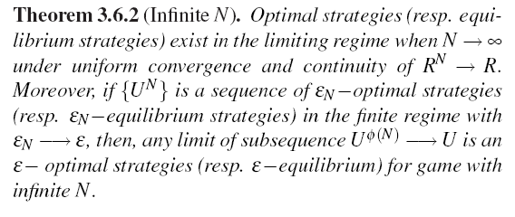
Decentralized Control
Game Theoretic setting; N players, each player has a class, each class has a policy; each player also has a state;
Set of states and classes is fixed and finite
Time is discrete; a number of players plays at any point in time.
Assume similar scaling assumptions as before.
[Tembine et al.(2009)Tembine, Le Boudec, El-Azouzi, and Altman] For large N the game converges to a single player game against a population;

Slide 51
Centralized Control
[Gast et al.(2010)Gast, Gaujal, and Le Boudec]
Markov decision process
Finite state space per object, discrete time, N objects
Transition matrix depends on a control policy
For large N the system without control converges to mean field
Mean field limit
ODE driven by a control function
Theorem: under similar assumptions as before, the optimal value function of MDP converges to the optimal value of the limiting system
The result transforms MDP into fluid optimization, with very different complexity

Slide 52
Conclusion
Mean field models are frequent in large scale systems
Writing the mean field equations is simple and provides a first order approximation
Mean field is much more than a fluid approximation: decoupling assumption / fast simulation
Decoupling assumption in stationary regime is not necessarily true.
Mean field equations may reveal emerging properties
Control on mean field limit may give new insights

Slide 53
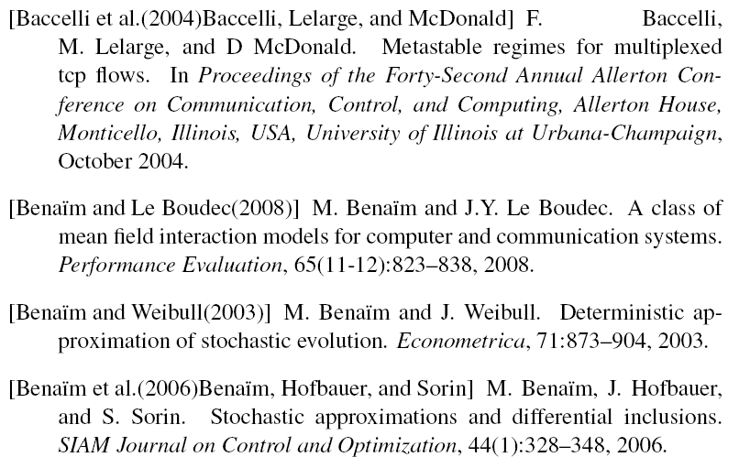
References

Slide 54
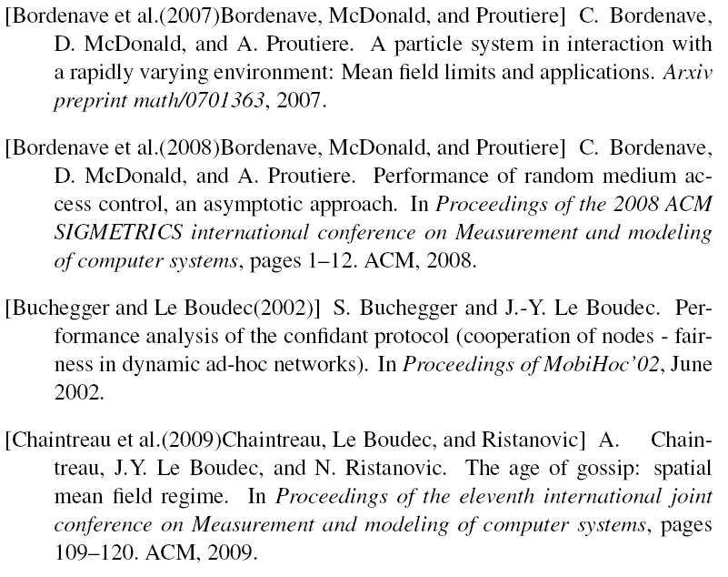

Slide 55
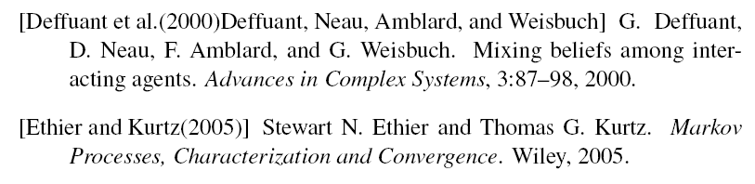
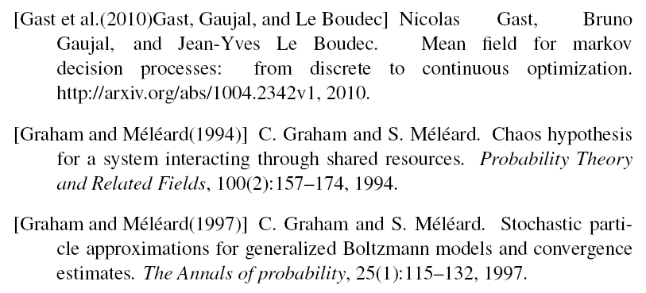
[Gomez, Graham, Le Boudec 2010] Gomez-Serrano J., Graham C. and Le Boudec, JY, « The Bounded Confidence Model of Opinion Dynamics », preprint, http://infoscience.epfl.ch/record/149416
2

Slide 56
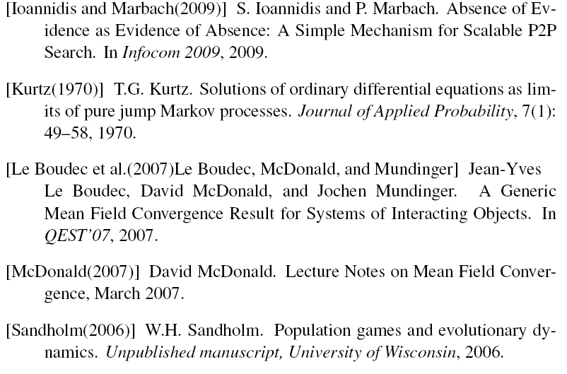

Slide 57
