Slide 1

A Class Of Mean Field Interaction Models for Computer and
Communication Systems
Jean-Yves Le Boudec
EPFL – I&C – LCA
Joint work with Michel Benaïm

Slide 2
Abstract
We review a generic mean field interaction model where N objects are evolving according to an object's individual finite state machine and the state of a global resource. We show that, in order to obtain mean field convergence for large N to an Ordinary Differential Equation (ODE), it is sufficient to assume that (1) the intensity, i.e. the number of transitions per object per time slot, vanishes and (2) the coefficient of variation of the total number of objects that do a transition in one time slot remains bounded. No independence assumption is needed anywhere. We find convergence in mean square and in probability on any finite horizon, and derive from there that, in the stationary regime, the support of the occupancy measure tends to be supported by the Birkhoff center of the ODE. We use these results to develop a critique of the fixed point method sometimes used in the analysis of communication protocols.
Full text available on infoscience.epfl.ch
http://infoscience.epfl.ch/getfile.py?docid=15295&name=pe-mf-tr&format=pdf&version=1

Slide 3
Contents
Mean Field Interaction Model
Vanishing Intensity
A Generic Mean Field Model
Convergence Result
Mean Field Approximation
and Decoupling Assumption
Stationary Regime
Fixed Point Method

Slide 4
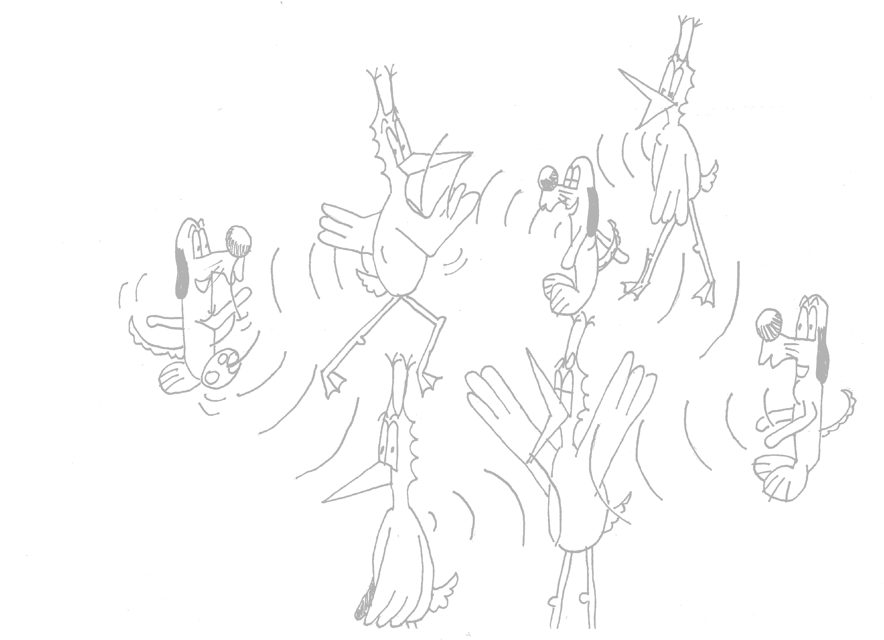
Mean Field Interaction Model
Time is discrete
N objects
Object n has state X_{n}(t) 2 {1,…,I}
Common ressource R(t) 2 {1,…,J}
(X₁(t), …, X_{N}(t),R(t)) is Markov
Objects can be observed only through their state
N is large, I and J are small
Example 1: N wireless nodes, state = retransmission stage k
Example 2: N wireless nodes, state = k,c (c= node class)
Example 3: N wireless nodes, state = k,c,x (x= node location)

Slide 5
What can we do with a Mean Field Interaction Model ?
Large N asymptotics
  ¼ fluid limit
  Markov chain replaced by a deterministic dynamical system
  ODE or deterministic map
Issues
  When valid
  Don’t want do a PhD to show mean field limit
  How to formulate the ODE
Large t asymptotic
  ¼ stationary behaviour
  Useful performance metric
Issues
  Is stationary regime of ODE an approximation of stationary regime of original system ?

Slide 6

Contents
Mean Field Interaction Model
Vanishing Intensity
A Generic Mean Field Model
Convergence Result
Mean Field Approximation
and Decoupling Assumption
Stationary Regime
Fixed Point Method

Slide 7
Intensity of a Mean Field Interaction Model
Informally:
Probability that an arbitrary object changes state in one time slot is O(intensity)
source | [L, McDonald, Mundinger] | [Benaïm,Weibull] | [Bordenave, McDonald, Proutière]
domain | Reputation System | Game Theory | Wireless MAC
an object is… | a rater | a player | a communication node
objects that attempt to do a transition in one time slot | all | 1, selected at random among N | every object decides to attempt a transition with proba 1/N, independent of others binomial(1/N,N)¼ Poisson(1)
intensity | 1 | 1/N | 1/N

Slide 8
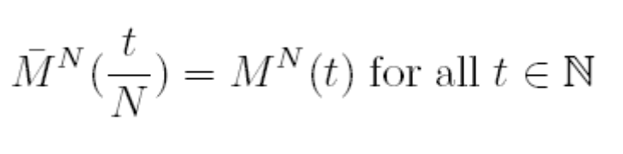
Vanishing Intensity
Hypothesis
limit _{N ! 1}intensity = 0
We rescale the system to keep the number of transitions per time slot of constant order
Definition: Occupancy Measure
M^{N}_{i}(t) = fraction of objects in state i at time t
Definition: Re-Scaled Occupancy measure
when Intensity = 1/N
If intensity vanishes, large N limit is in continuous time (ODE)
  Focus of this presentation
If intensity remains constant with N, large N limit is in discrete time
[L, McDonald, Mundinger]

Slide 9
Contents
Mean Field Interaction Model
Vanishing Intensity
A Generic Mean Field Model
Convergence Result
Mean Field Approximation
and Decoupling Assumption
Stationary Regime
Fixed Point Method

Slide 10
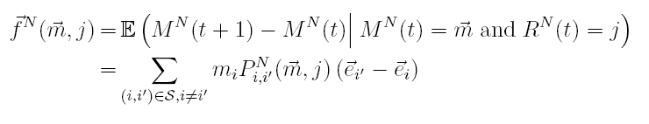
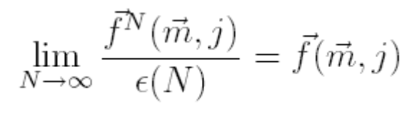
Model Assumptions
Definition: drift = expected change to M^{N}(t) in one time slot
Hypothesis (1): Intensity vanishes: there exists a function (the intensity) ε(N) ! 0 such that
  typically ε(N)=1/N
Hypothesis (2): coefficient of variation of number of transitions per time slot remains bounded
Hypothesis (3): marginal transition kernel of resource becomes independent of N and irreducible – not relevant for examples shown
Hypothesis (4): dependence on parameters is C¹ ( = with continuous derivatives)

Slide 11


source | [L, McDonald, Mundinger] | [Benaïm,Weibull] | [Bordenave, McDonald, Proutière]
domain | Reputation System | Game Theory | Wireless MAC
an object is… | a rater | a player | a communication node
objects that attempt to do a transition in one time slot | all | 1, selected at random among N | every object decides to attempt a transition with proba 1/N, independent of others binomial(1/N,N)¼ Poisson(1)
intensity (H1) | 1 | 1/N | 1/N
coef of variation (H2) |  | 0 | · 2
resource does not scale (H3) |  | no resource
C¹ (H4)

Slide 12
Other Examples Previously not Covered
Practically any mean field interaction model you can think of such that
  Intensity vanishes
  Coeff of variation of number of transitions per time slot remains bounded
Example:
  Pairwise meeting
  State of rater is its current belief (i 2 {0,1,…,I})
  Two raters meet and update their beliefs according to some finite state machine
source | new
domain | Reputation System
an object is… | a rater
objects that attempt to do a transition in one time slot | one pair, chosen randomly among N(N-1)/2
intensity (H1) | 1/N
coef of variation (H2) | 0
resource does not scale (H3) | no resource
C¹ (H4)

Slide 13
No independence assumption
Our model does not require any independence assumption
  Transition of global system may be arbitrary
A mean field interaction model as defined here means
  Objects are observed only through their state
  two objects in same state are subject to the same rules
  Number of states small, Number of objects large

Slide 14
Contents
Mean Field Interaction Model
Vanishing Intensity
A Generic Mean Field Model
Convergence Result
Mean Field Approximation
and Decoupling Assumption
Stationary Regime
Fixed Point Method

Slide 15
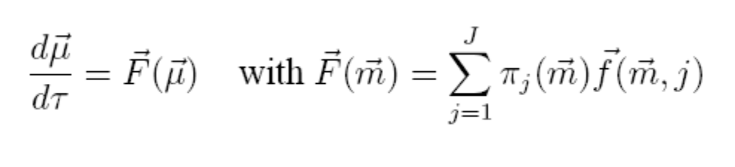
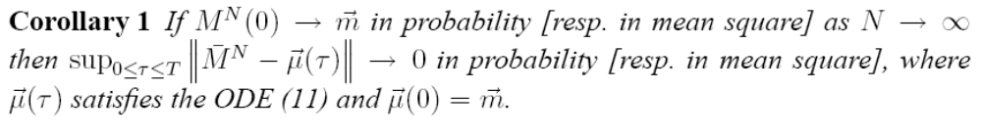
Convergence to Mean Field
The limiting ODE
Theorem: stochastic system M^{N}(t) can be approximated by fluid limit μ(t)
drift of M^{N}(t)

Slide 16
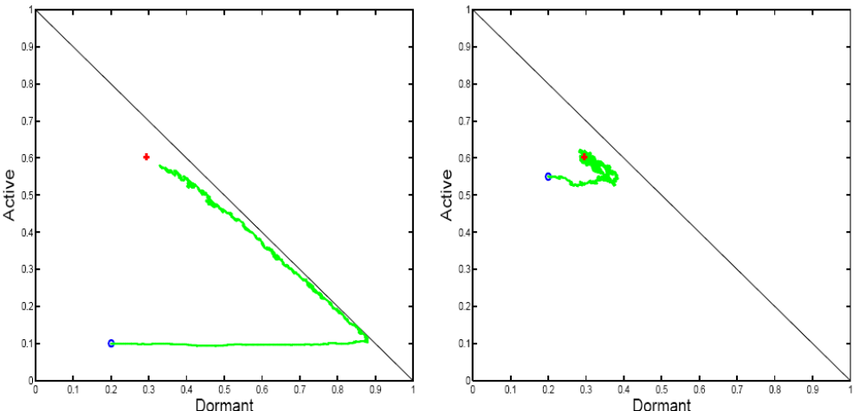
Example: 2-step malware propagation
Mobile nodes are either
  Susceptible
  “Dormant”
  Active
Mutual upgrade
  D + D -> A + A
Infection by active
  D + A -> A + A
Recruitment by Dormant
  S + D -> D + D
Direct infection
  S -> A
Nodes may
recover
A possible simulation
  Every time slot, pick one or two nodes engaged in meetings or recovery
  Fits in model: intensity 1/N

Slide 17
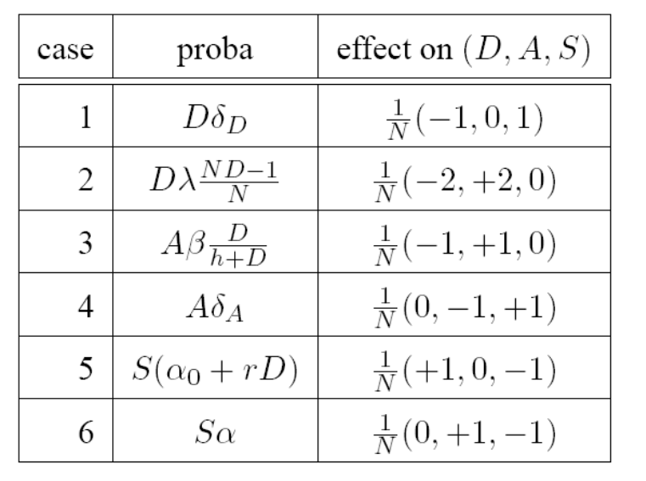
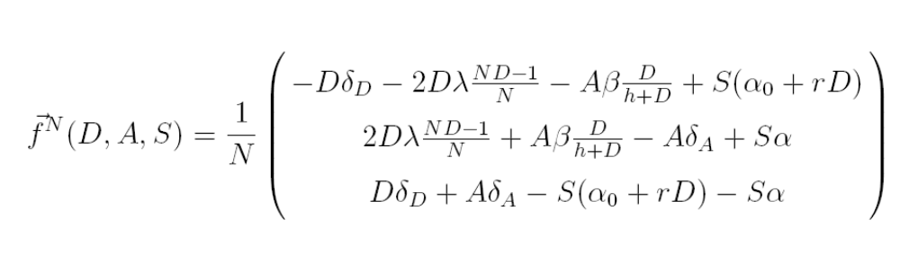
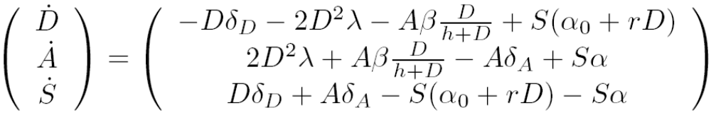
Computing the Mean Field Limit
Compute the drift of M^{N} and its limit over intensity

Slide 18
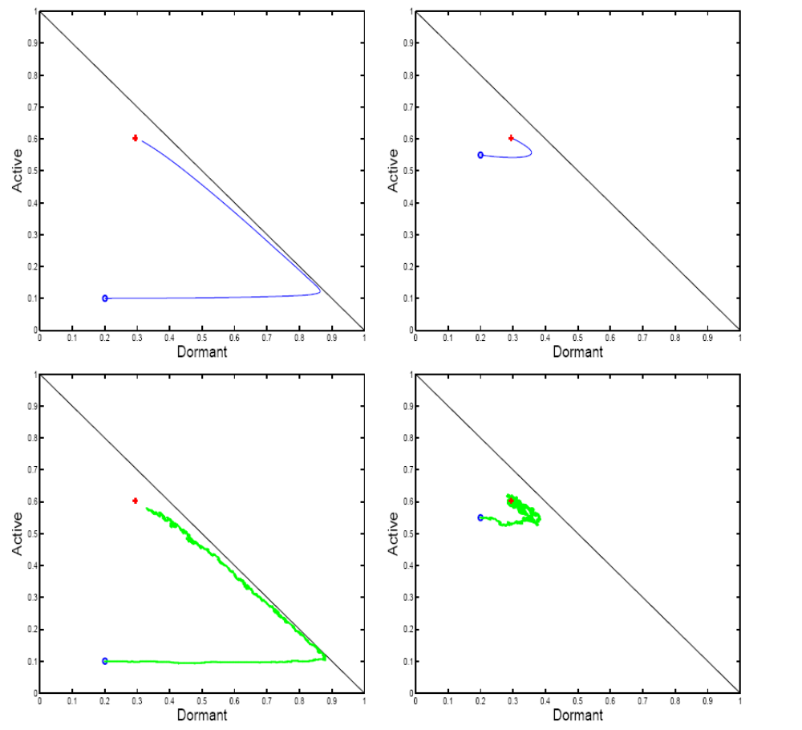
Mean field limit
N = +1
Stochastic
system
N = 1000

Slide 19
Contents
Mean Field Interaction Model
Vanishing Intensity
A Generic Mean Field Model
Convergence Result
Mean Field Approximation
and Decoupling Assumption
Stationary Regime
Fixed Point Method

Slide 20
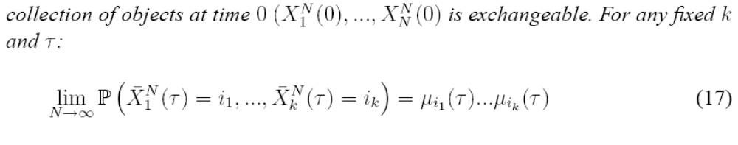
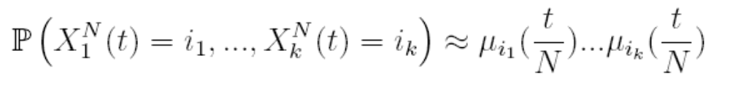
The Decoupling Assumption
Theorem [Sznitman]
thus we can approximate the state distribution of one object by the solution of the ODE:
We also have asymptotic independence. This is called the “decoupling assumption”.
Assume that the

Slide 21
The “Mean Field Approximation”
in literature, it may mean:
Large N approximation for a mean field interaction model
  i.e. many objects and few states per object
  replace stochastic by ODE
  examples in this slide show
  is valid for large N
Approximation of a non mean field interaction model by a mean field interaction model + large N approximation
  E.g.: wireless nodes on a graph
  N nodes, > N states
  Not a mean field interaction model

Slide 22
Contents
Mean Field Interaction Model
Vanishing Intensity
A Generic Mean Field Model
Convergence Result
Mean Field Approximation
and Decoupling Assumption
Stationary Regime
Fixed Point Method

Slide 23
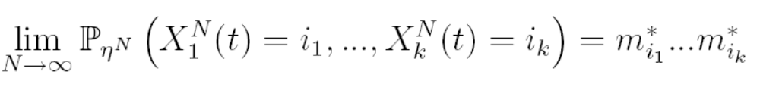
A Result for Stationary Regime
Original system (stochastic):
  (M^{N}(t), R(t)) is Markov, finite, discrete time
  Assume it is irreducible, thus has a unique stationary proba ν^{N}
Mean Field limit (deterministic)
  Assume (H) the ODE has a global attractor m*
    i.e. all trajectories converge to m*
Theorem Under (H)
i.e. we have
  Decoupling assumption
  Approximation of original system distribution by m*
m* is the unique fixed point of the ODE, defined by F(m*)=0

Slide 24
Mean field limit
N = +1
Stochastic
system
N = 1000

Slide 25
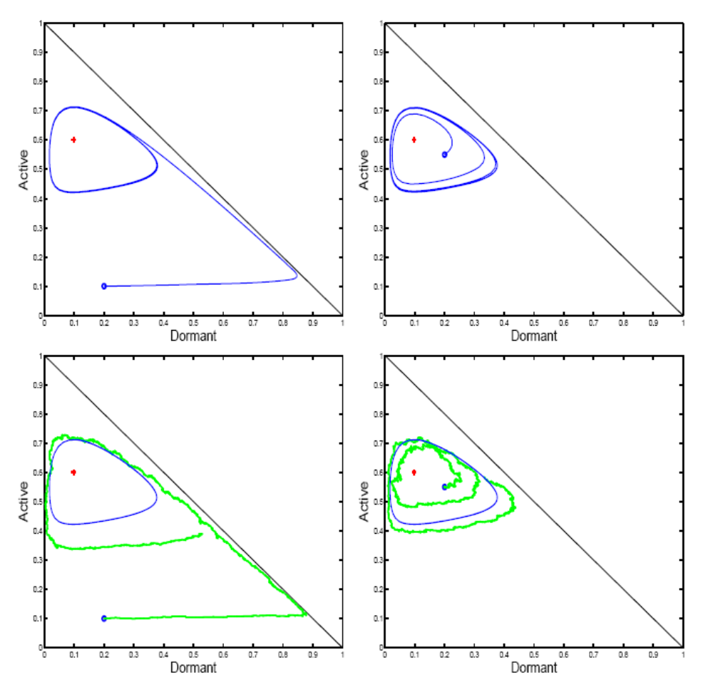
Stationary Regime in General
Assuming (H) a unique global attractor is a strong assumption
Assuming that(M^{N}(t), R(t)) is irreducible (thus has a unique stationary proba ν^{N} ) does not imply (H)
This example has a unique fixed point F(m*)=0 but it is not an attractor
Same as before
Except for one parameter value

Slide 26
Generic Result for Stationary Regime
Original system (stochastic):
  (M^{N}(t), R(t)) is Markov, finite, discrete time
  Assume it is irreducible, thus has a unique stationary proba ν^{N}
  Let ϖ^{N} be the corresponding stationary distribution for M^{N}(t), i.e.
  P(M^{N}(t)=(x₁,…,x_{I})) = ϖ^{N}(x₁,…,x_{I}) for x_{i} of the form k/n, k integer
Theorem
Birkhoff Center: closure of set of points s.t. m2 ω(m)
Omega limit: ω(m) = set of limit points of orbit starting at m

Slide 27
Here:
Birkhoff center = limit cycle  fixed point
The theorem says that the stochastic system for large N is close to the Birkhoff center,
i.e. the stationary regime of ODE is a good approximation of the stationary regime of stochastic system

Slide 28
Contents
Mean Field Interaction Model
Vanishing Intensity
A Generic Mean Field Model
Convergence Result
Mean Field Approximation
and Decoupling Assumption
Stationary Regime
Fixed Point Method

Slide 29
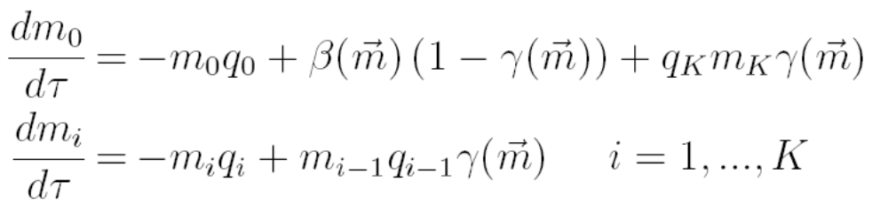


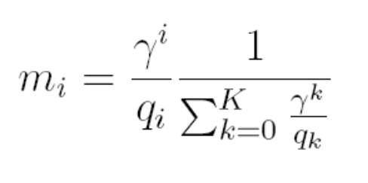
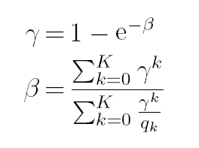
The Fixed Point Method
A common method for studying a complex protocols
  Decoupling assumption (all nodes independent);
  Fixed Point: let m_{i} be the probability that some node is in state i in stationary regime: the vector m must verify a fixed point
  F(m)=0
Example: 802.11 single cell
  m_{i} = proba one node is in backoff stage I
  β= attempt rate
  γ = collision proba
Solve for Fixed Point:

Slide 30
Bianchi’s Formula
The fixed point solution satisfies “Bianchi’s Formula” [Bianchi]
Is true only if fixed point is global attractor (H)
Another interpretation of Bianchi’s formula [Kumar, Altman, Moriandi, Goyal]
=
nb transmission attempts per packet/
nb time slots per packet
assumes collision proba γ remains constant from one attempt to next
Is true if, in stationary regime, m (thus γ) is constant i.e. (H)
If more complicated ODE stationary regime, not true
(H) true for q₀< ln 2 and K= 1 [Bordenave,McDonald,Proutière]

Slide 31
Correct Use of Fixed Point Method
Make decoupling assumption
Write ODE
Study stationary regime of ODE, not just fixed point

Slide 32

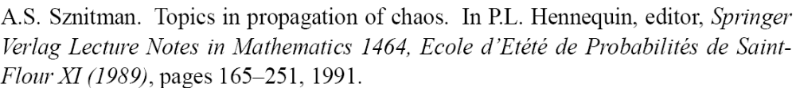
References
[L,Mundinger,McDonald]
[Benaïm,Weibull]
[Bordenave,McDonald,Proutière]
[Sznitman]

Slide 33
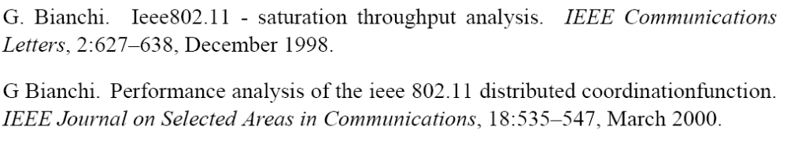
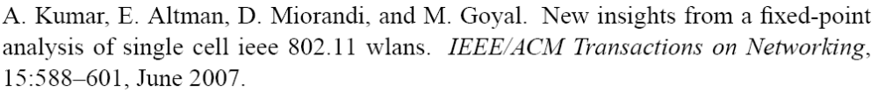
[Bianchi]
[Kumar, Altman, Moriandi, Goyal]

Slide 34


Conclusion
Stop making PhDs about convergence to mean field
  We have found a simple framework, easy to verify, as general as can be
  No independence assumption anywhere
Study ODEs instead
Essentially, the behaviour of ODE for t ! +1 is a good predictor of the original stochastic system
… but original system being ergodic does not imply ODE converges to a fixed point
  ODE may or may not have a global attractor
  Be careful when using the “fixed point” method and “decoupling assumption” if there is not a global attractor

