Slide 1

A Class Of Mean Field Interaction Models for Computer and
Communication Systems
Jean-Yves Le Boudec
EPFL – I&C – LCA
Joint work with Michel Benaïm

Slide 2
Abstract
We review a generic mean field interaction model where N objects are evolving according to an object's individual finite state machine and the state of a global resource. We show that, in order to obtain mean field convergence for large N to an Ordinary Differential Equation (ODE), it is sufficient to assume that (1) the intensity, i.e. the number of transitions per object per time slot, vanishes and (2) the coefficient of variation of the total number of objects that do a transition in one time slot remains bounded. No independence assumption is needed anywhere. We find convergence in mean square and in probability on any finite horizon, and derive from there that, in the stationary regime, the support of the occupancy measure tends to be supported by the Birkhoff center of the ODE. We use these results to develop a critique of the fixed point method sometimes used in the analysis of communication protocols.
Full text to appear in Performance Evaluation; also available on infoscience.epfl.ch
http://infoscience.epfl.ch/getfile.py?docid=15295&name=pe-mf-tr&format=pdf&version=1

Slide 3
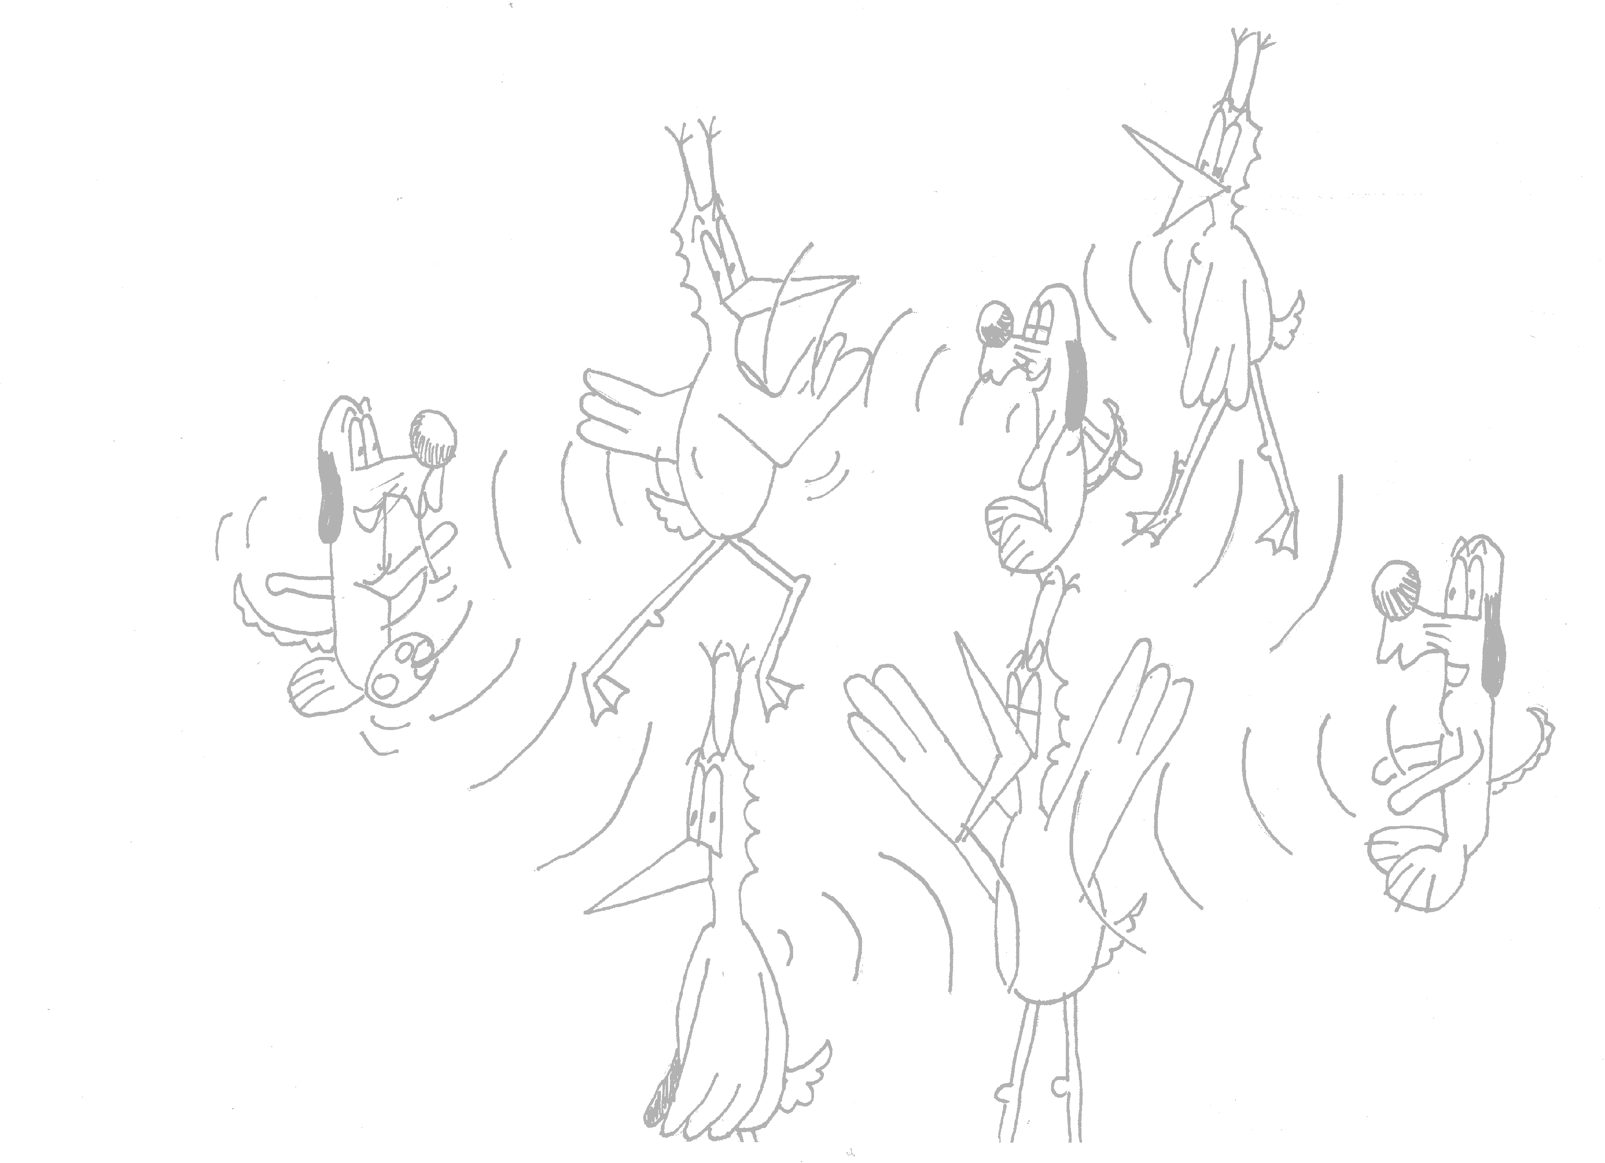
Mean Field Interaction Model
Time is discrete
N objects
Object n has state X_{n}(t) 2 {1,…,I}
(X₁(t), …, X_{N}(t)) is Markov
Objects can be observed only through their state
N is large, I is small
Can be extended to a common resource, see full text for details
Example 1: N wireless nodes, state = retransmission stage k
Example 2: N wireless nodes, state = k,c (c= node class)
Example 3: N wireless nodes, state = k,c,x (x= node location)

Slide 4
What can we do with a Mean Field Interaction Model ?
Large N asymptotics
  ¼ fluid limit
  Markov chain replaced by a deterministic dynamical system
  ODE or deterministic map
Issues
  When valid
  Don’t want do a PhD to show mean field limit
  How to formulate the ODE
Large t asymptotic
  ¼ stationary behaviour
  Useful performance metric
Issues
  Is stationary regime of ODE an approximation of stationary regime of original system ?

Slide 5

Contents
Mean Field Interaction Model
Vanishing Intensity
Convergence Result
Example
Stationary Regime

Slide 6
Intensity of a Mean Field Interaction Model
Informally:
Probability that an arbitrary object changes state in one time slot is O(intensity)
source | [L, McDonald, Mundinger] | [Benaïm,Weibull] | [Sharma, Ganesh, Key Bordenave, McDonald, Proutière]
domain | Reputation System | Game Theory | Wireless MAC
an object is… | a rater | a player | a communication node
objects that attempt to do a transition in one time slot | all | 1, selected at random among N | every object decides to attempt a transition with proba 1/N, independent of others binomial(1/N,N)¼ Poisson(1)
intensity | 1 | 1/N | 1/N

Slide 7
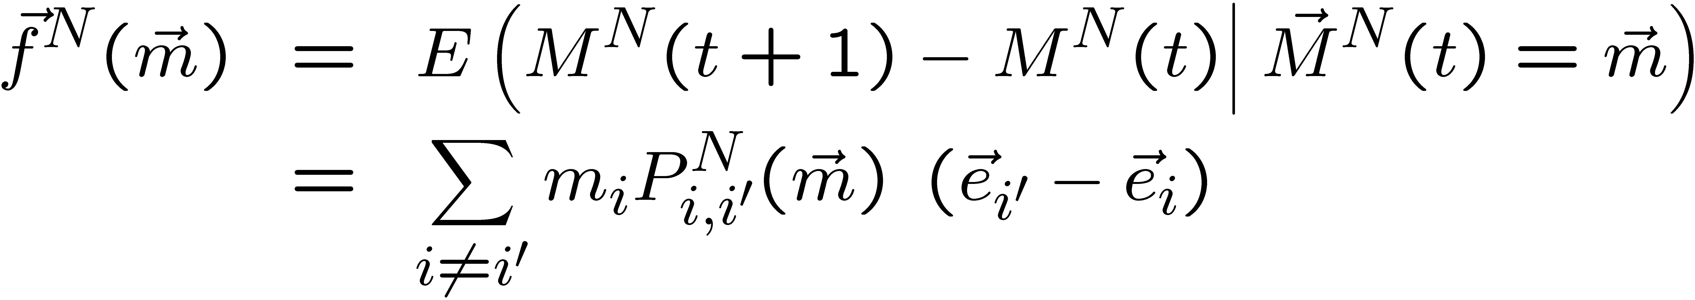
Formal Definition of Intensity
Definition: drift = expected change to M^{N}(t) in one time slot
Intensity : The function ε(N) is an intensity iff the drift is of order ε(N), i.e.

Slide 8
Vanishing Intensity and Scaling Limit
Definition: Occupancy Measure
M^{N}_{i}(t) = fraction of objects in state i at time t
There is a law of large numbers for M^{N}_{i}(t) when N is large
If intensity vanishes, i.e.
limit _{N ! 1}ε(N) = 0
then large N limit is in continuous time (ODE)
  Focus of this presentation
If intensity remains constant with N, large N limit is in discrete time
[L, McDonald, Mundinger]

Slide 9
Contents
Mean Field Interaction Model
Vanishing Intensity
Convergence Result
Example
Stationary Regime

Slide 10
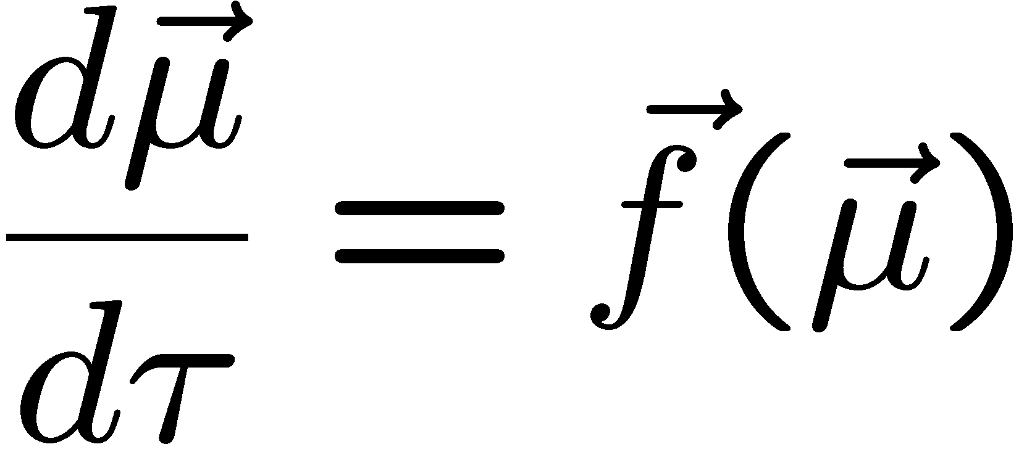
Convergence to Mean Field
Hypotheses
(1): Intensity vanishes:
(2): coefficient of variation of number of transitions per time slot remains bounded
(3): dependence on parameters is C¹ ( = with continuous derivatives)
Theorem: stochastic system M^{N}(t) can be approximated by fluid limit μ(t)
drift of M^{N}(t)

Slide 11


source | [L, McDonald, Mundinger] | [Benaïm,Weibull] | [Sharma, Ganesh, Key Bordenave, McDonald, Proutière]
domain | Reputation System | Game Theory | Wireless MAC
an object is… | a rater | a player | a communication node
objects that attempt to do a transition in one time slot | all | 1, selected at random among N | every object decides to attempt a transition with proba 1/N, independent of others binomial(1/N,N)¼ Poisson(1)
intensity (H1) | 1 | 1/N | 1/N
coef of variation (H2) |  | 0 | · 2
C¹ (H3)

Slide 12
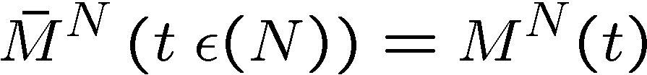
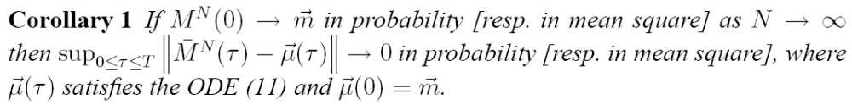
Exact Large N Statement
Definition: Occupancy Measure
M^{N}_{i}(t) = fraction of objects in state i at time t
Definition: Re-Scaled Occupancy measure

Slide 13
Contents
Mean Field Interaction Model
Vanishing Intensity
Convergence Result
Example
Stationary Regime

Slide 14
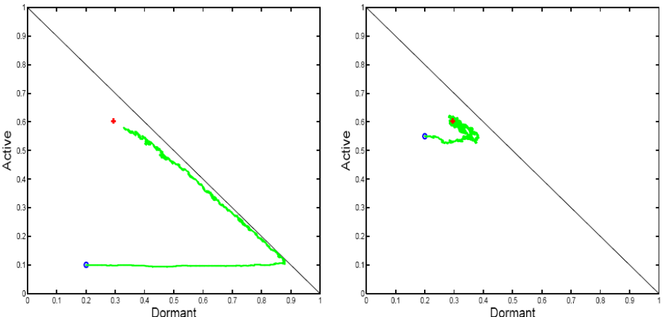
Example: 2-step malware propagation
Mobile nodes are either
  Susceptible
  “Dormant”
  Active
Mutual upgrade
  D + D -> A + A
Infection by active
  D + A -> A + A
Recruitment by Dormant
  S + D -> D + D
Direct infection
  S -> A
Nodes may
recover
A possible simulation
  Every time slot, pick one or two nodes engaged in meetings or recovery
  Fits in model: intensity 1/N

Slide 15
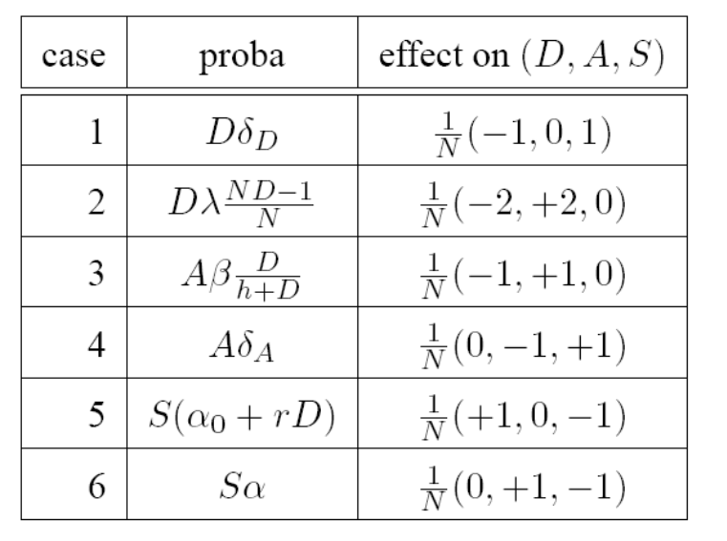
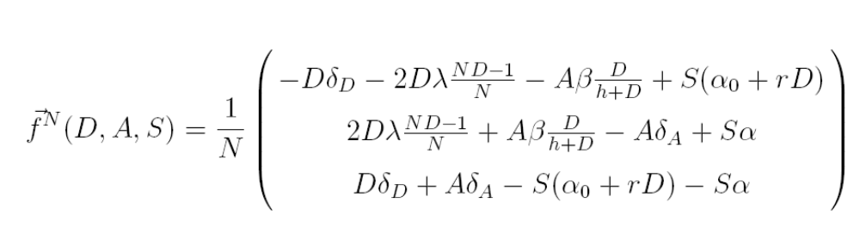
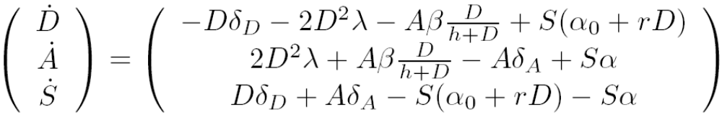
Computing the Mean Field Limit
Compute the drift of M^{N} and its limit over intensity

Slide 16
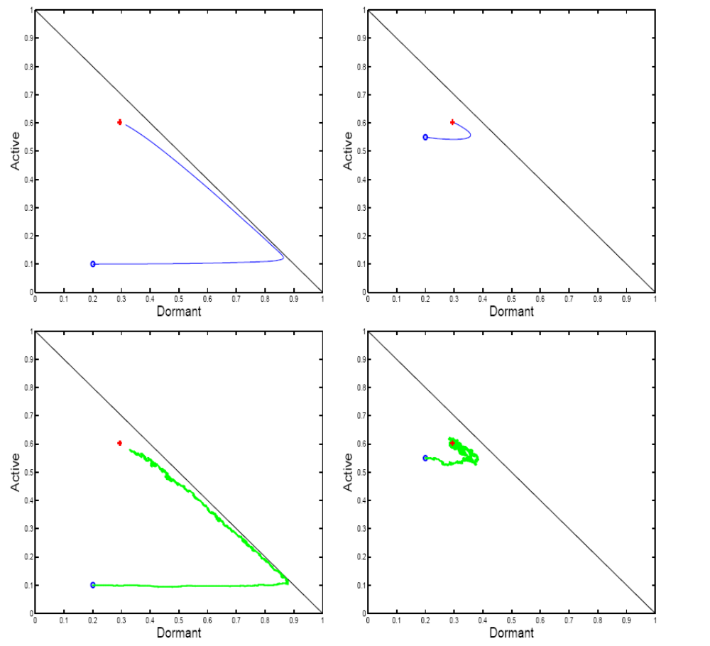
Mean field limit
N = +1
Stochastic
system
N = 1000

Slide 17
Contents
Mean Field Interaction Model
Vanishing Intensity
Convergence Result
Example
Stationary Regime

Slide 18
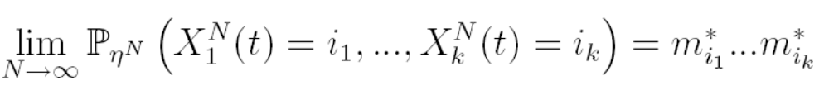
A Result for Stationary Regime
Original system (stochastic):
  (M^{N}(t), R(t)) is Markov, finite, discrete time
  Assume it is irreducible, thus has a unique stationary proba η^{N}
Mean Field limit (deterministic)
  Assume (H) the ODE has a global attractor m*
    i.e. all trajectories converge to m*
Theorem Under (H)
i.e. we have
  Decoupling assumption
  Approximation of original system distribution by m*
m* is the unique fixed point of the ODE, defined by F(m*)=0

Slide 19
Mean field limit
N = +1
Stochastic
system
N = 1000

Slide 20
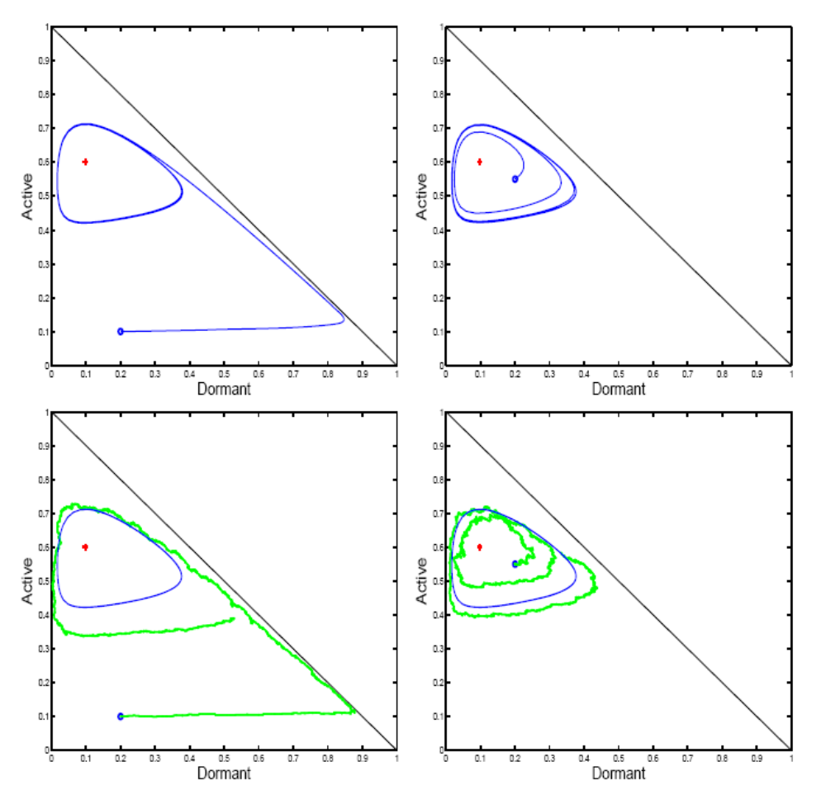
Stationary Regime in General
Assuming (H) a unique global attractor is a strong assumption
Assuming that(M^{N}(t), R(t)) is irreducible (thus has a unique stationary proba η^{N} ) does not imply (H)
This example has a unique fixed point F(m*)=0 but it is not an attractor
Same as before
Except for one parameter value

Slide 21
Generic Result for Stationary Regime
Original system (stochastic):
  (M^{N}(t), R(t)) is Markov, finite, discrete time
  Assume it is irreducible, thus has a unique stationary proba ν^{N}
  Let ϖ^{N} be the corresponding stationary distribution for M^{N}(t), i.e.
  P(M^{N}(t)=(x₁,…,x_{I})) = ϖ^{N}(x₁,…,x_{I}) for x_{i} of the form k/n, k integer
Theorem
Birkhoff Center: closure of set of points s.t. m2 ω(m)
Omega limit: ω(m) = set of limit points of orbit starting at m

Slide 22
Here:
Birkhoff center = limit cycle  fixed point
The theorem says that the stochastic system for large N is close to the Birkhoff center,
i.e. the stationary regime of ODE is a good approximation of the stationary regime of stochastic system

Slide 23
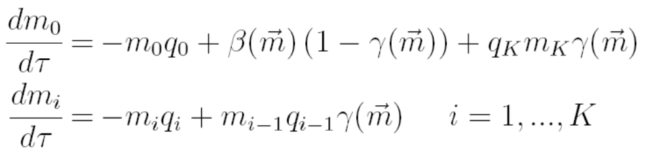


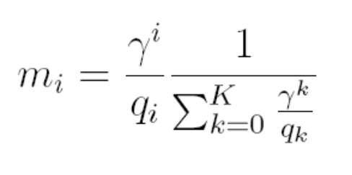
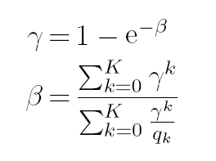
The Fixed Point Method
A common method for studying a complex protocols
  Decoupling assumption (all nodes independent);
  Fixed Point: let m_{i} be the probability that some node is in state i in stationary regime: the vector m must verify a fixed point
  F(m)=0
Example: 802.11 single cell
  m_{i} = proba one node is in backoff stage I
  β= attempt rate
  γ = collision proba
Solve for Fixed Point:

Slide 24
Bianchi’s Formula
The fixed point solution satisfies “Bianchi’s Formula” [Bianchi]
Is true only if fixed point is global attractor (H)
Another interpretation of Bianchi’s formula [Kumar, Altman, Moriandi, Goyal]
=
nb transmission attempts per packet/
nb time slots per packet
assumes collision proba γ remains constant from one attempt to next
Is true if, in stationary regime, m (thus γ) is constant i.e. (H)
If more complicated ODE stationary regime, not true
(H) true for q₀< ln 2 and K= 1 [Bordenave,McDonald,Proutière] and for K=1 [Sharma, Ganesh, Key]

Slide 25

Correct Use of Fixed Point Method
Make decoupling assumption
Write ODE
Study stationary regime of ODE, not just fixed point

Slide 26

Conclusion
Convergence to Mean Field:
  We have found a simple framework, easy to verify, as general as can be
  No independence assumption anywhere
  Can be extended to a common resource – see full text version
Essentially, the behaviour of ODE for t ! +1 is a good predictor of the original stochastic system
… but original system being ergodic does not imply ODE converges to a fixed point
  ODE may or may not have a global attractor
  Be careful when using the “fixed point” method and “decoupling assumption” if there is not a global attractor

Slide 27

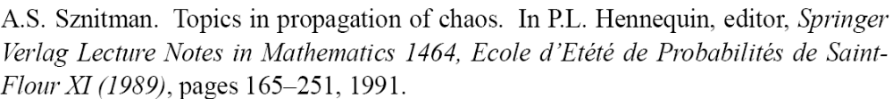
References
[L,Mundinger,McDonald]
[Benaïm,Weibull]
[Sharma, Ganesh, Key]
[Bordenave,McDonald,Proutière]
[Sznitman]

Slide 28
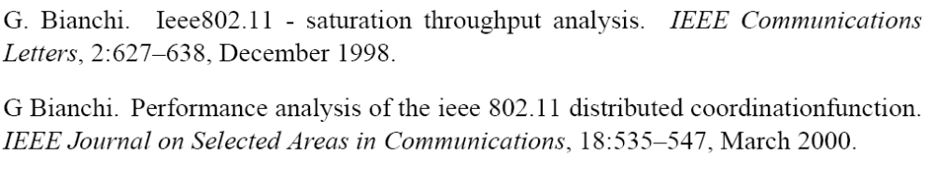
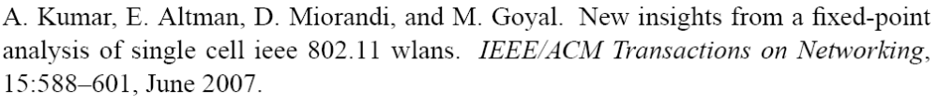
[Bianchi]
[Kumar, Altman, Moriandi, Goyal]

