Slide 1

Mean Field Interaction Models for Computer and Communication Systems and the Decoupling Assumption
Jean-Yves Le Boudec
EPFL – I&C – LCA
Joint work with Michel Benaïm

Slide 2
Abstract
We consider models of N interacting objects, where the interaction is via a common resource and the distribution of states of all objects. We introduce the key scaling concept of intensity; informally, the expected number of transitions per object per time slot is of the order of the intensity. We consider the case of vanishing intensity, i.e. the expected number of object transitions per time slot is o(N). We show that, under mild assumptions and for large N, the occupancy measure converges, in mean square (and thus in probability) over any finite horizon, to a deterministic dynamical system. The mild assumption is essentially that the coefficient of variation of the number of object transitions per time slot remains bounded with N. No independence assumption is needed anywhere. The convergence results allow us to derive properties valid in the stationary regime. We discuss when one can assure that a stationary point of the ODE is the large N limit of the stationary probability distribution of the state of one object for the system with N objects. We use this to develop a critique of the fixed point method sometimes used in conjunction with the decoupling assumption.
Full text to appear in Performance Evaluation; also available on infoscience.epfl.ch
http://infoscience.epfl.ch/getfile.py?docid=16148&name=pe-mf-tr&format=pdf&version=1

Slide 3
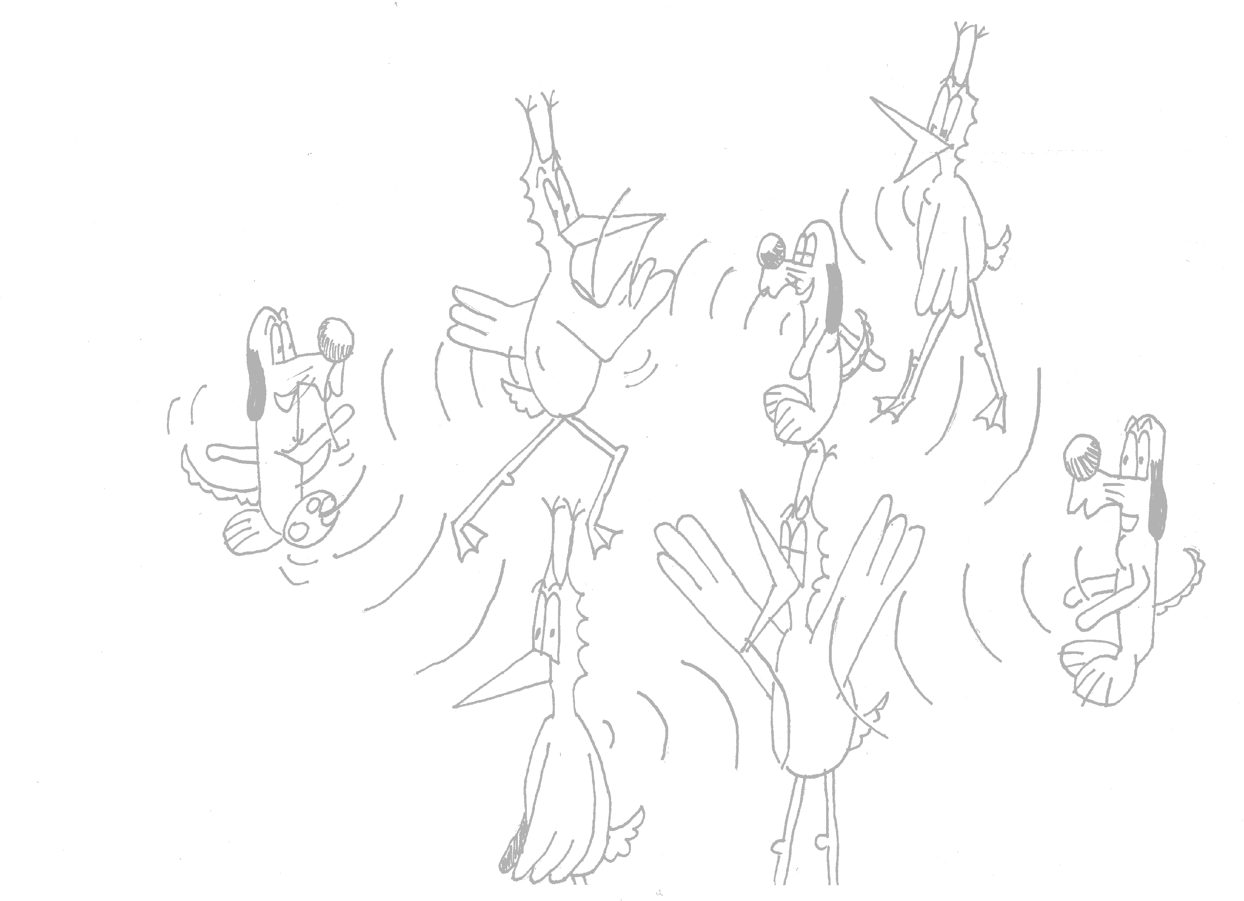
Mean Field Interaction Model
Time is discrete
N objects
Object n has state X_{n}(t) 2 {1,…,I}
(X₁(t), …, X_{N}(t)) is Markov
Objects can be observed only through their state
N is large, I is small
Can be extended to a common resource, see full text for details
Example 1: N wireless nodes, state = retransmission stage k
Example 2: N wireless nodes, state = k,c (c= node class)
Example 3: N wireless nodes, state = k,c,x (x= node location)

Slide 4
What can we do with a Mean Field Interaction Model ?
Large N asymptotics
  ¼ fluid limit
  Markov chain replaced by a deterministic dynamical system
  ODE or deterministic map
Issues
  When valid
  Don’t want do a PhD to show mean field limit
  How to formulate the ODE
Large t asymptotic
  ¼ stationary behaviour
  Useful performance metric
Issues
  Is stationary regime of ODE an approximation of stationary regime of original system ?
  Does this justify the “Decoupling Assumption” ?

Slide 5

Contents
Mean Field Interaction Model
Vanishing Intensity
Convergence Result
Example
The Decoupling Assumption
The Fixed Point Method
Stationary Regime

Slide 6
Intensity of a Mean Field Interaction Model
Informally:
Probability that an arbitrary object changes state in one time slot is O(intensity)
source | [L, McDonald, Mundinger] | [Benaïm,Weibull] | [Sharma, Ganesh, Key Bordenave, McDonald, Proutière]
domain | Reputation System | Game Theory | Wireless MAC
an object is… | a rater | a player | a communication node
objects that attempt to do a transition in one time slot | all | 1, selected at random among N | every object decides to attempt a transition with proba 1/N, independent of others binomial(1/N,N)¼ Poisson(1)
intensity | 1 | 1/N | 1/N

Slide 7
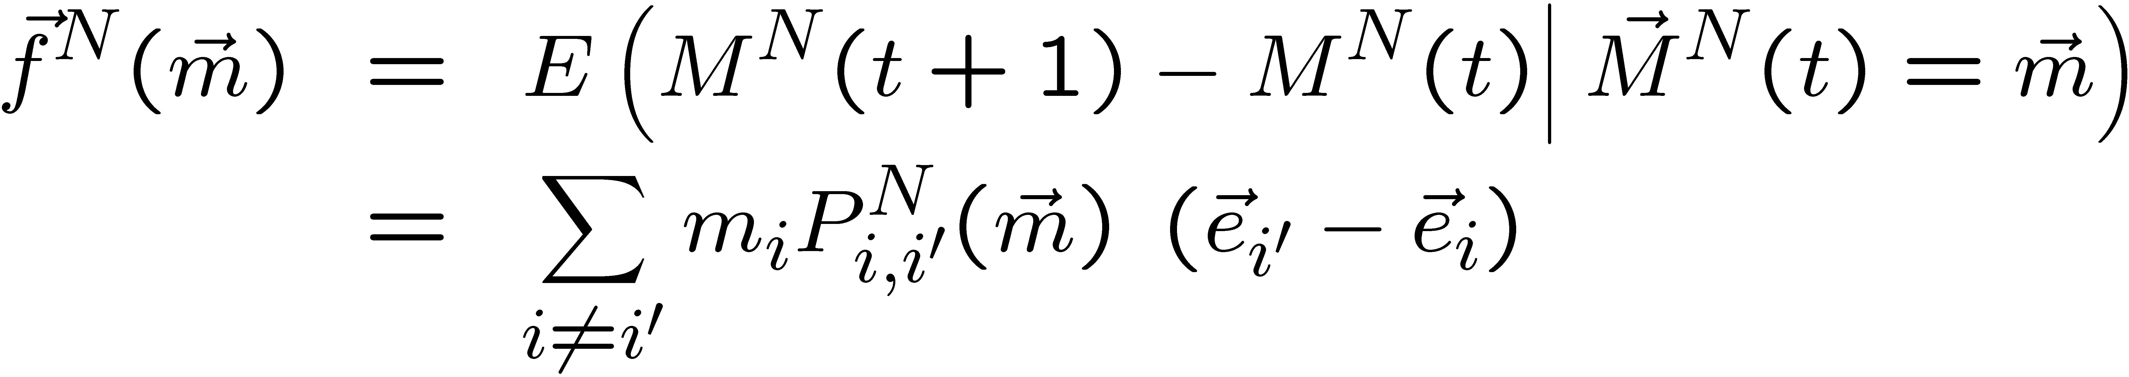
Formal Definition of Intensity
Definition: drift = expected change to M^{N}(t) in one time slot
Intensity : The function ε(N) is an intensity iff the drift is of order ε(N), i.e.

Slide 8
Vanishing Intensity and Scaling Limit
Definition: Occupancy Measure
M^{N}_{i}(t) = fraction of objects in state i at time t
There is a law of large numbers for M^{N}_{i}(t) when N is large
If intensity vanishes, i.e.
limit _{N ! 1}ε(N) = 0
then large N limit is in continuous time (ODE)
  Focus of this presentation
If intensity remains constant with N, large N limit is in discrete time
[L, McDonald, Mundinger]

Slide 9
Contents
Mean Field Interaction Model
Vanishing Intensity
Convergence Result
Example
The Decoupling Assumption
The Fixed Point Method
Stationary Regime

Slide 10
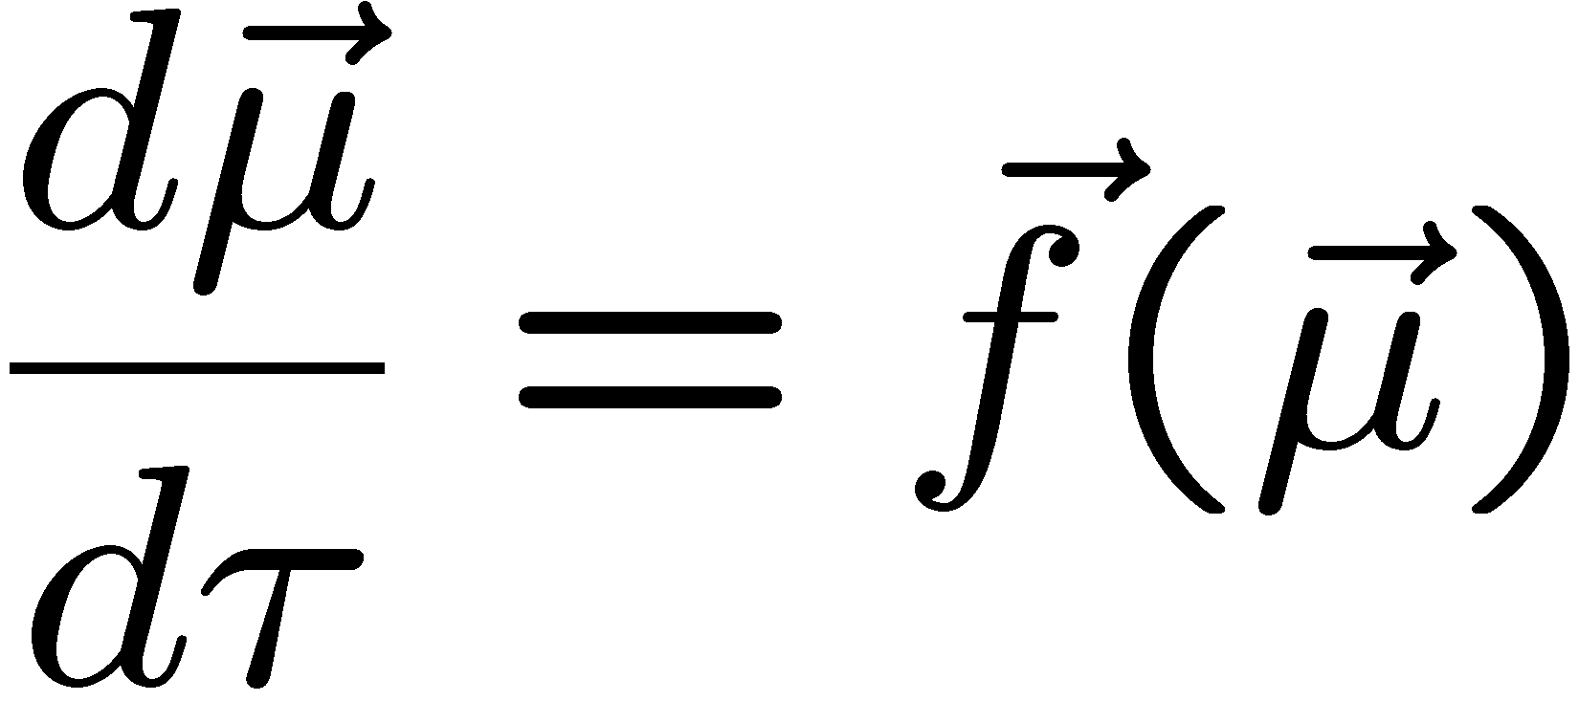
Convergence to Mean Field
Hypotheses
(1): Intensity vanishes:
(2): coefficient of variation of number of transitions per time slot remains bounded
(3): dependence on parameters is C¹ ( = with continuous derivatives)
Theorem: stochastic system M^{N}(t) can be approximated by fluid limit μ(t)
drift of M^{N}(t)

Slide 11


source | [L, McDonald, Mundinger] | [Benaïm,Weibull] | [Sharma, Ganesh, Key Bordenave, McDonald, Proutière]
domain | Reputation System | Game Theory | Wireless MAC
an object is… | a rater | a player | a communication node
objects that attempt to do a transition in one time slot | all | 1, selected at random among N | every object decides to attempt a transition with proba 1/N, independent of others binomial(1/N,N)¼ Poisson(1)
intensity (H1) | 1 | 1/N | 1/N
coef of variation (H2) |  | 0 | · 2
C¹ (H3)

Slide 12
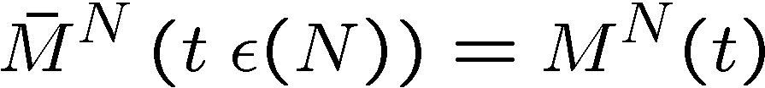
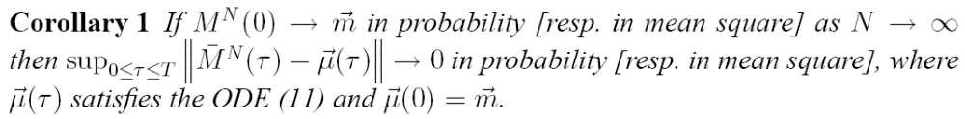
Exact Large N Statement
Definition: Occupancy Measure
M^{N}_{i}(t) = fraction of objects in state i at time t
Definition: Re-Scaled Occupancy measure

Slide 13
Contents
Mean Field Interaction Model
Vanishing Intensity
Convergence Result
Example
The Decoupling Assumption
The Fixed Point Method
Stationary Regime

Slide 14
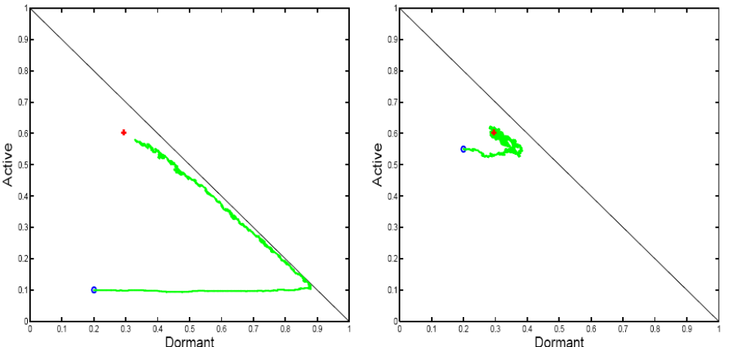
Example: 2-step malware propagation
Mobile nodes are either
  Susceptible
  “Dormant”
  Active
Mutual upgrade
  D + D -> A + A
Infection by active
  D + A -> A + A
Recruitment by Dormant
  S + D -> D + D
Direct infection
  S -> A
Nodes may
recover
A possible simulation
  Every time slot, pick one or two nodes engaged in meetings or recovery
  Fits in model: intensity 1/N

Slide 15
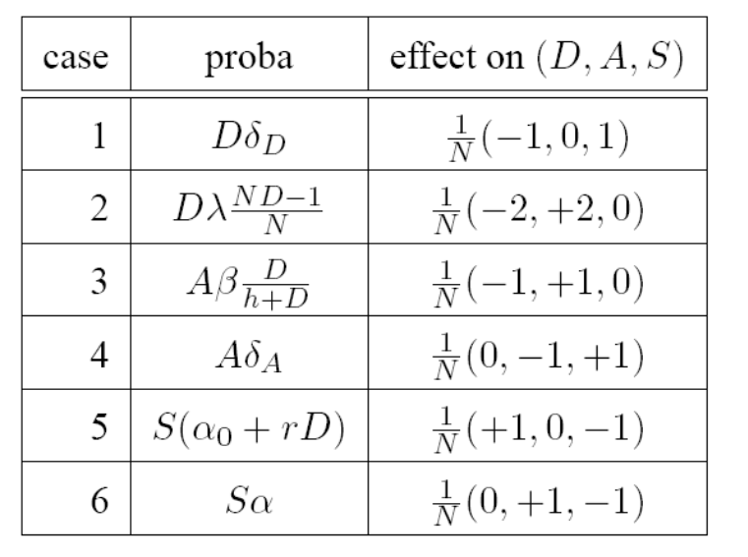
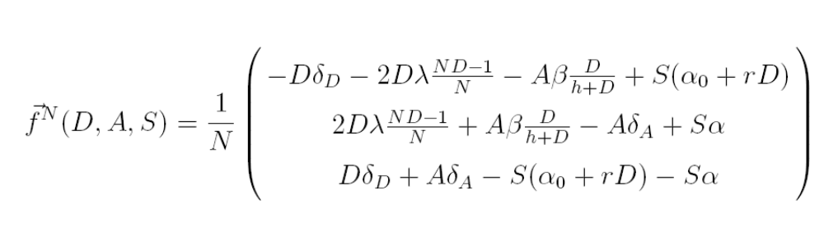
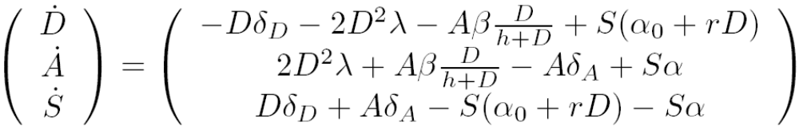
Computing the Mean Field Limit
Compute the drift of M^{N} and its limit over intensity

Slide 16
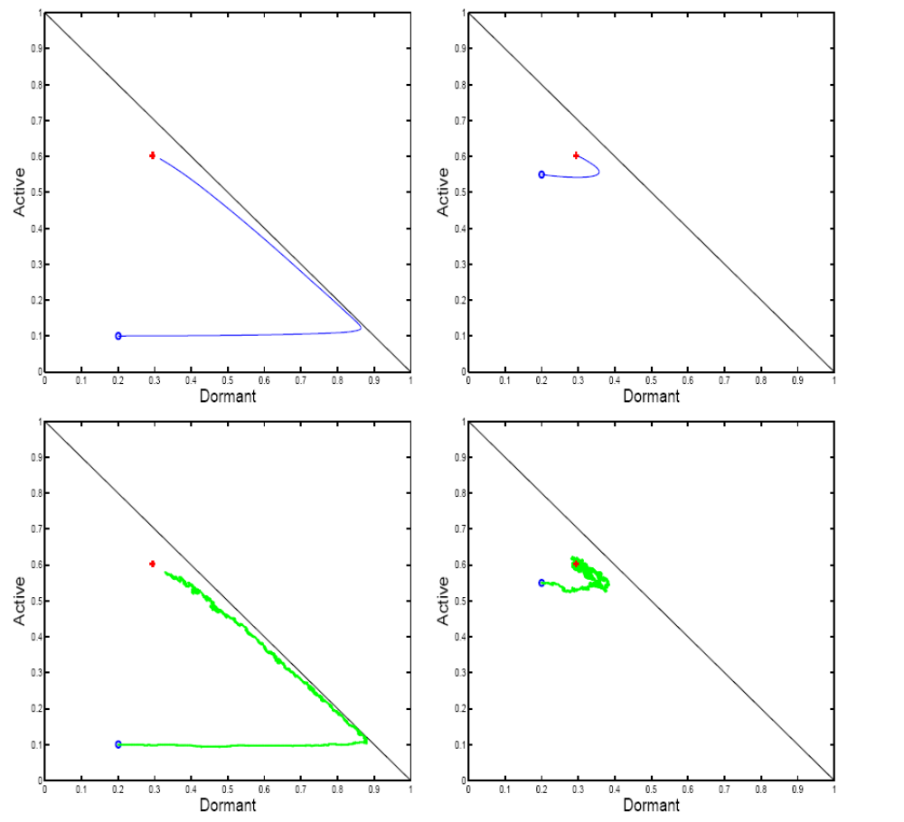
Mean field limit
N = +1
Stochastic
system
N = 1000

Slide 17
Contents
Mean Field Interaction Model
Vanishing Intensity
Convergence Result
Example
The Decoupling Assumption
The Fixed Point Method
Stationary Regime

Slide 18
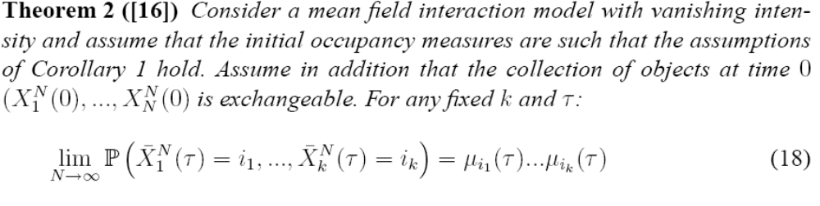
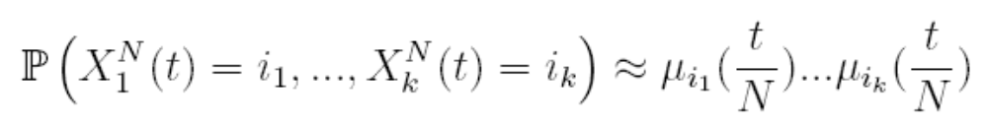
Propagation of Chaos
Convergence to an ODE implies “propagation of chaos” [Sznitman, 1991]
  This says that, for large N, any k objects are ¼ independent
mean field limit

Slide 19
Example
For large t
  k nodes are independent
  Prob (node n is dormant) ¼ 0.3
  Prob (node n is active) ¼ 0.6
  Prob (node n is susceptible) ¼ 0.1
Propagation of chaos is also called
  “decoupling assumption” (in computer science)
  “mean field independence” or even simply “mean field” (in physics)

Slide 20
Contents
Mean Field Interaction Model
Vanishing Intensity
Convergence Result
Example
The Decoupling Assumption
The Fixed Point Method
Stationary Regime

Slide 21

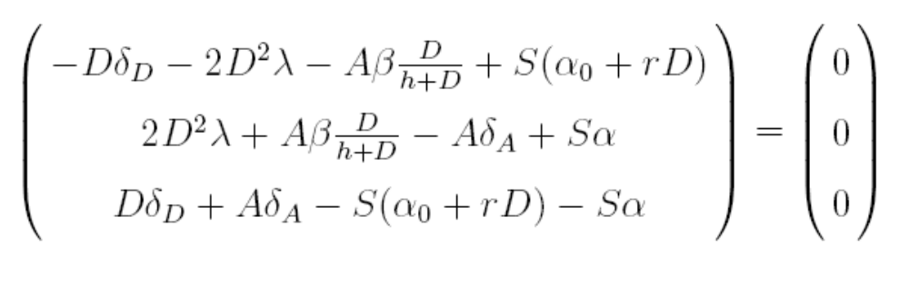
The Fixed Point Method
Commonly used when studying communication protocols; works as follows
  Nodes 1…N each have a state in {1,2,…,I}
  Assume N is large and therefore nodes are independent (decoupling assumption)
  Let m*_{i}be the proba that any given node n is in state I. The vector m^* is given by the equation where F is the drift.
  Can often be put in the form of a fixed point and solved iteratively.
Example: solve for D,S,A in
(with D+S+A = 1) and obtain D¼0.3, A¼ 0.6, S ¼ 0.1

Slide 22
Is the Fixed Point Method justified ?
With the fixed point method we do two assumptions
  Convergence to mean field, which is the same as decoupling assumption
  μ(τ) converges to some m*

Slide 23
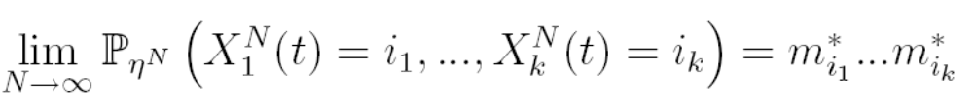
When the ODE has a global attractor, the fixed point method is justified
Original system (stochastic):
  (X^{N}(t)) is Markov, finite, discrete time
  Assume it is irreducible, thus has a unique stationary proba η^{N}
Mean Field limit (deterministic)
  Assume (H) the ODE has a global attractor m*
    i.e. μ(τ) converges to m* for all initial conditions
Theorem Under (H)
  i.e. the fixed point method is justified
m* is the unique fixed point of the ODE, defined by F(m*)=0

Slide 24
Mean field limit
N = +1
Stochastic
system
N = 1000

Slide 25
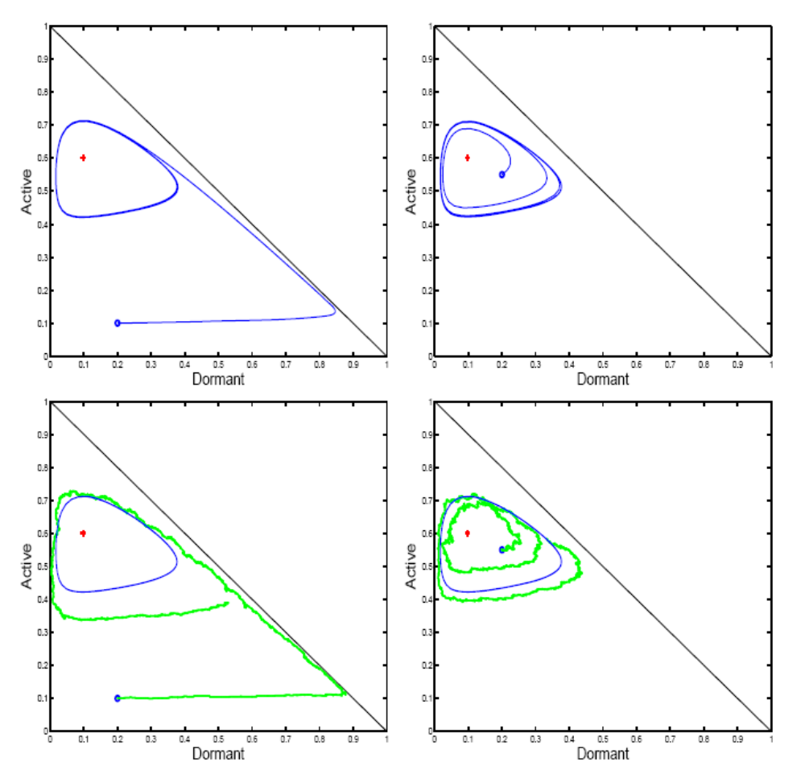
Assumption H may not hold, even for perfectly behaved example
Same as before
Except for one parameter value

Slide 26
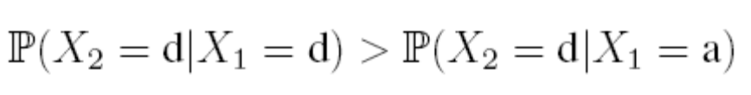
In this Example…
(X^{N}(t)) is irreducible and thus has a unique stationary probability η^{Ν}
There is a unique fixed point
  F(m*)=0 has a unique solution
  but it is not a stable equilibrium
The fixed point method would say here
  Prob (node n is dormant) ¼ 0.1
  Nodes are independent
… but in reality
  For large t, μ(t) oscillates along the limit cycle
  Given that node 1 is dormant, it is most likely that μ(t) is in region
  and thus node 2 has a high chance of being dormant
  Nodes are not independent
Fixed Point Method does not apply
1
1

Slide 27
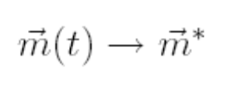
Be careful when mixing decoupling assumption and stationary regime
Decoupling assumption holds at any time t
It may not hold in the stationary regime
  k nodes are not independent
It does hold in the stationary regime if the ODE that defines the mean field limit has a global attractor

Slide 28
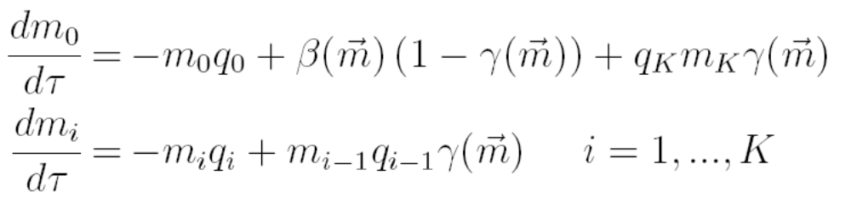


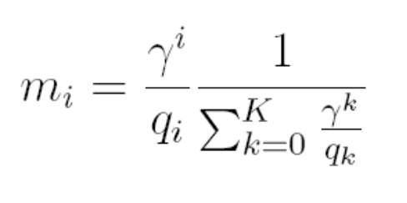
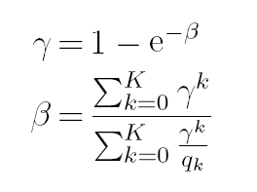
Example: Bianchi’s Formula
Example: 802.11 single cell
  m_{i} = proba one node is in backoff stage I
  β= attempt rate
  γ = collision proba
Solve for Fixed Point:

Slide 29
Bianchi’s Formula is not Demonstrated
The fixed point solution satisfies “Bianchi’s Formula” [Bianchi]
Another interpretation of Bianchi’s formula [Kumar, Altman, Moriandi, Goyal]
=
nb transmission attempts per packet/
nb time slots per packet
assumes collision proba γ remains constant from one attempt to next
Is true if, in stationary regime, m (thus γ) is constant i.e. (H)
If more complicated ODE stationary regime, not true
(H) true for q₀< ln 2 and K= 1 [Bordenave,McDonald,Proutière] and for K=1 [Sharma, Ganesh, Key]: otherwise don’t know

Slide 30
Contents
Mean Field Interaction Model
Vanishing Intensity
Convergence Result
Example
The Decoupling Assumption
The Fixed Point Method
Stationary Regime

Slide 31
Generic Result for Stationary Regime
Original system (stochastic):
  (X^{N}(t)) is Markov, finite, discrete time
  Assume it is irreducible, thus has a unique stationary proba ν^{N}
  Let ϖ^{N} be the corresponding stationary distribution for M^{N}(t), i.e.
  P(M^{N}(t)=(x₁,…,x_{I})) = ϖ^{N}(x₁,…,x_{I}) for x_{i} of the form k/n, k integer
Theorem
Birkhoff Center: closure of set of points s.t. m2 ω(m)
Omega limit: ω(m) = set of limit points of orbit starting at m

Slide 32
Here:
Birkhoff center = limit cycle  fixed point
The theorem says that the stochastic system for large N is close to the Birkhoff center,
i.e. the stationary regime of ODE is a good approximation of the stationary regime of stochastic system

Slide 33


Conclusion
Convergence to Mean Field:
  We have found a simple framework, easy to verify, as general as can be
  No independence assumption anywhere
  Can be extended to a common resource – see full text version
Essentially, the behaviour of ODE for t ! +1 is a good predictor of the original stochastic system
… but original system being ergodic does not imply ODE converges to a fixed point

Slide 34
Correct Use of Fixed Point Method
Make decoupling assumption
Write ODE
Study stationary regime of ODE, not just fixed point
If there is a global attractor, fixed point is a good approximation of stationary prob for one node and decoupling holds in stationary regime

Slide 35

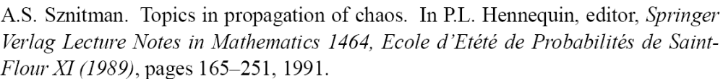
References
[Benaïm, L] A Class Of Mean Field Interaction Models for Computer and Communication Systems, to appear in Performance Evaluation
[L,Mundinger,McDonald]
[Benaïm,Weibull]
[Sharma, Ganesh, Key]
[Bordenave,McDonald,Proutière]
[Sznitman]

Slide 36
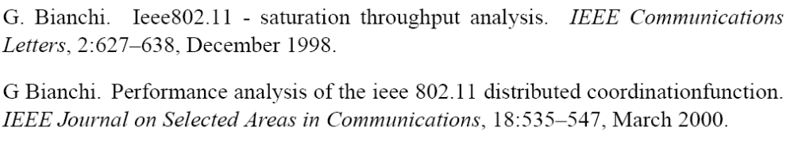
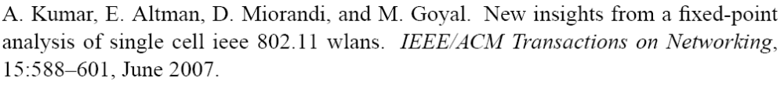
[Bianchi]
[Kumar, Altman, Moriandi, Goyal]

