Slide 1

A SERVICE CURVE APPROACH TO DEMAND RESPONSE
Jean-Yves Le Boudec
Dan-Cristian Tomozei
1

Slide 2
Agenda
Demand Response
Service Curve Approach
User Side Optimization
Operator Side Optimization

Slide 3
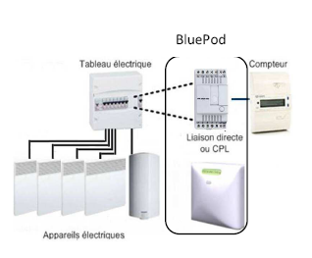
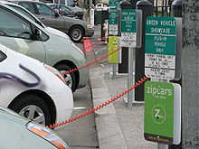

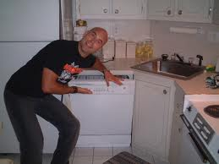
Demand Response
Some Demand can be delayed !
DSO provides best effort service with statistical guarantees [Keshav and Rosenberg 2010]
Voltalis Bluepod switches off thermal load for 30 mn
Programmable dishwasher
PeakSaver cycles AC for 15mn

Slide 4
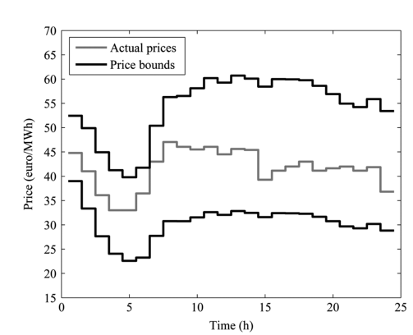
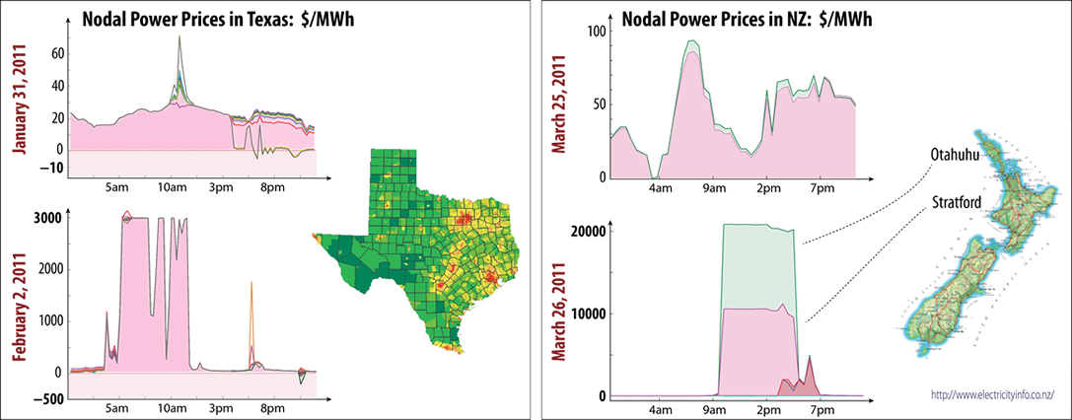
Price vs Quantity
Peaksaver, Bluepod act by quantity control
DSO/Aggregator switches off appliance
Price control often proposed as alternative
Users save when price is high
[Conejo et al, 2010]
[Meyn 2010] : high volatility is an inherent feature of electricity markets

Slide 5
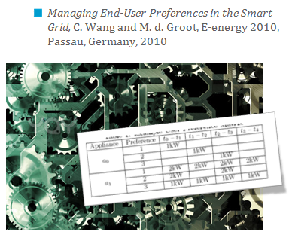
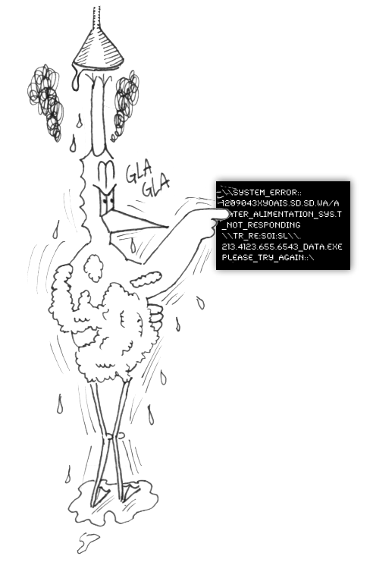
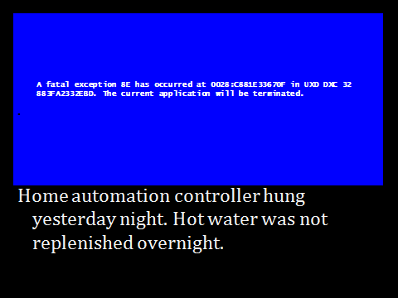
Centralized vs Distributed Control
Direct control by DSO/Aggregator for air conditioning, dryers
Not scalable, does not adapt to diversity and flexibility
Appliance control should be done close to end-users

Slide 6
Price Based Approach
Quantity Based Approach
+ Distributed, flexible, user can interact
- Volatility, Reconciliation, Predictability
+ Predictable costs
- Centralized, inflexible, no user input
Service Curve Approach
+ Distributed, flexible, user can interact
+ Predictable costs

Slide 7



Definition of Service Curve Approach
DSO
Instant power
Control by DSO
Service curve
contract
Customer agrees to be throttled, with a bound
Fixed price per kWh
Total load is controlled
Service curve

Slide 8
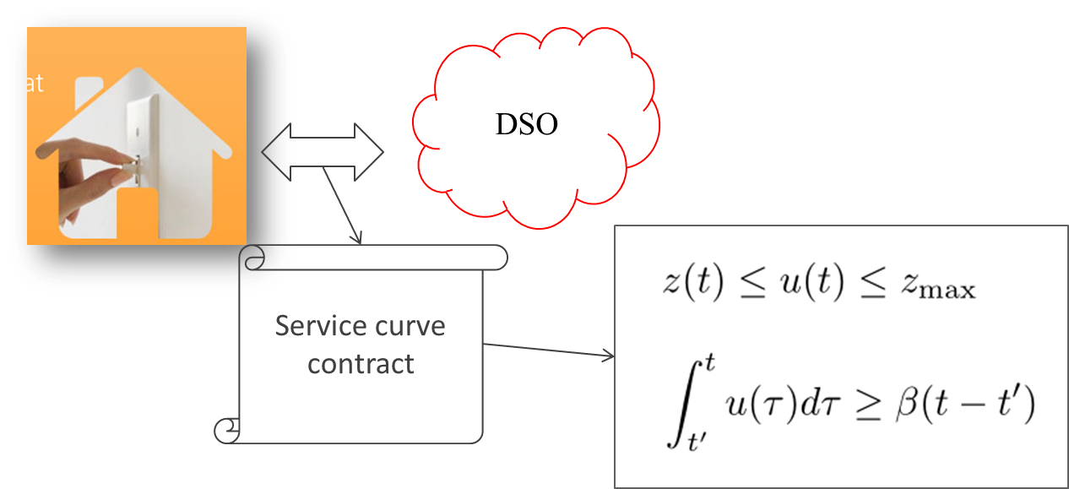
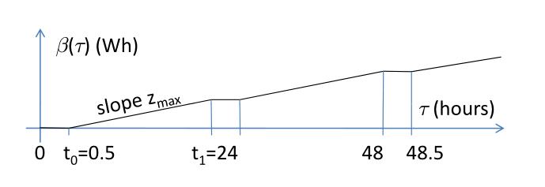
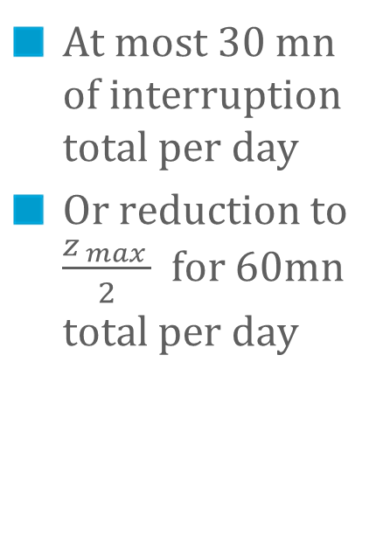
Example 1: Load Switching
At most 30 mn of interruption total per day
Or reduction to $\frac{z_{ max }}{2}$ for 60mn total per day

Slide 9
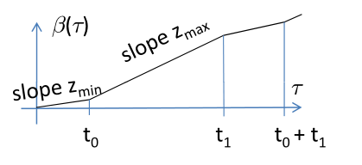
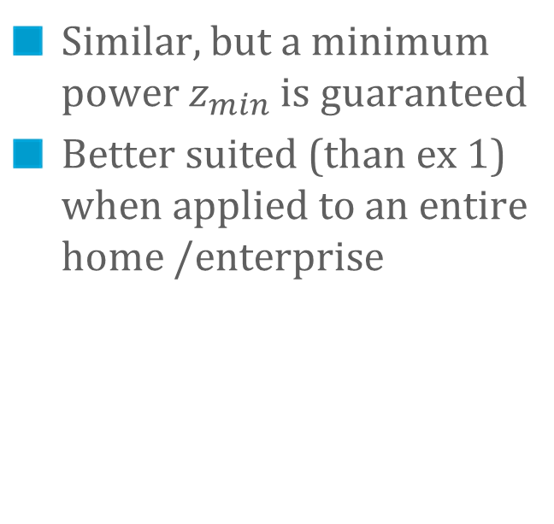
Example 2: Two Level Control
Similar, but a minimum power $z_{min}$ is guaranteed
Better suited (than ex 1) when applied to an entire home /enterprise

Slide 10
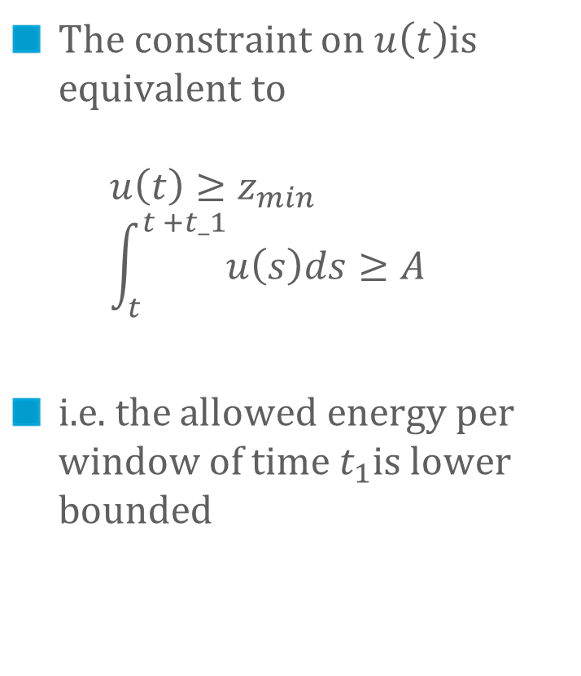
The Maths of Two-Level Control
The constraint on $u\left(t\right)$is equivalent to $u\left(t\right)≥z_{min}$ $\int_{t}^{t +t_1}{u\left(s\right)ds≥A}$
i.e. the allowed energy per window of time $t_{1}$is lower bounded

Slide 11

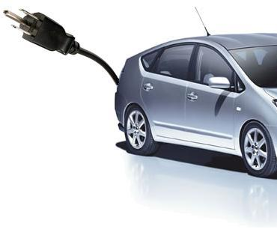
User Side Optimization
User can observe past signals and predict worst case future
Smart home controller can manage load accordingly [LeBoudec Tomozei 2011]

Slide 12
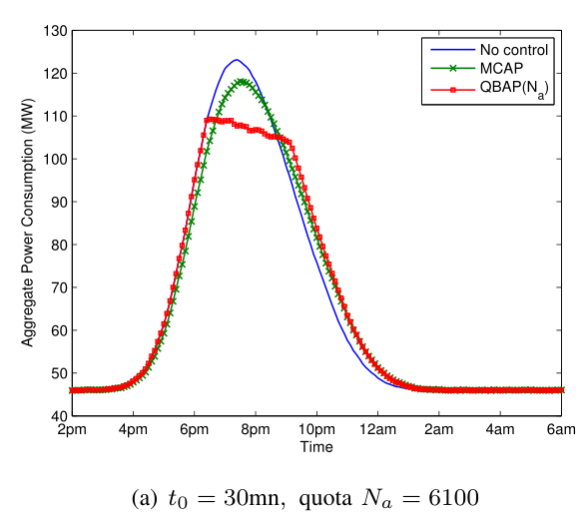
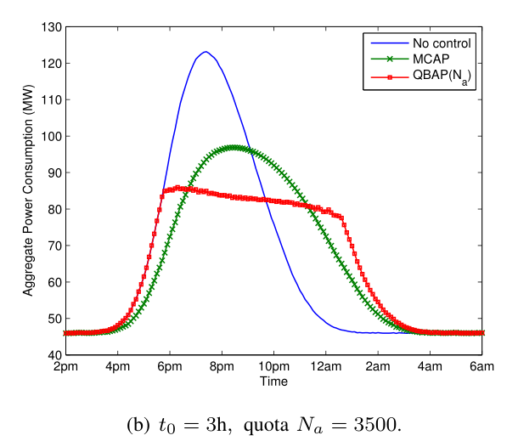
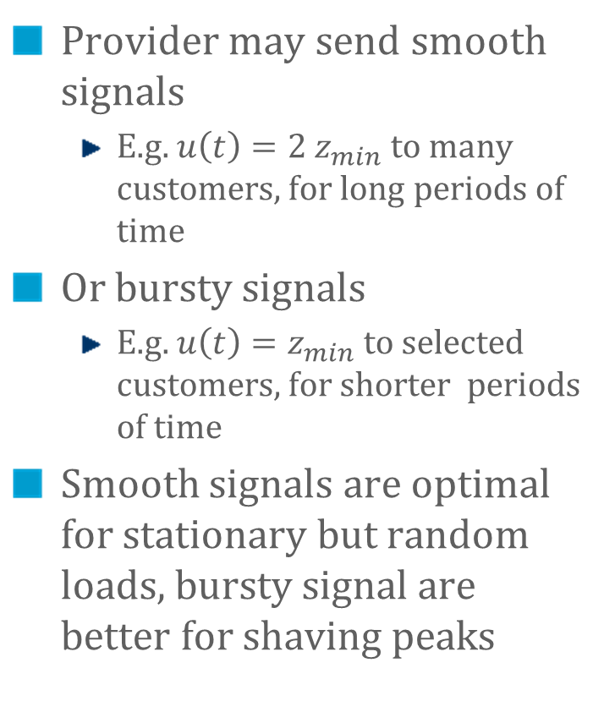
Provider Side Optimization
Provider may send smooth signals
E.g. $u\left(t\right)={2 z}_{min}$ to many customers, for long periods of time
Or bursty signals
E.g. $u\left(t\right)=z_{min}$ to selected customers, for shorter periods of time
Smooth signals are optimal for stationary but random loads, bursty signal are better for shaving peaks

Slide 13
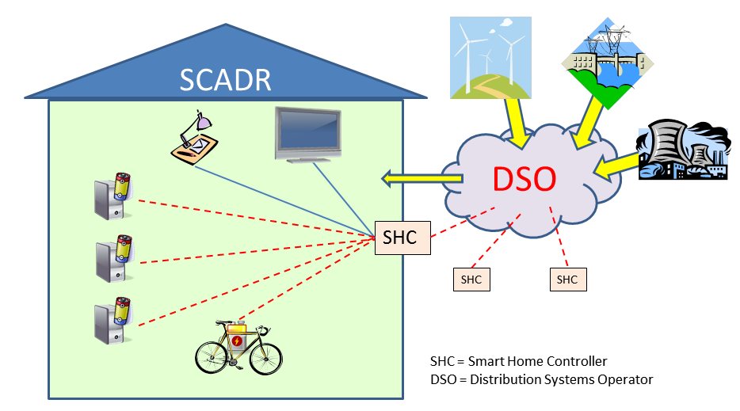
EPFL Testbed

Slide 14
Conclusions
We propose a service curve approach to demand response
Distributed Applies to total customer load Provides large flxibility to provider Protects user from price uncertainty
[Le Boudec Tomezei 2011] Le Boudec J.Y. and Tomozei, D.C “Demand Response Using Service Curves”, EPFL-REPORT-168868,
https://infoscience.epfl.ch/record/168868, 2011

