Slide 1
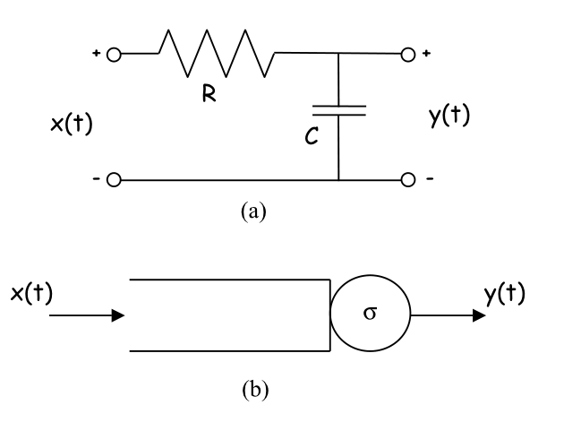
The System Theory of Network Calculus
J.-Y. Le Boudec
EPFL
WoNeCa, 2012 Mars 21

Slide 2
Contents
Network Calculus’s System Theory and Two Simple Examples
More Examples
Time versus Space

Slide 3
The Shaper
fresh traffic
σ
shaped traffic
σ-smooth
R
R*
shaper: forces output to be constrained by σ
greedy shaper stores data in a buffer only if needed
examples:
constant bit rate link (σ(t)=ct)
ATM shaper; fluid leaky bucket controller
Pb: find input/output relation

Slide 4

A Min-Plus Model of Shaper
fresh traffic
σ
shaped traffic
σ-smooth
R
x
Shaper Equations: (1) $x≤ x⊗σ$ (2) $x≤ R$
$R$ and $x$ are functions
$σ$ is sub-additive
$⊗$ is min-plus convolution

Slide 5
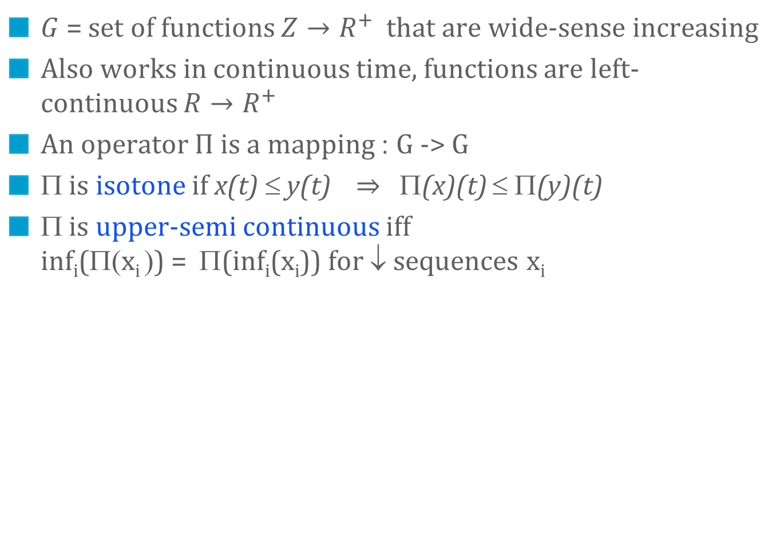
Network Calculus’s System Theory
$G$ = set of functions $Z→R^{+}$ that are wide-sense increasing
Also works in continuous time, functions are left-continuous $R→R^{+}$
An operator $Π$ is a mapping : G -> G
Π is isotone if x(t) ≤ y(t) $⇒$ Π(x)(t) ≤ Π(y)(t)
Π is upper-semi continuous iff inf_{i}(Π(x_{i} )) = Π(inf_{i}(x_{i})) for ↓ sequences x_{i}

Slide 6
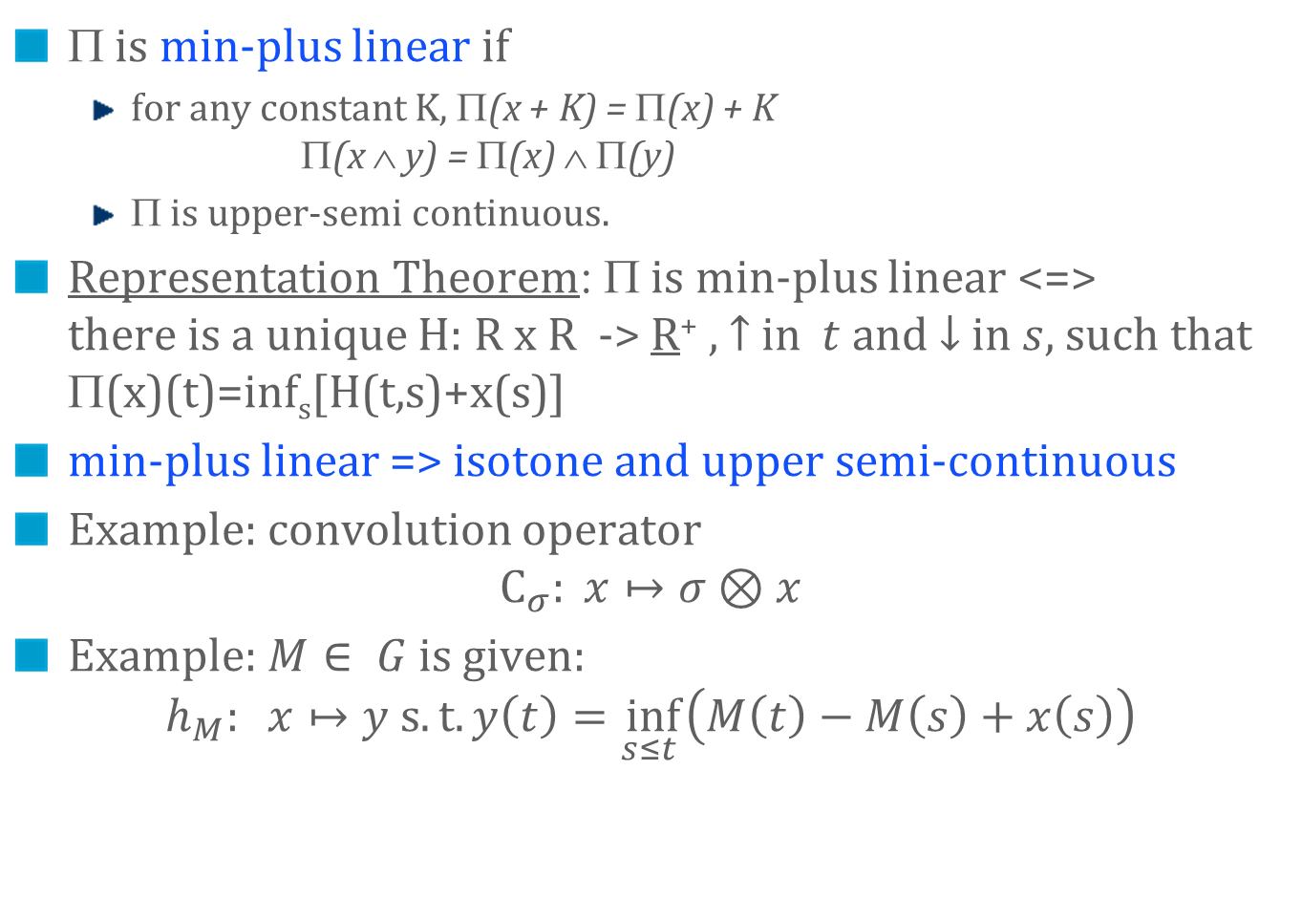
Min-Plus Linear Operators
Π is min-plus linear if
for any constant K, Π(x + K) = Π(x) + K Π(x ∧ y) = Π(x) ∧ Π(y)
Π is upper-semi continuous.
Representation Theorem: Π is min-plus linear <=> there is a unique H: R x R -> R⁺ , $↑$ in $t$ and $↓$in $s$, such that Π(x)(t)=inf_{s}[H(t,s)+x(s)]
min-plus linear => isotone and upper semi-continuous
Example: convolution operator $C_{σ}: x↦σ⊗x$
Example: $M∈ G$ is given: $h_{M}: x↦y s.t. y\left(t\right)=\inf_{s≤t }\left(M\left(t\right)−M\left(s\right)+x\left(s\right)\right)$

Slide 7
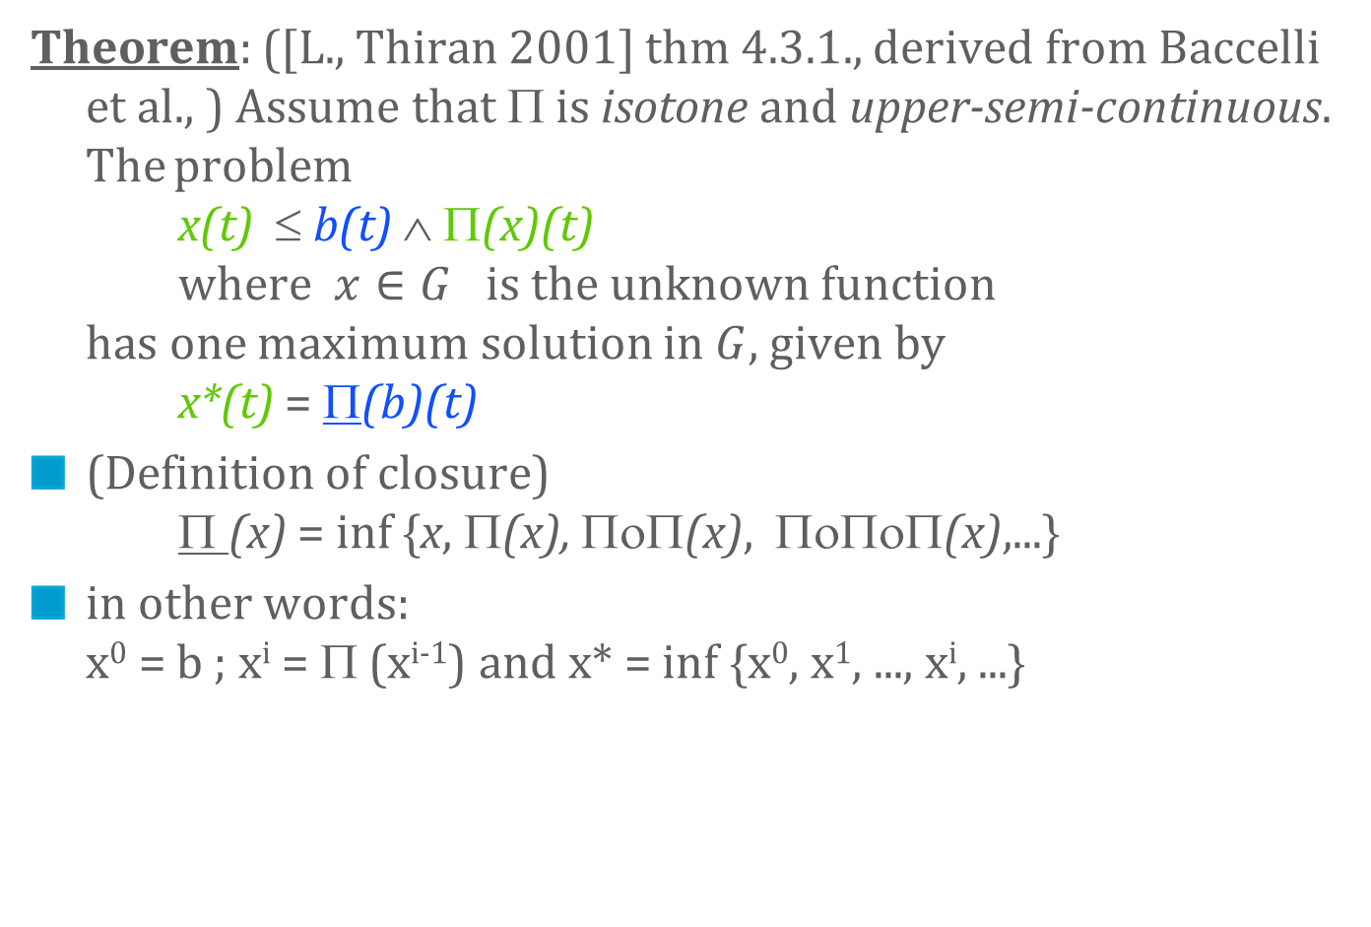
Min-Plus Residuation Theorem
Theorem: ([L., Thiran 2001] thm 4.3.1., derived from Baccelli et al., ) Assume that Π is isotone and upper-semi-continuous. The problem x(t) ≤ b(t) ∧ Π(x)(t) where $x∈G$ is the unknown function has one maximum solution in $G$, given by x*(t) = Π(b)(t)
(Definition of closure) Π (x) = inf {x, Π(x), ΠοΠ(x), ΠοΠοΠ(x),...}
in other words: x⁰ = b ; x^{i} = Π (x^{i-1}) and x* = inf {x⁰, x¹, ..., x^{i}, ...}

Slide 8
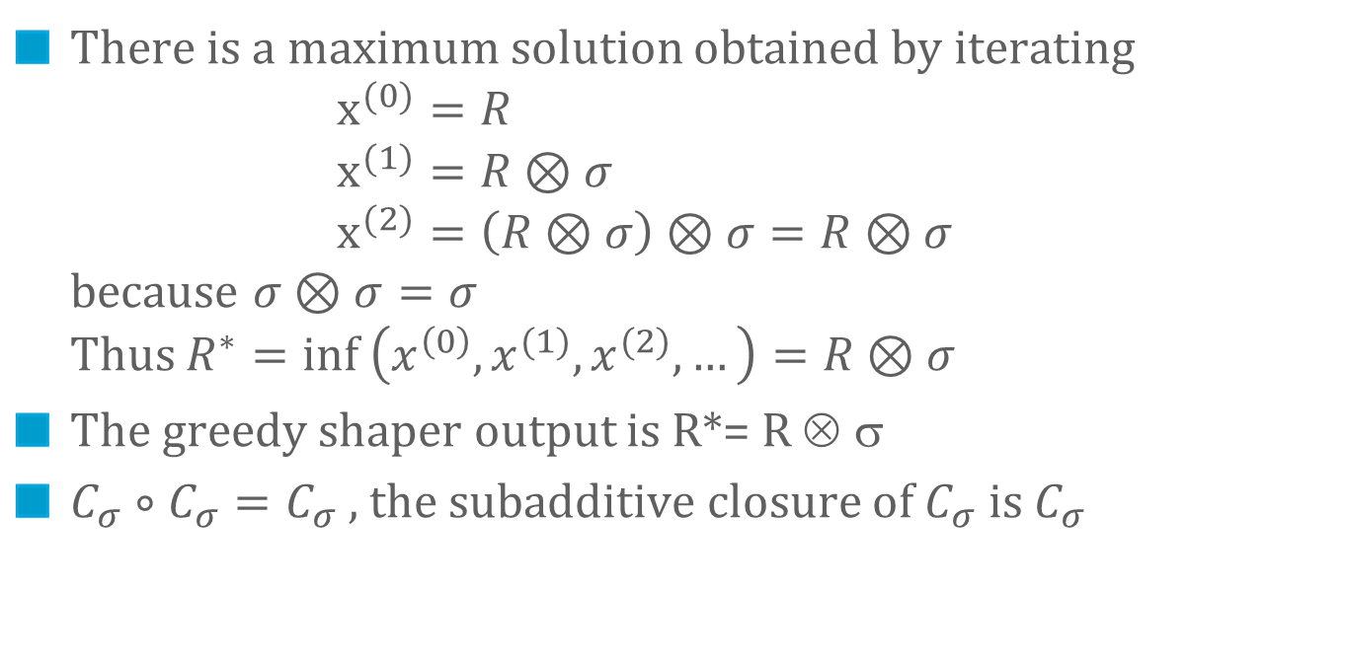
Application to Shaper
(1) x ≤ x ⊗ σ
(2) x ≤ R
fresh traffic
σ
shaped traffic
σ-smooth
R
R*
There is a maximum solution obtained by iterating $x^{(0)}=R$ $x^{(1)}=R⊗σ$ $x^{(2)}=\left(R⊗σ\right)⊗σ=R⊗σ$ because $σ⊗σ=σ$ Thus $R^{∗}=inf \left(x^{\left(0\right)}, x^{(1)},x^{(2)},…\right)=R⊗σ$
The greedy shaper output is R*= R ⊗ σ
$C_{σ}∘C_{σ}=C_{σ}$ , the subadditive closure of $C_{σ}$is $C_{σ}$

Slide 9
Variable Capacity Node
fresh traffic
μ(t)
R
R*
node has a time varying capacity µ(t) Define M(t) =∫₀^{t} μ(s) ds.
the output satisfies R*(t) ≤ R(t) R*(t) -R*(s) ≤ M(t) -M(s) for all s ≤ t and is “as large as possible”

Slide 10
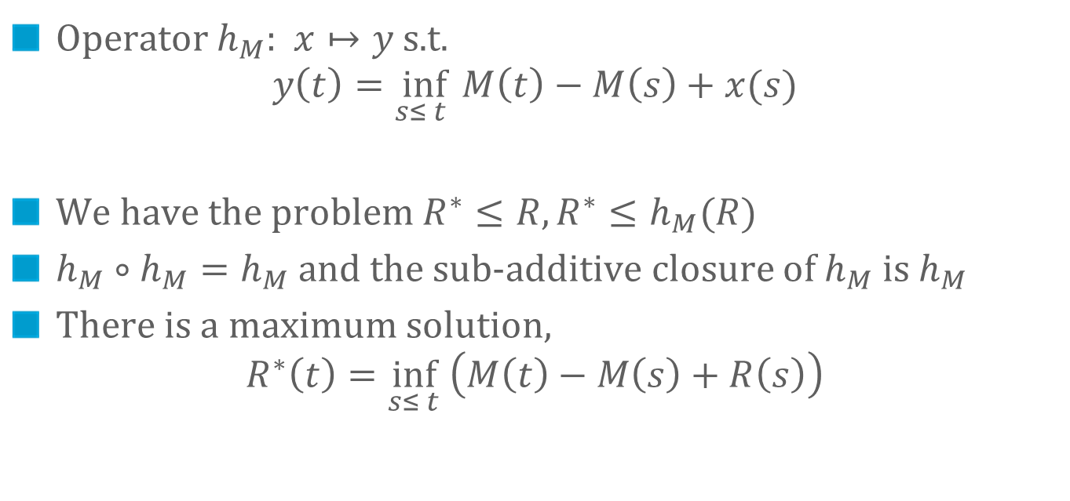
Variable Capacity Node
R*(t) ≤ R(t) R*(t) -R*(s) ≤ M(t) -M(s) for all s ≤ t
fresh traffic
μ(t)
R
R*
Operator $h_{M}$: $x↦y$s.t. $y\left(t\right)=\inf_{s≤ t } M\left(t\right)−M\left(s\right)+x(s)$
We have the problem $R^{∗}≤R, R^{∗}≤h_{M}(R)$
$h_{M}∘h_{M}=h_{M}$ and the sub-additive closure of $h_{M}$ is $h_{M}$
There is a maximum solution,
$$R^{∗}\left(t\right)=\inf_{s≤ t} \left(M\left(t\right)−M\left(s\right)+R\left(s\right)\right)$$

Slide 11
MORE examples
2.

Slide 12
A System with Loss [Chuang and Cheng 2000]
Loss L(t)
fresh traffic
R(t)
β
R’(t)
R*(t)
buffer X
node with service curve β(t) and buffer of size X
when buffer is full incoming data is discarded
modelled by a virtual controller (not buffered)
fluid model or fixed sized packets
Pb: find loss ratio

Slide 13


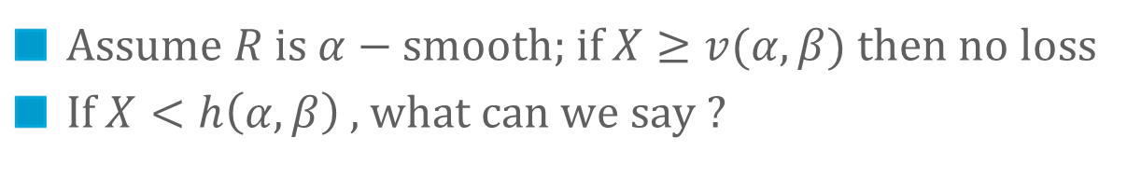



A System with Loss
Loss L(t)
fresh traffic
R(t)
β
R’(t)
R*(t)
buffer X
Assume $R$ is $α−$smooth; if $X≥v(α, β)$ then no loss
If $X<h\left(α, β\right)$ , what can we say ?
$α$(t)
$$v(α, β)$$
$$β(t)$$
$$X$$
$$t$$

Slide 14

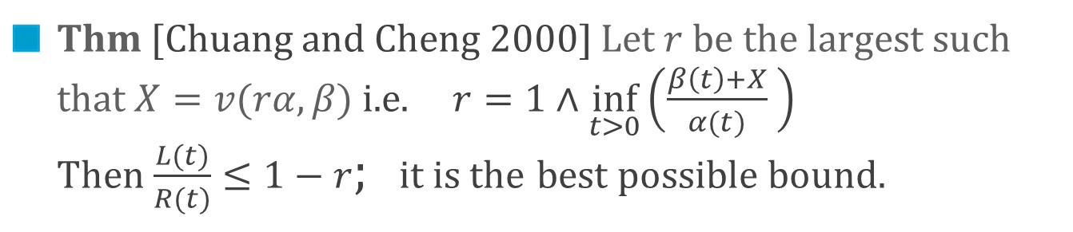



Bound on Loss Ratio
Loss L(t)
fresh traffic
R(t)
β
R’(t)
R*(t)
buffer X
Thm [Chuang and Cheng 2000] Let $r$ be the largest such that $X=v(rα, β)$ i.e. $r=1∧\inf_{t>0}\left(\frac{β\left(t\right)+X}{α(t)} \right)$ Then $\frac{L(t)}{R(t)}≤1−r$; it is the best possible bound.
$α$(t)
$r α$(t)
$$v(α, β)$$
$$β(t)$$
$$X$$
$$β(t)$$
$$X=v(rα, β)$$
$$t$$
$$t$$

Slide 15

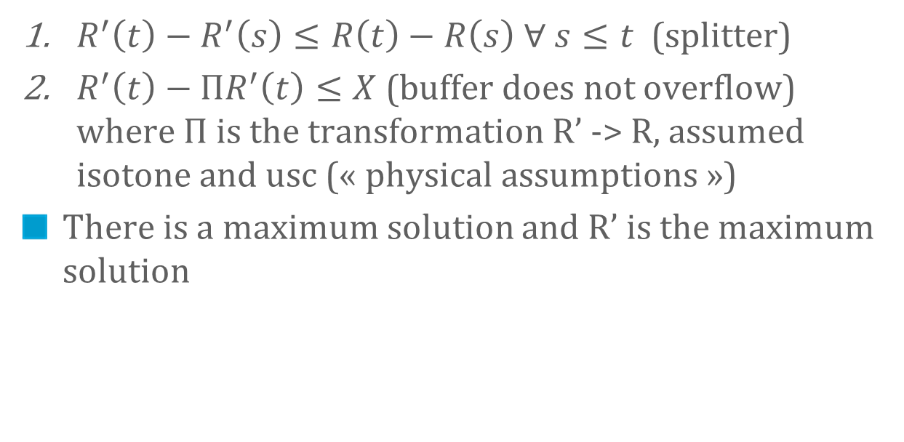
Analysis of System with Loss
Loss L(t)
fresh traffic
R(t)
β
R’(t)
R*(t)=$(ΠR′)(t)$
buffer X
$R^{′}\left(t\right)−R^{′}\left(s\right)≤R\left(t\right)−R\left(s\right) ∀ s≤t$ (splitter)
$R^{′}\left(t\right)−ΠR^{′}\left(t\right)≤X$ (buffer does not overflow) where $Π$ is the transformation R’ -> R, assumed isotone and usc (« physical assumptions »)
There is a maximum solution and R’ is the maximum solution

Slide 16
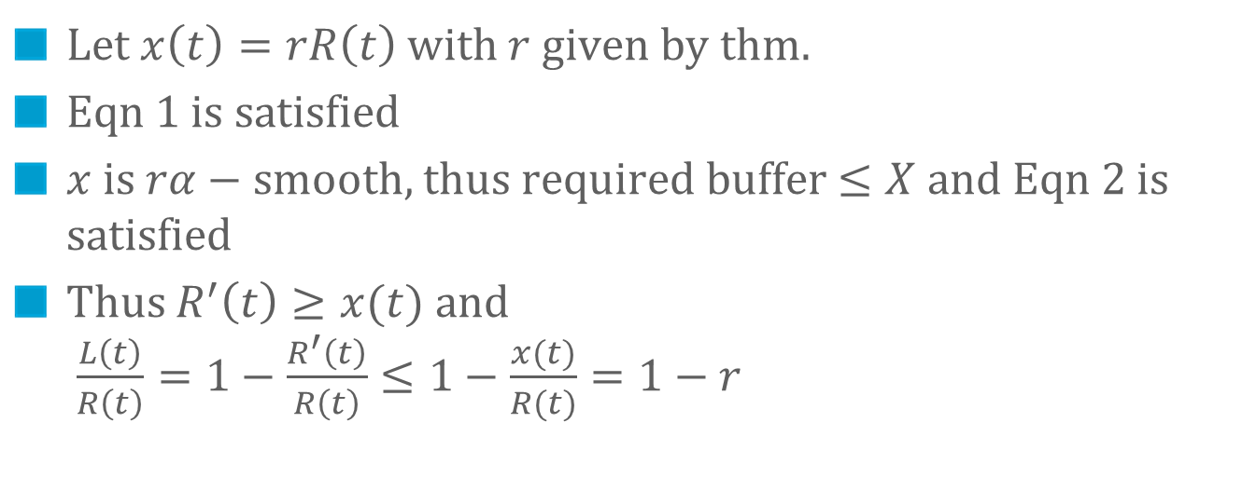

Analysis of System with Loss
Loss L(t)
fresh traffic
R(t)
β
R’(t)
R*(t)=$(ΠR′)(t)$
buffer X
Let $x\left(t\right)=rR\left(t\right)$ with $r$ given by thm.
Eqn 1 is satisfied
$x$ is $rα−$ smooth, thus required buffer $≤X$ and Eqn 2 is satisfied
Thus $R^{′}\left(t\right)≥x(t)$ and $\frac{L\left(t\right)}{R\left(t\right)}=1−\frac{R^{′}\left(t\right)}{R\left(t\right)}≤1−\frac{x(t)}{R(t)}=1−r$

Slide 17
Optimal Smoothing [L.,Verscheure 2000]
Video
server
Network
Video
display
Smoother
R(t)
R’(t)

R*(t)
R(t-D)
ß(t)
B
σ
Network + end-client offer a service curve β to flow R’(t)
Smoother delivers a flow R’(t) conforming to an arrival curve σ.
Video stream is stored in the client buffer, read after a playback delay D.
Pb: which smoothing strategy minimizes D?

Slide 18
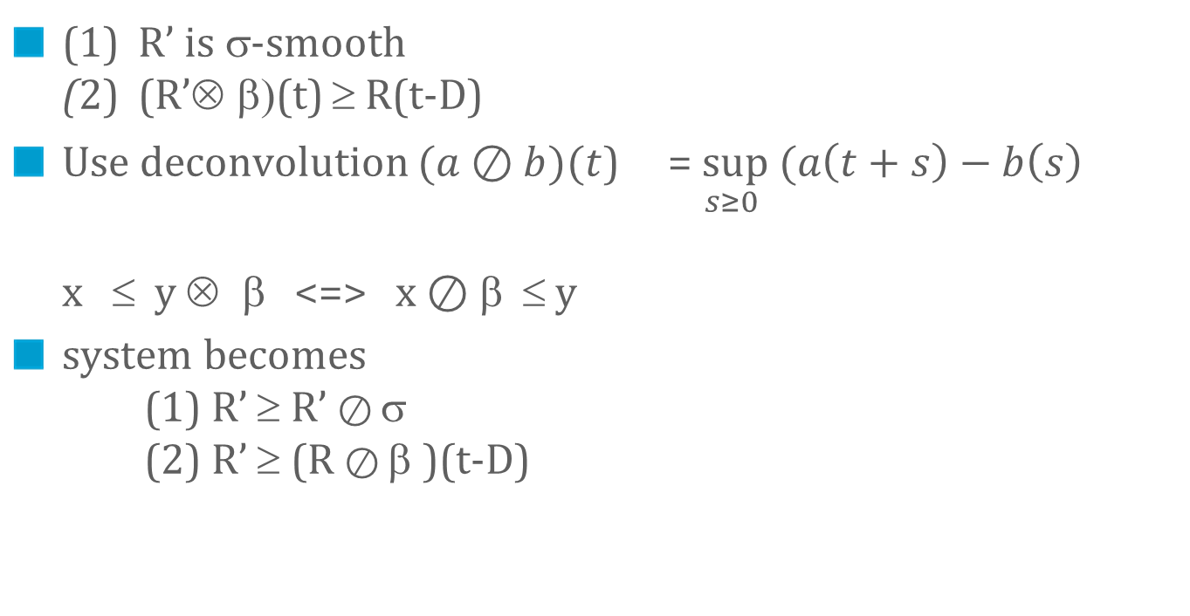
Optimal Smoothing, System Equations
Video
server
Network
Video
display
Smoother
R(t)
R’(t)

R*(t)
R(t-D)
ß(t)
B
σ
(1) R’ is σ-smooth (2) (R’⊗ β)(t) ≥ R(t-D)
Use deconvolution $(a⊘b)(t$) = $\sup_{s≥0 } (a\left(t+s\right)−b\left(s\right)$ x ≤ y ⊗ β <=> x $⊘$β ≤ y
system becomes (1) R’ ≥ R’ $⊘$ σ (2) R’ ≥ (R $⊘$ β )(t-D)

Slide 19
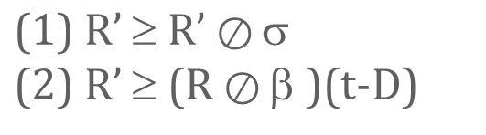
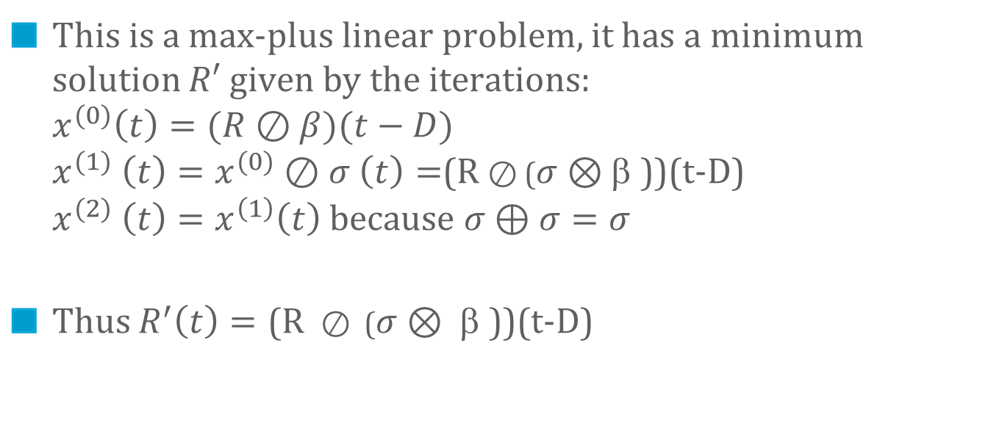
Optimal Smoothing, System Equations
Video
server
Network
Video
display
Smoother
R(t)
R’(t)

R*(t)
R(t-D)
ß(t)
B
σ
This is a max-plus linear problem, it has a minimum solution $R′$ given by the iterations: $x^{(0)}\left(t\right)=(R⊘β)(t−D)$ $x^{(1)} \left(t\right)=x^{(0)}⊘σ$ $\left(t\right)=$(R $⊘$ ($σ⊗$β ))(t-D) $x^{(2)} \left(t\right)=x^{\left(1\right)}\left(t\right)$ because $σ⊕σ=σ$
Thus $R^{′}\left(t\right)=\text{(}\text{R} ⊘\text{ (}σ⊗ \text{β }\text{))(}\text{t}\text{−}\text{D}\text{)}$

Slide 20
Example
5
4
3
2
1
* 10⁶
a possible R’(t)
R(t-D)
R ∅ (σ ⊗ β)(t-D)
σ ⊗ β(t)
-50 0 50 100 150 200 250 300 350 400 450
Frame #

Slide 21

Minimum Playback Delay
D must satisfy : R $⊘$ (β ⊗ σ) (-D) ≥ 0
this is equivalent to D ≥ h(R, β ⊗ σ)

Slide 22
R(t)
10000
70
60
50
8000
40
30
D = 435 ms
20
10
6000
100
200
300
400
(σ ⊗ β)(t)
4000
2000
100
200
300
400
10000
70
D = 102 ms
60
8000
50
40
30
6000
20
10
(σ ⊗ β)(t)
4000
100
200
300
400
2000
100
200
300
400

Slide 23
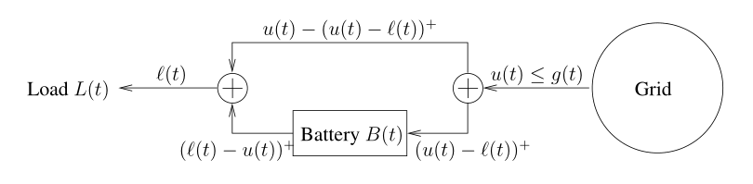
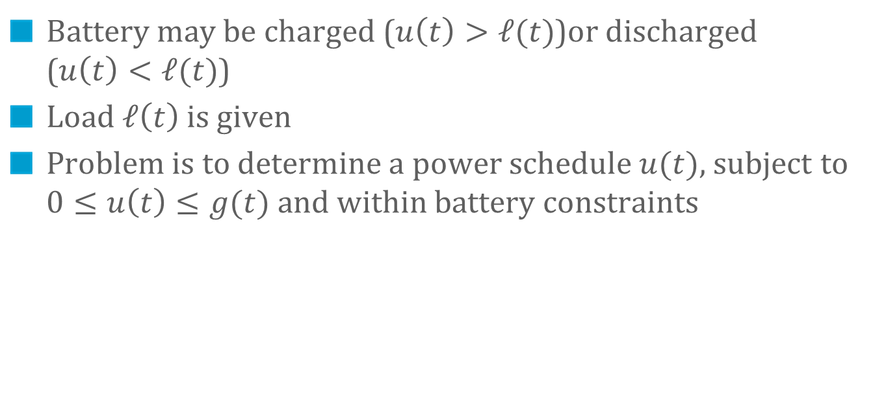
The Perfect Battery
Battery may be charged ($u\left(t\right)>ℓ(t)$)or discharged ($u\left(t\right)<ℓ(t)$)
Load $ℓ\left(t\right)$ is given
Problem is to determine a power schedule $u(t)$, subject to $0≤u\left(t\right)≤g(t)$ and within battery constraints

Slide 24
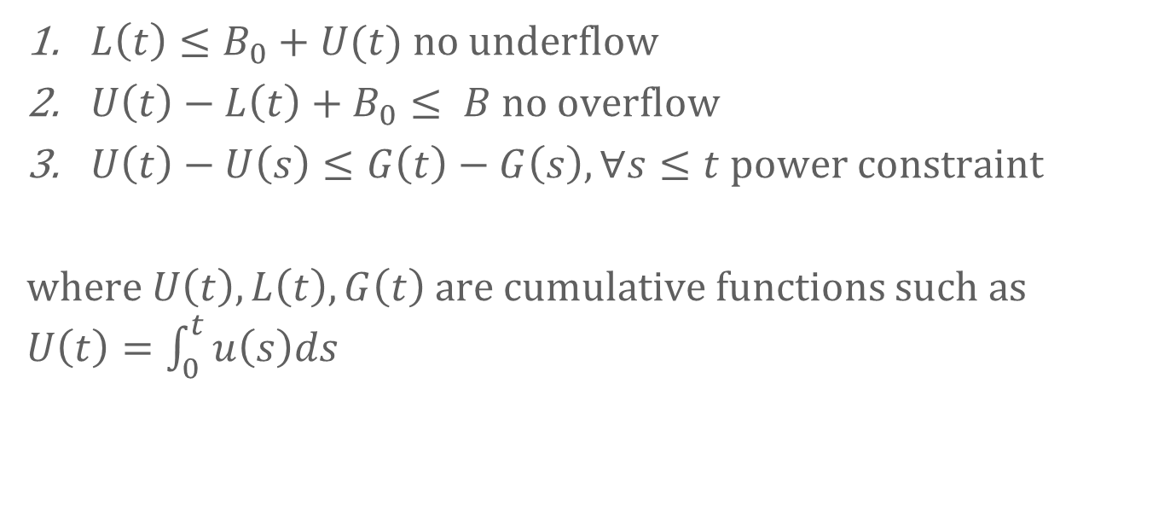
System Equations for the Perfect Battery
$L\left(t\right)≤B_{0}+U(t)$ no underflow
$U\left(t\right)−L\left(t\right)+B_{0}≤ B$ no overflow
$U\left(t\right)−U\left(s\right)≤G\left(t\right)−G\left(s\right), ∀s≤t$ power constraint
where $U\left(t\right), L\left(t\right), G\left(t\right)$ are cumulative functions such as $U\left(t\right)=\int_{0}^{t}{u\left(s\right)ds}$

Slide 25
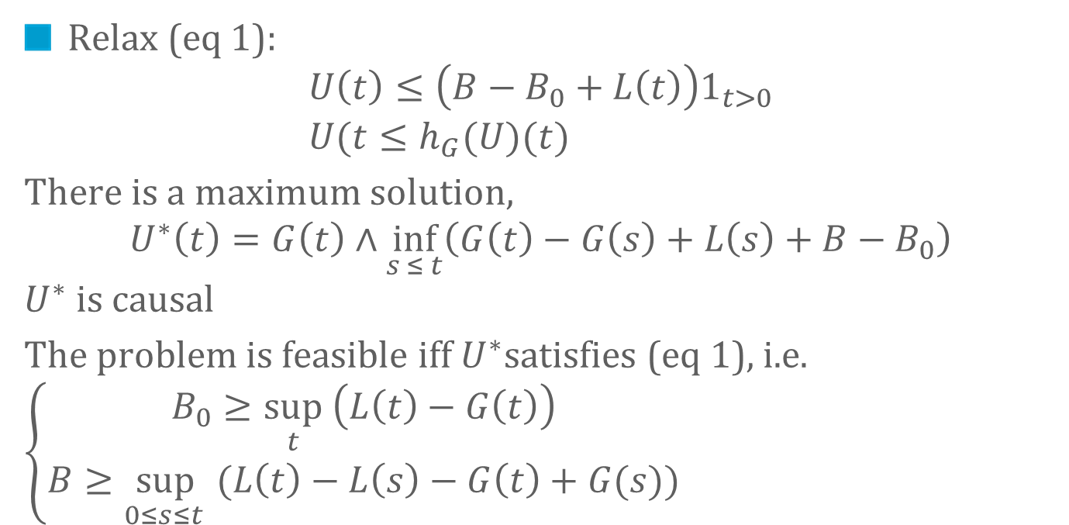
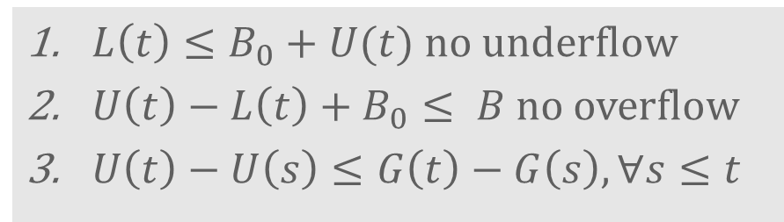
System Equations
$L\left(t\right)≤B_{0}+U(t)$ no underflow
$U\left(t\right)−L\left(t\right)+B_{0}≤ B$ no overflow
$U\left(t\right)−U\left(s\right)≤G\left(t\right)−G\left(s\right), ∀s≤t$
Relax (eq 1):
$$U\left(t\right)≤\left(B−B_{0}+L\left(t\right)\right)1_{t>0} \\ U(t≤h_{G}(U)(t)$$
There is a maximum solution, $$U^{∗}\left(t\right)=G\left(t\right)∧\inf_{s ≤ t}\left(G\left(t\right)−G\left(s\right)+L\left(s\right)+B−B_{0}\right)$$ $U^{∗}$ is causal
The problem is feasible iff $U^{∗}$satisfies (eq 1), i.e. $\left\{\begin{aligned}B_{0}≥\sup_{t} \left(L\left(t\right)−G\left(t\right)\right) \\ B≥\sup_{0≤s≤t }(L\left(t\right)−L\left(s\right)−G\left(t\right)+G(s))\end{aligned}\right.$

Slide 26
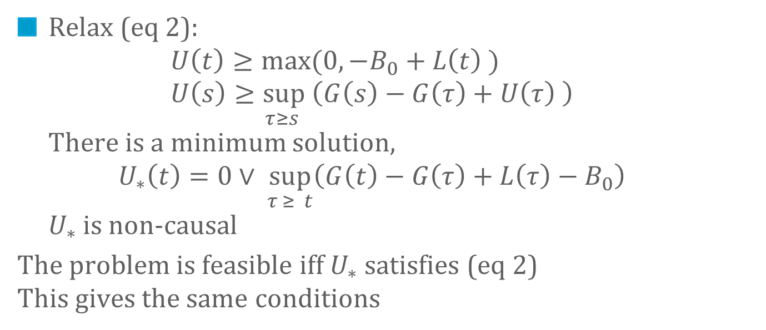

System Equations
$L\left(t\right)≤B_{0}+U(t)$ no underflow
$U\left(t\right)−L\left(t\right)+B_{0}≤ B$ no overflow
$U\left(t\right)−U\left(s\right)≤G\left(t\right)−G\left(s\right), ∀s≤t$
Relax (eq 2): $U\left(t\right)≥max(0,−B_{0}+L\left(t\right) )$ $U\left(s\right)≥\sup_{τ≥s } \left(G\left(s\right)−G\left(τ\right)+U\left(τ\right) \right)$ There is a minimum solution, $U_{∗}\left(t\right)=0∨ \sup_{τ ≥ t}\left(G\left(t\right)−G\left(τ\right)+L\left(τ\right)−B_{0}\right)$ $U_{∗}$ is non-causal
The problem is feasible iff $U_{∗}$satisfies (eq 2) This gives the same conditions

Slide 27
TIME versus Space
3.

Slide 28

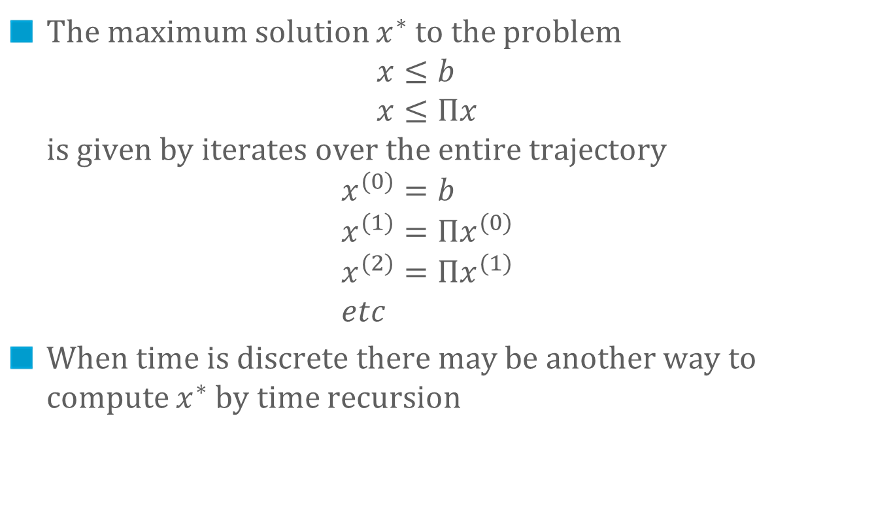
The Residuation Theorem is a Space Method
The maximum solution $x^{∗}$ to the problem $x≤b$ $x≤Πx$ is given by iterates over the entire trajectory $x^{(0)}=b$ $x^{(1)}=Πx^{(0)}$ $x^{(2)}=Πx^{(1)}$ $etc$
When time is discrete there may be another way to compute $x^{∗}$ by time recursion

Slide 29
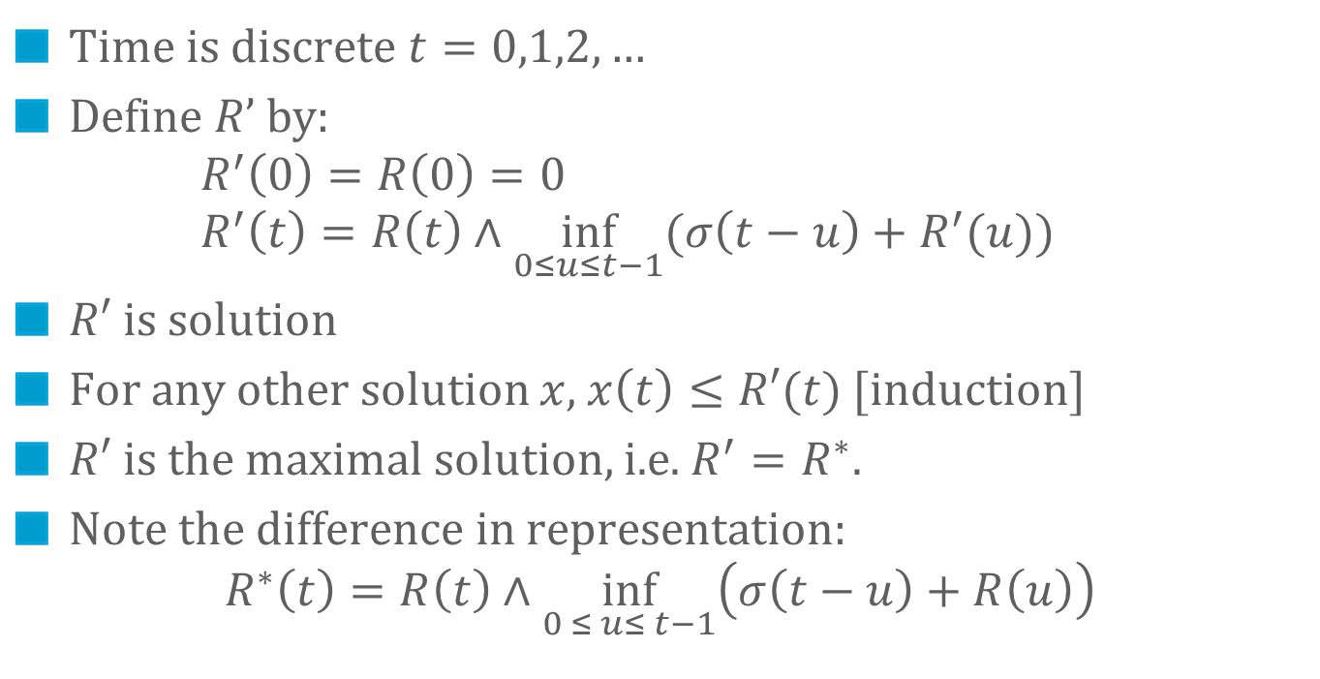
The Shaper, Time Method
(1) x ≤ x ⊗ σ
(2) x ≤ R
fresh traffic
σ
shaped traffic
σ-smooth
R
R*
Time is discrete $t=0,1,2,…$
Define $R’$by: $R^{′}\left(0\right)=R\left(0\right)=0$ $R^{′}\left(t\right)=R\left(t\right)∧\inf_{0≤u≤t−1}(σ\left(t−u\right)+R^{′}(u))$
$R′$ is solution
For any other solution $x$, $x\left(t\right)≤R′(t)$ [induction]
$R′$ is the maximal solution, i.e. $R^{′}=R^{∗}.$
Note the difference in representation: $R^{∗}\left(t\right)=R\left(t\right)∧\inf_{0 ≤ u≤ t−1}\left(σ\left(t−u\right)+R\left(u\right)\right)$

Slide 30
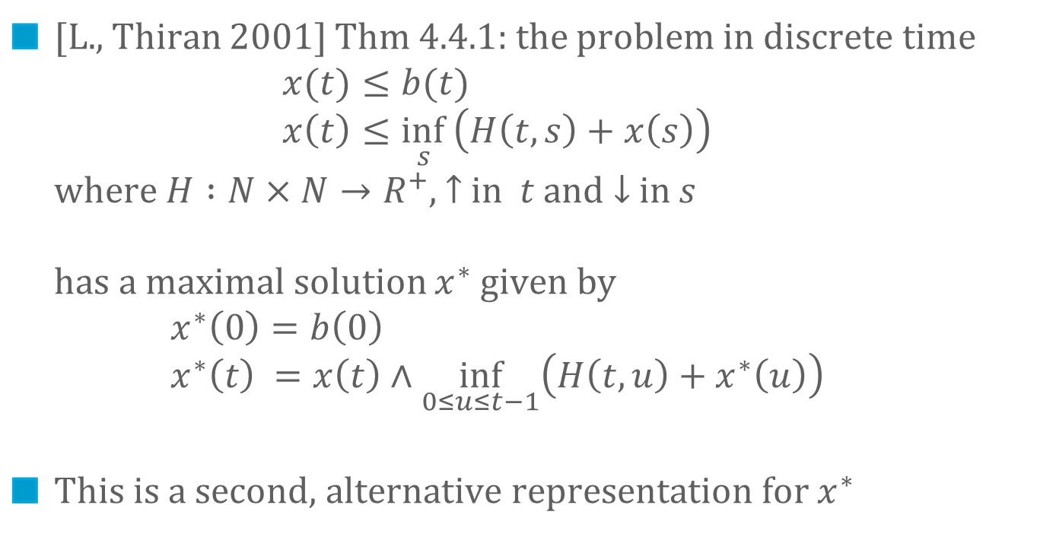
The Time Method for Linear Problems
[L., Thiran 2001] Thm 4.4.1: the problem in discrete time $x(t)≤b(t)$ $x\left(t\right)≤\inf_{s }\left(H\left(t,s\right)+x\left(s\right)\right)$ where $H :N×N→R^{+}$, $↑$ in $t$ and $↓$in $s$ has a maximal solution $x^{∗}$ given by $x^{∗}\left(0\right)=b\left(0\right)$ $x^{∗}\left(t\right) =x\left(t\right)∧\inf_{0≤u≤t−1}\left(H\left(t,u\right)+x^{∗}\left(u\right)\right)$
This is a second, alternative representation for $x^{∗}$

Slide 31
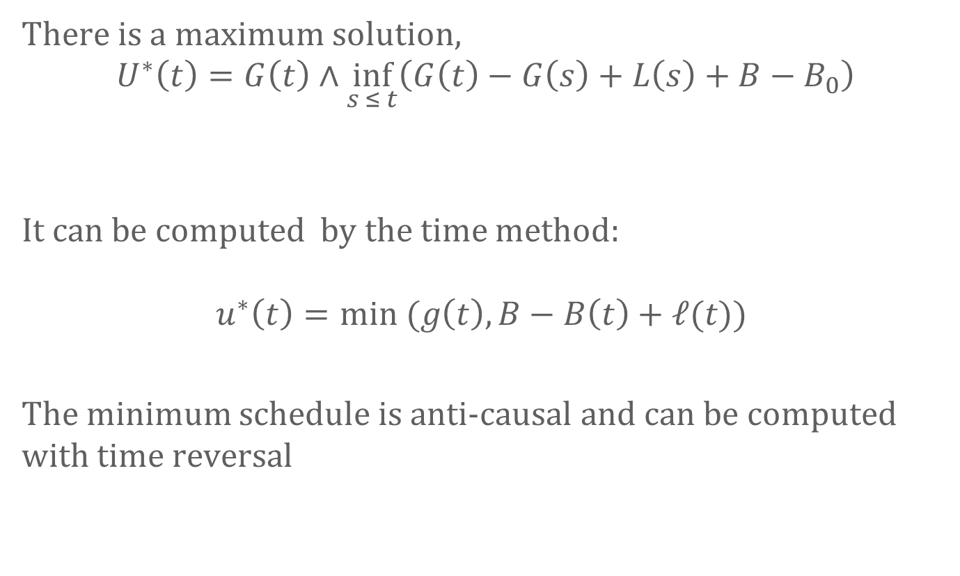
Perfect Battery
There is a maximum solution, $$U^{∗}\left(t\right)=G\left(t\right)∧\inf_{s ≤ t}\left(G\left(t\right)−G\left(s\right)+L\left(s\right)+B−B_{0}\right)$$
It can be computed by the time method:
$$u^{∗}\left(t\right)=min (g\left(t\right), B−B\left(t\right)+ℓ(t))$$
The minimum schedule is anti-causal and can be computed with time reversal

Slide 32
Conclusion
Min-plus and max-plus system theory contains a central result : residuation theorem ( = fixed point theorem) Establishes existence of maximum (resp. minimum) solutions and provides a representation
Space and Time methods give different representations

Slide 33
Thank You…

