Slide 1


A Short Course on Network Calculus
Jean-Yves Le Boudec
Patrick Thiran
ICA, EPFL
CH-1015 Ecublens
leboudec@epfl.ch
http://icawww.epfl.ch

Slide 2

The Network Calculus Book
available on-line (free download) from
Le Boudec’s or Thiran’s home page
or
ica1www.epfl.ch/PS_files/NetCal.htm
this presentation : based on chapters 1, 5 and 6 of the online version

Slide 3
Contents
1. What is “Network Calculus” ?
2. Preliminary Concepts
Sections 1.2, 1.3, 1.4.1
3. Another linear system theory: Min-Plus
Section 3.1
4. The composition theorem
Section 1.4.2
5. Optimal Shaping
Section 1.5
6. Optimal Smoothing
Reference [54] Le Boudec Verscheure 2000
http://lcawww.epfl.ch/Publications/LeBoudec/LeBoudecV00.pdf
7. Diff-Serv Bounds
Section 2.4.2

Slide 4
1. What is Network Calculus ?
Deterministic analysis of queuing / flow systems arising in communication networks
Abstraction of schedulers
uses min, max as binary operators and integrals (min-plus. max-plus algebra)

Slide 5
A simple example
R(t)
X
CBR trunk
bit rate c
assume R(t) = sum of arrived traffic in [0, t] is known
required buffer for a bit rate c is
sup _{s ≤ t} {R(t) - R(s) - c (t-s)}

Slide 6

2. Preliminary Concepts
Arrival and Service Curves
Internet integrated services use the concepts of arrival curve and service curves

Slide 7
Arrival Curves
Arrival curve α:R(t) -R(s) ≤ α(t-s)
Examples:
leaky bucket α(u) = ru+b
standard arrival curve in the Internet
α(u) = min (pu+M, ru+b)
bits
slope r
b
slope m
M
time

Slide 8
Arrival Curves can be assumed sub-additive
Theorem: α can be replaced by a sub-additive function
sub-additive: α(s+t) ≤ α(s) + α(t)
concave => subadditive

Slide 9
Service Curve
System S offers a service curve β to a flow iff for all t there exists some s such that
R
R*(t)
R(s)
R*
s
t

Slide 10
The constant rate server has service curve β(t)=ct
buffer
s t
Proof: take s = beginning of busy period:
R*(t) – R*(s) = c (t-s)
R*(t) – R(s) = c (t-s)

Slide 11
The guaranteed-delay node has service curve δ_{T}
R
R*
δ_{T} (t)
≤ T
t
seconds
0 T
Function δ_{T}

Slide 12
The standard model for an Internet router
rate-latency service curve
bits
R
T
seconds

Slide 13
Tight Bounds on delay and backlog
If flow has arrival curve α and node offers service curve β then
backlog ≤ sup (α(s) -β(s))
delay ≤ h(α, β)
α
h(α, β)
backlog
β

Slide 14
Example
r
R
h(α, β)
b
x
T
delay bound: b/R + T
backlog bound: b + rT

Slide 15
3. Another linear system theory: Min-Plus
Standard algebra: R, +, ×
a × (b + c) = (a × b) + (a × c)
Min-Plus algebra: R, min, +
a + (b ∧ c) = (a + b) ∧ (a + c)

Slide 16
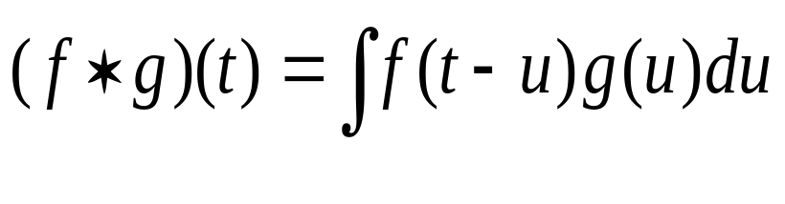
Min-plus convolution
Standard convolution:
Min-plus convolution
f ⊗ g (t) = inf_{u} { f(t-u) + g(u) }
g(t)
f(t)
(f ⊗ g)(t)
t

Slide 17
Examples of Min-Plus convolution
f ⊗ δ_{T} (t) = f (t-T)
convex piecewise linear curves, put segments end to end with increasing slope
r2
r2
⊗
s2
=
r1
r1
s1
s1
t1
u1
u1
u1 + t1

Slide 18
4. We can express arrival and service curves with min-plus
Arrival Curve property means
R ≤ R ⊗ α
Service Curve guarantee means
R* ≥ R ⊗ β

Slide 19
The composition theorem
Theorem: the concatenation of two network elements each offering service curve β_{i} offers the service curve β₁ ⊗ β₂
β₁
β₂
β₁ ⊗ β₂

Slide 20

Example
tandem of routers
R1
R1
⊗
R2
=
T1
T2
T2
T1+T2

Slide 21
Pay Bursts Only Once
D₁
D₂
α
β₁
β₂
D₁ +D₂ ≤ (2b + RT₁)/ R + T₁ + T₂
D
α
β₁⊗ β₂
D ≤ b /R + T₁ + T₂
end to end delay bound is less

Slide 22
5. Linear Characterization of Shapers
shaper σ
fresh traffic
β₁
β₂
R
R*
Definition: shaper
forces output to be constrained by σ
stores data in a buffer if needed
Theorem
Output of shaper is R* = R ⊗ σ

Slide 23
Proof of Shaper Theorem is a typical Min-Plus result
R*() is the maximum function x() such that
(1) x ≤ x ⊗ σ
(2)x ≤ R
Solution: x⁰ = R
x^{i} = x^{i-1} ⊗ σ
R* is given by R* = inf {x⁰, x¹, ..., x^{i}, ...}
Here: σ ⊗ σ = σ
x^{i} = R ⊗ σ for all i ≥ 1
R* = R ⊗ σ

Slide 24
Application: Re-shaping does not increase worst-case delay
shaper
σ ≥ α
fresh traffic
constrained by
α
β₂
β₁
Re-shaping is for free:
Proof :
h(α, β₁⊗ σ ⊗ β₂ ) = h(α, σ ⊗ β₁⊗ β₂ )= h(α, β₁⊗ β₂ )

Slide 25
Shaper Keeps Arrival Constraints
shaper σ
input traffic
constrained by α
R
R*
The output of the shaper is still constrained by α
Proof
R* = R ⊗ σ ≤ (R ⊗ α) ⊗ σ = ( R ⊗ σ ) ⊗ α = R* ⊗ α

Slide 26

6. Optimal Smoothing with pre-fecthing
Video
server
Network
Video
display
Smoother
R(t)
R’(t)
β
R*(t)
R(t-D)
ß(t)
σ
smoother is a scheduler which produces a σ-smooth output
may look-ahead
Q: given signal R(t), σ and β
what is the minimum playback delay D ?

Slide 27
System Equations
Video
server
Network
Video
display
Smoother
R(t)
R’(t)
β
R*(t)
R(t-D)
ß(t)
σ
(1) R’ is σ-smooth
(2) (R’⊗ β)(t) ≥ R(t-D)
R’(t) = 0 for t ≤ 0
Define min-plus deconvolution
(a Ø b)(t) = sup_{s ≥0} [a(s+t)-b(s)]
x ≤ y ⊗ β <-> x Ø β ≤ y

Slide 28
A max-plus model
Video
server
Network
Video
display
Smoother
R(t)
R’(t)
β
R*(t)
R(t-D)
ß(t)
σ
(1) R’ ≥ R’ Ø σ
(2) R’ ≥ (R Ø β )(t-D)
this is a max-plus problem, with minimum solution
x* = inf {x⁰, x¹, ..., x^{i}, ...}
x⁰ (t) = (R Ø β )(t-D)
x^{i} = x^{i-1} Ø σ
thus R’ = (R Ø β ) Ø σ (t-D) = R Ø (β ⊗ σ) (t-D)

Slide 29
Example
* 10⁶
σ ⊗ β(t)
5
4
3
2
1
R ∅ (σ ⊗ β)
R(t)
-50 0 50 100 150 200 250 300 350 400 450
minimum value of D
Frame #

Slide 30
Minimum Playback Delay
D must satisfy :
R Ø (β ⊗ σ) (-D) ≥ 0
this is equivalent to
D ≥ h(R, β ⊗ σ)

Slide 31
Back to our example
5
4
3
2
1
* 10⁶
D=h(R,σ ⊗ β)
σ ⊗ β(t)
R(t)
-50 0 50 100 150 200 250 300 350 400 450
Frame #

Slide 32
R(t)
10000
70
60
50
8000
40
30
D = 435 ms
20
10
6000
100
200
300
400
(σ ⊗ β)(t)
4000
2000
100
200
300
400
10000
70
D = 102 ms
60
8000
50
40
30
6000
20
10
(σ ⊗ β)(t)
4000
100
200
300
400
2000
100
200
300
400
Notes:
Ce théorème est le pendant du théorème de capacité

Slide 33
Other examples
Bounds for Diff-serv (chapter 2)
Packet Scale Rate Guarantee (chapter 7)
  used in the definition of EF (infocom 2001)

Slide 34
7. Diff-Serv Bounds
Problem Definition
Consider a network implementing aggregate scheduling
  For example: Expedited Forwarding (EF)
Problem: find a bound for the end-to-end delay variation that is
  valid for any network topology
  has closed form
  does not require per flow information

Slide 35
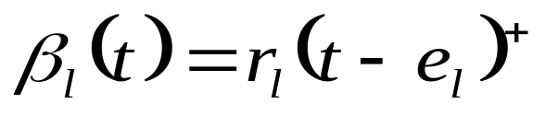
We assume aggregate scheduling and leaky bucket constraint microflows
ρ₅, σ₅
ρ₄, σ₄
ρ₆, σ₆
ρ₁, σ₁
r₁, e₁
r₂, e₂
ρ₂, σ₂
ρ₃, σ₃
r₃, e₃
r₄, e₄
microflows constrained by leaky buckets (ρ_{i}, σ_{i})
the aggregate receives a guaranteed service, with service curve

Slide 36
State of the art
Utilization factor ν = max_{l} (Σ _{f} ρ_{f} / r_{l})
Even if network is subcritical (ν <1), we don’t know:
  good bounds for a general topology
  if network is stable
M. Andrews presents an example of a network which is unstable for ν = 1 and claims it is also true for some ν < 1

Slide 37
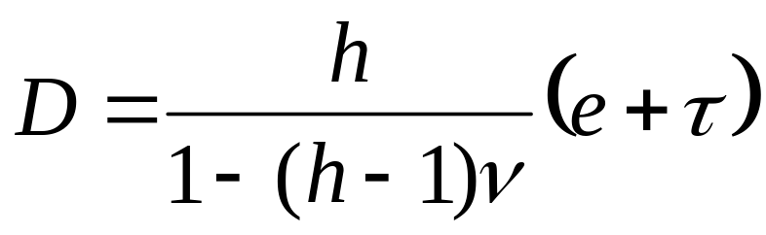
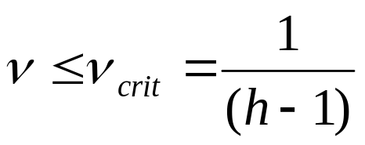
Our main result is a delay bound valid for small utilization factors
A better bound exists when peak rates C_{m} are known

Slide 38
Examples (h=10 hops)
D
C_{m} not known
C_{m} = 2 r
100 ms
0 ms
α
0.111
0.200
C_{m} not known
ν_{cri}= 1 / (h-1)
C_{m} = 2C
ν_{cri}= 2 / h

Slide 39
Derivation of the bound
Assume nodes are GR (orFIFO-per aggregate rate latency service curve elements)
1) Assume delay bound hD on low delay traffic (EF) exists, where h = max number of hops, D = max delay bound per node
2) An arrival curve of aggregate traffic at node i
α_{i}(t) = Σ_{m ∋ i} (ρ_{m}t + (h-1)ρ_{m}D + σ_{m}) = ν_{i}R_{i}t + (h-1) ν_{i}R_{i}D + ν_{i}R_{i} τ_{i}
where ν_{i} = (Σ_{m ∋ i} ρ_{m} )/R_{i} and τ_{i} = (Σ_{m ∋ i} σ_{m} )/ (Σ_{m ∋ i} r_{m} )
3) Compute horizontal distance between α_{i}(t) and β_{i}(t):
D_{i}= e_{i} + (h-1) ν_{i}D + ν_{i}τ_{i}
4) Deduce D <= (e + ντ)/(1 – (h-1)ν) where
e = max_{i} e_{i} , ν = max_{i} ν_{i} and τ = max_{i} τ_{i}
5) Show that finite bound exists
at any time t, and let t -> ∞
ν_{i}R_{i}
(h-1) ν_{i}R_{i}D + ν_{i}R_{i} τ_{i}
Di
Ri
Ti

Slide 40
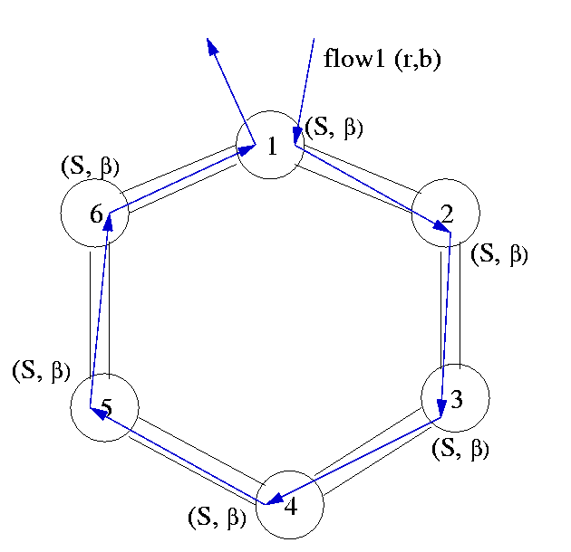
Is the bound tight ?
No
Consider only ν_{cri}
Example:
  Unidirectional ring with n nodes
  n flows, each of them going through n hops
  ν_{cri} = 1 [Tassiulas96]

Slide 41
Is the bound tight ?
1. No
2. Yes
However, the explosion may always occur at the point predicted by the bound
More precisely, if ν > 1 /(h−1), we can always construct a network where the worst case delay can be arbitrarily large

Slide 42
The elements in our toy network
internal node
one internal source
many transit sources
1 data
source
(h
-1)
kh
inputs
building block
1 output
h
-1 internal nodes
(h
-1)
kh
data sinks
If transit sources are able to send b packets back to back, then we can arrange the internal source to output a burst of b+1 packets

Slide 43
The output of level J-1 building blocks is a transit source for level J building blocks
level J-1
b packets back to back
level J
b+1 packets back to back

Slide 44
A network where α > α_{cri} with arbitrarily large delay
level J - 2
level J-1
level J
The worst-case delay at level J is at least Jτ, with τ depending only on α and h

Slide 45
Conclusion
Network Calculus is a set of tools and theories for the deterministic analysis of communication networks
Application of min-plus algebra
Explains and proves delay and backlog properties in networks
Book and slides available online at Le Boudec’s or Thiran’s home page

