Slide 1

Network calculus :
Jean-Yves Le Boudec and Patrick Thiran
LCA-ISC, I&C, EPFL
CH-1015 Lausanne
Jean-Yves.Leboudec Patrick.Thiran @epfl.ch
http://lcawww.epfl.ch

Slide 2

Contents
1. Greedy shapers and arrival curves, min-plus convolution
2. Service curves, backlog, delay bounds
3. Diffserv: intuition and formal definition behind EF
4. Min-plus algebra in action: Video smoothing
5. Statistical multiplexing with EF
free on-line at : http://lcawww.epfl.ch

Slide 3
What is Network Calculus ?
Deterministic analysis of queuing / flow systems arising in communication networks
Uses Min-Plus, Max-Plus and sometimes Min-Max algebra

Slide 4
The standard Linear Theory
+
+
x(t)
β(t)
y(t)
-
-
A LTI filter in conventional algebra (R, +, ×)
  Input signal = electrical voltage x(t)
  System = circuit (filter) with impulse response β(t)
  Output = convolution of x(t) and β(t) :
  y(t) = ∫ β(t-s) x(s) ds

Slide 5
Network Calculus uses Min-Plus Linear Theory
CBR shaper
x(t)
y(t)
bit rate c
A linear system in min-plus algebra (R, min, +)
  Input = arrived traffic in [0,t], x(t)
  System = CBR trunk of rate c : β(t) = ct
  Output = convolution of x(t) and β(t):
  y(t) = inf_{s} {β(t-s)+ x(s) }

Slide 6

Two key Concepts
Arrival and Service Curves
IntServ and DiffServ use the concepts of arrival curve and service curves

Slide 7
Contents
Arrival curves
  Arrival curve: definition
  Leaky bucket and GCRA
  Arrival curve and min-plus convolution
  Good arrival curves are sub-additive
  Minimal arrival curve and min-plus deconvolution
  Greedy shaper and its properties
  Packetization
2. Service curves, GPS, backlog, delay bounds
3. Diffserv: intuition and formal definition behind EF
4. Min-plus algebra in action: Video smoothing
5. Statistical multiplexing with EF

Slide 8
Cumulative flows
Cumulative flow R(t) ∈ F , t real or integer
F = { x(t) | x(t) is non decreasing and x(t) = 0 for t < 0 }
Examples:
bits
bits
bits
R1(t)
R2(t)
R3(t)
1
2
5
6
7
time t
1
5
5.5
time t
1
2
5
6
time t
Fluid model (continuous)
Packet model
(left continuous)
Discrete-time model
(left continuous)

Slide 9
Example
MPEG files, 25 frames/sec
R
R
α
α

Slide 10
Arrival Curves
Arrival curve α: For any times 0 ≤ s ≤ t, the cumulative flow R(.) satisfies
 R(t) -R(s) ≤ α(t-s)
Example 1: affine arrival curve γ_{r,b}
α(t) = γ_{r,b}(t) = rt+b for t>0
bits
slope r
R(t)
b
time

Slide 11
Arrival Curves
Example 2: stair arrival curve kv_{T,τ}
α(t) = kv_{T,τ} (t) = k ⎡(t+τ)/T⎤ with T = period, τ = tolerance, k = constant packet size
Characterizes flows that are periodic stream of packets of same size k (cells), that suffers a variable delay <= τ
kv_{T,τ} (t) = k⎡(t+τ)/T⎤
bits
All packets of size k. Then
R conforms to α =kv_{T,τ}
R conforms to α = γ_{r,b}
with r = k/T and b = k(τ+T)/T
4k
3k
2k
k
τ
T-τ
2T-τ
3T-τ
time

Slide 12
Leaky bucket
All packets of flow R are declared conformant by a leaky buket controller of rate r and size b
⬄ R conforms to α(t) = γ_{r,b}(t) = rt+b for t>0
γ_{r,b}
R(t)
R(t)
R(t)
slope r
b
b
b
x(t)
x(t)
1
5
5.5
t
r

Slide 13
GCRA (T,τ)
All packets (cells) of flow R are of the same size k
Arrival time of nth = A_{n}
Theoretical arrival just after nth arrival is θ_{n} = max(A_{n},θ_{n-1}) + T
If A_{n+1} >= θ_{n} – τ then cell is conformant, otherwise not
Example: GCRA (10,2)
n 1 2 3 3 4 5
θ_{n-1} 0 11 21 21 31 41
A_{n} 1 11 16 20 29 38
c c nc c c nc
Equivalences: R conforms to GCRA (T,τ)
⬄ R conforms to staircase arrival curve α = kv_{T,τ}
⬄ R conforms to leaky bucket (r = k/T, b = k(τ+T)/T)
R conforms to affine arrival curve α= γ_{r,b}

Slide 14
Combining leaky buckets
standard arrival curve in the Internet (∧ = min) α(u) = min (pu+M, ru+b) = (pu+M) ∧(ru+b)
bits
bits
slope r
slope r
b
b
slope m
time
M
time

Slide 15
Sub-additivity and arrival curves
If α is an arrival curve for flow R, so is α
α(t) ≤ α(t)
What is α(t) ?
The answer uses min-plus convolution and sub-additivity
α(t)
α(t)
4k
4k
3k
3k
2k
2k
k
k
T
2T
3T
4T
T
2T
3T
4T

Slide 16
Min-plus convolution ⊗
Definition
(f ⊗ g) (t) = inf_{u} { f(t-u) + g(u) }
g(t)
f(t)
(f ⊗ g)(t)
t

Slide 17
Example
f(t)
(f ⊗ g) (t) = ?
R
K
t
f(s)
(f⊗g)(t)
T
(f⊗g)(t)
r
g(t)
K+b
g(t-s)
K
R
r
t
t
s
T
b
t

Slide 18
Some properties of min-plus convolution
(f ⊗ g) ∈ F
⊗ is associative
⊗ is commutative
Neutral element: δ₀ : f ⊗ δ₀ = f ( δ₀ (t) = 0 for t = 0 and δ₀ (t) = ∞ for t > 0)
⊗ is distributive with respect to min (∧)
⊗ is isotone: f ≤ f’ and g ≤ g’ ⇒ f ⊗ g ≤ f’ ⊗ g’
Functions passing through the origin (f(0) = g(0) = 0): f ⊗ g ≤ f ∧ g
Concave functions passing through the origin: f ⊗ g = f ∧ g
Convex piecewise linear functions: f ⊗ g is the convex piecewise linear function obtained by putting end-to-end all linear pieces of f and g, sorted by increasing slopes

Slide 19
Example: rate latency function
δ_{T}(t)
λ_{R}(t)=Rt
β_{R,T}(t)
⊗
=
Slope (rate) R
Rate R
delay T
latency T
δ_{T} is convex
(delay function)
λ_{R} is convex
(delay function)
β_{R,T} is convex
(rate-latency function)

Slide 20
Example bis (using rules)
f(t)
f⊗g = (K + δ_{T} ⊗ λ_{R}) ⊗ γ_{r,b}
= K + ((δ_{T} ⊗ λ_{R}) ⊗ γ_{r,b})
= K + (δ_{T} ⊗ (λ_{R} ⊗ γ_{r,b} ))
= K + (δ_{T} ⊗ (λ_{R} ∧ γ_{r,b} ))
= K + (δ_{T} ⊗ λ_{R} ) ∧ (δ_{T} ⊗ γ_{r,b} )
= K + β_{R,T} ∧ (δ_{T} ⊗ λ_{r} +b)
= K + β_{R,T} ∧ (β_{r,T} +b)
R
f = K + β_{R,T}
= K + δ_{T} ⊗ λ_{R}
K
t
T
g(t)
g = γ_{r,b} = δ₀ ∧ (λ_{r} +b) concave with g(0) = 0
(f⊗g)(t)
r
r
b
K+b
K
R
t
t
T

Slide 21
We can express arrival curves with min-plus convolution
Arrival Curve property means for all 0 ≤ s ≤ t,
x(t) -x(s) ≤ α(t-s)
⬄ x(t) ≤ x(s) + α(t-s) for all 0 ≤ s ≤ t
⬄ x(t) ≤ inf_{u} { x(u) + α(t-u) }
⬄ x ≤ x ⊗ α

Slide 22
Sub-additive function
f is sub-additive ⬄ f (t) + f(s) ≥ f(t+s)
f is concave with f(0) = 0 ⇒ f is sub-additive
f is sub-additive ⇒ f is concave
f,g are sub-additive and pass through the origin (f(0) = g(0) = 0) ⇒ f ⊗ g is sub-additive

Slide 23
Examples
bits
v_{T,τ} (t)
bits
γ_{r,b}(t)
4k
3k
slope r
b
2k
k
time
τ
T-τ
2T-τ
3T-τ
time
v_{T,τ} is not concave, but is sub-additive
γ_{r,b} is concave

Slide 24
Sub-additive closure
f = inf {δ₀ ,f,f ⊗ f, f ⊗ f ⊗ f,… }
f is sub-additive with f(0) = 0
f is sub-additive with f(0) = 0 ⬄ f =f ⬄ f = f ⊗ f

Slide 25
Examples
(β_{R,T}(t)+K’)⁽²⁾
bits
bits
β_{R,T}(t)+K’’
β_{R,T}(t)+K’
2K’
β_{R,T}(t)+K’
R
R
(β_{R,T}(t)+K’)⁽²⁾
K’
β_{R,T}(t)+K’’
K’’
T
2T
time
T
2T
time

Slide 26
Sub-additivity and arrival curves
What is α(t) ?
α can be replaced by its sub-additive closure α.
From now on: we will always take sub-additive arrival curves passing through the origin.
bits
α(t)
α(t)
4k
3k
2k
k
T
2T
3T
4T
T
2T
3T
4T

Slide 27
Minimal arrival curve
If the only available information on a flow is obtained from measurements, i.e if we only know R, how can we compute its minimal arrival curve α ?
The answer uses min-plus deconvolution
R

Slide 28
Min-plus deconvolution Ø
Definition
(f Ø g) (t) = sup_{u} { f(t+u) - g(u) }
(f ∅ g)(t)
g(t)
f(t)
t

Slide 29
Some properties of min-plus deconvolution
(f ∅ g) ∉ F in general
(f ∅ f) ∈ F
(f ∅ f) is sub-additive with (f ∅ f) (0) = 0
(f ∅ g) ∅ h = f ∅ (g ⊗ h)
Duality with ⊗ : f ∅g ≤ h ⇔ f ≤ g ⊗ h

Slide 30
Minimal arrival curve
The minimal arrival curve of flow R is α = R Ø R .
Proof:
  It is an arrival curve because
    R(t) – R(s) = R((t-s)+s) - R(s)
    ≤ sup_{u} { R((t-s)+u) - R(u) } = (R Ø R) (t-s)
  If α’ is another arrival curve for flow R, then R ≤ R ⊗ α’
  ⇔ R Ø R ≤ α’ so that α ≤ α’ .

Slide 31
Example
MPEG files, 25 frames/sec
R
R
α
α

Slide 32
Greedy shaper
Shaper
R(t)
x(t)
σ
Definition of Greedy shaper
forces output to be constrained by arrival curve σ
x(t) - x(s) ≤ σ(t - s)
stores data in a buffer if needed
Hence the shaper maximises x(t) such that
x(t) ≤ R(t)
x(t) ≤ (x⊗ σ) (t)

Slide 33
Output of a Greedy shaper
Shaper
R(t)
x(t)
σ
If σ is sub-additive and σ(0) = 0, x = R⊗ σ
Proof:
  x = R ⊗ σ is a solution because
    x = R ⊗ σ ≤ R since σ(0) = 0
    x = R ⊗ σ = R ⊗ (σ ⊗ σ) = (R ⊗ σ) ⊗ σ = x ⊗ σ
  If x’ is another solution then x’ ≤ R and x ’ ≤ x’ ⊗ σ . Combining the two and using isotonicity of ⊗ : x ’ ≤ x’ ⊗ σ ≤ R ⊗ σ = x

Slide 34
Greedy shaper = linear min-plus filter
Standard convolution in (R, x, +) (LTI filter)
y(t) = (σ ∗ x)(t) = ∫ σ(t-u) x(u) du
Min-plus convolution in (R, +, ∧) is linear (∧ = min)
y(t) = (σ ⊗ x) (t) = inf_{u} { σ(t-u) + x(u) }
+
+
x(t)
σ(t)
y(t)
-
-
x
y
shaper σ

Slide 35
What is done by shaping cannot be undone by shaping
Shaper
R(t)
x(t)
α-smooth
σ
Suppose that R(t) is constrained by arrival curve α : R ≤ R ⊗ α .
Then x = R ⊗ σ ≤ (R ⊗ α) ⊗ σ = R ⊗ (α ⊗ σ) ≤ R ⊗ α since σ(0) = 0.
Therefore shaping keeps arrival constraints.
In fact, the output flow has α ⊗ σ as arrival curve

Slide 36
Packetization
The shaper presented before is for constant size packets or ideal fluid systems
Real life systems are modelled by adding a packetizer
  transforms fluid input into packets of size l₁, l₂, l₃, …
Packetizer adds some distortion, well understood
l₃
l₂
l₁
l₃
l₂
l₁
R*(t)
R(t)
c
(P^{L} )
l₁ + l₂ + l₃
R’(t)
l₁ + l₂
constant rate server
=
greedy shaper σ(t)=ct
+ packetizer
l₁
T₁
T₂
T₃

Slide 37
Contents
Arrival curves
2. Service curves, backlog, delay bounds
  Service curve: definition
  Backlog and delay bounds
  Guaranteed Rate Servers
  Application to IntServ
  Application to Core-Stateless
3. Diffserv: intuition and formal definition behind EF
4. Min-plus algebra in action: Video smoothing
5. Statistical multiplexing with EF

Slide 38
Goal of Service Curve and GR node definitions
define an abstract node model
independent of a specific type of scheduler
applies to real routers, which are not a single scheduler, but a complex interconnection of delay and scheduling elements
applies to nodes that are not work-conserving

Slide 39
Service Curve
System S offers a (minimal) service curve β to a flow iff for all t there exists some s such that
y(t) - x(s) ≥ β (t-s)
S
x
y
β (t)
x
y
y(t)
x(s)
s
t

Slide 40
The constant rate server has service curve β(t)=ct
buffer
ct
t
s t
0
Proof: take s = beginning of busy period:
y(t) – y(s) = c (t-s) and y(s) = x(s)
-> y(t) – x(s) = c (t-s)

Slide 41
The service curve of a Greedy shaper is its shaping curve
Shaper
x(t)
y(t)
σ
If σ is sub-additive and σ(0) = 0, y(t) = (x⊗ σ) (t).
The service curve of a shaper is thus σ.

Slide 42
The guaranteed-delay node has service curve δ_{T}
x
y
δ_{T} (t)
≤ T
t
seconds
0 T
Function δ_{T}

Slide 43
The standard model for an Internet router
rate-latency service curve
bits
R
T
seconds

Slide 44
We can express service curves with min-plus convolution
Service Curve guarantee means there exists some 0 ≤ s ≤ t : y(t) - x(s) ≥ β (t-s)
⬄ y(t) ≥ x(s) + β(t-s) for some 0 ≤ s ≤ t
⬄ y(t) ≥ inf_{u} { x(u) + β(t-u) }
⬄ y ≥ x ⊗ β

Slide 45
Tight Bounds on delay and backlog
If flow has arrival curve α and node offers service curve β then
backlog ≤ sup (α(s) -β(s)) = (α Ø β)(0) = v(α, β)
delay ≤ inf { s ≥ 0 : (α Ø β)(-s) ≤ 0 } = h(α, β)
α
h(α,β)
v(α,β)
β

Slide 46
The composition theorem
Theorem: the concatenation of two network elements each offering service curve β_{i} offers the service curve β₁ ⊗ β₂
β₁
β₂
β₁ ⊗ β₂

Slide 47

Example
tandem of routers
R1
R1
⊗
R2
=
T1
T2
T2
T1+T2

Slide 48
Pay Bursts Only Once
D₁
D₂
α
β₁
β₂
D₁ +D₂ ≤ (2b + RT₁)/ R + T₁ + T₂
D
α
β₁⊗ β₂
D ≤ b /R + T₁ + T₂
end to end delay bound is less

Slide 49
Re-shaping is for free
end-to-end
service curve
β₁
β₂
β₁ ⊗ β₂
α
Shaper
β₁
β₂
β₁ ⊗σ ⊗β₂
α
σ ≥ α
Re-shaper is added to re-enforce some fraction of the original constraint
Delay for original system = h(α, β₁ ⊗ β₂)
For system with re-shaper = h(α, β₁ ⊗ σ ⊗β₂) = h(α, σ ⊗ β₁ ⊗β₂)
Now h(α, σ ⊗ β₁ ⊗β₂) = h(α, β₁ ⊗β₂)
interpretation: put re-shaper before node 1; it is transparent
formal proof uses delay = inf { d : α Ø(β₁ ⊗ β ₂) (-d)≤ 0 }
Therefore delay bound for both systems are equal

Slide 50
Guaranteed Rate node
An alternative definition to service curve for FIFO
  for rate-latency service curves only
Definition (Goyal, Lam, Vin; Chang):
a node is GR(r,e) if
D(n) ≤ F(n) + e
F(n) = max{A(n), F(n-1)} + L(n)/r
D(n) : departure time for packet n
A(n) : arrival time
F(n) : virtual finish time, F(0) = 0
L(n) : length in bits for packet n

Slide 51
F(n) = max{A(n), F(n-1)} + L(n)/r
L(n)/r
F(n-1)
D(n-1)
A(n)
F(n)
D(n)
L(n)/r
A(n)
F(n-1)
D(n-1)
F(n)
D(n)

Slide 52
GR is equivalent to rate-latency service curve -- for FIFO per flow
GR(r,e) is equivalent to
D(n) ≤ max_{k≤n}[A(k) + (L(k) + … + L(n))/r] + e
  max-plus analog to service curve
Theorem (equivalence for FIFO per flow nodes):
  a GR node is a service curve element with rate-latency service curve (r,e) followed by a packetizer
  conversely, consider a node which is FIFO per flow and serves entire packets. If it has the rate-latency service curve (R,T) then it is GR(R,T).
FIFO per flow is true in IntServ context

Slide 53
Properties of GR nodes
(FIFO per flow or not)
delay bound = h(α, β)
D_{max}= e + sup[α(t)/r-t]
for FIFO per flow nodes = delay at service curve element (packetizer does not add per-packet delay)
backlog bound = v(α, β) + L_{max}
B_{max}= sup[α(t)-R(t-T)⁺] + L_{max}
bits
α(t)
r
D_{max}= e + sup(α(t)/r-t)
e
time

Slide 54
Modelling a node with GR
queue with rate C: R=C, T=0
priority queue with rate c: R=C, T=L_{max}/C
element with bounded delay d: R = ∞, T=d
and combine these elements

Slide 55
Concatenation of GR nodes
FIFO per flow nodes: apply service curve rule
non FIFO per-flow: not true (LeBoudec Charny, Infocom 2002)
GR(r₁,e₁)
GR(r₂,e₂)
GR(r,e)
r = min(r₁,r₂)
e = e₁ + e₂ + L_{max}/r₁

Slide 56
Core-Stateless
Imagine routers can maintain flow state information and offer per flow guarantees
Core
router
Core
router
Core
router
Edge
router
A₀(n)
A₁(n)
GR(r,e)
D₂(n) = A₂(n)
GR(r,e)
D₂(n)
A_{h-1}(n)
GR(r,e)
D_{h-1}(n)
r
q rate-based routers GR(0,r): A_{i} (n) = max(A_{i-1}(n), A_{i}(n-1)) + L(n)/r
h-q delay-based routers GR(e,∞): A_{i} (n) = max(A_{i-1}(n), A_{i}(n-1)) + e
Arrival curve at core edge is α(t) = γ_{r,Lmax} (t) = L_{max} + rt
Service curve for the core is β(t) = β_{r,(h-q)e+ (q-1)Lmax/r} (t)
= r[t-((h-q)e + (q-1)L_{max} /r)]⁺
-> Delay bound is h(α, β ) = (h-q)e + qL_{max} /r
(neglecting propagation delays)

Slide 57
Core-Stateless
Core routers do not maintain per flow information
Core
router
Core
router
Core
router
Edge
router
A₀(n)
A₁(n)
D₂(n)
A₂(n)
D₂(n)
A_{h-1}(n)
D_{h-1}(n)
GR(r,e)
A’₁(n)
F’₁(n)
Replace it by the use of timestamps, with the virtual arrival time: virtual arrival time at router i for nth packet is A’_{i} (n)
NB: A virtual delay adjustment is also inserted (not considered here) (it is the delay that nth packet would have experienced in the ideal system with flow state information – qL(n) /r)
Compute the virtual finish time F’_{i}(n) = A’_{i}(n) + L(n)/r + e

Slide 58
Core-Stateless
Core routers do not maintain per flow information
Core
router
Core
router
Core
router
Edge
router
A₀(n)
A₁(n)
D₂(n)
A₂(n)
D₂(n)
A_{h-1}(n)
D_{h-1}(n)
GR(r,e)
GR(r,e)
GR(r,e)
A’₁(n)
F’₁(n)
A’₂(n)
F’₂(n)
A’_{h-1}(n)
F’_{h-1}(n)
The actual departure time D_{i} (n) of the nth packet from the ith core router is less than F’_{i}(n) + processing delay
Update virtual arrival time: A’_{i+1}(n) = F’_{i}(n) + processing delay + propagation delay
Property: with q rate-based routers and h-q delay-based routers, delay bound is h(α, β ) = (h-q)e + qL_{max} /r + sum of processing delays + sum of propagation delays

Slide 59
Contents
Arrival curves
2. Service curves, backlog, delay bounds
3. Diffserv: intuition and formal definition behind EF
  PSRG
  non-FIFO and min-max
  SETF
4. Min-plus algebra in action: Video smoothing
5. Statistical multiplexing with EF

Slide 60
Expedited Forwarding is a building block for Diff-Serv
EF microflows
EF
microflows
scheduler
EF aggregates
best effort
DiffServ uses aggregate treatment of flows (for scalability)
shaping at edge + aggregate scheduling
≈ priority queue
used to build « Virtual Wire », a service similar to ATM CBR

Slide 61
Specification of EF :
RFC 2598, June 1999
for one EF aggregate: departure rate ≥ r
  measured over any interval ≥ 1 packet
  r is the configured rate at one EF node
departure rate

Slide 62

The old EF specification is used in Virtual Wire drafts to bound delay jitter
playout buffer
at destination
EF
cloud
Virtual Wire drafts conclude that
  end-to-end delay jitter ≤ α T
  α = utilization factor, T = interval at source

Slide 63
The Virtual Wire jitter bound contradicts other known results
jitter bounds are hard to find for edge shaping + aggregate scheduling
existence of finite bounds in the general case is still an open problem
  Lu and Kumar 1991, Rybko and Stolar 1992, Seidmann 1994, Bramson 1994, Andrews 2000
Andrews 2000 presents an example of a network which is unstable for some α<1

Slide 64
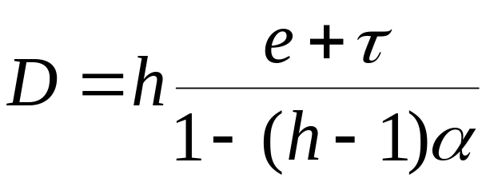
Closed form bounds for delay
if α ≤ 1/(h-1) there is a closed form bound
h = number of hops, α = utilization factor
the bound diverges for α -> 1 / (h-1)
compare to virtual wire bound α T
if α > 1/(h-1), for any x, there is a network where the worst case jitter ≥ x
this contradicts the Virtual Wire bound

Slide 65
Derivation of the bound
Assume nodes are GR (orFIFO-per aggregate rate latency service curve elements)
1) Assume delay bound hD on low delay traffic (EF) exists, where h = max number of hops, D = max delay bound per node
2) An arrival curve of aggregate traffic at node i
α_{i}(t) = Σ_{m ∋ i} (r_{m}t + (h-1)r_{m}D + b_{m}) = ν_{i}R_{i}t + (h-1) ν_{i}R_{i}D + ν_{i}R_{i} τ_{i}
where ν_{i} = (Σ_{m ∋ i} r_{m} )/R_{i} and τ_{i} = (Σ_{m ∋ i} b_{m} )/ (Σ_{m ∋ i} r_{m} )
3) Compute horizontal distance between α_{i}(t) and β_{i}(t):
D_{i}= T_{i} + (h-1) ν_{i}D + ν_{i}τ_{i}
4) Deduce D <= (T + ντ)/(1 – (h-1)ν) where
T = max_{i} T_{i} , ν = max_{i} ν_{i} and τ = max_{i} τ_{i}
5) Show that finite bound exists
at any time t, and let t -> ∞
ν_{i}R_{i}
(h-1) ν_{i}R_{i}D + ν_{i}R_{i} τ_{i}
Di
Ri
Ti

Slide 66
The contradiction is in the specification of EF
for practically all known nodes, the EF condition is not true
  jitter and source rate fluctuations
departure rate may be > r

Slide 67
Another specification is needed
should allow delay and backlog computations
should apply well to reasonable routers
  combinations of schedulers, queue, delay elements
  basic schedulers should be easy to model
  concatenation
at the 49th IETF (Dec 2000, San Diego), the old EF specification is abandoned in favor of a new one based on packet scale rate guarantee

Slide 68
Why not use GR as a node model ?
has all nice properties seen before: bounds, concatenation
but: delay-from-backlog bound
given observed backlog is B, delay ?
why ?
  we want to control delay from backlog
  diff-serv is not loss-free
  if a network element has a small buffer, it should guarantee a low delay

Slide 69
GR node does not support a backlog-from-delay bound
backlog
delay
bits
input R(t)
output
minimum output
D_{max}
time

Slide 70
Packet Scale Rate Guarantee is the definition used for EF
d(n) ≤ f(n) + e
f(n) = max{a(n), min[d(n-1), f(n-1)]}+ L(n)/r
d(n) : departure time for packet n
a(n) : arrival time
f(n) : virtual finish time, f(0) = 0

Slide 71
f(n) = max{a(n), min[d(n-1), f(n-1)]}+ L(n)/r
L(n)/r
f(n-1)
d(n-1)
a(n)
f(n)
d(n)
L(n)/r
a(n)
f(n-1)
d(n-1)
f(n)
d(n)
L(n)/r
a(n)
d(n-1)
f(n-1)
f(n)
d(n)

Slide 72
PSRG has all the nice properties
priority scheduler: r=C, e=L_{max}/C
packet based GPS, with accuracy E₁, E₂:
G(n)- E₁ ≤ d(n) ≤ G(n) + E₂
G(n) = departure time in fluid GPS system
⇒ rate r, e = E₁ + E₂
concatenation of FIFO nodes: same as GR

Slide 73
Delay from Backlog
Theorem :
packet scale rate guarantee
⇒ delay ≤ Q/r + e
Q: backlog upon arrival
intuitively clear -- and proof is simple -- if node is FIFO (infocom 2001)

Slide 74
Delay bounds
We can combine all results above and find finite and infinite buffer bounds
1
delay
0.8
0.6
1 MB
h=10
e = 2 MTU/r
r=150 Mb/s
C=5R
0.4
0.4 MB
0.2
0.1 MB
0.05
0.1
0.15
0.2
0.25
α

Slide 75
PSRG versus Service Curve
PSRG => GR
  (but not conversely !)
thus PSRG(r,e) => service curve (r, e+l_{max}/r)
there are identical relations
  PSRG <-> adaptive service curve (Cruz, 1998)
  GR <-> service curve

Slide 76
A Min-Max approach to solve the non-FIFO case
routers are FIFO per flow
  all OK with IntServ (per-flow scheduling)
EF use aggregate scheduling
  routers are not FIFO per aggregate
establishing the properties of PSRG with non-FIFO nodes has been an open challenge
a Min-Max approach can break it

Slide 77
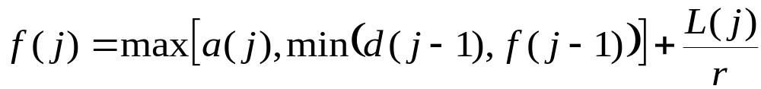
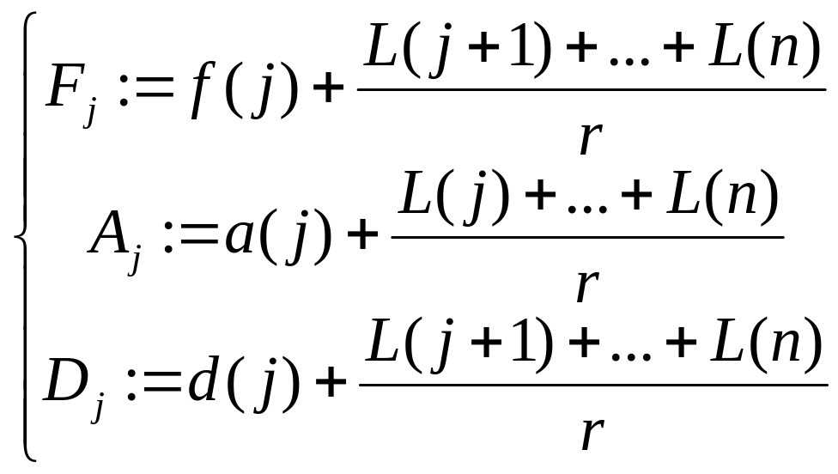
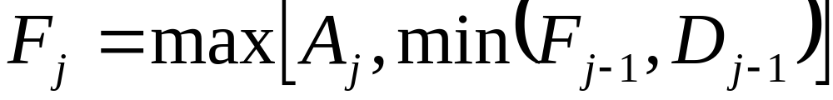
we can get rid of f(n) by solving
(1)
define
we obtain
(2)

Slide 78
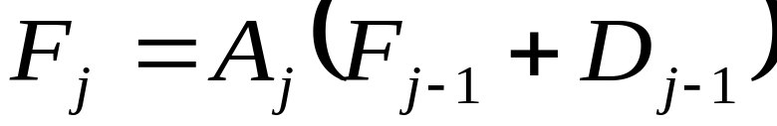
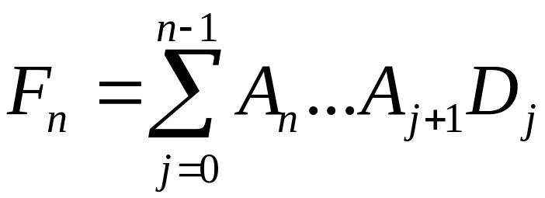
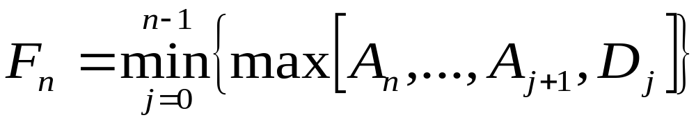
The beauty of algebra
(2)
re-write (2) by the replacement rule
(min, max) -> (+,x) and obtain
use Gauss elimination
use the reverse replacement rule

Slide 79
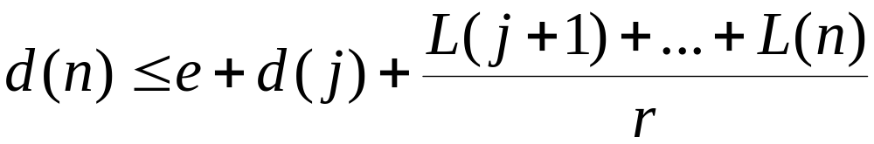
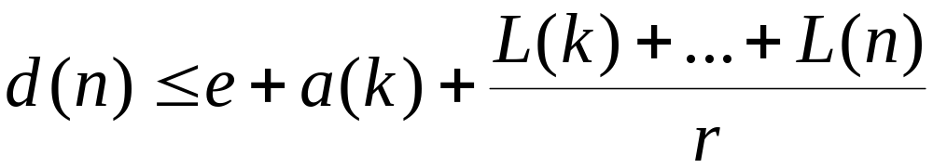
Alt. Characterization of PSRG
a node is PSRG(r,e) iff
for all n and j in [0, n-1]
(A)
or there is some k in [j+1,…, n] such that
(B)
interpretation: replaces VJ’s intuition

Slide 80
Applications
Theorem :
packet scale rate guarantee
⇒ delay ≤ Q/r + e
holds also for non-FIFO nodes

Slide 81
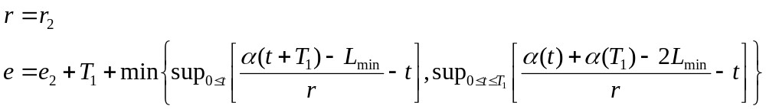
PSRG has all the nice properties…
… but concatenation results for non-FIFO nodes are harder to get
(Le Boudec and Charny 2001):
PSRG
(r,e)
delay
T₁
PSRG
(r₂,e₂)

Slide 82
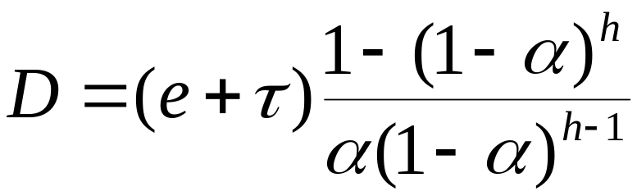
SETF
an alternative to EF [Zhi-Li Zhang 2000]
leads to a worst case bound which is finite for all α<1
packets stamped with arrival time at network access
  aggregate scheduling
  inside aggregate, order is that of timestamps
  Theorem:
  Proof: similar to previous bound

Slide 83
Contents
Arrival curves
2. Service curves, backlog, delay bounds
3. Diffserv: intuition and formal definition behind EF
4. Playback Delay for pre-recorded video
5. Statistical multiplexing with EF

Slide 84

Network delivery of Pre-recorded video
Video
server
Network
Video
display
Smoother
a(t+d)
x(t)
β
y(t)
a(t-D)
ß(t)
B
σ
Le Boudec and Verscheure ToN 2000, Thiran, Le Boudec and Worm, Infocom 2001
Network + end-station offers a service curve β to flow x(t) (intserv or diffserv + real time model of end-station)
Smoother delivers a flow x(t) conforming to an arrival curve σ. Can look-ahead on the server (max d time units)
Video stream is stored in the client buffer B and read after a playback delay D.

Slide 85
Network delivery of Pre-recorded video
Video
server
Network
Video
display
Smoother
a(t+d)
x(t)
β
y(t)
a(t-D)
ß(t)
B
σ
What are the minimal values of D and B, given d, σ and β ?
What is the scheduling (smoothing) strategy at the sender side that achieves these minimal values ?
Is this optimal smoothing strategy unique ?
Does a large look-ahead delay d help in reducing D and B ?

Slide 86
Putting the Problem into Equations
Video
server
Network
Video
display
Smoother
a(t+d)
x(t)
β
y(t)
a(t-D)
ß(t)
B
σ
Smoothed flow x(t) such that
x(t) ≤ δ₀(t) (i.e, x(t) = 0 if t ≤0)
x(t) ≤ a(t+d) (look-ahead up to d time units)
x(t) ≤ (x⊗ σ) (t) (smoothing)
Output flow y(t) such that
y(t) ≥ a(t-D) (no buffer underflow)
y(t) ≤ a(t-D) + B (no buffer overflow)
y(t) = Π(x)(t) is not known but (x⊗ β)(t) ≤ y(t) ≤ x(t)

Slide 87
The Min-Plus Residuation Theorem
From Baccelli et al, “Synchronization and Linearity”
Theorem: Assume that the operator Π is isotone and upper-semi-continuous. the problem x(t) ≤ a(t) ∧ Π(x)(t) has one maximum solution, given by x(t) = Π(a)(t)
(Definition of closure of an operator) Π (x) = inf {x, Π(x), ΠοΠ(x), ΠοΠοΠ(x),...}
Π is isotone if x(t) ≤ y(t) -> Π(x)(t) ≤ Π(y)(t)
Π is upper-semi continuous if inf_{i}(Π(x_{i} )) = Π (inf_{i}(x_{i}))
  true in practice for all our systems
The greedy shaper output is an example of use

Slide 88
Massaging the Equations to use Residuation
Output flow y(t) such that (x⊗ β)(t) ≥ a (t-D) (no buffer underflow) x(t) ≤ a(t-D) + B (no buffer overflow)
or equivalently using deconvolution operator Ø x(t) ≥ (a Ø β )(t-D) = sup_{u} { a(t-D+u) - β(u) } x(t) ≤ a(t-D) + B
Therefore find smallest D, B s.t. maximal solution of
x(t) ≤ { δ₀(t) ∧ a(t+d) ∧ (a(t-D) + B) } ∧ {(x⊗ σ) (t) }
verifies
x(t) ≥ (a Ø β )(t-D)

Slide 89
Applying Residuation to our Problem
Maximal solution of x(t) ≤ { δ₀(t) ∧ a(t+d) ∧ (a(t-D) + B) } ∧ {(x ⊗ σ) (t) } is, with σ sub-additive, x(t) = σ ⊗ { δ₀(t) ∧ a(t+d) ∧ (a(t-D) + B) } = σ(t) ∧ { (σ ⊗ a)(t-D) + B } ∧ (σ ⊗ a)(t+d)
Need to check that this solution x(t) ≥ (a Ø β )(t-D)
  σ(t) ≥ (a Ø β )(t-D)
-> D ≥ h(a, β ⊗ σ)
  (σ ⊗ a)(t-D) + B ≥ (a Ø β )(t-D)
-> B ≥ v(a Ø a , β ⊗ σ)
  (σ ⊗ a)(t+d) ≥ (a Ø β )(t-D)
-> D + d ≥ v(a Ø a , β ⊗ σ)

Slide 90
Bounds for D, B and d
In summary, we have shown that
  the set of admissible playback delays D, playback buffer B and look-ahead limit d is
  D ≥ D_{min} = h(a, β ⊗ σ)
  D + d ≥ (D+d)_{min} = h(a Ø a , β ⊗ σ)
  B ≥ B_{min} = v(a Ø a , β ⊗ σ)
  in particular, there is a minimum playback delay.
  if D, d, B satisfy the constraints above, a schedule is possible;
  else, there is no schedule that can guarantee correct operation

Slide 91
The formulae have a simple graphical interpretation
(1) compute σ ⊗ β
(2) compute the horizontal deviation
bits
β
bits
D_{min} = h(a, σ ⊗ β)
a
σ
σ ⊗ β
σ ⊗ β
time
(3) compute a ∅ a
and the horizontal deviation
(4) compute the vertical deviation
bits
bits
(D + d)_{min} = h(a ∅ a, σ ⊗ β)
σ ⊗ β
σ ⊗ β
B_{min} = v(a ∅ a , σ ⊗ β)

Slide 92
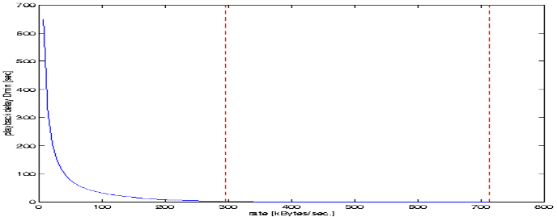
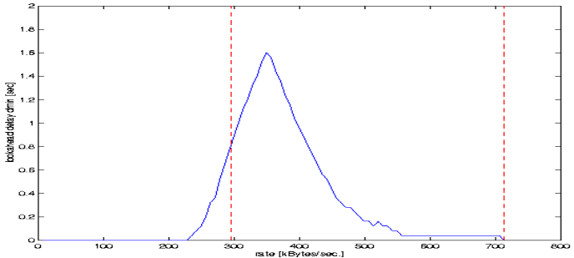
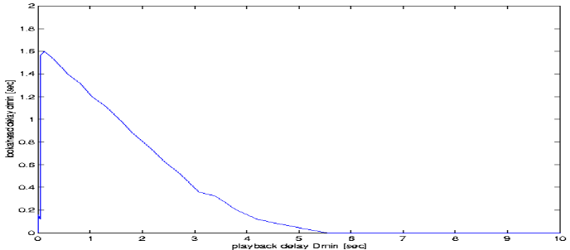
Example: MPEG Trace
MPEG files, 25 frames/sec, discretized in packets of 416 bytes
D_{min}
r
(D+d)_{min} - D_{min}
₋
D_{min}
rt
a(t)
r
(D + d)_{min}
(a Ø a)(t)
d
D_{min}

Slide 93
Actual values of delays depend on the length of the stream and the position of largest burst, and the ability to predict it
Example: in Jurassic Park trace, largest burst occurs between frames 28000 - 29000
40000 frames
20000 frames
40000 frames
20000 frames

Slide 94
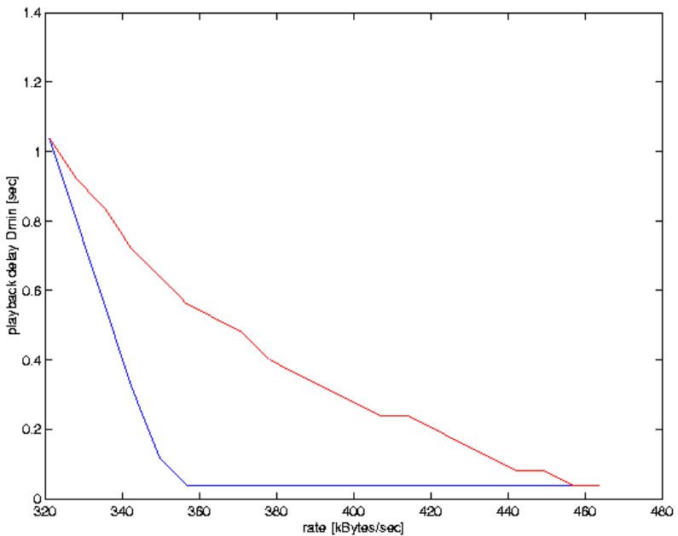
Actual values of delays depend on the length of the stream, the position of largest burst, and the ability to predict it
D
D1
D2
D3
D4
max (D1,D2,D3,D4)
max over 4 slices of
100 frames
D
400 frames

Slide 95
Scheduling for D_{min}, d_{min} and B_{min}
x_{max}(t) = σ(t) ∧ (σ ⊗ a)(t+d_{min}) ∧ { (σ ⊗ a)(t-D_{min}) + B_{min} }
σ (t)=rt
x_{max}(t)
a(t)
B_{min}
a(t+d_{min} )
a(t-D_{min} )
d_{min}
D_{min}
t

Slide 96
Example 3: Dual problem formulation
Find smallest D, B and d s.t. the maximal solution of
x(t) ≤ δ₀(t) ∧ R(t+d) ∧ {R(t-D) + B} ∧ (x⊗ σ) (t)
verifies
x(t) ≥ (R Ø β )(t-D) .
Property of Ø : x ≤ (x ⊗ σ ) <-> (x Ø σ ) ≤ x
Find smallest D, B and d s. t. the minimal solution of
x(t) ≥ (R Ø β )(t-D) ∨ (x Ø σ ) (t)
verifies
x(t) ≤ δ₀(t) ∧ R(t+d) ∧ {R(t-D) + B} .

Slide 97
Max-Plus System Theory in Action
From Baccelli et al, “Synchronization and Linearity”; assume that Π is isotone and lower-semi-continuous. Theorem : the problem x(t) ≤ a(t) ∨ Π(x)(t) has one minimum solution, given by x_{min}(t) = Π(a)(t)
(Definition of super-additive closure) Π (x) = sup {x, Π(x), ΠοΠ(x), ΠοΠοΠ(x),...}
Minimal solution of x(t) ≥ (R Ø β )(t-D) ∨ (x Ø σ ) (t)
is, with σ sub-additive with σ(0) = 0, x_{min}(t) = (R Ø (β ⊗ σ))(t-D)

Slide 98
Scheduling for D_{min}, d_{min} and B_{min}
x_{max}(t) = σ(t) ∧ (σ ⊗ R)(t+d_{min}) ∧ { (σ ⊗ R)(t-D_{min}) + B_{min} }
x_{min}(t) = (R Ø (β ⊗ σ))(t-D) (Le Boudec, Verscheure 2000)
+ Other metrics (Feng, Rexford 99):
+ minimal rate variability (Salehi, Zhang, Kurose, Towsley 98)
+ ON-OFF (Zhang, Hui 97)
x_{max}(t)
R(t)
x_{min}(t)
B_{min}
R(t+d_{min} )
R(t-D_{min} )
d_{min}
D_{min}
t

Slide 99
Contents
Arrival curves
2. Service curves, backlog, delay bounds
3. Diffserv: intuition and formal definition behind EF
4. Min-plus algebra in action: Video smoothing
5. Statistical multiplexing with EF

Slide 100
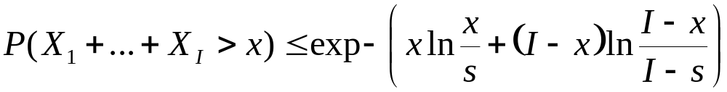
5. Stochastic Bounds
network calculus gives deterministic bounds on delay and loss
combine with Hoeffding bounds [1963]: Assume
  X_{i} are independent and 0 ≤ X_{i} ≤ 1
  E(X₁+…+ X_{I}) = s is known
then for s < x < I

Slide 101
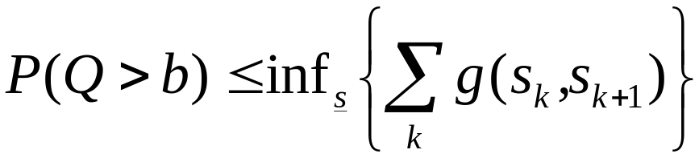
Bound on loss probability
I independent, stationary sources with identical constraints σ_{i} served in a network element with super-additive service curve β [Chang, Vojnovic and L]
where 0 = s₀ < s₁ <… < s_{K}=τ, τ = inf {t: α(t) ≤ β(t) }
and for α(v) - β(u) > b
else g(u,v) = 0

Slide 102


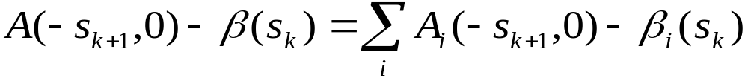
Step 1: reduction to horizon τ
Step 2:
Step 3 : Hoeffding to each term

Slide 103
Application to DiffServ
micro-flows in one aggregate assumed independent at network access only
at node i majorize the amount of data in [s,t] by
R^{i}_{j}(t)- R^{i}_{j}(s) ≤ R⁰_{j}(t) - R⁰_{j}(s-d)
and apply the previous [Chang, Song and Siu Sigmetrics 2001, Vojnovic and Le Boudec Infocom 2002]
R⁰_{j}(t)
access
node i
R^{i}_{j}(t)

Slide 104
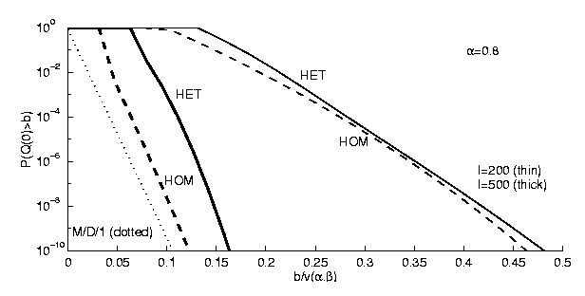
Compare to Poisson Approximation
Poisson approximation proposed [Bonald, Proutière, Roberts, Infocom ‘01] for CBR flows
Bound converges to Poisson for many flows and small burstiness
deterministic
200 flows
500 flows
Poisson

Slide 105
Conclusion
Network Calculus is a set of tools and theories for the deterministic analysis of communication networks
A new system theory, which applies min-plus algebra to communication networks
Does not supersede stochastic queueing analysis, but gives new tools for analysis of sample paths
“Network calculus”, J-Y Le Boudec and P. Thiran, Lecture Notes in Computer Sciences vol. 2050, Springer Verlag, also available on-line at http://lcawww.epfl.ch

