Slide 1


Network Calculus
Jean-Yves Le Boudec, lecturer
Patrick Thiran
Pisa 2003

Slide 2
Lecture Plan
Introduction
Arrival curves, Service curves, Pay Bursts only Once, IntServ and ATM
Shapers, shapers keep arrival constraints
Packetizers. Fixed Point Theorem and Residuation.
GR nodes and schedulers.
Aggregate Multiplexing and Instability. Explicit bounds. Diff-Serv
Optimal Smoothing. Video Playback

Slide 3

A simple example
R(t)
X
CBR trunk
bit rate c
assume
  R(t) = sum of arrived traffic in [0, t] is known
(Reich:) required buffer for a bit rate c is
sup _{s ≤ t} {R(t) - R(s) - c (t-s)}

Slide 4
What is Network Calculus ?
Deterministic analysis of queuing / flow systems arising in communication networks
Abstraction of schedulers
  systems that are not a single queue, Reich’s formula does not apply
Uses min, max for binary operators and integrals (min-plus / max-plus algebra)

Slide 5
Examples
Pay Bursts only Once
Re-Shaping is For Free
Minimum Playout Buffer
Diff-Serv delay dimensioning

Slide 6
Day 1

Slide 7

Arrival and Service Curves
Internet integrated services use the concepts of arrival curve and service curves

Slide 9
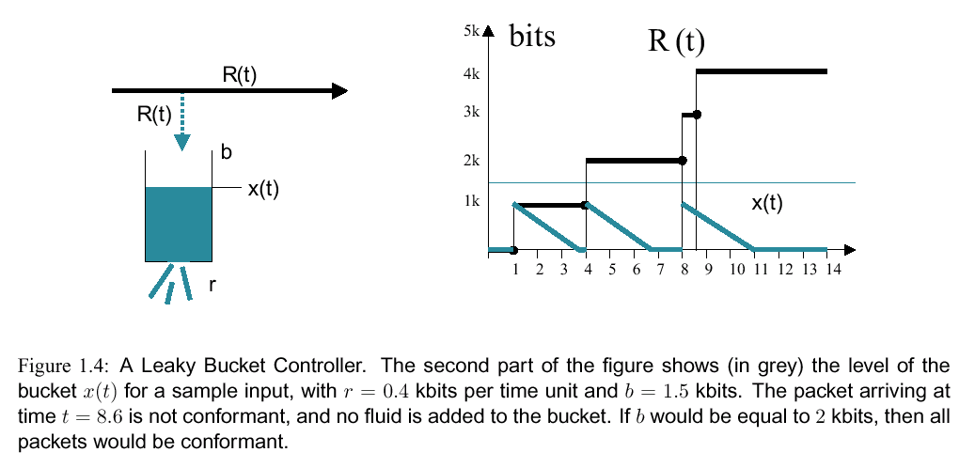

Slide 10
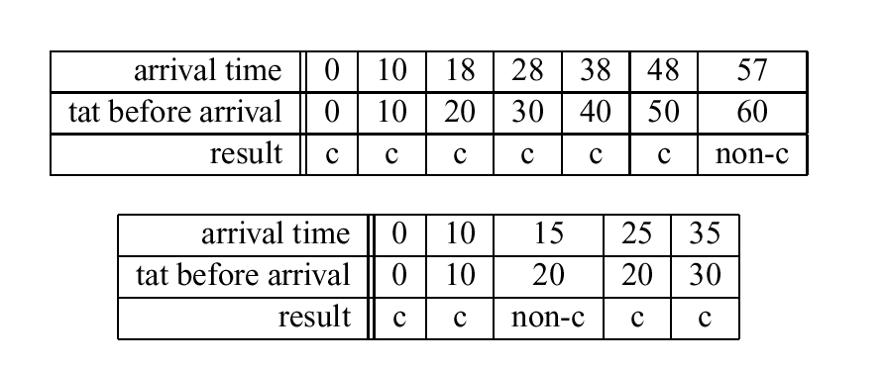

Slide 11
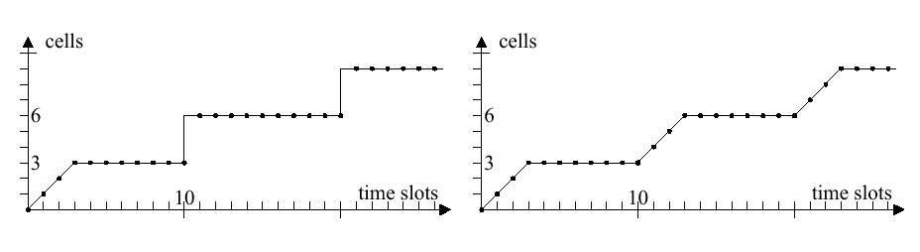

Slide 12
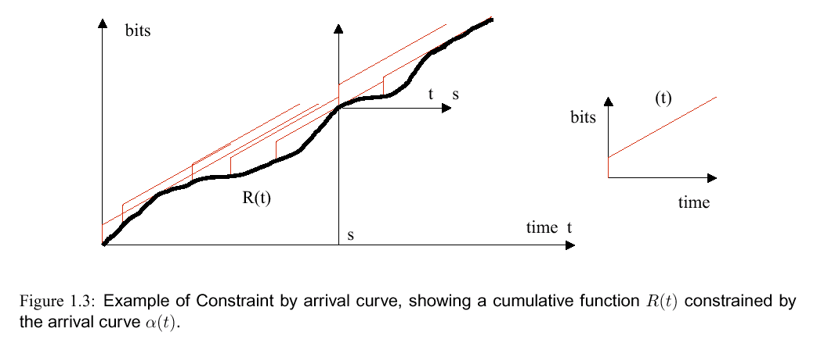

Slide 13
Min-plus convolution ⊗
Definition
(f ⊗ g) (t) = inf_{u} { f(t-u) + g(u) }
g(t)
f(t)
(f ⊗ g)(t)
t

Slide 14
Convolution Example 1
f(t)
(f ⊗ g) (t) = ?
R
K
t
f(s)
(f⊗g)(t)
T
(f⊗g)(t)
g(t)
r
g(t-s)
K
r
t
s
T
t
t

Slide 15
Convolution Example 2
(f⊗f)(t)
R
f(t)
(f⊗f)(t)
f(t-s)
2K’
f(s)
R
K’
s
T
t
t
2T
t
(f ⊗ f) (t) = ?

Slide 16
Star-shaped, concave, convex functions
f is concave
  ⬄ ∀ 0 ≤ u ≤ 1, f (ux + (1-u)y) ≥ uf(x) + (1-u)f(y)
f is convex
  ⬄ -f is concave
f is star-shaped
  ⬄ f(t)/t ≤ f(s)/s ∀ s ≤ t
f is concave ⇒ f is star-shaped

Slide 17
Examples
bits
u_{T,τ} (t)
bits
γ_{r,b}(t)
4k
3k
slope r
b
2k
k
time
T-τ
2T-τ
3T-τ
4T-τ
time
is u_{T,τ} star-shaped ?
concave ?
γ_{r,b} is concave

Slide 18
Examples
bits
bits
bits
δ_{T}(t)
β_{R,T}(t)
Slope (rate) R
delay T
time
latency T
time
β_{R,T} is convex
δ_{T} is convex

Slide 19
Examples
β_{R,T}(t)+K’
β_{R,T}(t)+K’’
bits
bits
R
K’
R
K’’
T
time
T
time
is β_{R,T} + K’ star-shaped ? concave ?
is β_{R,T} + K’’ star-shaped ?
concave ?

Slide 20
Some properties of min-plus convolution
⊗ is associative
⊗ is commutative
K + (f ⊗ g) = (K + f) ⊗ g when K is a constant
f ⊗ δ_{T} (t) = f (t-T)
  δ_{T} (t) = 0 for t ≤ T and δ₀ (t) = ∞ for t > T
Star-shaped (concave) functions passing through the origin: f ⊗ g = f ∧ g

Slide 21
Example 1 (using rules)
f(t)
f⊗g = (K + δ_{T} ⊗ λ_{R}) ⊗ λ_{r}
= K + ((δ_{T} ⊗ λ_{R}) ⊗ λ_{r})
= K + (δ_{T} ⊗ (λ_{R} ⊗ λ_{r} ))
= K + (δ_{T} ⊗ (λ_{R} ∧ λ_{r} ))
= K + (δ_{T} ⊗ λ_{r} )
= K + β_{r,T}
R
f = K + β_{R,T}
= K + δ_{T} ⊗ λ_{R}
K
t
T
g(t)
g = λ_{r} concave
with g(0) = 0
(f⊗g)(t)
r
r
K
t
t
T

Slide 22
Min-Plus convolution rule for convex functions
convex piecewise linear wide-sense increasing, passing by origin: put segments end to end with increasing slope
r2
r2
⊗
s2
=
r1
r1
s1
s1
t1
u1
u1
u1 + t1

Slide 23
Example: rate latency function
δ_{T}(t)
λ_{R}(t)=Rt
β_{R,T}(t)
⊗
=
Slope (rate) R
Rate R
delay T
latency T
δ_{T} is convex
(delay function)
λ_{R} is convex
(delay function)
β_{R,T} is convex
(rate-latency function)
we could also use: f ⊗ δ_{T} (t) = f (t-T)

Slide 24
We can express arrival curves with min-plus convolution
Arrival Curve property means for all 0 ≤ s ≤ t,
x(t) -x(s) ≤ α(t-s)
<-> x(t) ≤ x(s) + α(t-s) for all 0 ≤ s ≤ t
<-> x(t) ≤ inf_{u} { x(u) + α(t-u) }
<-> x ≤ x ⊗ α

Slide 25
Sub-additive functions
bits
u_{T,τ} (t)
bits
γ_{r,b}(t)
4k
3k
slope r
b
2k
k
time
T-τ
2T-τ
3T-τ
4T-τ
time
is γ_{r,b} sub-additive ?
is u_{T,τ} sub-additive ?

Slide 26
Sub-additive closures ?
β_{R,T}(t)+K’
β_{R,T}(t)+K’’
bits
bits
R
K’
R
K’’
T
time
T
time
β_{R,T} + K’ is star-shaped ? Sub-additive ?
β_{R,T} + K’’ is star-shaped ?
Sub-additive ?

Slide 27
Examples
(β_{R,T}(t)+K’)⁽²⁾
bits
bits
β_{R,T}(t)+K’’
β_{R,T}(t)+K’
2K’
β_{R,T}(t)+K’
R
R
(β_{R,T}(t)+K’)⁽²⁾
K’
β_{R,T}(t)+K’’
K’’
T
2T
time
T
2T
time

Slide 28
Minimum Arrival Curves
R
R
α
α

Slide 29
Day 2

Slide 30
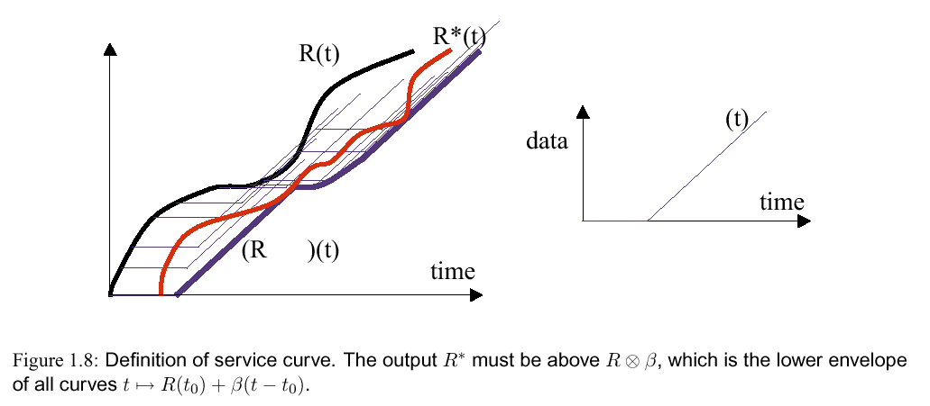

Slide 31
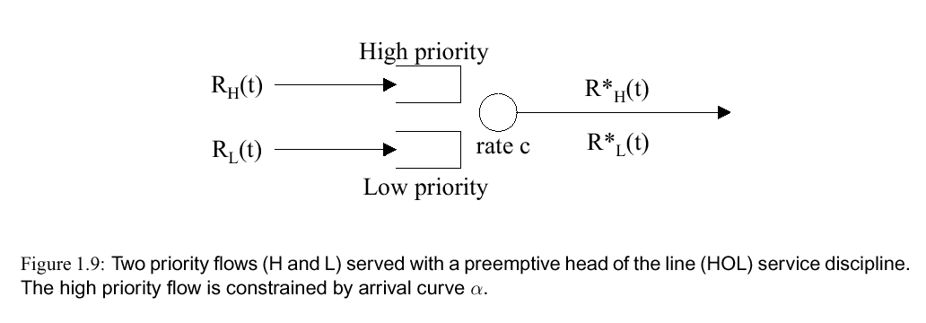

Slide 32
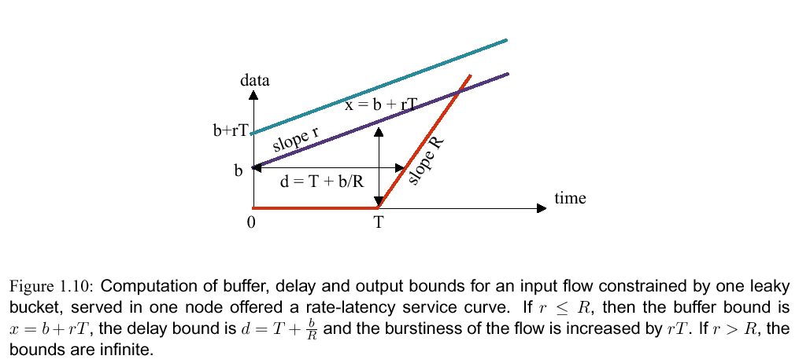

Slide 33
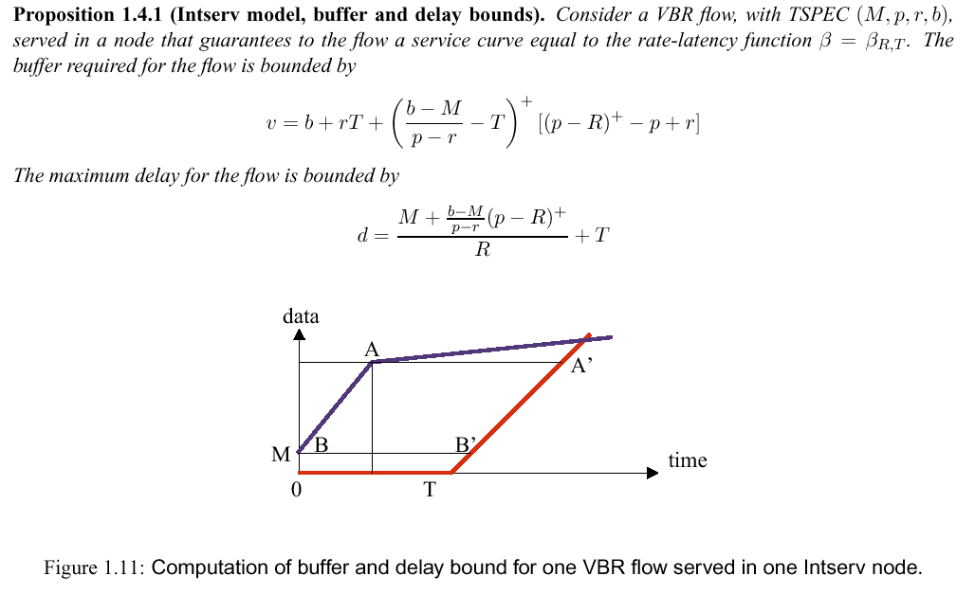

Slide 34
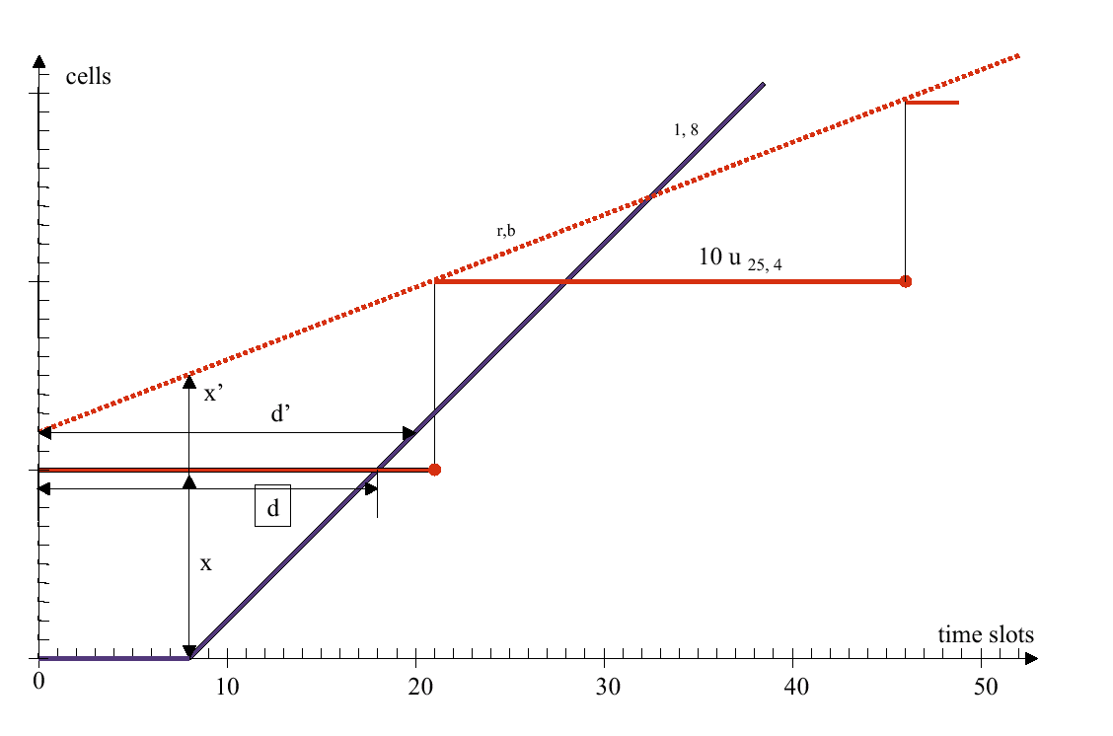

Slide 35
Pay Bursts Only Once
D₁
D₂
α
β₁
β₂
D₁ +D₂ ≤ (2b + rT₁)/ R + T₁ + T₂
D
α
β₁⊗ β₂
D ≤ b /R + T₁ + T₂
end to end delay bound is less

Slide 36

Application: Intserv (RSVP/IP)
Intserv arrival curve α(t) = min (pt+M, rt+b)
Rate-latency service curve β_{i}(t) = max(0,R_{i}(t-T_{i})) for node i, with T_{i} = C_{i}/R_{i} +D_{i} where C_{i}, D_{i} are router-specific values
End-to-end service curve is thus β(t) = max(0,R(t-T)) with
R = min_{i} R_{i} and T = Σ_{i} T_{i} = Σ_{i} (C_{i} /R_{i} +D_{i} )
Flow set-up: advertizement with PATH message from source (TSPEC (p,M,r,b), computes AD-SPEC (Σ_{i} C_{i,} Σ_{i} D_{i} ) along the path)
(p,M,r,b)
(p,M,r,b)
( )
(C_{1,} D₁ )
(p,M,r,b)
(C₁+C_{2,} D₁+D₂)

Slide 37
Application: Intserv (RSVP/IP)
End-to-end delay bound is, if R_{i} = R for all i,
((b-M)/R) max(0,(p-R)/(p-r)) + (M + Σ_{i} C_{i})/R + Σ_{i} D_{i}
Flow set-up: reservation with RESV message where R is computed so that end-to-end delay bound <= delay objective.
( )
(p,M,r,b)
(C_{1,} D₁ )
(p,M,r,b)
(C₁+C_{2,} D₁+D₂)
R
(p,M,r,b)
R
R

Slide 38
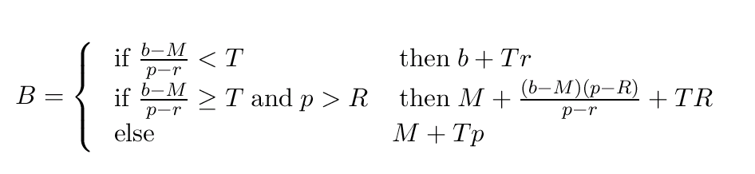
IntServ: Re-Shaper Buffer Dimensioning

Slide 39
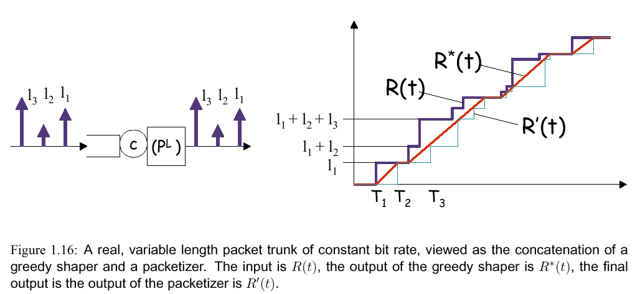

Slide 40
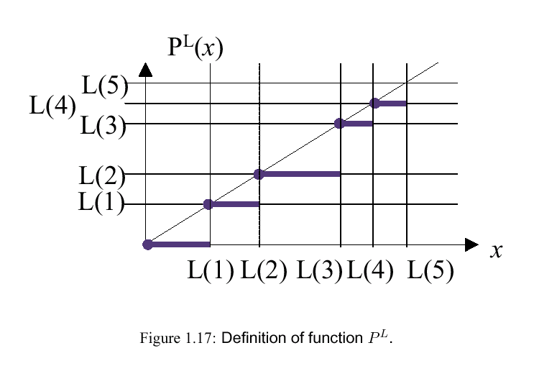

Slide 41
Day 3

Slide 42
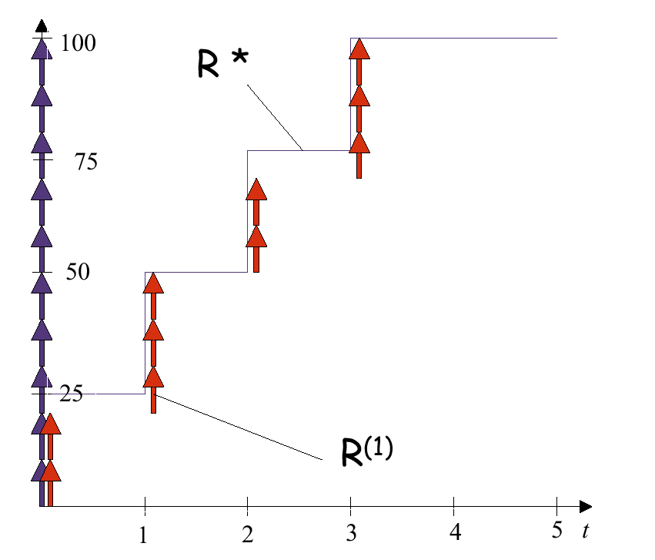

Slide 43
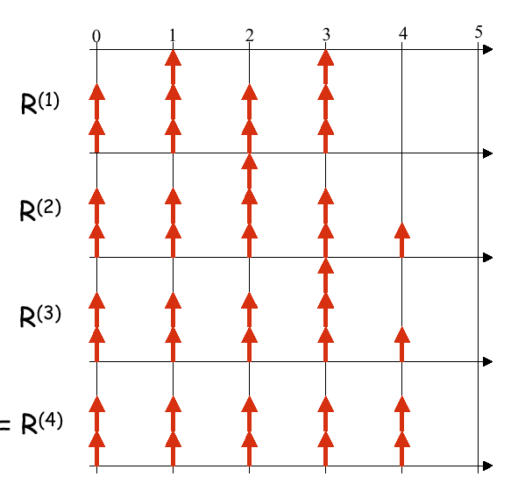

Slide 44
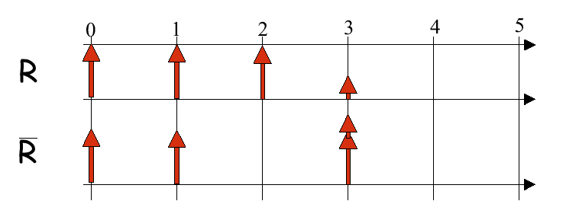

Slide 45
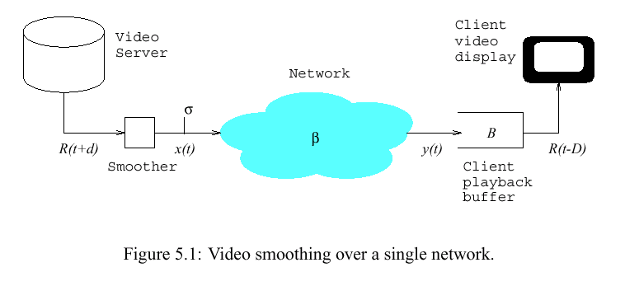

Slide 46
A max-plus model
x satisfies:
(1) x ≥ x Ø σ
(2) x ≥ (R Ø β )(t-D)
a max-plus system, , with minimum solution
x* = inf {x⁰, x¹, ..., x^{i}, ...}
x⁰ (t) = (R Ø β )(t-D)
x^{i} = x^{i-1} Ø σ
thus x = (R Ø β ) Ø σ (t-D) = R Ø (β ⊗ σ) (t-D)

Slide 47
Example
* 10⁶
σ ⊗ β(t)
5
4
3
2
1
R ∅ (σ ⊗ β)
R(t)
-50 0 50 100 150 200 250 300 350 400 450
minimum value of D
Frame #

Slide 48
Back to our example
5
4
3
2
1
* 10⁶
D=h(R,σ ⊗ β)
σ ⊗ β(t)
R(t)
-50 0 50 100 150 200 250 300 350 400 450
Frame #

Slide 49
R(t)
10000
70
60
50
8000
40
30
D = 435 ms
20
10
6000
100
200
300
400
(σ ⊗ β)(t)
4000
2000
100
200
300
400
10000
70
D = 102 ms
60
8000
50
40
30
6000
20
10
(σ ⊗ β)(t)
4000
100
200
300
400
2000
100
200
300
400
Notes:
Ce théorème est le pendant du théorème de capacité

Slide 50
Deconvolution is the time inverse of convolution
(4) Invert time again
bits
(2) S(t) in inverted time
R(∞ )
R(∞ )
bits
(1) R (t) in real time
bits
bits
R(∞)
R(∞)
S(t)
R ∅ (σ ⊗ β )
R(t)
S ⊗ σ ⊗ β
R(t)
R(t)
T
T
T
(3) Shape with σ ⊗ β
T
σ ⊗ β

Slide 51
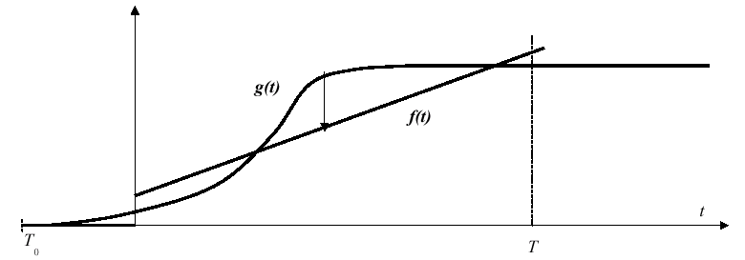
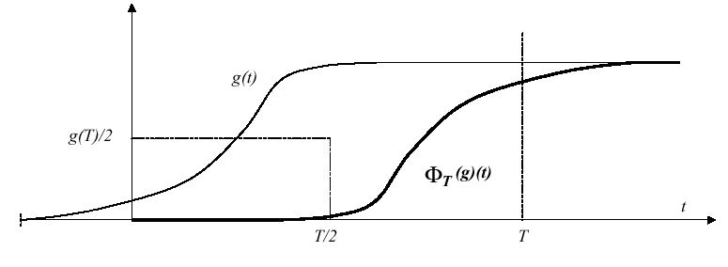
Compute g ∅ f
1. rotate g

Slide 52
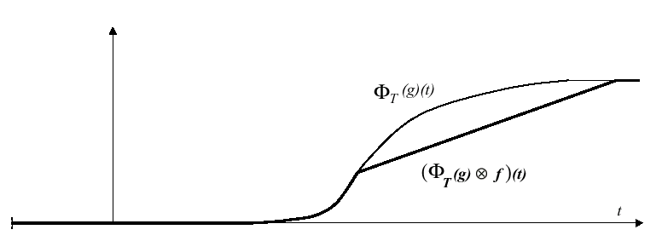
Compute g ∅ f
2. shape by f

Slide 53
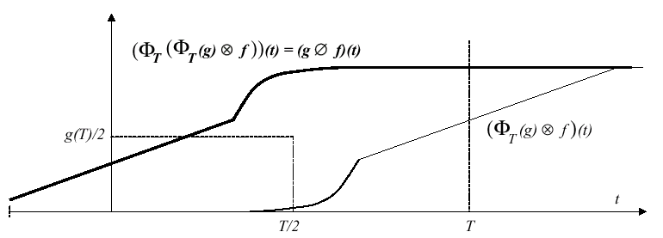
Compute g ∅ f
3. rotate again

Slide 54
Shaping Versus Smoothing
Optimal
Smoothing
D=0
Optimal
Shaping
D > 0
R(t)
R(t-D)
x*(t)
R(t)
x(t)
D > 0
α(t)

Slide 55
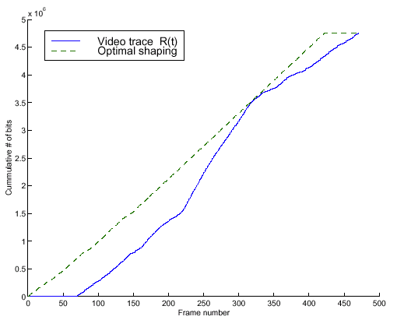
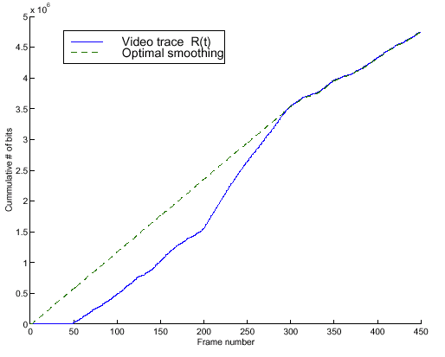

Slide 56
Day 4

Slide 57
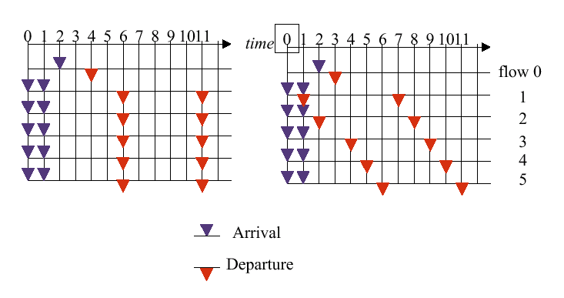

Slide 58
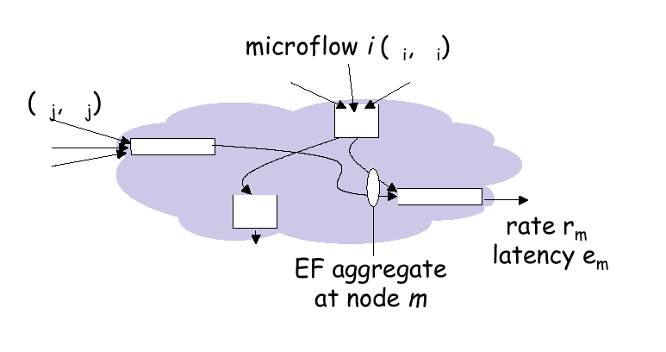

Slide 59
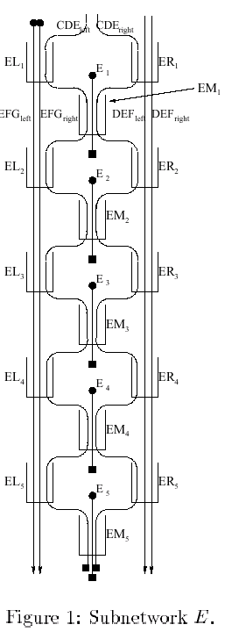
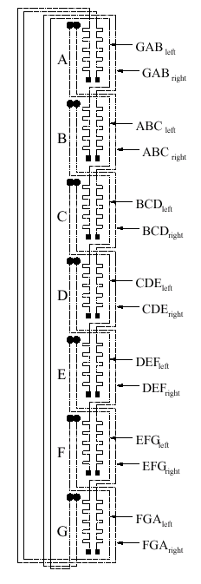
« Instability of FIFO in Session-Oriented Networks »
Matthew Andrews
Bell Labs
SODA 2000

Slide 60
GR and Service Curve do not Give Backlog from Delay Bound
backlog
delay
bits
input R(t)
output
minimum output
D_{max}
time

Slide 61
f(n) = max{a(n), min[d(n-1), f(n-1)]}+ L(n)/r
L(n)/r
f(n-1)
d(n-1)
a(n)
f(n)
d(n)
L(n)/r
a(n)
f(n-1)
d(n-1)
f(n)
d(n)
L(n)/r
a(n)
d(n-1)
f(n-1)
f(n)
d(n)

Slide 62
Packet Scale Rate Guarantee
f(n) = max{a(n), min[d(n-1), f(n-1)]}+ L(n)/r
L(n)/r
a(n)
d(n-1)
f(n-1)
f(n)
d(n)
Guaranteed Rate
f(n) = max{a(n), f(n-1)]}+ L(n)/r
L(n)/r
a(n)
d(n-1)
f(n-1)
f(n)
d(n)

Slide 63
Delay Bounds with PSRG versus with GR node model
1
delay
0.8
0.6
1 MB
h=10
e = 2 MTU/r
r=150 Mb/s
C=5R
0.4
0.4 MB
0.2
0.1 MB
0.05
0.1
0.15
0.2
0.25
α

Slide 64
Day 5

Slide 65
Loss System
Loss L(t)
fresh traffic
R(t)
β
R’(t)
R*(t)
buffer X
node with service curve β(t) and buffer X
when buffer is full incoming data is discarded
modelled by a virtual controller (not buffered)
fluid model or fixed sized packets
Pb: find loss ratio

Slide 66

Bound on Loss Ratio
Theorem [Chuang and Cheng]: if R is α-smooth, then
L(t)/R(t) ≤ 1 - r
  with r = min(1, inf _{t ≥ 0} [β(t) +X] /α(t))
best bound with these assumptions
proof:
  R’ ≤ (X + Π(R’)) ∧ h _{R}(R’) ∧δ₀ where Π is the transformation R’ -> R, assumed isotone and usc (« physical assumptions ») R’ is the maximum solution
  define x(t) = r R(t)
  x satisfies the system equation:
  x ≤ (X + x ⊗ β) ∧ h _{R}(x) ≤ (X + Π(x)) ∧ h _{R}(x)
  R’ is the maximum solution
  => x(t) ≤ R’(t) for all t

Slide 67
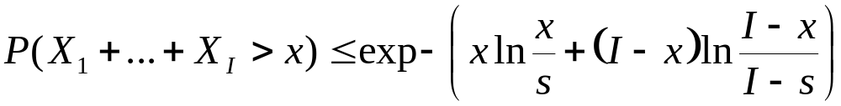
Stochastic Bounds
network calculus gives deterministic bounds on delay and loss
combine with Hoeffding bounds [1963]: Assume
  X_{i} are independent and 0 ≤ X_{i} ≤ 1
  E(X₁+…+ X_{I}) = s is known
then for s < x < I

Slide 68
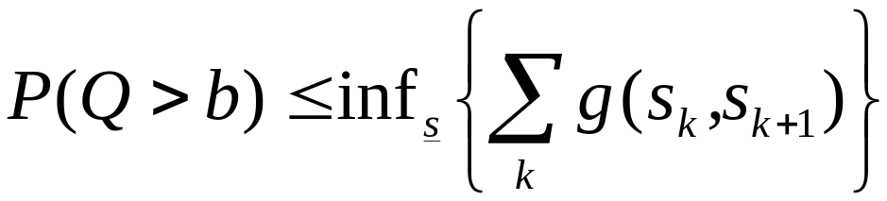
Example: Bound on loss probability
I independent, stationary sources with identical constraints σ_{i} served in a network element with super-additive service curve β [Chang, Vojnovic and L, Infocom 2002]
where 0 = s₀ < s₁ <… < s_{K}=τ, τ = inf {t: α(t) ≤ β(t) }
and for α(v) - β(u) > b
else g(u,v) = 0

Slide 69


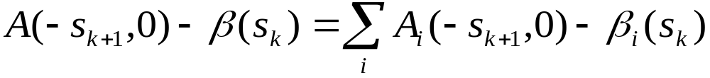
Step 1: reduction to horizon τ
Step 2:
Step 3 : Hoeffding to each term

Slide 70
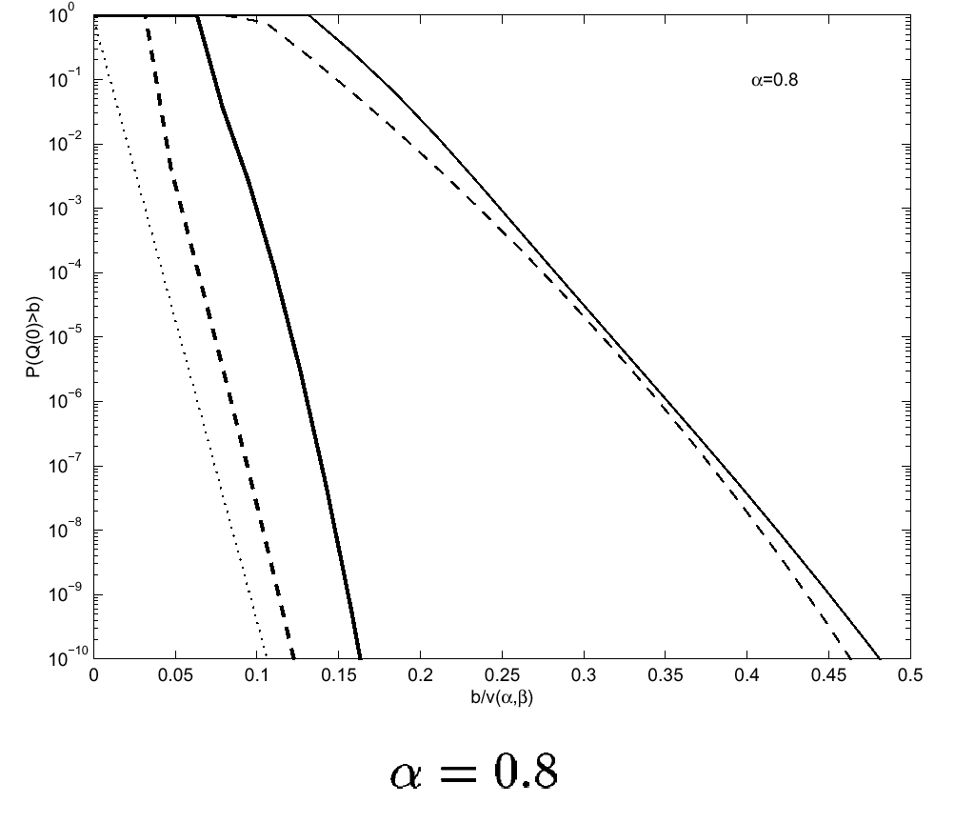

Slide 71
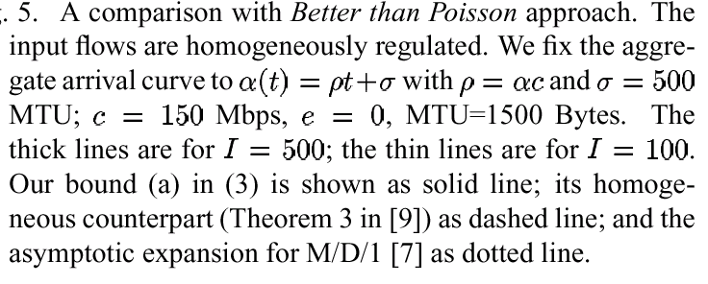

Slide 72
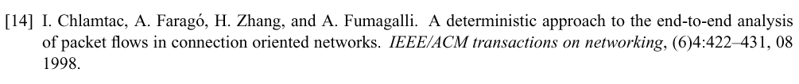
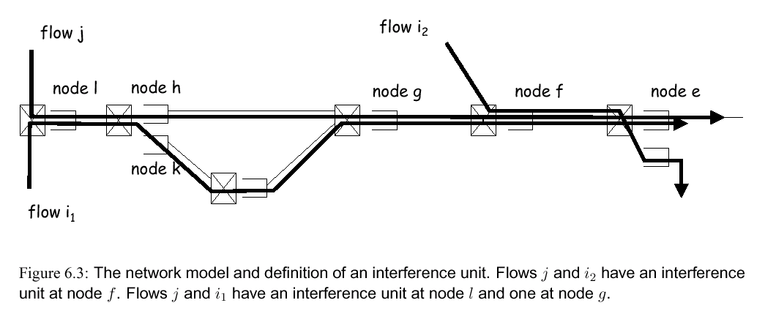

Slide 73
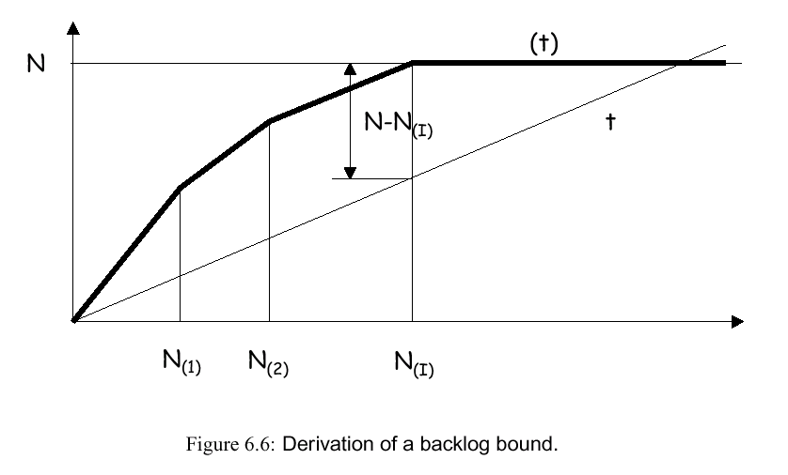

Slide 74
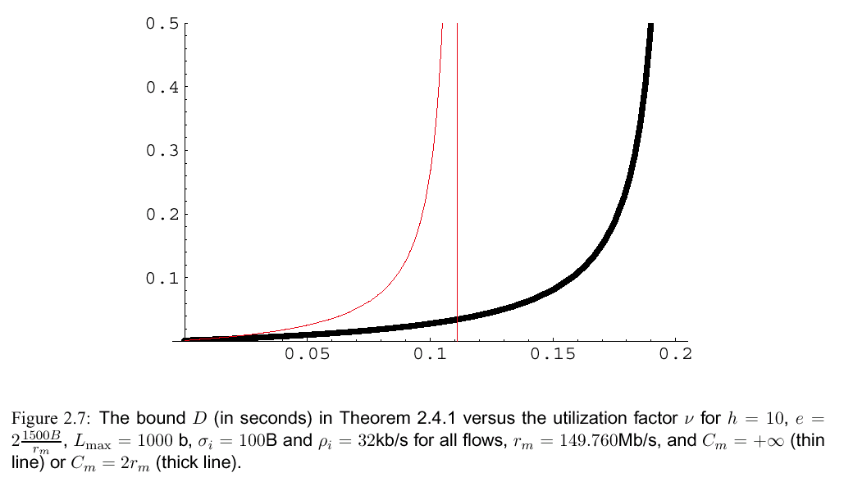

Slide 75
