Slide 1
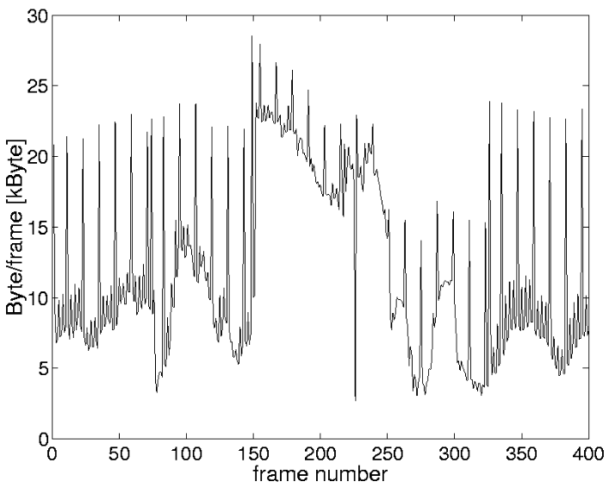
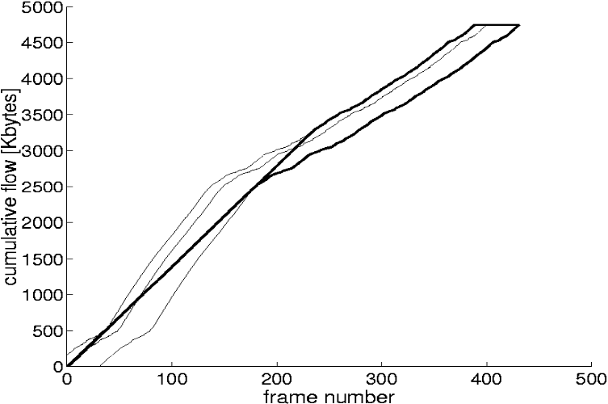

D
a(t)
x(t)
β
y(t)
a(t-D)
ß(t)
B
σ
Video
server
Video
display
Smoother
Network

