Slide 1
source i
node i
node i+1
node i+n
destination i

Slide 2
0
1
2
3
4
5
6
7
8
9
10
11
0
1
2
3
4
5
6
7
8
9
10
time
11
flow 0
1
2
3
4
5
Arrival
Departure

Slide 3
100
R*(t)
R⁽¹⁾(t)
R(t)
10
0
T
2T
3T

Slide 4
0
T
2T
3T
4T
5T
25
R⁽¹⁾
25
R⁽²⁾
25
R⁽³⁾
25
R = R⁽⁴⁾

Slide 5
Packetized Greedy Shaper
R(t)
R(t)
inf
σ
P^{L}
take the latest
bit-by-bit greedy shaper
packetizer

Slide 6
constant rate link
input R(t)
α-smooth
R⁽¹⁾(t)
packetized
output
c
R*
P
ct
α(t)=rt+b
R(t)
R*(t)
R⁽¹⁾(t)
packetized
output

Slide 7
β _{R, 2 lmax}
λ_{R}
P^{L}
λ_{R}
P^{L}
λ_{R}
P^{L}
β _{R, 3 lmax}

Slide 8
Rate R, latency (m – 1) l_{max}/R
GPS
R
P^{L}
GPS
R
P^{L}
GPS
R
P^{L}

Slide 9
Combined System
R(t)
R*(t)
P^{(L)}
R’(t)
β, γ
Bit-by-bit system

Slide 10
Packetized Greedy Shaper
(L) and σ
(σ)
(P^{L} )

Slide 11
0
1
2
3
4
5
R⁽¹⁾
R
R
R⁽²⁾
inf
P^{L}
σ
R⁽³⁾
R = R⁽⁴⁾

Slide 12
0
1
2
3
4
5
R
R

Slide 13
100
R *
75
50
25
R⁽¹⁾
1
2
3
4
5
t

Slide 14
σ
P^{L}
R(t)
R*(t)
R⁽¹⁾ (t)
(P^{L} )
(σ)
(P^{L} )
R₀(t)
R(t)
R*(t)
R⁽¹⁾ (t)

Slide 15
R*(t)
l₃
l₂
l₁
l₂
l₁
R(t)
l₃
l₁ + l₂ + l₃
R’(t)
c
(P^{L} )
l₁ + l₂
l₁
T₁
T₂
T₃

Slide 16
R^{GPS}(t)
R(t)
R^{GPS-p}(t)

Slide 17
P^{L}(x)
L(5)
L(4)
L(3)
L(2)
L(1)
x
L(1)
L(2)
L(3)
L(4)
L(5)

Slide 18
5000
b (KB)
4000
Region of
Admissible (r,b)
3000
2000
1000
r (Mb/s)
0
0
1
2
3
4

Slide 19
70
60
10000
50
8000
D1
40
30
6000
20
4000
10
2000
100
200
300
400
100
200
300
400
70
60
10000
D2
50
8000
40
30
6000
20
4000
10
2000
100
200
300
400
100
200
300
400

Slide 20
70
60
D
10000
50
8000
R(t)
40
6000
(α ⊗ β)(t)
30
20
4000
10
2000
100
200
300
400
100
200
300
400
(1)
(2)
8000
10000
6000
α
8000
4000
β
6000
4000
2000
2000
50
100
150
200
250
100
200
300
400

Slide 21
14
D (seconds)
D (seconds)
12
10
0.03
8
0.02
6
4
0.01
2
2
3
4
5
3
3.5
4
4.5
5
c (Mb/s)
c (Mb/s)

Slide 22
bits
α
h(α,β)
β
d(t)
time
bits
β
bits
D = h(R, α ⊗ β)
α
α ⊗ β
α ⊗ β
R
time
time
(1)
(2)

Slide 23
bits
bits
R⁻(t)
R(t)
R’(t)
R(t-D)
X
R⁻(t−D)
time
time
−D
0
0
D−D
D
(1)
(2)

Slide 24
arrival curve
slope r
200
A₁
b
100
slope p
50
M
A₀
Q
20
0.05
0.1
0.2
0.5
1
2

Slide 25
α
β _{1,8}
α∗₀
Node S₁
delay = 4
maximum rate = 1
α
α∗₁
β _{1,2}
β _{1,2}
Node S₂
delay = 4
maximum rate = 1
α
α∗₂
β _{1,2}
β _{1,2}

Slide 26
cells
β_{1, 8}
γ_{r,b}
10 u _{25, 4}
x’
d’
d
x
time slots
0
10
20
30
40
50

Slide 27
cells
β_{1, 8}
α = 10 u _{25, 4}
time slots
0
10
20
30
40
50

Slide 28
cells
α₀∗ = 10 u _{25, 12} (t)
α₁∗(t) = (10 u _{25, 4} ⊗ λ₁)(t+4)
α₂∗(t) = (10 u _{25, 8} ⊗ λ₁)(t)
time slots
0
10
20
30
40
50

Slide 29
R(t)
R*(t)
data
β(t)
data
time
(R⊗ β)(t)
time
shaper
σ
fresh traffic
β₁
β₂
R
R*

Slide 30
data
α
R
β
R*
α
data
time
R
β
0
u₀
u₀ + t₀
R*
α
β
α
β
δ₁
u₁
t₁
δ₂
u₂
t₂
0
u₀
s₀= u₀ + t₀
s₁
s₂
time

Slide 31
High priority
R_{H}(t)
R*_{H}(t)
data
rate R
R_{L}(t)
rate c
R*_{L}(t)
Low priority
0
T
time
data
α
α(θ)
A
A’
β
M
B
B’
time
0
θ
T
α∗
data
α
x = b + rT
β
b+rT
slope r
slope R
b
d = T + b/R
time
0
T

Slide 32
bits
R(t)
R*(t)
S(t)
d(t)
(D2)
R(t)
R*(t)
S(t)
R*(t)
S
S’
(D2): r (t - d(0+) - Δ)
(D1): r(t - d(0+) + Δ)
time
t1
d(0) - Δ
d(0+)
d(0+) + Δ

Slide 33
5k
bits
5k
R₁
R₂
4k
4k
d(t)
3k
x(t)
R₁*
3k
R₂*
2k
2k
1k
time
1k
1
2
3
4
5
6
7
8
9
10
11
12
13
14
1
2
3
4
5
6
7
8
9
10
11
12
13
14
5k
4k
R₃
3k
2k
1k
R₃*
1
2
3
4
5
6
7
8
9
10
11
12
13
14

Slide 34
bits
t − s
α(t)
bits
R(t)
time
s
time t
rate p
rate r
b
M

Slide 35
bits
t − s
α(t)
bits
R(t)
time
s
time t

Slide 36
b
2k
k
T−τ
2T−τ
3T−τ
4T−τ
0
5k
bits
R (t)
R(t)
4k
R(t)
3k
b
2k
x(t)
x(t)
1k
r
1
2
3
4
5
6
7
8
9
10
11
12
13
14

Slide 37
cells
cells
6
6
3
3
10
time slots
10
time slots

Slide 38
encoder
R(t)
smoother
R’(t)
β
R*(t)
R(t-D₁)
decoder
σ
decoding buffer
guaranteed service network
ossysdes
“null” network
guaranteed service network
D’
D”
R(t)
R₂’(t)
encoder
smoother
β
decoder
σ
delay
equalization
decoding buffer
deleq
bits
D”
R(t)
S(t)
B
B
R⁻(t)
(S⊗σ)(t)
slope r
T−t
t
−D”
θ
T
Τ−θ
(1)
(2)

Slide 39
bits
R(t)
R’(t)
L(3)
l₃
S(t)
L(2)
S⁰(t)
l₂
slope r
L(1)
l₁
A₁
A₂
D₁
D₂
D⁰₂
t

Slide 40
bits
R(t)
R’(t)
L(3)
l₃
S(t)
L(2)
l₂
L(1)
l₁
slope r
t
A₁
A₂
A₃
D₁
D₂
D₃

Slide 41
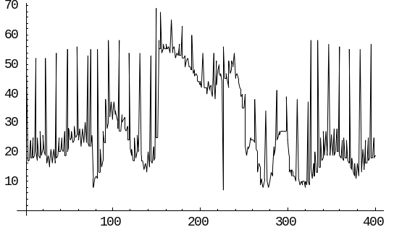
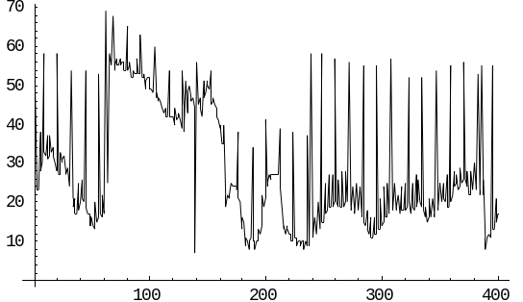
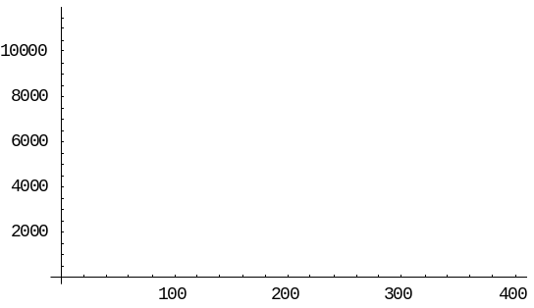
r₁(t)
r₂(t)
A₁(t)
A₂(t)

Slide 42
β_{i} (t)
n
R_{i} (t)
R_{i}^{n}(t)
A_{i}^{n}
D_{i}^{n}
t

Slide 43
R₄
R₅
R₆
R₁
S₁
R₂
S₂
R₃

Slide 44
Node 0
Flow 0
Flow 3
Node 2
Node 1

Slide 45
Switching Fabric
Scheduler k
To other router
From other router
Damper n
Scheduler m
Router M
Router N
Scheduler l
Damper l

Slide 46
Departure from l
Deadline at l
d
Packet sent from M to N
d
Arrival at node N
a
a + d - δ
a + d
Eligibility time picked by damper l

Slide 47
v_{j}
B_{j}
Cell c_{j-1}
s_{j-1}
A⁰_{j}
t’_{j-1}
t_{j}
Cell c_{j}
s’_{j}
time

Slide 48
flow j
flow i₂
node l
node h
node g
node f
node e
node k
flow i₁

Slide 49
cell d
cell c₁
cell c₂
l
h
g
cell c₂
e
cell d
f
cell c₁

Slide 50
α(t)
N
N-N_{(I)}
t
N₍₁₎
N₍₂₎
N_{(I)}

Slide 51
B
R(t)
B − ε
R*(t)
Ct

