Slide 1
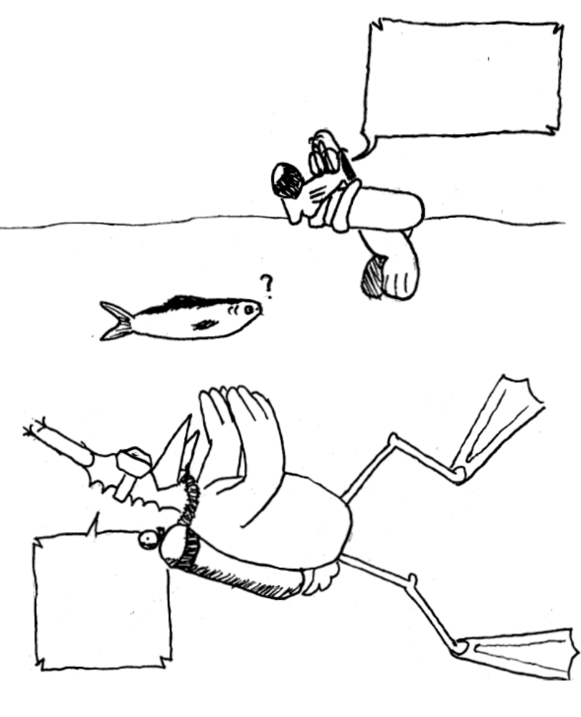

This fish
is black
This fish
is white

