Slide 1
Queuing Theory
for those who cannot wait

Slide 2
5.2 Queuing Theory 101
5.2.1 Deterministic delay computations – application to playback buffer sizing

Slide 3
bits
A(t)
D(t)
d(t)
Q(t)
time
t

Slide 4
bits
A(t)
A’(t)
D(t)
d(t)
A(t)
A’(t)
D(t)
S
S’
(D1): r(t - d(0) + Δ)
(D2): r (t - d(0) - Δ)
time
d(0) - Δ
d(0)
d(0) + Δ

Slide 5
5.3 Classical Results
Section 5.3

Slide 6
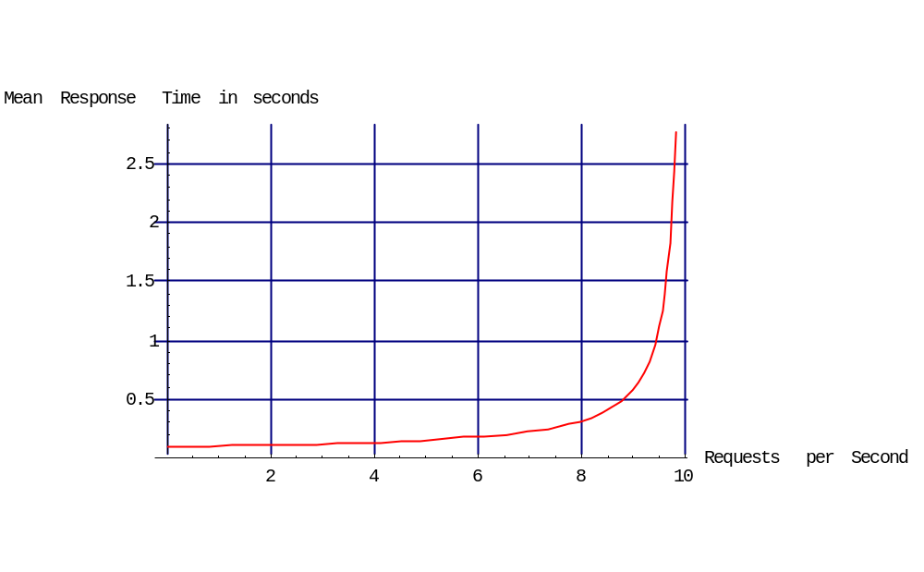
Non Linearity of Response Time

Slide 7
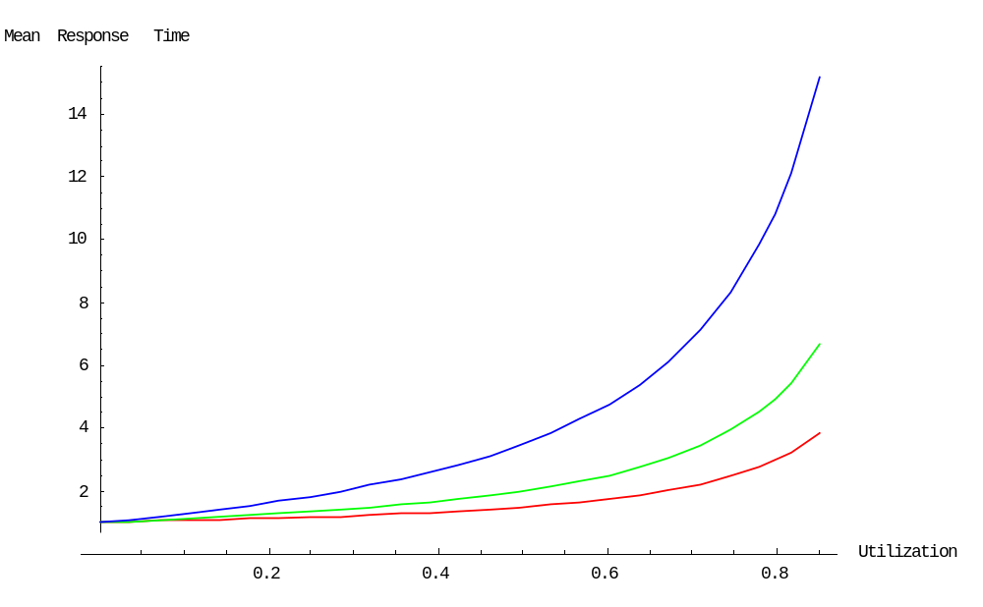
Impact of Variability

Slide 8
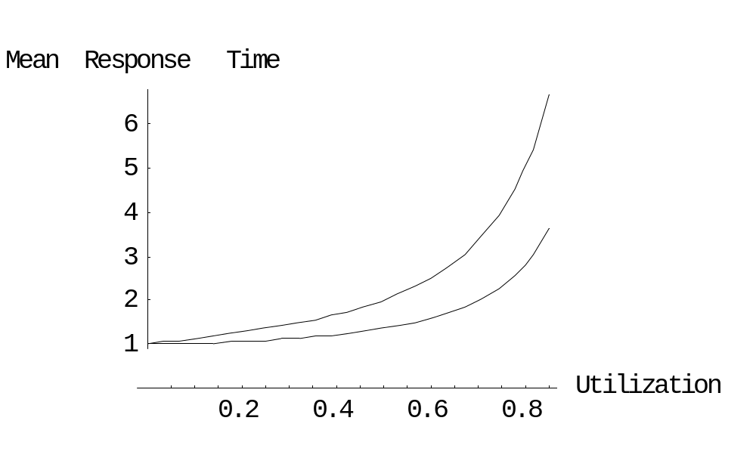
Optimal Sharing
System 1
System 2
S
λ
S
2λ
2λ
λ
S
S

Slide 9
5.4 Operational Laws
5.4.1 Little’s Law
Z
R
λ
Service
Center
n users

Slide 10
5.4.2 Network Laws
λ_{k}
λ
node k
λ

Slide 11
5.4.3 Bottleneck Analysis
A
CPU
B
n users
in think time

Slide 12
throughput
n/(Z+ ∑V_{k}S_{k})
1/(V_{A} S_{A})
B₀
1/(V_{CPU} S_{CPU})
B₁
B₂
n

Slide 13
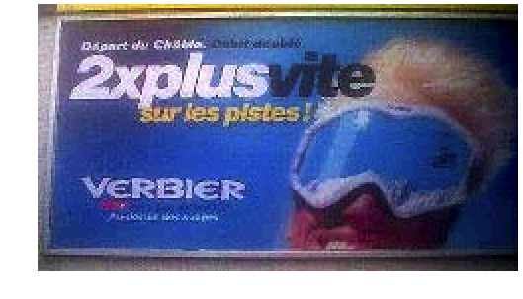
5.6 Case Study
Waiting room
Gate
Lift

Slide 14
Transient Analysis
bits
d_{max}
d_{max}/2
B
A(t)
b(t)=2ct
b₀(t)=ct
time

Slide 15
Stationary Analysis
A Refined Model
think time
Waiting room
T
Gate
Lift
Slope
c
Z
waiting time
Z/(N-1)
1/c
-Z

