Slide 1

Forecasting Part 1
Jean-Yves Le Boudec 2021

Slide 2
Performance Evaluation Mini-Project
Goal = Practice skills of performance analyst
Typically based on a project of your own
(group of 1 or 2 students)
Current or past, done outside this course
May also be based on one or several published papers
May also address a methodology issue (rather than case study)
Technical work: size of 2 homeworks
Step 0: one paragraph definition (due April 14).

Slide 3
Contents
What is forecasting ?
Linear Regression
Estimation error vs Prediction interval
Avoiding Overfitting
Use of Bootstrap

Slide 4
1. What is forecasting ?
Assume you have been able to define the nature of the load for your study
It remains to have an idea about its intensity
It is impossible to forecast without error
The good engineer should
Forecast what can be forecast
Give uncertainty intervals
The rest is outside our control

Slide 5
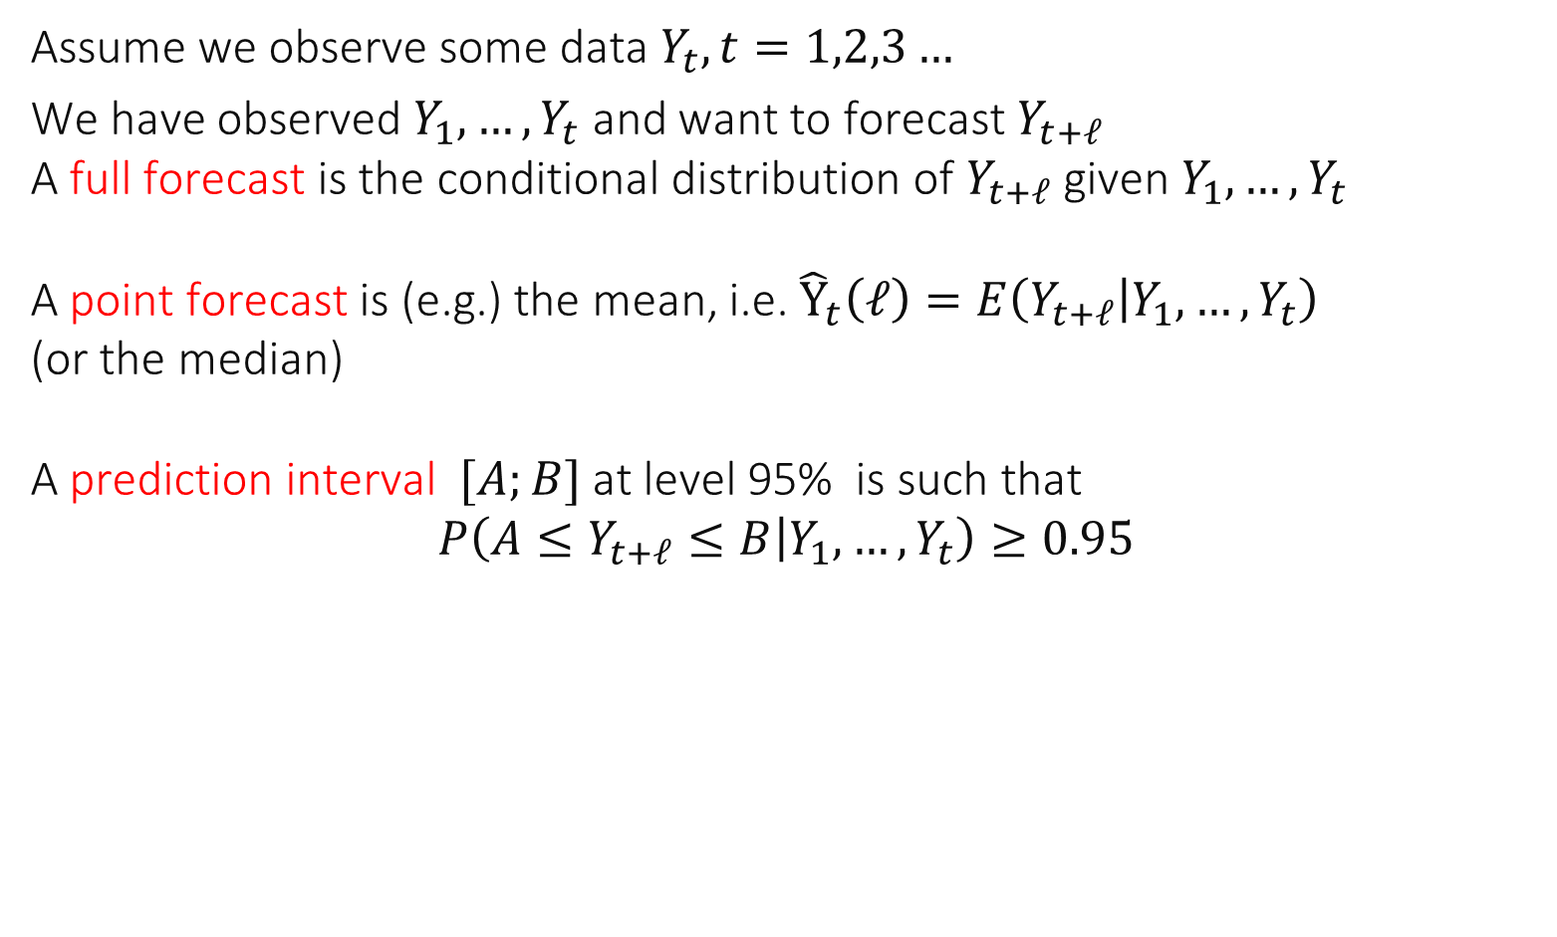
Forecasting = finding conditional distribution of future given past
Assume we observe some data $Y_{t}, t=1,2,3…$
We have observed $Y_{1},…,Y_{t}$ and want to forecast $Y_{t+ℓ}$ A full forecast is the conditional distribution of $Y_{t+ℓ}$ given $Y_{1},…,Y_{t}$ A point forecast is (e.g.) the mean, i.e. ${\hat{Y}}_{t}\left(ℓ\right)=E\left(Y_{t+ℓ} | Y_{1},…,Y_{t}\right)$ (or the median) A prediction interval $[A;B]$ at level 95% is such that $$P\left(A≤Y_{t+ℓ}≤B | Y_{1},…,Y_{t}\right)≥0.95$$

Slide 6
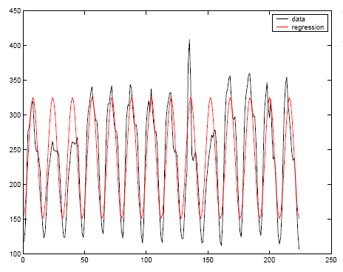

2. Use of Regression Models
Simple, often used
Based on a model fitted over the past, assumed to hold in the future
Example:
$$Y_{t}=238.2475−871876\cos\left(\frac{π}{8}t\right)−4.2961\sin\left(\frac{π}{8}t\right)+ε_{t}$$ with $ε_{t}∼iid N\left(0,σ^{2}\right),$
and $σ=38.2667$

Slide 7
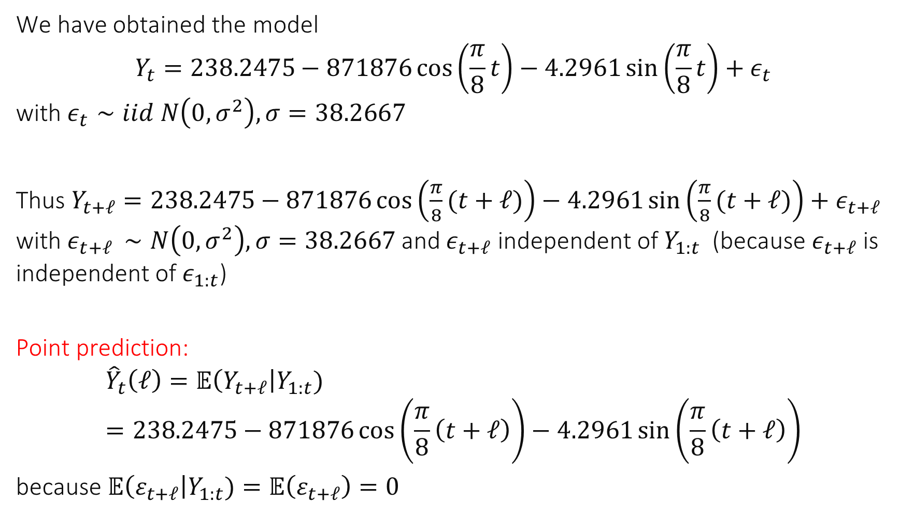
Prediction
We have obtained the model $$Y_{t}=238.2475−871876\cos\left(\frac{π}{8}t\right)−4.2961\sin\left(\frac{π}{8}t\right)+ε_{t}$$ with $ε_{t}∼iid N\left(0,σ^{2}\right), σ=38.2667$
Thus $Y_{t+ℓ}=238.2475−871876\cos\left(\frac{π}{8}(t+ℓ)\right)−4.2961\sin\left(\frac{π}{8}(t+ℓ)\right)+ε_{t+ℓ}$ with $ε_{t+ℓ }∼N\left(0,σ^{2}\right), σ=38.2667$ and $ε_{t+ℓ}$ independent of $Y_{1:t}$ (because $ε_{t+ℓ}$ is independent of $ε_{1:t}$)
Point prediction:
$${\hat{Y}}_{t}\left(ℓ\right)=𝔼\left(Y_{t+ℓ}\right|Y_{1:t})=238.2475−871876\cos\left(\frac{π}{8}\left(t+ℓ\right)\right)−4.2961\sin\left(\frac{π}{8}\left(t+ℓ\right)\right)$$ because $𝔼\left(ε_{t+ℓ}\right|Y_{1:t})=𝔼\left(ε_{t+ℓ}\right)=0$

Slide 8
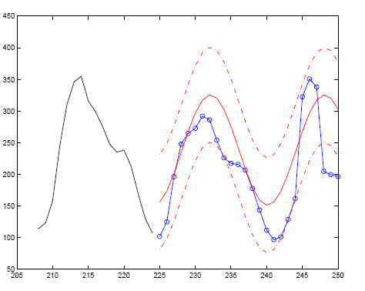

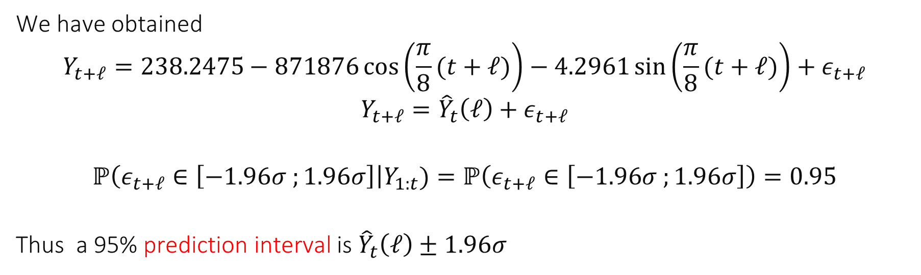

$${\hat{Y}}_{t}\left(ℓ\right)$$
We have obtained
$$Y_{t+ℓ}=238.2475−871876\cos\left(\frac{π}{8}(t+ℓ)\right)−4.2961\sin\left(\frac{π}{8}(t+ℓ)\right)+ε_{t+ℓ}$$
$$Y_{t+ℓ}={\hat{Y}}_{t}\left(ℓ\right)+ε_{t+ℓ}$$
$$ℙ\left(ε_{t+ℓ}∈\left[−1.96σ ;1.96σ\right]\right|Y_{1:t})=ℙ\left(ε_{t+ℓ}∈\left[−1.96σ ;1.96σ\right]\right)=0.95$$
Thus a 95% prediction interval is ${\hat{Y}}_{t}\left(ℓ\right)±1.96σ$

Slide 9
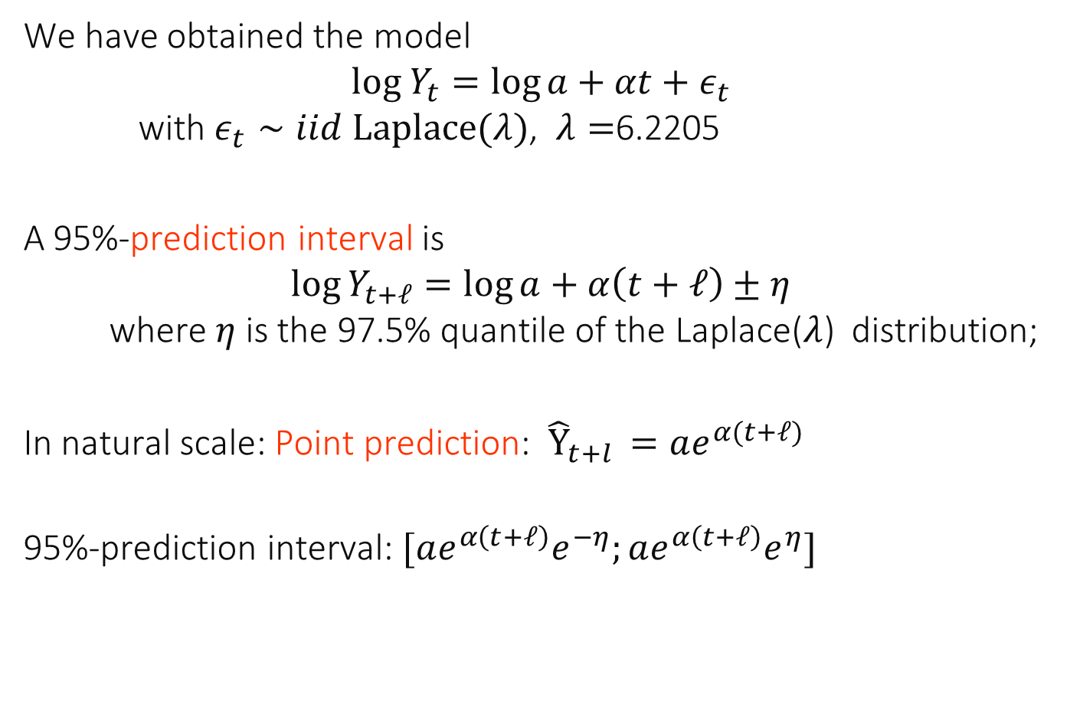
Virus Growth Data
We have obtained the model $$log Y_{t}=\log{a}+αt+ε_{t}$$ with $ε_{t}∼iid Laplace(λ)$, $λ=$6.2205
A 95%-prediction interval is $$\log{Y_{t+ℓ}=\log{a}+α\left(t+ℓ\right)±η}$$ where $η$ is the 97.5% quantile of the Laplace($λ$) distribution;
In natural scale: Point prediction: ${\hat{Y}}_{t+l }=ae^{α(t+ℓ)}$
95%-prediction interval: $[ae^{α\left(t+ℓ\right)}e^{−η};ae^{α\left(t+ℓ\right)}e^{η}]$

Slide 10
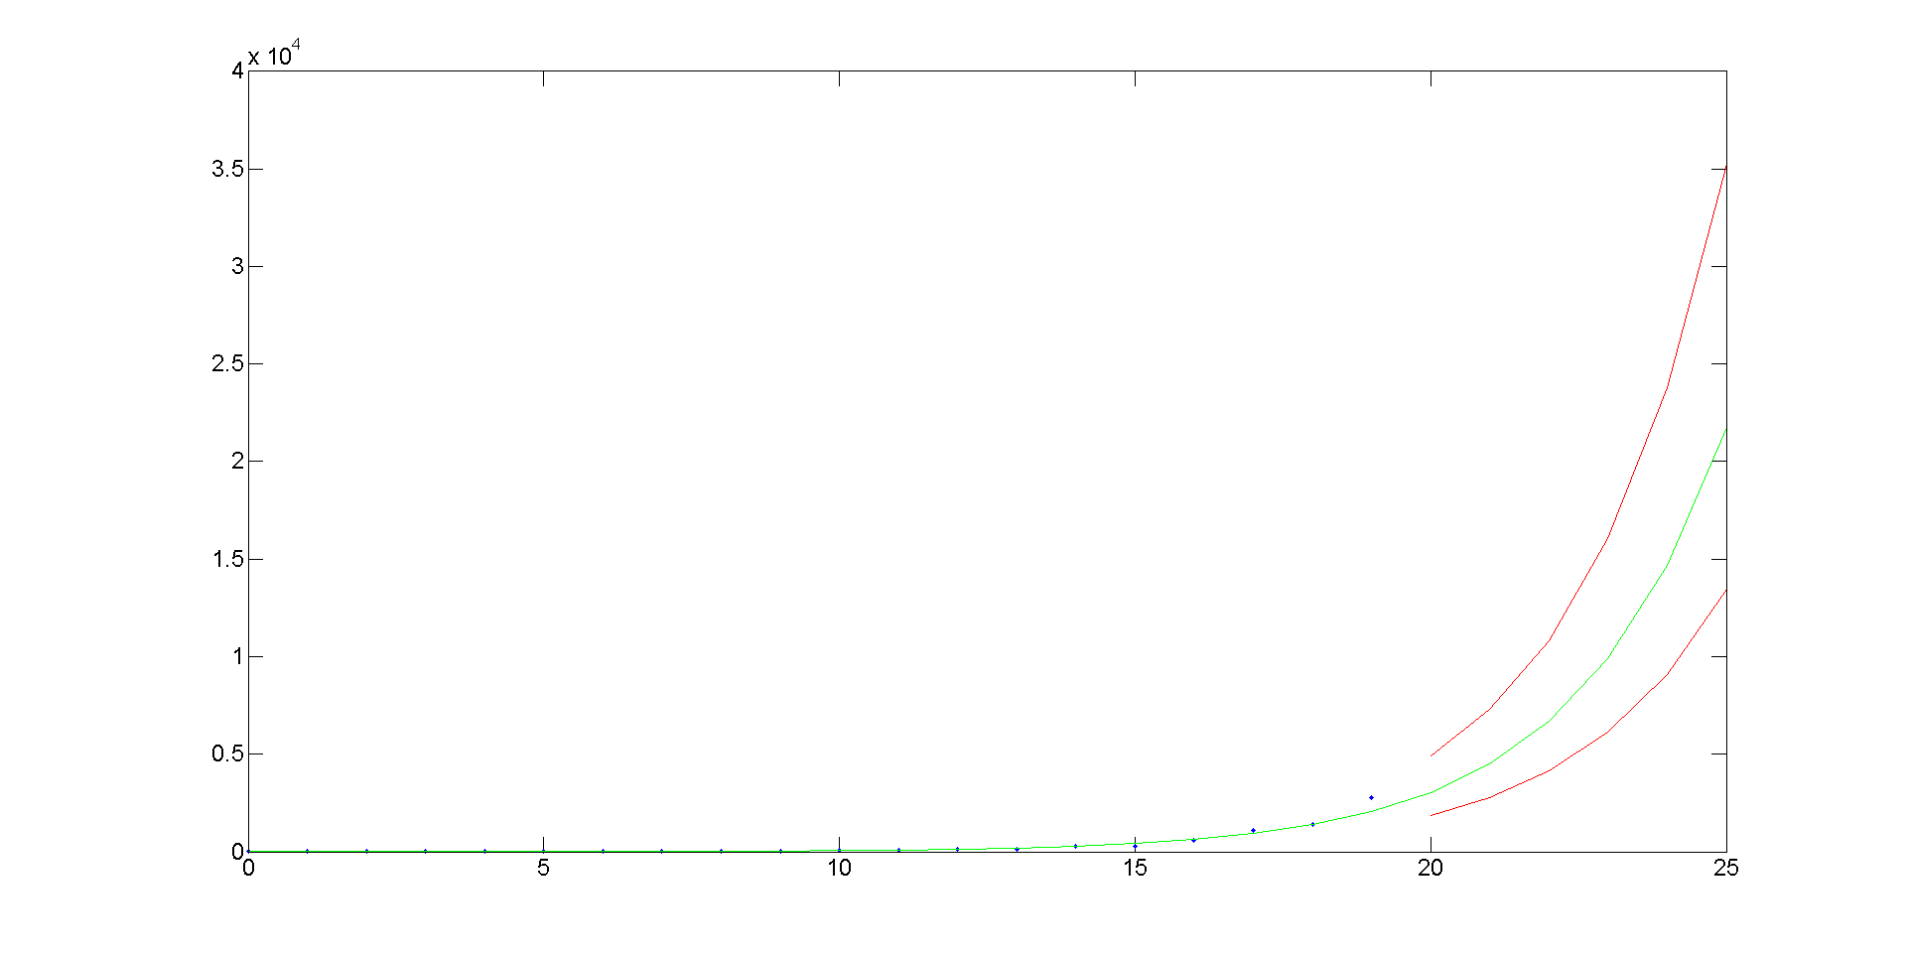
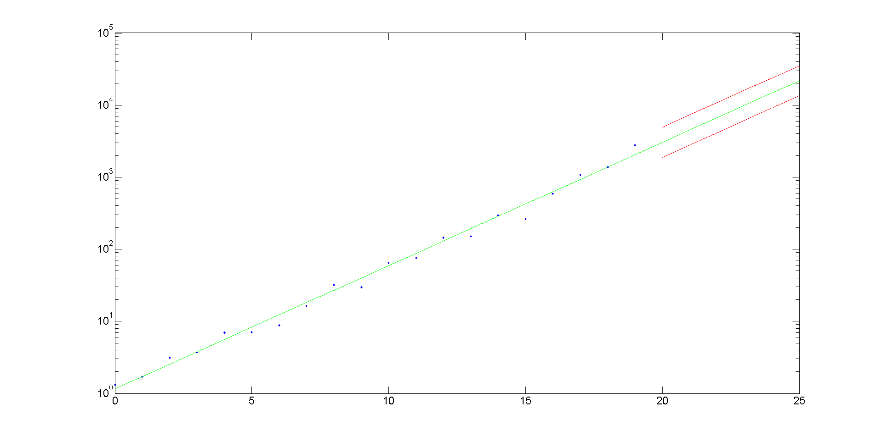
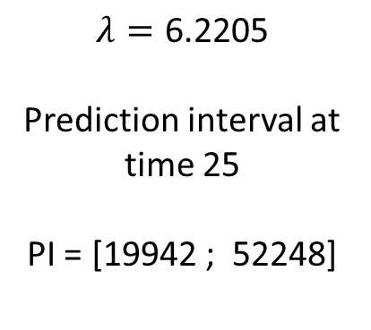
Natural scale
Log scale
$$λ=\text{6.2205}$$
Prediction interval at time 25
PI = [19942 ; 52248]

Slide 11

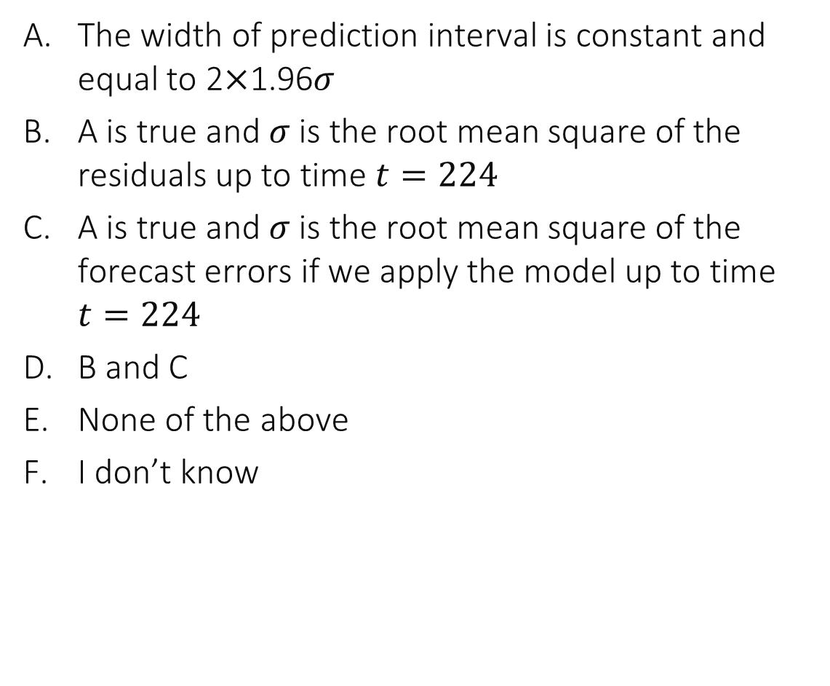
Say what is true, for this model $→$
The width of prediction interval is constant and equal to 2$×$1.96𝜎
A is true and $σ$ is the root mean square of the residuals up to time $t=224$
A is true and $σ$ is the root mean square of the forecast errors if we apply the model up to time $t=224$
B and C
None of the above
I don’t know

Slide 12
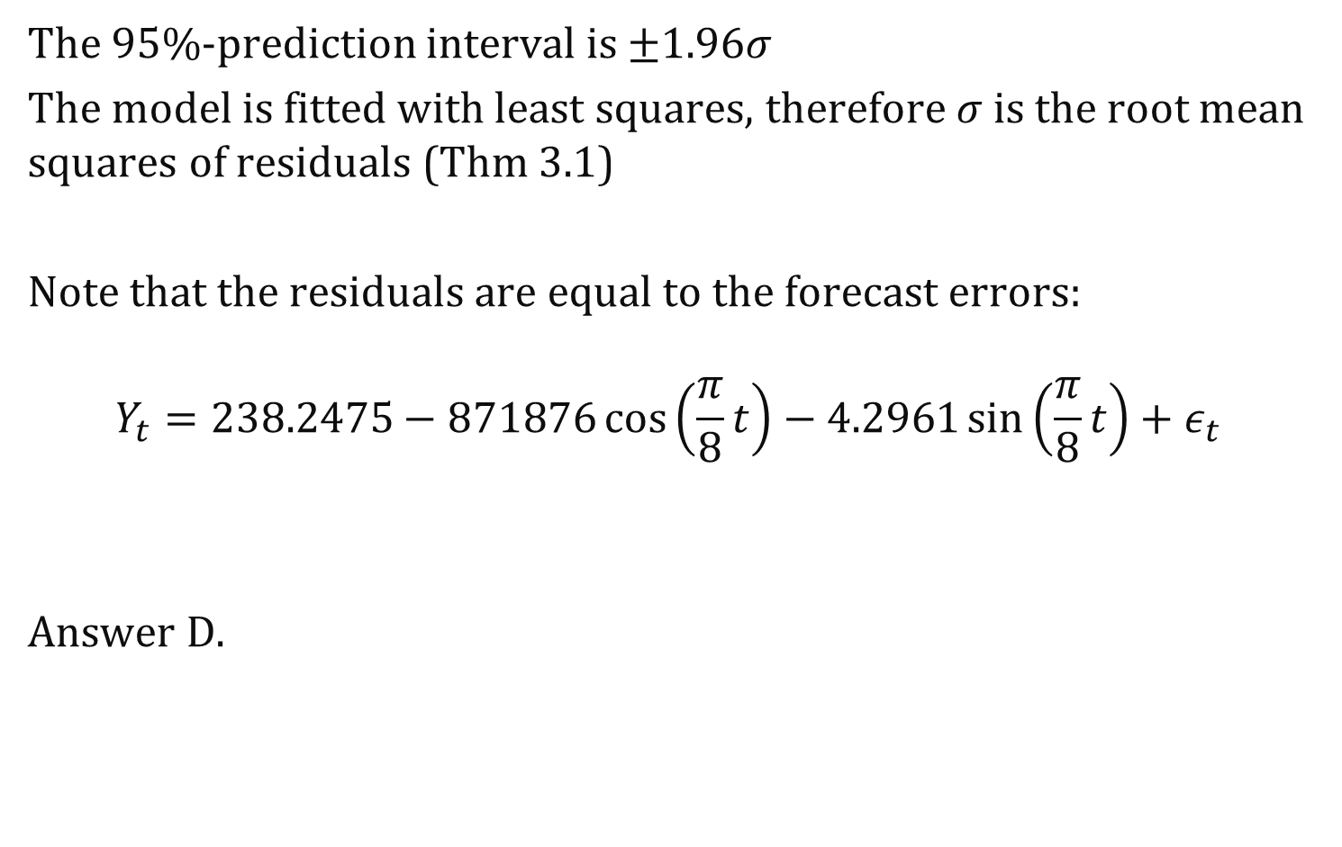

Solution
The 95%-prediction interval is $±1.96σ$
The model is fitted with least squares, therefore $σ$ is the root mean squares of residuals (Thm 3.1)
Note that the residuals are equal to the forecast errors: $$Y_{t}=238.2475−871876\cos\left(\frac{π}{8}t\right)−4.2961\sin\left(\frac{π}{8}t\right)+ε_{t}$$
Answer D.
Forecast ${\hat{Y}}_{t−ℓ}\left(ℓ\right)$ = residuals

Slide 13
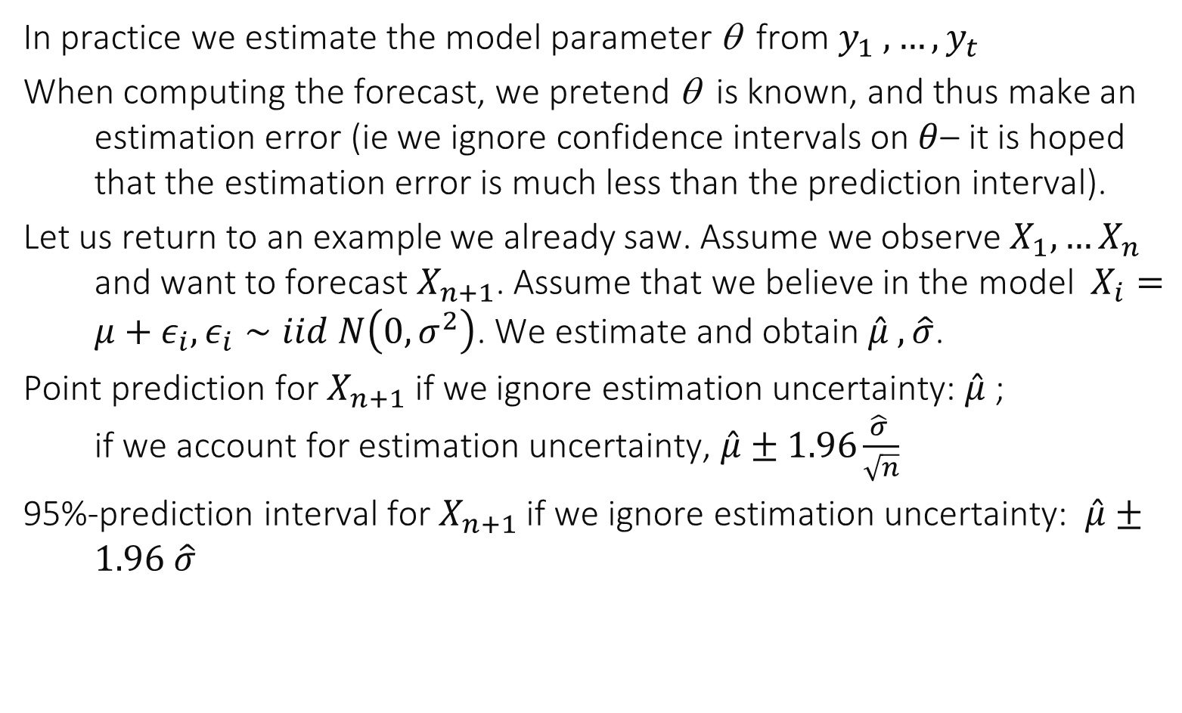
3. How about the estimation error ?
In practice we estimate the model parameter θ from $y_{1} , …, y_{t}$
When computing the forecast, we pretend θ is known, and thus make an estimation error (ie we ignore confidence intervals on $θ$– it is hoped that the estimation error is much less than the prediction interval).
Let us return to an example we already saw. Assume we observe $X_{1},…X_{n}$ and want to forecast $X_{n+1}$. Assume that we believe in the model $X_{i}=μ+ε_{i},ε_{i}∼iid N\left(0,σ^{2}\right)$. We estimate and obtain $\hat{μ} , \hat{σ}$.
Point prediction for $X_{n+1}$ if we ignore estimation uncertainty: $\hat{μ}$; if we account for estimation uncertainty, $\hat{μ}±1.96\frac{\hat{σ} }{\sqrt{n}}$
95%-prediction interval for $X_{n+1}$ if we ignore estimation uncertainty: $\hat{μ}±1.96 \hat{σ}$

Slide 14
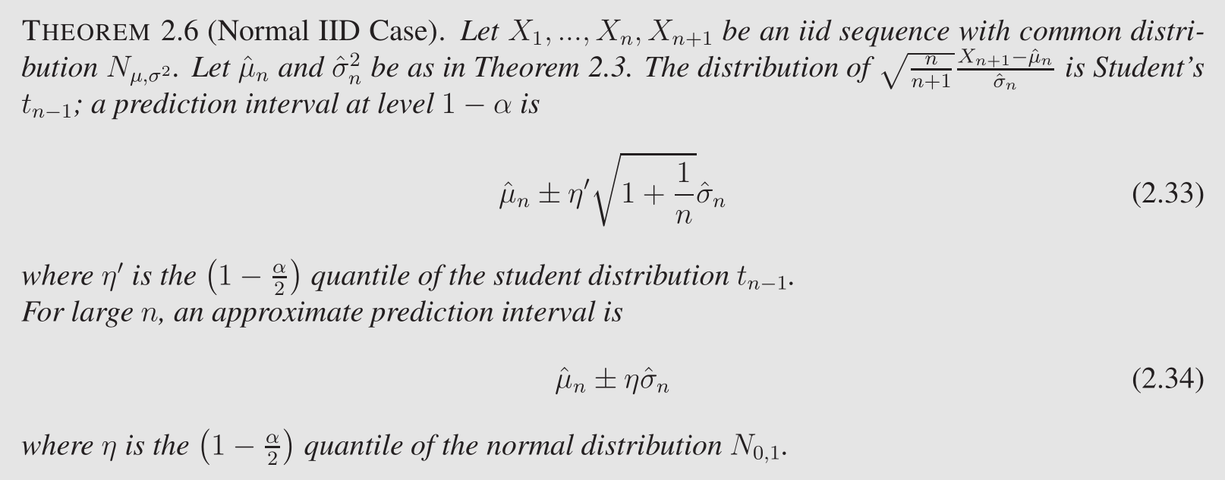
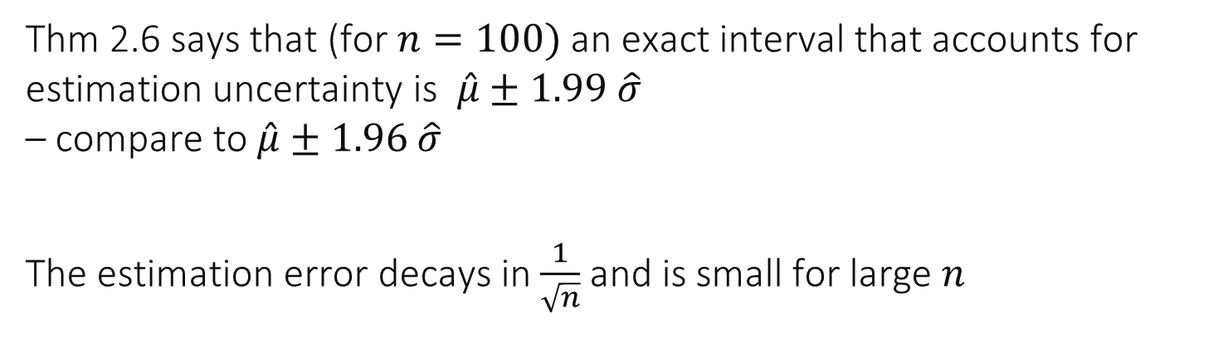
Thm 2.6 says that (for $n=100)$ an exact interval that accounts for estimation uncertainty is $\hat{μ}±1.99 \hat{σ}$ – compare to $\hat{μ}±1.96 \hat{σ}$
The estimation error decays in $\frac{1}{\sqrt{n}}$ and is small for large $n$

Slide 15
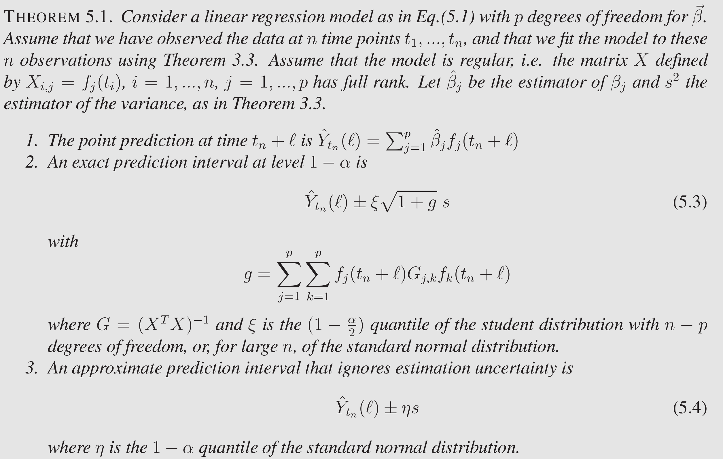
Exact Formulas exist for Linear Regression with LS

Slide 16
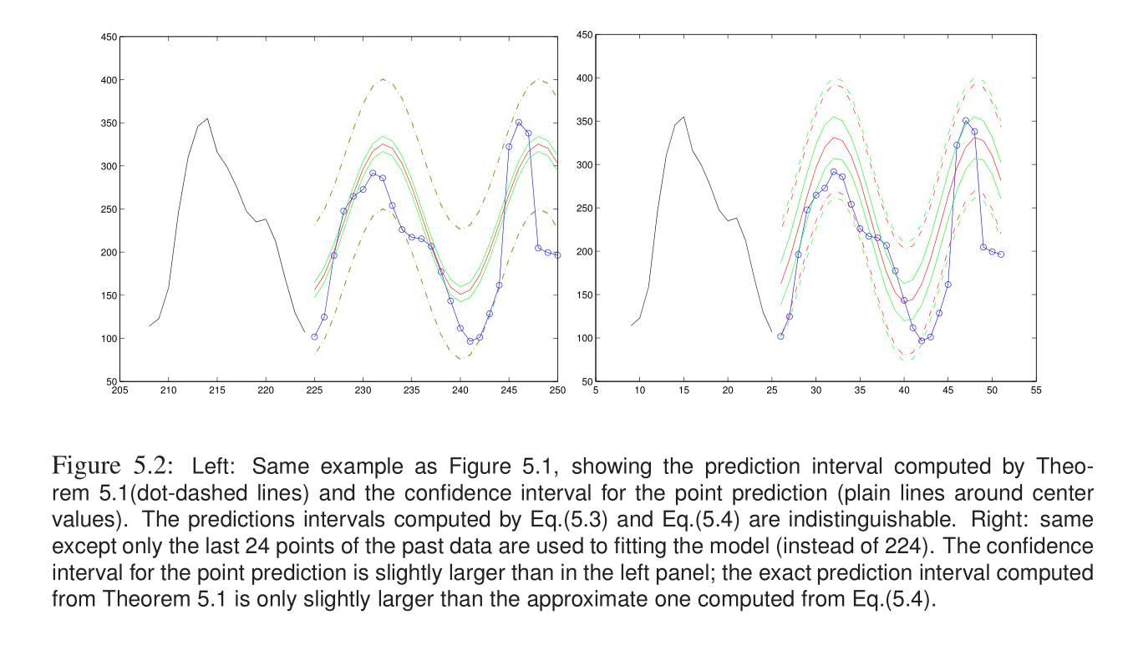

Slide 17
Take-Home Message
When we use a fitted model there is some uncertainty that adds to the prediction intervals.
In most cases we can ignore the model uncertainty because it impacts the prediction intervals only marginally.
In some rare cases (e.g. linear regression with gaussian errors) there are exact formulas.

Slide 18
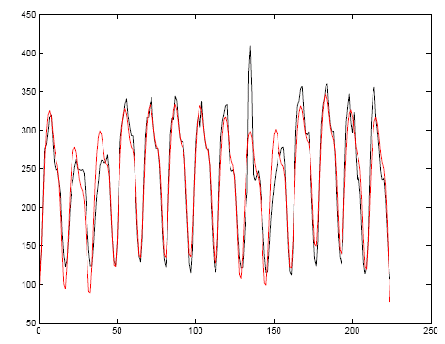
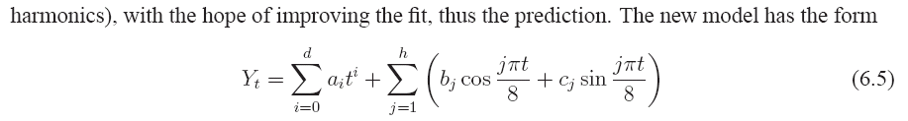


4. The Overfitting Problem
Assume we want to improve our model by adding more parameters: add a polynomial term + more harmonics
$$d=0, h=1$$
$$d=10, h=3$$

Slide 19
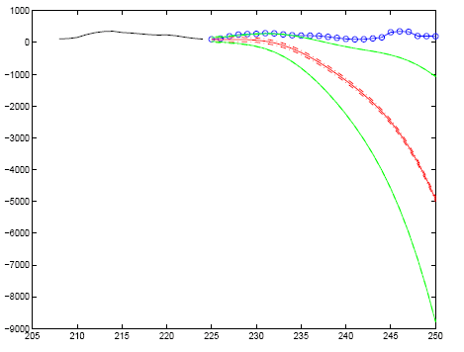
Prediction for the better model
This is the overfitting problem: a better fit is not the best predictor – in the extreme case, a model can fit exactly the data and is unable to model it

Slide 20
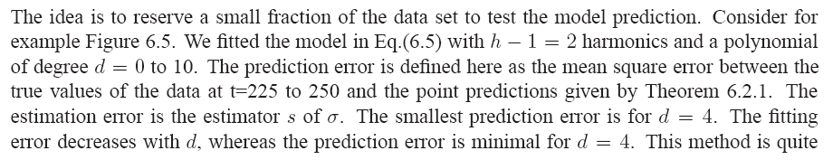
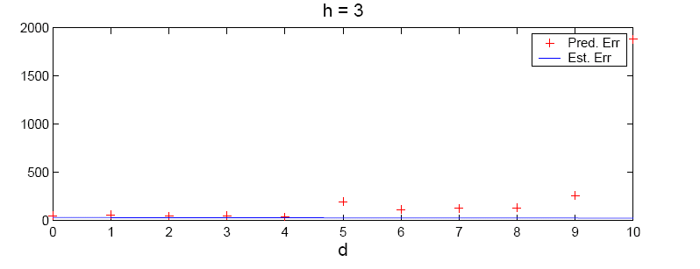
How to avoid overfitting
Method 1: reserve some data for testing

Slide 21
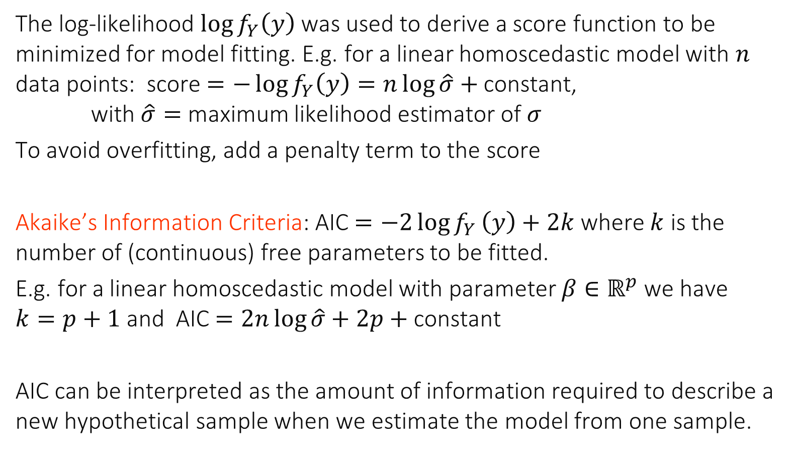
Method 2: Information Criteria
The log-likelihood $\log{f_{Y}\left(y\right)}$ was used to derive a score function to be minimized for model fitting. E.g. for a linear homoscedastic model with $n$ data points: score $=−\log{f_{Y}\left(y\right)}=n\log{\hat{σ}}+$constant, with $\hat{σ}=$ maximum likelihood estimator of $σ$
To avoid overfitting, add a penalty term to the score
Akaike’s Information Criteria: AIC $=−2\log{f_{Y}}\left(y\right)+2k$ where $k$ is the number of (continuous) free parameters to be fitted.
E.g. for a linear homoscedastic model with parameter $β∈ℝ^{p}$ we have $k=p+1$ and AIC $=2n\log{\hat{σ}}+2p+$constant
AIC can be interpreted as the amount of information required to describe a new hypothetical sample when we estimate the model from one sample.

Slide 22
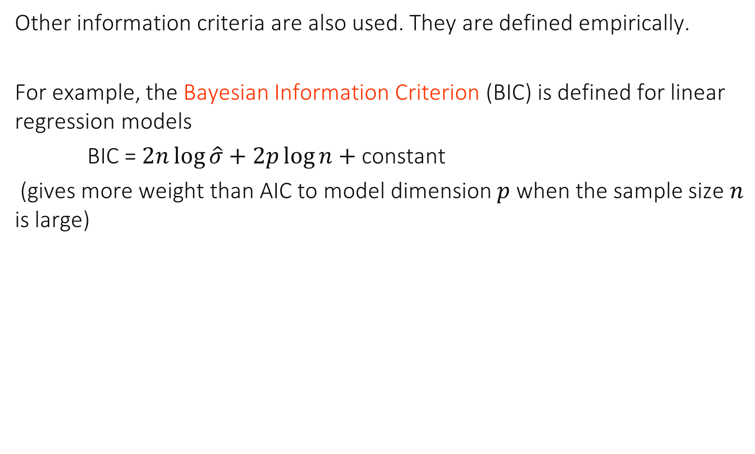
Other information criteria are also used. They are defined empirically.
For example, the Bayesian Information Criterion (BIC) is defined for linear regression models
BIC = $2n\log{\hat{σ}}+2p\log{n}+$constant
(gives more weight than AIC to model dimension $p$ when the sample size $n$ is large)

Slide 23
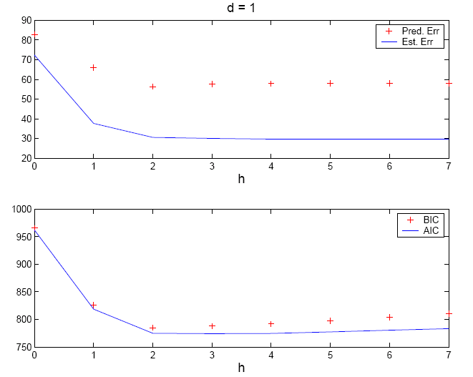

Best Model for Internet Data, $d=1$, $h$ up to 10
Information criteria are able to identify the best model

Slide 24
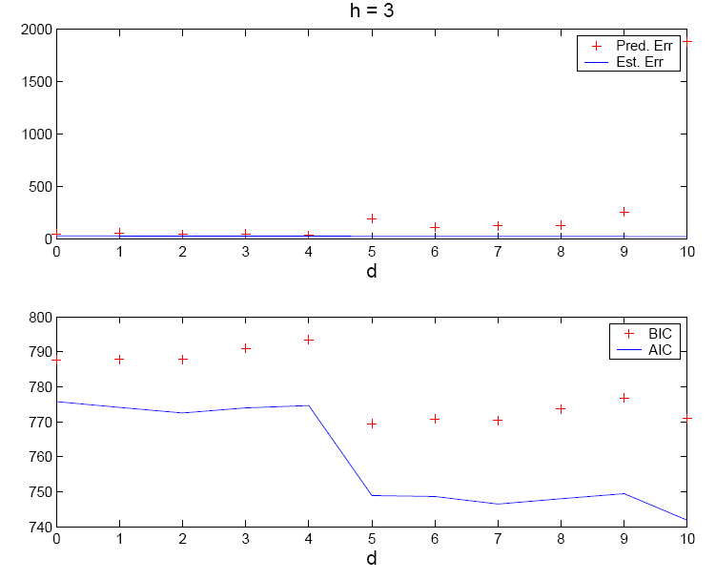

Best Model for Internet Data, $h=3$, $d$ up to 10
Information criterions are not able to identify the best model; the polynomial models are not a good class of models

Slide 25

Say what is true
When doing the fit and if we use an information criterion, we can use all data available up to time 𝑡
When doing the fit and if we use a score + test data we can use all data available up to time $t$
A and B
None
I don’t know

Slide 26
Solution
A is true
B is not true: if we use test data we need to keep a subset of the data for testing the prediction accuracy. We should not use this subset of data for fitting the model, otherwise the prediction performance is not properly assessed.
Answer A

Slide 27
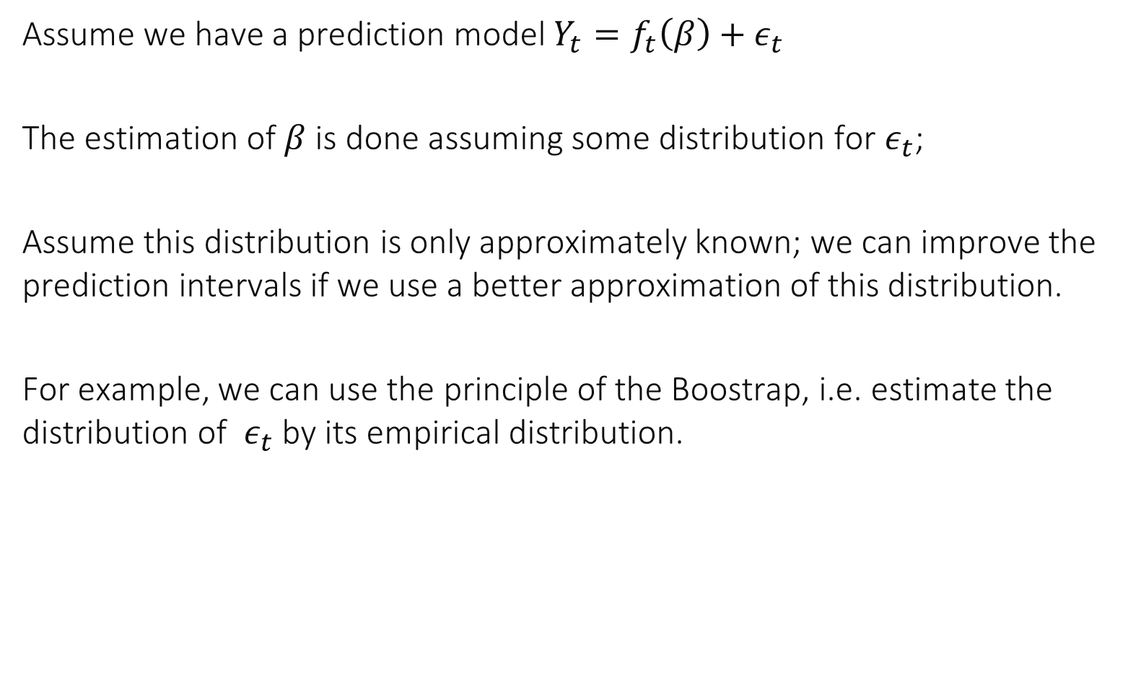
5. Use of Bootstrap
Assume we have a prediction model $Y_{t}=f_{t}\left(β\right)+ε_{t}$
The estimation of $β$ is done assuming some distribution for $ε_{t}$;
Assume this distribution is only approximately known; we can improve the prediction intervals if we use a better approximation of this distribution.
For example, we can use the principle of the Boostrap, i.e. estimate the distribution of $ε_{t}$ by its empirical distribution.

Slide 28
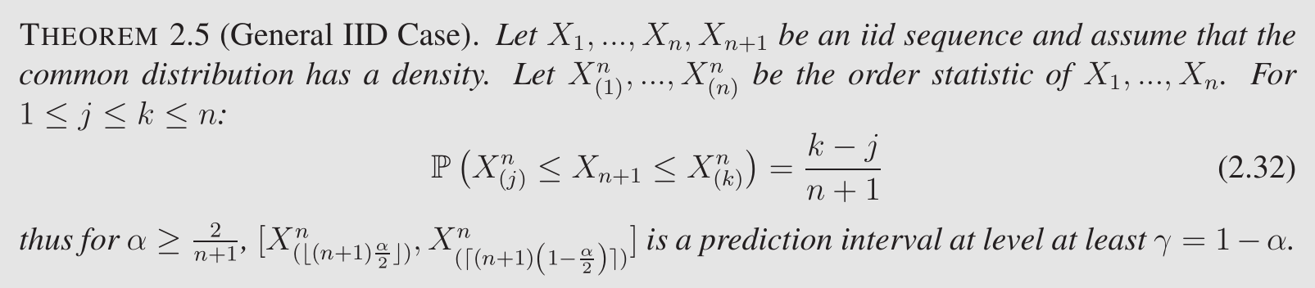
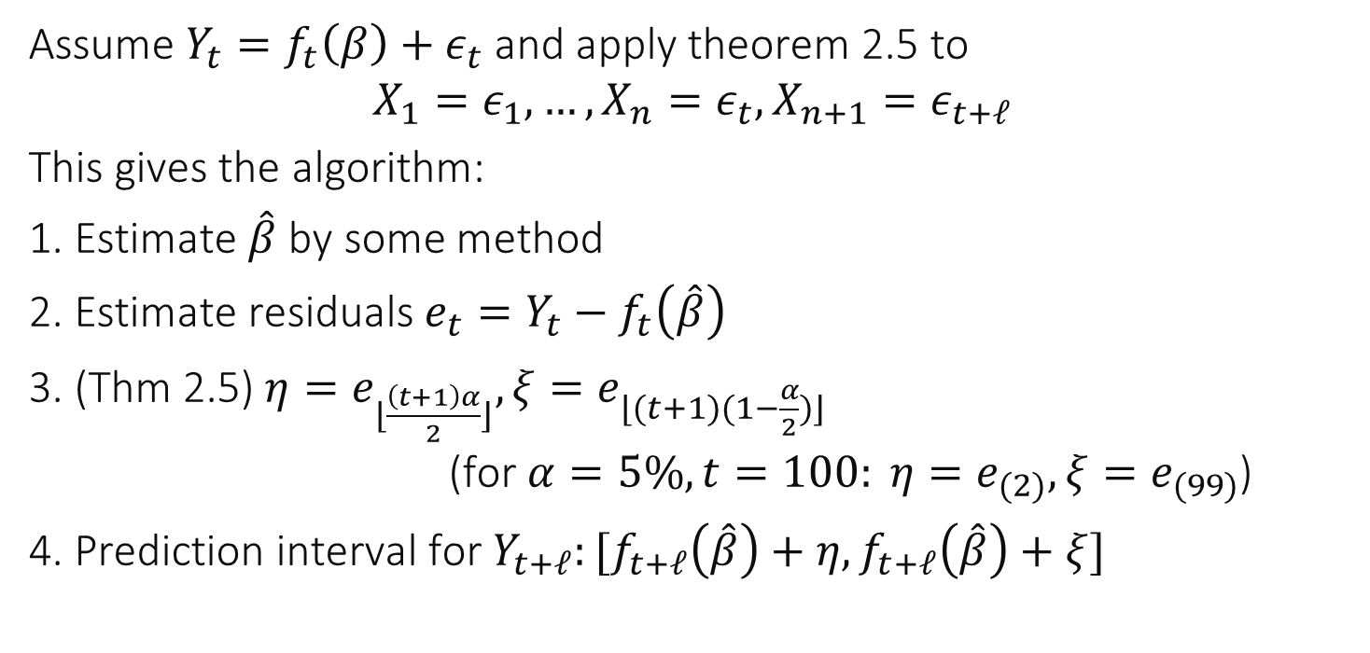
Assume $Y_{t}=f_{t}\left(β\right)+ε_{t}$ and apply theorem 2.5 to $$X_{1}=ε_{1},…,X_{n}=ε_{t}, X_{n+1}=ε_{t+ℓ}$$
This gives the algorithm:
1. Estimate $\hat{β}$by some method
2. Estimate residuals $e_{t}=Y_{t}−f_{t}\left(\hat{β}\right)$
3. (Thm 2.5) $η=e_{⌊\frac{\left(t+1\right)α}{2}⌋}, ξ=e_{⌊(t+1)(1−\frac{α}{2})⌋}$ (for $α=5\%, t=100: η=e_{(2)},ξ=e_{(99)}$)
4. Prediction interval for $Y_{t+ℓ}:[f_{t+ℓ}\left(\hat{β}\right)+η,f_{t+ℓ}\left(\hat{β}\right)+ξ]$

Slide 29
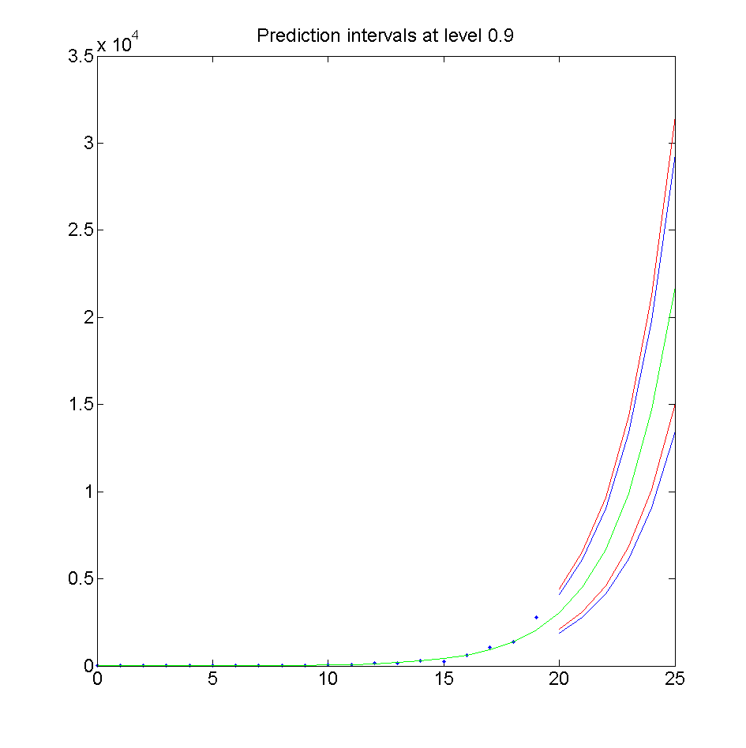
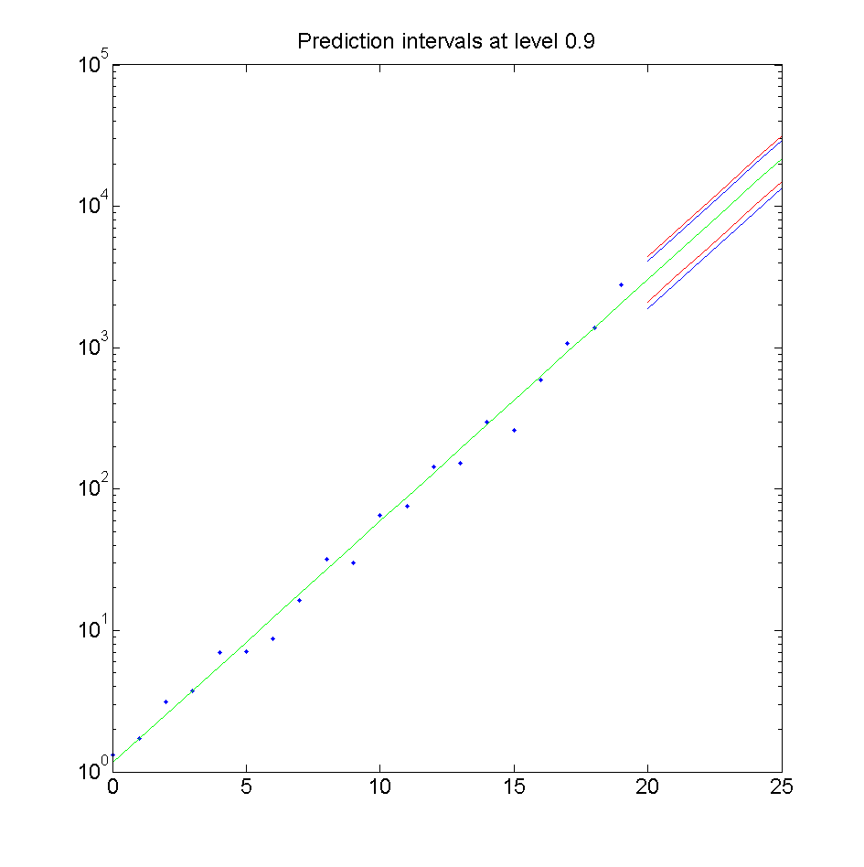
Example
For this example, the bootstrap (done in log scale) gives asymmetric prediction interval
Assuming Laplace noise
bootstrap

Slide 30
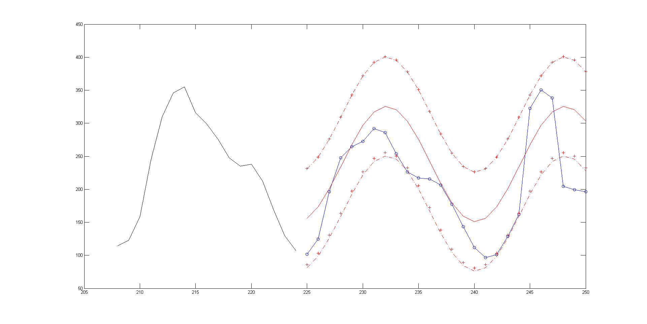

Example
For this example, the bootstrap gives slightly smaller intervals than the ones based on gaussian noise
bootstrap
Assuming gaussian noise

