Slide 1

Performance Evaluation
Jean-Yves Le Boudec
2021

Slide 2
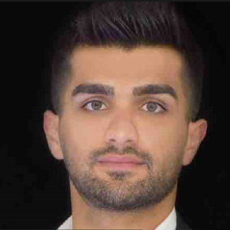
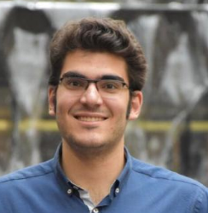
Your Team
Prof. Jean-Yves Le Boudec, lecturer
Ehsan Mohammadpour, head TA Hossein Tabatabaee
Where to start
moodle.epfl.ch

Slide 3
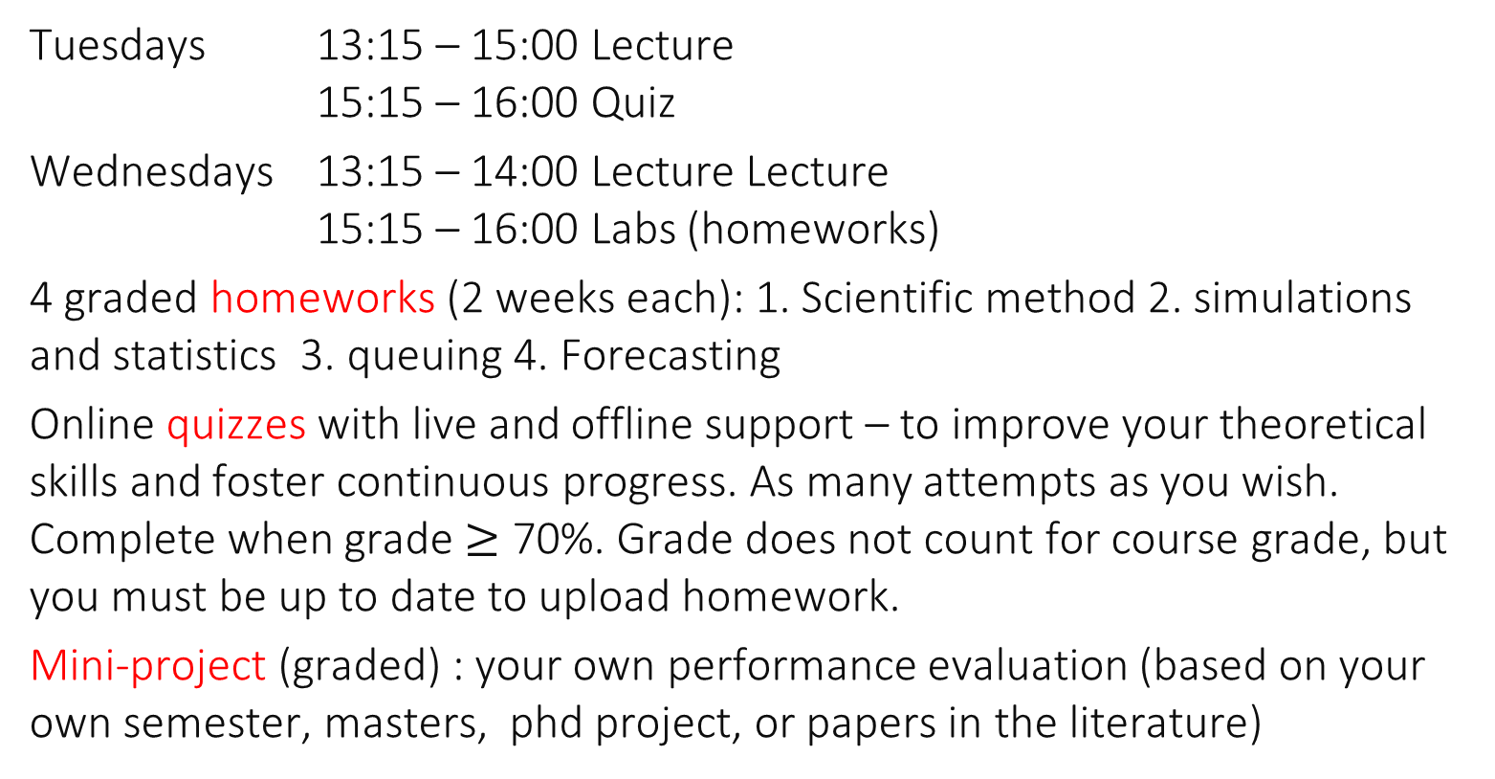
Learning = Lecture + Exercises + Homeworks + Miniproject
Tuesdays 13:15 – 15:00 Lecture 15:15 – 16:00 Quiz
Wednesdays 13:15 – 14:00 Lecture Lecture 15:15 – 16:00 Labs (homeworks)
4 graded homeworks (2 weeks each): 1. Scientific method 2. simulations and statistics 3. queuing 4. Forecasting
Online quizzes with live and offline support – to improve your theoretical skills and foster continuous progress. As many attempts as you wish. Complete when grade $≥$ 70%. Grade does not count for course grade, but you must be up to date to upload homework.
Mini-project (graded) : your own performance evaluation (based on your own semester, masters, phd project, or papers in the literature)

Slide 4

Grading
One exam in exam session = $E$
Average of homeworks = $H$
Mini-project grade = $M$
Final Grade = $( E + M+H)/3$
Exam: details to be discussed later

Slide 5

Lecture Notes
Text book Performance Evaluation Of Computer And Communication Systems Jean-Yves Le Boudec
http://perfeval.epfl.ch
ISBN: 978-2-940222-40-7 2010, 420 pages, 16x24 cm, Hardcover
Pdf freely and legally available

Slide 6
Outline of the Lecture
Lectures Labs
Methodology (today) L1
Confidence Intervals
Simulation L2
Queuing L3
Model fitting
Forecasting L4
Tests
Model fitting 2
Palm Calculus

Slide 7
Performance Evaluation Mini-Project
Goal = Practice skills of performance analyst
In principle based on a project of your own
Current or past, done outside this course
May also be based on one or several published papers
May also address a methodology issue (instead of case study)
Size of 2 homeworks (4 weeks)

Slide 8
Examples of past projects
Performance Evaluation of Multimodal Word Distributions
Performance evaluation of different methods using Python 3.7 to iterate through large datasets
Measuring the effect of data filtering in source localization
Comparison of three Java garbage collectors
Model fitting for CO 2 measurements
Analysis of transfer speed over WiFi
Performance of a Ridge Regression
Performance of Karger-Stein Algorithm for Minimum Cuts
Performance Evaluation of Neutrality Inference Algorithm
Performance of Lossless Compression Methods
Performance Evaluation of Graph Libraries in Python
Comparison of Three Memory Allocators in a Multi-threaded Setting
Comparison of imputation methods
Comparing Java and Scala
Evaluating “Fairness in Classification”
Performance Evaluation of an approximation algorithm implemented in Spark

Slide 9
Examples of past projects
Evaluating the impact of batch size in Squall
Performance of compression algorithms for genomic data
Performance comparison between Python and non-script languages
Modeling Heavy-Tails in Traffic Sources for Network Perfomance Evaluation
NAS on Odroid
SQLite and Realm, performance analysis of mobile databases on Android platform
kvm vs lxc at polylan
Optimizing The Location Obfuscation In Location-Based Mobile
A comparison of Rust and C++
Comparison of Matrix Operation Performance between Matlab and Python-Numpy/Scipy
Performance analysis of multi-threading in In-Memory Data-Stores
SystemsPacket Sampling with Delayed Disclosure
Performance of Cartography web application in JavaScript
Performance Evaluation of Mersenne arithmetic on GPUs
Independence of Packet Losses in Wireless Networks

Slide 10
Mini-Project: Process
Phase 1: project definition Project proposal (one paragraph) uploaded by you on Moodle by April 14 at 23:55 Obtain feedback from me – not graded If needed, update your final project definition by April 21 at 23:55
Phase 2: project development 1 Intermediate checkpoint (slide show, at most 10 slides) on May 5 - 12 – not graded
Phase 3: project development 2 Defenses on May 25- June 2

