Slide 1

Importance Sampling

Slide 2
What is Importance Sampling ?
A simulation technique
Used when we are interested in rare events
Examples:
Bit Error Rate on a channel,
Failure probability of a reliable system

Slide 3
What is the Problem ?
Assume you can simulate a system
You want to evaluate the probability of a rare event
Do you do a stationary or terminating simulation ?
Assume proba of rare event is 1E-06: how many simulation runs do you need to obtain one rare event ?

Slide 4
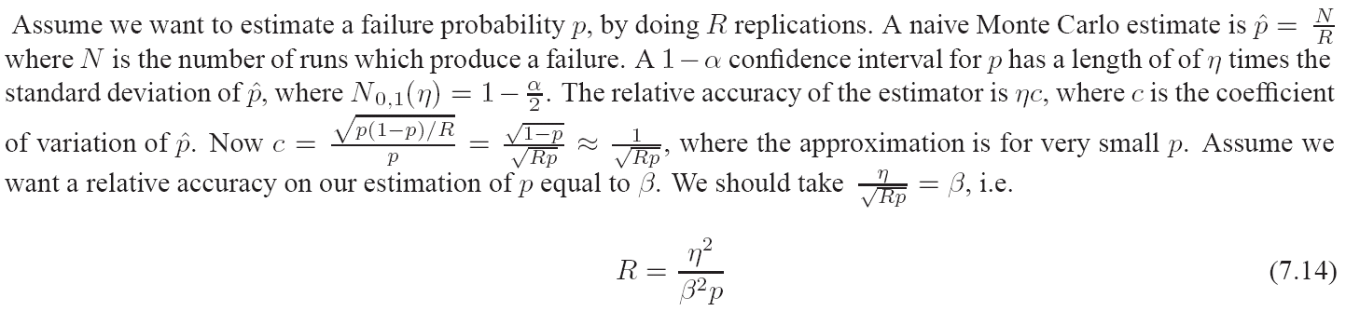
Simulating Rare Events
You simulate a rare event using R replications
You want to estimate p, proba of rare event
You obtain a confidence interval p-u, p+u; you want accuracy 10%
u/p = 0.1
With proba 95%

Slide 5
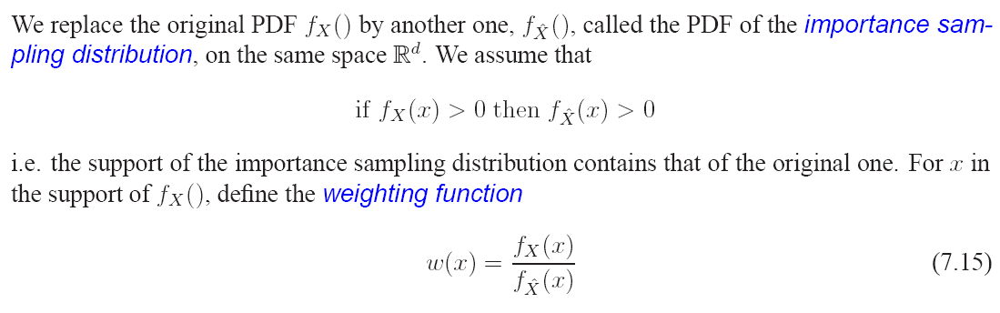
The Idea of Importance Sampling

Slide 6


The Idea of Importance Sampling (cont’d)
If we simulate X, how do we estimate p ?
If we simulate instead of X , we cannot use
But:
Show this !

Slide 7
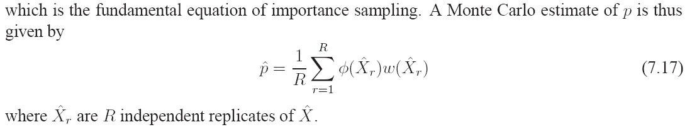
Importance Sampling Monte Carlo

Slide 8
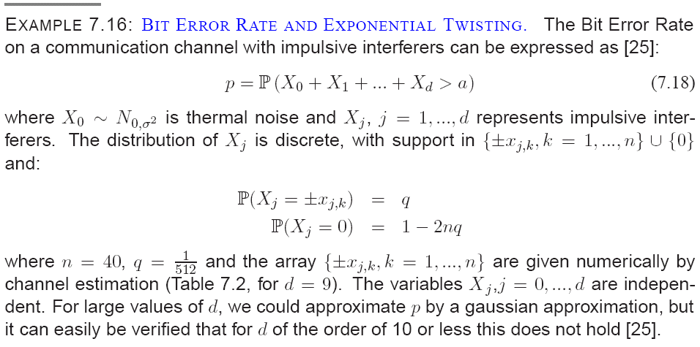
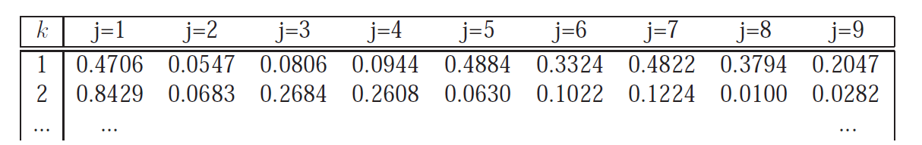
Example: Bit Error Rate (BER)

Slide 9
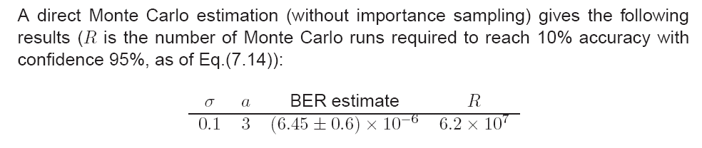
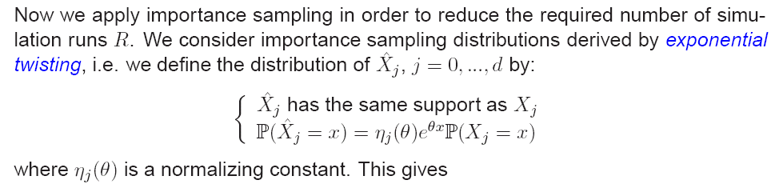

Slide 10
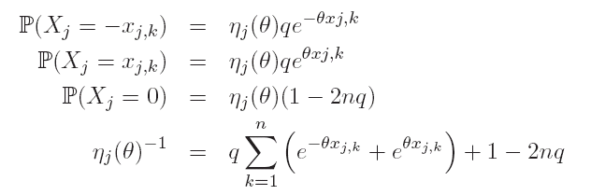
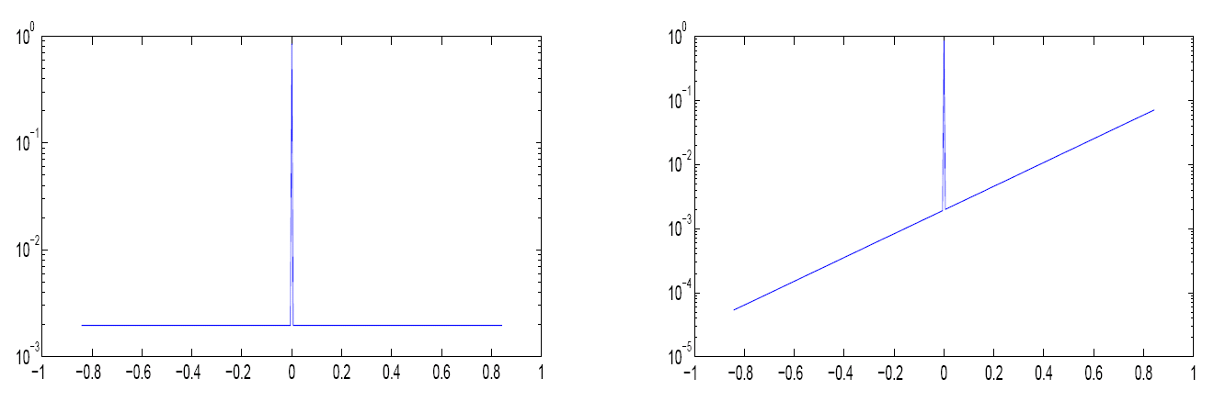

Slide 11
Wake Up Slot
What is the twisted distribution of X₀ ?
What is the weighting function ?

Slide 12
Answer

Slide 13
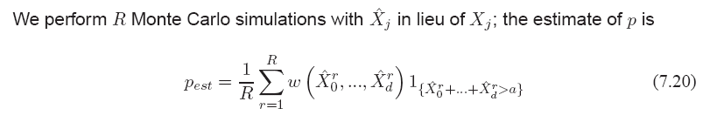
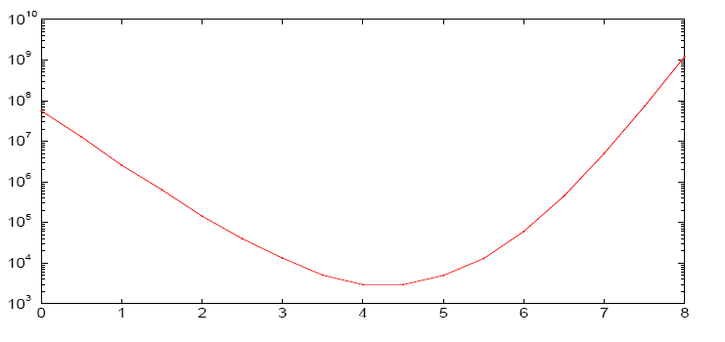
Importance Sampling Monte Carlo
What is the gain ?
Is Importance Sampling always better ?
R
theta

Slide 14
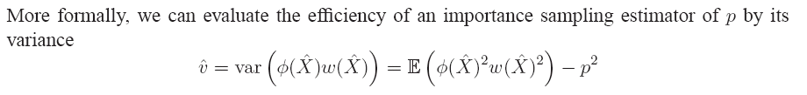
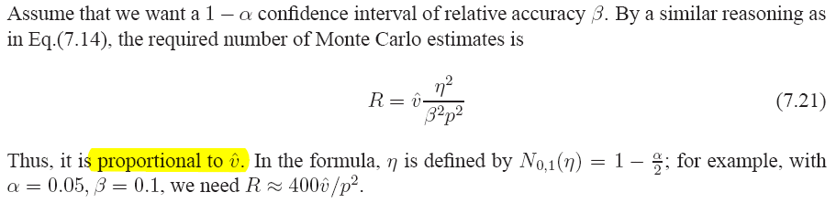
Choosing an Importance Sampling Distribution
What is a good importance sampling distribution ? One that minimizes the number of runs
This can be quantified with the variance of the importance sampling estimator

Slide 15
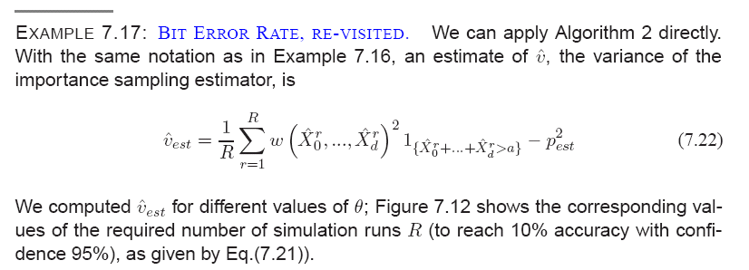

Slide 16
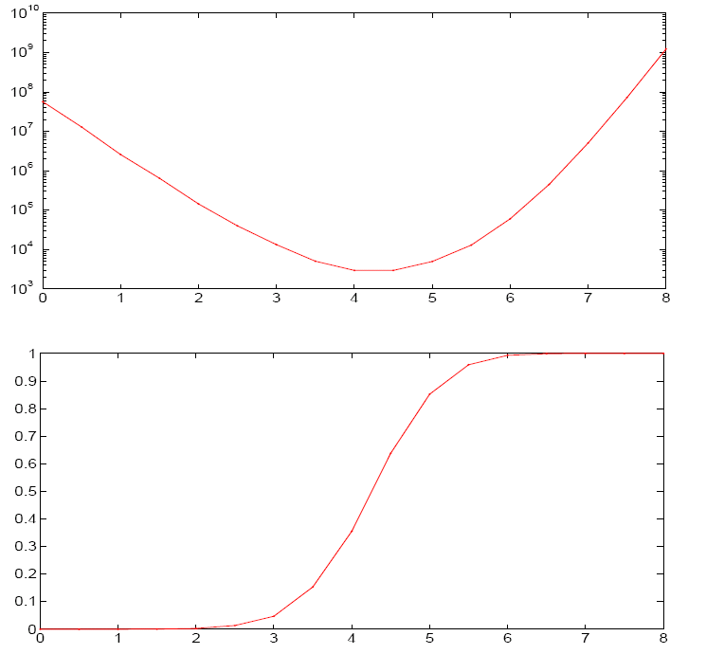


R (proportional to variance)
The smallest variance is for

Slide 17
Choosing an Importance Sampling Distribution (1)
Rule of thumb:
The events of interest, under the importance sampling distribution should be not rare not certain

Slide 18

Choosing an Importance Sampling Distribution (2)
The optimal importance sampling distribution is the one that minimizes
Wake up question: is it the same as minimizing the variance of the importance sampling estimator ?

Slide 19
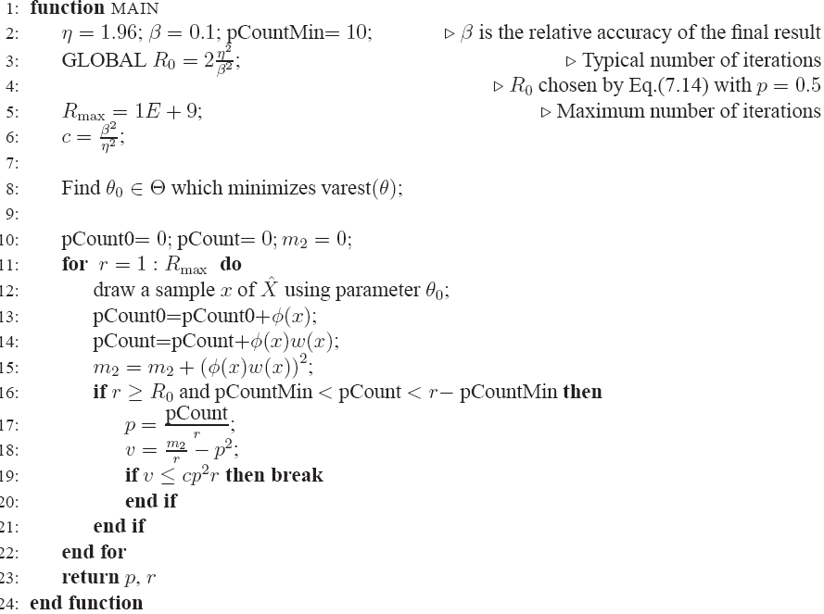

Slide 20
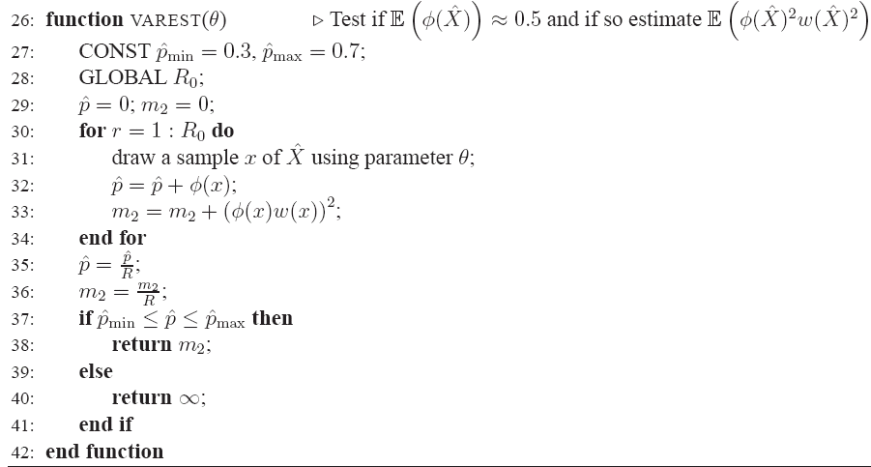

Slide 21
A Generic Algorithm
Ideas : empirically find importance sampling distribution such that
Average occurrence of event of interest is close to 0.5
Minimizes
Can be computed by Monte Carlo with small number of runs
The algorithm does not say how to do one important thing: which one ?

Slide 22
Exercise
Q: We simulate R = 10 000 samples and find no bit error. What can we say about the bit error rate ?
A: with confidence 0.95, BER < 3.7 E-04

Slide 23
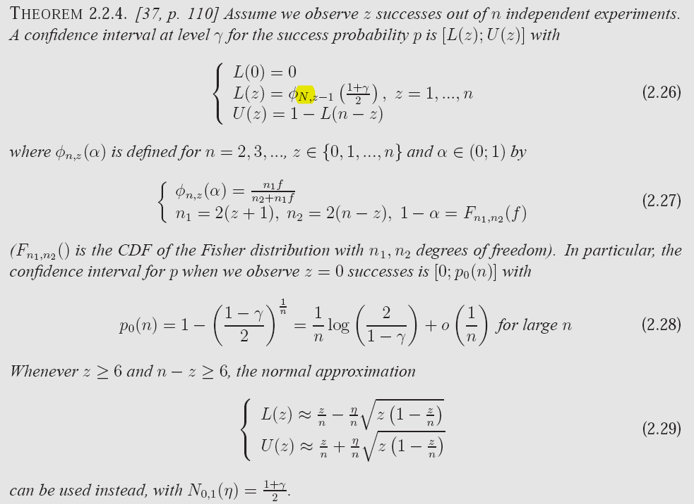

Slide 24
Conclusion
If you have to simulate rare events, importance sampling is probably applicable to your case and will provide siginificant speedup
A generic algorithm can be used to find a good sampling distribution

