Slide 1
Mini-Projects
Jean-Yves Le Boudec
2021

Slide 2
Performance Evaluation Mini-Project
Goal = Practice skills of performance analyst
Typically based on a project of your own
(group of 1 or 2 students)
Current or past, done outside this course
May also be based on one or several published papers
May also address a methodology issue (rather than case study)
Technical work: size of 2 homeworks
Step 0: one paragraph definition (due April 14).

Slide 3
Check-List for Mini-Project
What is your goal ? What are the main issues ? Which ones require a detailed performance analysis
What are : the load and the metrics ?
What are the factors ? Are there nuisance factors ?
What is the solution method used by you or the paper ?
Use the scientific method to draw conclusions in an iterative way.
If required, do more numerical analyses or experiments
Which performance patterns did you encounter ?
Give your results with confidence intervals if appropriate.
Present your work in a slide show

Slide 4
Intermediate Checkpoint
Early in the project, obtain feedback, during an intermediate checkpoint, on
Your goals
Your technical approach
Your presentation skills
Obtain a slot (see moodle) on May 11 or 12 (see Moodle)
Prepare a slide show (7 slides max, target speaking time 10 mn)

Slide 5
Public Defence
15 mn presentation + 15mn Q&A
Two colleagues are your audience ; they must summarize what they understood
You are audience for one other group, drawn randomly during session
Both roles are graded
May 25, 26 and June 1, 2.
5

Slide 6
Archive
Put all other documents (e.g. papers, source codes, matlab scripts) in a zip file on Moodle so we can reproduce your findings.
6

Slide 7
Dos and Donts
Do: prepare a first slide show for private defence and listen to feedback received
Don’t: spend too much time re-doing all simulations
Don’t believe everything that is written in the literature
Do: make graphics that are
Economical
True

Slide 8
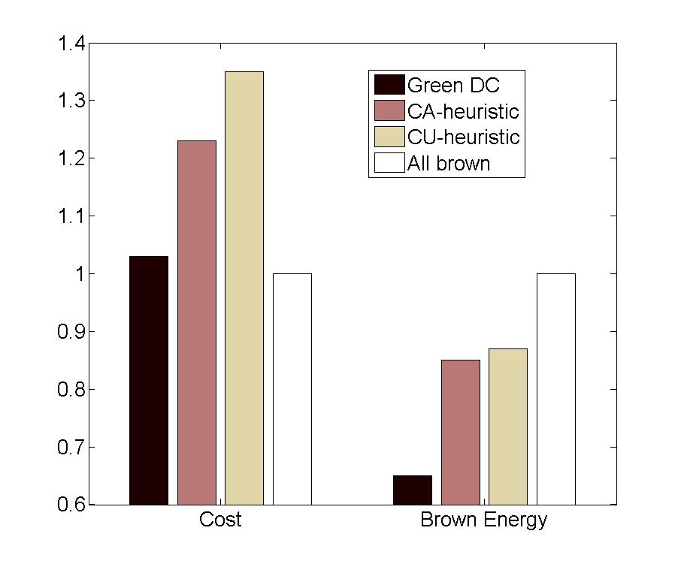
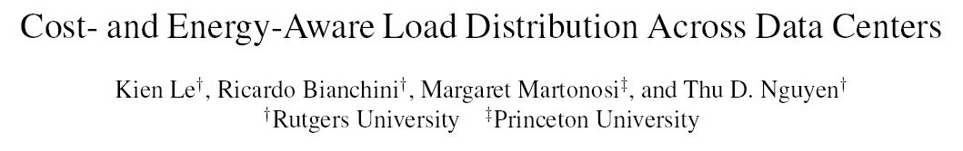
What’s wrong with this graphic ?
Made with data from:

Slide 9
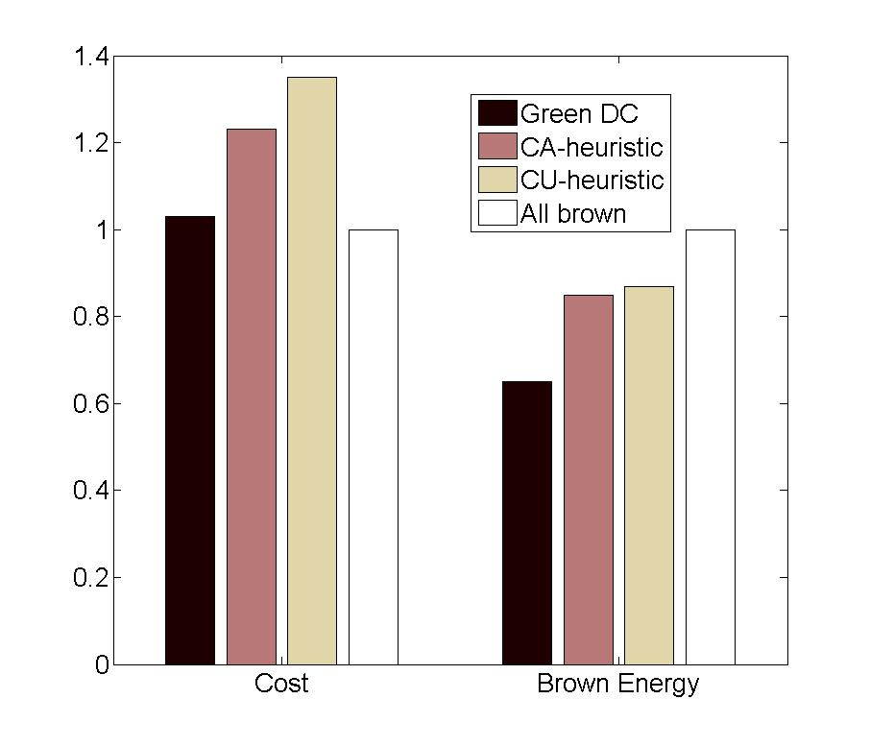
Better Graphics
Y scale starts at 0
Previous representation was not true

Slide 10
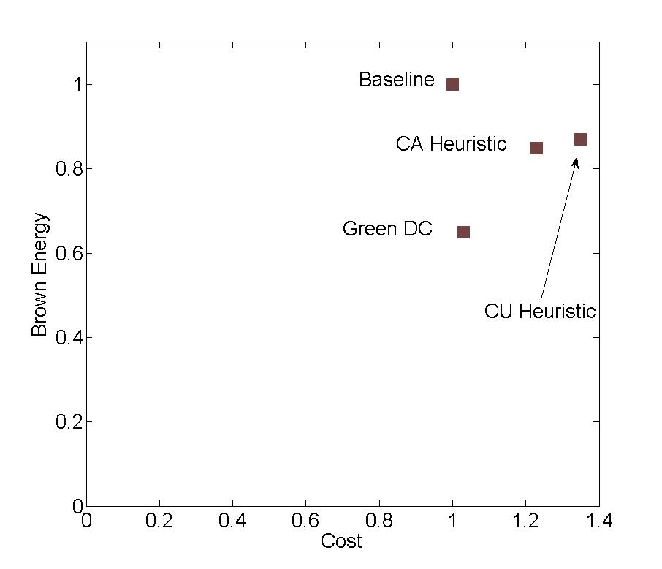
Perhaps Even Better Graphics
Baseline and Green DC are non dominated
Representation is more economical

