Slide 1
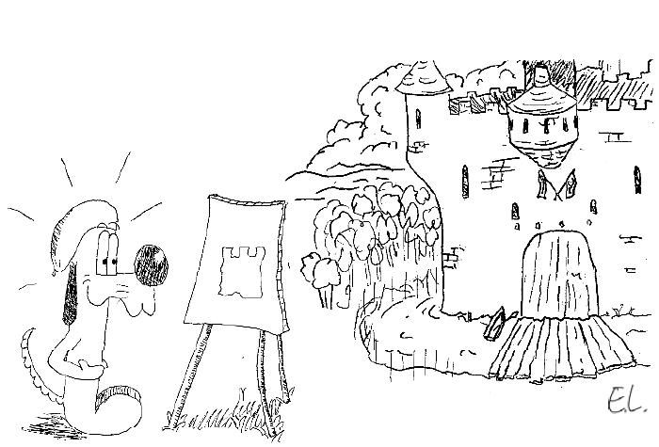
Model Fitting Part 2
Jean-Yves Le Boudec
2021

Slide 2
Contents
Features of a distribution
Infinite Variance, Heavy Tail
Fitting a distribution
Illustration

Slide 3
1. Choosing a Distribution
Know a catalog of distributions, use the following features to do a pre-selection
Shape
Kurtosis, Skewness
Power laws
Hazard Rate
Fit
Verify the fit visually or with a test (see later)

Slide 4
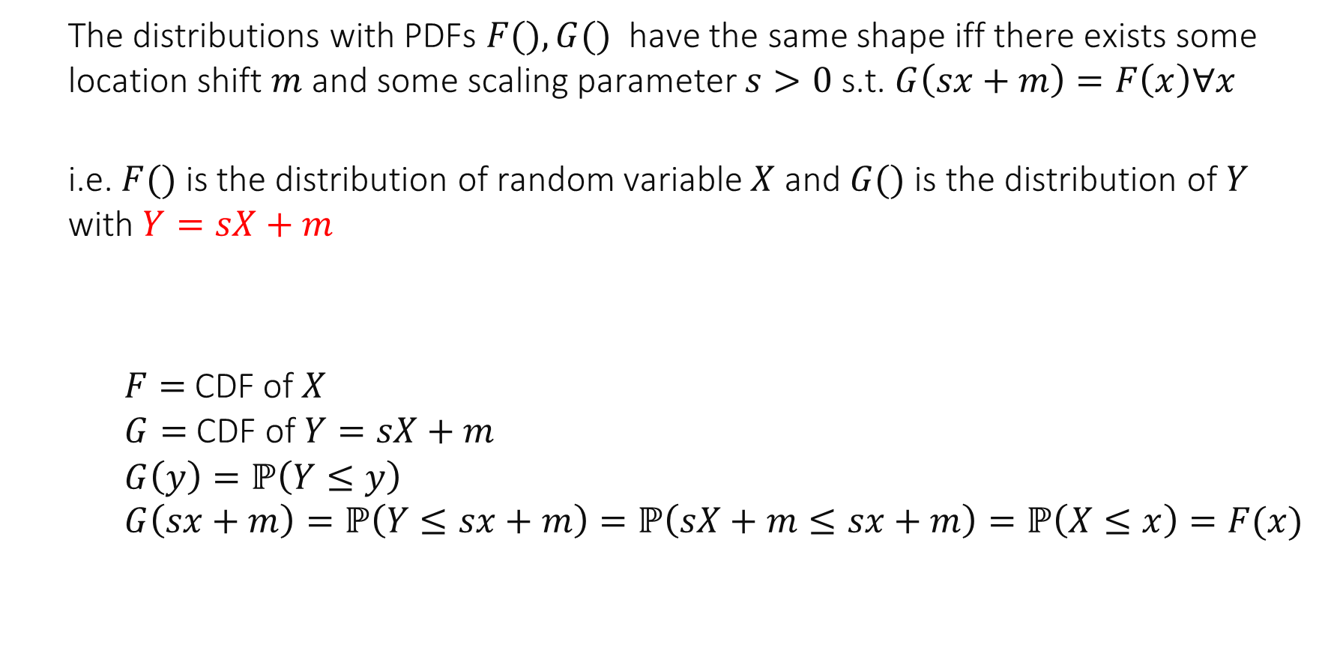
Feature 1: Distribution Shape
The distributions with PDFs $F(), G()$ have the same shape iff there exists some location shift $m$ and some scaling parameter $s>0$ s.t. $G\left(sx+m\right)=F\left(x\right)∀x$
i.e. $F()$ is the distribution of random variable $X$ and $G()$ is the distribution of $Y$ with $Y=sX+m$
$F=$CDF of $X$ $G=$ CDF of $Y=sX+m$ $$G\left(y\right)=ℙ\left(Y≤y\right) \\ G\left(sx+m\right)=ℙ\left(Y≤sx+m\right)=ℙ\left(sX+m≤sx+m\right)=ℙ\left(X≤x\right)=F(x)$$

Slide 5
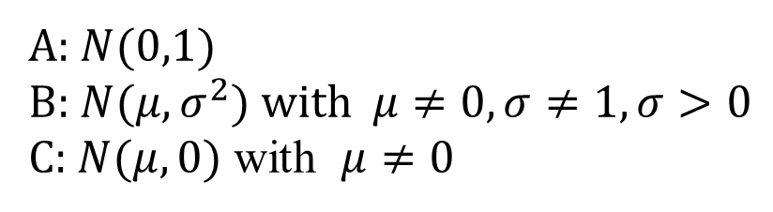
Which distributions have the same shape ?
A and B
A and C
B and C
All have the same shape
All shapes are different
I don’t know
A: $N(0,1)$
B: $N(μ,σ^{2})$ with $μ≠0, σ≠1, σ>0$ C: $N(μ,0)$ with $μ≠0$

Slide 6
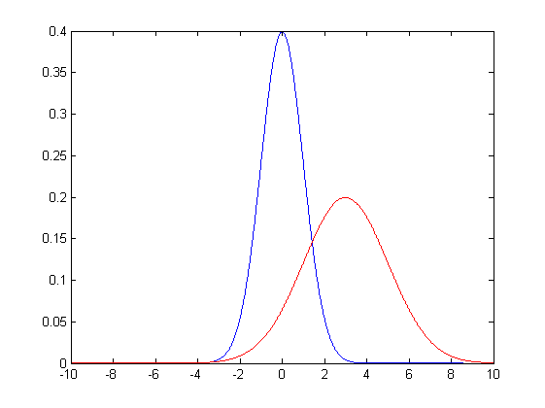
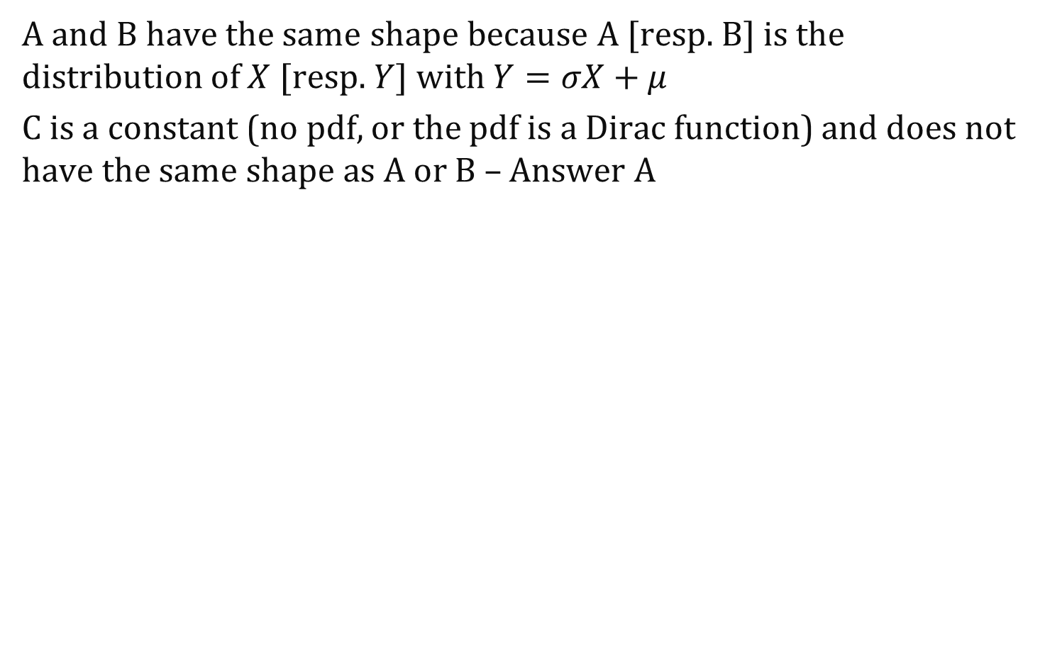
Solution
A and B have the same shape because A [resp. B] is the distribution of $X$ [resp. $Y$] with $Y=σX+μ$
C is a constant (no pdf, or the pdf is a Dirac function) and does not have the same shape as A or B – Answer A
N(0,1)
N(-6,0)
N(3,4)

Slide 7
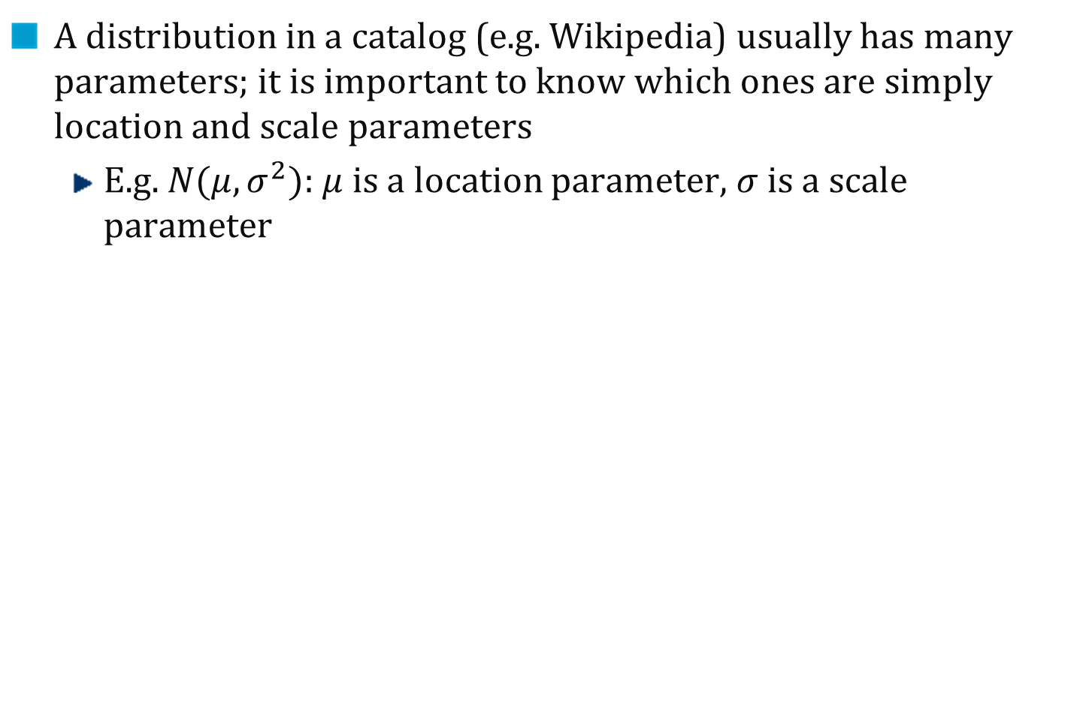
Location and Scale Parameters
A distribution in a catalog (e.g. Wikipedia) usually has many parameters; it is important to know which ones are simply location and scale parameters
E.g. $N(μ,σ^{2})$: $μ$ is a location parameter, $σ$ is a scale parameter

Slide 8

For the exponential distribution expo($λ$), $1/λ$ is …
A location parameter
A scale parameter
Both
None
I don’t know

Slide 9
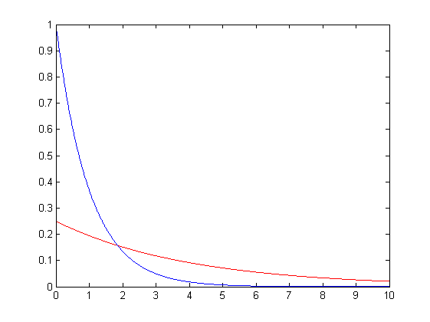

Solution
Answer B We have seen (sampling from a distribution) that if $X∼exp⁡(1)$ and $Y=\frac{1}{λ}X$ then $Y∼exp⁡(λ)$:
Exp(1)
Exp(0.25)

Slide 10
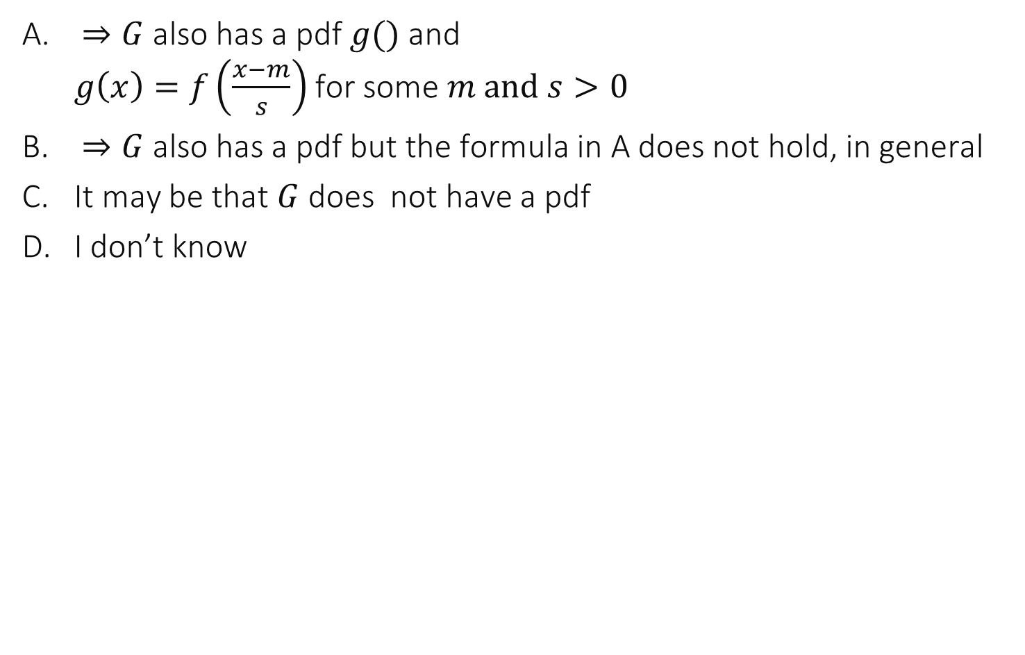
$F()$ and $G()$ have the same shape and$F()$ has a pdf $f()$ …
$⇒G$ also has a pdf $g()$ and $g\left(x\right)=f\left(\frac{x−m}{s}\right)$ for some $m and s>0$
$⇒G$ also has a pdf but the formula in A does not hold, in general
It may be that $G$ does not have a pdf
I don’t know

Slide 11
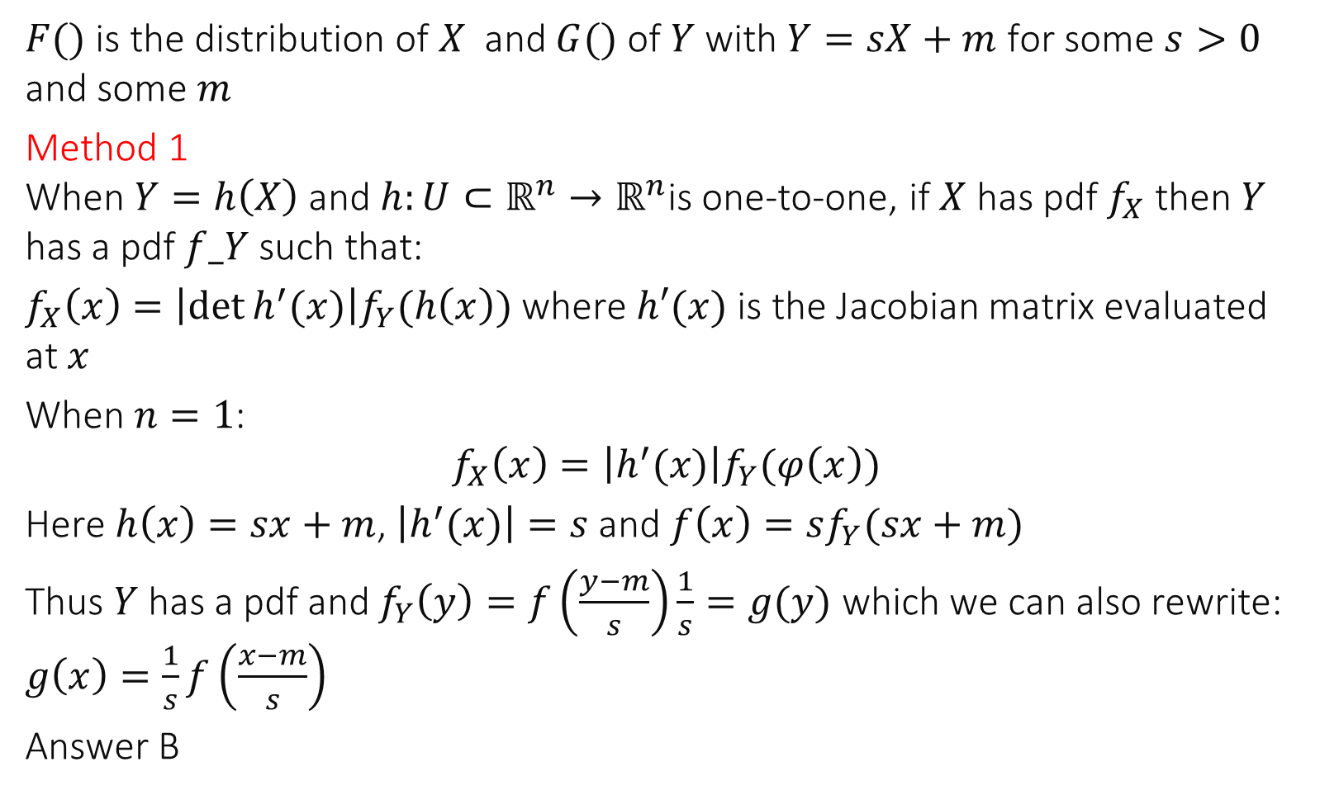
$F()$ is the distribution of $X$ and $G()$ of $Y$ with $Y=sX+m$ for some $s>0$ and some $m$
Method 1 When $Y=h\left(X\right)$ and $h:{U⊂ℝ}^{n}→ℝ^{n}$is one-to-one, if $X$ has pdf $f_{X}$ then $Y$ has a pdf $f_Y$ such that:
$f_{X}\left(x\right)=\left|\det{h^{′}(x)}\right|f_{Y}(h\left(x\right))$ where $h′(x)$ is the Jacobian matrix evaluated at $x$
When $n=1$:
$$f_{X}\left(x\right)=\left|h^{′}(x)\right|f_{Y}(φ\left(x\right))$$
Here $h\left(x\right)=sx+m$, $\left|h^{′}(x)\right|=s$ and $f\left(x\right)=sf_{Y}(sx+m)$
Thus $Y$ has a pdf and $f_{Y}\left(y\right)=f\left(\frac{y−m}{s}\right)\frac{1}{s}=g(y)$ which we can also rewrite: $g\left(x\right)=\frac{1}{s}f\left(\frac{x−m}{s}\right)$
Answer B

Slide 12
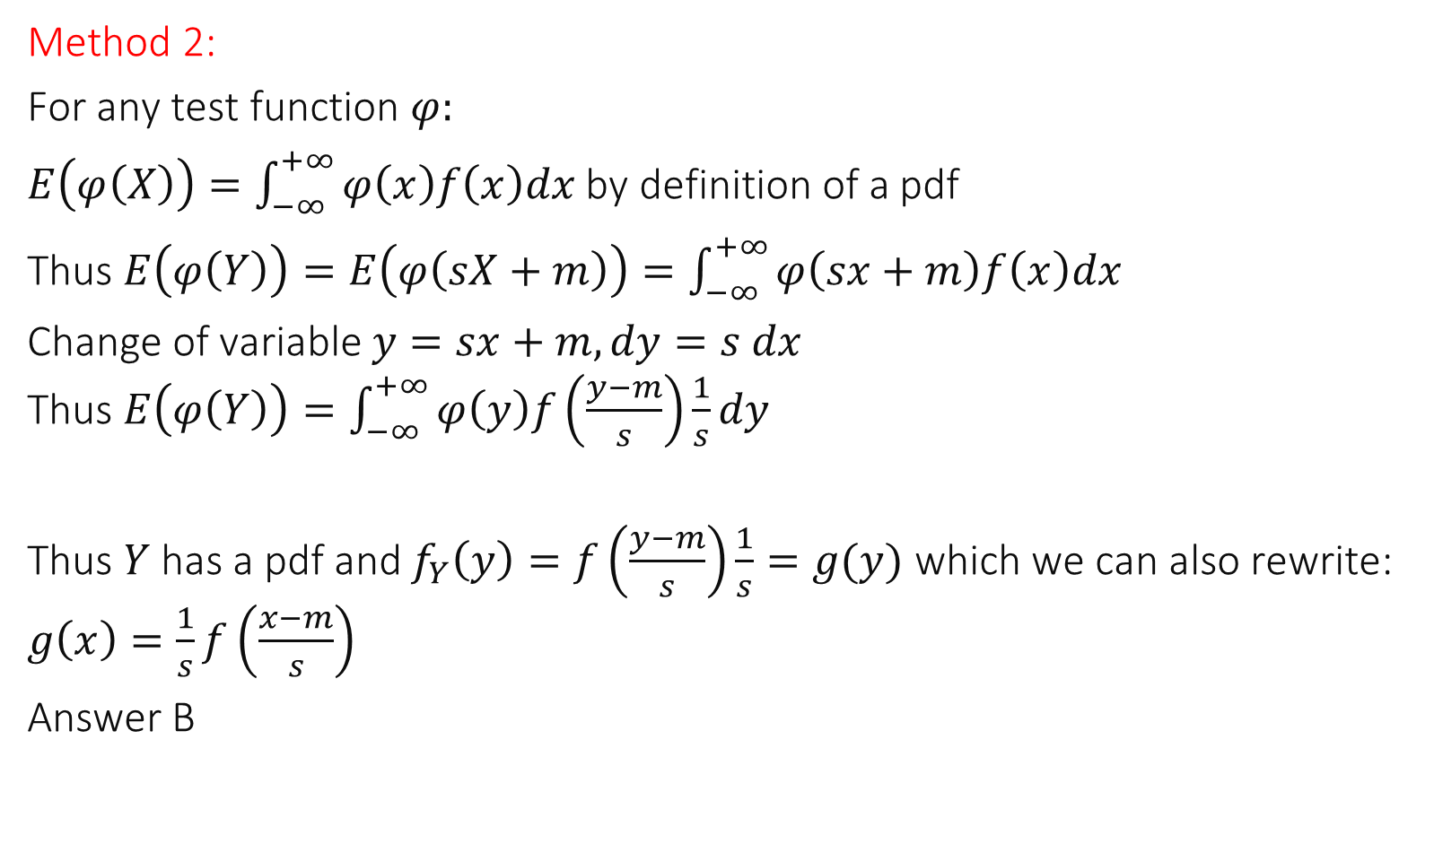
Method 2:
For any test function $φ:$
$E\left(φ\left(X\right)\right)=\int_{−∞}^{+∞}{φ\left(x\right)f\left(x\right)dx}$ by definition of a pdf
Thus $E\left(φ\left(Y\right)\right)=E\left(φ\left(sX+m\right)\right)=\int_{−∞}^{+∞}{φ\left(sx+m\right)f\left(x\right)dx}$
Change of variable $y=sx+m, dy=s dx$ Thus $E\left(φ\left(Y\right)\right)=\int_{−∞}^{+∞}{φ\left(y\right)f\left(\frac{y−m}{s}\right)\frac{1}{s}dy}$
Thus $Y$ has a pdf and $f_{Y}\left(y\right)=f\left(\frac{y−m}{s}\right)\frac{1}{s}=g(y)$ which we can also rewrite: $g\left(x\right)=\frac{1}{s}f\left(\frac{x−m}{s}\right)$
Answer B

Slide 13
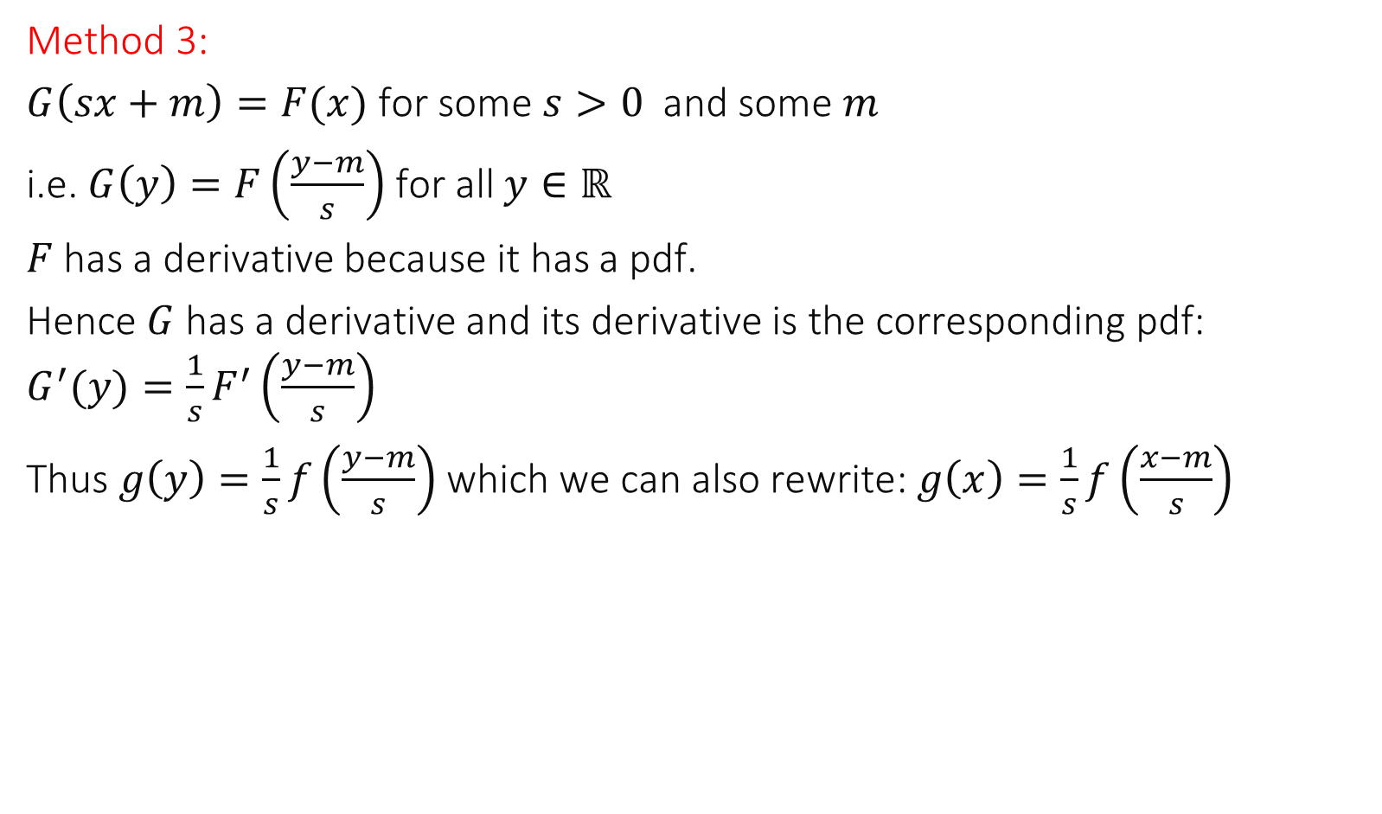
Method 3:
$G\left(sx+m\right)=F(x)$ for some $s>0$ and some $m$
i.e. $G\left(y\right)=F\left(\frac{y−m}{s}\right)$ for all $y∈ℝ$
$F$ has a derivative because it has a pdf.
Hence $G$ has a derivative and its derivative is the corresponding pdf: $G^{′}(y)=\frac{1}{s}F^{′}\left(\frac{y−m}{s}\right)$
Thus $g\left(y\right)=\frac{1}{s}f\left(\frac{y−m}{s}\right)$which we can also rewrite: $g\left(x\right)=\frac{1}{s}f\left(\frac{x−m}{s}\right)$

Slide 14
Standard Distribution
In a good catalog of distributions, only distributions with different shapes are worth mentioning. For each shape, we pick one particular distribution, which we call standard.
Standard normal: N(0,1)
Standard exponential: Exp(1)
Standard Uniform: U(0,1)

Slide 15

Log-Normal Distribution
$X$ has log-normal distribution iff $X=e^{Z}$ and $Z$ has a normal
(= Gaussian) distribution $N_{μ, σ^{2}}$
often used as a result of rescaling
Note that the support of $X$is $[0;+∞)$
Furthermore $Z={μ+σZ}_{0}$ with $Z_{0}$ standard normal $N_{0,1}$ hence
$$X=e^{{μ+σZ}_{0}}=e^{μ}{\left(e^{Z_{0}}\right)}^{σ}$$

Slide 16
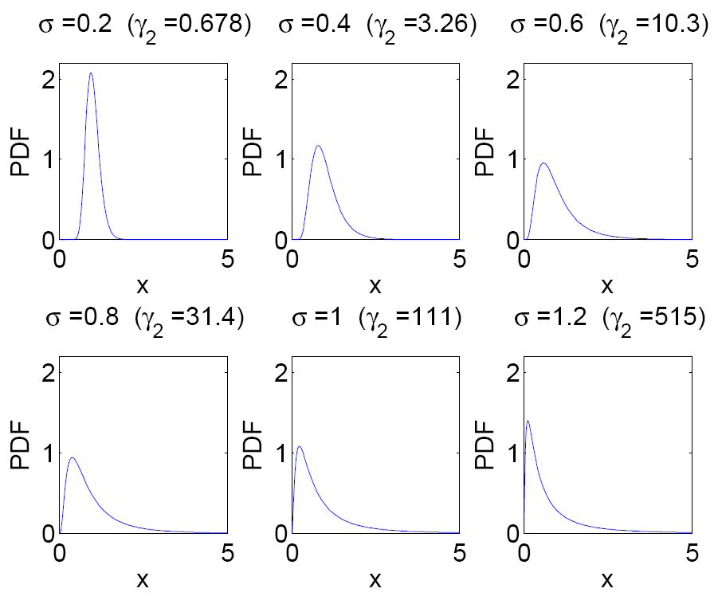

Slide 17
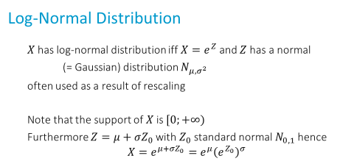

For the log-normal distribution…
$μ$ is a location parameter
$σ$ is a scale parameter
A and B
None
I don’t know

Slide 18
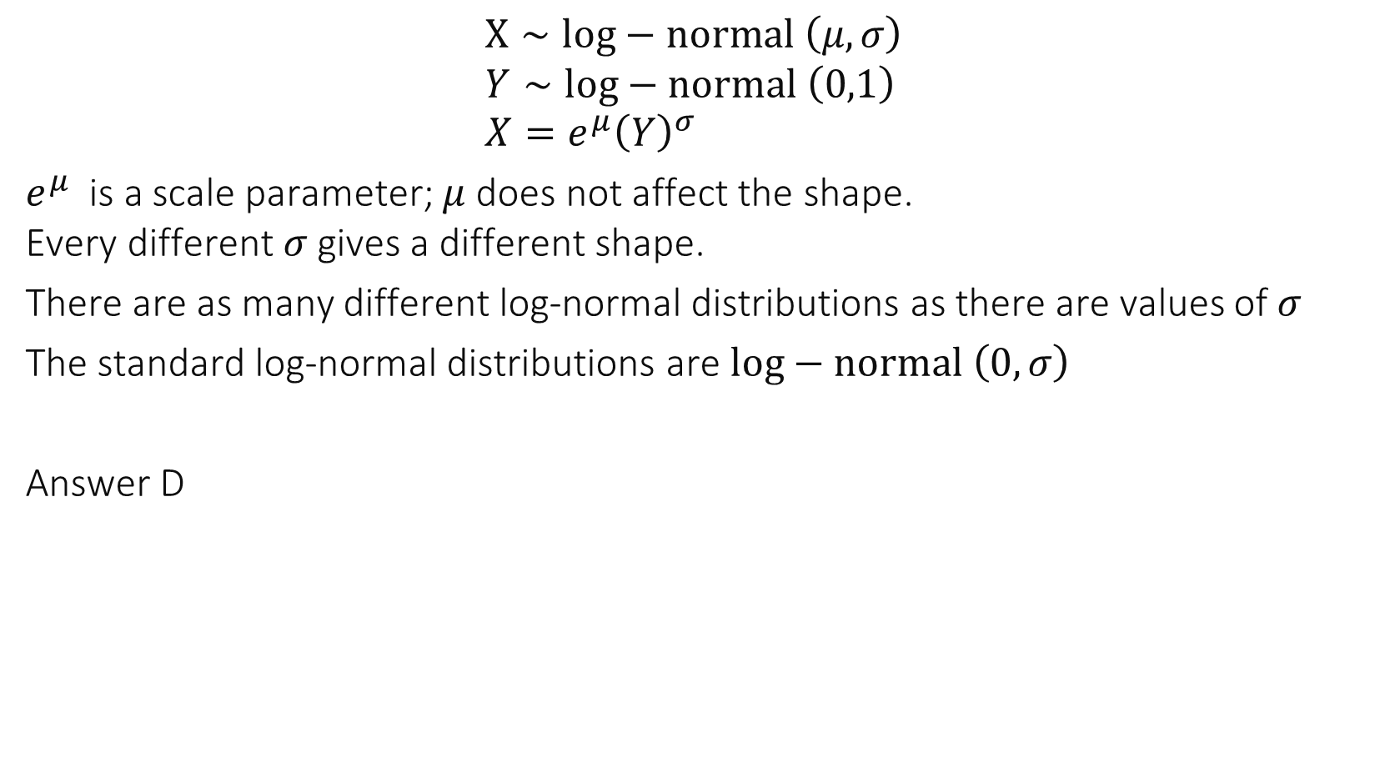
Solution
$$X∼log−normal \left(μ,σ\right) \\ Y∼log−normal \left(0,1\right) \\ X=e^{μ}{\left(Y\right)}^{σ}$$
$e^{μ}$ is a scale parameter; $μ$ does not affect the shape. Every different $σ$ gives a different shape.
There are as many different log-normal distributions as there are values of $σ$
The standard log-normal distributions are $log−normal \left(0,σ\right)$
Answer D

Slide 19
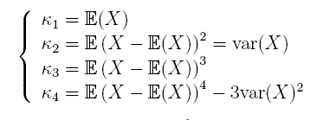
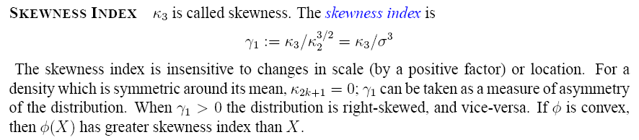
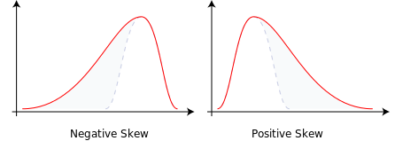
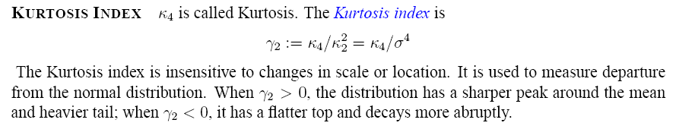
Feature 2: Skewness and Curtosis
By Rodolfo Hermans (Godot) at en.wikipedia. - Own work; transferred from en.wikipedia by Rodolfo Hermans (Godot)., CC BY-SA 3.0, https://commons.wikimedia.org/w/index.php?curid=4567445
Measures symmetry of distribution
Measures departure from the Bell-shape of normal distribution Equal to 0 for normal distribution

Slide 20
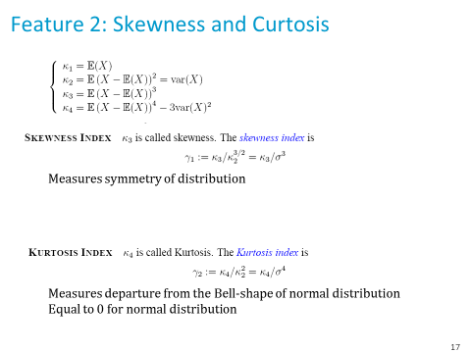
If $F()$ and $G()$ have the same shape…
They have the same skewness index
They have the same Kurtosis index
Both
None
I don’t know

Slide 21
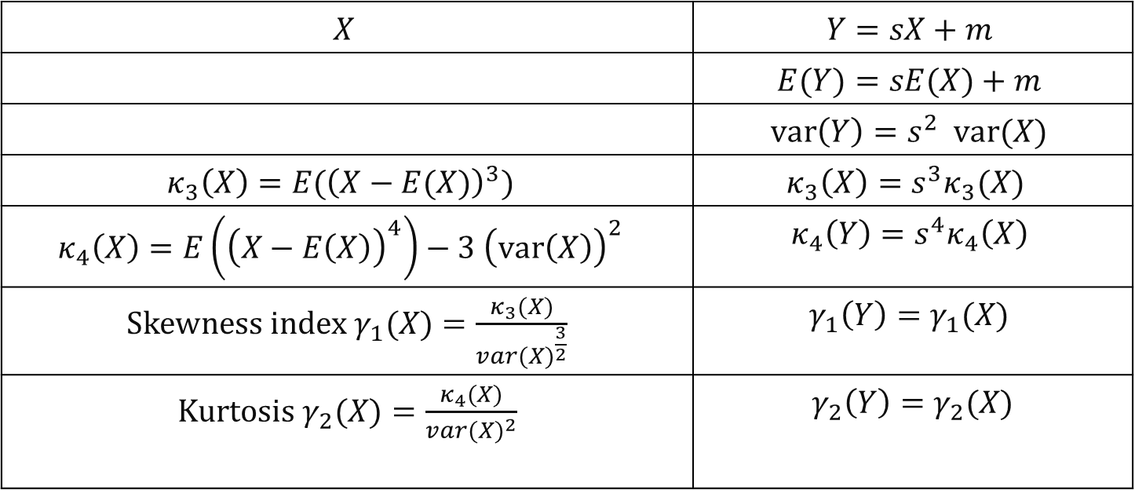
Solution
$$X$$ | $$Y=sX+m$$
 | $$E(Y)=sE(X)+m$$
 | $$var\left(Y\right)=s^{2} var(X)$$
$$κ_{3}\left(X\right)=E({\left(X−E(X)\right)}^{3})$$ | $$κ_{3}\left(X\right)=s^{3}κ_{3}(X)$$
$$κ_{4}\left(X\right)=E\left({\left(X−E\left(X\right)\right)}^{4}\right)−3 {\left(var\left(X\right)\right)}^{2}$$ | $$κ_{4}\left(Y\right)=s^{4}κ_{4}\left(X\right)$$
Skewness index $γ_{1}(X)=\frac{κ_{3}(X)}{va{r(X)}^{\frac{3}{2}}}$ | $$γ_{1}\left(Y\right)=γ_{1}(X)$$
K$urtosis γ_{2}(X)=\frac{κ_{4}(X)}{va{r(X)}^{2}}$ | $$γ_{2}\left(Y\right)=γ_{2}(X)$$
Answer C

Slide 22
Skewness and Curtosis

Slide 23
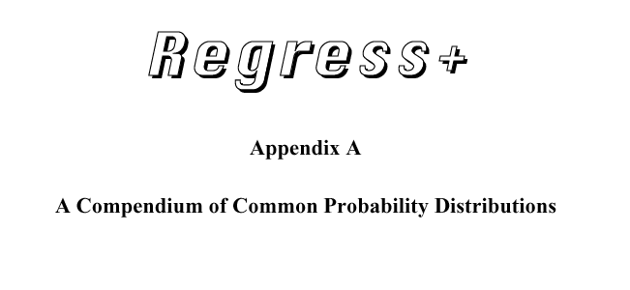
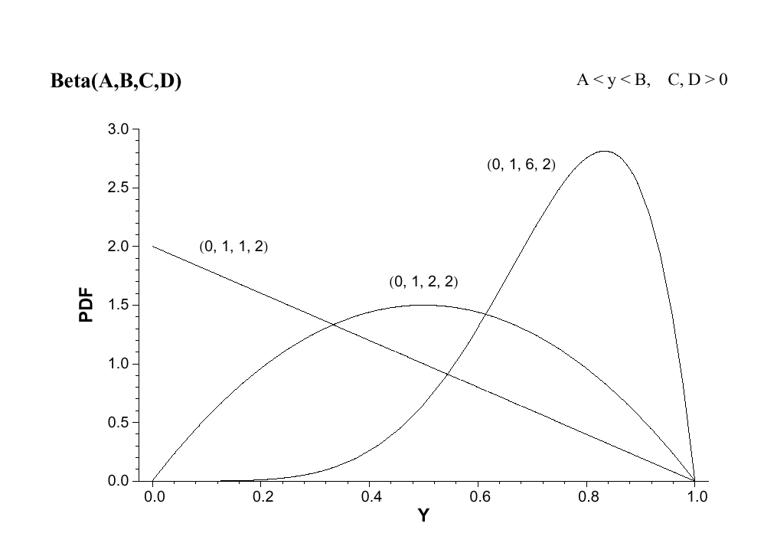

[McLaughlin]
skewness < 0
kurtosis >0
skewness = 0
kurtosis < 0

Slide 24
Log-normal distributions
shape is independent of $μ$ - $μ$ chosen such that mean is 1

Slide 25
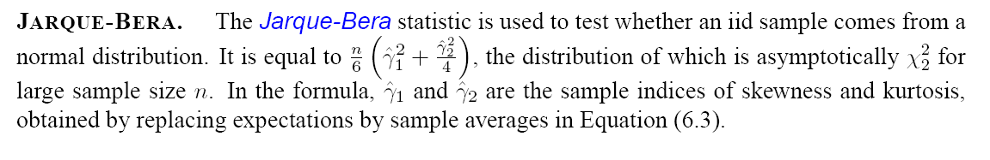
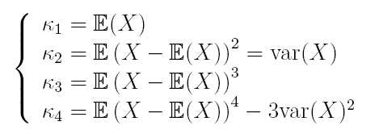
Jarque Bera test of normality (Chapter 4)
Based on Kurtosis and Skewness
Should be 0 for normal distribution

Slide 26
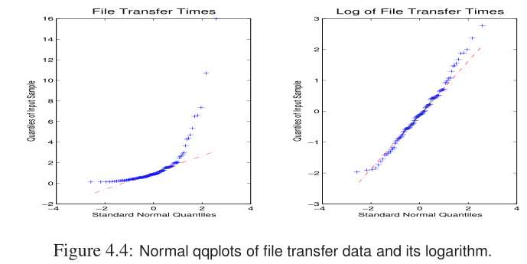
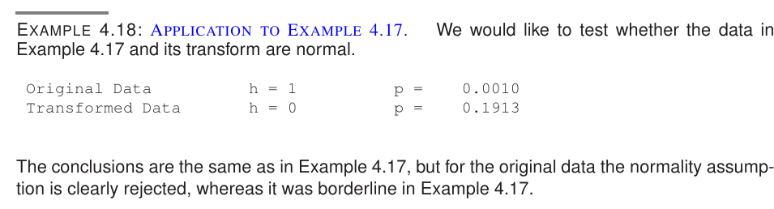

Slide 27
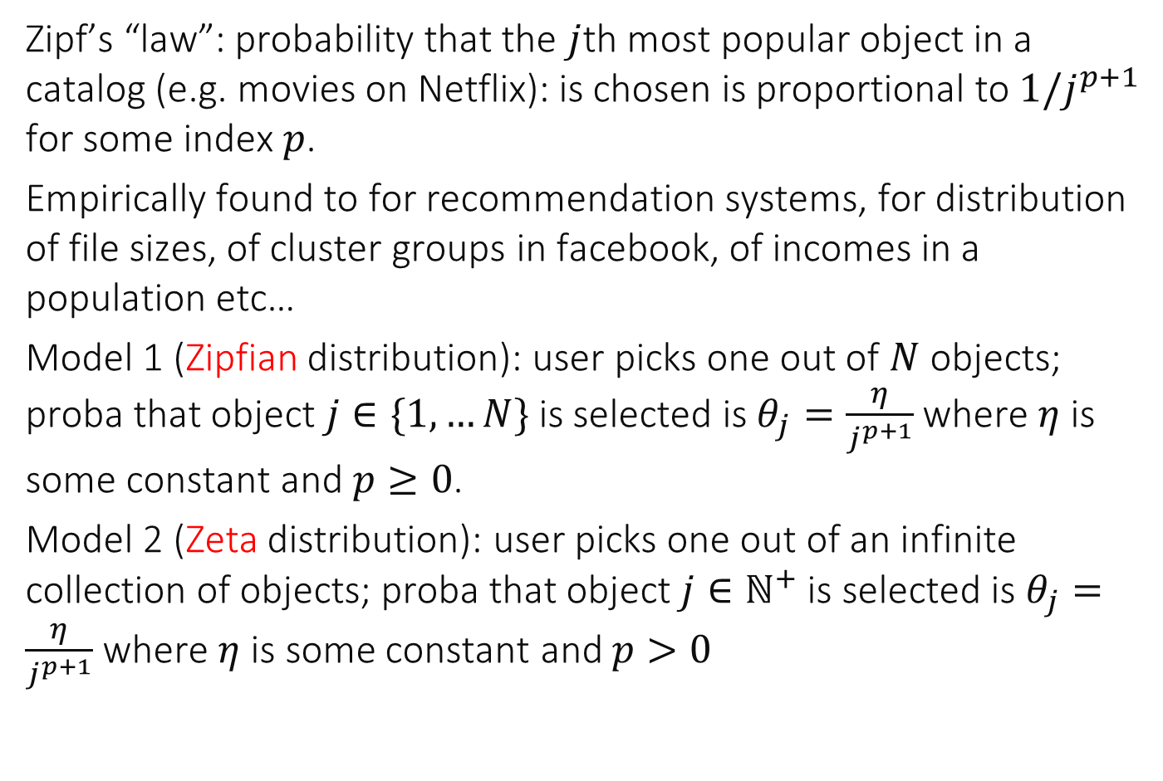
Feature 3: Power Laws
Zipf’s “law”: probability that the $j$th most popular object in a catalog (e.g. movies on Netflix): is chosen is proportional to $1/j^{p+1}$ for some index $p$.
Empirically found to for recommendation systems, for distribution of file sizes, of cluster groups in facebook, of incomes in a population etc…
Model 1 (Zipfian distribution): user picks one out of $N$ objects; proba that object $j∈\{1,…N\}$ is selected is $θ_{j}=\frac{η}{j^{p+1}}$ where $η$ is some constant and $p≥0$.
Model 2 (Zeta distribution): user picks one out of an infinite collection of objects; proba that object $j∈ℕ^{+}$ is selected is $θ_{j}=\frac{η}{j^{p+1}}$ where $η$ is some constant and $p>0$

Slide 28
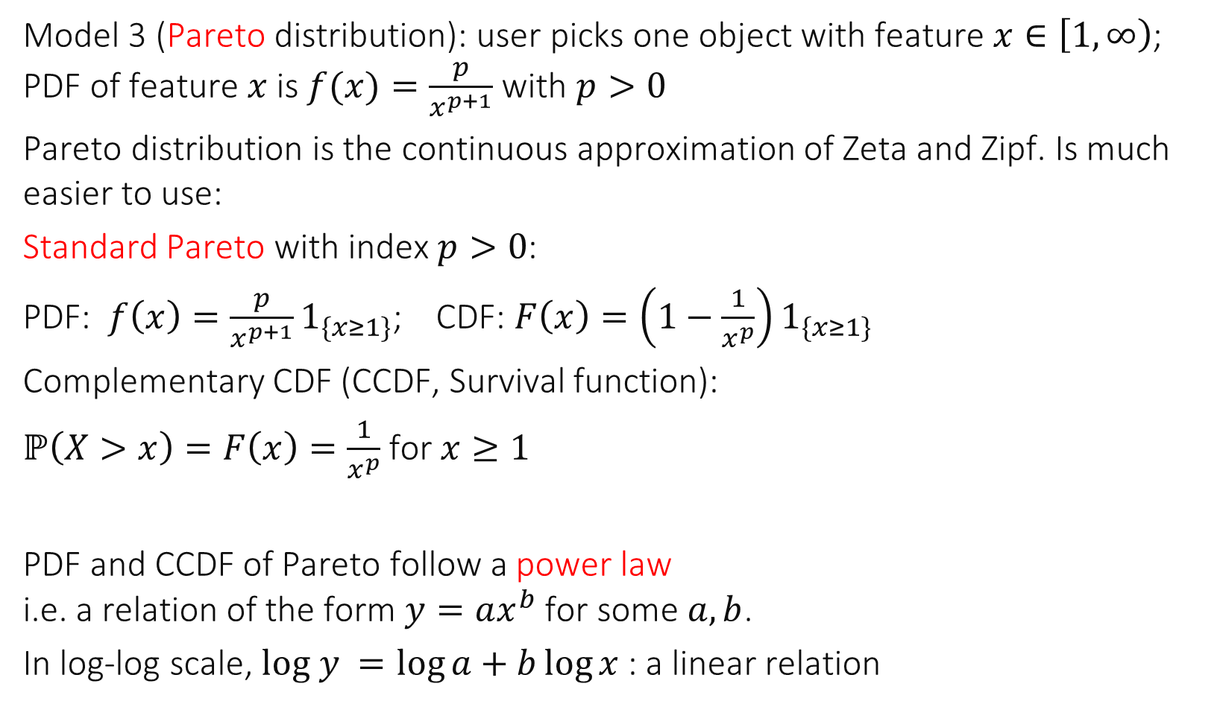
Pareto Distribution
Model 3 (Pareto distribution): user picks one object with feature $x∈\left[1,∞\right)$; PDF of feature $x$is $f(x)=\frac{p}{x^{p+1}}$ with $p>0$
Pareto distribution is the continuous approximation of Zeta and Zipf. Is much easier to use:
Standard Pareto with index $p>0$:
PDF: $f\left(x\right)=\frac{p}{x^{p+1}}1_{\{x≥1\}}$; CDF: $F\left(x\right)=\left(1−\frac{1}{x^{p}}\right)1_{\{x≥1\}}$
Complementary CDF (CCDF, Survival function):
$ℙ\left(X>x\right)=F\left(x\right)=\frac{1}{x^{p}}$ for $x≥1$
PDF and CCDF of Pareto follow a power law i.e. a relation of the form $y=ax^{b}$ for some $a,b$.
In log-log scale, $log y =\log{a}+b\log{x}$ : a linear relation

Slide 29
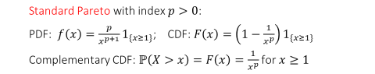


For the Pareto distribution with index $p$…
$p$ is a location parameter
$p$ is a scale parameter
A and B
None
I don’t know

Slide 30
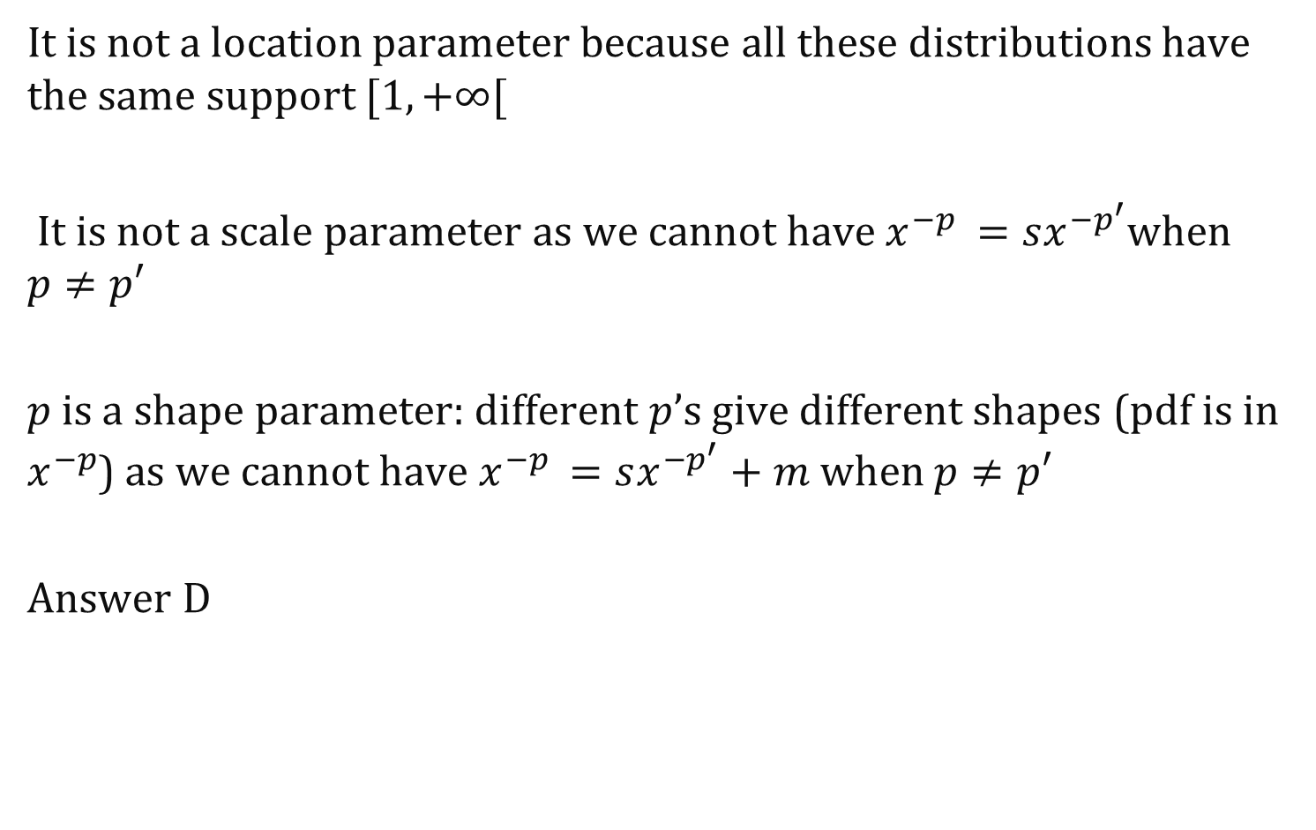
Solution
It is not a location parameter because all these distributions have the same support $[1,+∞[$
It is not a scale parameter as we cannot have $x^{−p }=sx^{−p^{′}}$when $p≠p′$
$p$ is a shape parameter: different $p$’s give different shapes (pdf is in $x^{−p}$) as we cannot have $x^{−p }=sx^{−p^{′}}+m$ when $p≠p′$
Answer D

Slide 31
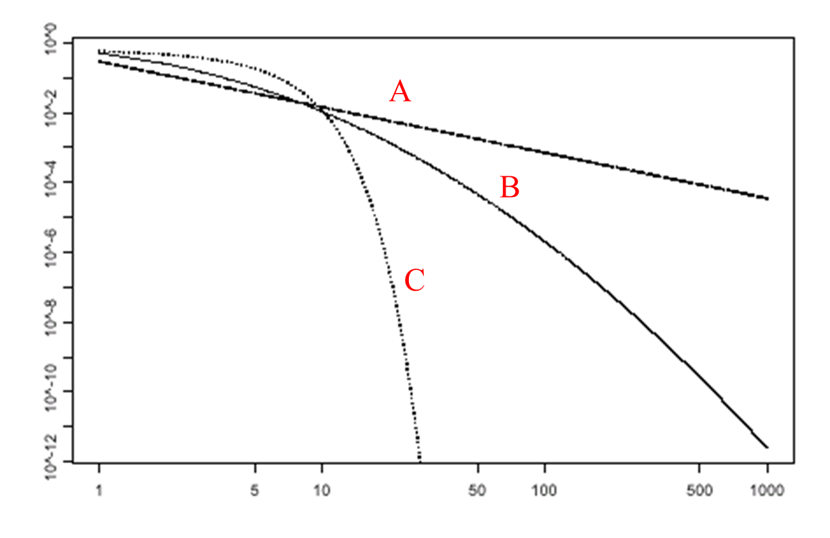
Complementary Distribution Functions in Log-log Scales Say which is what
A-lognormal, B- pareto, C-normal
A-p, B-l, C-n
A-l, B-n, C-p
A-n, B-l, C-p
A-p, B-n, C-l
A-n, B-p, C-l
I don’t know

Slide 32
Solution
Pareto is power-law -> straight line in log-log scale; Pareto is A
Normal has a lower tail than log-normal: Normal is C, log-normal can only be B
Answer B

Slide 33
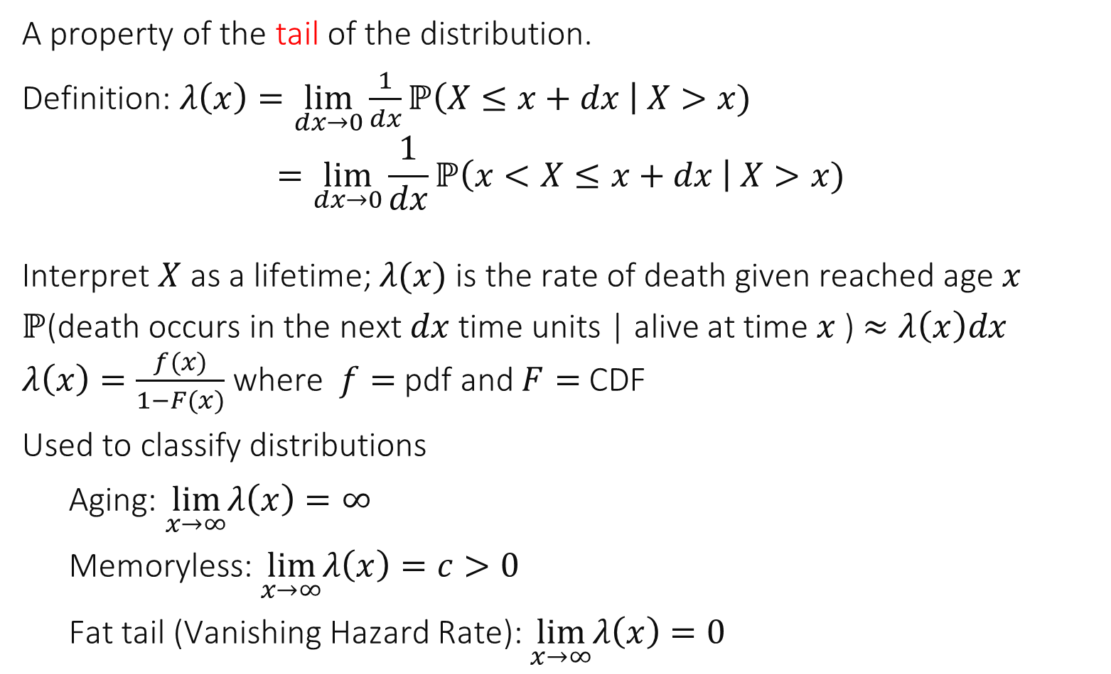
Feature 4: Hazard Rate
A property of the tail of the distribution.
Definition: $λ\left(x\right)=\lim_{dx→0}\frac{1}{dx}ℙ\left(X≤x+dx \right| X>x)$ $$=\lim_{dx→0}\frac{1}{dx}ℙ\left(x<X≤x+dx \right| X>x)$$ Interpret $X$ as a lifetime; $λ(x)$ is the rate of death given reached age $x$
$ℙ$(death occurs in the next $dx$ time units | alive at time $x$ ) $≈λ\left(x\right)dx$ $λ\left(x\right)=\frac{f(x)}{1−F(x)}$ where $f=$ pdf and $F=$ CDF
Used to classify distributions
Aging: $\lim_{x→∞}λ\left(x\right)=∞$
Memoryless: $\lim_{x→∞}λ\left(x\right)=c>0$
Fat tail (Vanishing Hazard Rate): $\lim_{x→∞}λ\left(x\right)=0$

Slide 34
Which is what ?
Exponential: aging; Pareto: memoryless, Normal: fat-tailed
E-M; P-A; N-F
E-A; P-F; N-M
E-F; P-A; N-M
E-F; P-M; N-A
E-M; P-F; N-A
I don’t know

Slide 35
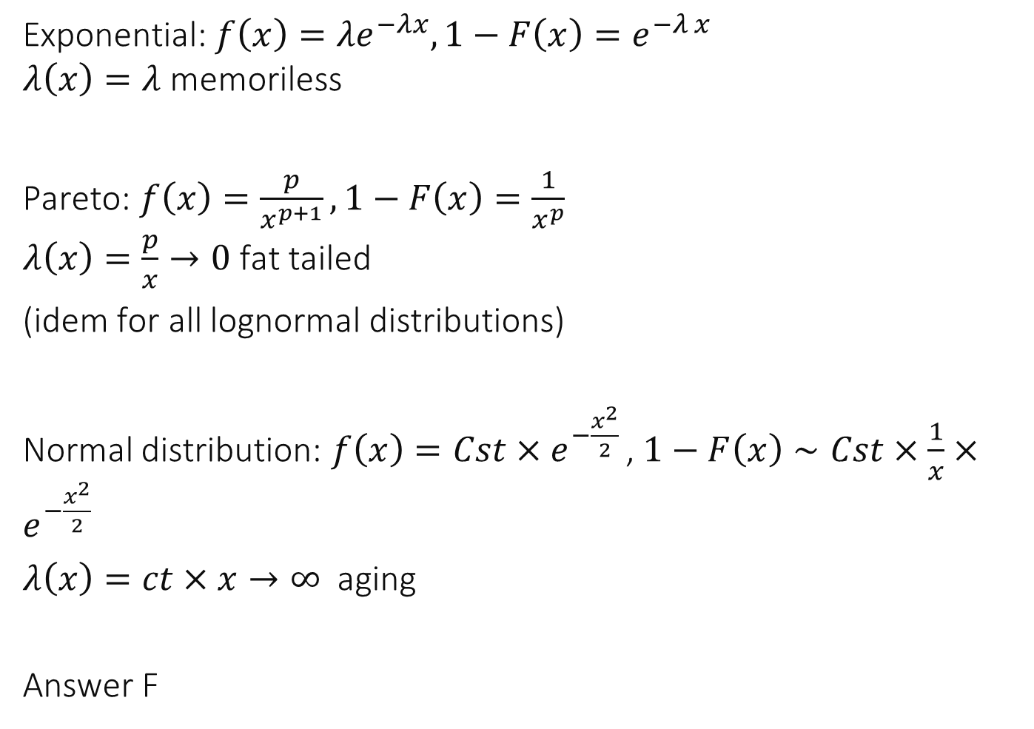
Solution
Exponential: $f\left(x\right)=λe^{−λx}, 1−F\left(x\right)=e^{−λ x}$ $λ\left(x\right)=λ$ memoriless
Pareto: $f\left(x\right)=\frac{p}{x^{p+1}}, 1−F\left(x\right)=\frac{1}{x^{p}}$ $λ\left(x\right)=\frac{p}{x}→0$ fat tailed
(idem for all lognormal distributions)
Normal distribution: $f\left(x\right)=Cst×e^{−\frac{x^{2}}{2} }$, $1−F\left(x\right)∼Cst×\frac{1}{x}×e^{−\frac{x^{2}}{2} }$
$λ\left(x\right)=ct×x→∞$ aging
Answer F

Slide 36
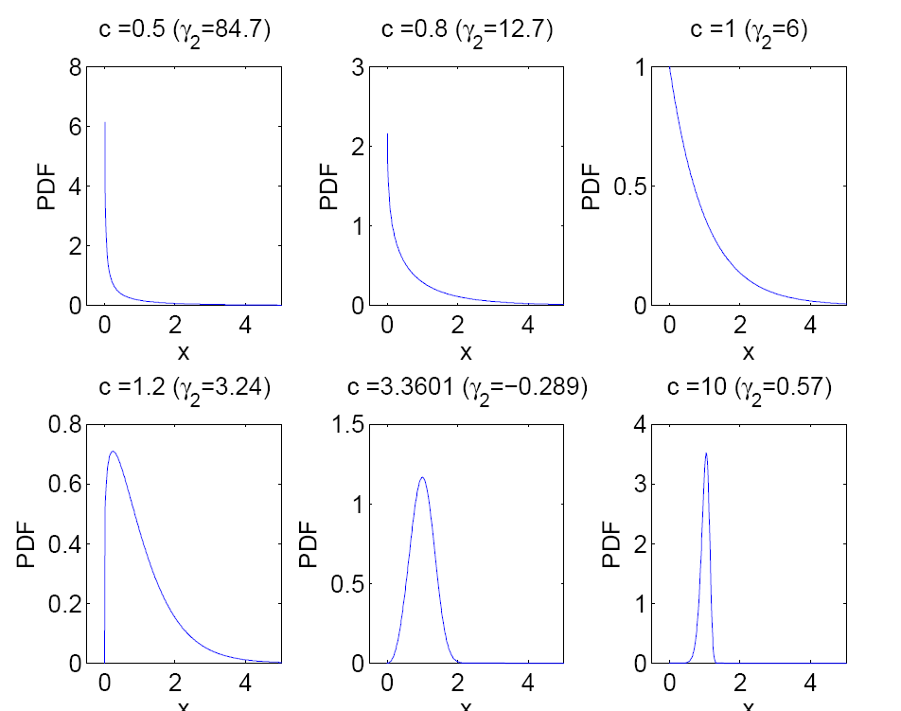


The Weibull Distribution with shape parameter $c$
Support on $[0,+∞)$
Standard Weibull $F\left(x\right)=1−e^{−(x^{c})}$
Aging for c > 1
Memoryless for c = 1
Fat tailed for c <1

Slide 37
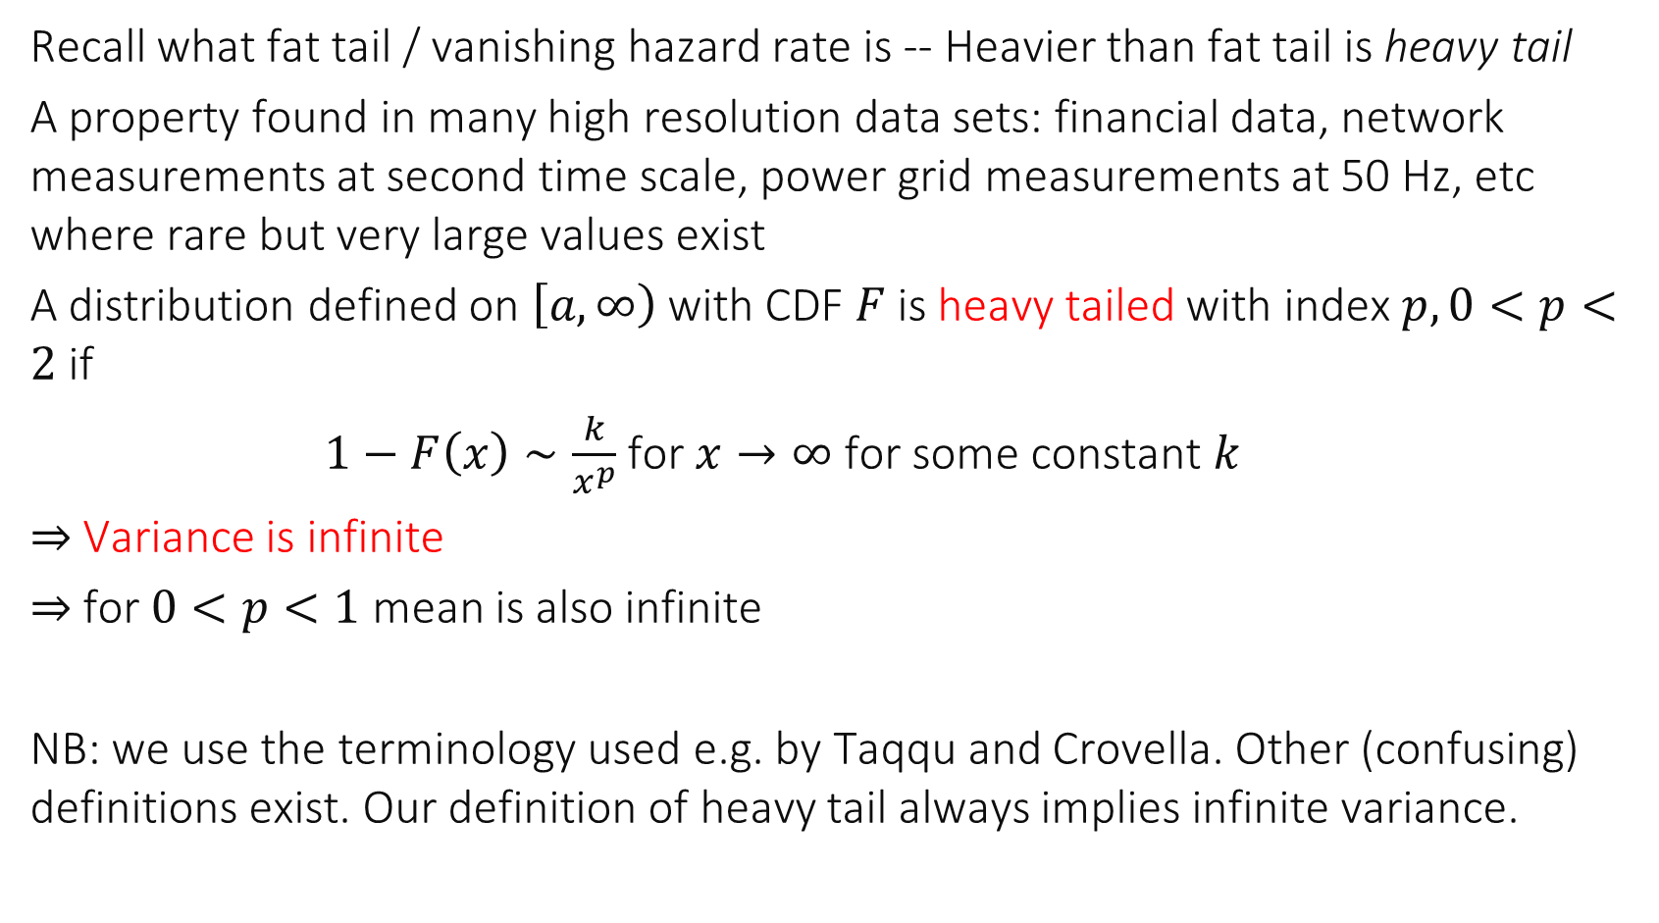
2. Heavy Tail
Recall what fat tail / vanishing hazard rate is -- Heavier than fat tail is heavy tail
A property found in many high resolution data sets: financial data, network measurements at second time scale, power grid measurements at 50 Hz, etc where rare but very large values exist
A distribution defined on $\left[a,∞\right)$ with CDF $F$ is heavy tailed with index $p, 0<p<2$ if
$1−F\left(x\right)∼\frac{k}{x^{p}}$ for $x→∞$ for some constant $k$
$⇒$ Variance is infinite
$⇒$ for $0<p<1$ mean is also infinite
NB: we use the terminology used e.g. by Taqqu and Crovella. Other (confusing) definitions exist. Our definition of heavy tail always implies infinite variance.

Slide 38

Examples
Pareto distribution: $1−F\left(x\right)=\frac{p+1}{x^{p}}$ is heavy tailed for $0<p<2$
Log-normal distribution is not heavy tailed (its variance is finite)
Weibull distribution: $1−F\left(x\right)=e^{−(x^{c})}$ is not heavy tailed
One-sided Cauchy distribution $f\left(x\right)=\frac{2}{π\left(1+x^{2}\right)}1_{\{x≥0\}}$ is heavy tailed with $p=1$

Slide 39
Heavy Tail means Central Limit does not hold
Central limit theorem: a sum of n independent random variables with finite second moment tends to have a normal distribution, when n is large this explains why we can often use normal assumption
But it does not always hold. It does not hold if random variables have infinite second moment.

Slide 40
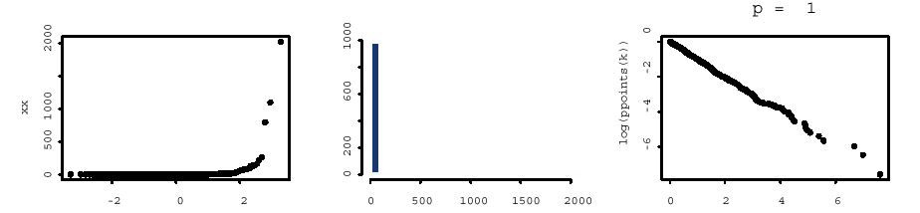
Central Limit Theorem for Heavy Tails
normal qqplot
histogram
complementary d.f.
log-log
One Sample of 10000 points
Pareto p = 1

Slide 41
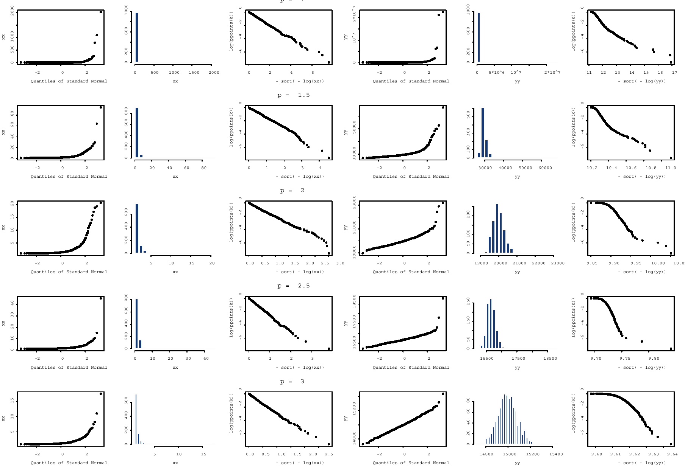
p=1
1 sample, 10000 points
average of 1000 samples
p=1.5
p=2
p=2.5
p=3

Slide 42
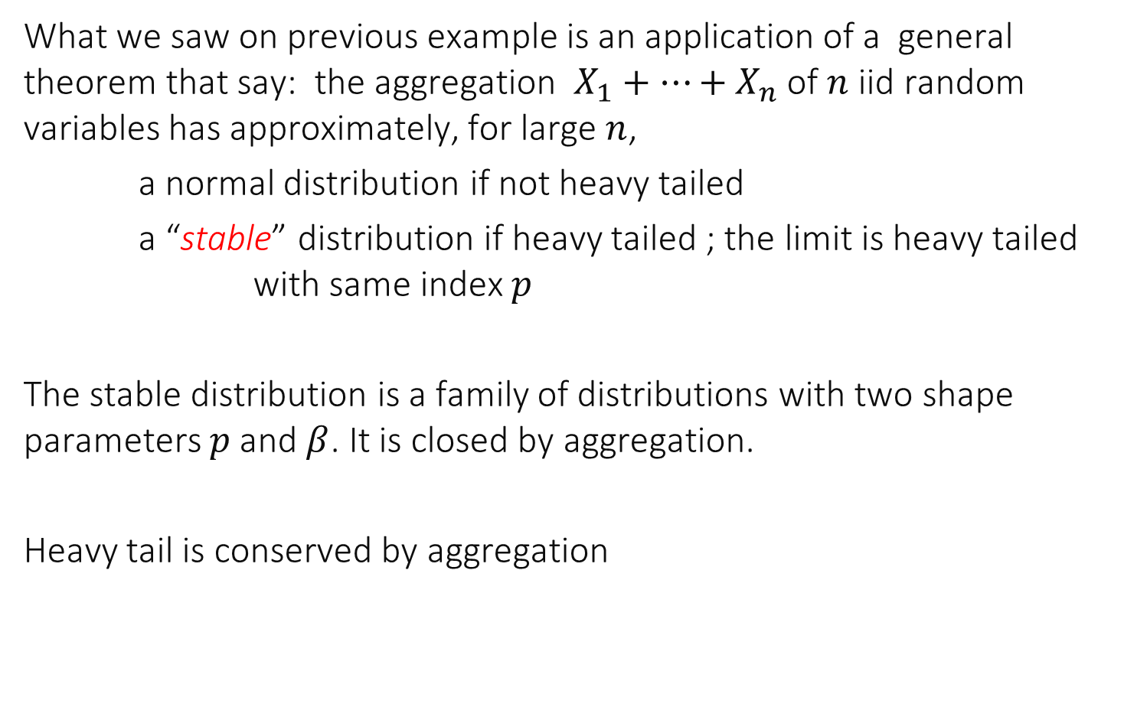
Central Limit for heavy tailed distributions
What we saw on previous example is an application of a general theorem that say: the aggregation $X_{1}+…+X_{n}$ of $n$ iid random variables has approximately, for large $n$,
a normal distribution if not heavy tailed
a “stable” distribution if heavy tailed ; the limit is heavy tailed with same index $p$
The stable distribution is a family of distributions with two shape parameters $p$ and $β$. It is closed by aggregation.
Heavy tail is conserved by aggregation

Slide 43
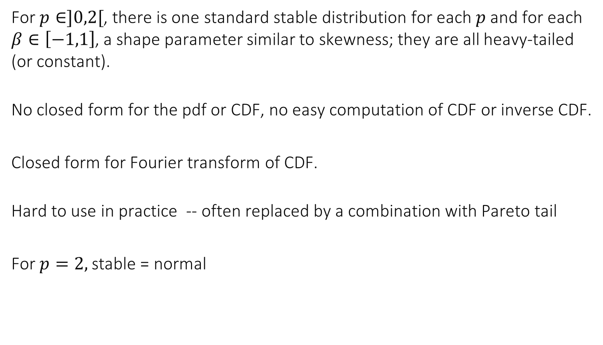

Standard Stable Distributions with Index $p$
For $p∈]0,2[$, there is one standard stable distribution for each $p$ and for each $β∈\left[−1,1\right]$, a shape parameter similar to skewness; they are all heavy-tailed (or constant).
No closed form for the pdf or CDF, no easy computation of CDF or inverse CDF.
Closed form for Fourier transform of CDF.
Hard to use in practice -- often replaced by a combination with Pareto tail
For $p=2,$stable = normal

Slide 44
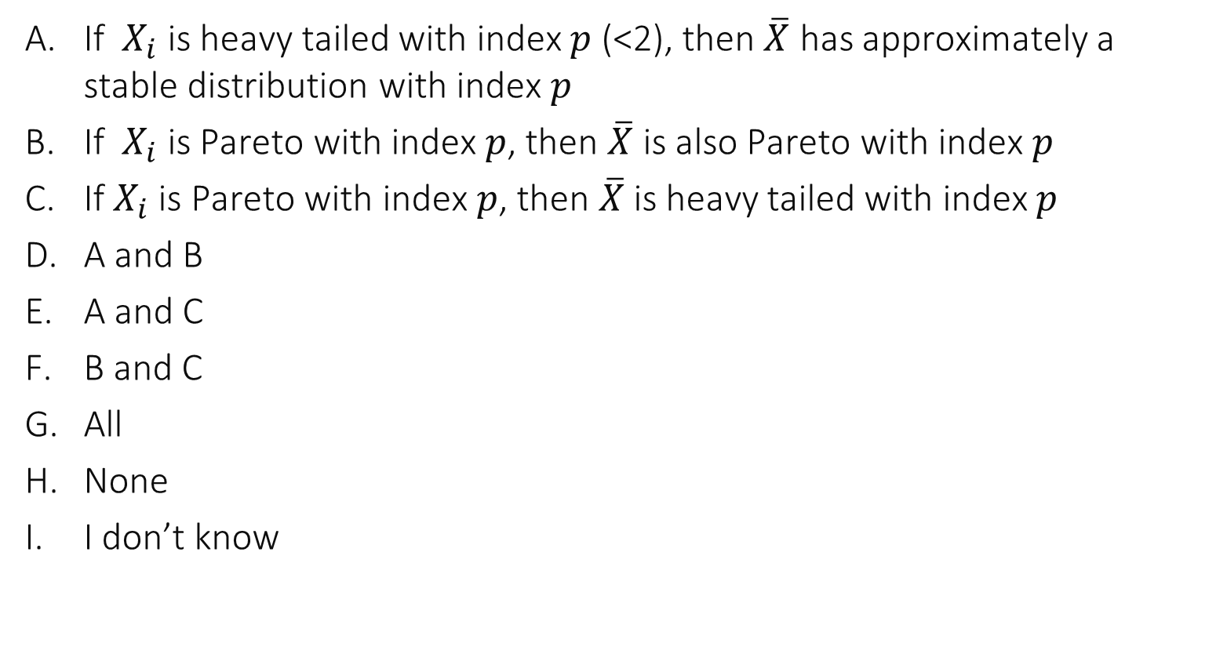
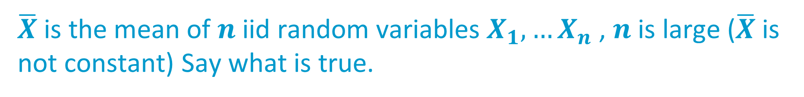
$\overline{X}$is the mean of $n$iid random variables $X_{1},…X_{n}$ , $n$ is large ($\overline{X}$is not constant) Say what is true.
If $X_{i}$ is heavy tailed with index 𝑝 (<2), then $\overline{X}$ has approximately a stable distribution with index 𝑝
If $X_{i}$ is Pareto with index 𝑝, then $\overline{X}$ is also Pareto with index 𝑝
If $X_{i}$ is Pareto with index $p$, then $\overline{X}$is heavy tailed with index $p$
A and B
A and C
B and C
All
None
I don’t know

Slide 45

Solution
A is true by the convergence theorem mentioned earlier
B not true. If $p<2$then $\overline{X}$is approximately stable with index $p$. If $p≥2$ then $\overline{X}$ is approximately normal.
C is true only for $p<2$
Answer A

Slide 46

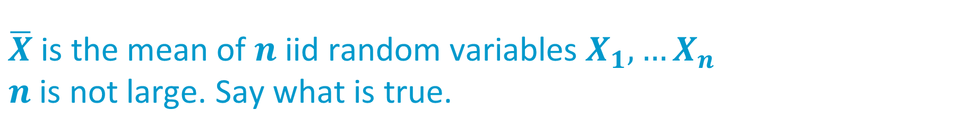
$\overline{X}$is the mean of $n$iid random variables $X_{1},…X_{n}$ $n$ is not large. Say what is true.
If $X_{i}$ is stable with index 𝑝, then $\overline{X}$ is also stable with index 𝑝
If $X_{i}$ is normal then $\overline{X}$is normal
A and B
None
I don’t know

Slide 47
Solution
A and B are both true.

Slide 48


Application to Confidence Intervals
$X_{i}∼$ iid Standard Pareto $p=1.25$ i.e. $f_{X}\left(x\right)=\frac{1.25}{x^{2.25} }$ for $x≥1$ True mean of $X_{i}$ is $μ=5$ and true median is $1.74$
Assume we don’t know the model and have received a sample of $n$values, where $n$ is large; we want to compute the mean and the median of $X_{i}$

Slide 49

Which formula is correct (confidence level =0.95)?
An approximate confidence interval for the mean is $x ± 1.96\frac{s}{\sqrt{n}}$with $\overline{x}= \frac{1}{n} \sum_{i}{x_{i}}$ and $s=\frac{1}{n}\sum_{i}{{\left(x_{i}−\overline{x}\right)}^{2}}$
An approximate confidence interval for the median is $[x_{\left(i\right)}, x_{\left(j\right)}]$ with $i=⌊0.5 n−0.980\sqrt{n}⌋$ and $j=⌈0.50 n+1+0.980\sqrt{n}⌉$
A and B
None
I don’t know

Slide 50

Solution
A is not true; the distribution of $X_{i}$ has infinite variance, the mean of $X_{i}$ is not approximately gaussian. In contrast, it follows a stable distribution with $p=1.25$.
B is true. The theorem for estimation of median is valid for any distribution

Slide 51

A Distribution with Infinite Variance
CI based on std dv
True mean
CI based on bootsrp
True median
CI for median
True mean
True median

Slide 52


Detecting Heavy Tail
Assume you have very large data set and you suspect your distribution has infinite variance --- hard to test because everything we do is finite
An alternative is to look for heavy tail by plotting CCDF in log-scale
Estimating the index $p$ can be done with Taqqu’s method (and the aest tool, see lecture notes)

Slide 53
3. Fitting A Distribution
Assume iid
Use maximum likelihood
We know how to do this (model fitting)
-> maximum likelihood estimation
Frequent issues
Censoring
Combinations

Slide 54

Censored Data
Example: We want to propose a distribution for file sizes transferred over a network; we think a lognormal distribution is adequate but we can never observe very large values, by the nature of the experiment
Lognormal is fat tailed so we cannot ignore the tail
Idea: we assume that what we observed is produced by the following simulator sample $X∼F_{0}()$ ( a log-normal distribution) if $X≤a$ deliver $X$ else drop $X$

Slide 55



The samples produced by this model have the following pdf… ($f_{0}=$ pdf of $F_{0})$
$f\left(x\right)=f_{0}\left(x\right)×1_{\{x≤a\}}×constant$
$f\left(x\right)=f_{0}\left(x−a\right)$
$f\left(x\right)=\frac{1}{a}f\left(\frac{x}{a}\right)$
None of the above
I don’t know

Slide 56

This is rejection sampling the distribution of the output $Y$ is the conditional distribution of $X$ given that $X≤a$ therefore $f_{Y}\left(x\right)=\frac{ f_{0}\left(x\right)1_{\{x≤a\}}}{P(X≤a)}=\frac{ f_{0}\left(x\right)1_{\{x≤a\}}}{F_{0}(a)}$
Answer A

Slide 57

Estimation of censored distribution
We have some data $x_{i}$, assumed iid, and want to estimate the parameters of $F_{0}$ and $a$ in the model: $X_{i}$ iid with pdf $\frac{ f_{0}\left(x\right)1_{\{x≤a\}}}{F_{0}(a)}$
Log-likelihood $=\sum_{i}{\log{f_{0}(x_{i}|θ)}}−n\log{F_{0}\left(a | θ\right)} (1)$ Problem is: find $a,θ$ which maximize (1) subject to $a≥x_{i}∀i$
Step 1: (1) is decreasing with $a$ hence optimal solution satisfies
$$\hat{a}=\max{x_{i}}$$
Step 2: solve
$$\hat{θ}={argmax}_{θ}{\left(1\right)}_{a=\hat{a}}$$
Can be done explicitly for log-normal; see details in lecture notes

Slide 58


Fit ignoring the censoring (i.e. fit log of data to a normal distribution)
Fit with correct technique

Slide 59





Combinations
We want to fit a log normal distrib to the body and pareto to the tail
Often used when the tail is well identified More tractable than stable distribution
We want to fit the body (left of $a$) to a right-truncated log-normal and the tail to a Pareto left-truncated to start at $a$
This corresponds to the pdf $f\left(x\right)=q\frac{f_{1}(x)}{F_{1}\left(a\right)}1_{x≤a}+\left(1−q\right)\frac{f_{2}(x)}{1−F_{2}\left(a\right)}1_{x>a}$
where $F_{1}$ is a log-normal CDF and $F_{2}$ a Pareto CDF
Distribution
$$F_{1}$$
(log-normal)
Distribution
$$F_{2}$$
(Pareto)
$$a$$

Slide 60



This pdf corresponds to the following simulator output
A
B
None
Both
I don’t know
$f\left(x\right)=q\frac{f_{1}(x)}{F_{1}\left(a\right)}1_{x≤a}+\left(1−q\right)\frac{f_{2}(x)}{1−F_{2}\left(a\right)}1_{x>a}$
A:
Draw U $∼$U(0,1) if $U<q$ draw X from $F_{1}$ until $X≤a$ else draw $X$ from $F_{2}$ until $X>a$
Deliver X
B:
Draw X from $F_{1}$ until $X≤a$
Draw Y from $F_{2}$ until $Y>a$
With proba $q$deliver X else deliver Y

Slide 61

Solution
Algorithm B produces $X∼$ pdf $\frac{f_{1}\left(x\right)1_{\{x≤a\}}}{F_{1}\left(a\right)}$ and $Y$ with pdf $\frac{f_{1}\left(x\right)1_{\{>a\}}}{F_{2}\left(a\right)}$
With proba $q$ the output is X, else Y, therefore the pdf is as required. B is a correct implementation.
A produces the same output as B and is also a correct implementation. A is more efficient in that it computes only $X$ or $Y$.
Answer D

Slide 62


Maximum Likelihood Estimation of Combination
Step 1:
The MLE satisfies $\hat{q} =\frac{n_{1}\left(a\right)}{n}$ where $n_{1}(a)=\sum_{i=1:n}{1_{x_{i}≤a}}$
Proof:
$$\frac{∂ℓ}{∂q}=\frac{n_{1}(a)}{q}−\frac{n−n_{1}(a)}{1−q}$$

Slide 63





Maximum Likelihood estimation of combination
Step 2: for a fixed $a$, compute $F_{1}$ and $F_{2}$ (closed form) Step 3: find optimal $a$ numerically
Distribution
$$F_{1}$$
(log-normal)
Distribution
$$F_{2}$$
(Pareto)
$$a$$

Slide 64
4 Illustration A Load Generator: Surge
Designed to create load for a web server
Sophisticated load model by Crovella and Barford
It is an example of a well constructed benchmark.

Slide 65

User Equivalent Model
Idea: find a stochastic model that represents user well
User modelled as sequence of downloads, followed by “think time”
Tool can implement several “user equivalents”
Used to generate real work over TCP connections

Slide 66

Characterization of UE

Slide 67
Conclusion
Fitting a distribution is useful to simplify a theoretical study
Distributions have shapes, important to distinguish parameters that affect the shape and those that do not
Power laws do occur in many large scale data sets Pareto distributions can be used to model tails of such distributions
Power laws may imply heavy tail, then central limit theorem does not hold as expected
Fitting truncations and combinations requires careful examination of likelihood

