Slide 1

Palm Calculus Part 1 The Importance of the Viewpoint
Jean-Yves Le Boudec 2021
April 2019

Slide 2

AirBnB claims: median occupancy of rented listings is 11% (40 days a year) Airbnb. Data on the Airbnb community in New York City . Technical report, AirBnB corporation, Dec. 2015.
Who says the truth ?
Insideairbnb.com claims:
median occupancy of rented listings is 40-50% (165 days a year)
Lecuyer, M., Tucker, M. and Chaintreau, A., 2017, April. Improving the Transparency of the Sharing Economy. In Proceedings of the 26th International Conference on World Wide Web Companion (pp. 1043-1051). International World Wide Web Conferences Steering Committee.

Slide 3
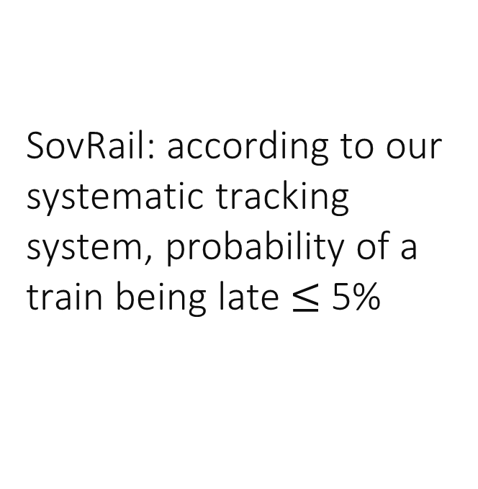
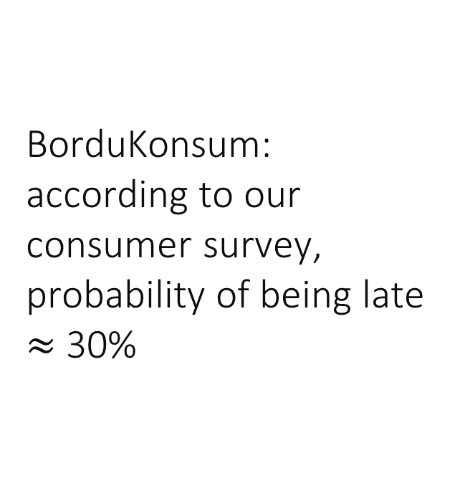
SovRail: according to our systematic tracking system, probability of a train being late $≤$ 5%
Who says the truth ?
BorduKonsum: according to our consumer survey, probability of being late $≈$ 30%

Slide 4
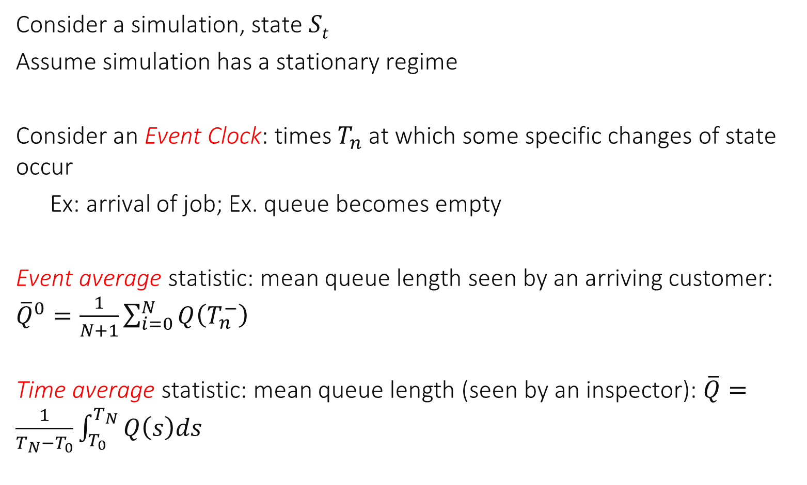
1. Event versus Time Averages
Consider a simulation, state $St$
Assume simulation has a stationary regime
Consider an Event Clock: times $T_{n}$ at which some specific changes of state occur
Ex: arrival of job; Ex. queue becomes empty
Event average statistic: mean queue length seen by an arriving customer: ${\overline{Q}}^{0}=\frac{1}{N+1}\sum_{i=0}^{N}{Q\left(T_{n}^{−}\right)}$
Time average statistic: mean queue length (seen by an inspector): $\overline{Q}=\frac{1}{T_{N}−T_{0}}\int_{T_{0}}^{T_{N}}{Q\left(s\right)ds}$

Slide 5
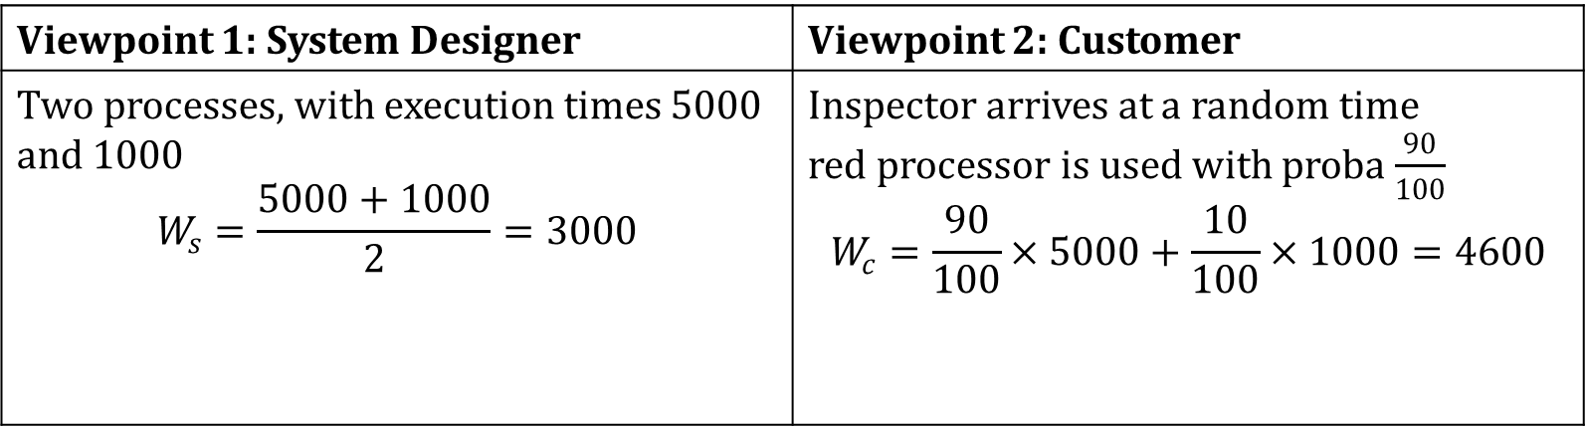
Example: Gatekeeper; Average execution time
job arrival
0
90
100
190
200
290
300
Real time t (ms)
Execution time for a job that arrives at t (ms)
5000
5000
5000
1000
1000
1000
Viewpoint 1: System Designer | Viewpoint 2: Customer
Two processes, with execution times 5000 and 1000 $$W_{s}=\frac{5000+1000}{2}=3000$$ | Inspector arrives at a random time red processor is used with proba $\frac{90}{100}$ $$W_{c}=\frac{90}{100}×5000+\frac{10}{100}×1000=4600$$

Slide 6
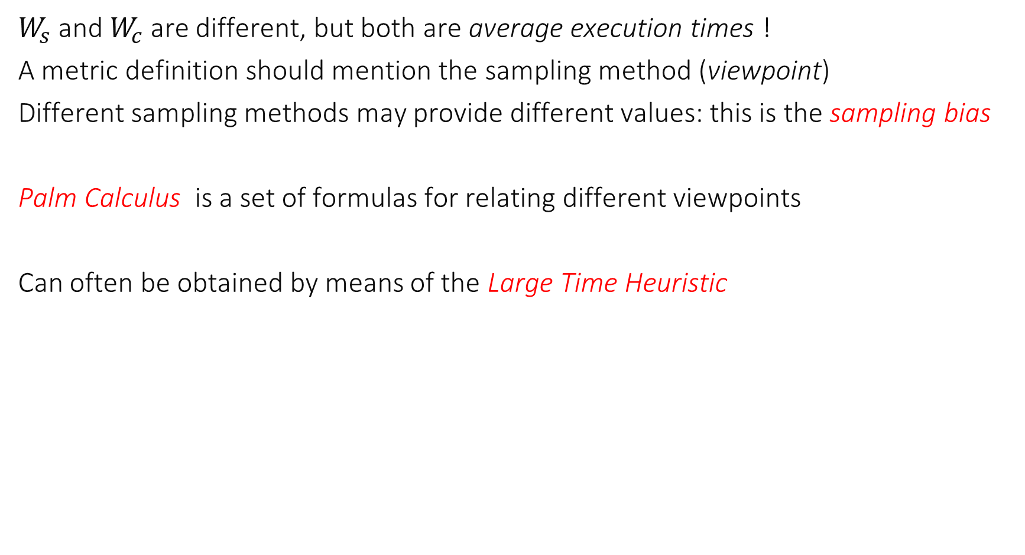
Sampling Bias
$W_{s}$and $W_{c}$ are different, but both are average execution times !
A metric definition should mention the sampling method (viewpoint)
Different sampling methods may provide different values: this is the sampling bias
Palm Calculus is a set of formulas for relating different viewpoints
Can often be obtained by means of the Large Time Heuristic

Slide 7
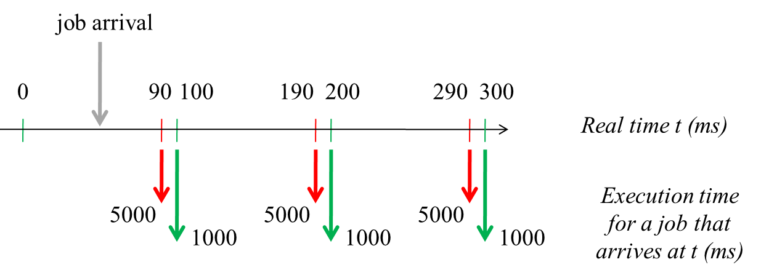










Large Time Heuristic Explained on an Example
We want to relate $W_{s}$ and $W_{c}$ We apply the large time heuristic
How do we evaluate these metrics in a simulation ?
$$W_{s}=\frac{1}{N}\sum_{n=1…N}{X_{n}}=\overline{X} \\ W_{c}=\frac{1}{T}\int_{0}^{T}{X_{N^{+}\left(t\right)}dt}$$ where $N^{+}\left(t\right)=$ index of next green or red arrow at or after $T$
$T_{1} T_{2}$
$T_{3} T_{4}$
$T_{5} T_{6}$
$$S_{3}$$
$$X_{1}$$
$$X_{3}$$
$$X_{5}$$
$$X_{2}$$
$$X_{3}$$
$$X_{6}$$

Slide 8
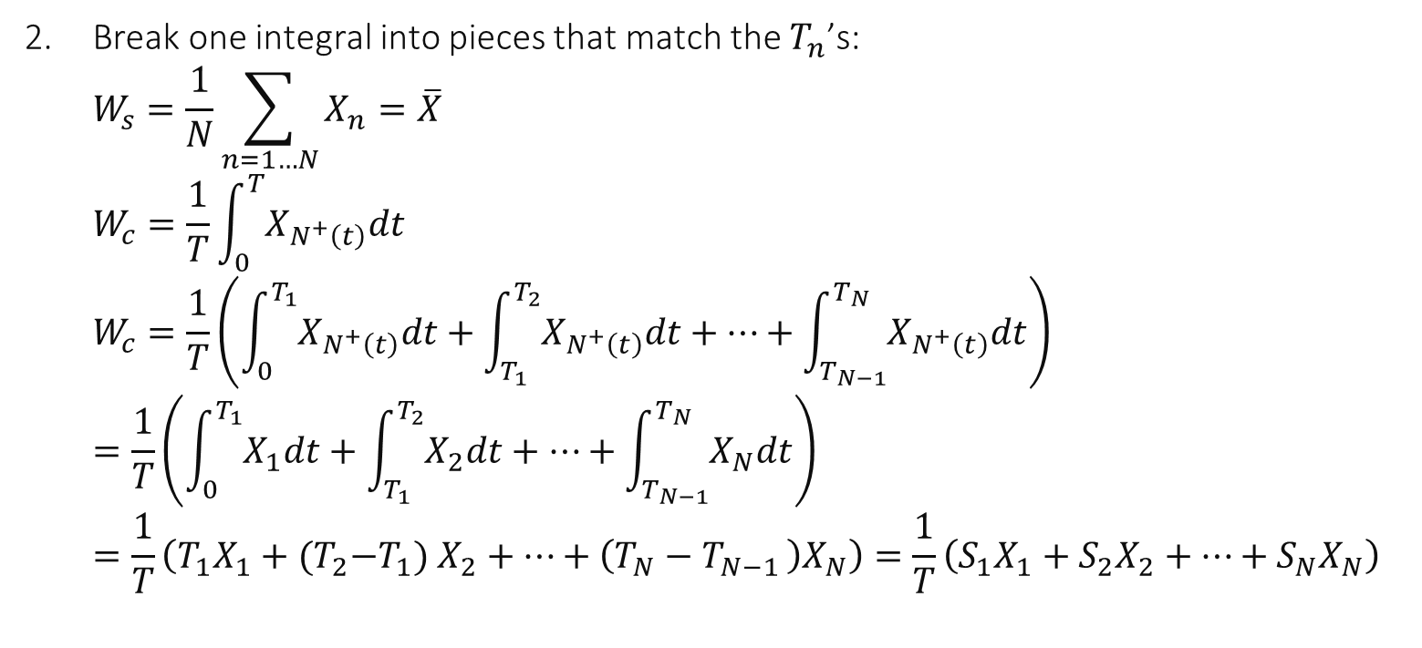

Large Time Heuristic Explained on an Example
$T_{1} T_{2}$
$T_{3} T_{4}$
$T_{5} T_{6}$
$$S_{3}$$
$$X_{1}$$
$$X_{3}$$
$$X_{5}$$
$$X_{2}$$
$$X_{3}$$
$$X_{6}$$
Break one integral into pieces that match the $T_{n}$’s: $W_{s}=\frac{1}{N}\sum_{n=1…N}{X_{n}}=\overline{X}$ $W_{c}=\frac{1}{T}\int_{0}^{T}{X_{N^{+}\left(t\right)}dt}$ $W_{c}=\frac{1}{T}\left(\int_{0}^{T_{1}}{X_{N^{+}\left(t\right)}dt}+\int_{T_{1}}^{T_{2}}{X_{N^{+}\left(t\right)}dt}+…+\int_{T_{N−1}}^{T_{N}}{X_{N^{+}\left(t\right)}dt}\right)$ $=\frac{1}{T}\left(\int_{0}^{T_{1}}{X_{1}dt}+\int_{T_{1}}^{T_{2}}{X_{2}dt}+…+\int_{T_{N−1}}^{T_{N}}{X_{N}dt}\right)$ $=\frac{1}{T}\left(T_{1}X_{1}+{(T}_{2}−T_{1}) X_{2}+…+\left(T_{N}−T_{N−1 }\right)X_{N}\right)=\frac{1}{T}\left(S_{1}X_{1}+S_{2}X_{2}+…+S_{N}X_{N}\right)$

Slide 9

Large Time Heuristic Explained on an Example
$T_{1} T_{2}$
$T_{3} T_{4}$
$T_{5} T_{6}$
$$S_{3}$$
$$X_{1}$$
$$X_{3}$$
$$X_{5}$$
$$X_{2}$$
$$X_{3}$$
$$X_{6}$$
Compare $W_{c}=\frac{1}{T}\left(S_{1}X_{1}+S_{2}X_{2}+…+S_{N}X_{N}\right)$ $=\frac{N}{T}×\frac{1}{N}\left(S_{1}X_{1}+S_{2}X_{2}+…+S_{N}X_{N}\right)$ $=λ×\left(cov\left(S,X\right)+\overline{S} \overline{X}\right)=λ×\left(cov\left(S,X\right)+\frac{1}{λ} \overline{X}\right)$ $W_{c}=λ cov\left(S,X\right)+W_{s}$

Slide 10



This is Palm Calculus !
$$S_{n}$$
$$X_{n}$$
$$W_{c}=λ cov\left(S,X\right)+W_{s}$$

Slide 11
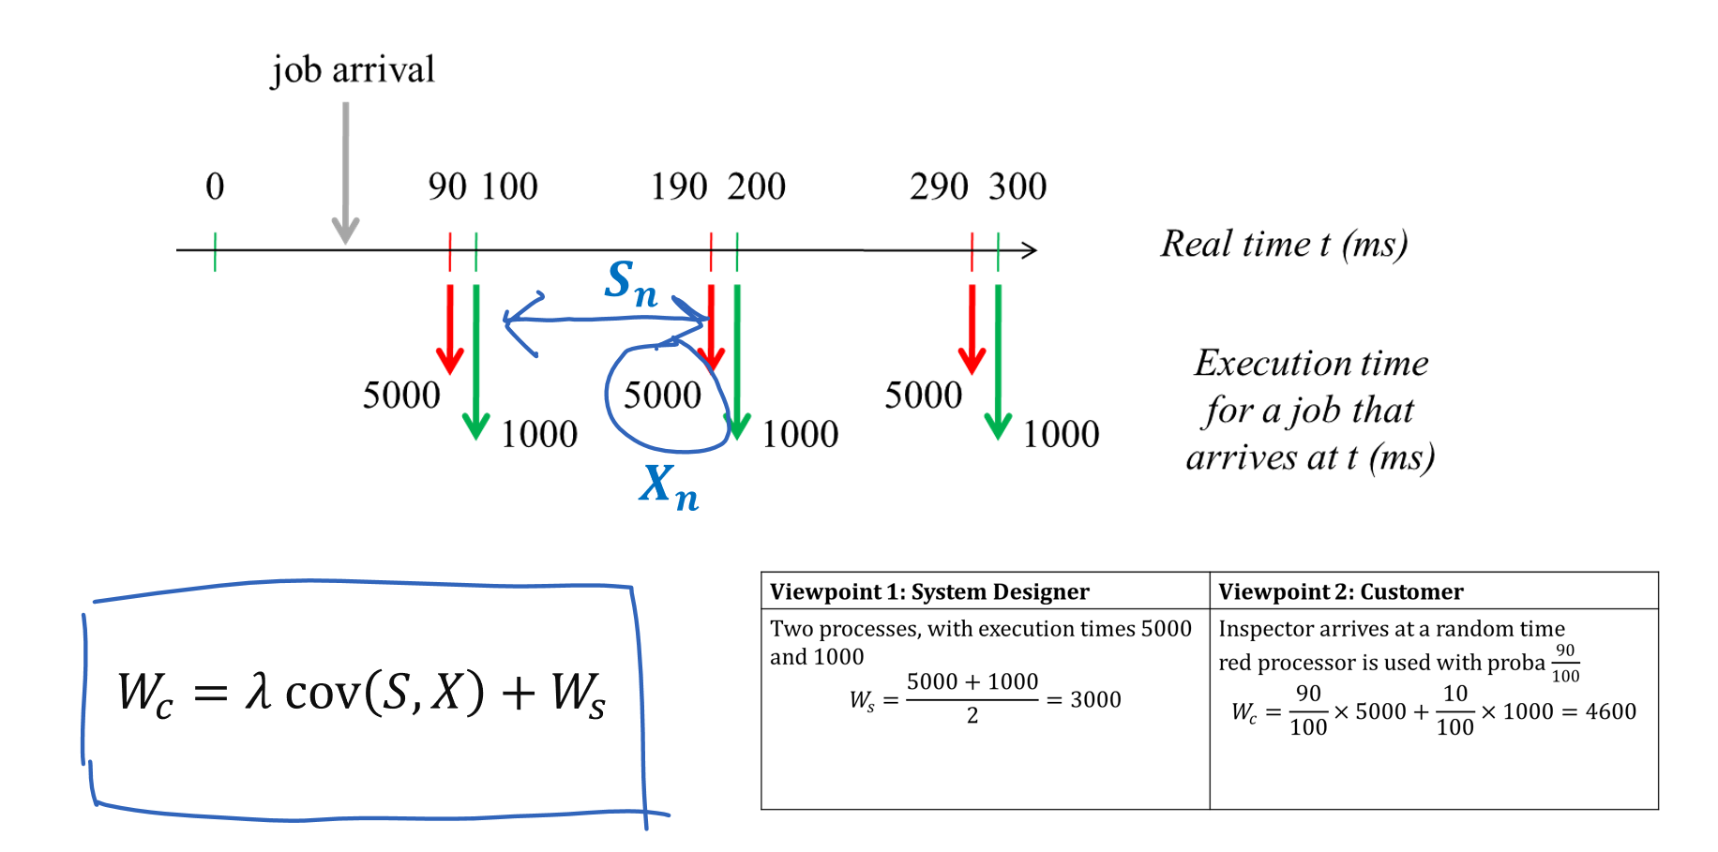
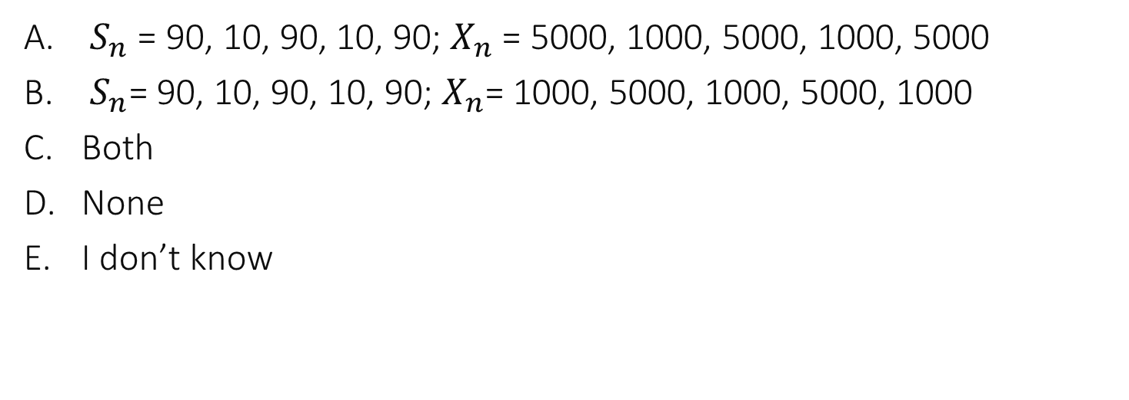
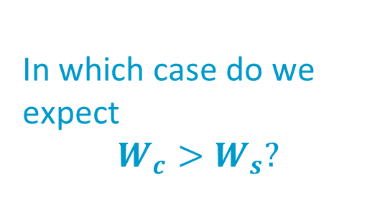
In which case do we expect $$W_{c}>W_{s}?$$
$S_{n}$ = 90, 10, 90, 10, 90; $X_{n}$ = 5000, 1000, 5000, 1000, 5000
$S_{n}$= 90, 10, 90, 10, 90; $X_{n}$= 1000, 5000, 1000, 5000, 1000
Both
None
I don’t know

Slide 12
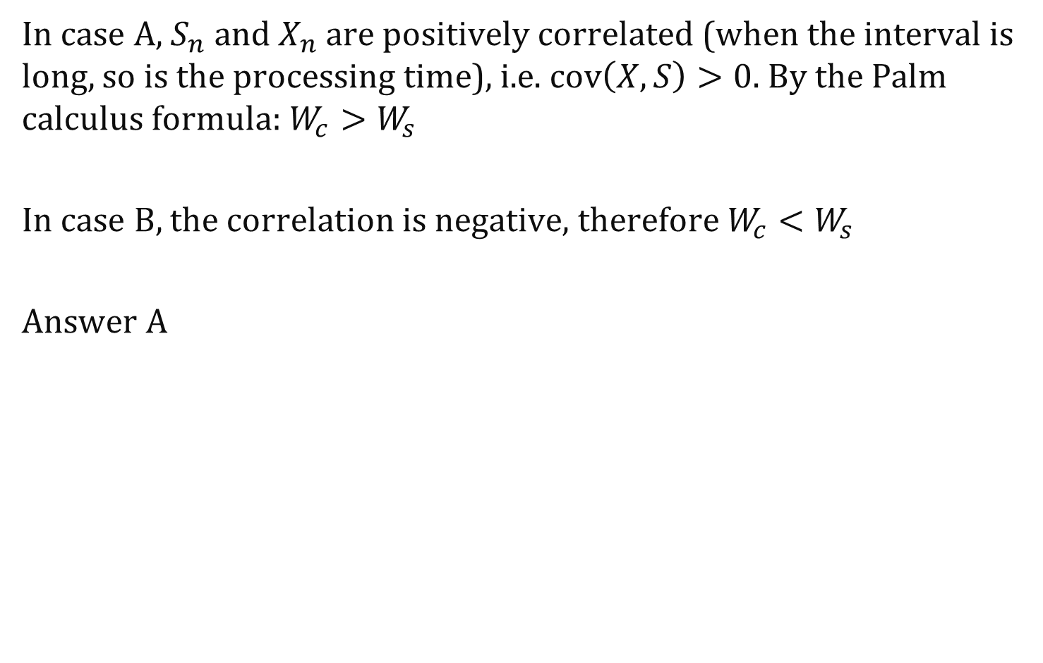
Solution
In case A, $S_{n}$ and $X_{n}$ are positively correlated (when the interval is long, so is the processing time), i.e. $cov\left(X,S\right)>0$. By the Palm calculus formula:$W_{c}>W_{s}$
In case B, the correlation is negative, therefore $W_{c}<W_{s}$
Answer A

Slide 13
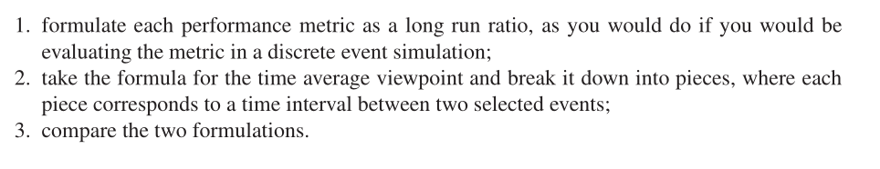
The Large Time Heuristic
Formally correct if simulation is stationary
It is a robust method, i.e. independent of assumptions on distributions (and on independence)

Slide 14
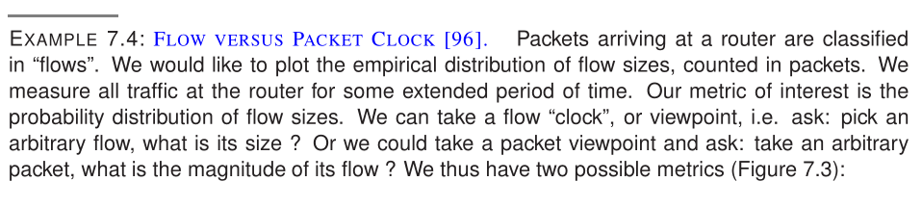



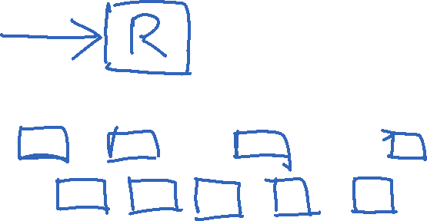
Other «Clocks»
Distribution of flow sizes
for an arbitrary flow for an arbitrary packet
Flow 1
Flow 2
Flow 3

Slide 15
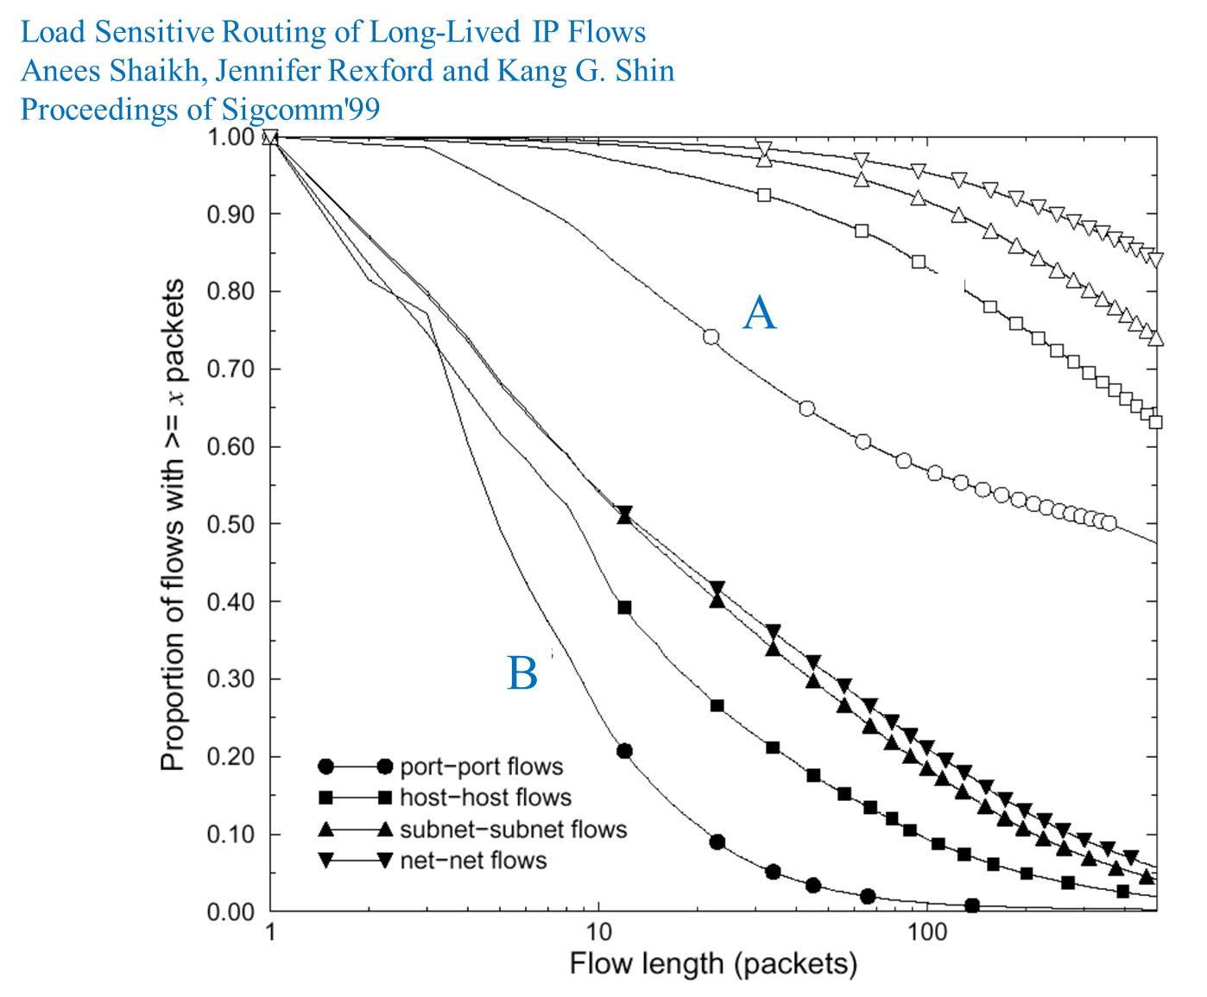
Which curves are for the per-packet viewpoint ?
A
B
It depends
I don’t know

Slide 16
Solution
Answer A There are more packets in the large flows. So more packets experience a large flow size.

Slide 17
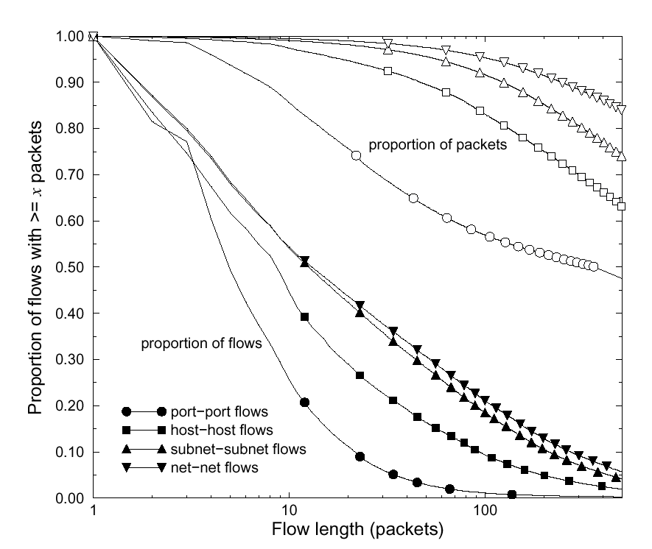
Load Sensitive Routing of Long-Lived IP Flows Anees Shaikh, Jennifer Rexford and Kang G. Shin Proceedings of Sigcomm'99
ECDF, per packet viewpoint
ECDF, per flow viewpoint

Slide 18
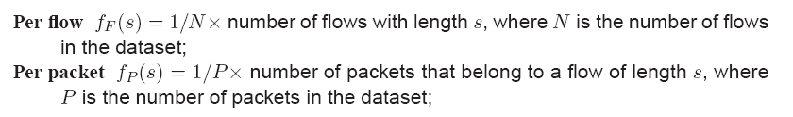
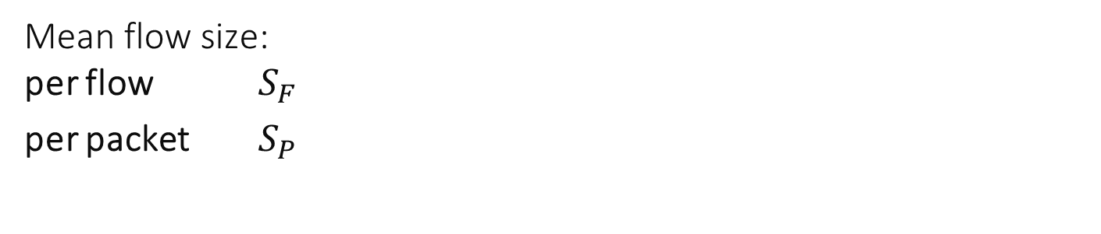
Distribution of flow sizes
for an arbitrary flow for an arbitrary packet
Flow 1
Flow 2
Flow 3
Mean flow size: per flow $S_{F}$
per packet $S_{P}$

Slide 19
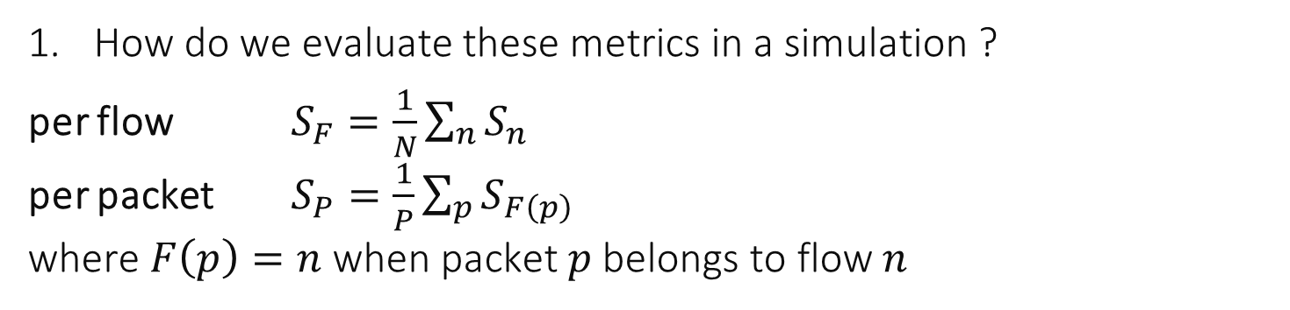
Large «Time» Heuristic
How do we evaluate these metrics in a simulation ?
per flow $S_{F}=\frac{1}{N}\sum_{n}{S_{n}}$ per packet $S_{P}=\frac{1}{P}\sum_{p}{S_{F\left(p\right)}}$ where $F\left(p\right)=n$when packet $p$ belongs to flow $n$

Slide 20
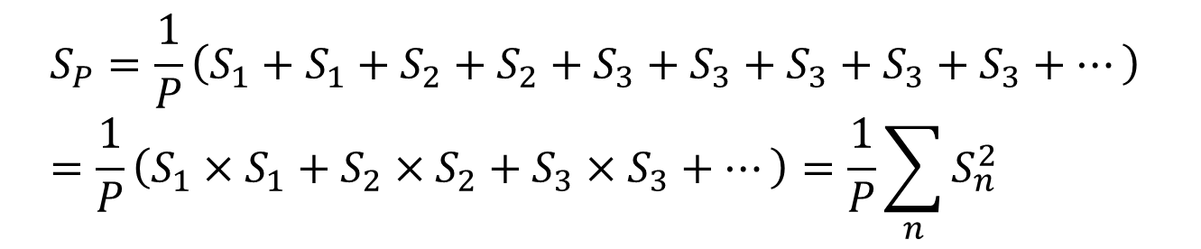

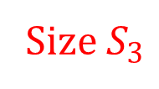
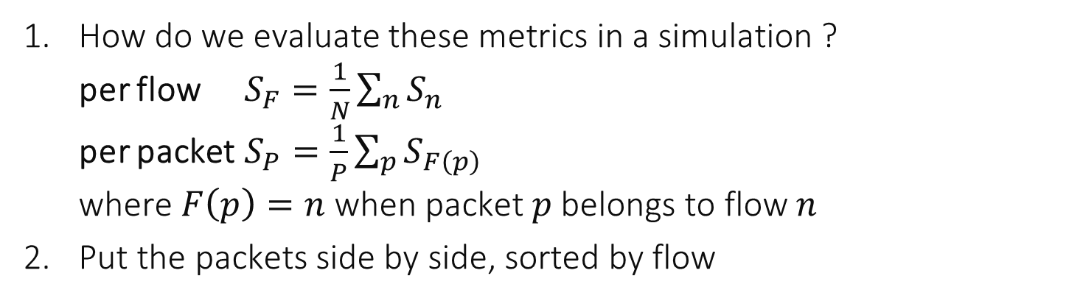
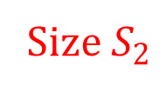

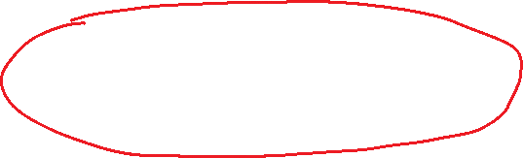
How do we evaluate these metrics in a simulation ? per flow $S_{F}=\frac{1}{N}\sum_{n}{S_{n}}$ per packet $S_{P}=\frac{1}{P}\sum_{p}{S_{F\left(p\right)}}$ where $F\left(p\right)=n$when packet $p$ belongs to flow $n$
Put the packets side by side, sorted by flow
Flow n=1
Flow n=2
Flow n=3
p=2
p=3
p=4
p=5
p=6
p=7
p=8
p=9
p=1
Size $S_{1}$
Size $S_{2}$
Size $S_{3}$
$$S_{P}=\frac{1}{P}\left(S_{1}+S_{1}+S_{2}+S_{2}+S_{3}+S_{3}+S_{3}+S_{3}+S_{3}+…\right) \\ =\frac{1}{P}\left(S_{1}×S_{1}+S_{2}×S_{2}+S_{3}×S_{3}+…\right)=\frac{1}{P}\sum_{n}{S_{n}^{2}}$$

Slide 21
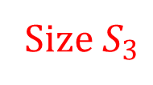


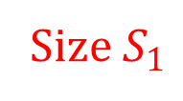

Flow n=1
Flow n=2
Flow n=3
p=2
p=3
p=4
p=5
p=6
p=7
p=8
p=9
p=1
Size $S_{1}$
Size $S_{2}$
Size $S_{3}$
Compare
$S_{P}=\frac{1}{P}\sum_{n}{S_{n}^{2}}$
$S_{F}=\frac{1}{N}\sum_{n}{S_{n}}=\frac{1}{N}P$ $S_{P}=\frac{N}{P}×\frac{1}{N}\sum_{n}{S_{n}^{2}}=\frac{1}{S_{F}}×\frac{1}{N}\sum_{n}{S_{n}^{2}}=\frac{1}{S_{F}}×\left(S_{F}^{2}+{var}_{F}\left(S\right)\right)$ $S_{P}=S_{F}+\frac{1}{S_{F}}{var}_{F}\left(S\right)$

Slide 22
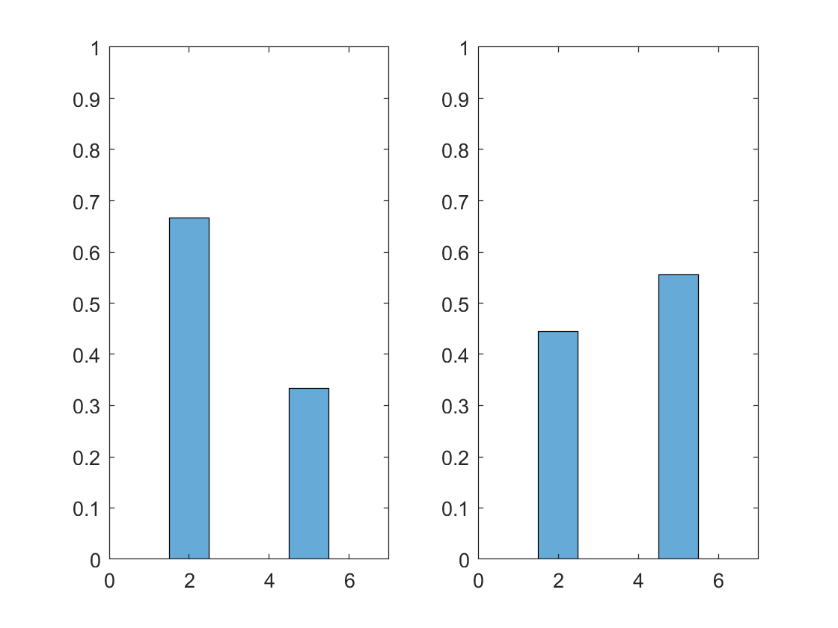

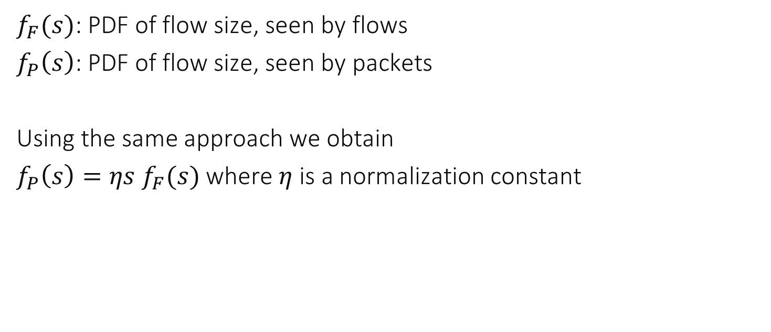
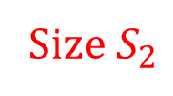

PDFs of flow sizes
Flow n=1
Flow n=2
Flow n=3
p=2
p=3
p=4
p=5
p=6
p=7
p=8
p=9
p=1
Size $S_{1}$
Size $S_{2}$
Size $S_{3}$
$f_{F}(s)$: PDF of flow size, seen by flows
$f_{P}\left(s\right)$: PDF of flow size, seen by packets
Using the same approach we obtain
$f_{P}\left(s\right)=ηs f_{F}(s)$ where $η$ is a normalization constant
seen by flows
seen by packets

Slide 23
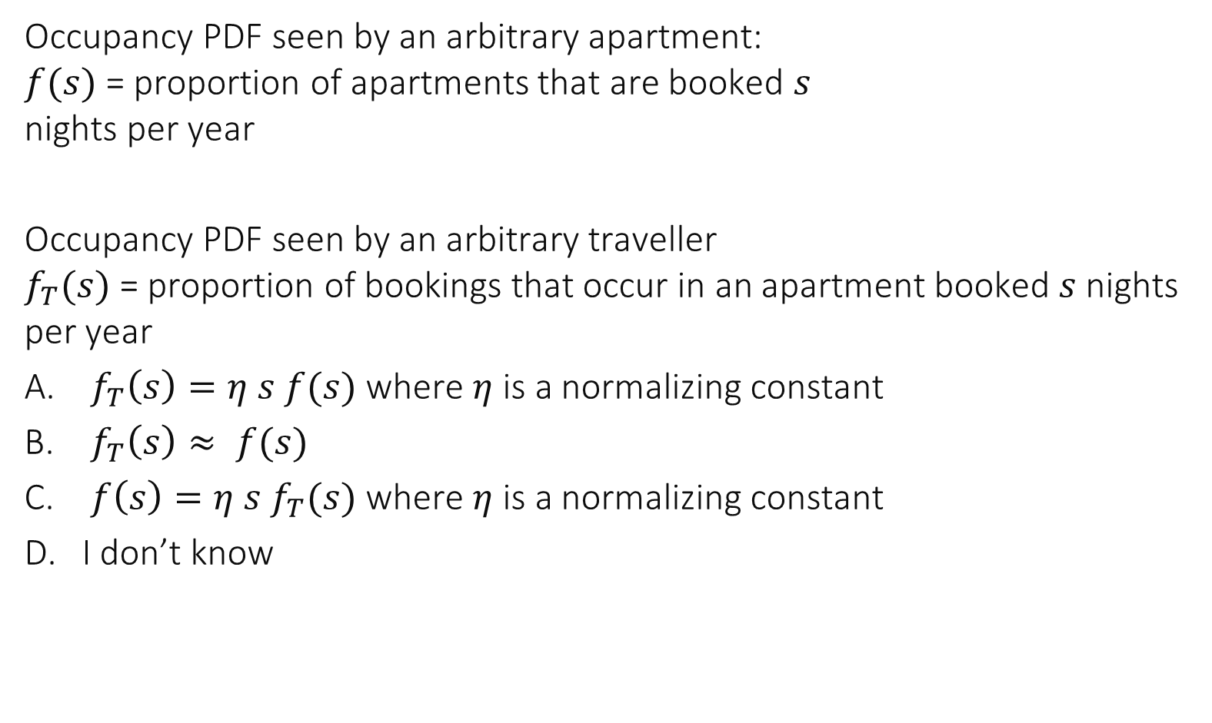
AirBnB’s Paradox
Occupancy PDF seen by an arbitrary apartment: $f(s)$ = proportion of apartments that are booked $s$ nights per year
Occupancy PDF seen by an arbitrary traveller $f_{T}(s)$ = proportion of bookings that occur in an apartment booked $s$ nights per year
$f_{T}\left(s\right)=η s f(s)$ where $η$ is a normalizing constant
$f_{T}\left(s\right)≈ f(s)$
$f\left(s\right)=η s f_{T}(s)$ where $η$ is a normalizing constant
I don’t know

Slide 24



Assuming every rental is for just one night, this would be the same case as with files (apartments) and packets (bookings).
Therefore, with the same arguments $f_{T}\left(s\right)=η s f(s)$
An arbitrary traveller is more likely to fall in a listing that is often booked.
Apartment 1
Apartment 2
Apartment 3
Apartment 4

Slide 25

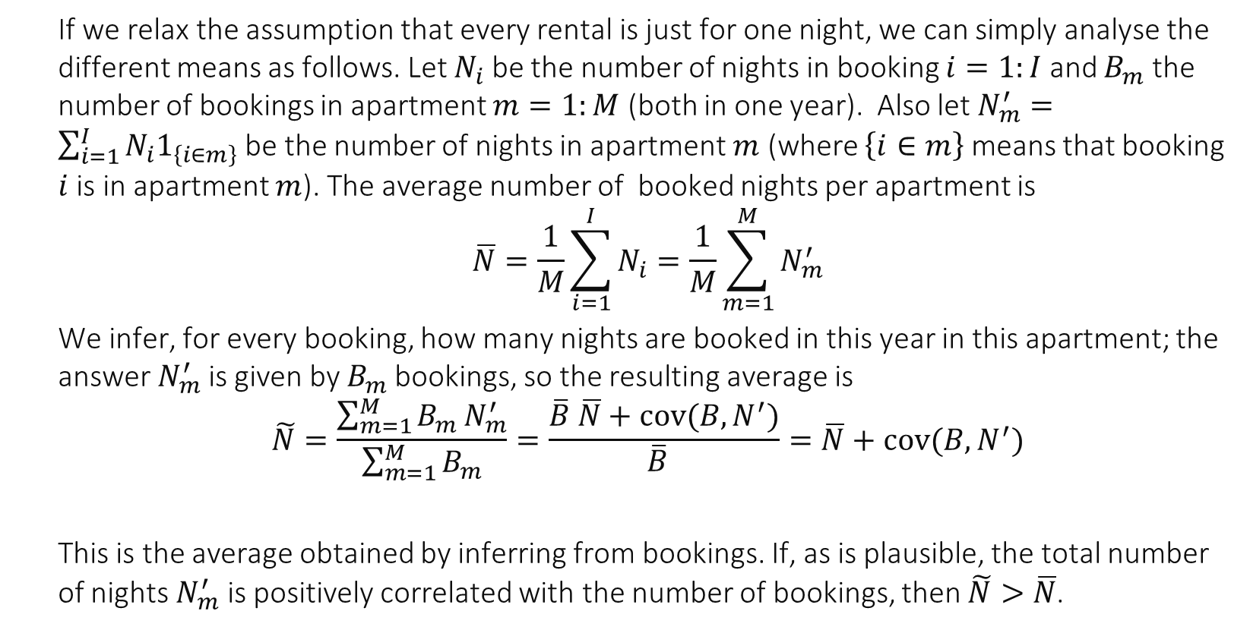


Apartment 1
$B_{1}$bookings
Apartment 2
Apartment 3
Apartment $M$
$N_{i}$nights
If we relax the assumption that every rental is just for one night, we can simply analyse the different means as follows. Let $N_{i}$ be the number of nights in booking $i=1:I$ and $B_{m}$ the number of bookings in apartment $m=1:M$ (both in one year). Also let $N_{m}^{′}=\sum_{i=1}^{I}{N_{i}1_{\left\{i∈m\right\}}}$ be the number of nights in apartment $m$ (where $\left\{i∈m\right\}$means that booking $i$ is in apartment $m$). The average number of booked nights per apartment is
$$\overline{N}=\frac{1}{M}\sum_{i=1}^{I}{N_{i}}=\frac{1}{M}\sum_{m=1}^{M}{N_{m}^{′}}$$
We infer, for every booking, how many nights are booked in this year in this apartment; the answer $N_{m}^{′}$is given by $B_{m}$bookings, so the resulting average is $$\tilde{N}=\frac{\sum_{m=1}^{M}{B_{m}}N_{m}^{′}}{\sum_{m=1}^{M}{B_{m}}}=\frac{\overline{B} \overline{N}+cov(B,N^{′})}{\overline{B} }=\overline{N}+cov(B,N^{′})$$
This is the average obtained by inferring from bookings. If, as is plausible, the total number of nights $N_{m}^{′}$ is positively correlated with the number of bookings, then $\tilde{N}>\overline{N}$.

Slide 26
Take-Home Message
How we sample data to compute a metric (the viewpoint) should be screened carefully.
Apparent paradoxes come from confusions in viewpoints.
Metrics may be misleading if sampling method is not appropriate.
Next we will see a formal theory (Palm Calculus) and its use in simulations.

