Slide 1

Queuing Networks
Jean-Yves Le Boudec

Slide 2
Networks of Queues Stability
Queuing networks are frequently used models
The stability issue may, in general, be a hard one
Necessary condition for stability (Natural Condition) server utilization < 1 at every queue

Slide 3
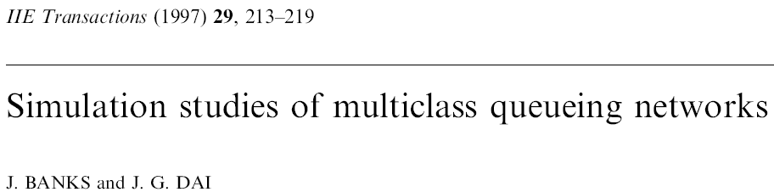
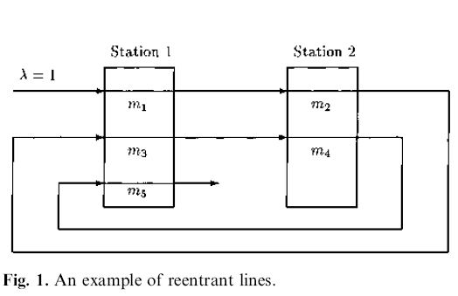
Instability Examples
Poisson arrivals ; jobs go through stations 1,2,1,2,1 then leave
A job arrives as type 1, then becomes 2, then 3 etc
Exponential, independent service times with mean m_{i}
Priority scheduling
Station 1 : 5 > 3 >1
Station 2: 2 > 4
Q: What is the natural stability condition ?
A: λ (m₁ + m₃ + m₅ ) < 1 λ (m₂ + m₄) < 1

Slide 4
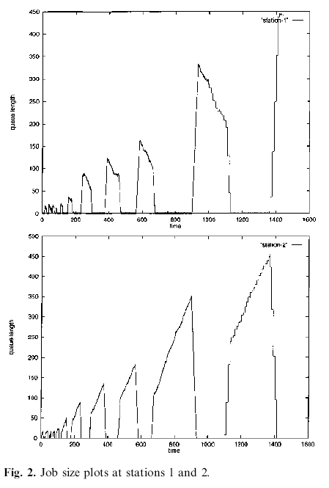
λ = 1 m₁ = m₃ = m₄ = 0.1 m₂ = m₅ = 0.6
Utilization factors
Station 1: 0.8
Station 2: 0.7
Network is unstable !
If λ (m₁ + … + m₅ ) < 1 network is stable; why?

Slide 5
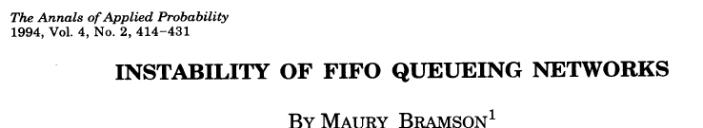
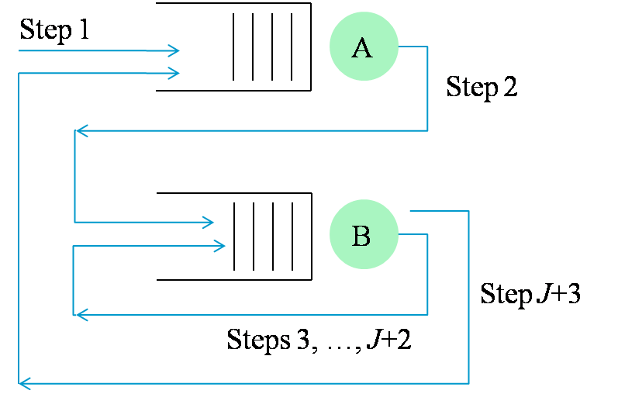
Bramson’s Example 1: A Simple FIFO Network
Poisson arrivals; jobs go through stations A, B,B…,B, A then leave
Exponential, independent service times
Steps 2 and last: mean is L
Other steps: mean is S
Q: What is the natural stability condition ?
A: λ ( L + S ) < 1 λ ( (J-1)S + L ) < 1
Bramson showed: may be unstable whereas natural stability condition holds

Slide 6
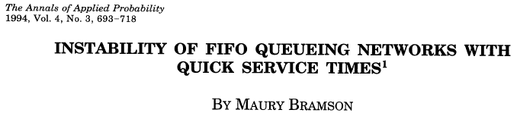

Bramson’s Example 2 A FIFO Network with Arbitrarily Small Utilization Factor
m queues
2 types of customers
λ = 0.5 each type
routing as shown, … = 7 visits
FIFO
Exponential service times, with mean as shown
S
S
L
S
S
L
S
S
L
S
S
L
Utilization factor at every station ≤ 4 λ S
Network is unstable for S ≤ 0.01 L ≤ S⁸ m = floor(-2 (log L )/L)

Slide 7
Take Home Message
The natural stability condition is necessary but may not be sufficient
There is a class of networks where this never happens. Product Form Queuing Networks

Slide 8

Product Form Networks
Customers have a class attribute
Customers visit stations according to Markov Routing
External arrivals, if any, are Poisson
2 Stations
Class = step, J+3 classes
Can you reduce the number of classes ?

Slide 9
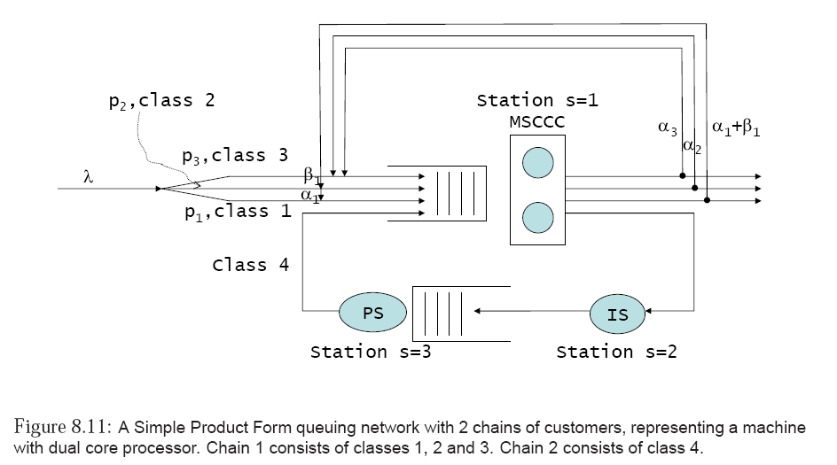
Chains
Customers can switch class, but remain in the same chain
ν

Slide 10
Chains may be open or closed
Open chain = with Poisson arrivals. Customers must eventually leave
Closed chain: no arrival, no departure; number of customers is constant
Closed network has only closed chains
Open network has only open chains
Mixed network may have both

Slide 11
3 Stations
4 classes
1 open chain
1 closed chain
ν

Slide 12
Bramson’s Example 2 A FIFO Network with Arbitrarily Small Utilization Factor
S
S
L
S
S
L
S
S
L
S
S
L
2 Stations
Many classes
2 open chains
Network is open

Slide 13
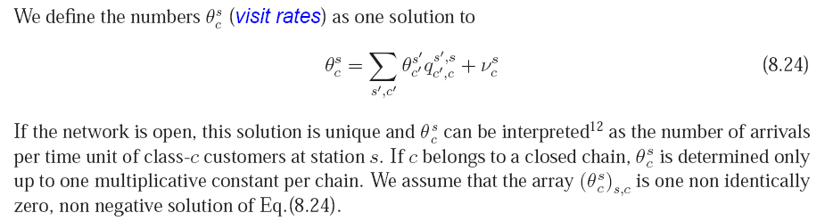
Visit Rates

Slide 14
2 Stations
5 classes
1 chain
Network is open
Visit rates θ¹₁ = θ¹₃ = θ¹₅ = θ²₂ = θ²₄ = λ θ^{s}_{c} = 0 otherwise

Slide 15
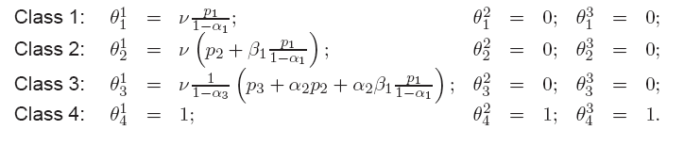
ν

Slide 16
Constraints on Stations
Stations must belong to a restricted catalog of stations
See Section 8.4 for full description
We will give commonly used examples
Example 1: Global Processor Sharing
One server
Rate of server is shared equally among all customers present
Service requirements for customers of class c are drawn iid from a distribution which depends on the class (and the station)
Example 2: Delay
Infinite number of servers
Service requirements for customers of class c are drawn iid from a distribution which depends on the class (and the station)
No queuing, service time = service requirement = residence time

Slide 17
Example 3 : FIFO with B servers
B servers
FIFO queueing
Service requirements for customers of class c are drawn iid from an exponential distribution, independent of the class (but may depend on the station)
Example of Category 2 (MSCCC station): MSCCC with B servers
B servers
FIFO queueing with constraints
At most one customer of each class is allowed in service
Service requirements for customers of class c are drawn iid from an exponential distribution, independent of the class (but may depend on the station)
Examples 1 and 2 are insensitive (service time can be anything) Examples 3 and 4 are not (service time must be exponential, same for all)

Slide 18
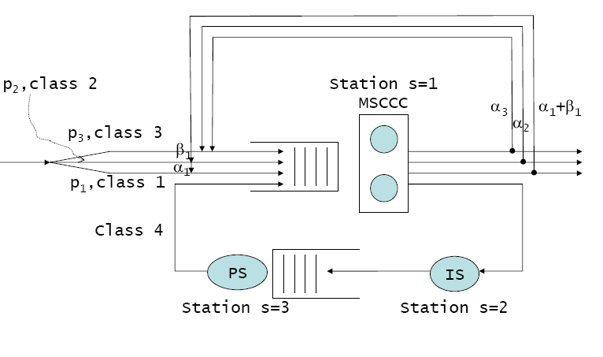
Say which network satisfies the hypotheses for product form
A
B (FIFO, Exp)
C (Prio, Exp)

Slide 19
The Product Form Theorem
If a network satisfies the « Product Form » conditions given earlier
The stationary distrib of numbers of customers can be written explicitly
It is a product of terms, where each term depends only on the station
Efficient algorithms exist to compute performance metrics for even very large networks
For PS and Delay stations, service time distribution does not matter other than through its mean (insensitivity)
The natural stability condition holds

Slide 20
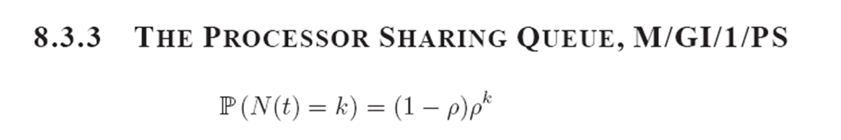
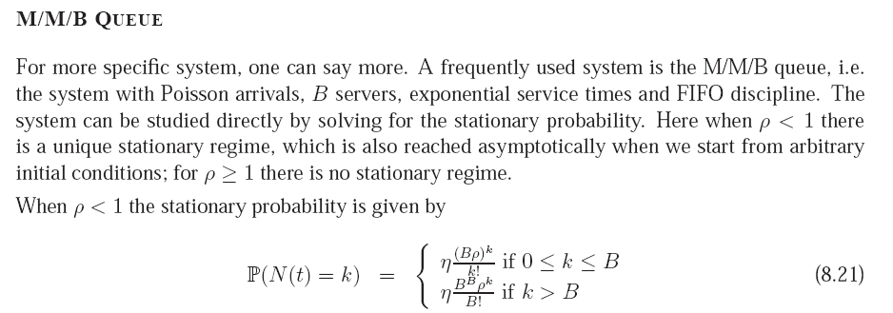

Slide 21
