Slide 1
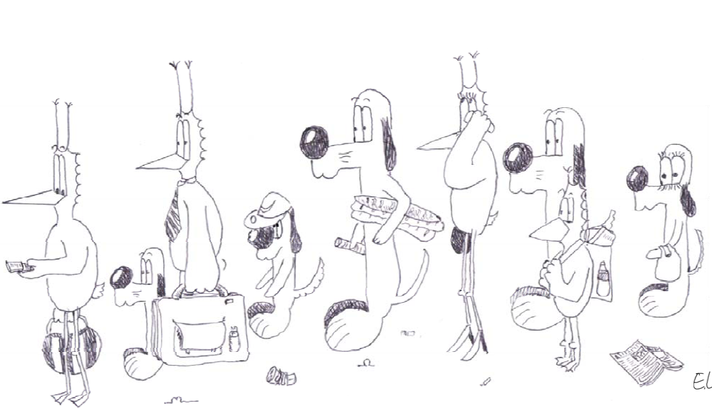
Queuing Networks Mean Value Analysis
Jean-Yves Le Boudec

Slide 2
Goal of This Module
Learn on an example how to solve a product-form queuing network

Slide 3
Reminder : A queuing network is called «Product Form» if…
Station are either
Markov routing
One or several classes
External arrivals, if any are Poisson
FIFO
with one or more servers (possibly with exclusion constraints - MSCCC)
exponential service times, independent of class
Or insensitive station:
delay, processor sharing, LCFS among others
Service time is arbitrary, with finite mean – may depend on class

Slide 4

A product-form queuing network…
…is stable when the natural stability condition holds
The stationary distribution of state and of number of customers has product form (Theorem 8.7): $P\left({\vec{n}}_{1}, …,{\vec{n}}_{S}\right)=K p_{1}\left({\vec{n}}_{1}\right)…p_{S}\left({\vec{n}}_{S}\right)$
$p_{s}\left({\vec{n}}_{s}\right)=f_{s}\left({\vec{n}}_{s}\right)θ_{1,s}^{n_{1,s }}…θ_{C,s}^{n_{C,s }}$
Normalizing
constant
Station 1
Station S
Depends only on station and visit rates, not on the othernetwork around
Visit rate for class C at station s
Station function depends only on station in isolation

Slide 5
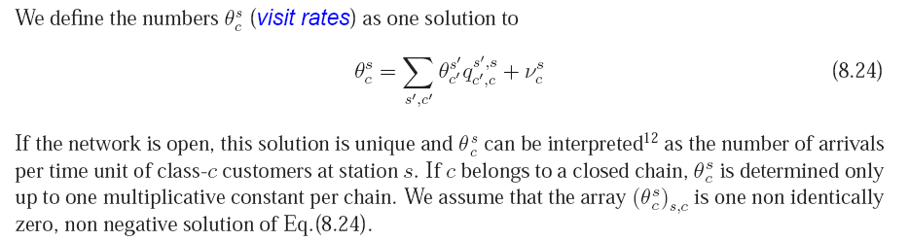
Visit Rates

Slide 6

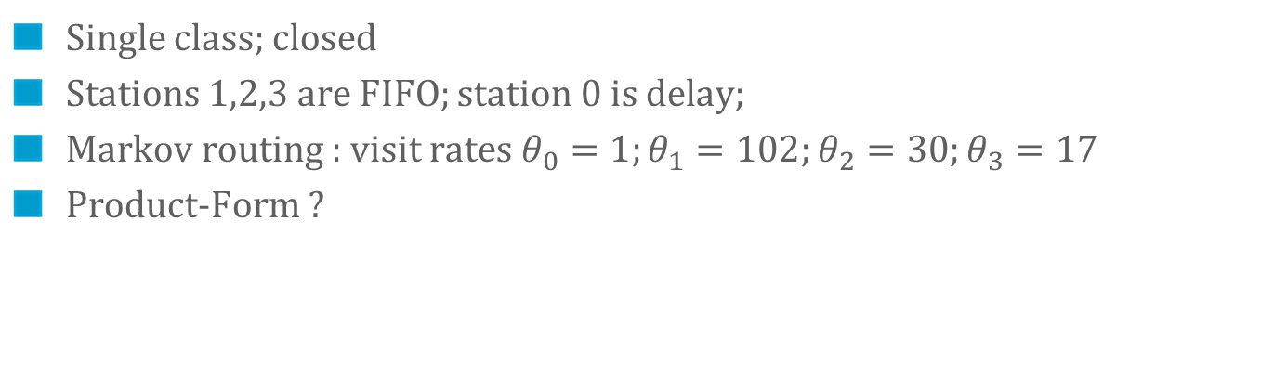


Let us apply these results to this network
B=1
server
FIFO
K jobs in total
B=1
server
FIFO
$$S_{2}$$
Think time Z
$$S_{1}$$
B=1
server
FIFO
$$S_{3}$$
Single class; closed
Stations 1,2,3 are FIFO; station 0 is delay;
Markov routing : visit rates $θ_{0}=1;θ_{1}=102;θ_{2}=30;θ_{3}=17$
Product-Form ?

Slide 7
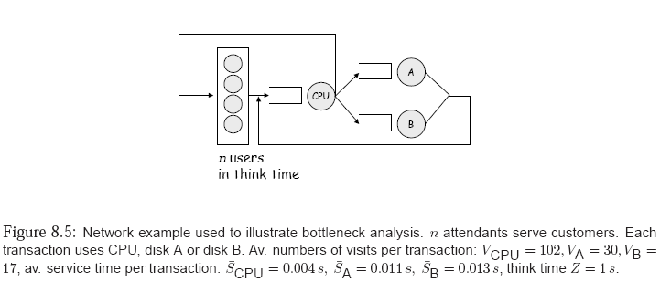
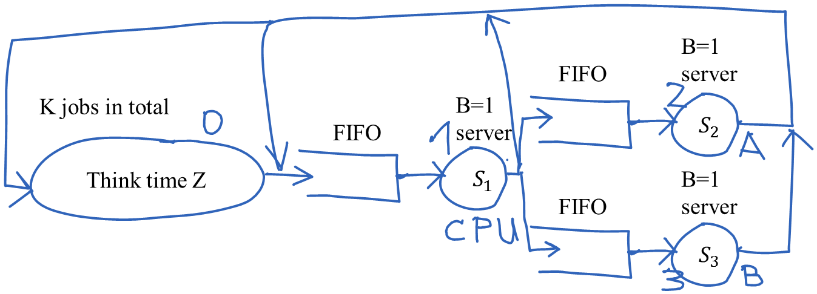
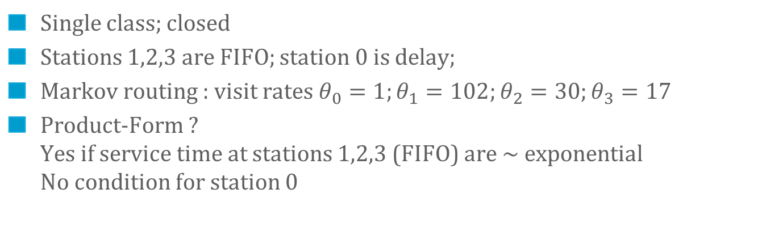
Let us apply these results to this network
Single class; closed
Stations 1,2,3 are FIFO; station 0 is delay;
Markov routing : visit rates $θ_{0}=1;θ_{1}=102;θ_{2}=30;θ_{3}=17$
Product-Form ? Yes if service time at stations 1,2,3 (FIFO) are $∼$exponential No condition for station 0

Slide 8
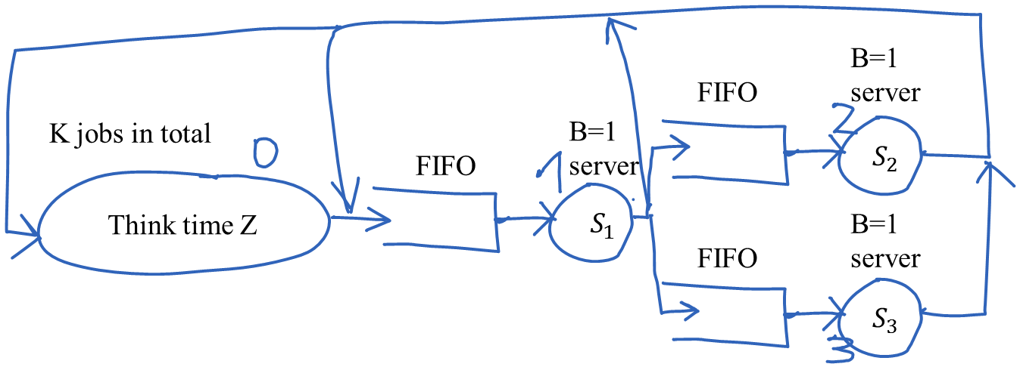
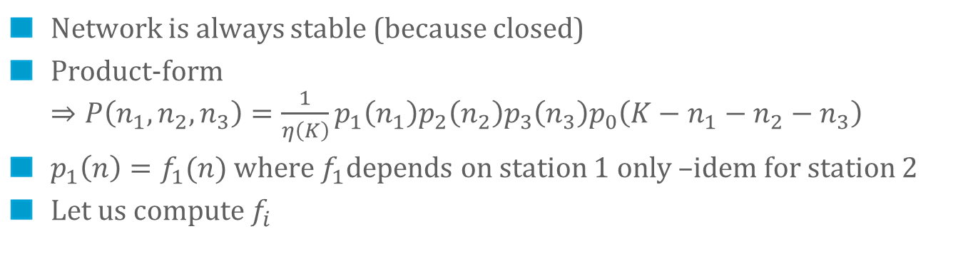
The Product-Form
Network is always stable (because closed)
Product-form $⇒P\left(n_{1},n_{2},n_{3}\right)=\frac{1}{η\left(K\right)}p_{1}\left(n_{1}\right)p_{2}\left(n_{2}\right)p_{3}\left(n_{3}\right)p_{0}\left(K−n_{1}−n_{2}−n_{3}\right)$
$p_{1}\left(n\right)=f_{1}(n)$ where $f_{1}$depends on station 1 only –idem for station 2
Let us compute $f_{i}$

Slide 9


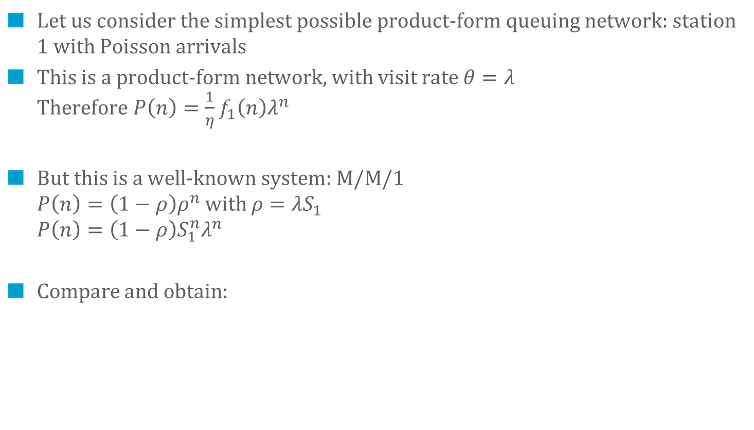
Station function $f_{1}$
B=1
server
FIFO
$$S_{1}$$
Let us consider the simplest possible product-form queuing network: station 1 with Poisson arrivals
This is a product-form network, with visit rate $θ=λ$ Therefore $P\left(n\right)=\frac{1}{η}f_{1}\left(n\right)λ^{n}$
But this is a well-known system: M/M/1 $P\left(n\right)=\left(1−ρ\right)ρ^{n}$with $ρ=λS_{1}$ $P\left(n\right)=\left(1−ρ\right)S_{1}^{n}λ^{n}$
Compare and obtain:

Slide 10
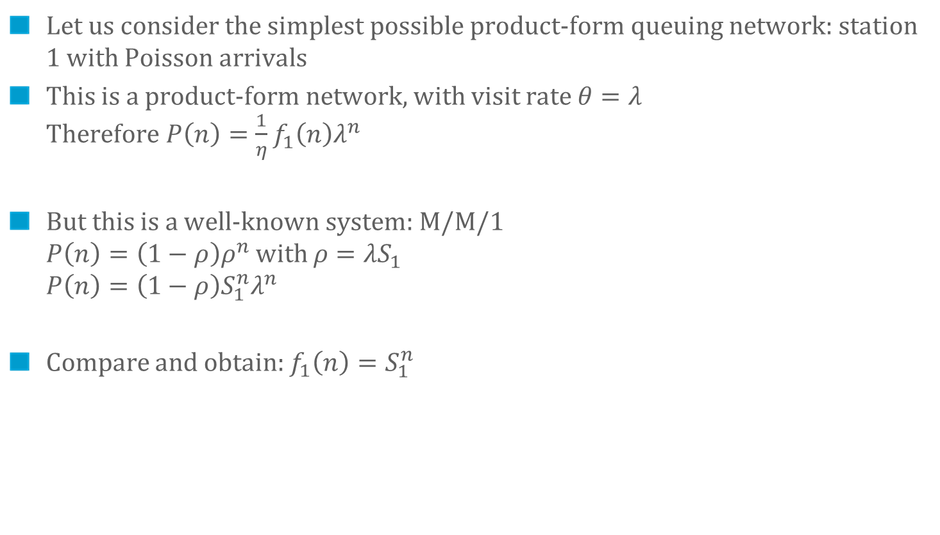
Station function $f_{1}$
B=1
server
FIFO
$$S_{1}$$
Let us consider the simplest possible product-form queuing network: station 1 with Poisson arrivals
This is a product-form network, with visit rate $θ=λ$ Therefore $P\left(n\right)=\frac{1}{η}f_{1}\left(n\right)λ^{n}$
But this is a well-known system: M/M/1 $P\left(n\right)=\left(1−ρ\right)ρ^{n}$with $ρ=λS_{1}$ $P\left(n\right)=\left(1−ρ\right)S_{1}^{n}λ^{n}$
Compare and obtain: $f_{1}\left(n\right)=S_{1}^{n}$

Slide 11

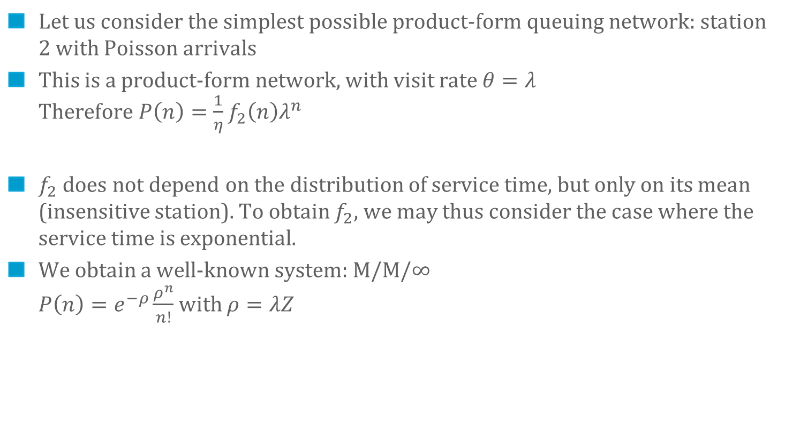
Station function $f_{0}$
Think time Z
Let us consider the simplest possible product-form queuing network: station 2 with Poisson arrivals
This is a product-form network, with visit rate $θ=λ$ Therefore $P\left(n\right)=\frac{1}{η}f_{2}\left(n\right)λ^{n}$
$f_{2}$ does not depend on the distribution of service time, but only on its mean (insensitive station). To obtain $f_{2}$, we may thus consider the case where the service time is exponential.
We obtain a well-known system: M/M/$∞$ $P\left(n\right)=e^{−ρ}\frac{ρ^{n}}{n!}$with $ρ=λZ$

Slide 12
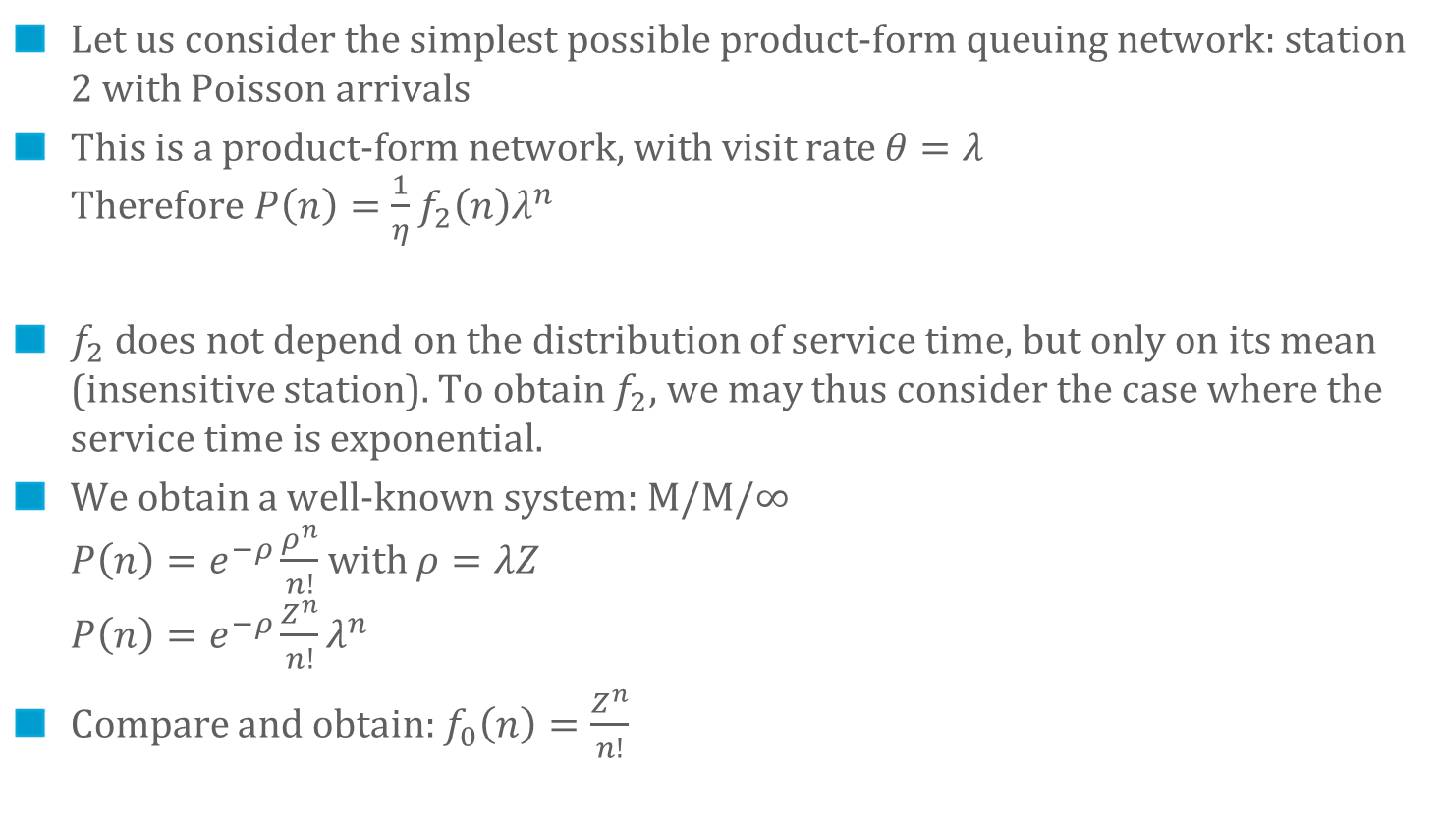
Station function $f_{0}$
Think time Z
Let us consider the simplest possible product-form queuing network: station 2 with Poisson arrivals
This is a product-form network, with visit rate $θ=λ$ Therefore $P\left(n\right)=\frac{1}{η}f_{2}\left(n\right)λ^{n}$
$f_{2}$ does not depend on the distribution of service time, but only on its mean (insensitive station). To obtain $f_{2}$, we may thus consider the case where the service time is exponential.
We obtain a well-known system: M/M/$∞$ $P\left(n\right)=e^{−ρ}\frac{ρ^{n}}{n!}$with $ρ=λZ$ $P\left(n\right)=e^{−ρ}\frac{Z^{n}}{n!}λ^{n}$
Compare and obtain: $f_{0}\left(n\right)=\frac{Z^{n}}{n!}$

Slide 13
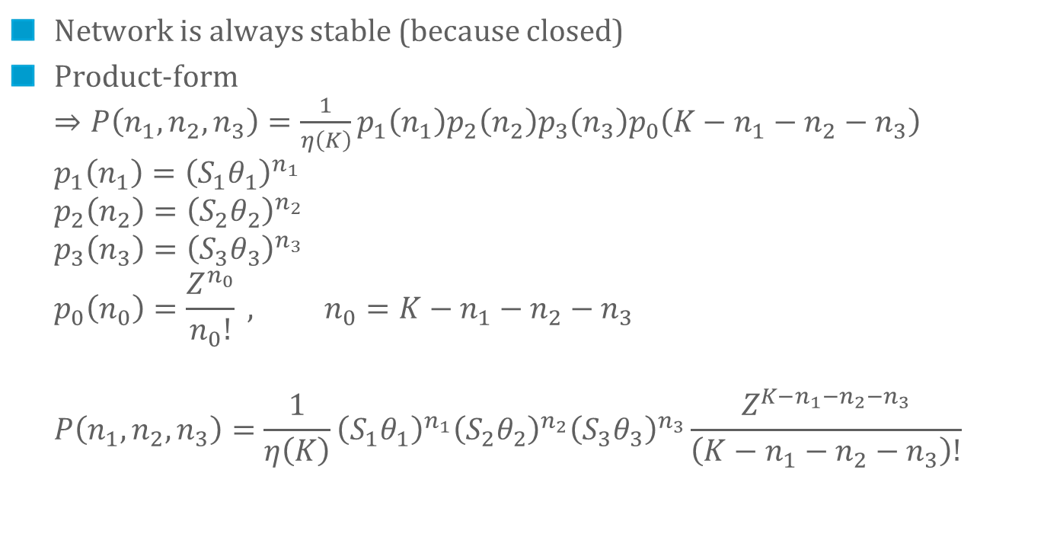
The Product-Form
Network is always stable (because closed)
Product-form $⇒P\left(n_{1},n_{2},n_{3}\right)=\frac{1}{η\left(K\right)}p_{1}\left(n_{1}\right)p_{2}\left(n_{2}\right)p_{3}\left(n_{3}\right)p_{0}\left(K−n_{1}−n_{2}−n_{3}\right)$ $p_{1}\left(n_{1}\right)={\left(S_{1}θ_{1}\right)}^{n_{1}}$ $p_{2}\left(n_{2}\right)={\left(S_{2}θ_{2}\right)}^{n_{2}}$ $p_{3}\left(n_{3}\right)={\left(S_{3}θ_{3}\right)}^{n_{3}}$ $p_{0}\left(n_{0}\right)=\frac{Z^{n_{0}}}{n_{0}!} , n_{0}=K−n_{1}−n_{2}−n_{3}$ $P\left(n_{1},n_{2},n_{3}\right)=\frac{1}{η\left(K\right)}{\left(S_{1}θ_{1}\right)}^{n_{1}}{\left(S_{2}θ_{2}\right)}^{n_{2}}{\left(S_{3}θ_{3}\right)}^{n_{3}}\frac{Z^{K−n_{1}−n_{2}−n_{3}}}{\left(K−n_{1}−n_{2}−n_{3}\right)!}$

Slide 14
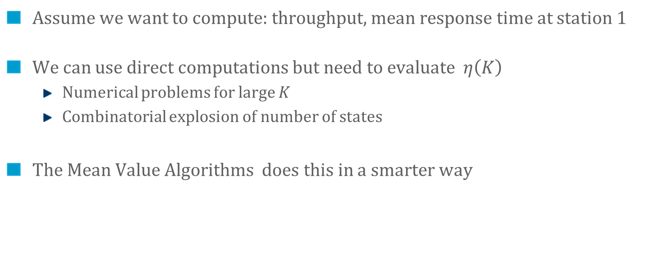
Mean Value Analysis
$$P\left(n_{1},n_{2},n_{3}\right)=\frac{1}{η\left(K\right)}{\left(S_{1}θ_{1}\right)}^{n_{1}}{\left(S_{2}θ_{2}\right)}^{n_{2}}{\left(S_{3}θ_{3}\right)}^{n_{3}}\frac{Z^{K−n_{1}−n_{2}−n_{3}}}{\left(K−n_{1}−n_{2}−n_{3}\right)!}$$
Assume we want to compute: throughput, mean response time at station 1
We can use direct computations but need to evaluate $η\left(K\right)$
Numerical problems for large $K$
Combinatorial explosion of number of states
The Mean Value Algorithms does this in a smarter way

Slide 15


Arrival Theorem
The distribution of customers at an arbitrary point in time is $P\left(n_{1},n_{2},n_{3}\right)=$
The distribution of customers seen by a customer just before arriving at station 1 (excluding herself) $P^{0}\left(n_{1},n_{2},n_{3}\right)=$

Slide 16
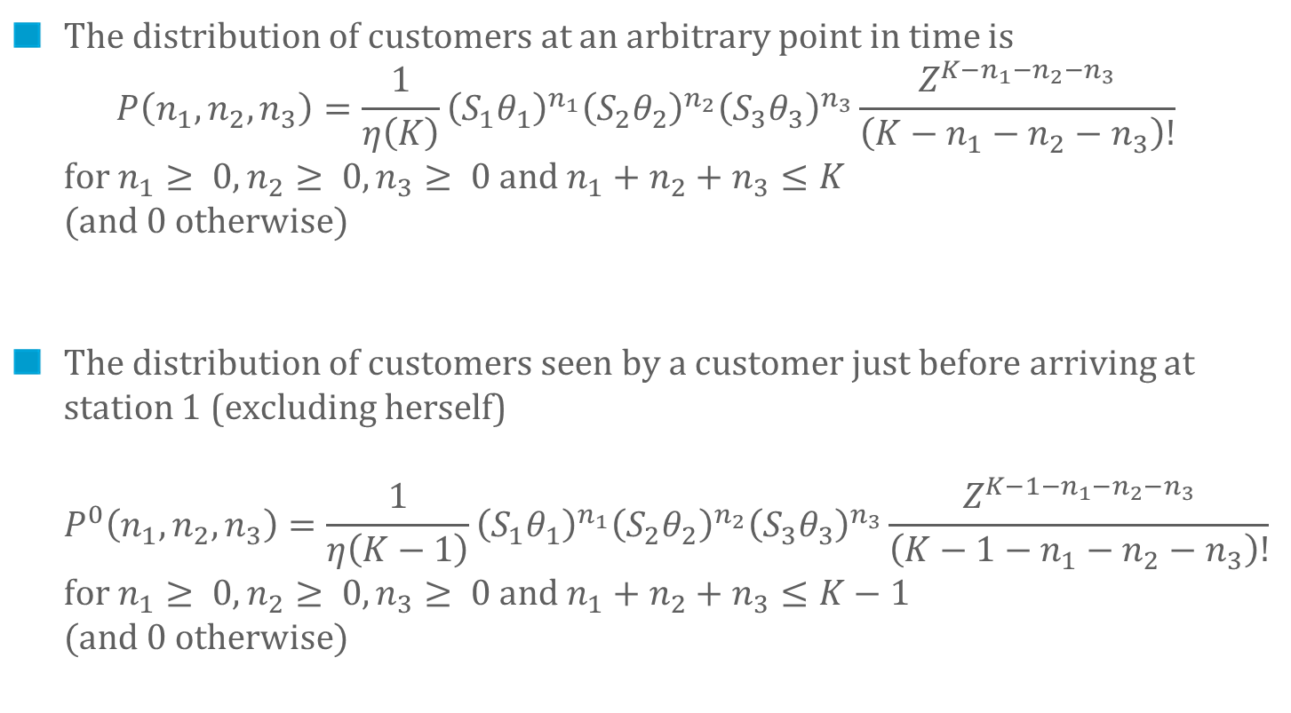
Arrival Theorem
The distribution of customers at an arbitrary point in time is $P\left(n_{1},n_{2},n_{3}\right)=\frac{1}{η\left(K\right)}{\left(S_{1}θ_{1}\right)}^{n_{1}}{\left(S_{2}θ_{2}\right)}^{n_{2}}{\left(S_{3}θ_{3}\right)}^{n_{3}}\frac{Z^{K−n_{1}−n_{2}−n_{3}}}{\left(K−n_{1}−n_{2}−n_{3}\right)!}$ for $n_{1}≥ 0,n_{2}≥ 0,n_{3}≥ 0$and $n_{1}+n_{2}+n_{3}≤K$ (and 0 otherwise)
The distribution of customers seen by a customer just before arriving at station 1 (excluding herself) $P^{0}\left(n_{1},n_{2},n_{3}\right)=\frac{1}{η\left(K−1\right)}{\left(S_{1}θ_{1}\right)}^{n_{1}}{\left(S_{2}θ_{2}\right)}^{n_{2}}{\left(S_{3}θ_{3}\right)}^{n_{3}}\frac{Z^{K−1−n_{1}−n_{2}−n_{3}}}{\left(K−1−n_{1}−n_{2}−n_{3}\right)!}$ for $n_{1}≥ 0,n_{2}≥ 0,n_{3}≥ 0$and $n_{1}+n_{2}+n_{3}≤K−1$ (and 0 otherwise)

Slide 17
Mean Value Analysis applied to our Network
Avoids the numerical problems due to computation of normalizing constant
Iterates on population $K$
Variables : $R_{i}(K)$ (response time at station i) $N_{i}(K)$ (mean number of jobs, station i) $λ(K)$ (throughput at station 0)
Uses :
Arrival theorem: $R_{i}\left(K\right)=\left(1+N_{i}\left(K−1\right)\right)S_{i}$ for $i=1,2,3$ $R_{0}\left(K\right)=Z$
Little’s formula : $N_{0}\left(K\right)=λ\left(K\right) Z$ $N_{i}\left(K\right)=λ\left(K\right)θ_{i} R_{i}(K)$
Conservation of total number of customers $N_{0}\left(K\right)+N_{1}\left(K\right)+N_{2}\left(K\right)+N_{3}\left(K\right)=K$

Slide 18
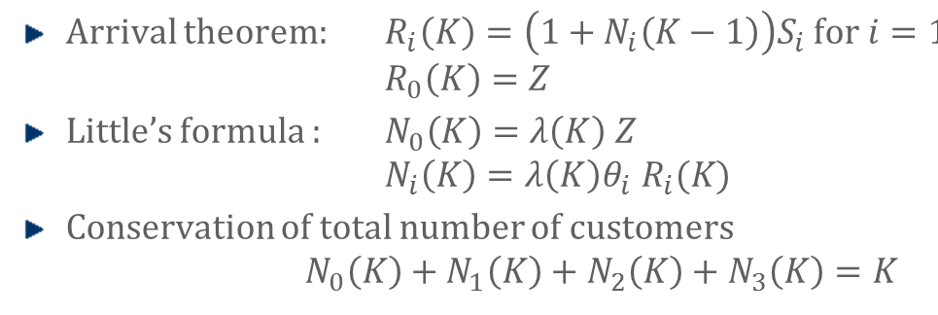
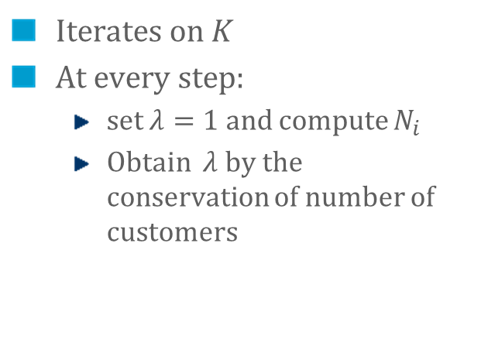
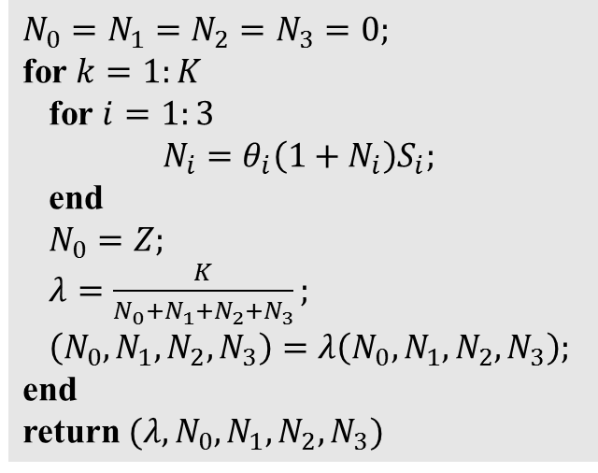
Mean Value Analysis applied to our Network
$N_{0}=N_{1}=N_{2}=N_{3}=0;$ for $k=1:K$ for $i=1:3$ $N_{i}=θ_{i}\left(1+N_{i}\right)S_{i};$
end $N_{0}=Z;$ $λ=\frac{K}{N_{0}+N_{1}+N_{2}+N_{3}};$
$\left(N_{0},N_{1}, N_{2},N_{3}\right)=λ\left(N_{0},N_{1}, N_{2},N_{3}\right);$
end
return $(λ, N_{0},N_{1},N_{2}, N_{3})$
Iterates on $K$
At every step:
set $λ=1$ and compute $N_{i}$
Obtain $λ$ by the conservation of number of customers

Slide 19
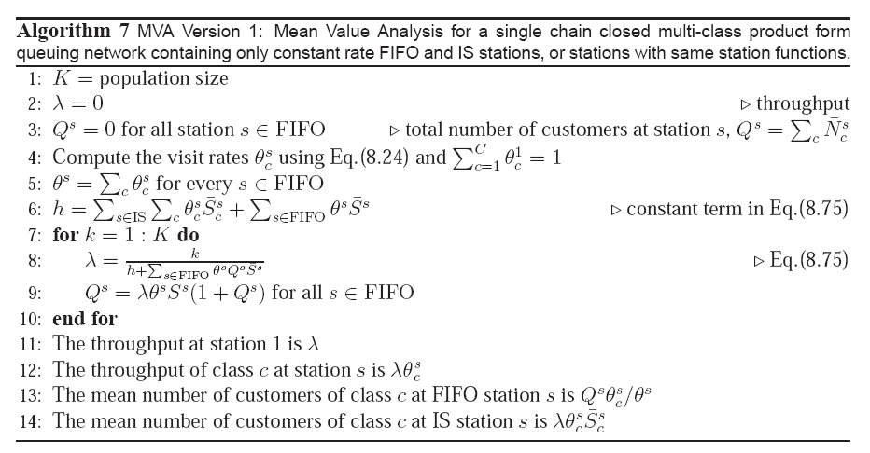

Slide 20
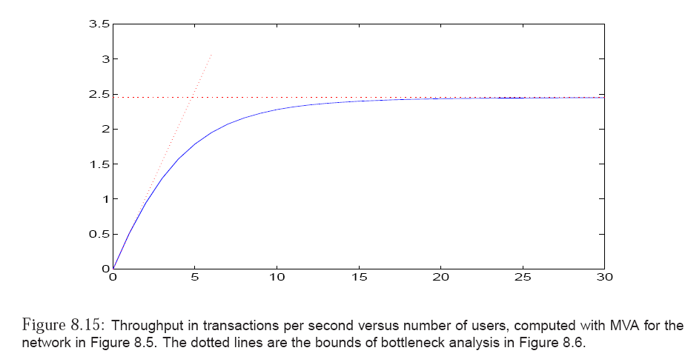

Slide 21
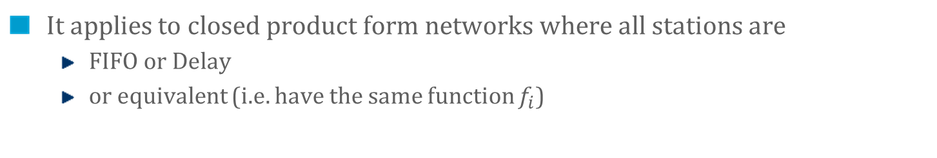
The algorithm we just used is called Mean Value Analysis (MVA) version 1
It applies to closed product form networks where all stations are
FIFO or Delay
or equivalent (i.e. have the same function $f_{i}$)

Slide 22
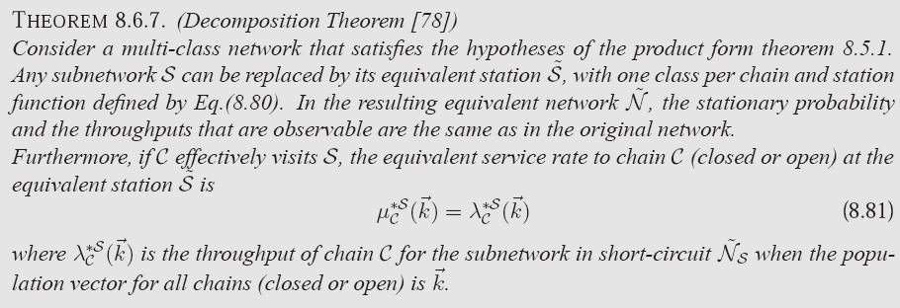
MVA Version 2
Applies to more general networks;
Gives not only means but also full distribs
Uses the decomposition and complement network theorems

Slide 23
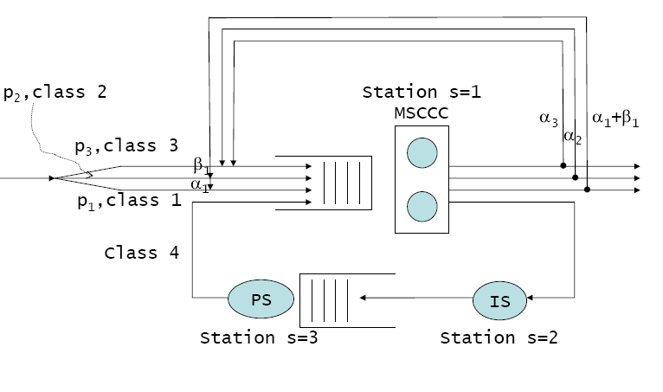
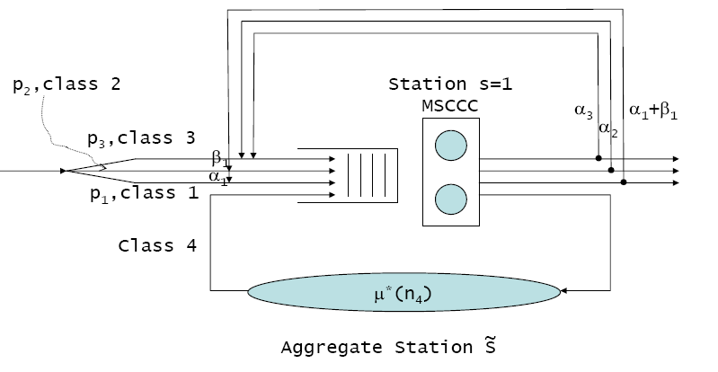
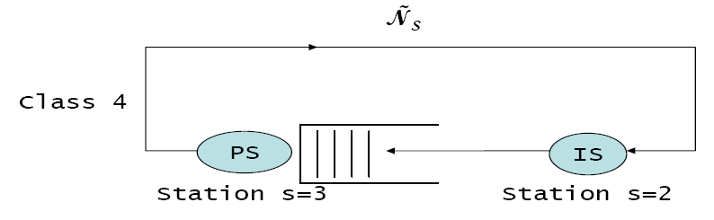
is equivalent to:
where the service rate μ*(n₄) is the throughput of

Slide 24
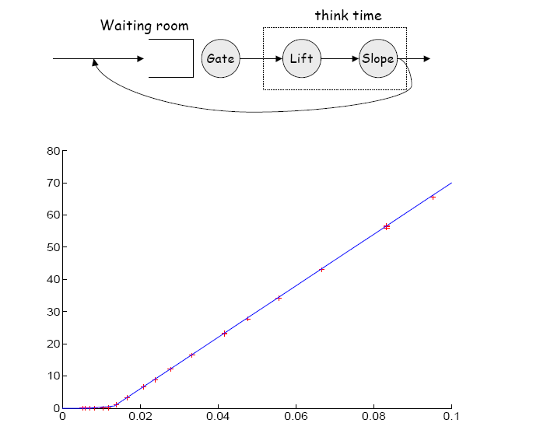
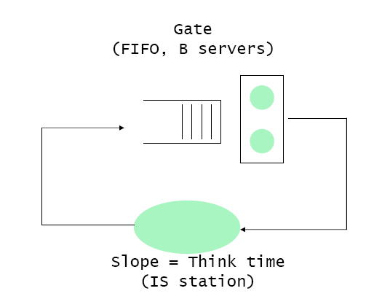
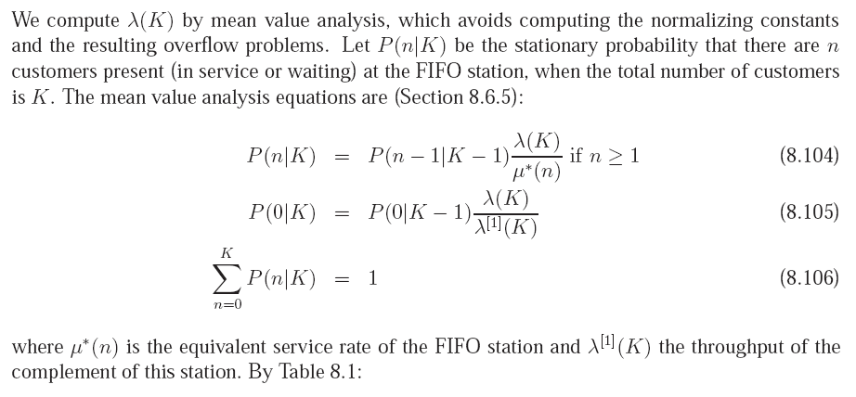

Slide 25
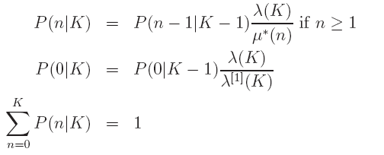
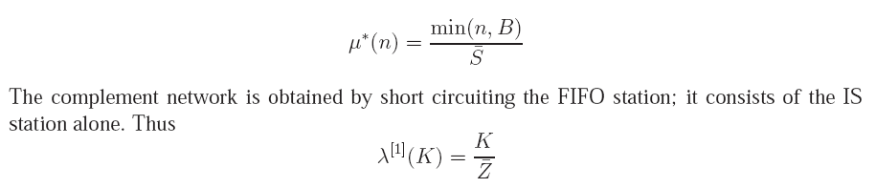

Slide 26
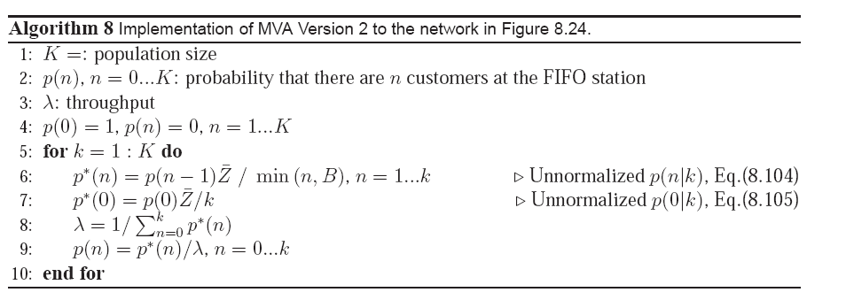

Slide 27
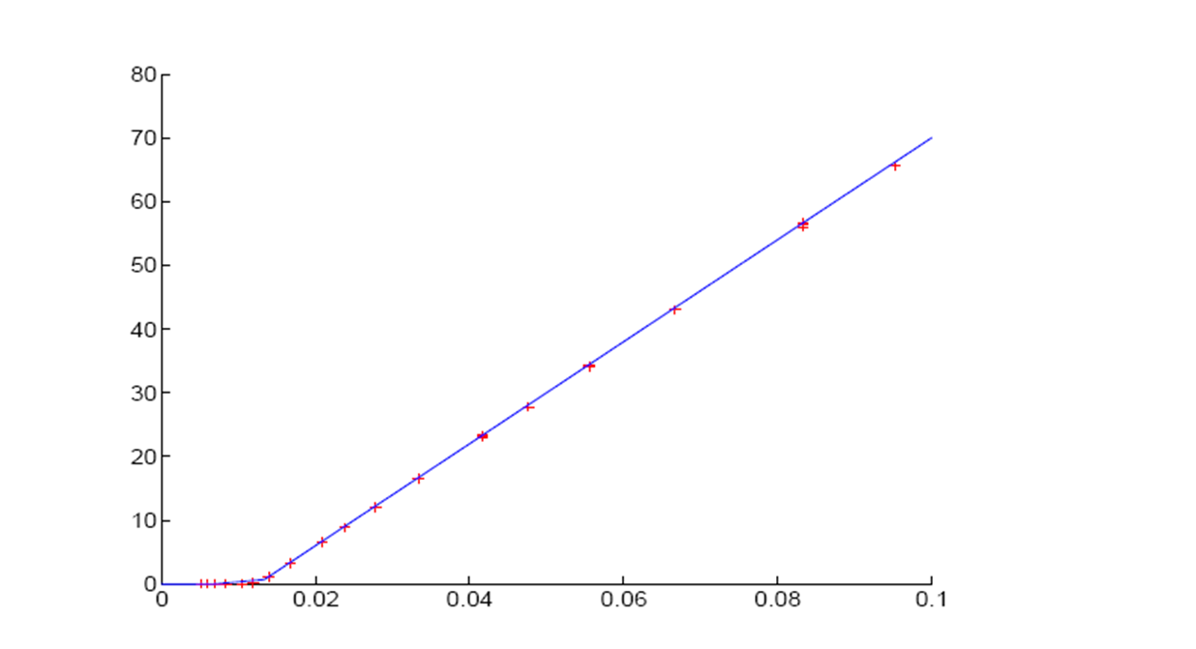


Bottleneck analysis
Waiting time
MVA for various $\overline{S}$ and $B$
$$\frac{1}{c}=\frac{\overline{S}}{B }$$

Slide 28
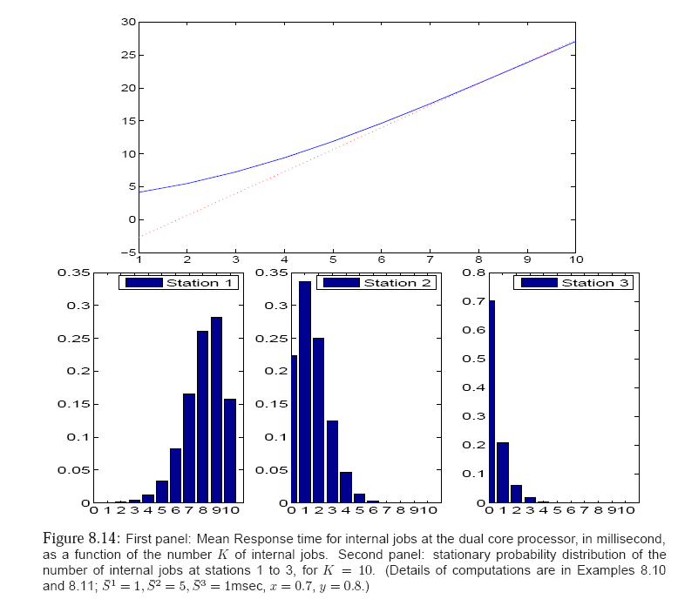

Slide 29
Conclusions
Product-form queueing networks can be analyzed with very efficient algorithms

