Slide 1


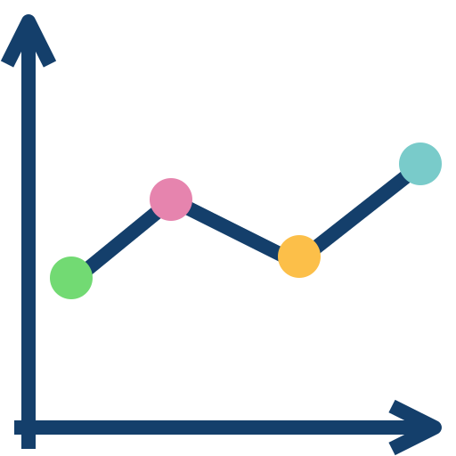
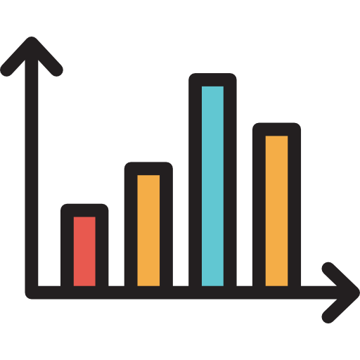
Low-level Visual Analytics Tasks
Plot Type
Plot Difficulty
Retrieve Value
Scatter
Easy Labeled
Easy Unlabeled
Hard Labeled
Hard Unlabeled
Filter
LLM
Compute Derived value
Line
X
Find Extremum
Sort
Determine Range
Bar
Find Anomalies
20 sets of each
Cluster
Correlate

