Slide 1




Plot Difficulty
Plot Type
Plot Difficulty
Low-level Visual Analytics Tasks
Scatter
Easy Labeled
Easy Unlabeled
Hard Labeled
Hard Unlabeled
Retrieve Value
Filter
LLM
Compute Derived value
Line
X
Find Extremum
Sort
Determine Range
Bar
Find Anomalies
20 sets of each
Cluster
SVG Format
Correlate

Slide 2
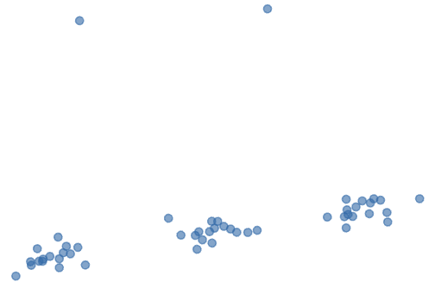
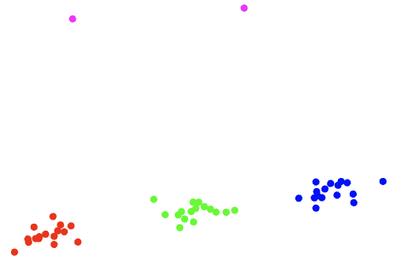
Retrieve Value
Successful responses
Failed response
Cluster
Prompt
<input>: SVG of a scatterplot
<output>: SVG of a scatterplot with clusters highlighted in different colors
Extract the data coordinates…
…
<SVG code of the input chart>

Slide 3
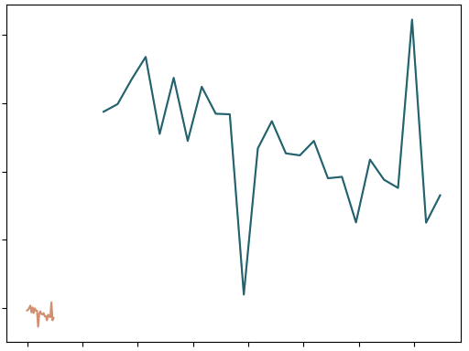
Input line chart
Retrieved line

Slide 4
<input>: An SVG scatter plot with n points.
<output>: SVG code only and no other textual response
Instructions:
Identify the outlier in the scatter plot, defined as data points that significantly deviate from the clusters.
Reconstruct the SVG scatter plot, coloring the outlier with a different color compared to the rest of the points.
Omit the axes, title, legends, and any other unnecessary elements in the reconstructed SVG.
Ensure that the reconstructed SVG contains only the data points, with the same number of points as the input SVG.
Include the necessary shape definitions in the reconstructed SVG code. Please provide the complete SVG code for the scatter plot with the outliers colored differently, without any additional textual response.
<SVG code of the input chart> …

