Slide 1
AI-Optimized Fmax Search
Predicting each device's maximum frequency to cut frequency-search tests by 40%, without risking speed-bin quality
Final project presentation · November 2026
Notes:
This project asks whether measurements a chip already has before its frequency test can tell the tester where to look for Fmax. Short answer: yes. On the supplied dataset the search needs 40% fewer test steps, and no device ends up in a faster speed bin than it can sustain. All numbers come from a synthetic dataset, so they show feasibility, not production savings.

Slide 2
Every device gets a blind frequency search
Test time per voltage / temperature corner
40.5
T = N_{steps} × (t_{switch} + t_{apply})
tests per device
Linear sweep, 1,600–2,400 MHz in 10 MHz steps
Each step reprograms the clock, waits for it to settle, then runs the full pattern set.
The whole search repeats at every corner that defines a speed bin.
Most of that time confirms what earlier measurements (ring oscillators, IDDQ, Vmin) already predict.
6.45
tests per device
Binary search, the production default
Notes:
Fmax is found by trying frequencies until the device fails. Each try costs a clock switch plus a full pattern run, and the whole search repeats per corner. A linear sweep on our grid needs about 40 tries; binary search, the usual production choice, needs six or seven. Every device gets the same blind search, even though the ring oscillators and leakage measured earlier already say roughly where its Fmax is.

Slide 3






Predict where to look, then measure there
1 Measure
2 Predict
3 Bound
4 Search
5 Bin
10 ring oscillators, IDDQ, Vmin and die position, all taken before the search
A linear model estimates Fmax in 1.3 µs per device
Split-conformal 95% interval, about ±48 MHz
Binary search inside the window; extend it if the boundary lies outside
Bin from the measured Fmax with an 8 MHz guard band
Fallback. If a device's measurements fall outside the training distribution (range check or Mahalanobis distance), the prediction is not trusted: the tester skips steps 2–4 and runs the full binary search.
Notes:
The model never decides the bin. It only decides where the tester looks. One: we read the measurements the device already has. Two: the model predicts Fmax. Three: conformal calibration turns that into a 95% interval. Four: the tester binary-searches inside the interval and extends the search if the boundary turns out to be outside. Five: the bin is assigned from what the tester measured, with the usual guard band. Devices that look unlike the training data skip the model entirely and get the normal full search.

Slide 4

6,000 devices, fixed splits, no leakage
Predefined splits, never reshuffled
Model inputs (15)
1,500
500
4,000
ro_01 … ro_10, iddq_norm, vmin_norm, die_x, die_y, radius_sq
Train
Calib.
Test
6,000 rows × 25 columns; all features numeric
Never reach the model (10)
fmax_true_mhz, fmax_pred_mhz, window_low_mhz, window_high_mhz, true_bin_mhz, tests_binary, tests_windowed, fmax_measured_windowed_mhz, unit_id, split
0 missing values, 0 duplicate rows or unit IDs
Supplied speed bins reproduced from Fmax for 99.9% of rows
Enforced in code: a model input containing any of these raises an error.
Notes:
We kept the supplied split: 1,500 devices to train, 500 held back only for calibrating the intervals, and 4,000 for the final test, which nothing was tuned on. The data was clean, with no missing values or duplicates. Leakage was the main risk, because the file also contains the target, an existing prediction and search results. Only the 15 pre-search measurements can reach a model, and the code refuses to train if anything else slips in.

Slide 5
Linear model: as accurate, far faster
0.941
R² on the held-out test split
25.4 MHz
RMSE, about 1.3% of Fmax
1.3 µs
per device: 7–43× faster than the tree models
Notes:
We compared four model families. All were selected using five-fold cross-validation on the training split only; the test split was never used to choose. They land within about one and a half megahertz of each other, and the plain linear model was slightly the best. Since it is also seven to forty times faster at inference and easy to embed in a test program, it is the one we ship. For reference, the prediction already supplied in the dataset scores 26.9 MHz.

Slide 6

Calibrated windows with a safe way out
Conformal prediction interval
Out-of-distribution fallback
94.7%
0.6%
of true Fmax values fall inside the 95% interval
of test devices routed to the full binary search
Width about 97 MHz (±48 MHz), roughly 10 tester steps. Calibrated on 500 devices the model never trained on.
Range check plus Mahalanobis distance. It caught 79% of devices given a synthetic ring-oscillator shift.
Notes:
A point prediction alone isn't enough to steer a tester. Split conformal prediction gives a window with a coverage guarantee: we asked for 95% and got 94.7% on unseen devices. The window is about 97 MHz wide, so the search inside it is short. The second safeguard is the out-of-distribution check. Devices whose measurements look unlike training data, about 0.6% of the test set, skip the model and get the normal full search.

Slide 7
40% fewer tests than binary search
6.45 → 3.87
tests per device, per corner
194 → 116 ms
at 25 ms pattern + 5 ms clock switch per step
0
over-bin escapes; measured Fmax matches binary search accuracy
Notes:
All strategies ran on the same 4,000 devices with the same noisy simulated tester. Binary search needs 6.45 tests; the deployed flow, model window plus fallback, needs 3.87. That is 40% less, comfortably past the 30% target. The 95th percentile is 4 tests, and only 4% of devices needed the window extended. A linear sweep, not shown, needs 40.5. Accuracy and binning are unchanged because the answer is still a measurement.

Slide 8
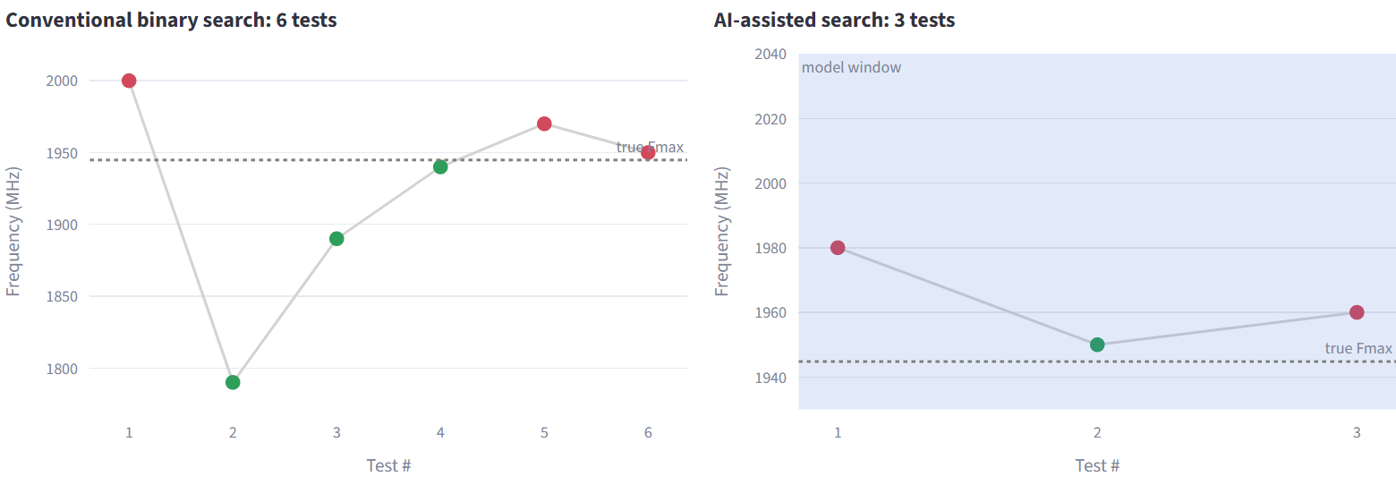
One device: 6 tests become 3
Device U02001 (true Fmax 1,944.8 MHz), from the dashboard's device explorer. Green = pass, red = fail. The model's window (shaded) starts the search next to the boundary. Tester noise makes the two final readings differ by one step, but both land in the same 1,900 MHz bin.
Notes:
Here is one real device from the test set. Binary search starts at the middle of the full range and needs six tries. With the model, the first try is already inside a 110 MHz window around the boundary, and three tries are enough. The readings differ by one step because the simulated tester has 4 MHz of noise; that's exactly what the guard band is for, and both put the device in the 1,900 MHz bin.

Slide 9




What 2.6 fewer steps per corner is worth
3.1 s
17,200
$248k
saved per device
tester-hours per year
per year in tester time
Illustrative only. Uses the technical document's example: system-level test at 3 voltage corners, 0.4 s per step, 20 million devices a year and $0.004 per tester-second, with the 2.58-step saving measured here. Substitute product values before quoting any figure.
Notes:
To put the step saving in context, we plugged it into the cost example from the technical document. At system-level test, where each step takes almost half a second, 2.6 steps saved at three corners is about 3 seconds per device, which at 20 million devices is around seventeen thousand tester-hours and a quarter of a million dollars a year. These are the document's illustrative assumptions, not measured production figures.

Slide 10
Bins come from measurements, not predictions
Measured flow (deployed)
0
over-bin escapes in 4,000 devices
Cost: 9.5% of devices sit one bin low, the same as plain binary search under the 8 MHz guard band.
Prediction only
9.6% over-binned with no guard band. Removing every escape needs 3σ, which pushes 72% of devices into a lower bin.
Notes:
Why not skip the test and bin straight from the prediction? The chart answers that. With no margin, almost one device in ten would be sold as faster than it is. Pushing that to zero takes a three-sigma margin, which drops nearly three quarters of devices a bin. Our flow avoids the trade-off: the bin comes from the tester's measurement, and we saw zero over-bin escapes.

Slide 11
Five of six acceptance targets met
Criterion | Target | Result | Status
Regression R² | ≥ 0.90 | 0.941 | Met
Prediction-interval coverage | ≈ 95% | 94.7% | Met
Test iterations vs binary search | ≥ 30% fewer | 40.0% fewer | Met
Speed-bin accuracy | ≥ 95% | 90.5% | Not met
Data leakage | None known | Allowlist enforced in code | Met
Fallback mechanism | Tested | 79% of shifted devices caught | Met
Bin accuracy is limited by the guard band, not the model. The 8 MHz margin absorbs tester noise; plain binary search also scores 90.5% under the same rule. With no guard band accuracy reaches 97.3%, but 1.4% of devices over-bin.
Notes:
Against the PRD, five of six targets are met on the held-out test split. The one miss is speed-bin accuracy at 90.5%. That number is identical for plain binary search, so it isn't the model: it's the 8 MHz guard band, which deliberately drops devices just above a bin edge one bin to protect against tester noise. Hitting 95% would mean shrinking that margin, and the data shows that lets real over-bin escapes through. That's a product decision, not a modelling one.

Slide 12
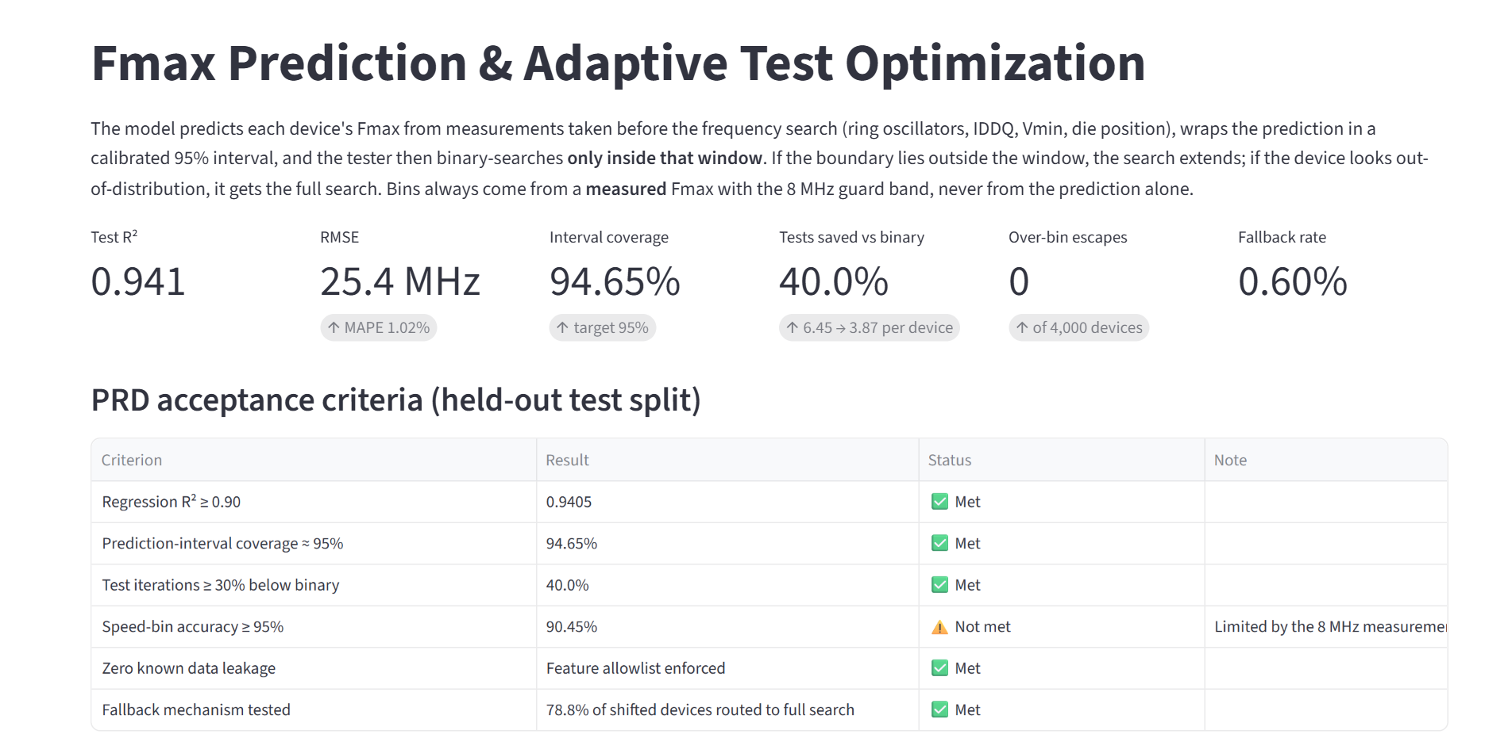





What was delivered
Pipeline
python -m fmax.pipeline: validate, train, calibrate, benchmark
REST API
FastAPI: /predict, /simulate, /metrics
30 automated tests
Validation, leakage, search, conformal, API
Versioned artifacts
Model bundle, metrics, per-device results, report
Streamlit dashboard, overview page: 9 pages covering models, uncertainty, search, binning, a device explorer and live prediction.
EDA notebook
Distributions, correlations, wafer map
Notes:
Everything is reproducible from one command. The pipeline validates the data, trains and compares the models, calibrates the intervals, runs the search benchmark and writes the report. The dashboard is the main way to explore the results, including a per-device view of every search. The same model is served by a small REST API, which is how a tester cell would ask for a window. Thirty automated tests cover the risky parts: leakage, search correctness and the fallback.

Slide 13

Limitations and next steps
Limitations
Next steps
Synthetic data: the monitor–Fmax relationships and noise levels are assumptions
One voltage / temperature corner simulated
Zero escapes in 4,000 devices only bounds the rate below ~750 ppm (95% confidence)
The 95% bin-accuracy target needs a product decision on the guard band
Shadow mode on real lots: predict, but keep the reference flow
Audit sampling: about 60 fully searched devices per monitoring period
Drift monitoring: residual EWMA, feature PSI, live coverage
Reuse the window across voltage corners for further savings
Notes:
The main limitation is the data: it is synthetic, so these numbers show the method works, not what a real product will save. We also simulated a single corner, and 4,000 devices can't demonstrate a parts-per-million escape rate. The path to production follows the technical document: run the model in shadow mode on real lots, keep a small audited sample on the full search for unbiased monitoring, watch for drift, and then extend the windows across voltage corners.

