Slide 1
Business Exchange Services (BES)
Overview

Slide 2
DXC’s Proven Service – Business Exchange Services
One of the largest, mature, EDI outsourcing solutions in the world
25+ years of EDI and EDI expertise
160+ EDI professionals (average experience >13 years)
1,750+ clients in over 20 countries
160,000+ trading partners
3 Billion+ mission critical documents per year
EDI and Integration skills
Multi-vendor consulting (OpenText/GXS,
IBM Sterling, Seeburger, Axway, Software AG,
Oracle, Edifecs, Sybase, etc.)
Listed by Gartner as an integration brokerage product (https://www.gartner.com/reviews/market/integration-brokerage)
Standard global delivery processes
Service depth – consulting through operations
Unsurpassed service excellence - leveraged,
high-availability, 24x7 support
EMEA
AMERICAS
Warrington, UK
Leixlip, Ireland
BES EMEA Platform
BES Energy Platform
APJ
Oshawa, Ontario
BES Canada Platform
Antwerp, Belgium
Tulsa, Oklahoma
BES GSP (Commercial EDI) Platform
BES MFT Platform
Böblingen, Germany
Pune, India
Bangalore, India
Zaragoza, Spain
Manila, Philippines
Plano, Texas
BES Healthcare Clearinghouse Platform
BES GSP (Commercial EDI) Fail-over Platform
BES MFT Platform
Client
Suppliers
Customers
DXC BES
Notes:
Down the left side you can see some stats and information about the BES team
Point out:
Gartner’s ranking of BES in the “challenger” quadrant for Integration Brokerage providers
And ranked BES #2 in market share for Integration Brokerage providers
the average years of experience that team has (mature expert staff)
Staff has grown up in the automotive manufacturing space
On the right you can see the BES global footprint and where our system are hosted and where we have support teams.
Point out:
ELIT MFT is in Plano and Auburn Hills and that is also where our commercial EDI platform is hosted
ELIT (with all of its GM and supplier connections) is the transport for our EDI platform
Also have a large presence in European and Asia Pacific regions

Slide 3

































































BES Serves Many Global Enterprises
DXC Internal Use Only

Slide 4








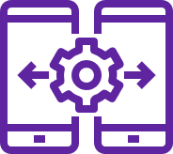



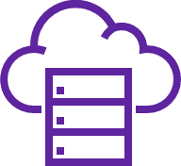



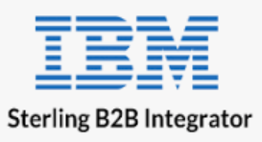


Trading Partner EDI Integration for Mission-critical Processes
Business Exchange Services
Managed File Transfer
Managed EDI
VAN
Global Standards Libraries
Any-to-any Translation
Monitoring & Support
Data Stores
Split & Merge
Customers
Onboarding
Smart Validation – Auto Exceptions
Pre/Post Processing
Middleware
Security Protocols
Suppliers
Cloud Scalable
Mapping Factory
Flexible Connectivity
iPaaS
Banks

Slide 5
BES Solutions and Value Provided
bes-sales-support@dxc.com
Solution | Description | Key Value | Other Benefits
Managed File Transfer (MFT) | Connect reliably and securely to VAN and Internet trading partners | Cost Reduction - 40-80+% reduction in TCO of EDI communications | Reduced complexity; integrates seamlessly with most protocols
File eXchange Service (FXS) | Secure human-to-human file sharing | Eliminate security breaches of ad-hoc file transfers | Fast setup; high-speed ad hoc file transfers of large and confidential files
EDI Managed Service (Fully leveraged & Hybrid) | Migrate EDI processing to DXC; send and receive ERP data over a single connection – DXC translates and connects the trading partners and supports end-to-end including e-Invoicing compliance. Leveraged as well as dedicated platforms available. | Cost reduction - 20-40% reduction in TCO of EDI operations | Op Ex vs. Cap Ex; modernization; standards, DRP; scalability
Dedicated EDI Service (SEEBURGER) | Dedicated and bespoke EDI or File-Transfer solutions based on SEEBURGER Software, on-premise or in the cloud | High levels of flexibility and customization opportunities to met specific company and industry needs | Industry specific configuration frameworks. Tools for partner self-service, partner management and migration
Trading partner EDI enablement | Web/mobile tools for smaller trading partners to use clients’ more automated EDI channels, also providing light integration via CSV | Cost reduction - automates “the long tail” that otherwise tends to generate out-sized error rates and support calls. | Provides an efficient channel for on-going communications with hundreds or thousands of smaller trading partners, self-serve platform.
Trading community onboarding and management | Accelerated, managed campaigns to onboard hundreds/thousands of client trading partners via self-serve portals and support staff. | Speed-to-value – realizing automation savings sooner.

Slide 6
Operational Models
Fully Managed EDI
Hybrid EDI
Dedicated EDI
Shared EDI Service Management & Onboarding
Dedicated EDI Service Management & Onboarding
Shared EDI Development
Dedicated EDI Development
Shared DXC Partner Apps
(Multi-tenant)
Dedicated DXC Partner Apps
(Single-tenant)
Dedicated Apps
(Single-tenant, DXC or Client)
“Any” EDI*
Shared DXC Infrastructure (Cloud)
Client or DXC Infrastructure
*Not technically any EDI software, but the vast majority of common EDI products in use today

Slide 7
EDI Challenges Typical in the Industry
M&A activity leaves an EDI landscape of under-utilized, fragmented and non-standard EDI systems and operating environments
Out-dated and/or un-supported EDI software, lacking key features the business needs
Unable to scale, extend, and/or add new trading partners or functionality as fast as needed
Inconsistent Security policy implementation – security holes abound (FTP, clear text transfers)
Weak or non-existent Disaster Recovery and Business Continuity plans and capability
Inconsistent monitoring – lack of end-to-end process visibility, and resulting process failures (lost $)
Inconsistent service levels between different EDI programs in different parts of the company
Redundant staff – EDI skills are scattered across people in too many different groups
Difficulty finding staff with the right software skills
Old VAN contracts with costs well above current market rates
Ineffective or absent visibility and governance – limited or no ability to provide EDI program oversight
Resulting in Poor Performance and High Cost

Slide 8
The case for EDI Managed Service
What you get
A single global EDI operating environment
Modern, flexible EDI software
Leveraged EDI “Center of Excellence” for well-trained, available, best-shore staff
Built-in redundancy and fail-over
Transparent technology re-fresh
Global governance, control and visibility
Effective trading partner on-boarding and management
Consistent service levels
Consistent security policies
Why it matters
Lower TCO by 20-40% - Better and leveraged utilization, eliminated capital expenditures (hardware, software), leveraged best shore staffing, and EDI traffic consolidation
Better ability to support growth and new business requirements
Fewer process failures – proactive monitoring and end-to-end visibility
Better overall performance through a leveraged, scalable platform
Improved trading partner relationships, and happier internal and external customers
Lower business risk through consistent SLA, standard security practices and DRP
Resulting in Performance Improvement and Lower Costs

Slide 9
BES EDI Framework – A Multi-Enterprise Collaboration Service
Manage Visibility and Intelligence
Manage Process
Manage
Partner
Process Catalog
Rules Management
Process Monitoring
Process Presentment and Integration
Profile Management
Manage and Integrate Data
Onboarding
Tracking and Reporting
Application Integration
Translation EDI, XML, Any-to-Any
Transformation
Validation
Training
Compliance Certification
Exception Management
Connect Partner and Deliver Data
Termination
Reliable
Secure
Scalable
Multi-Protocol Support
SLA and Score Carding
Service and Support
24 x 7 x 365
Service Level Management
Proactive Monitoring
Billing and
Reporting
Scalable Infrastructure
Security and Profile Management

Slide 10
DXC Global Shared Platform (GSP)
Benefits
Lower Total Cost of Ownership by 20%+
Ability to scale up and down at will
Better ability to support new business requirements
Better overall performance by SLA
Lower business risk and exposure
Improved trading partner relationships, and happier internal and external customers
DRP/Site redundancy
Cloud based
High availability
CMMI3 - ISO9001
2 Client environments (Test/Prod)
Sterling Integrator
ITIL - SAS70
2 DXC environments (Integration/QA)
Implementation methodology
Clustered
Pre-built processing flows
Global support
BES Service management
Self-serve portal, help desk, CSM

Slide 11
BES’ Translation Platform
Data Processing System
Translations processed within SEDIi
Pre and Post processes external to SEDIi
Tracking and Reporting System
External to SEDIi
Events provided by all application components
System Services
Archive
Backup and Recovery
Disaster Recovery
Monitoring
Optional Services
Trading Partner Community Management
EDI Process Visibility
Environments
Production
Model Office / Disaster Recovery
Quality Assurance
Integration
Development
Notes:
This is our Commercial EDI translation platform
Fully Managed Service that not only does translation, but also provide Trading Partner Community Management and EDI Process Visibility as well as the other services listed across the bottom of the picture
On monthly basis the BES EDI platform, GSP, currently process’s approximately 60,000 files, 22 million kilo characters and containing about 7.8 million documents per month.
Examples of pre/post processing - decryption/encryption, xml to csv conversion, unzip & zip of files
GM in 2004 did on average about 83,000 Kilo characters per month for indirect EDI
840 REQUEST FOR QUOTE
843 RESPONSE TO REQUEST FOR QUOTE
850 PURCHASE ORDER
860 PURCHASE ORDER CHANGE REQUEST
997 FUNCTIONAL ACKNOWLEDGEMENT
List of GSP clients (as of January 2018)
Avery
Convenience Pay (Fiserv)
Decor-Rest Furniture
Marzilli International (div. of Decor-Rest)
Hitachi
INCS
KBR Inc.
McCain Foods
Mitsubishi Motors NA
North Star BlueScope Steel
Reichhold Chemical
Russel Metals
Satpanth Capital
STI - Specialty Textiles, Inc.
Brentwood (div. of STI)
Thomas Built Buses
TOPS Markets
University of Western Ontario
Vitafoam

Slide 12

BES Managed File Transfer Network (MFT Network)
In commercial operation for more than 25 years
Supports all common connection types, protocols & networks
MFT
Network
Global reach
23 commercial VAN interconnects
1000+ Clients
Proactive monitoring & resolution handling
65,000+ network nodes
24/7 365 days a year client & partner support

Slide 13
MFT Network and Protocol Support
VAN Service Interconnects
Commerce Solutions
Covisint
Descartes
DINET
EasyLink
EC/EDI Inc.
ECOM Systems
EDICOM
Embratel
Emergis
OpenText (formerly GXS)
IBM Sterling Commerce (Ordernet)
I-Connect
VAN Service Interconnects (continued)
Intertrade
Kleinschmidt
Loren Data
Liaison (formerly Nubridges, MCI Worldcom, BT Tymnet)
Promethean (was ECEDIVAN)
RailInc
Softshare
Sterling Commerce (Ordernet)
Transentric (formerly UP Technologies)
York Worldwide
Ford
Chrysler (FCA)
Protocols*
AIAG E5 or E5 2000
AS2
FTP
SFTP
FTP/S
HTTP
HTTPS
MFT (proprietary)
RFC 1867 File Transfer over HTTPS
SOAP/HTTPS
X12.56
Cisco (proprietary)
*Key and certificate management handled by BES

Slide 14
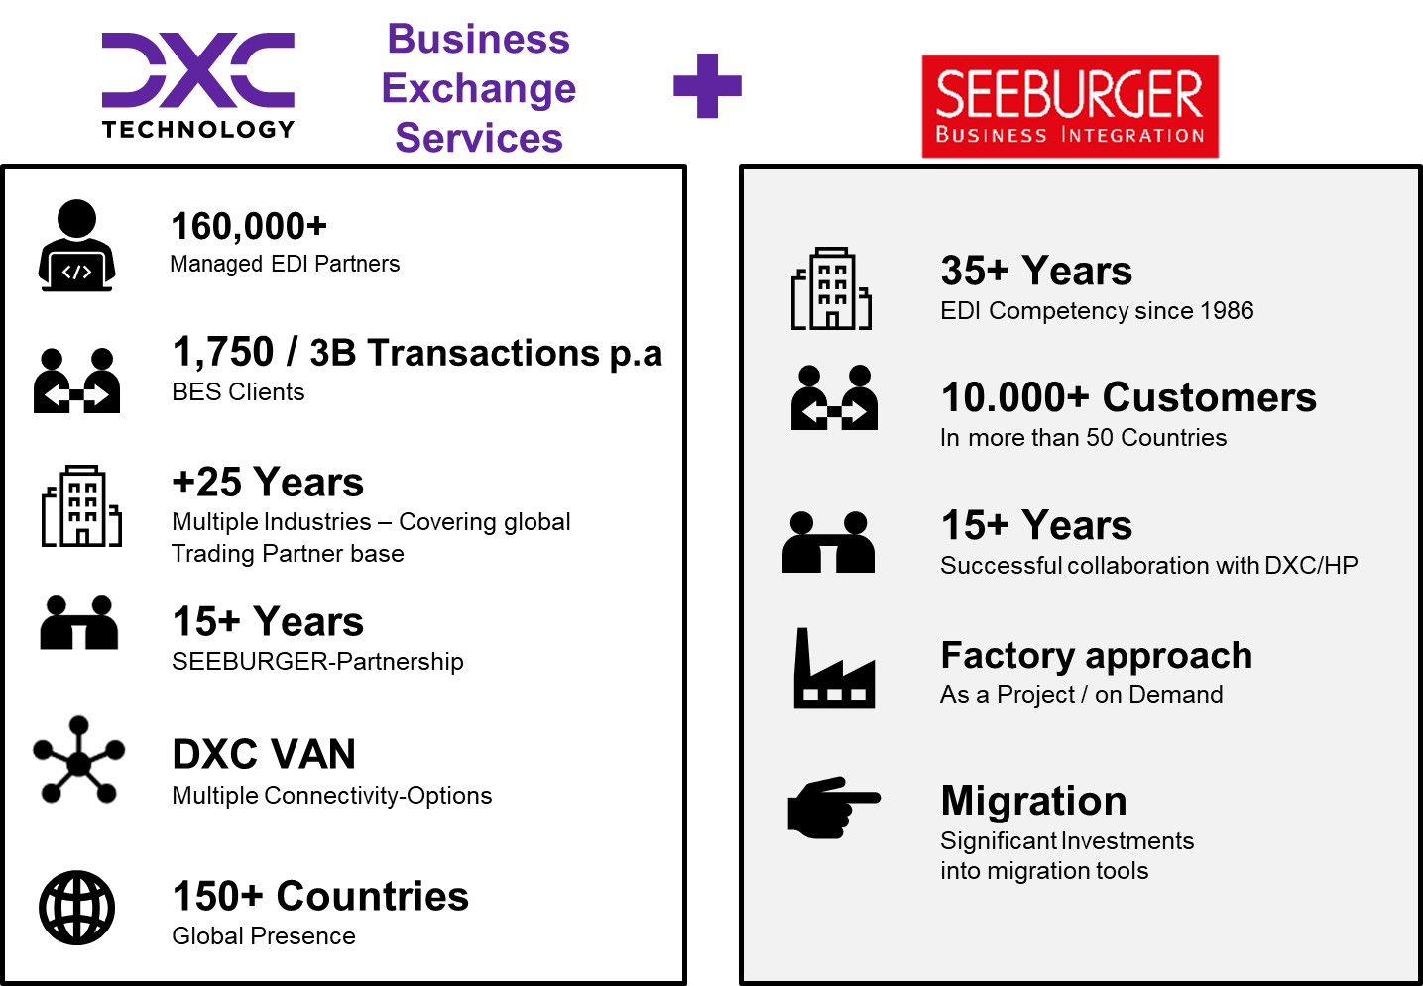
DXC BES SEEBURGER COE
Key services and solutions
EDI
20+ Years creating and running EDI Solutions
MFT
Flexible , customized MFT Solutions
FXS
Human-to-human secure file exchange
Migrate
Proven capabilities to replace your legacy EDI solution with state-of-the-art software
Run
We support your environment cost-efficiently and with highest quality
For dedicated and bespoke SEEBURGER integration solutions:
EDI, MFT, File Exchange – on-premise or in the cloud
Key Differentiators And Value Propositions
We have a global team with 20+ years of EDI/B2B and 15+ years experience on SEEBURGER products
As part of the DXC Business Exchange Services (BES) organization, we have access to 200+ further integration experts across the globe
We run DXC’s own EDI and MFT environments with the same products and expertise as we use with our clients
In close partnership with SEEBURGER, we modernize your Integration environment, using state-of-the-art technologies and tools
We have the experience and tools to guide you and your trading partners through this migration, utilizing self-service and other proven migration techniques
We implement proven best-practices and processes to improve compliance and long-term supportability
We adjust to your hosting and operations preferences. From on-premise to public cloud, from managed service to self-supported
Security, High Availability and DR are at the center of our solutions
We have the expertise and experience in managing operations to provide the highest quality of support for your environment

Slide 15
Customer Case Study: Major Office Supplies CPG
BUSINESS PROBLEM
Aging EDI environment - required investment in platform and software. Outages were happening frequently and causing business impact (missed transactions).
Costly Support - system required resources skilled in EDI, communications, mapping, testing and troubleshooting.
Growth - Trading Partners were requesting EDI compliance and EDI was expected to grow 200% within the next two years.
Expanding Capabilities – Trading Partners were requiring new technologies such as XML translation, flat-to-flat translation and non-VAN communications which required custom connectivity protocols and interaction models.
SOLUTION VALUE
Cost Reduction – The company selected Business Exchange Services (BES). After migrating to the EDI Outsourcing solution, the client’s overall costs dropped by 44%.
Smooth migration – Leveraging BES’ proven methodology, project management and EDI skilled resources, the company experienced a smooth transition to the new environment without any business impact. The client was able to meet new requests from Trading Partners because they had access to the large pool of BES skilled resources.
Consistency and flexibility – The company gained consistency in service levels and security, as well as improved capabilities and flexibility to support changing business needs.

Slide 16
Thank you.
DXC Business Exchange Services (BES)
Americas Contact:
Mats Jansson
mats.jansson2@dxc.com
+1.916.220.0224
EMEA/AP Contact:
Stefan Ceulemans
stefan.ceulemans@dxc.com
+32 15 794 162

Slide 18

How Clients make use of DXC BES: Use Case 1 - Consolidate trading partner communications with MFT Network
MFT Network Support, Portal and Reports
Client Trading Partners
BES MFT Network
Listen/Connect
Receive data
Transform/Process
Connect/Deliver data
Notify Exceptions
Client
EDI Apps
Business Applications

Slide 19
How Clients make use of DXC BES: Use Case 2 – Migrate all EDI processing to EDI Managed Service
EDI Managed Service Support, Portal and Reports
Client Trading Partners
EDI Managed Service
Listen/Connect
Receive data
Transform/Process
Connect/Deliver data
Notify Exceptions
Client
Business Applications

Slide 20
Benefits
 | Use Case 1 – MFT Network | Use Case 2 – EDI Managed Service
Eliminate or reduce VAN bills | Yes | Yes
Eliminate special comm (AS2+) software | Yes | Yes
Eliminate or reduce business disruptions caused by certificate expirations | Yes | Yes
Reduce in-house EDI work | - | Yes
Eliminate EDI software license costs and associated RDBMS etc. | - | Yes
Re-purpose infrastructure or reduce infrastructure costs used for EDI software | - | Yes
Manage EDI through SLA with trusted partner DXC | Yes | Yes (incl. EDI translation)
Ability to manage growth and changing EDI needs by service request | Yes | Yes (incl. EDI translation)

Slide 21



Some DXC EDI references
Ceva Logistics (GEFCO)
Took over struggling EDI operations in 2015. Extended in 2020, further 5 years.
DXC successfully migrated 600 mappings, 4.000+ physical connections, 20.000+ trading partner relationships.
All EDI activities run 7*24 by DXC
Triumph
DXC executed migration from BIS 5 to BIS 6 in 2015
Operated SEEBURGER BIS Platform since 2015.
Adidas
DXC BES running EDI services since 1999.
All EDI activities run 7*24 by DXC
Partners | >7.600
Maps | >770
Transactions per month | >150 mio
Partners | >2.000
Maps | >750
Transactions per month | >1 mio
Partners | >730
Maps | >780
Transactions per month | >14 mio

Slide 22





BES Automotive Industry Experience
BES roots
Automotive network
BES roots are in automotive EDI – we started in the 1980s with large EDI programs for GM (US) and GM Europe (Opel-Vauxhall-Saab)
DXC supports active EDI links to all major automotive OEMs and Tier-1 suppliers including:
OEMs: GM, Opel, Vauxhall, Holden, Ford, Chrysler, Peugeot, Citroen, Renault, Audi, Porsche, Seat, Skoda, Volvo, Jaguar Land Rover, Nissan, Toyota, VW, Ferrari, Fiat, Honda, Hyundai, Iveco, Isuzu, Man, MCC, Mitsubishi, Scania, DAF, KIA, Maserati, Caterpillar, CNH, Piaggio ….
Tier 1 suppliers: Delphi, Visteon, Lear, Bosch, Johnson Controls, Dana, Detroit Diesel, Eaton, Karmann, Textron, Denso, Magna, Magneti, Michelin, Motorola, NSK, PPG, Tenneco, Gates, ThyssenKrupp, Tyco, Valeo, Continental AG, ZF Friedrichshafen, …. …. and thousands more
DXC VAN: DXC-owned VAN services
65,000 trading partner end points, 23 Interconnects
Web-Interface for Tracking und Monitoring
All protocols supported
SEEBURGER uses the DXC VAN
+2.000 managed & supported mappings
Supports more than 2.000 EDI translations (maps) for our automotive clients
All common translations from/to Odette, VDA, EDIFACT, ANSI X.12, XML and others
Automotive customer
Automotive customers include GM, Stellantis, SKF, NSK, Gates, Lear, Thomas Built Buses, Allison Transmission, and many others

Slide 23
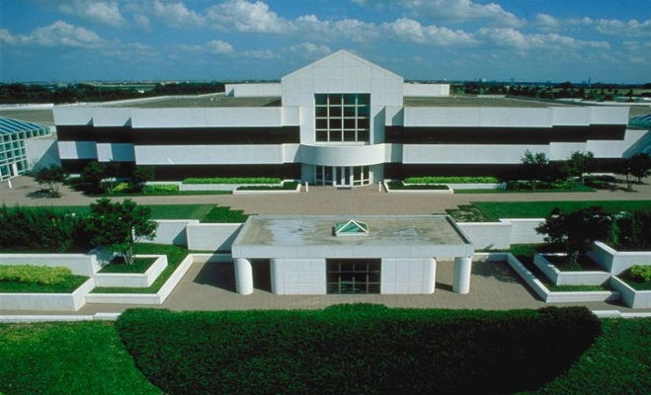
Data Centers/Hosting Facilities
Your Privacy and Security is our #1 Concern
Logical Security
Tulsa, OK and Plano, TX
Data Center Specifications
Root access restriction
Server auditing/scanning
National Computer Security Administration (NCSA) certified firewall security
Firewall management
Digital certificates
Security socket layer (SSL)
Hidden IP addresses
Virtual private networks (VPNs)
Vulnerability assessment scanning
Real-time intrusion detection and response
Structures built to withstand a Force 5 tornado
Dual electrical circuits and dual A/C
Tulsa raised floor: 160,000 sq. ft.
Power source:
2 utility substations
design load capacity in excess of 20MW
Plano raised floor: 243,861 sq. ft.
Power source:
3 utility substations
6-3.2mW generators
Physical Security
Electronic and biometric controlled access
Secure rooms
Security personnel 24 hours a day, 7 days a week
Fire and smoke detection and suppression
Extensive disaster safeguards, preparations, and plans

Slide 24
BES File Exchange Service (SEEBURGER FXS)
File eXchange Service (FXS) is a high-speed managed file transfer service to securely exchange content.
Accessible via a web GUI¹, secure encrypted transfers over HTTPS.
Complies with industry standard security policies.
Any file, any size².
Uses multiple streams to transfer files up to 10 times faster³ than traditional transfer methods (for example FTP/SFTP). Additionally, files can also be compressed in transit.
Resume downloads from last position in the event of temporary network disconnections.
Allows files to be transferred in parallel.
Compartmentalizes the storage of files (only the owner can access their files).
Allows users to create shares, with specific permissions, to share files with other members of their team.
Create temporary transfer permits to exchange content.
¹ A command line tool is also available to script transfers. ² Subject to agreed storage quotas. ³ The speed of transfer is always dependent on local network performance (end to end).

