Slide 1
System Architecture
DDR3
Zynq
AXI
AXI4
Accelerator
AXI
AXI4 Lite
Interrupt
CDMA
AXI
AXI
Data Mover
AXI4
AXI
BRAM Controller
BRAM I/F
BRAM
BRAM I/F
CNN Core
AXI
BRAM Controller
BRAM I/F
BRAM
BRAM I/F
FC Core
AXI
BRAM Controller
BRAM I/F
BRAM
BRAM I/F

Slide 2
1. Accelerator IP Design
Accelerator
AXI4 Lite
1. 곱셈
Data Mover
2. 누산
CNN Core
Kernel
3. 바이어스
Data Mover
4. ReLU, 양자화
CNN Core
Data Mover
FC Core
FC Core
Kernel

Slide 3
1. Accelerator IP Design
i_fmap
Data Mover
BRAM
CNN Core
BRAM
Kernel
i_weight
BRAM
o_result

Slide 4
1. Accelerator IP Design
1st Window
2nd Window
25 clk
[0]
[1]
[2]
[3]
[4]
[20]
[21]
[22]
[23]
[24]

Slide 5
1. Accelerator IP Design
2nd Window
delete
[0]
[1]
[2]
[3]
[4]
[20]
[21]
[22]
[23]
[24]

Slide 6
FIFO
Shift REG
224
32
8
CNN Kernel
200

Slide 7
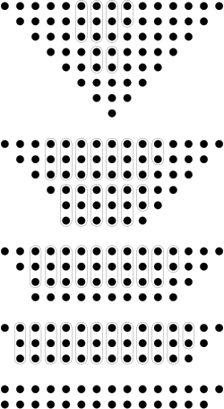
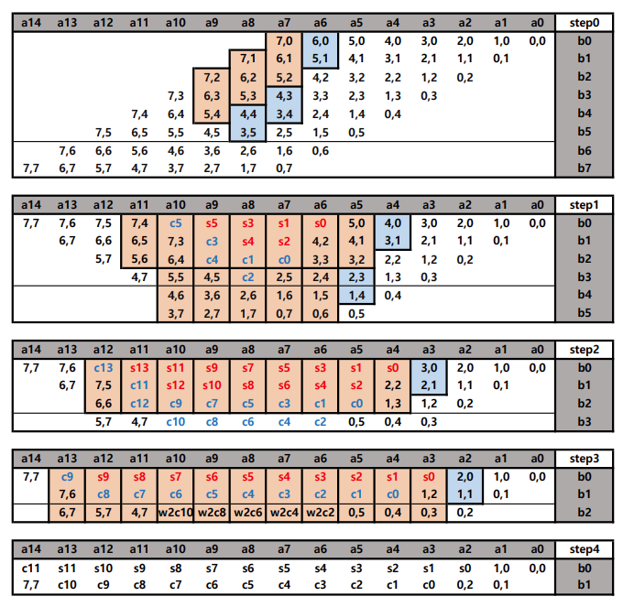

Slide 8
