Slide 1
Estimation of area for REDD+ using stratified sampling estimator: get started with SEPAL
Rémi D’Annunzio
16-19 May 2017, Phnom Penh, Cambodia
remi.dannunzio@fao.org

Slide 2
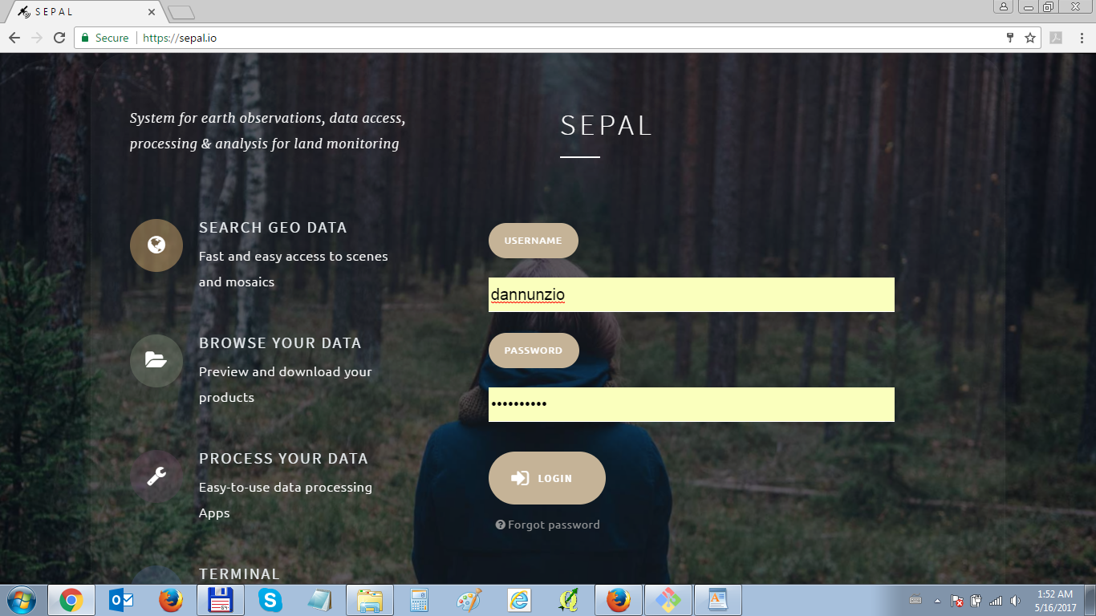
Open https://sepal.io

Slide 3
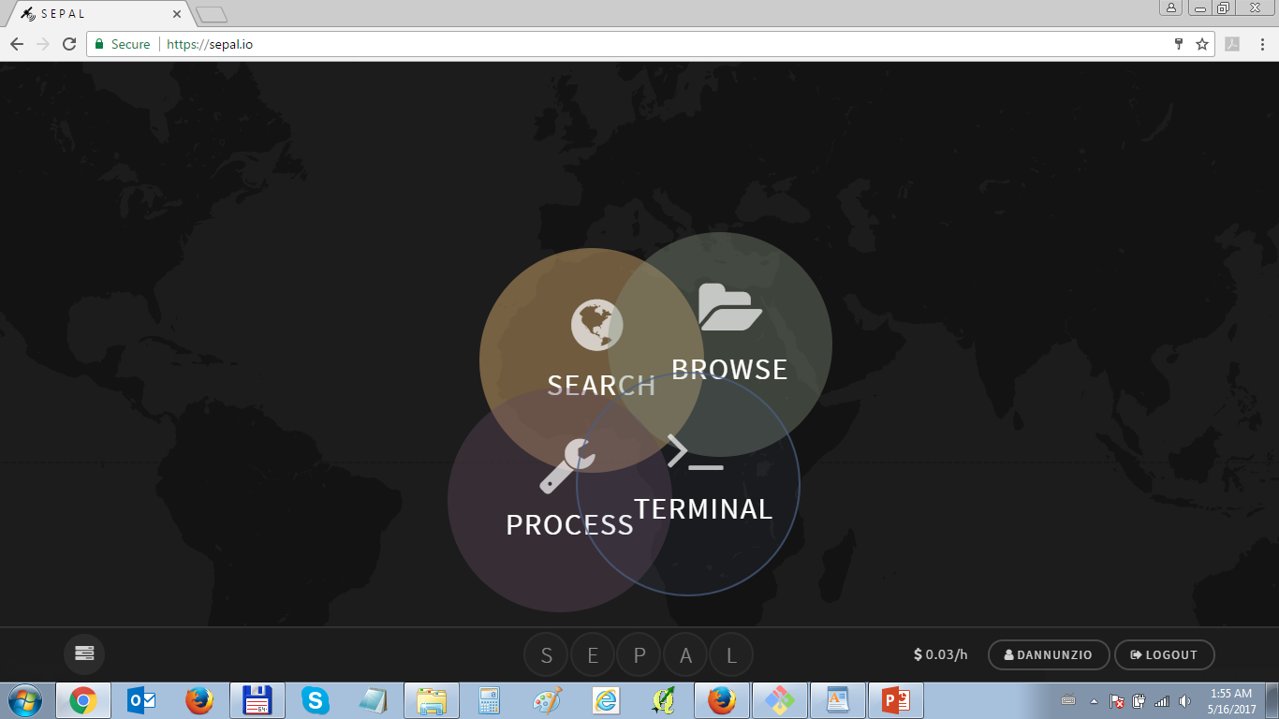
Start the terminal

Slide 4
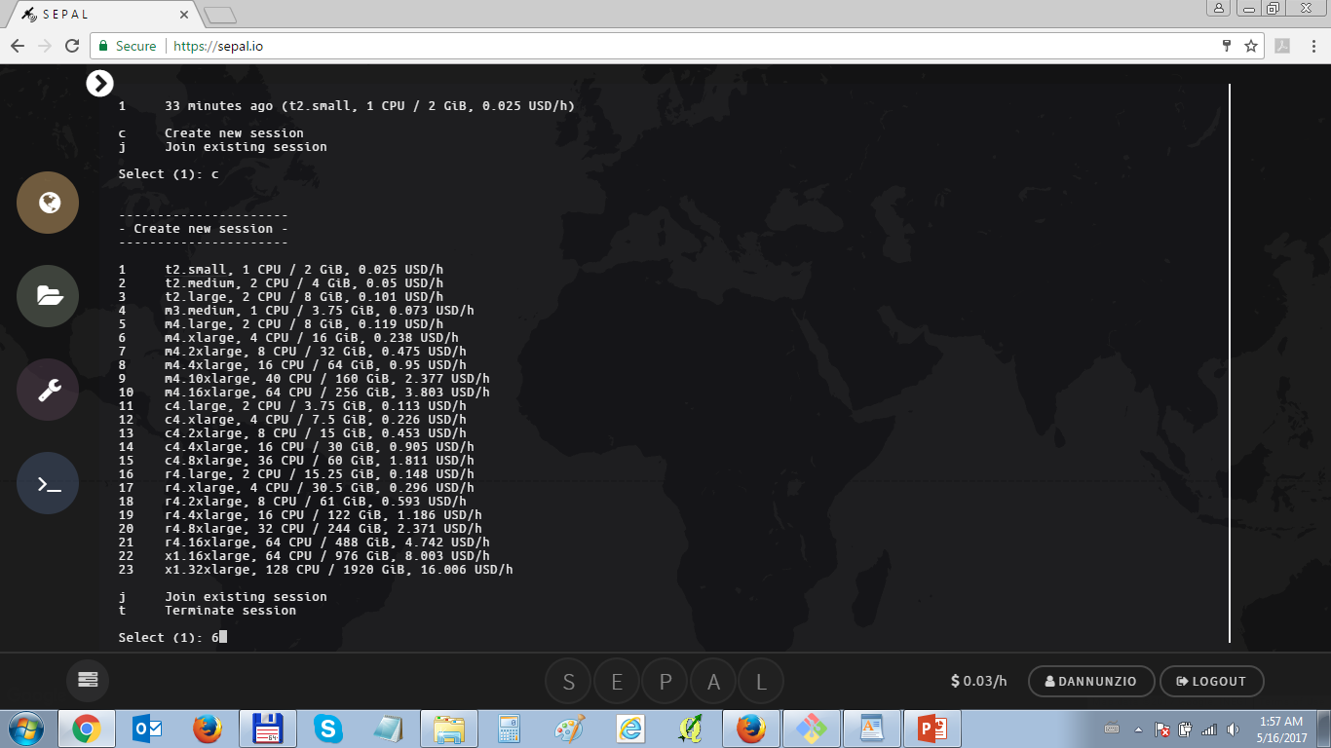
Choose instance #6 (type 6 and press enter)
Check your status by clicking on your username

Slide 5
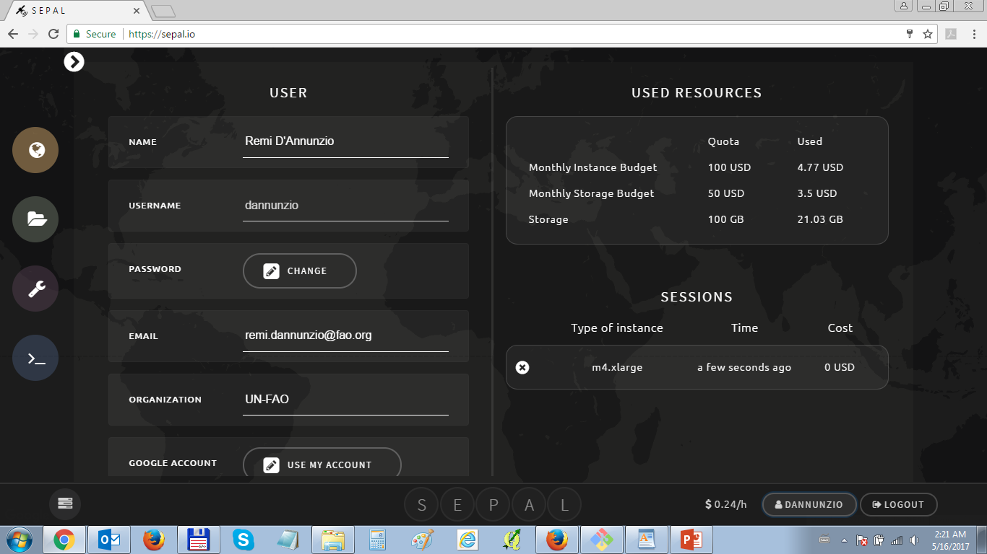
Check your status, budget, parameters

Slide 6
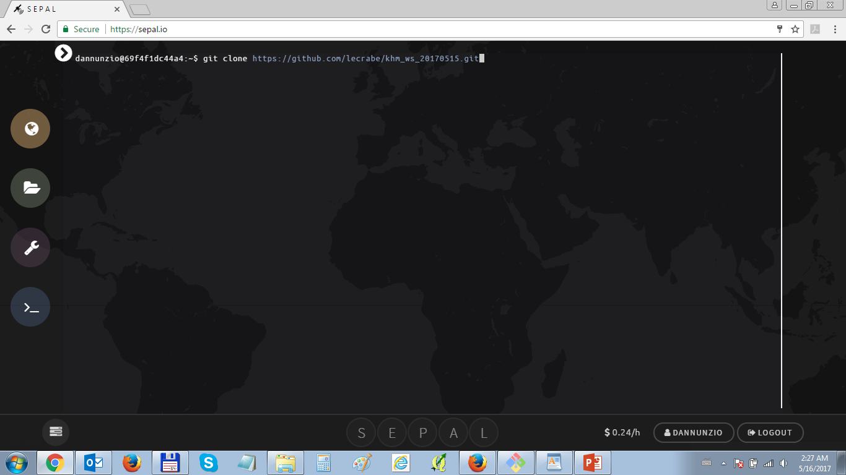
Back in the terminal, clone the GIT repository
git clone https://github.com/lecrabe/khm_ws_20170515.git
Once cloning finished, go to processing

Slide 7
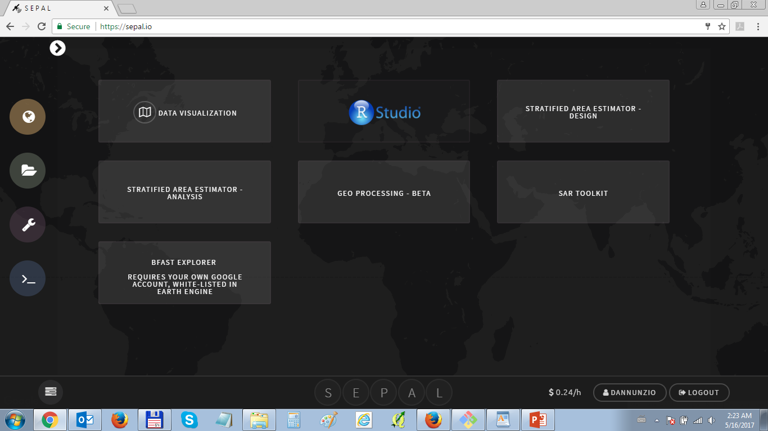
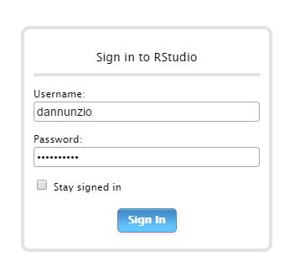
Select RSTUDIO and sign in
Only lowercase here

Slide 8
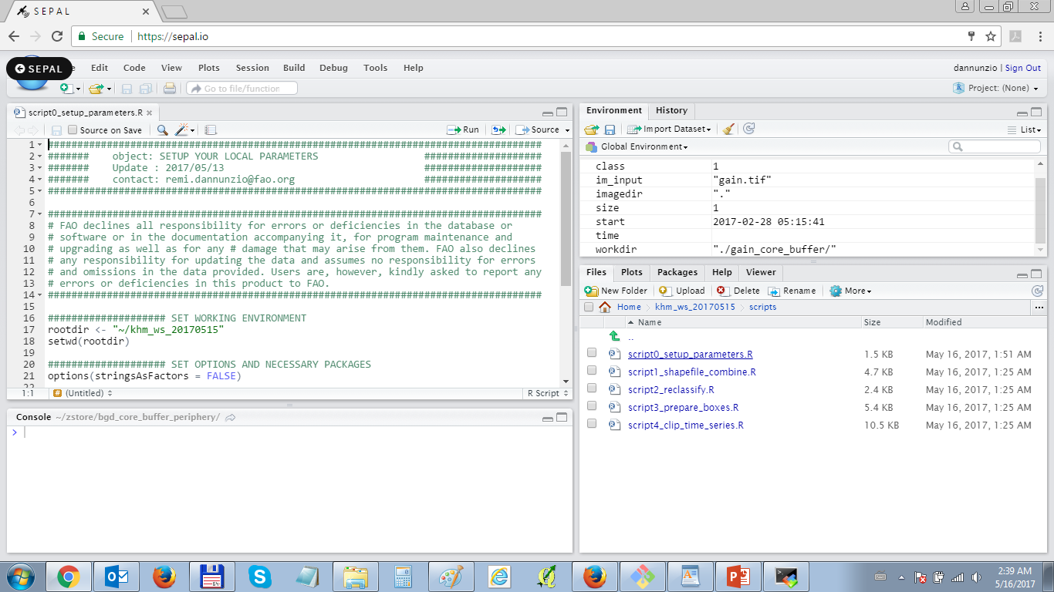
Open the khm_ws_20170515 folder/scripts/

Slide 9
Click on SOURCE to run each script
Script0_ : setup parameters and download data
Script1_ : combine shapefiles into 2-dates raster
Script2_ : reclassify change raster into simplified

Slide 10
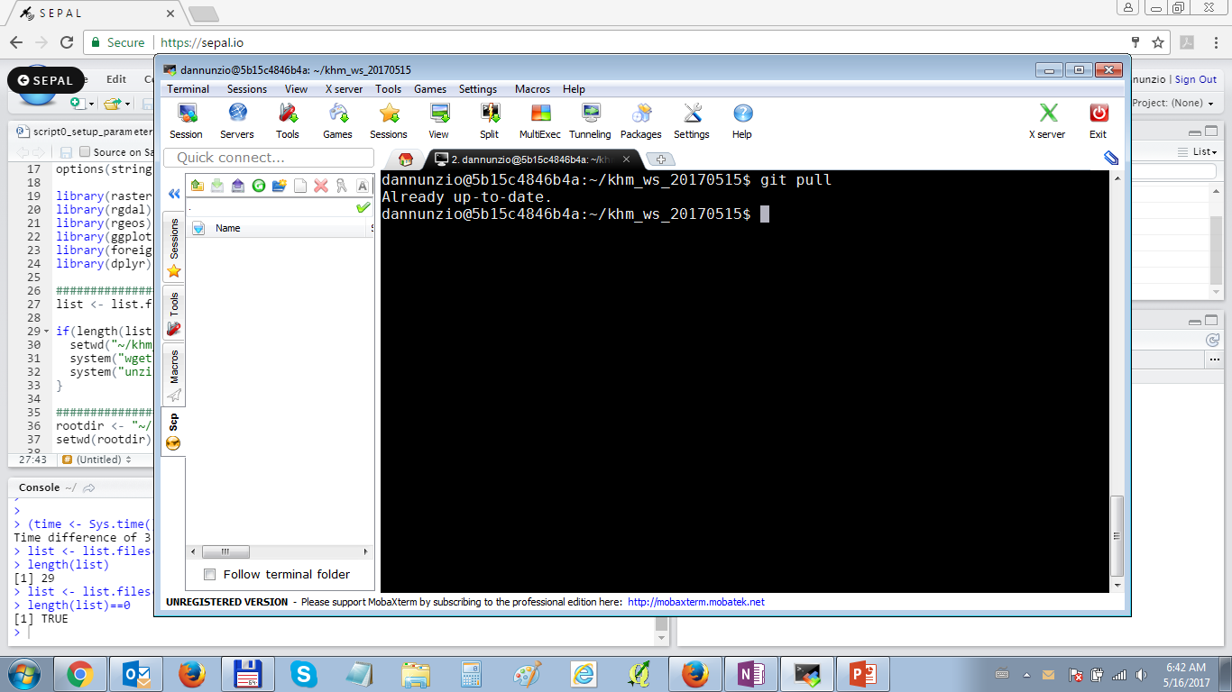
Go back into terminal to update scripts
cd ~/khm_ws_20170515
git pull

