Slide 1
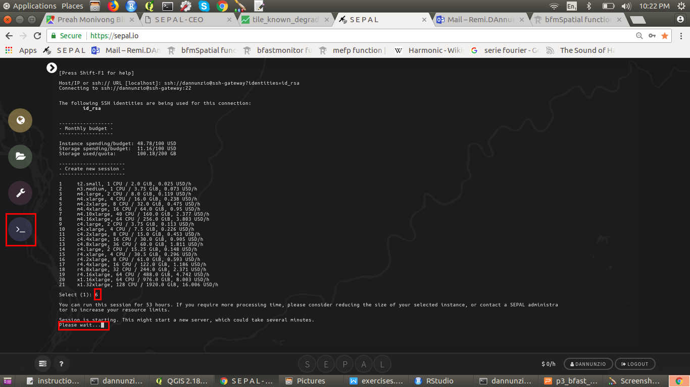


gee - python
api
github.com/openforis
/lecrabe
git pull (terminal)
code.earthengine.
google.com
sepal.io
push
SSH FileZilla
google.drive
(upload Fusion Tables)
(download Results)
git pull
(Github Desktop)
desktop
Very small data flux (scripts)
Small data flux (classification)
Large data flux (satellite images)

