Slide 1
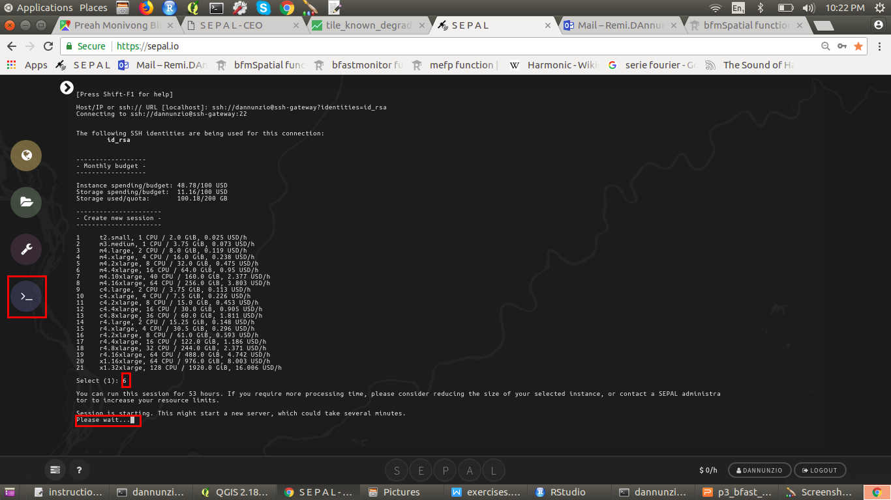


gee - python
api
github.com/openforis
/lecrabe
git pull (terminal)
code.
earthengine.
google.com
sepal.io
push
SSH FileZilla
google.drive
(upload Fusion Tables)
(download Results)
git pull
(Github Desktop)
desktop
Small data flux (~kB, eg. scripts)
Medium data flux (~MB, e.g classification)
Large data flux (~GB, e.g satellite images)

