Slide 1
I only got [15]* slides
* Including the current slide

Slide 2
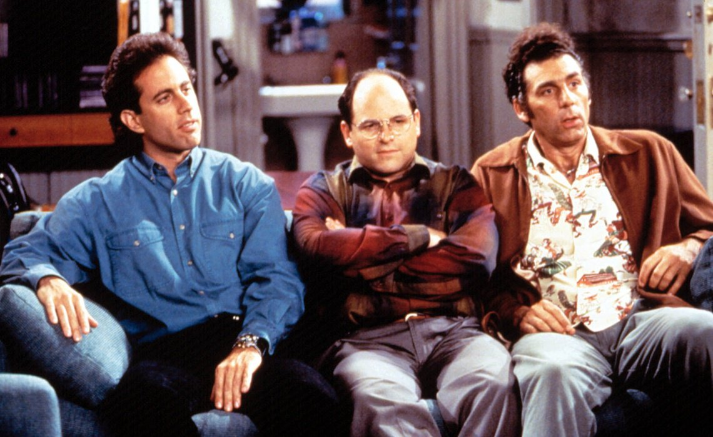

Slide 3
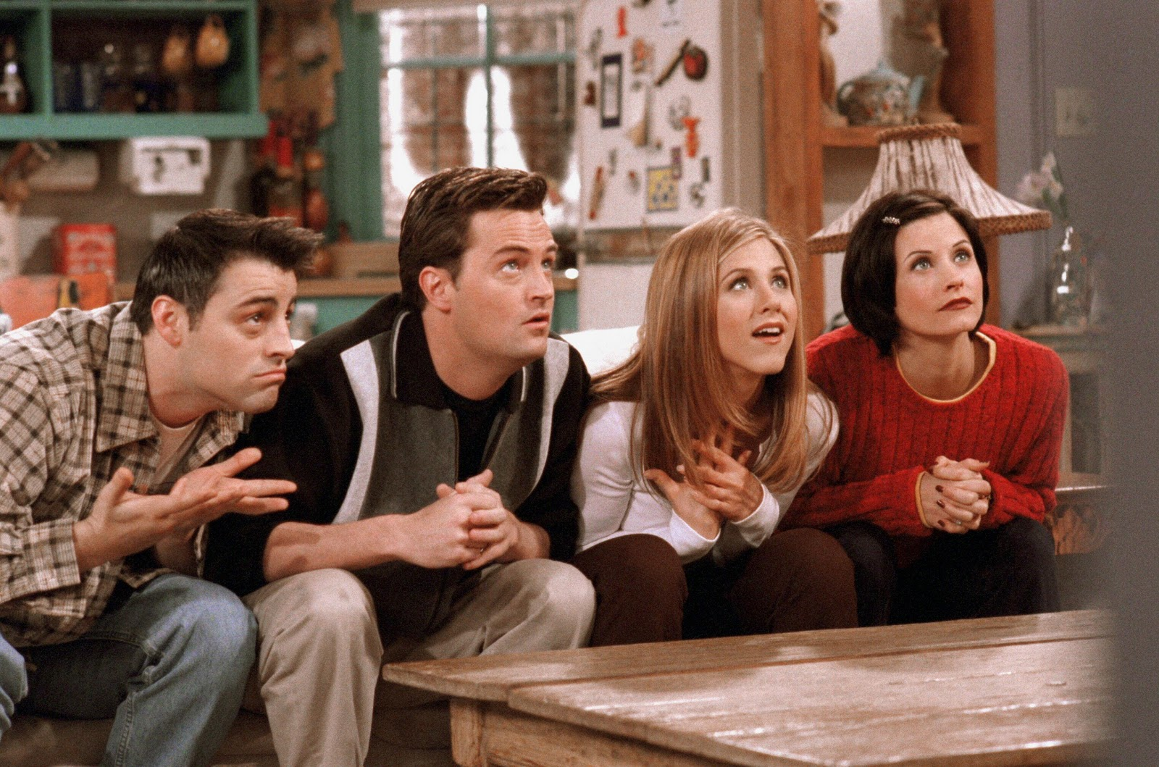

Slide 4


Slide 5
Gradle

Slide 6
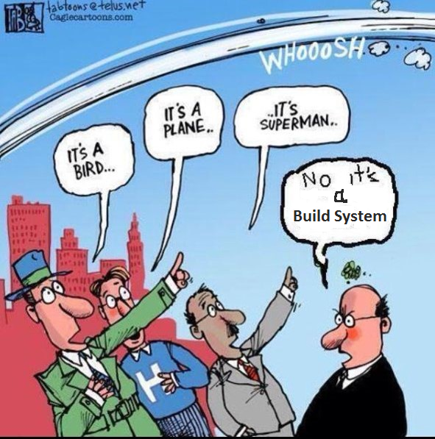

Slide 7
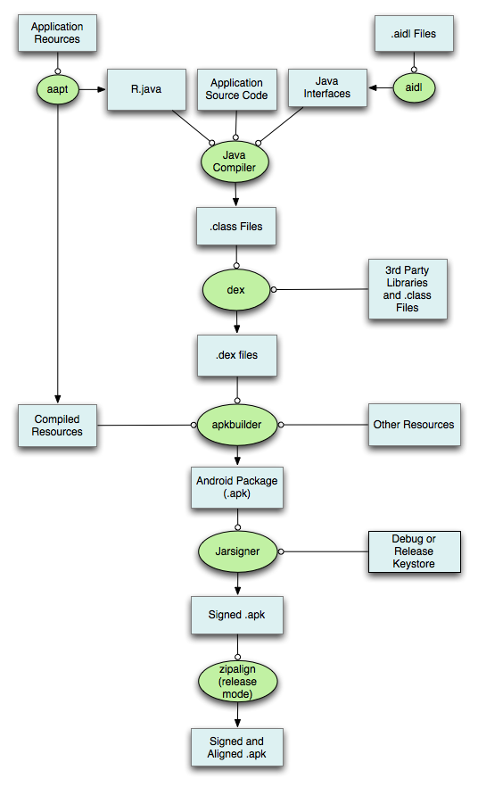

Slide 8
Me: So Gradle builds your projects and generates your ARTIFACT
You: Hey, wait a second. I already use Jenkins to build my project. So, why do I need Gradle?
Me: ?!$@#!?!$!#!

Slide 9




Slide 10
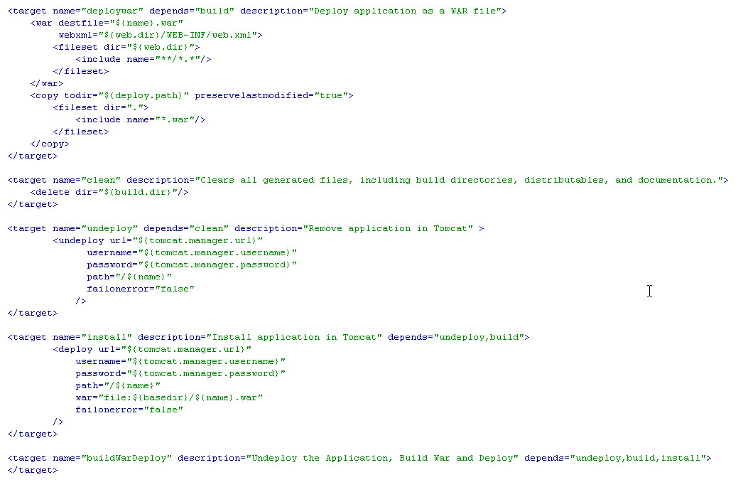

Slide 11
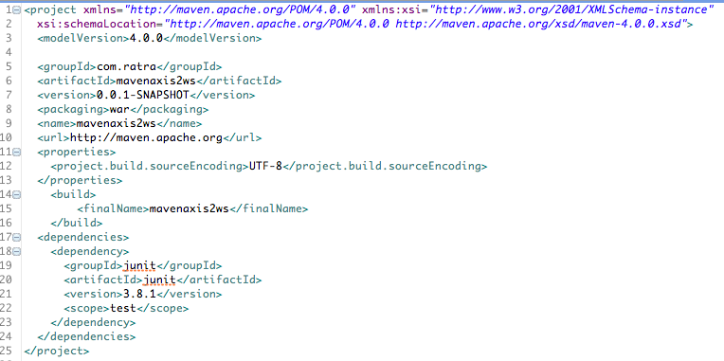

Slide 12
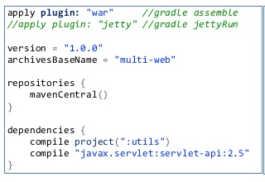


Slide 13
Features
Declarative
Imperative
Dependency Management
Up To Date
Groovy

Slide 14
Demo

Slide 15
?

