Slide 1
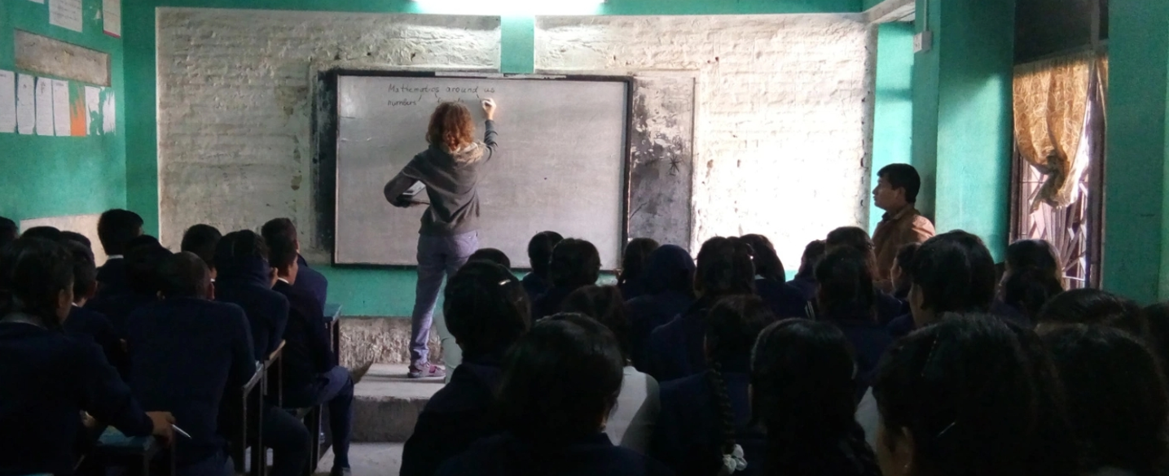
Lecturers without borders
Structure of platform FOR LECTURERS
SePtember 2019
Notes:
<number>
fdwfdsf

Slide 2








Lecturers without borders Lecturers without borders matches scientists with schools so that more teenagers hear inspiring talks on science around the world
Motivation and philosophy
Achievements and experience
Teenagers often lack motivation to study science and are not aware of the state-of-the-art science
High-school teachers are mostly not scientists themselves and cannot adequately motivate their students
Schools are interested to motivate students and give additional training to teachers
Many scientists (master and PhD students, PostDocs and professors) would like to give outreach lectures and frequently travel to different cities
Lecturers without borders matches scientists with schools: scientists give lectures to high-school students while travelling on professional or personal purposes
2017
Foundation of Lecturers without border
~100
Registered lecturers
27
Lectures organized
Partners

Slide 3



Matching and coordination Professional full-time manual coordination will be a middle step before launching an automated Airbnb-like platform
Current matching and coordination process
Transition period: full-time professional coordination
SCHOOL
For transition period LwB needs a dedicated person
to expand the school database
to match existing lecturers with new schools and to coordinate the lectures
Dedicated person will work full-time:
ca. 60% of the time for the school database expansion
ca. 40% of the time for coordination
Transition period will last 1 year
In the second half of the year, processes will be documented
The database of lecturers will be expanded once there are enough schools to cover potential travel destinations with 80% probability
LECTURERS WITHOUT BORDERS
LECTURER
Personal email with travel information
Waiting for instructions
Hands-on matching and coordination
Heavy workload for the founder of LwB
Personal contacts with unclear internal coordinator
Waiting for support
Optimal process – Airbnb for lecturers
LECTURERS WITHOUT BORDERS
SCHOOL
LECTURER
Regular update of travel information
Defined process to plan a lecture
Airbnb-like platform for matching
Limited personal support for special situations
Dedicated internal coordinator
Proacitve communication with the lecturer
Need for schools in every region and defined experience-based processes

Slide 4
School database expansion In every big city schools schould be found and qualified in a comprehensive interview process
Goals
Expanding the school database with appropriate schools from ca. 100 to 500-1000¹
KPIs
Number of added schools, school response rate
City analysis
School interviews
Database entry
After preliminary research on scientists‘ frequent destinations, school landscape of every destination should be studied
Sources of information are
LwB network
Other (local) educational networks
Local community and educational media
Per destination 2-3 probably appropriate schools are chosen
2-3 chosen schools run through a comprehensive interview process (via Skype etc., ~30 minutes)
Schools schould qualify to following criteria:
Good level of science education
English-speaking students (local languages also possible)
Accessible location
Support by the head of the school
Dedicated person
Time and energy for coordination
Good English
Support at school
Appropriate schools are documented in a database (currently, Airtable)
Information allows lecturers to choose a right school and get in contact (though for the first year matching can be done by LwB – see next slide):
Focus of the school
Special notes about students
Logistical details
Contacts
¹ There are ~500 cities with over 1.000.000 citizens in the world.
Notes:
<number>
fdwfdsf

Slide 5
Coordination in the transition period In the transition period lectures will be coordinated manually in order to establish a working process
Goals
Coordinate ~3-5 lectures per month, gather process experience, refine frequent destinations list
KPIs
Number of coordinated lectures, quality of lecturers‘ and schools‘ feedback
Gathering information
from lecturers
Lecture scheduling and coordination
Follow-up
Registered scientists send information on their travel plans and give preliminary dates for a lecture
LwB actively requests travels information only from a small group of active scientists
After the 1st year and the expansion of the school database, scientists‘ travel information will be requested regularly
LwB coordinator
searches for schools in the travel destination sites – either in the database or through the school-searching process (see previous slide)
connects the school contact person with the scientist and lets them agree on the lecture topics, stundents group and exact time
coordinates the process until the lecture, supporting both the scientist and the school
Feedback is gathered from the scientist and the school (incl. Feedback from students and other people involved)
Process and feedback are documentes
Scientist and school information can be ammended after a lecture experience
List and prioritization of frequent destionations can be ammended
¹ There are ~500 cities with over 1.000.000 citizens in the world.
Notes:
<number>
fdwfdsf

