Slide 2
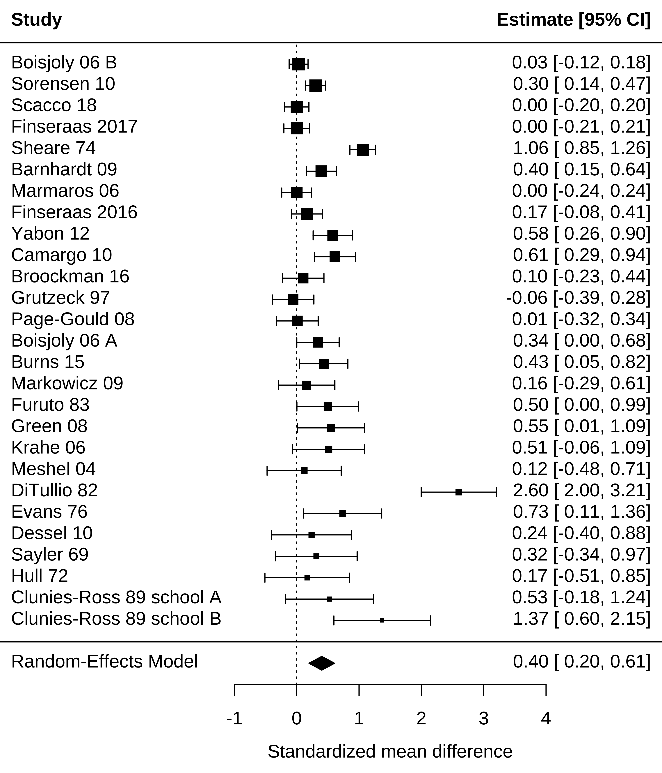
Research synthesis
Using meta-analysis
https://experimentology.io/016-meta.html

Slide 3
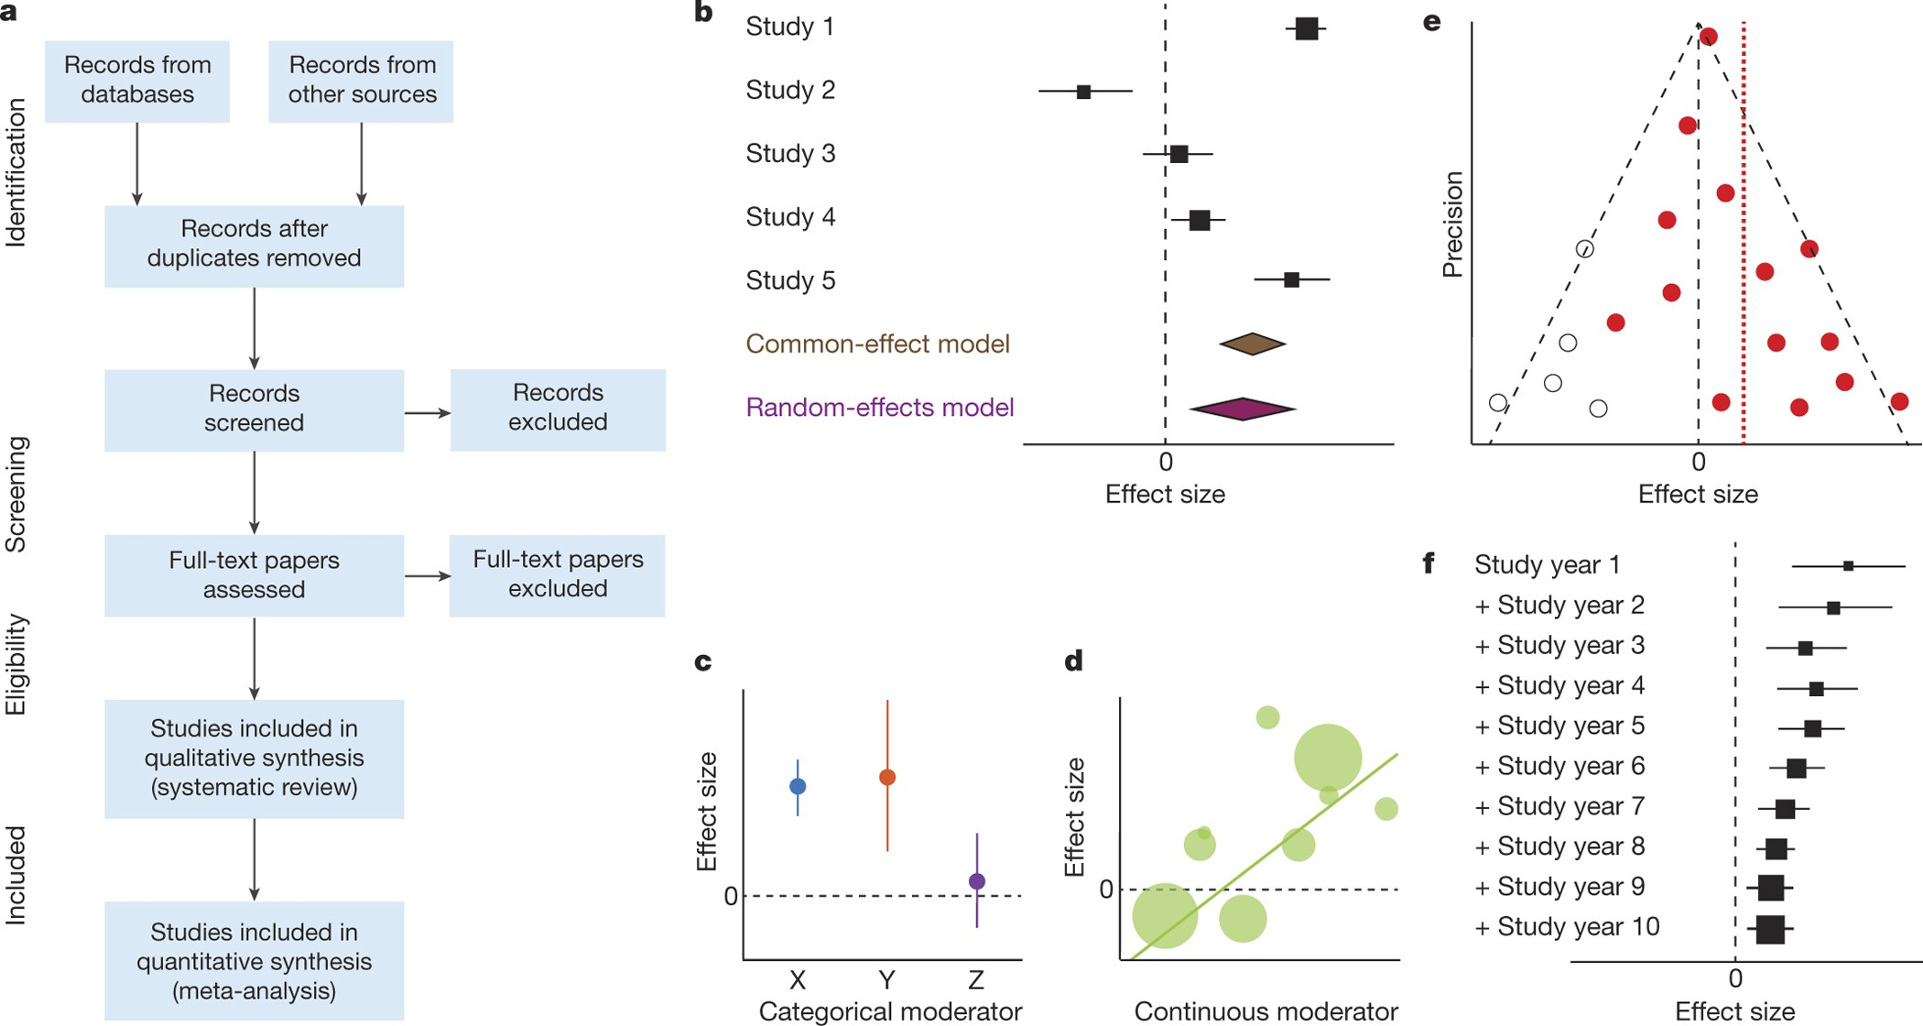
Figure 1: Various charts and plots common to meta-analysis.
https://www.nature.com/articles/nature25753

