Slide 1
Bias from selection and corrections using matching

Slide 2
Test Score
Test Score
A
a
B
b
Socio-Econ. Status
C
c
Class Size
Class Size
When we add a control variable that IS correlated with the policy variable it affects both the slope and the standard error.

Slide 3
“There are two types of people”

Slide 4
Microfinance example of bias from selection
Number of people per category
 | Not an Entrepreneur | Entrepreneur
No Loan | 30 | 15
Takes a Loan | 20 | 35
Average weekly income per category
 | Not an Entrepreneur | Entrepreneur
No Loan | $10 | $20
Takes a Loan | $10 | $20
The loan appears to
have an impact even
when we know it didn’t!

Slide 5
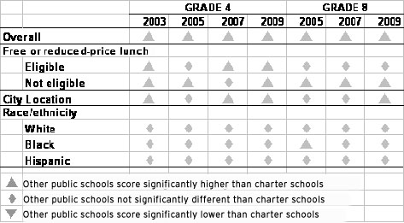
Charter school example

Slide 6
The “selection” problem
Program
Outcome
Choice to
participate
When happens when people are given the choice to participate in a program? When do problems arise? How do we estimate program impact in this case?

Slide 7
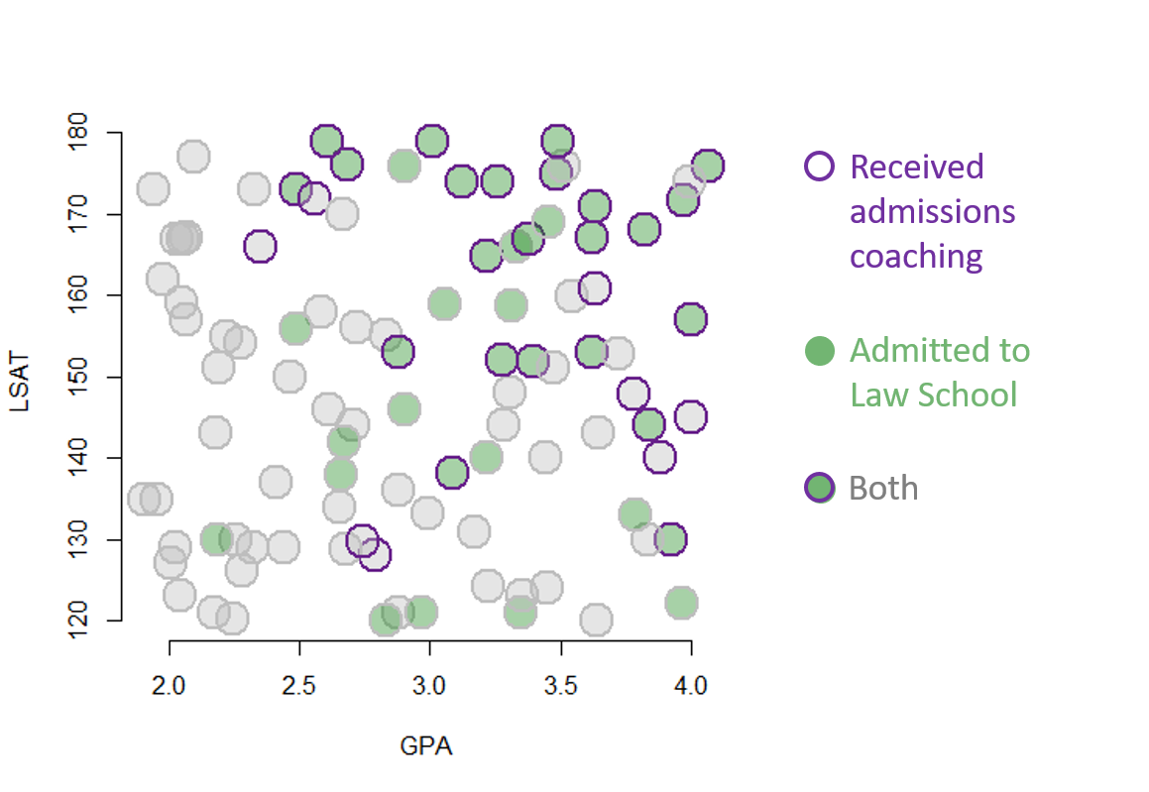

Slide 8
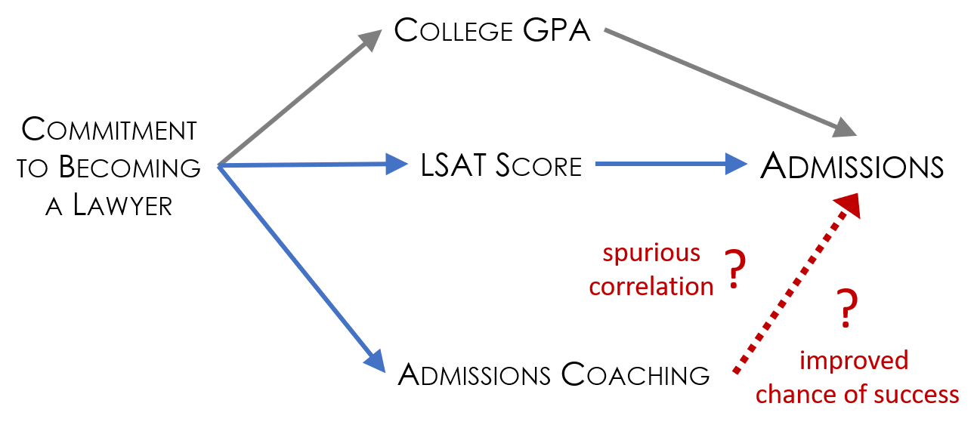
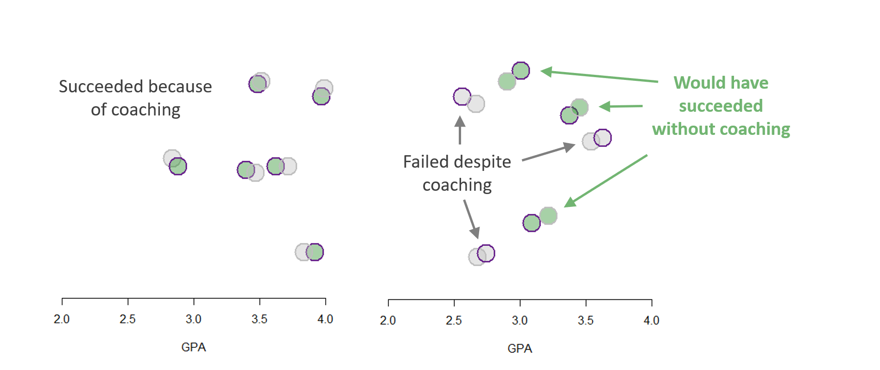

Slide 9
Propensity score matching
Program
Outcome
This is the
“propensity”
Selection bias is just another case of omitted variable bias

Slide 10
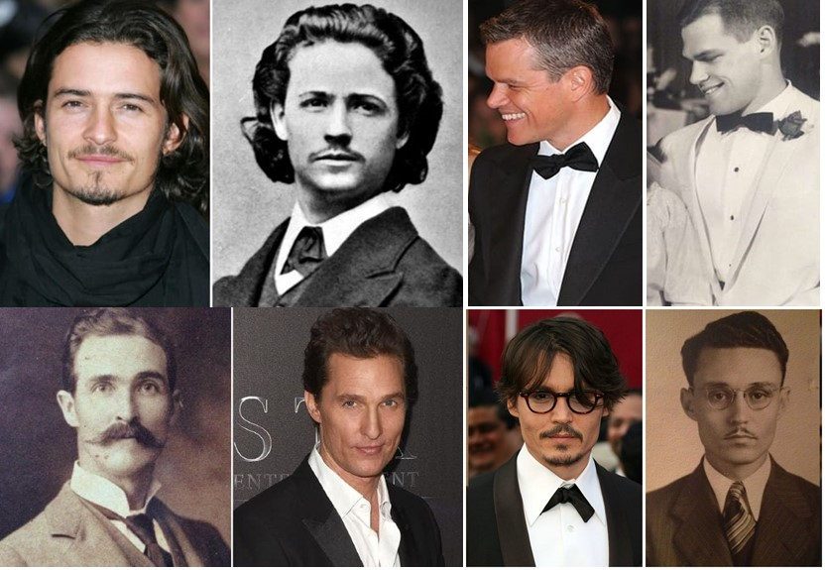
Matching

Slide 11
Propensity score matching
ID# | Age | Group | Outcome | Program?
#1 | 40 | Blue | $75 | 0
#2 | 43 | Blue | $64 | 1
#3 | 54 | Blue | $69 | 0
#4 | 23 | Red | $32 | 0
#5 | 41 | Red | $49 | 0
#6 | 38 | Red | $87 | 1

Slide 12
Probability Models
Linear Probability
Model (OLS)
Logit
Model
Program?
Program?
1
1
0
0
Age
Age
These models predict the probability of participation
in the program, i.e. the “propensity” of an individual

Slide 13
Propensity score matching
ID# | Age | Race | Outcome | Program? | Predicted Propensity
#1 | 40 | Blue | $75 | 0 | 0.87
#2 | 43 | Blue | $64 | 1 | 0.98
#3 | 54 | Blue | $69 | 0 | 0.45
#4 | 23 | Red | $32 | 0 | 0.53
#5 | 41 | Red | $49 | 0 | 1.02
#6 | 38 | Red | $87 | 1 | 1.11
We add a variable for the predicted propensity score. Remember not to use your outcome in your propensity score calculations.

Slide 14
Propensity score matching
ID# | Age | Race | Outcome | Program? | Predicted Propensity
#1 | 40 | Blue | $75 | 0 | 0.87
#2 | 43 | Blue | $64 | 1 | 0.98
#3 | 54 | Blue | $69 | 0 | 0.45
#4 | 23 | Red | $32 | 0 | 0.53
#5 | 41 | Red | $49 | 0 | 1.02
#6 | 38 | Red | $87 | 1 | 1.11
Then matches are made to form a synthetic control group:
#5 <--> #6
#2 <--> #1

Slide 15
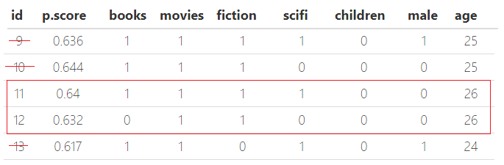
Nearest Neighbors

Slide 16
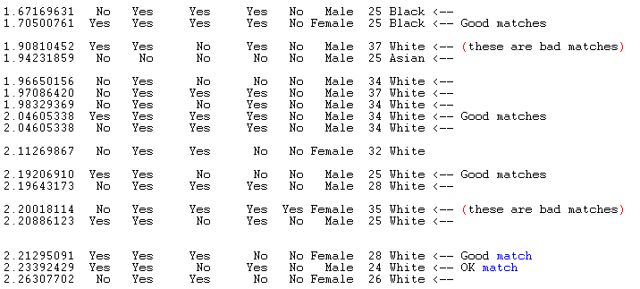
Harry Potter Example
Propensity Score

Slide 17
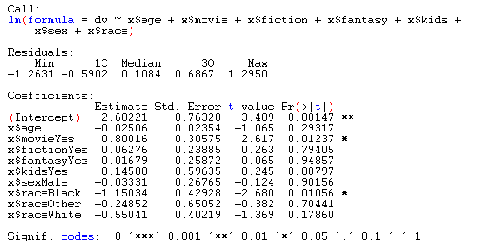
Harry Potter Example

Slide 18
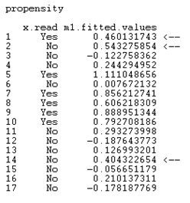
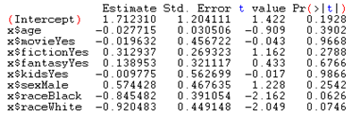

Harry Potter Example

Slide 19
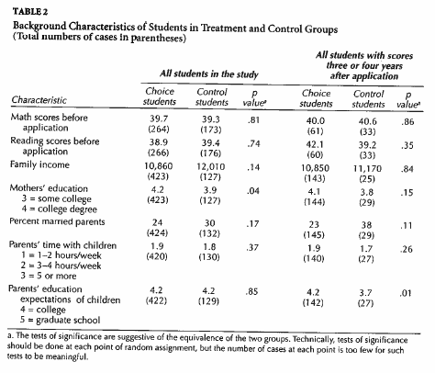
How do we know matching has been successful?
“balance”

Slide 20
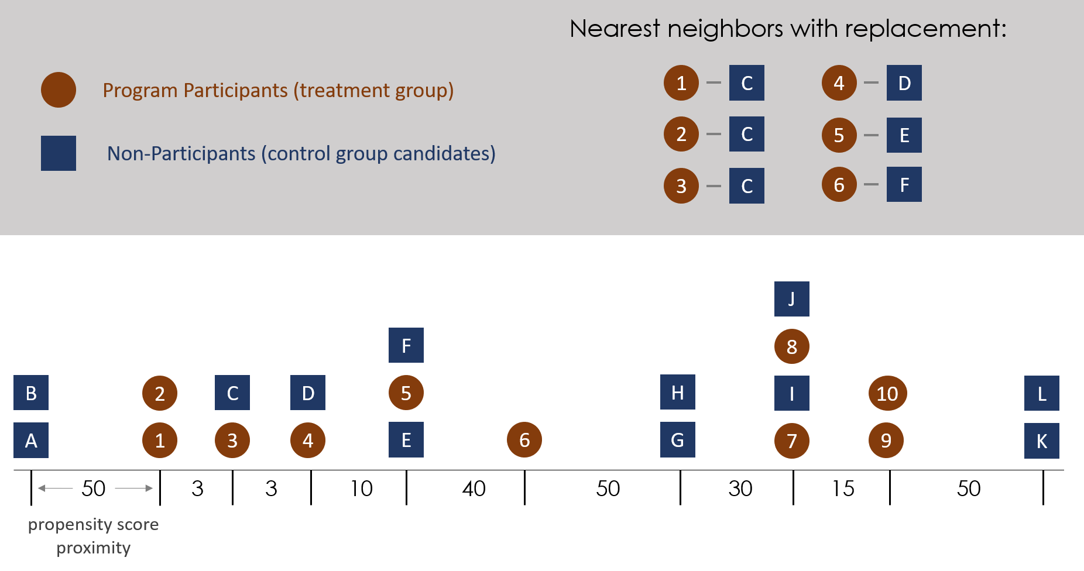
Greedy Search

Slide 21
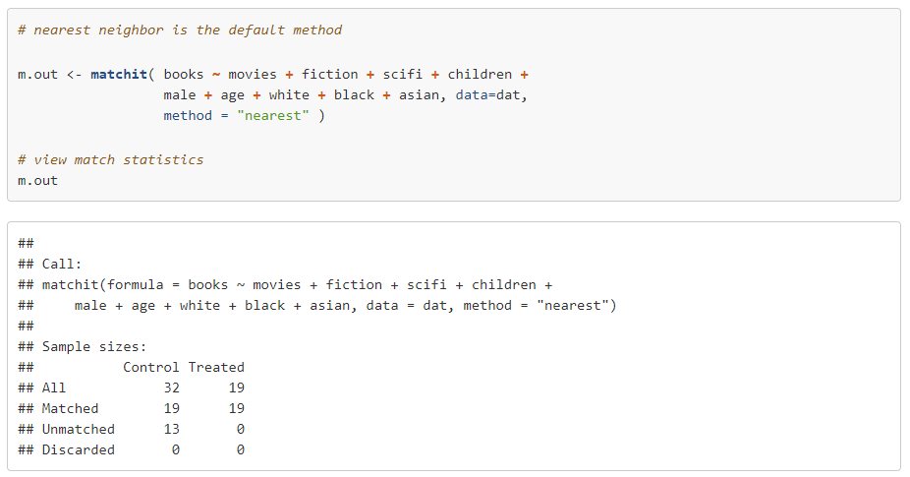

Slide 22
http://www.youtube.com/watch?v=pNn_oJwZ2sg&feature=related

Slide 23
What are the problems with Propensity Scores?
http://www.youtube.com/watch?v=Zg7gxAG8YS4&feature=related

Slide 24
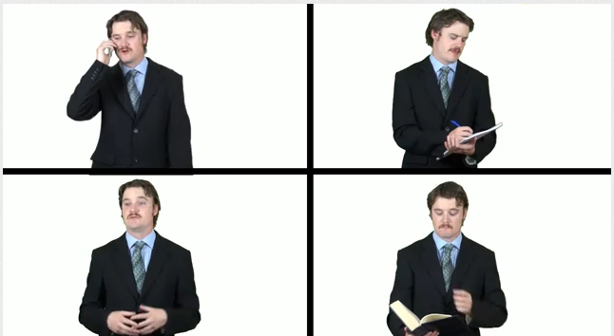
What are the problems with Propensity Scores?
You can only match on observables!
http://www.youtube.com/watch?v=Zg7gxAG8YS4&feature=related

Slide 25
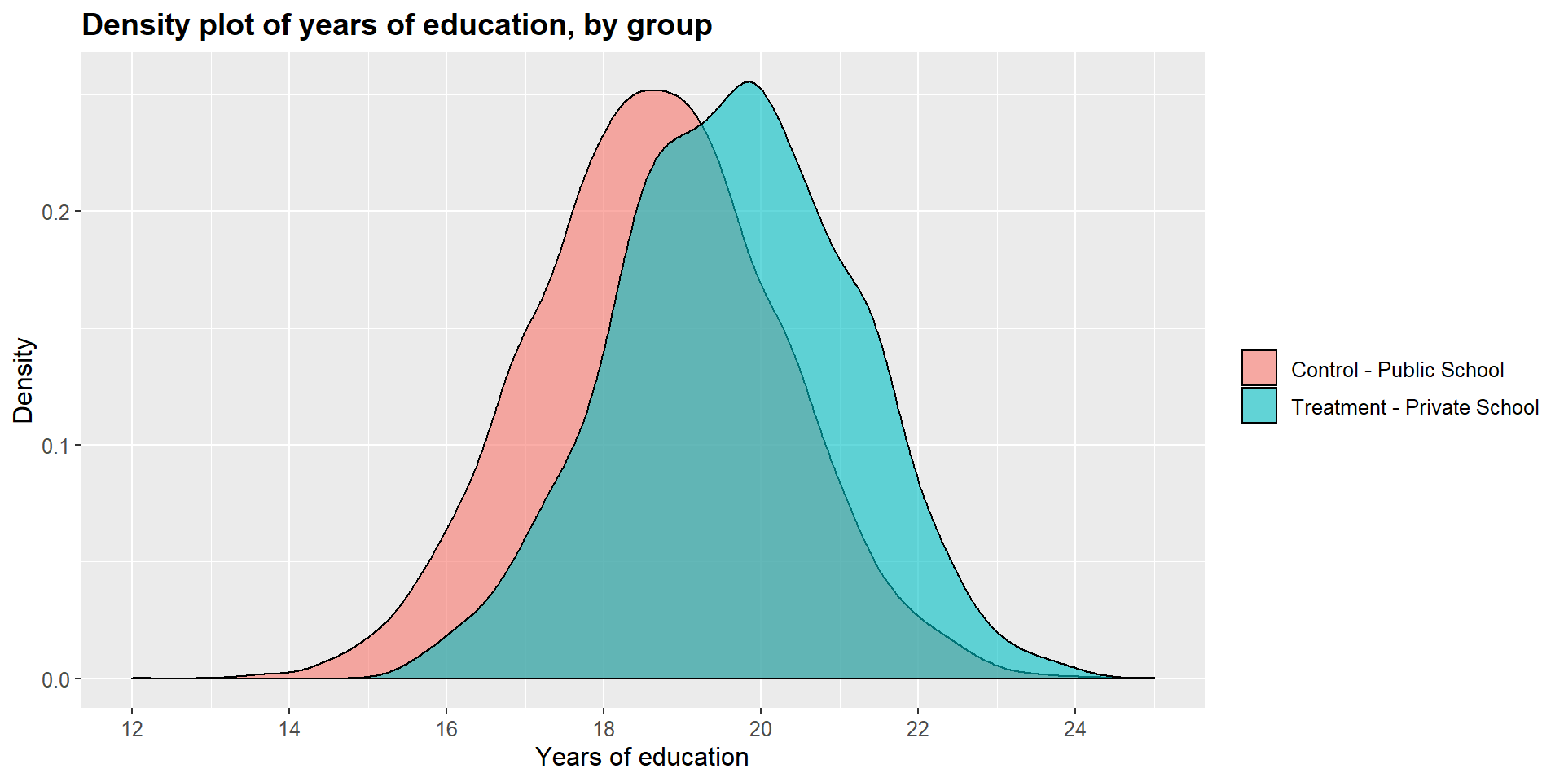
Common Support

