Slide 1
Logistic Regression

Slide 2
Data
URL <- "https://raw.githubusercontent.com/DS4PS/pe4ps-textbook/master/data/admissions.csv"
dat <- read.csv( URL, stringsAsFactors=F )

Slide 3
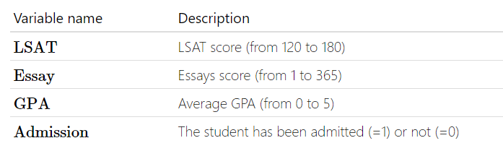
Predicting Law School Admissions:

Slide 4
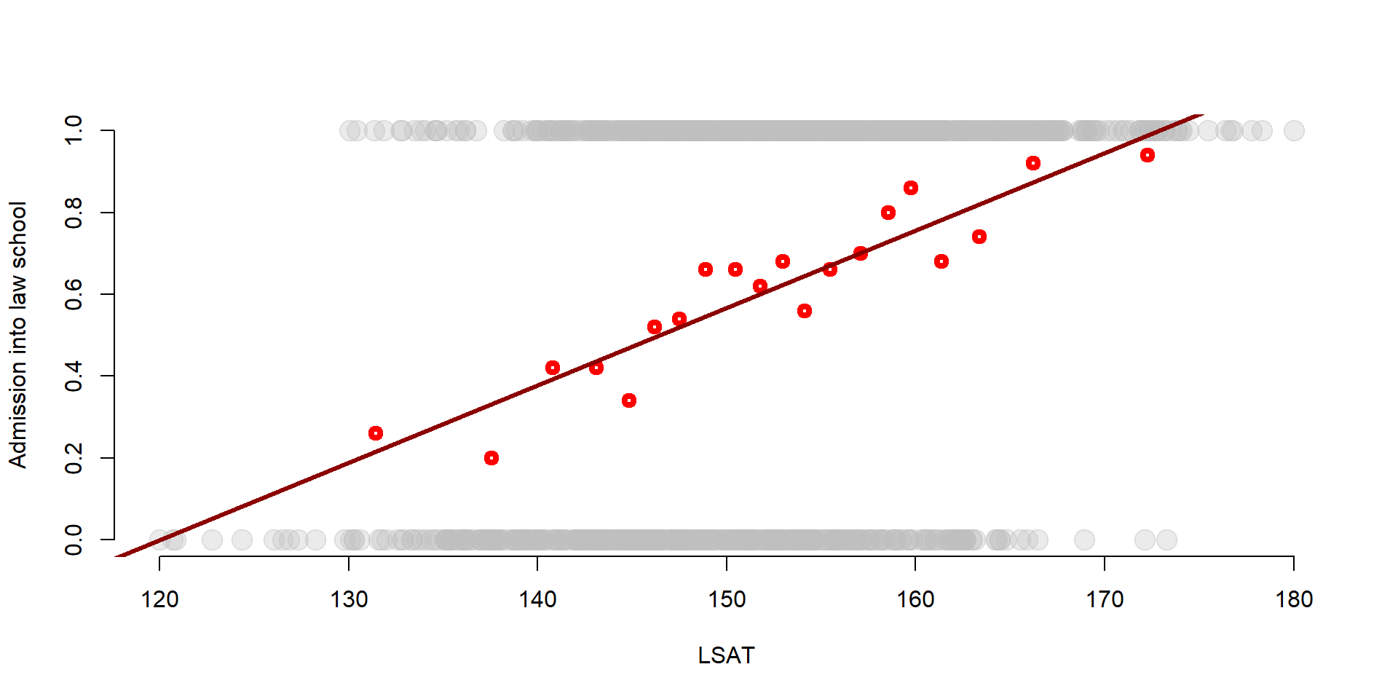
Linear Probability Model:

Slide 5
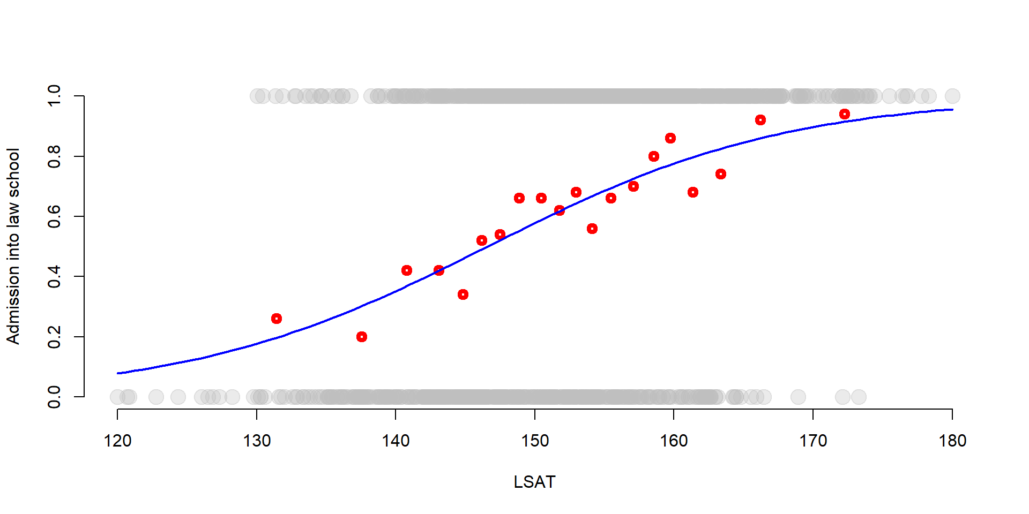
Logit Model:

Slide 6
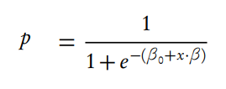
Interpretation:
Logit link function:
Translates regression coefficients to probabilities.

Slide 7
Both models would produce similar predictions.
The predictions would differ most in the tails.

Slide 8
URL <- "https://raw.githubusercontent.com/DS4PS/pe4ps-textbook/master/data/admissions.csv"
dat <- read.csv( URL, stringsAsFactors=F )
head( dat )
#### LINEAR PROBABILITY MODEL
m1 <- lm( Admission ~ LSAT + Essay + GPA, data=dat )
summary( m1 )
# Marginal effects comparison:
#
# The standard deviation is a "reasonable"
# approximation of a big improvement.
#
# Which of these three things should I spend
# time on to improve my likelihood of admissions?
sd.lsat <- sd( dat$LSAT )
sd.essay <- sd( dat$Essay )
sd.gpa <- sd( dat$GPA )
b0 <- m1$coefficients[1]
b1 <- m1$coefficients[2]
b2 <- m1$coefficients[3]
b3 <- m1$coefficients[4]
sd.lsat * b1 # gains from improvement in LSAT
sd.essay * b2 # gains from improvement in essay
sd.gpa * sd.gpa # gains from improvement in gpa
# predicted prob of success (admissions) for a specific individual:
gpa <- 3.0
lsat <- 145
essay <- 90
b0 + b1*lsat + b2*essay + b3*gpa
#### LOGIT MODEL
m2 <- glm( Admission ~ LSAT + Essay + GPA, data = dat, family = "binomial" )
summary( m2 )
# LOGIT LINK FUNCTION
p = 1 / ( 1 + exp( - ( b0 + b1*x1 + b2*x2 ) ) )
# predicted prob of success (admissions) for a specific individual:
b0 <- m2$coefficients[1]
b1 <- m2$coefficients[2]
b2 <- m2$coefficients[3]
b3 <- m2$coefficients[4]
gpa <- 3.0
lsat <- 145
essay <- 90
# Model reports log-odds
y.hat <- b0 + b1*lsat + b2*essay + b3*gpa
# convert log-odds to probabilities
1 / ( 1 + exp( - ( y.hat ) ) )
# Marginal effects comparison:
#
# We must "center" other variables
# to look at marginal effects of one (LSAT here):
gpa <- mean( dat$GPA )
essay <- mean( dat$Essay )
lsat <- 150
y.hat <- b0 + b1*lsat + b2*essay + b3*gpa
1 / ( 1 + exp( - ( y.hat ) ) )
# Expected gains change greatly depending
# on the baseline, eg LSAT of 130 vs 150 vs 170
# value of 10-point increase in LSAT
# when current score is a 140
gpa <- mean( dat$GPA )
essay <- mean( dat$Essay )
lsat <- 140
y.hat <- b0 + b1*lsat + b2*essay + b3*gpa
p.140 <- 1 / ( 1 + exp( - ( y.hat ) ) )
lsat <- 150
y.hat <- b0 + b1*lsat + b2*essay + b3*gpa
p.150 <- 1 / ( 1 + exp( - ( y.hat ) ) )
p.150 - p.140
# value of 10-point increase in LSAT
# when current score is a 120
lsat <- 120
y.hat <- b0 + b1*lsat + b2*essay + b3*gpa
p.120 <- 1 / ( 1 + exp( - ( y.hat ) ) )
lsat <- 130
y.hat <- b0 + b1*lsat + b2*essay + b3*gpa
p.130 <- 1 / ( 1 + exp( - ( y.hat ) ) )
p.130 - p.120
# value of 10-point increase in LSAT
# when current score is a 170
lsat <- 170
y.hat <- b0 + b1*lsat + b2*essay + b3*gpa
p.170 <- 1 / ( 1 + exp( - ( y.hat ) ) )
lsat <- 180
y.hat <- b0 + b1*lsat + b2*essay + b3*gpa
p.180 <- 1 / ( 1 + exp( - ( y.hat ) ) )
p.180 - p.170

