Slide 1
partitioned regression
Fundamentals of
PROGRAM EVALUATION
JESSE LECY

Slide 2
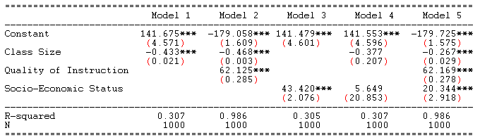
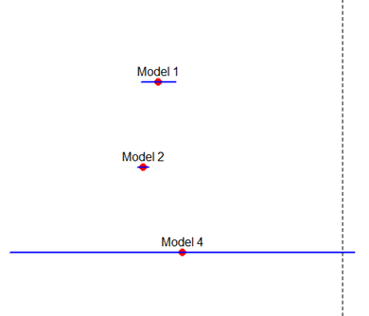
Example: Classroom Size
Why are slopes and standard errors changing
when we add “control” variables?

Slide 3
Example: Classroom Size
Teacher
Quality
Test Scores
Socio-
Economic
Status
Classroom
Size

Slide 4
Partitioning the Variance of Y
Y
e
-> SSE
Y-hat
-> RSS
X

Slide 5
Standard Error in Regression
Sum of Squared Error Terms
Variance of the residual
Standard error of the slope

Slide 6
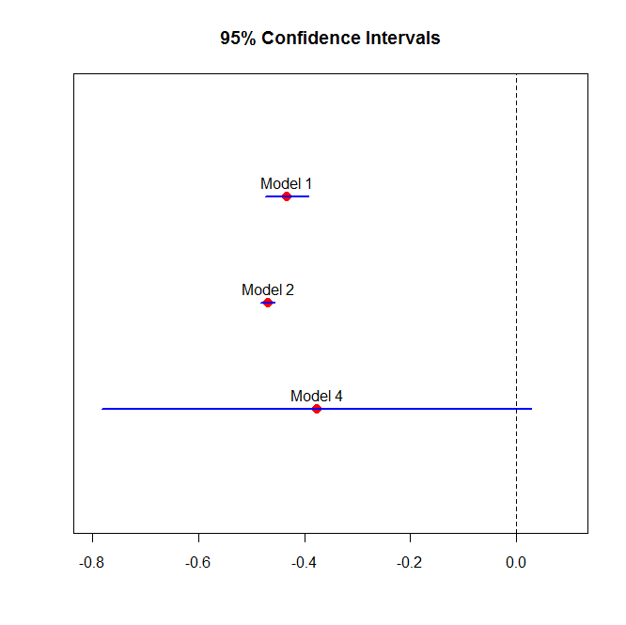
Model 1
Test
Score
CS
Model 2
Test
Score
TQ
CS
Test
Score
Model 4
CS
SES

Slide 7
Partitioned regression

Slide 8
Ballentine venn diagram
Dependent
Variable
Y
C
A
B
X1
X2
Policy
Variable
Control
Variable

Slide 9
Ballentine venn diagram
Variance of Y
X1
Cov( X1, Y )

Slide 10
Ballentine venn diagram
Variance
of X1
Variance
of X2
Cov( X1, X2 )

Slide 11
partitioned regression
Fundamentals of
PROGRAM EVALUATION
JESSE LECY

Slide 12
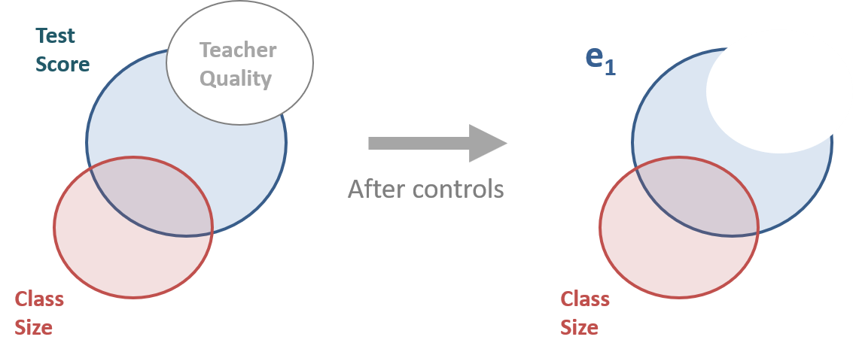
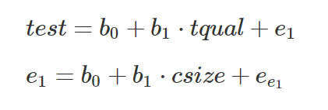
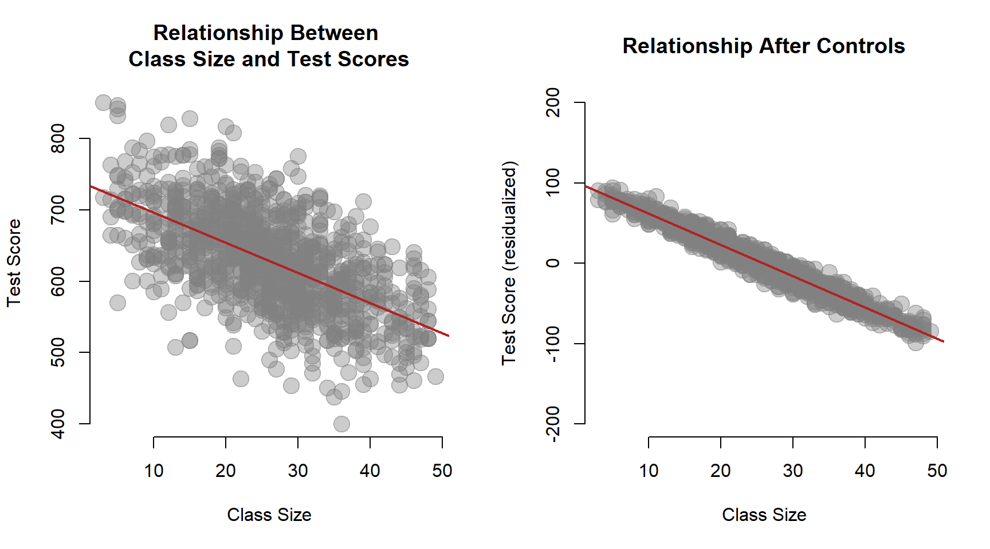

Slide 13
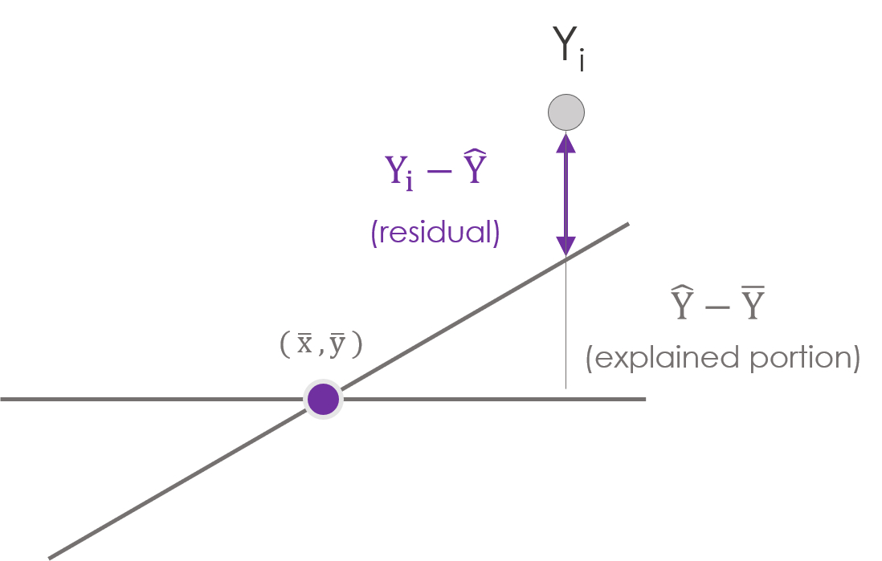
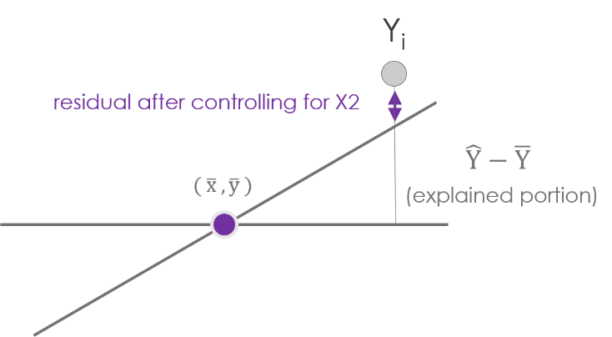

Slide 14
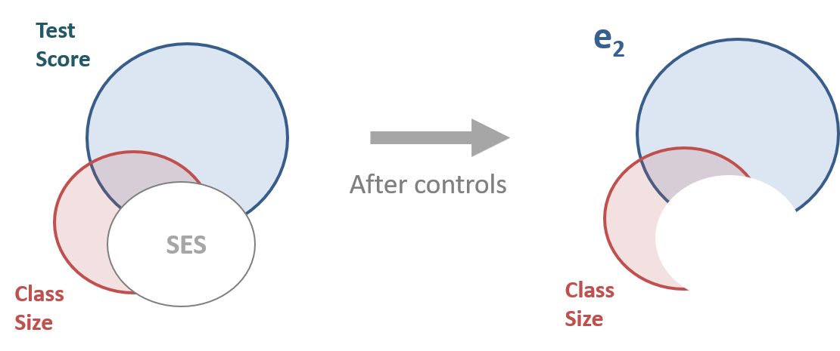
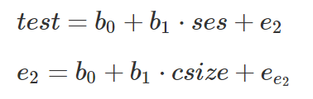
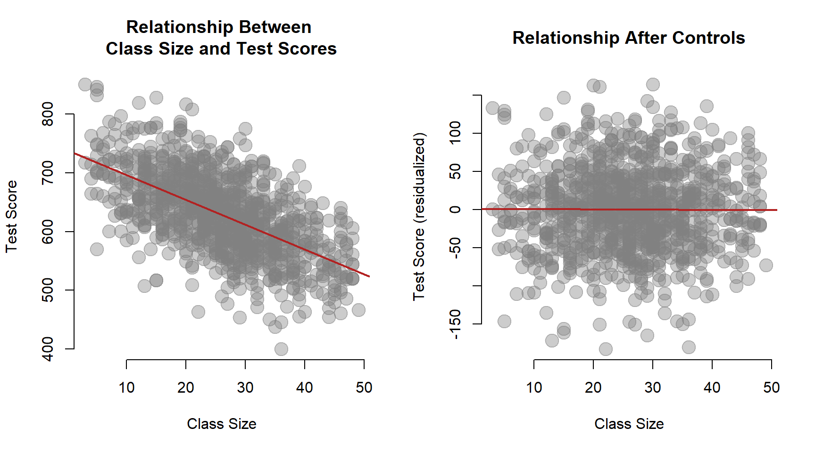

Slide 15
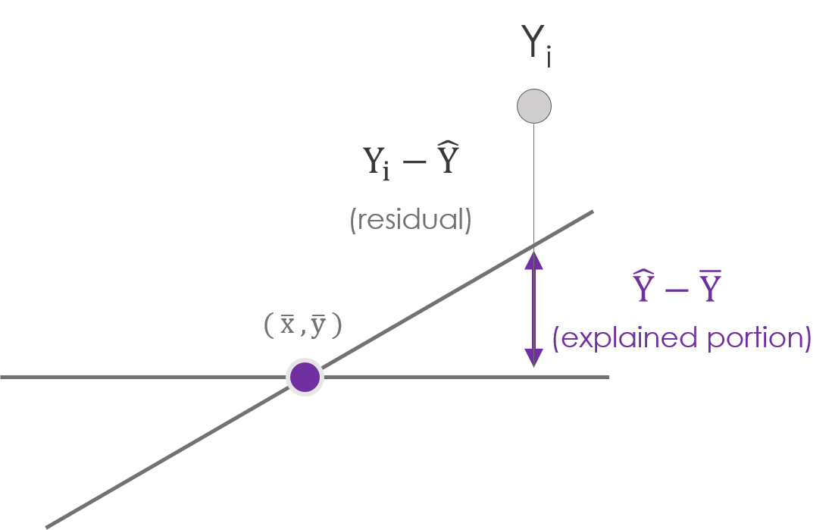
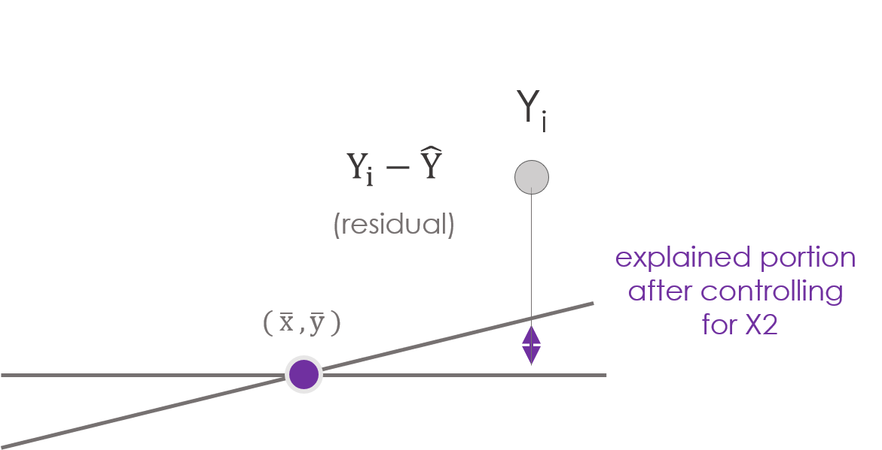

Slide 16
Ballentine venn diagram
C = Unexplained Portion of Y (the residual)
A = Cov( X1, Y) after removing effects of X2 (“controlling for”)
Y
C
A
B
X1
X2
A + B = Variance of X1 after controlling for X2

Slide 17
Partitioned Regression
Y
e₁
X2
X1
e₂
X2

Slide 18
Partitioned Regression
e₁
C
A
e₂
B

Slide 19
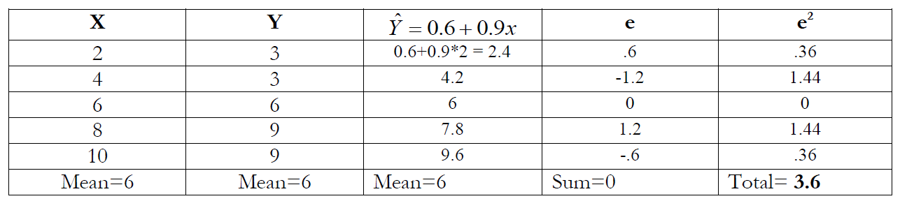
Why can we do this?
The residual is just another variable.
The order of operations is important in partitioned regression.

Slide 20
Note: Multiple Regression Context
If there is more than one control variable make sure you cleanse all of the nuisance variance from both your dependent variable and your policy variable.

Slide 21
Example 1:
$$SWB=β_{0}+β_{1}PSS+β_{2}ND+β_{3}NP+ε$$
“policy variable”
Coefficientsª
Model |  | Unstandardized Coefficients |  | Standardized Coefficients | t | Sig.
 |  | B | Std. Error | Beta
1 | (Constant) | -1.507 | 2.633 |  | -.572 | .567
 | Perceived Social Support | .310 | .032 | .460 | 9.645 | .000
 | Network Diversity | -.215 | .210 | -.055 | -1.025 | .306
 | # People in Social Network | .023 | .014 | .087 | 1.654 | .099
Dependent Variable: Subjective Well Being

Slide 22

Auxiliary Regression #1
$$SWB=b_{0}+b_{1}ND+b_{2}NP+e_{1}$$
Coefficientsª
Model |  | Unstandardized Coefficients |  | Standardized Coefficients | t | Sig.
 |  | B | Std. Error | Beta
1 | (Constant) | 21.630 | 1.207 |  | 17.915 | .000
 | Network Diversity | .224 | .228 | .057 | .979 | .328
 | # People in Social Network | .039 | .016 | .148 | 2.540 | .011
Dependent Variable: Subjective Well Being
Regress the DV on all IV’s except the policy variable.
Save the residuals.

Slide 23
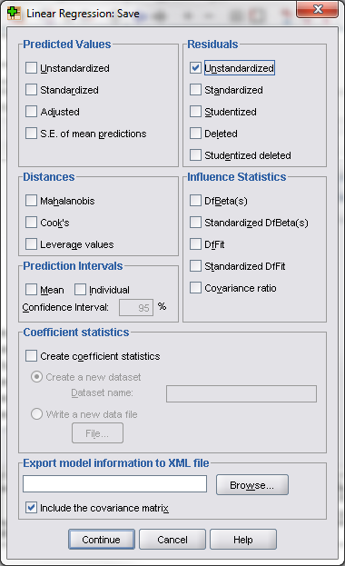

Auxiliary Regression #1
$$SWB=b_{0}+b_{1}ND+b_{2}NP+e_{1}$$
Coefficientsª
Model |  | Unstandardized Coefficients |  | Standardized Coefficients | t | Sig.
 |  | B | Std. Error | Beta
1 | (Constant) | 21.630 | 1.207 |  | 17.915 | .000
 | Network Diversity | .224 | .228 | .057 | .979 | .328
 | # People in Social Network | .039 | .016 | .148 | 2.540 | .011
a. Dependent Variable: Subjective Well Being

Slide 24

Auxiliary Regression #2
$$PSS=a_{0}+a_{1}ND+a_{2}NP+e_{2}$$
Coefficientsª
Model |  | Unstandardized Coefficients |  | Standardized Coefficients | t | Sig.
 |  | B | Std. Error | Beta
1 | (Constant) | 74.720 | 1.720 |  | 43.438 | .000
 | Network Diversity | 1.417 | .325 | .244 | 4.356 | .000
 | # People in Social Network | .052 | .022 | .133 | 2.364 | .019
Dependent Variable: Perceived Social Support
Regress the policy variable on all of the IV’s.
Save the residuals.

Slide 25

Partitioned Regression
$$e_{1}=c_{0}+β_{1}e_{2}+ε$$
Regress the residuals on each other.
Coefficientsª
Model |  | Unstandardized Coefficients |  | Standardized Coefficients | t | Sig.
 |  | B | Std. Error | Beta
1 | (Constant) | 2.369E-15 | .253 |  | .000 | 1.000
 | Unstandardized Residual | .310 | .032 | .441 | 9.670 | .000
Dependent Variable: Unstandardized Residual
We have recovered the
original slope!

Slide 26
Why is this important?
It illustrates the idea of statistical controls in policy work – get rid of the nuisance variance!
Provides insight into the regression error term.
Serves as a tool for future methods (instrumental variables).
It paved the way for modern computational econometrics.

Slide 27
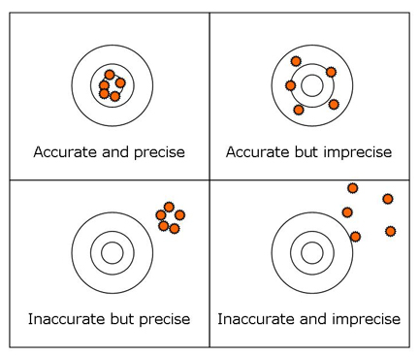
Why we care:
Results need to be:
Unbiased (accurate)
Efficient (precise)
Biased and inefficient
Biased and efficient
Unbiased and inefficient

Slide 28
Effects of controls determined by their correlations with the outcome and policy variables
Teacher
Quality
Test Scores
Classroom
Size

Slide 29
Partitioning the Variance of Y
Final Exam Scores
Unexplained Portion
SES: Race / Gender / Income
Previous Coursework
Hours of Sleep
What happens if we omit
variables from the model?
Hours of Preparation

Slide 30
Partitioning the Variance of Y
Teacher Quality
B
A
A
Test
Score
B
TS
*Test
Score
TQ
A
Teacher Quality

Slide 31
Effects of the Control Variable
Test
Score
Test
Score
TQ
e₁
e₂
CS
CS

Slide 32
Effects of the Control Variable
Test
Score
Test
Score
TQ
e₁
e₂
e₁ > e₂
CS
CS
e₁
e₂

Slide 33
Partitioning y with multiple variables

Slide 34
What happens to slopes and standard errors when we add more variables?
Y
A
B
X
D
C
Z

Slide 35
Multiple Regression Mechanics: SLOPE
Y
A
B
X
D
C
Z
The formula for the slope is different when you add more variables

Slide 36
Multiple Regression Mechanics: STANDARD ERRORS
Y
A
B
X
Z
The unexplained variance is different when you add more variables

Slide 37
Bias correction through instrumental variables
Fundamentals of
PROGRAM EVALUATION
JESSE LECY

Slide 38
Three minute version:

Slide 39
We have an ovb problem:
Y
X1
_{(policy variable)}
X2
(Omitted Variable)

Slide 40
We have an
instrumental variable:
Y
Z
_{(Instrument)}
X1
_{(policy variable)}
X2
(Omitted Variable)
Z is correlated with X1 (the policy variable),
uncorrelated with X2 (the omitted variable).

Slide 41
We have an
instrumental variable:
Y
Z
_{(Instrument)}
X1
_{(policy variable)}
X2
(Omitted Variable)
Z is correlated with Y only THROUGH X1.
There is no causal relationship between Z and Y.

Slide 42
x
y
z
Correlation between Y and Z is natural extension of this causal structure.
In this data, Y has no direct causal relationship with Z, but there will be a strong correlation in the data because of Y and Z are both correlated with X.

Slide 43
Step 1:
Partition X1 into parts correlated and uncorrelated with Z
X1-hat
e₁
Z
_{(Instrument)}
X1
_{(policy variable)}
X1 = a₀ + a₁*Z + e₁

Slide 44
Step 2:
Y
X1-hat
X2
(Omitted Variable)
Y = b₀ + b₁*X1-hat + e₂
Keep only the part of X1 that is correlated with Z.

Slide 45
Ovb mitigated:
Y
Y
X2
(Omitted Variable)
X1
_{(policy variable)}
X2
(Omitted Variable)
X1-hat
Y = B₀ + B₁*X1 + B₂*X2 + e
Y = b₀ + b₁*X1-hat + e₂
b₁ ≈ B₁
Full Model
IV Model
Naïve slope close to the true slope

Slide 46
Full version:

Slide 47
We have used a correlation model to examine omitted variable bias
Y
X
(policy variable)
Omitted
Variable X₂

Slide 48
But there are many possible causal models:
Case 1: Not Problematic
X₁
Y
X₂
Y
X₂
X₁

Slide 49
But there are many possible causal models:
Case 2
Case 3
Case 4
X₁
Y
X₁
Y
X₁
Y
X₂
X₂
X₂
These are problematic when we omit X₂ because our slope on X₁ will not be biased
Y
X₁
X₂

Slide 50
Lurking variables…spurious correlations
Case 5
Case 6
X₁
Y
X₁
Y
X₂
X₂
X₁
Y
X₂
Y
X₂
X₁
Don’t worry about these cases for now

Slide 51
So how do we fix this?

Slide 52
Instrumental variables exploit exogeneity:
Z
X₁
Y
Exogeneous
X₂
Exogenous: Variable that is correlated with the policy variable but NOT with the omitted variable.
Z
Z
X₁
Y
X₁
Y
X₂
NOT
Exogeneous
X₂
Z
X₁
Y
X₂

Slide 53
Example:
Where have all the criminals gone?
Steven Levitte makes the claim that increasing policing only reduces crime slightly.
Why will patrol hours and the number of criminals be correlated? Will there be a positive or negative relationship?
Crime Rate
Patrol Hours
Number of
Criminals

Slide 54
Example:
Where have all the criminals gone?
Steven Levitte makes the claim that increasing policing only reduces crime slightly. The problem with the estimation:
“Cities with high crime rates, therefore, may tend to have large police forces, even if police reduce crime. Detroit has twice as many police officers per capita as Omaha, and a violent crime rate over four times as high, but it would be a mistake to attribute the differences in crime rates to the presence of the police. Similarly, within a particular city, if more police are hired when crime is increasing, a positive correlation between police and crime can emerge, even if police reduce crime.”
Crime Rate
Patrol Hours
Number of
Criminals

Slide 55
Example:
Where have all the criminals gone?
Steven Levitte makes the claim that increasing policing only reduces crime slightly.
Where would we find a measure of the number of criminals?
Crime Rate
Patrol Hours
Number of
Criminals

Slide 56
The fix:
Where have all the criminals gone?
We need to find an exogenous variable correlated to policing intensity but uncorrelated with crime rates
Z
X₁
Y
X₂
Crime Rate
???
Number of
Criminals
Patrol Hours

Slide 57
The fix:
Where have all the criminals gone?
“The primary innovation of the paper is the approach used to break the simultaneity between police and crime. In order to identify the effect of police on crime, a variable is required that affects the size of the police force, but does not belong directly in the crime "production function." The instrument employed in this paper is the timing of mayoral and gubernatorial elections.”
Levitt, 1997
Crime Rate
Election cycle
Number of
Criminals
Z
Patrol Hours
X₁
Y
X₂

Slide 58
Another example:
???
Smoking
Health
Other unhealthy
behaviors

Slide 59
Another example:
Tobacco Taxes
Smoking
Health
Other unhealthy
behaviors

Slide 60
How does it work?
Residuals ( e )
Predicted Values of Y
( y-hat )
Y
X
Recall, Y is partitioned into explained and unexplained portions

Slide 61
Exogenous Criteria:
Z
_{(Instrument)}
X1
_{(policy variable)}
X2
(Omitted Variable)
Z is uncorrelated with X2

Slide 62
Exogenous Criteria:
Y
BIAS
X1
_{(policy variable)}
X2
(Omitted Variable)
X2 is a problematic omitted variable

Slide 63
Exogenous Criteria:
Y
Z
_{(Instrument)}
X1
_{(policy variable)}
X2
(Omitted Variable)
Z is correlated with Y, but only THROUGH X1

Slide 64
Recall:

Slide 65
Example #1
x
y
z

Slide 66
Example #2
x
y
z

Slide 67
Example #3
x
y
z

Slide 68
Exogenous Criteria:
Y
Z
_{(Instrument)}
X1
_{(policy variable)}
X2
(Omitted Variable)
z
x
y
This is a natural property of correlation structures.
We exploit this property to isolate the uncontaminated portion of X1!

Slide 69
Exogenous Criteria:
Y
Z
_{(Instrument)}
X1
_{(policy variable)}
X2
(Omitted Variable)
z
x
y

Slide 70
This is how instrumental variables work:
X₃
Y
Z
X₂
X₁

Slide 71
We use instrumental variables when:
We know that we have an omitted variable problem
We don’t have a way to include the omitted variable
We have an exogenous variable
But how do we know that we have an exogenous variable???
Instrumental variables are justified by assumption, i.e. a good story. There is a test you can run if you have multiple instrumental variables, but often we rely on the story.

Slide 72
Procedure for IV approach:
X2 is the omitted variable – if it is omitted it means we don’t have it so we can’t include it in the model.
X1 is the policy variable.
Z is the exogeneous variable.
X3, X4, X5, etc. are all included in the model, but are not affected by the omitted variable in the same way that the policy variable is.
In the first stage, we predict model X1 with the exogeneous variable and the other variables.
In the second stage, we ONLY include predicted values of X1, because these predicted values will be independent of the influences of the omitted variable since Z and X2 are uncorrelated.

Slide 73
Exogenous Criteria:
Y
X1
_{(policy variable)}
X2
(Omitted Variable)
Z
_{(Instrument)}
This case would result from a weak correlation between Z and X1.
Z will not work as an instrument here.

Slide 74
The theory:
Using the instrument, we surgically remove the portion of X₁ that is “contaminated” by the omitted variable.
Instrumental variables rely on the assumption of exogeneity, but this assumption can be tested statistically if there is more than one exogenous variable.
The models needs at least on exogenous variable for every independent variable that is endogeneous.
We need good predicted values for X_{1,} so the R-square of the regression must be high (an F-stat of over 10 is the rule of thumb).

