Slide 1
Emerging Data
Citation Standards
Jesse Lecy

Slide 2
Value of PROPER citation
Proper citations make it easier to search for existing data and tools and users are more likely to give credit with the citation method is clear .
Researchers can measure impact by tracking DOIs across multiple contexts:
(1) scientific research
(2) the media
(3) on social media
Proper citations enable reproducible workflows, and thus promote open science best practices
  Reproducible pipelines make analytics extensible, meaning new insights can be
  generated faster and more reliably using existing infrastructure and workflows
  It is easier to identify and correct scientific errors in research

Slide 3
CHALLENGES of
Data citation systems
They are not well-established standards for citing data
  Data is typically generated as part of a research project and has historically been references through published research done with the data, not as a distinct citation.
Data is not one thing: is can be tables, text, crosswalks, images, video, voice, or workflows
Unlike publications, “data” looks more like a Russian Doll than a single entity:
  A panel includes many years of data
  A database includes many tables
  A data series can include multiple databases
  An ecosystem can link multiple data series
Data is dynamic:
  Panels are updated by adding new waves
  Data is cleaned and refined
  Linking datasets can add new columns to existing data
Standards for defining “distinct” or enhanced are poorly-defined:
  Do modifications to an existing dataset constitute new data?
  Does linking two datasets result in a new dataset?

Slide 4
digital
object
identifiers
(DOIs)

Slide 5
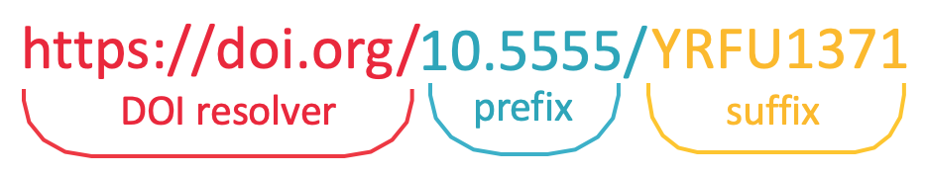
DOI STRUCTURE
prefix = organization
suffix = object id (ex. pub, data)
In the DOI database the citations can be hierarchical:
  https://doi.org/ 10.7910 / DVN / 1EMHTK
Example:
Gary King, Benjamin Schneer, & Ariel White. (2017). Replication Data for: How the News Media Activates Public Expression and Influences National Agendas. Harvard Dataverse.
https://doi.org/10.7910/DVN/1EMHTK.
Havard Dataverse
project ID
object ID

Slide 6
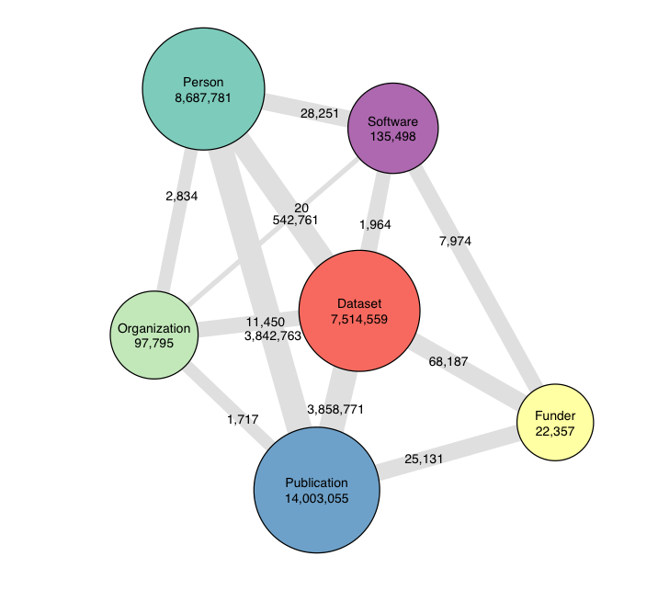
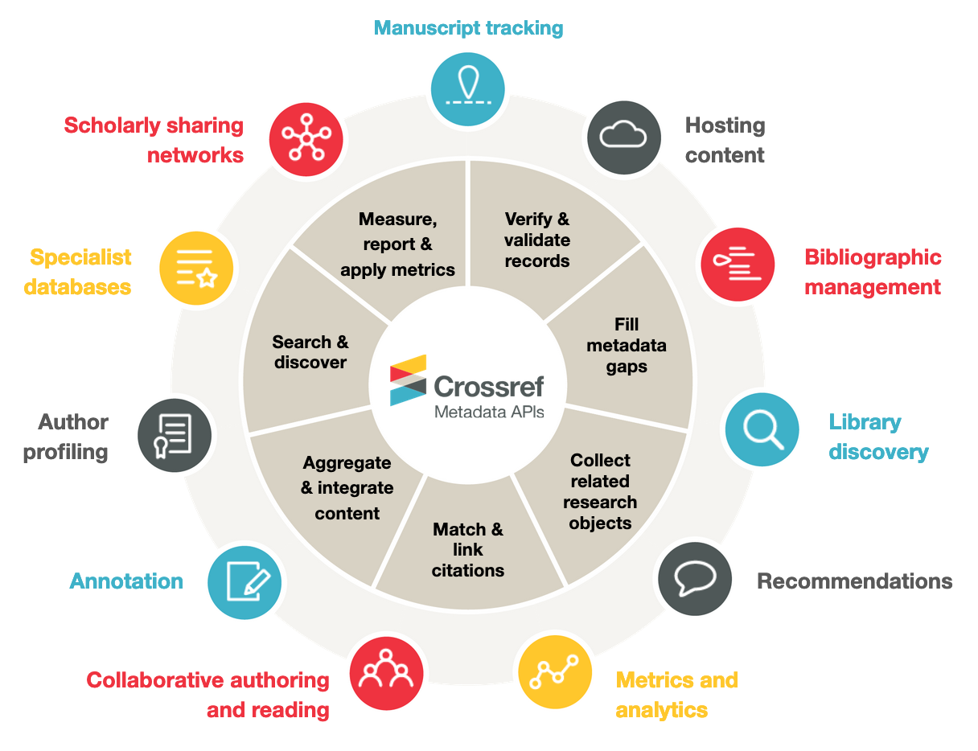
VALUE OF DOI DATABASE:

Slide 7

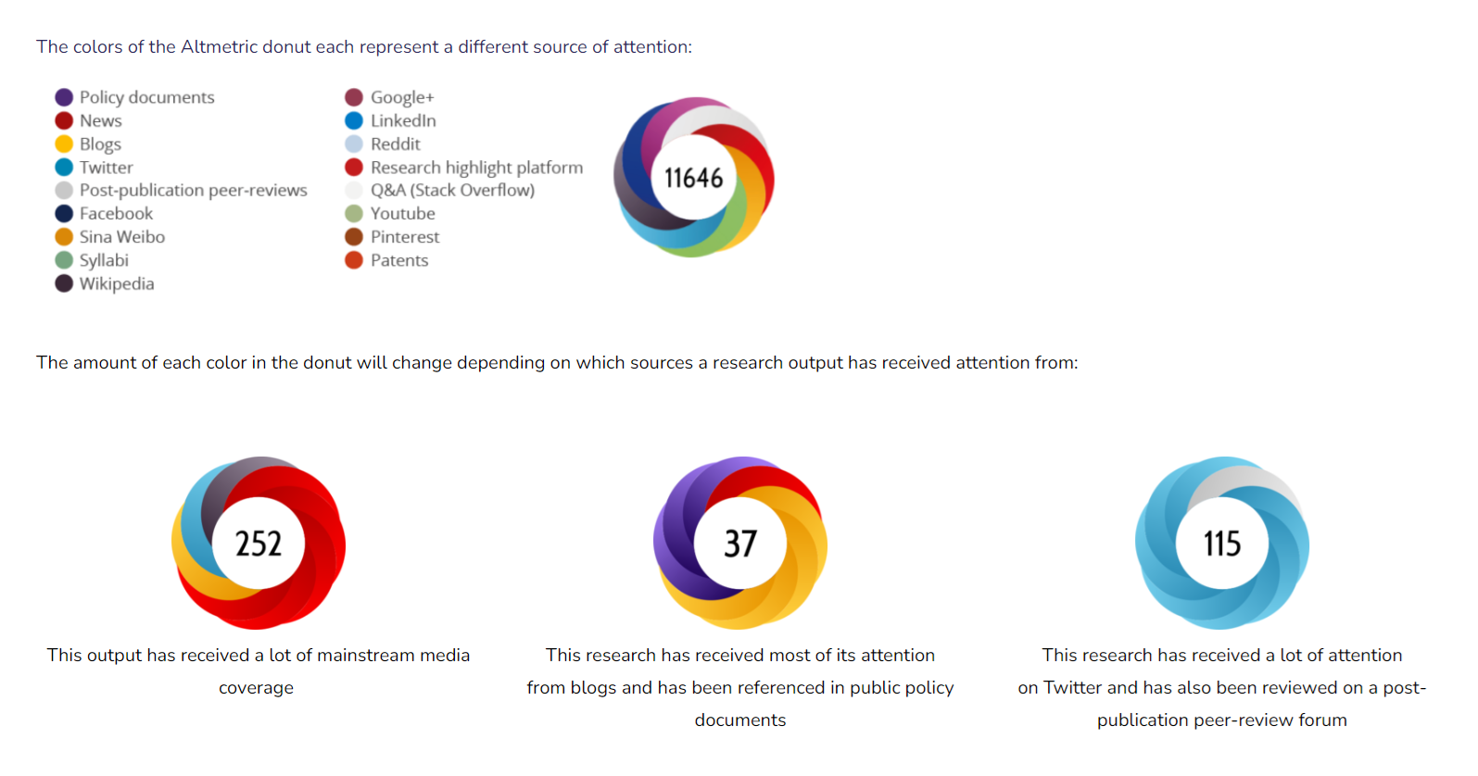
DOIs Enable Tracking Content Use –
The First Step of Measuring Impact

Slide 8
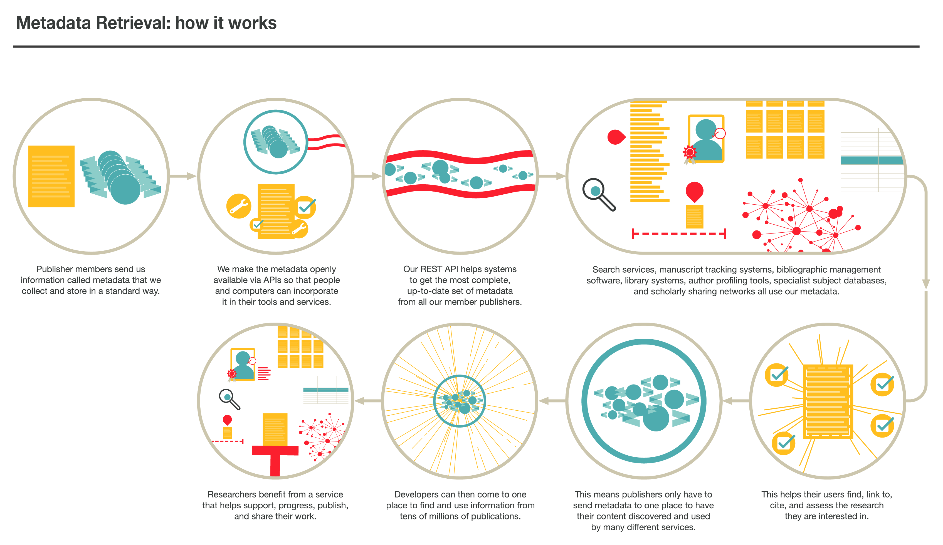

Slide 9
CUSTOMIZING DOIs
possible NCCS DOIs
  doi/xx-urban/ pub/report/id
  doi/xx-urban/ pub/book/id
  doi/xx-urban/ pub/blog/id
  doi/xx-urban/ pub/series/id
  doi/xx-urban/ data/meta/npnames
  doi/xx-urban/ data/meta/nplocations
  doi/xx-urban/ data/crosswalk/ntee-to-pcs
publications series:
  pub/sectorbrief/sib2018
  pub/sectorbrief/sib2019
Data series:
  data/core
  data/bmf
  data/pub78
Tables in a database?
  data/meta/npnames
  data/meta/nplocations
  data/meta/npmissions

Slide 10
How do you
cite data?

Slide 11
Should you cite a data series,
database, or table?
Data has time dimensions (annual waves), different tables for different orgs, and multiple versions.
NCCS Data, downloaded in 2024
(typical, but not helpful)
NCCS Core: doi/xxx
NCCS Core: doi/xxx/V3.41
NCCS Core: doi/xxx/V3.41 (2003)
NCCS Core:
doi/xxx/V3.41/PC-501cX-2003
Example using NCCS Core data series
Core HARMONIZED
Core 2003 Legacy
Core 2003 HARMONIZED
PZ
PZ
PC
PC
501c3
501cX
PFs
501c3
501cX
PFs
Core 2004 Legacy
Core 2004 HARMONIZED
PZ
PZ
PC
PC
only the last version is reproducible in a workflow
501c3
501cX
PFs
501c3
501cX
PFs

Slide 12
LIFE-CYCLE of a research paper through DOIs
Research has a life-cycle and products takes on different forms at different stages.
Pre-
Registration
White
Paper
preprint
published
manuscript
correction
issued
Grant
V0
V1
V2
V3
V4
V5
ONE paper, many citations
Unique
DOIs
DOI databases use Dublin Core attributes to link DOIs
Is Version Of
Has Version
Is Replaced By
Replaces
Is Required By
Requires
Is Part Of
Has Part
Is Referenced By
References
Is Format Of
Has Format
Conforms To
is part of
V2
V5
V0
is version of
replaces
requires
V1
V3
V4
is version of

Slide 13
DATA PROVENANCE (history of the dataset)
Similarly, data has a life-cycle and takes on different forms at different stages.
raw
data
TRANSFORM
& CLEAN
LINK WITH
OTHER DATA
fix aN
ERROR
add NEW
wave
synthetic
PUF version
V0
V1
V2
V3
V4
V5
Unique DOIs through versioning (ideal case)
Unique
DOIs
V0: doi/xxx/ v0.0.0 archive of public dataset
V1: doi/xxx/ v1.0.0 transformation into new dataset
V2: doi/xxx/ v1.1.0 improvement (link with other data)
V3: doi/xxx/ v1.1.1 fix and error
V4: doi/xxx/ v1.2.1 improvement (add new wave)
V5: doi/xxx/ v1.2.1/puf public use version of restricted file
data provenance means not treating all VERSIONS as THE SAME dataset
Notes:
https://dataverse.org/files/dataverseorg/files/metadataprovenance-mercecrosas.pdf

Slide 14
emerging
citation
standards

Slide 15
Joint Declaration of data citation principle
1. Importance
Data should be considered legitimate, citable products of research. Data citations should be accorded the same importance in the scholarly record as citations of other research objects, such as publications[1].
2. Credit and Attribution
Data citations should facilitate giving scholarly credit and normative and legal attribution to all contributors to the data, recognizing that a single style or mechanism of attribution may not be applicable to all data[2].
3. Evidence
In scholarly literature, whenever and wherever a claim relies upon data, the corresponding data should be cited[3].
4. Unique Identification
A data citation should include a persistent method for identification that is machine actionable, globally unique, and widely used by a community[4].
5. Access
Data citations should facilitate access to the data themselves and to such associated metadata, documentation, code, and other materials, as are necessary for both humans and machines to make informed use of the referenced data[5].
6. Persistence
Unique identifiers, and metadata describing the data, and its disposition, should persist — even beyond the lifespan of the data they describe[6].
7. Specificity and Verifiability
Data citations should facilitate identification of, access to, and verification of the specific data that support a claim. Citations or citation metadata should include information about provenance and fixity sufficient to facilitate verifying that the specific timeslice, version and/or granular portion of data retrieved subsequently is the same as was originally cited[7].
8. Interoperability and Flexibility
Data citation methods should be sufficiently flexible to accommodate the variant practices among communities, but should not differ so much that they compromise interoperability of data citation practices across communities[8].
Data Citation Synthesis Group: Joint Declaration of Data Citation Principles. Martone M. (ed.) San Diego CA: FORCE11; 2014 https://doi.org/10.25490/a97f-egyk

Slide 16
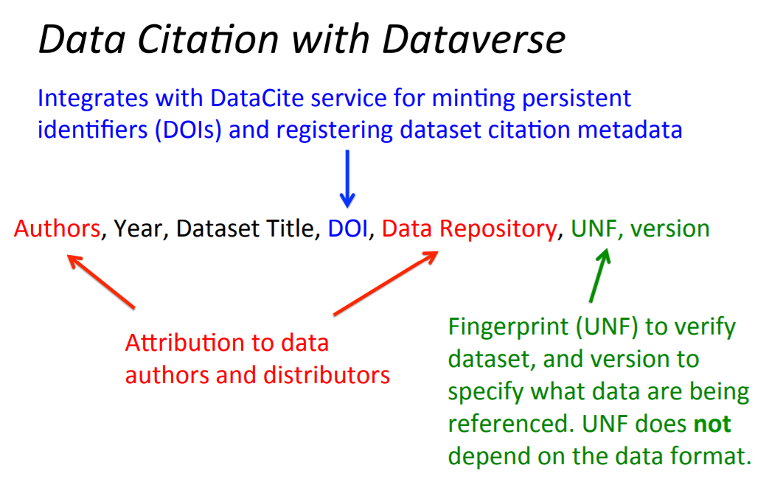

Slide 17
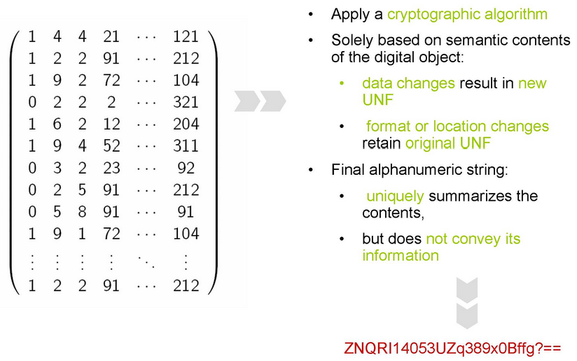
Universal Numeric
Fingerprint (UNF)
https://guides.dataverse.org/en/latest/developers/unf/index.html
Universal Numerical Fingerprint (UNF) is a unique signature of the semantic content of a digital object. It is not simply a checksum of a binary data file. Instead, the UNF algorithm approximates and normalizes the data stored within. A cryptographic hash of that normalized (or canonicalized) representation is then computed. The signature is thus independent of the storage format. E.g., the same data object stored in, say, SPSS and Stata, will have the same UNF.
Early versions of the Dataverse Software were using the first released implementation of the UNF algorithm (v.3, implemented in R). Starting with Dataverse Software 2.0 and throughout the 3.* lifecycle, UNF v.5 (implemented in Java) was used. Dataverse Software 4.0 uses the latest release, UNF v.6. Two parallel implementation, in R and Java, will be available, for cross-validation.
Learn more: Micah Altman and Gary King. 2007. “A Proposed Standard for the Scholarly Citation of Quantitative Data.” D-Lib Magazine, 13. Publisher’s Version Copy at https://j.mp/2ovSzoT

Slide 18
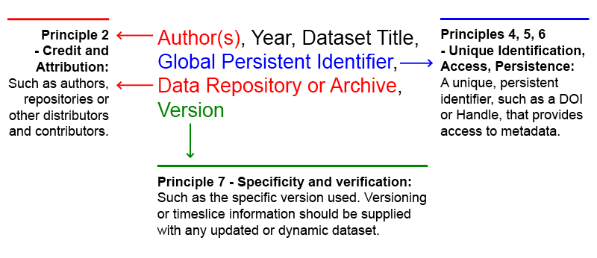
Illustrated in the figure below, is an example of how the data citation is formulated in a Dataverse repository, using the Joint Declaration of Data Citation Principles (2014) : a synthesis of all previously existing principles and initiatives on data citation.

Slide 19
semantic
version
control

Slide 20
Semantic Versioning Convention
  V1.0.0
  V1.0.1 (small update, typically bug fix in software)
  V1.1.0 (larger update, often a new feature)
  V2.0.0 (major update)
Note, if error is corrected the version changes as follows:
  # periods are categories, not decimals
  CORRECT: V1.0.12 --> V1.1.12
  INCORRECT: V1.0.12 --> V1.1.00
IN THEORY, categories can be defined for a specific context (data contexts versus software categories):
  major version | new wave in panel | data improvement
  BMF/v1.03.01
  BMF/v2.00.00 # harmonized
  BMF/v2.00.01 # NTEE improved, new field added
  BMF/v2.01.01 # new month of data integrated

Slide 21
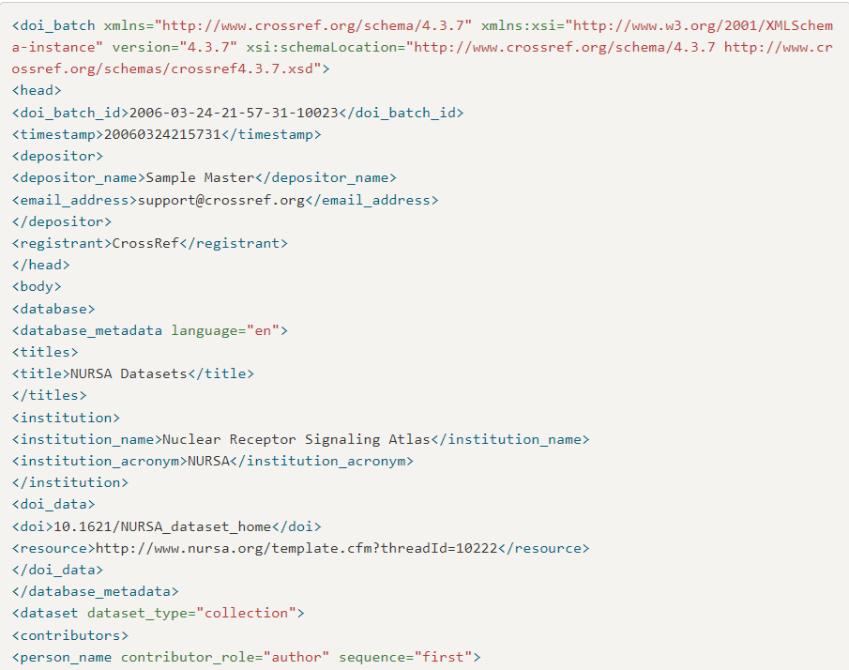
Generating custom DOIs via Crossref:
In practice, it is currently hard to customize DOIs through Crossref because they don’t yet have a form for depositing new datasets – the XML has to be generated manually, including dataset metadata.
https://www.crossref.org/documentation/schema-library/markup-guide-record-types/datasets/
https://gitlab.com/crossref/schema/-/blob/master/best-practice-examples/dataset.5.3.0.xml

Slide 22
combining
all three

Slide 23
Versions can be incorporated into DOIs
  Gary King, Benjamin Schneer, & Ariel White. (2017). Replication Data for: How the News Media Activates Public Expression and Influences National Agendas. Harvard Dataverse. https://doi.org/10.7910/DVN/1EMHTK,
  version:sha256:0f81072b859159923abd0c47 (“fingerprint” convention using unique data hash)
  Gary King, Benjamin Schneer, & Ariel White. (2017). Replication Data for: How the News Media Activates Public Expression and Influences National Agendas. Harvard Dataverse.
  https://doi.org/10.7910/DVN/1EMHTK/v2.15 (versioning convention)
  (Zenodo generates a completely unique DOI for each new version)
DOI databases contain metadata elements that link versions:
  <!-- From Dublin core -->
  < xsd:enumeration value="isVersionOf“ />

Slide 24
Versions represent a project or group
Since there is only one DOI created for each dataset and each DOI points to a single URL, a DOI with or without the version number would point to a dataset landing page or changelog that lists all available versions.
  https://doi.org/10.7910/DVN/1EMHTK/v2.15 --> v2.15
  https://doi.org/10.7910/DVN/1EMHTK/ --> landing page with all versions

Slide 25
Semantic Versioning Convention
Currently supported on Dataverse:
  major revision / minor revision
  BMF/v1.12
Would be better to define custom semantics, but would require Datacite membership:
  major version / new wave in panel / data improvement
  BMF/v1.03.01
  BMF/v2.00.00 # harmonized
  BMF/v2.00.01 # NTEE improved, new field added
  BMF/v2.01.01 # new month of data integrated

Slide 26
Harvard
dataverse

Slide 27
Harvard Dataverse
Open Science repository for storing data, data workflows, and replication files.
Free for all researchers to use.
Limits:
  2GB per file
  1 TB per dataverse (organization or scholar)
  (some limits are negotiable)
Advantages:
  R and Python packages make depositing easy
  Supports public and private projects (can use API to access private data)
  Supports versioning
  Has an API for accessing data

Slide 28
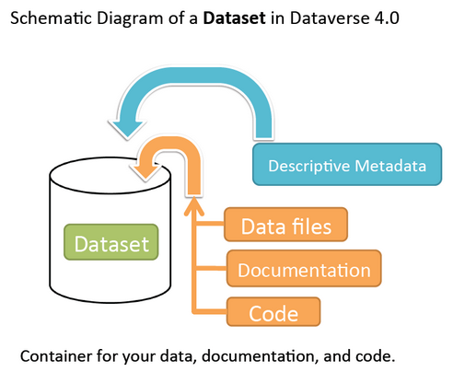
Vocabulary:
Dataverse – collection of datasets owned by a person or organization
Dataset – a collection of files
  tabular data
  documentation
  code
Metadata – many standards supported
  https://guides.dataverse.org/en/4.6/user/appendix.html#metadata-references
File upload limits
  Maximum of 1,000 files per upload.
  File upload limit is 2.5 GB per file.
  Tabular file ingest is limited to 143.1 MB.
See also Data Documentation Initiative (DDI) standards for dataset metadata, and the associated R package:
https://cran.r-project.org/web/packages/DDIwR/index.html

Slide 29
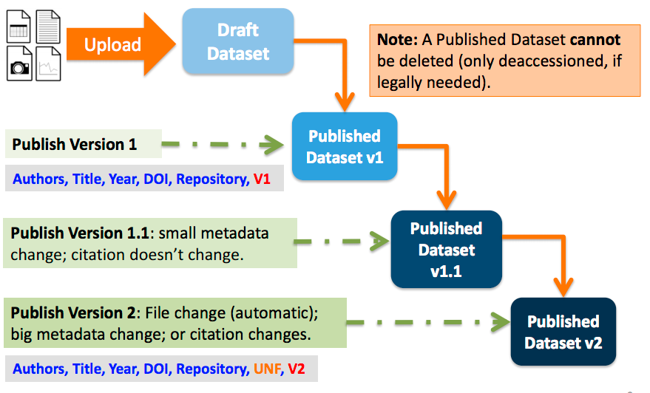
Semantic Versioning Convention
Currently supported on Dataverse:
  major revision / minor revision
  BMF/v1.12

Slide 30
R Package for Dataverse – depositing a dataset:
  # create the dataset. e/g/
  ds <- create_dataset("mydataverse") # pick a name of dataset
  # add files
  tmp <- tempfile() # In this example, we write to a temporary destination
  write.csv(iris, file = tmp)
  add_dataset_file(file = tmp, dataset = ds)
  # publish dataset
  publish_dataset(ds)
  # dataset will now be published
  get_dataverse("mydataverse")

Slide 31
  library("dataverse")
  Sys.setenv("DATAVERSE_SERVER" = "dataverse.harvard.edu")
  Sys.setenv("DATAVERSE_KEY" = "examplekey12345“)
  create_dataset() # dataset can be multiple tables
  add_dataset_file() # add new table, dictionary, crosswalk, code
  update_dataset() # update description, documentation
  publish_dataset() # can chose MINOR or MAJOR revision

Slide 32
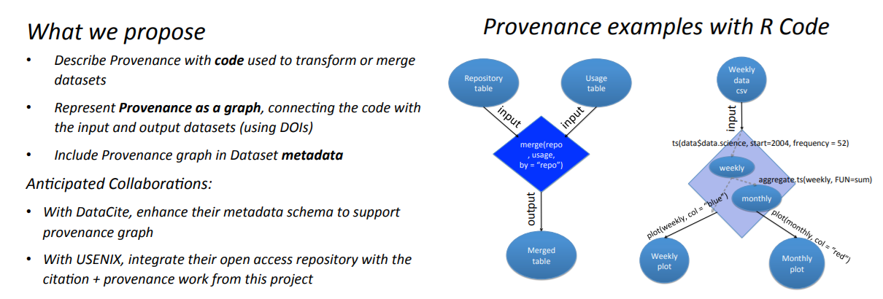
Planned Support for Data Provenance (workflows):

Slide 33
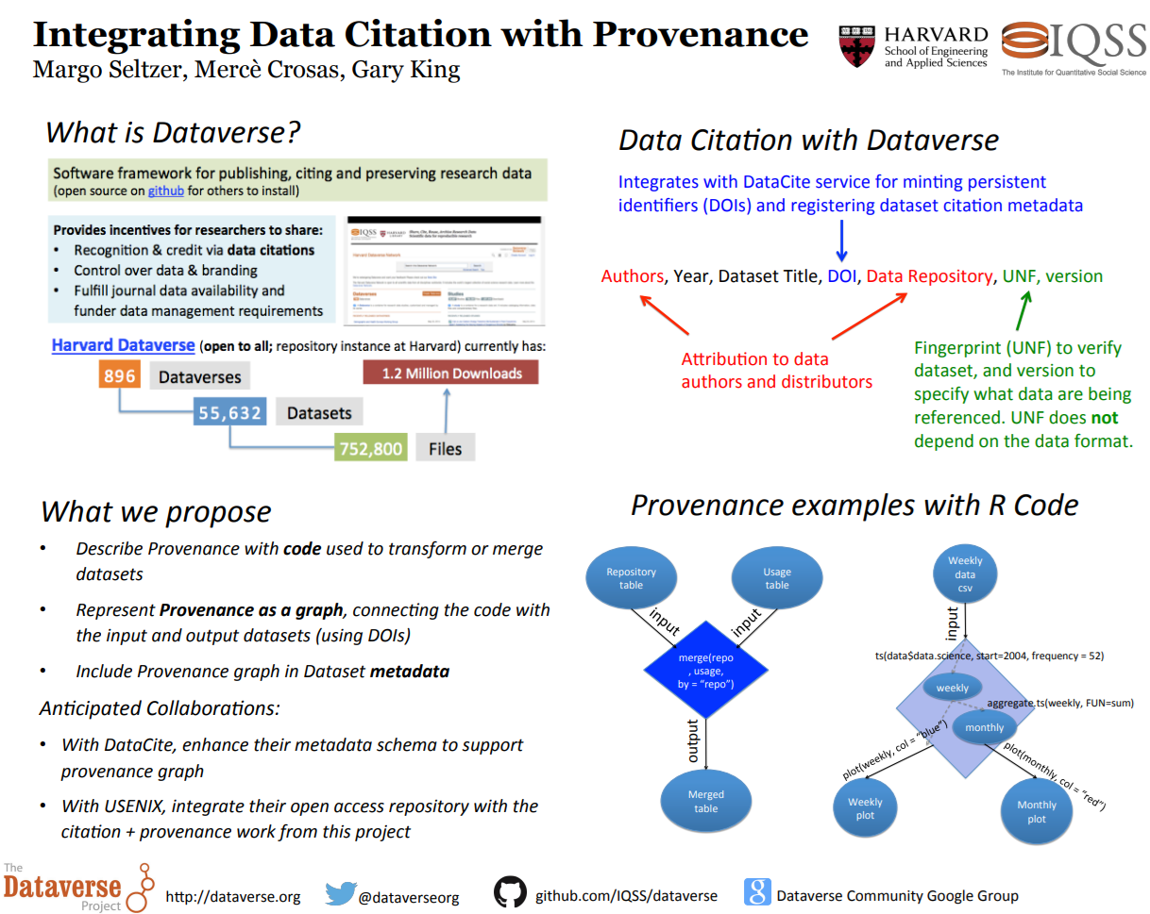

Slide 34
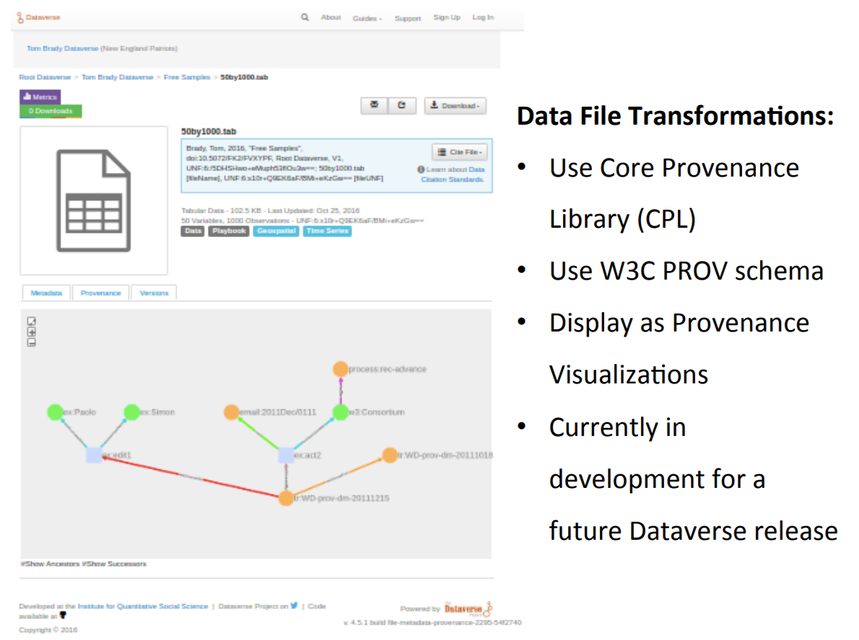
https://dataverse.org/files/dataverseorg/files/metadataprovenance-mercecrosas.pdf

