Slide 1
partitioned regression
Fundamentals of
PROGRAM EVALUATION
JESSE LECY

Slide 2
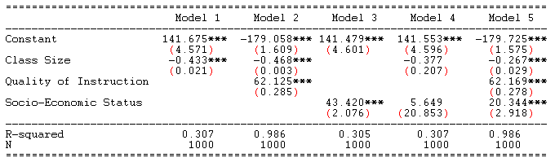
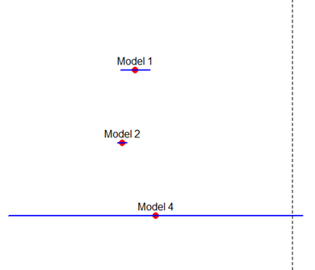
Example: Classroom Size
Why are slopes and standard errors changing
when we add “control” variables?

Slide 3
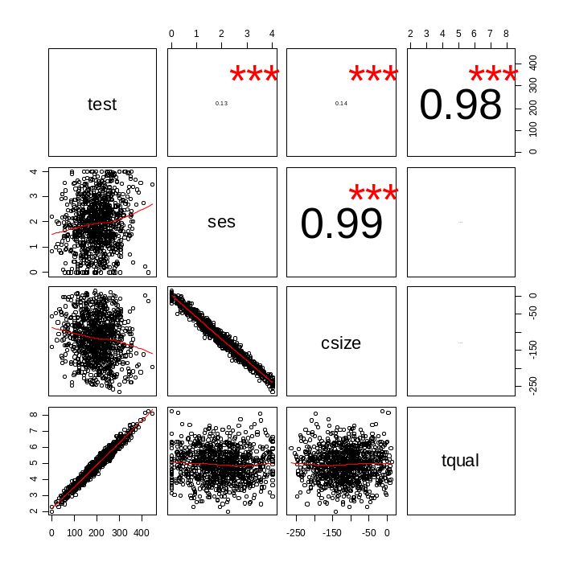
Example: Classroom Size
Teacher
Quality
Test Scores
Socio-
Economic
Status
Classroom
Size

Slide 4
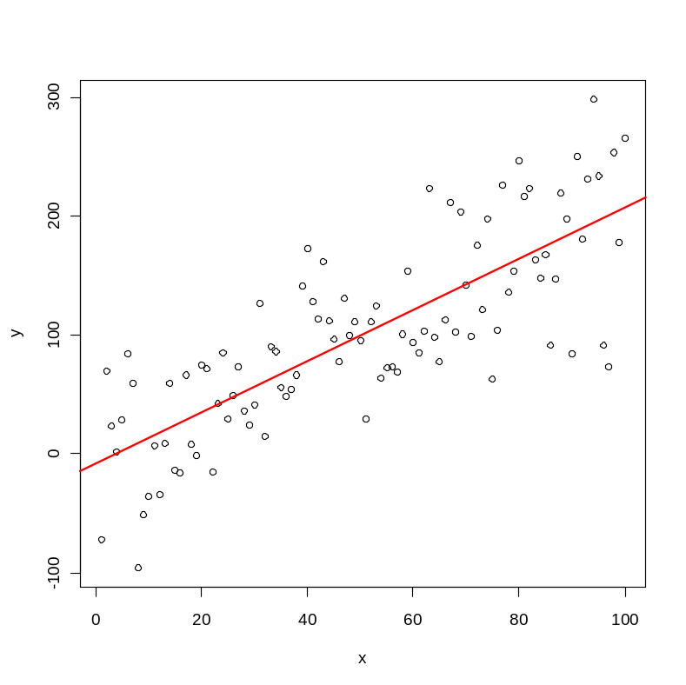


Partitioning the Variance of Y
Y
e
-> SSE
Y-hat
-> RSS
X

Slide 5



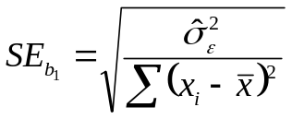
Standard Error in Regression
Sum of Squared Error Terms
Variance of the residual
Standard error of the slope

Slide 6
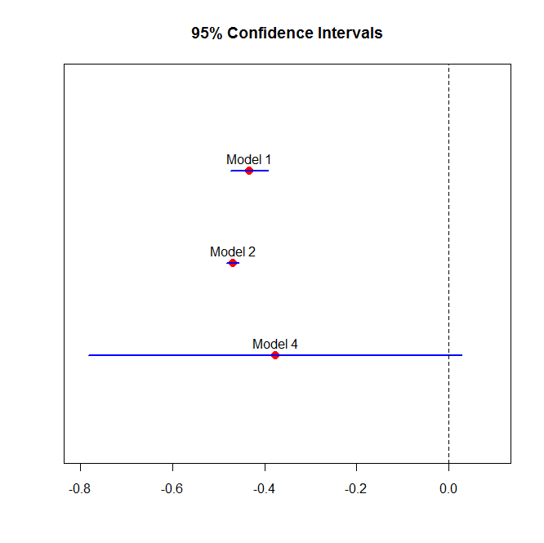
Model 1
Test
Score
CS
Model 2
Test
Score
TQ
CS
Test
Score
Model 4
CS
SES

Slide 7
Partitioned regression

Slide 8
Ballentine venn diagram
Dependent
Variable
Y
C
A
B
X1
X2
Policy
Variable
Control
Variable

Slide 9
Ballentine venn diagram
Variance of Y
X1
Cov( X1, Y )

Slide 10
Ballentine venn diagram
Variance
of X1
Variance
of X2
Cov( X1, X2 )

Slide 11
Ballentine venn diagram
C = Unexplained Portion of Y (the residual)
A = Cov( X1, Y) after removing effects of X2 (“controlling for”)
Y
C
A
B
X1
X2
A + B = Variance of X1 after controlling for X2

Slide 12


Partitioned Regression
Y
e₁
X2
X1
e₂
X2

Slide 13
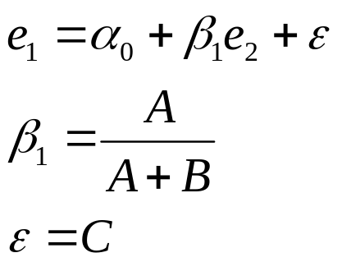
Partitioned Regression
e₁
C
A
e₂
B

Slide 14
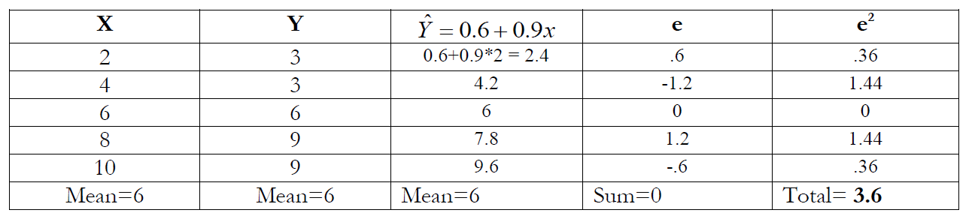
Why can we do this?
The residual is just another variable.
The order of operations is important in partitioned regression.

Slide 15


Note: Multiple Regression Context
If there is more than one control variable make sure you cleanse all of the nuisance variance from both your dependent variable and your policy variable.

Slide 16
Example 1:
$$SWB=β_{0}+β_{1}PSS+β_{2}ND+β_{3}NP+ε$$
“policy variable”
Coefficientsª
Model |  | Unstandardized Coefficients |  | Standardized Coefficients | t | Sig.
 |  | B | Std. Error | Beta
1 | (Constant) | -1.507 | 2.633 |  | -.572 | .567
 | Perceived Social Support | .310 | .032 | .460 | 9.645 | .000
 | Network Diversity | -.215 | .210 | -.055 | -1.025 | .306
 | # People in Social Network | .023 | .014 | .087 | 1.654 | .099
Dependent Variable: Subjective Well Being

Slide 17

Auxiliary Regression #1
$$SWB=b_{0}+b_{1}ND+b_{2}NP+e_{1}$$
Coefficientsª
Model |  | Unstandardized Coefficients |  | Standardized Coefficients | t | Sig.
 |  | B | Std. Error | Beta
1 | (Constant) | 21.630 | 1.207 |  | 17.915 | .000
 | Network Diversity | .224 | .228 | .057 | .979 | .328
 | # People in Social Network | .039 | .016 | .148 | 2.540 | .011
Dependent Variable: Subjective Well Being
Regress the DV on all IV’s except the policy variable.
Save the residuals.

Slide 18
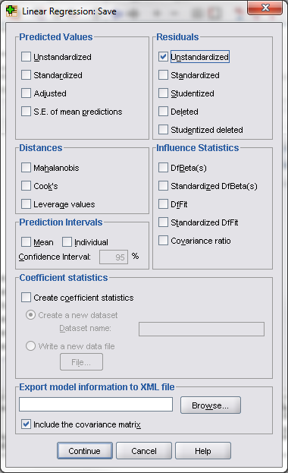

Auxiliary Regression #1
$$SWB=b_{0}+b_{1}ND+b_{2}NP+e_{1}$$
Coefficientsª
Model |  | Unstandardized Coefficients |  | Standardized Coefficients | t | Sig.
 |  | B | Std. Error | Beta
1 | (Constant) | 21.630 | 1.207 |  | 17.915 | .000
 | Network Diversity | .224 | .228 | .057 | .979 | .328
 | # People in Social Network | .039 | .016 | .148 | 2.540 | .011
a. Dependent Variable: Subjective Well Being

Slide 19

Auxiliary Regression #2
$$PSS=a_{0}+a_{1}ND+a_{2}NP+e_{2}$$
Coefficientsª
Model |  | Unstandardized Coefficients |  | Standardized Coefficients | t | Sig.
 |  | B | Std. Error | Beta
1 | (Constant) | 74.720 | 1.720 |  | 43.438 | .000
 | Network Diversity | 1.417 | .325 | .244 | 4.356 | .000
 | # People in Social Network | .052 | .022 | .133 | 2.364 | .019
Dependent Variable: Perceived Social Support
Regress the policy variable on all of the IV’s.
Save the residuals.

Slide 20

Partitioned Regression
$$e_{1}=c_{0}+β_{1}e_{2}+ε$$
Regress the residuals on each other.
Coefficientsª
Model |  | Unstandardized Coefficients |  | Standardized Coefficients | t | Sig.
 |  | B | Std. Error | Beta
1 | (Constant) | 2.369E-15 | .253 |  | .000 | 1.000
 | Unstandardized Residual | .310 | .032 | .441 | 9.670 | .000
Dependent Variable: Unstandardized Residual
We have recovered the
original slope!

Slide 21
Why is this important?
It illustrates the idea of statistical controls in policy work – get rid of the nuisance variance!
Provides insight into the regression error term.
Serves as a tool for future methods (instrumental variables).
It paved the way for modern computational econometrics.

Slide 22
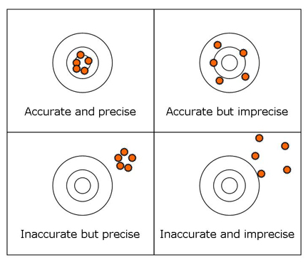
Why we care:
Results need to be:
Unbiased (accurate)
Efficient (precise)
Biased and inefficient
Biased and efficient
Unbiased and inefficient

Slide 23
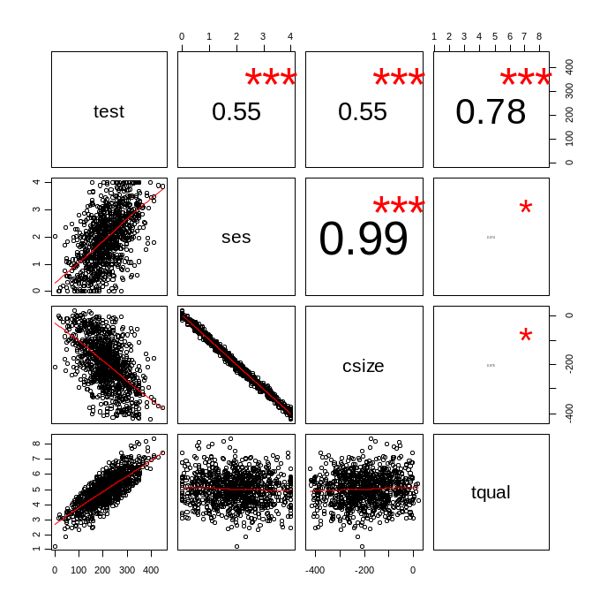
Effects of controls determined by their correlations with the outcome and policy variables
Teacher
Quality
Test Scores
Classroom
Size

Slide 24

Partitioning the Variance of Y
Final Exam Scores
Unexplained Portion
SES: Race / Gender / Income
Previous Coursework
Hours of Sleep
What happens if we omit
variables from the model?
Hours of Preparation

Slide 25
Partitioning the Variance of Y
Teacher Quality
B
A
A
Test
Score
B
TS
*Test
Score
TQ
A
Teacher Quality

Slide 26
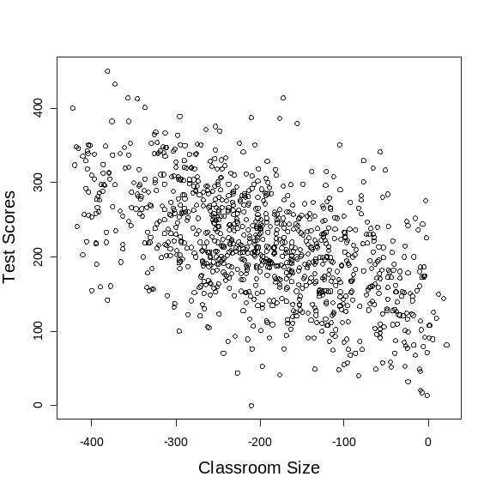
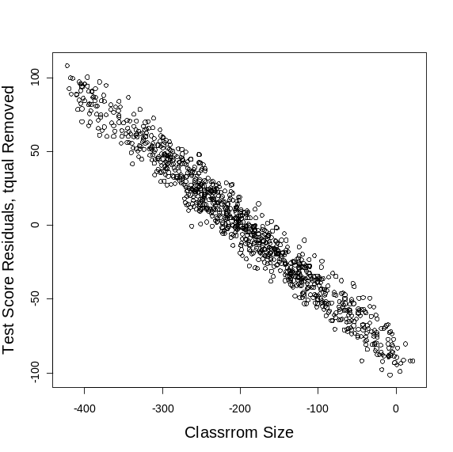
Effects of the Control Variable
Test
Score
Test
Score
TQ
e₁
e₂
CS
CS

Slide 27
Effects of the Control Variable
Test
Score
Test
Score
TQ
e₁
e₂
e₁ > e₂
CS
CS
e₁
e₂

Slide 28
Partitioning y with multiple variables

Slide 29
What happens to slopes and standard errors when we add more variables?
Y
A
B
X
D
C
Z

Slide 30
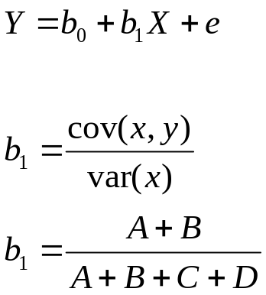
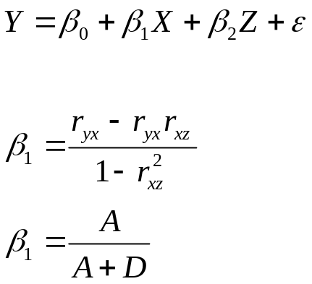
Multiple Regression Mechanics: SLOPE
Y
A
B
X
D
C
Z
The formula for the slope is different when you add more variables

Slide 31
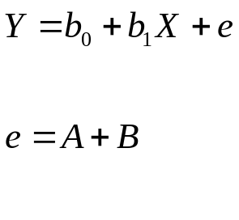
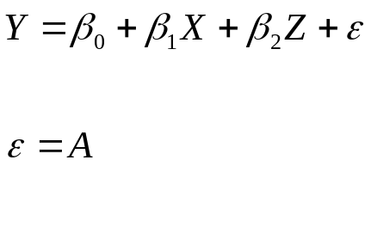
Multiple Regression Mechanics: STANDARD ERRORS
Y
A
B
X
Z
The unexplained variance is different when you add more variables

