Slide 1
Research design for counter-factual analysis
Lecy * NLM 530

Slide 2
Core Concepts
Counter-Factual Analysis for Causal Reasoning
Randomization Process
Control versus Comparison Group
Treatment Effects
Average Treatment Effect (ATE)
Intention to Treat (ITT)
Treatment on the Treated (TOT)
Calculation of Program Impact (effect size)

Slide 3
Counter-factual analysis

Slide 4
Were suicide rates HIGH for a specific high school in suburban California?

Slide 5
Were suicide rates HIGH for a specific high school in suburban California?
Null
95% CI:
Average Rate Per Year at HS
Null Hypothesis: Population Average

Slide 6
Were suicide rates HIGH for a specific high school in suburban California?
Null
95% CI:
Average Rate Per Year at HS
Null Hypothesis: Population Average
Null
Null Hypothesis: All HS Students
OR All Californians

Slide 7
Were suicide rates HIGH for a specific high school in suburban California?
Null
95% CI:
Average Rate Per Year at HS
Null Hypothesis: Population Average
These are all valid counter-factuals. How we define our comparison drives the conclusions.
Null
Null Hypothesis: All HS Students
OR All Californians
Null
Null Hypothesis: All Suburban HS Students

Slide 8
A valid counter-factual allows us to answer the following two questions:
Compared to what? The program outcomes are different than outcomes in the comparison group. The comparison group is defined by the researcher. In some special cases the comparison group is identical (statistically speaking) to the treatment group. In this case we call it a “control” group.

Slide 9
A valid counter-factual allows us to answer the following two questions:
Compared to what? The program outcomes are different than outcomes in the comparison group. The comparison group is defined by the researcher. In some special cases the comparison group is identical (statistically speaking) to the treatment group. In this case we call it a “control” group.
How big is the program effect? Is the difference meaningful (statistically significant and socially salient)? In the simple case the program effects is just the difference of the average outcome of the treatment and control group, but in practice there are many ways we calculate an effect.

Slide 10
Were suicide rates HIGH for a specific high school in suburban California?
Null
95% CI:
Average Rate Per Year at HS
Null Hypothesis: Population Average
These are all valid conter-factuals. How we define our comparison drives the conclusions.
Null
Null Hypothesis: All HS Students
OR All Californians
Null
Null Hypothesis: All Suburban HS Students

Slide 11
Program impact: The “effect”

Slide 12
The program evaluation framework: “Discrete” treatment groups (yes/no)
Heart Rate
Treatment (Caffeine)
Control (No caffeine)

Slide 13

The program evaluation framework
$$Effect = T2−C2$$
Heart Rate
Treatment (Caffeine)
Control (No caffeine)
T2= Mean of treatment group after treatment
Mean of control group after treatment period= C2

Slide 14
DIFFERENCE
OF MEANS
b₁ = MEAN_{treat} - MEAN_{control}
Heart Rate
b₁
Control (No caffeine)
Treatment (Caffeine)
b₁ = 0
CONFIDENCE INTERVAL

Slide 15
b₁ = MEAN_{treat} - MEAN_{control}
Heart Rate
b₁
Control (No caffeine)
Treatment (Caffeine)
b₁ = 0
NULL HYPOTHESIS
(b₁=0 means NO IMPACT)

Slide 16
STATISTICAL SIGNIFICANCE (CONF. INT. CONTAINS ZERO?)
b₁ = MEAN_{treat} - MEAN_{control}
Heart Rate
b₁
Control (No caffeine)
Treatment (Caffeine)
b₁ = 0
NOT SIGNIFICANT
(NO PROGRAM IMPACT)

Slide 17
STATISTICAL SIGNIFICANCE (CONF. INT. CONTAINS ZERO?)
b₁ = MEAN_{treat} - MEAN_{control}
Heart Rate
Treatment (Caffeine)
b₁
Control (No caffeine)
b₁ = 0
SIGNIFICANT
(POSITIVE PROGRAM IMPACT)

Slide 18
STATISTICAL SIGNIFICANCE (CONF. INT. CONTAINS ZERO?)
b₁ = MEAN_{treat} - MEAN_{control}
Heart Rate
Control (No caffeine)
b₁
Treatment (Caffeine)
b₁ = 0
SIGNIFICANT
(NEGATIVE PROGRAM IMPACT)

Slide 19
Definition of EFFECT in program eval:
Observed change + confidence interval
(size of observed impact plus accuracy, can we say with confidence it’s positive)
b₁ = MEAN_{treat} - MEAN_{control}
Heart Rate
b₁
Control (No caffeine)
Treatment (Caffeine)
b₁ = 0

Slide 20
True experiments

Slide 21
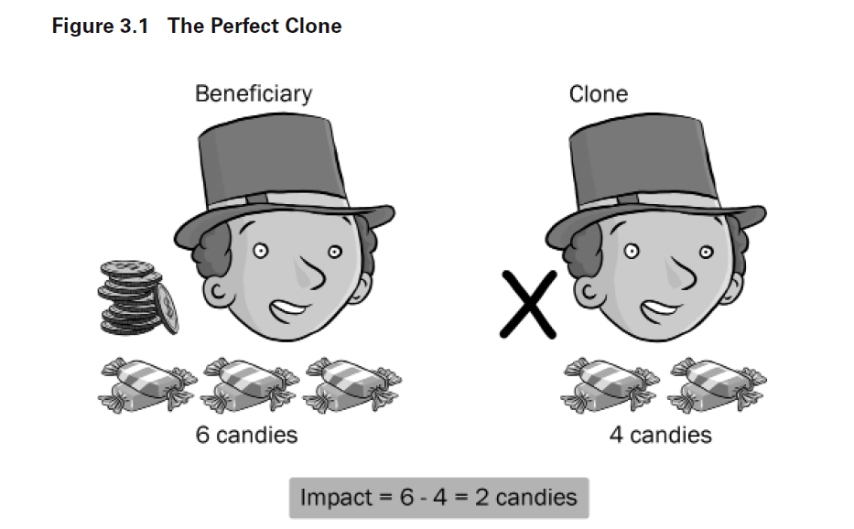

Slide 22
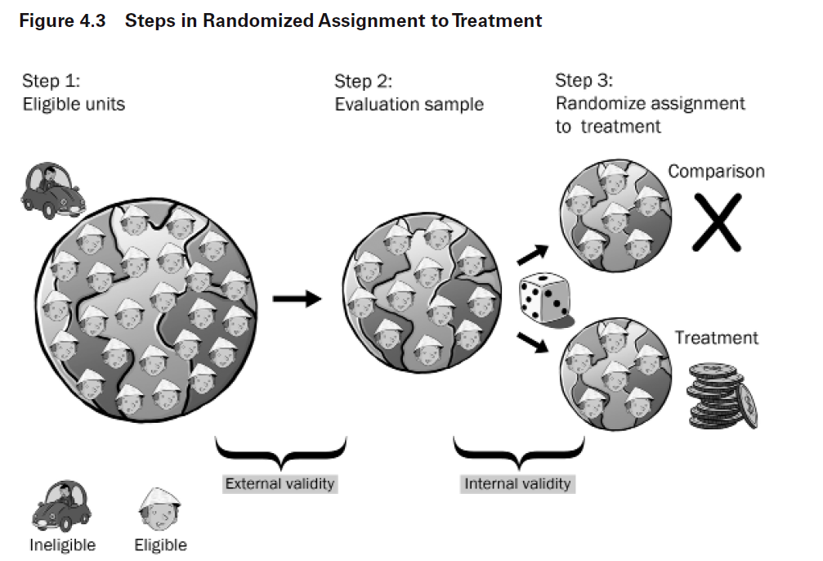

Slide 23
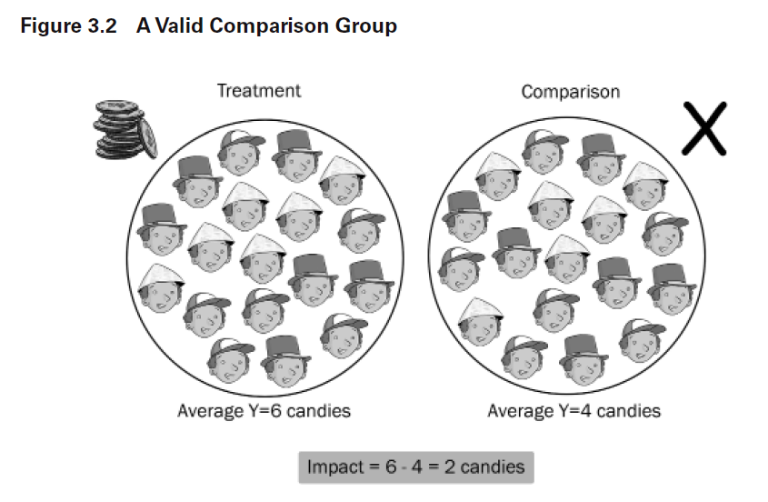
b₁ = T2 – C2

Slide 24
b₁ = MEAN_{treat} - MEAN_{control}
b₁ = T2 – C2
No Program Impact
Outcome
b₁
Control
Treatment
b₁ = 0

Slide 25
b₁ = MEAN_{treat} - MEAN_{control}
b₁ = T2 – C2
Positive Program Impact
Outcome
Treatment
b₁
Control
b₁ = 0

Slide 26
Happy randomization

Slide 27
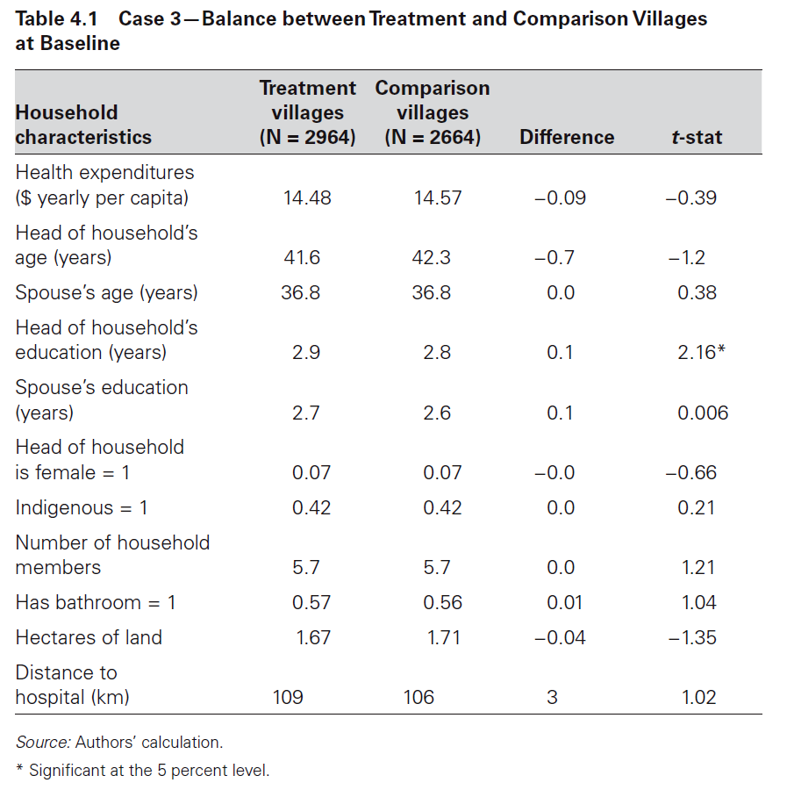
Is this problematic?

Slide 28
Bonferroni Correction:
When we want to be 95% confident that two groups are the same, and we can measure those groups using a set of contrasts, then our decision rule is no longer to reject the null (that the groups are the same) if the p-value < 0.05. A “contrast” is a comparison of means of any measured characteristic between two groups.
If we have a 5% chance of observing a p-value of 0.05 for each contrast, then the probability of observing at least one contrast with a p-value that small is greater than 5%! It is actually n*.05, where n is the number of contrasts.
So if we want to be 95% confident that the groups are different (not just the contrasts), we have to adjust our decision rule to α/n.
For example, if we have 10 contrasts, then our decision rule is now 0.05/10, or 0.005. The p-value of at least one contrast must be below 0.005 for us to conclude that the groups are different.
x1 <- rbinom( 10000, 6, 0.05 )
table( x1 ) / 10000
y1 <- rbinom( 10000, 6, 0.05/6 )
table( y1 ) / 10000

Slide 29
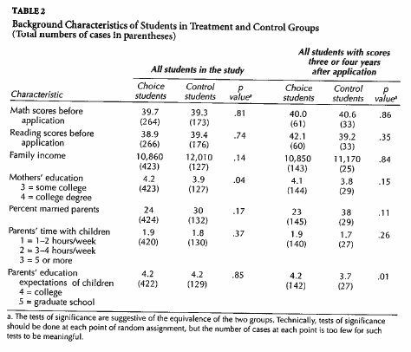
Test for “Happy” Randomization
0.05 / 6 = 0.0083
x1 <- rbinom( 10000, 6, 0.05 )
table( x1 ) / 10000
y1 <- rbinom( 10000, 6, 0.05/6 )
table( y1 ) / 10000

Slide 30
RCT versus Natural Experiments:
RCT assumes complete control over the assignment process
Natural Experiments often utilize randomization:
Charter Schools Example
Vietnam Veterans Example

Slide 31
Selection Problem

Slide 32
Microfinance example of bias from selection INTO a study group
Number of people per category
 | Not an Entrepreneur | Entrepreneur
No Loan | 30 | 15
Takes a Loan | 20 | 35
Average weekly income per category
 | Not an Entrepreneur | Entrepreneur
No Loan | $10 | $20
Takes a Loan | $10 | $20
The loan appears to have an impact even when we know it didn’t!

Slide 33
“Selection” Problem
Those that participate in the program (treatment group) are different from those that do not (control group).
This is the biggest problem in impact evaluation!
The Fix:
Use randomization or matching to ensure an apples to apples comparison.

Slide 35
Test for “Happy” Randomization

Slide 36
Microfinance example of bias from selection OUT OF a study group
Reflexive design
$3.00
$2.50
$2.00
$1.50
$1.00
$3.00
$2.50
$2.00
$1.50
$1.00
Mean = $2.00
Mean = $2.00
Household daily income before program
After program
T2 - T1 = 0, estimate of effect is accurate (“unbiased”)

Slide 37
Random Attrition Example
$3.00
$2.50
$2.00
$1.50
$1.00
$3.00
$2.50
$2.00
$1.50
$1.00
Attrit
Mean = $2.00
Mean = $2.00
Attrit
T2 - T1 = 0, Impact study accurately represents program effects

Slide 38
Non-Random Attrition Example
$3.00
$2.50
$2.00
$1.50
$1.00
$3.00
$2.50
$2.00
$1.50
$1.00
Mean = $2.50
Mean = $2.00
Attrit
T2 – T1 ≠ 0, We over-estimate program effects

Slide 39
Non-Random Attrition Example
$3.00
$2.50
$2.00
$1.50
$1.00
$3.00
$2.50
$2.00
$1.50
$1.00
Attrit
Mean = $2.00
Mean = $1.50
T2 – T1 ≠ 0, We under-estimate program effects

Slide 40
Non-Random Attrition
If the people that leave a program or study are different than those that stay, the calculation of effects will be biased.
The Fix:
Examine characteristics of those that stay versus those that leave.

Slide 41
Test for Attrition
Can also be tested in another way: do background characteristics of T1 = T2

Slide 42
Different interpretations of program effects

Slide 43
One of The Physicists Behind The Higgs Boson Has Made an Algorithm to Replace The Pill
It's up to 99.5% effective at stopping pregnancy.
Those more effective methods are ones that don't require people to remember to take a pill, put on a condom, or record their temperature daily, such as intrauterine contraception or implants.
That's because human error can mess with things quite a lot. In fact, the UK's National Health Service (NHS) explained that when the app was used perfectly all the time, only five out of every 1,000 women would fall pregnant every year - a rate slightly better than the pill (99.5 percent).
But for "typical use" - where the app isn't used entirely correctly every day - it's more likely that seven out of every 100 women would experience accidental pregnancies, which is around 93 percent efficiency.
Is REAL effectiveness 99.5 percent, or 93 percent?
https://www.sciencealert.com/one-of-the-physicists-behind-the-higgs-boson-has-made-an-algorithm-to-replace-the-pill

Slide 44
Estimation of the counter-factual:
Given Bed Nets
Control Group
Given Bed Nets AND Use Them!
Program Effect = ( T2 – T1 ) – (C2 – C1 )
Is Group T those that are given bed nets, or those that use them?

Slide 45
Terminology:
“Average” treatment effects
Treatment on the Treated (TOT) Effects
Intention to Treat (ITT) Effects
Given Bed Nets
Given Bed Nets AND Use Them!

Slide 46
One of The Physicists Behind The Higgs Boson Has Made an Algorithm to Replace The Pill
It's up to 99.5% effective at stopping pregnancy.
Those more effective methods are ones that don't require people to remember to take a pill, put on a condom, or record their temperature daily, such as intrauterine contraception or implants.
That's because human error can mess with things quite a lot. In fact, the UK's National Health Service (NHS) explained that when the app was used perfectly all the time, only five out of every 1,000 women would fall pregnant every year - a rate slightly better than the pill (99.5 percent).
But for "typical use" - where the app isn't used entirely correctly every day - it's more likely that seven out of every 100 women would experience accidental pregnancies, which is around 93 percent efficiency.
Which is treatment on the treated effect?
Which is the intention-to-treat effect?
https://www.sciencealert.com/one-of-the-physicists-behind-the-higgs-boson-has-made-an-algorithm-to-replace-the-pill

Slide 47
Three main types of Counterfactual analysis

Slide 48
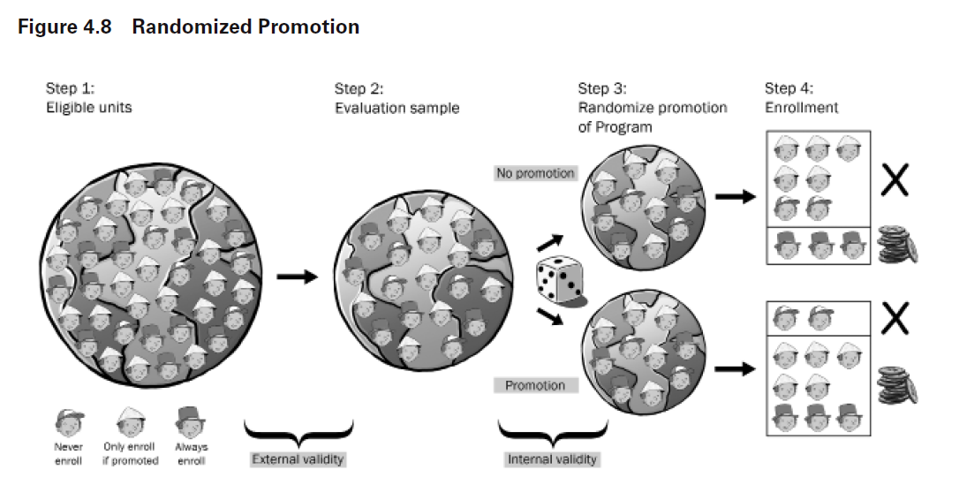
Calculation of Treatment Effects:
Intervention
We compare the group averages for the treatment and control groups after the study. The “effect” represents program impact:
Effect = T2 - C2
C2
T1 & C1
T2

Slide 49
Varieties of the Counter-Factual:
Treatment Groups, T1=before, T2=after
Each counterfactual has a different formula for program effects.
Control Groups, C1=before, C2=after
Pre-Post With Control
(T2-T1) – (C2-C1)
Pre-Post Reflexive (T2-T1)
Post-Only (T2-C2)
(Diff-in-Diff)
Effect
Effect
A
Effect: A-B
B
t=1
t=2
t=1
t=2
t=1
t=2
Program
Program
Program

Slide 50
The Three Counterfactuals:
Difference-in-Difference: Gains in the treatment group compared to gains in the comparison group. Effect calculation: (T2-T1) – (C2-C1)
Reflexive Design: Gains in the treatment group only. Effect Calculation: (T2-T1)
Post-Test Only Design: Differences between the treatment and control groups after the program is delivered. Effect Calculation: (T2-C2)

Slide 51
One “strong” counterfactual: Diff-in-Diff
Pre-Post With Control
(Diff-in-Diff)
A
Effect: A-B
B
T=1
T=2
Program
Accounts for initial difference in groups and secular trends

Slide 52
The difference in difference estimator:
Program Impact= (T2 – T1) – (C2 – C1)
Gains during the program period
by
treatment group
Gains as a result of trend

Slide 53
T2
T2 – T1 = Total Gains in Treatment Group
C2
C2 – C1 = Total Gains in Control Group (trend)
T1
C1
(T2-T1)-(C2-C1) = Program Impact

Slide 54
“Control” Versus “Comparison” Groups
Outcome
T2
Policy / program group
T1
C2
Two Considerations:
Does C1 = T1 ?
Not usually for comparison groups.
Is C2 – C1 accurate reflection of trend?
In some cases, the comparison group can adequately capture trend.
C1
Control / comparison group
time=1
time=2
Program
Single Difference: Difference in Difference:
Effect = T2 – T1 Effect = (T2 – T1) – (C2 – C1)
Effect = T2 – C2
*trend*

Slide 55
Two “weak” counterfactuals
Pre-Post Reflexive
Post-Only
Effect
Effect
time=1
time=2
time=1
time=2
Program
Program
These are only valid (high internal validity) when certain conditions are met.

Slide 56
Validity of two “weak” counterfactuals:
Reflexive (Pre-Post)
(T2 – T1) – (C2 – C1) = T2 – T1
IFF
C2 – C1 = 0
(no trend)
Outcome
T2
T1
T2 – T1
C1
C2
time=1
time=2
Program

Slide 57
Validity of two “weak” counterfactuals:
Post-Only
(T2 – T1) – (C2 – C1) = T2 – C2
IFF
C1 – T1 = 0
(equivalent at time 1)
Outcome
T2
Randomization gives us this. Therefore we can use post-test only estimators
in experiments.
T1
C2
C1
time=1
time=2
Program

Slide 58
T2
Post-Test Only Measure
True Effect = T2 – C2
C2
If C1 = T1
T1
Measured effect accurately represents program impact
C1
Outcome
T2
T2 – C2 Too big
C1 < T1
T1
C2
C1
T1
Measured effect overstates program impact
C1
time=1
time=2
Program
T2 – C2 Too small
C1>T1
C1
T1
Measured effect understates program impact

Slide 59
Counterfactuals in practice: Quasi-Experiment Methods
Difference-in-Difference: Effect = (T2-T1) – (C2-C1)
Difference-in-Difference Analysis
Fixed Effects Models
Reflexive Design: Effect = T2 – T1
Pre-Post Design with only a Treatment Group
Time Series Regression
Post-Test Only Design: Effect = T2 – C2
True Experiments (T2-C2)
Post-Test Only Comparison, No Baseline (T2-C2)
Propensity Score Matching
Regression Discontinuity Design

Slide 60
Case Study from readings

Slide 61
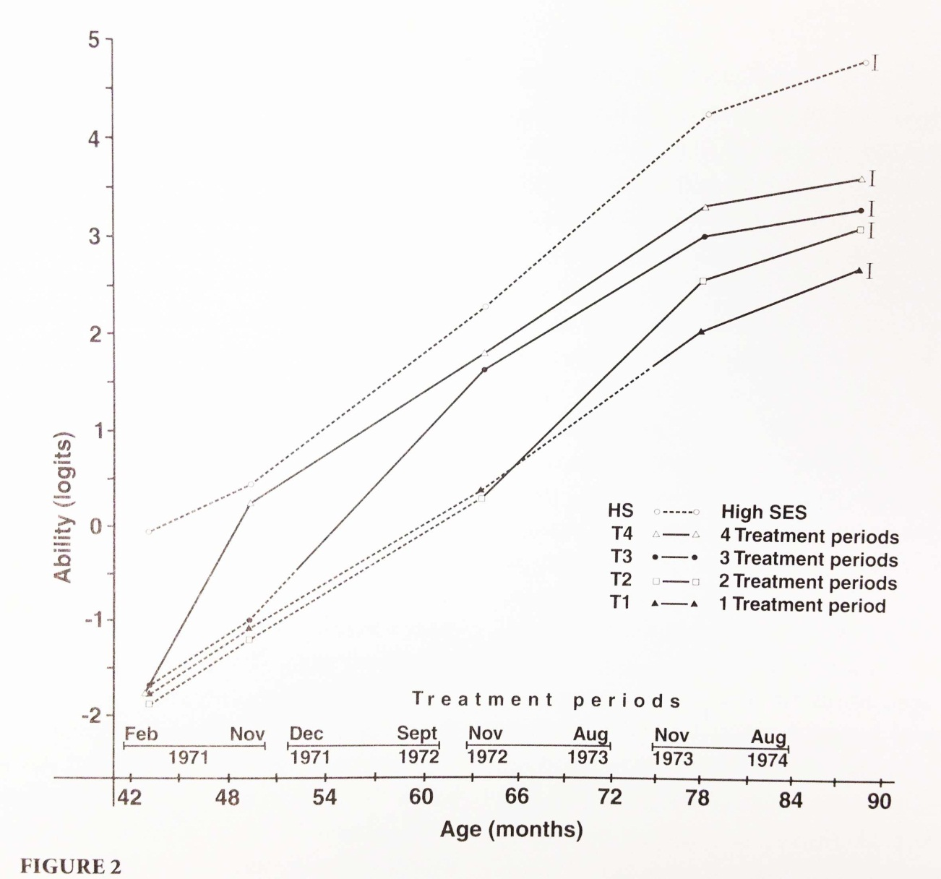
Another Example:

Slide 62
Treatment Groups
x
G1_{t=0} G1_{t=1} G1_{t=2} G1_{t=3} G1_{t=4}
G2_{t=0} G2_{t=1} G2_{t=2} G2_{t=3} G2_{t=4}
G3_{t=0} G3_{t=1} G3_{t=2} G3_{t=3} G3_{t=4}
G4_{t=0} G4_{t=1} G4_{t=2} G4_{t=3} G4_{t=4}
x
x
x
Control Groups

Slide 63
Treatment Group Control Group
x
G1_{t=0} G1_{t=1} G1_{t=2} G1_{t=3} G1_{t=4}
G2_{t=0} G2_{t=1} G2_{t=2} G2_{t=3} G2_{t=4}
G3_{t=0} G3_{t=1} G3_{t=2} G3_{t=3} G3_{t=4}
G4_{t=0} G4_{t=1} G4_{t=2} G4_{t=3} G4_{t=4}
x
x
x
Specific tests: treatment gains for late treatment?

Slide 64
Discussion Questions:
Is this an RCT? Do we have an identical “control group”?
What role does the high SES group perform?
Why do we have four treatment groups?
What outcome is measured here? Is it valid and reliable?
How would I test whether two treatment periods has the same impact as three periods, but is more cost-effective?
Can you identify a weakness in the design or a threat to validity?

Slide 65
Stats

Slide 66
Sampling distribution

Slide 68
Sampling Distribution
sample size = 10

Slide 69
Sampling Distribution
sample size = 50

Slide 70
Confidence intervals

Slide 71
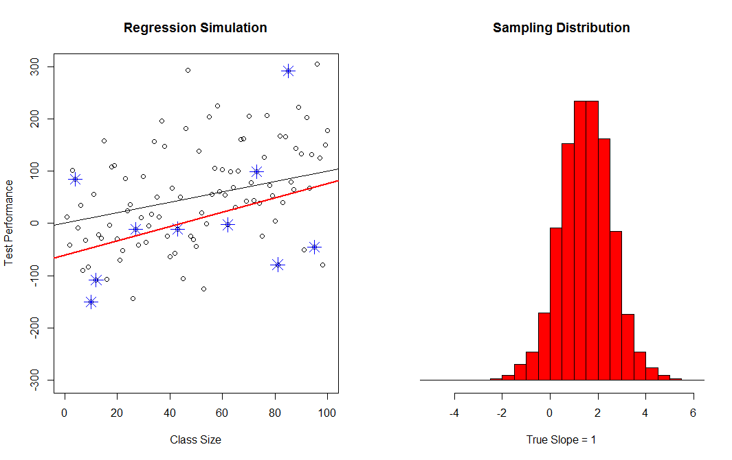
95% confidence Interval
Sampling Distribution
of the Slope
*
Our One
Sample
Best Guess of the Slope
*
*
*
True Slope
*
*
*
*
*
2.5% of
Sample Statistics
Smaller Than C.I.
2.5% of
Sample Statistics
Greater Than C.I.
*
95%
Confidence
Interval

Slide 72
60% Confidence Interval
90% Confidence Interval
95% Confidence Interval
99% Confidence Interval

Slide 73
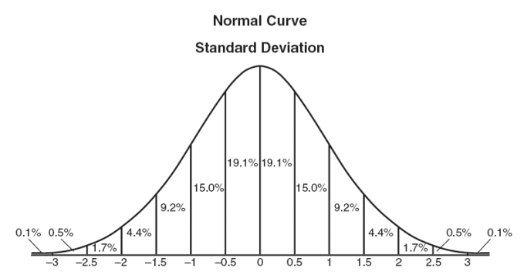
Data in Normal Distribution

Slide 74
Sampling Distribution
sample size = 50

Slide 75
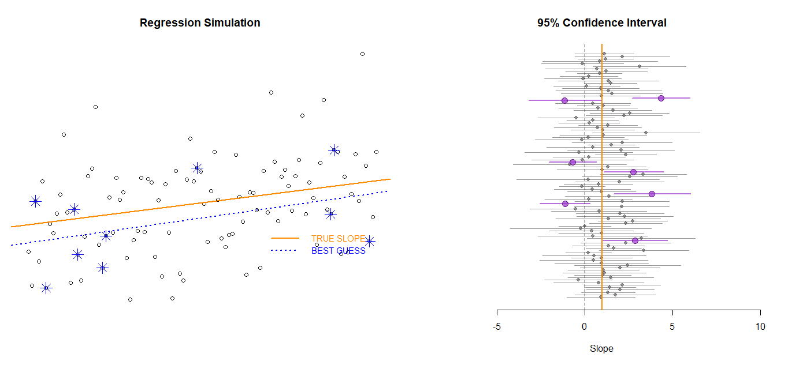
Alpha = 0.05
(level of confidence)
Confidence intervals from
100 samples (the sampling distribution)
CI that does NOT contain the true slope (happens in alpha % of samples)
Confidence interval from a single sample
Both Cis contain the true slope but only one is statistically significant
Note that statistical power is different from the level of confidence. Power determines how often we reject the null (the CI does not contain ZERO). Level of confidence is how often a confidence interval drawn from a random sample will contain the TRUE SLOPE. Here we observe Type I Errors in 7 out of 100 cases (the sample CI does not contain the true slope). But note that we would fail to reject the null in more than half of the samples (p-values > alpha), even though the true slope is not zero. This means the sample framework has low power (ability to detect actual effects).
NULL HYPOTHESIS:
SLOPE = 0
TRUE SLOPE = 1
Point estimate plus the standard error (size of the CI) determines the p-value. The p-value is roughly the probability that the slope = 0

Slide 76
Note that we are using Type I Error, or a FALSE POSITIVE, in two distinct ways.
The first type of FALSE POSITIVE is linked to the level of confidence (alpha), which determines how often we will tolerate confidence intervals that fail to contain the true slope. This is the statistical sampling version that uses the true slope as the NULL. The purple CIs are all samples that would lead us to conclude that the slope is NOT equal to one (even though it is).
The more important version is the program evaluation context, in which case a TYPE I ERROR or a FALSE POSITIVE means we conclude that a program produced a meaningful change when it did not. This version assumes the NULL is zero (no program effect). The p-value produced by a regression model corresponds to this version. Here, since about half of the Cis contain zero, the p-value would be around 0.50.
Similarly, a TYPE II ERROR (a FALSE NEGATIVE) is when we can’t differentiate the true slope from the NULL, even when they differ.
STATISTICAL POWER is the probability of identifying a specific program effect (slope or effect size) using a specific sampling framework. In this case power is very low.
Alpha = 0.05
(level of confidence)
CI that does NOT contain the true slope (happens in alpha % of samples)
Both Cis contain the true slope but only one is statistically significant
NULL HYPOTHESIS:
SLOPE = 0
TRUE SLOPE = 1
Point estimate plus the standard error (size of the CI) determines the p-value. The p-value is roughly the probability that the slope = 0

Slide 77
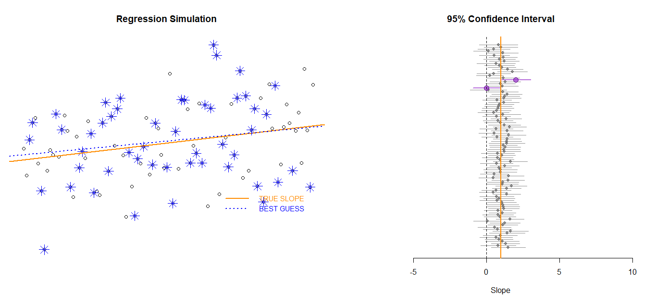
We can increase STATISTICAL POWER by increasing the sample size or adding control variables, thus reducing the standard error and shrinking confidence intervals. Increasing the sample size from 10 to 50 has improved our ability to detect program effects. We are only failing to reject the NULL in 1/3 of cases instead of ½ of cases.

Slide 78
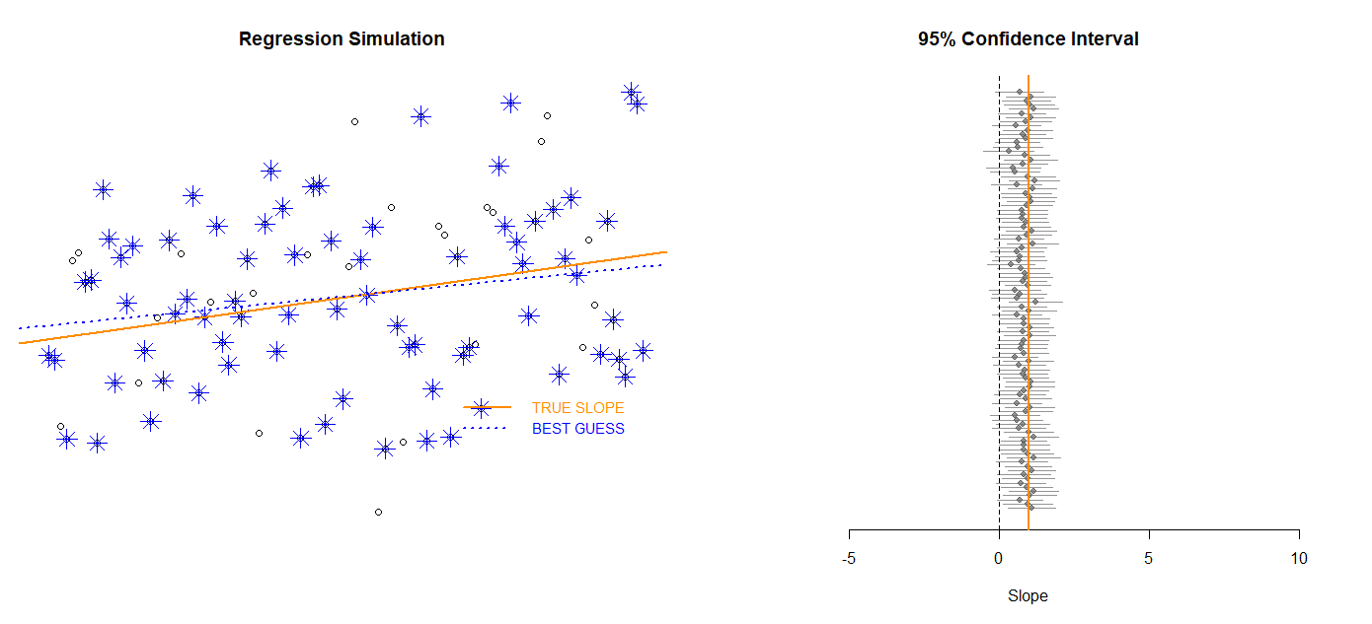

Slide 79
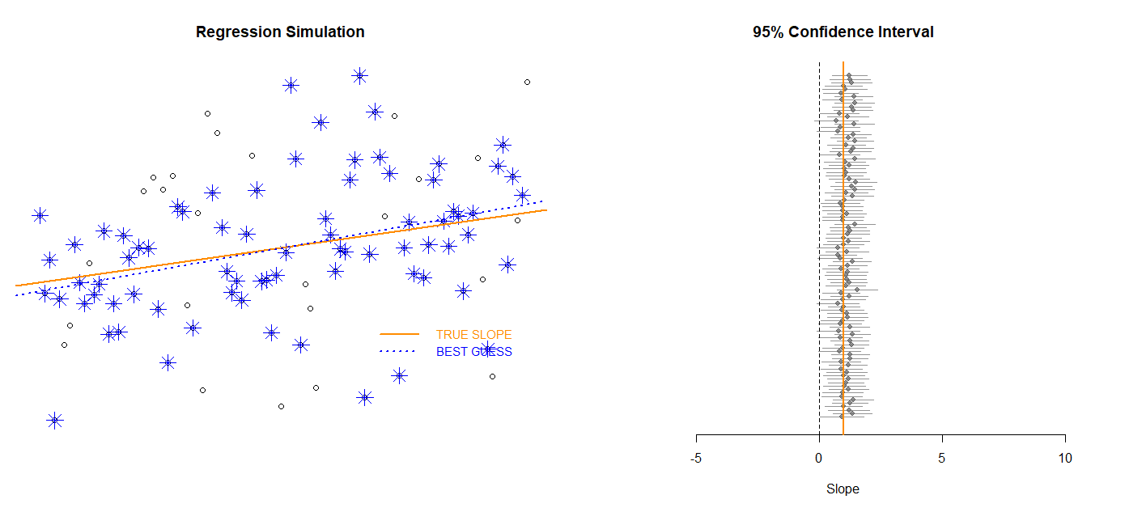
We do even better when the sample size is increased to 75. Now we only fail to identify program effects around 5% to 10% of the time in these case (about 5 or 10 CIs still contain zero).

Slide 80
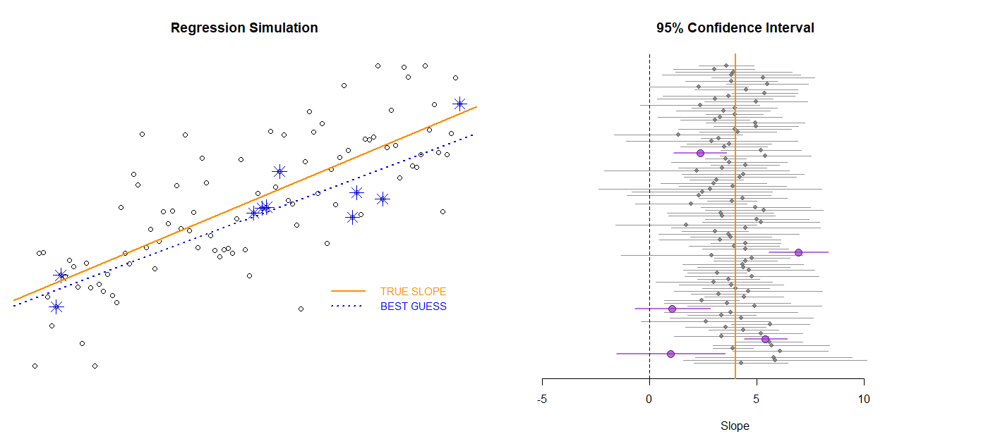
If the sample size remains low (n=10) but the program impact is large (slope of 4 instead of slope of 1) we achieve a lot more statistical power.
This should be somewhat intuitive - it is easier to detect large changes than small changes.
NULL HYPOTHESIS:
SLOPE = 0
TRUE SLOPE = 4

Slide 81
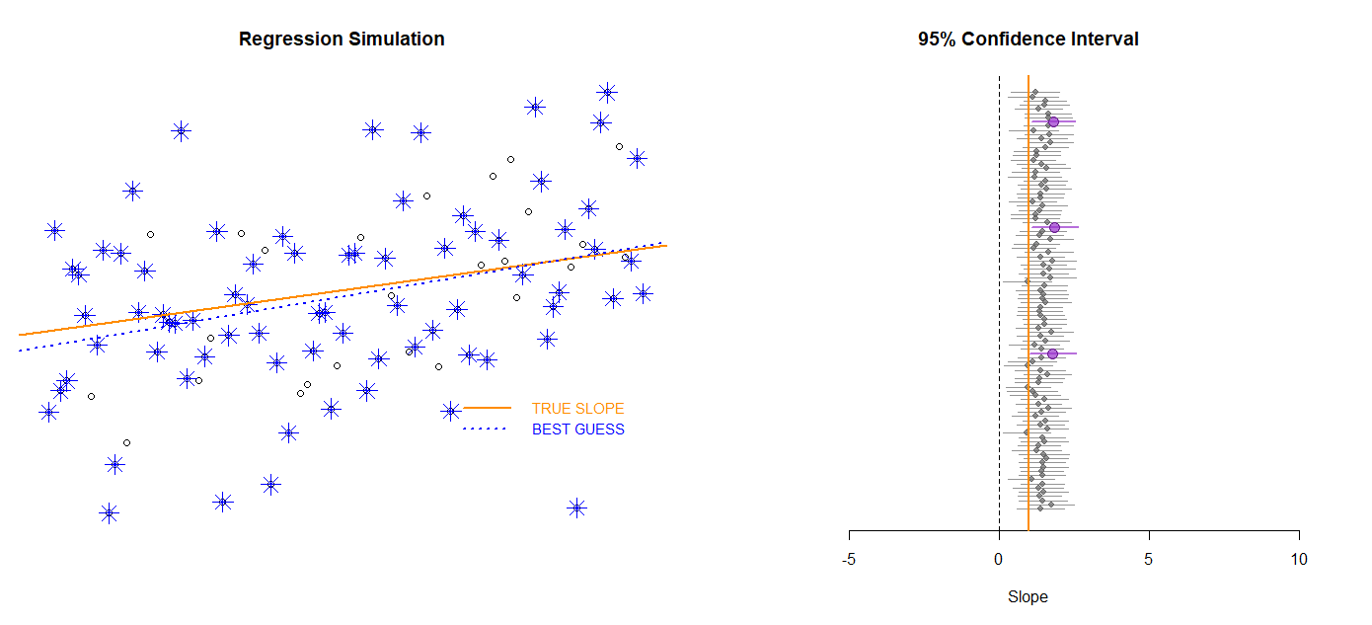
Any idea what is happening here? The sample slope estimates are systematically too large, even though they represent random samples? Hint, it is a type of specification bias.

Slide 82
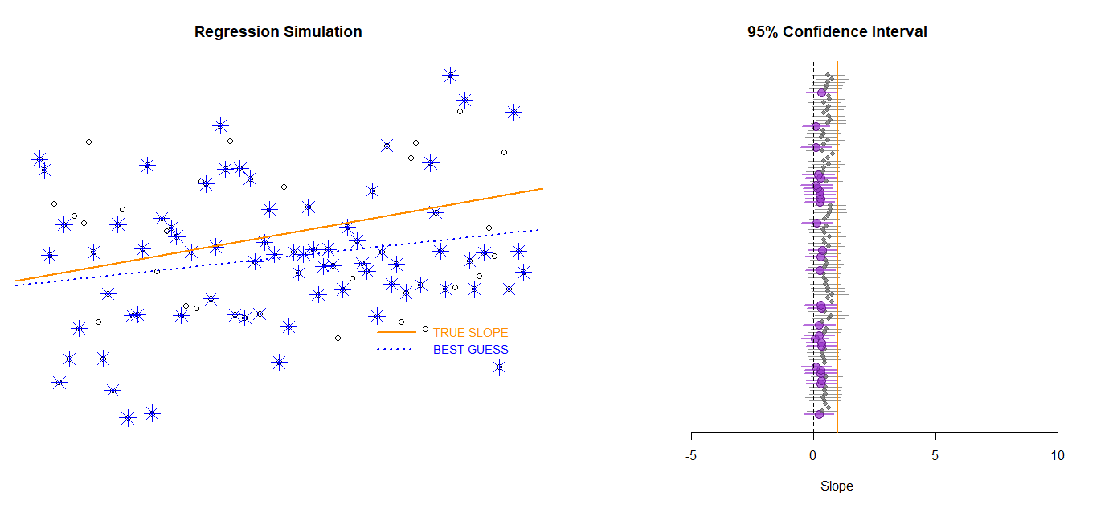
And similarly, here?

Slide 83
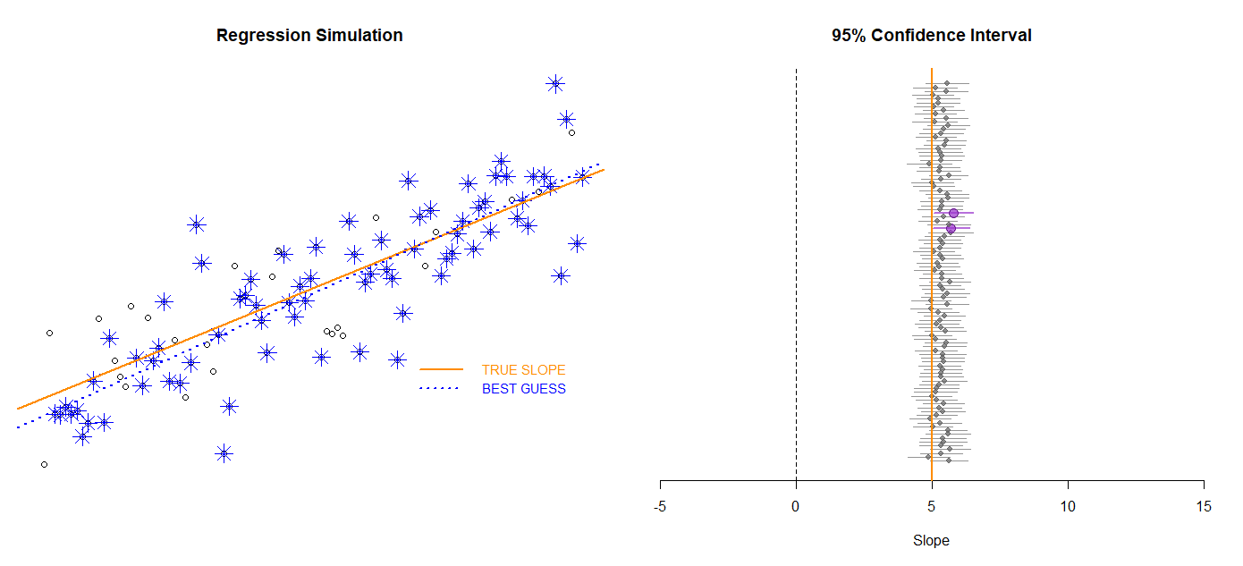
“Leverage”
“Leverage”

Slide 84
“Leverage”

Slide 85
Threats to validity

Slide 86
Time frame

Slide 87
Study Time-Frame
If the study is not long enough it make look like the program had no impact when in fact it did. If the study is too long then attrition becomes a problem.
The Fix:
Use prior knowledge or research from the study domain to pick an appropriate study period.
Examples:
Michigan Affirmative Action Study
Iowa liquor law change

Slide 88
